Slide 1

Milánský kongres

Slide 2
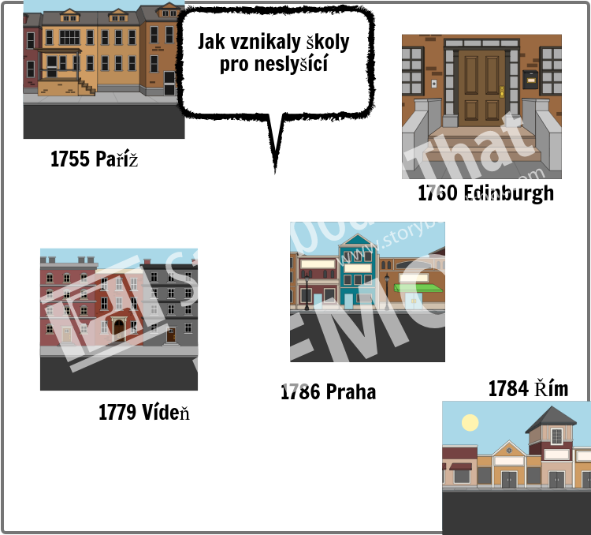
Add Title Here
Add Text Here

Slide 3
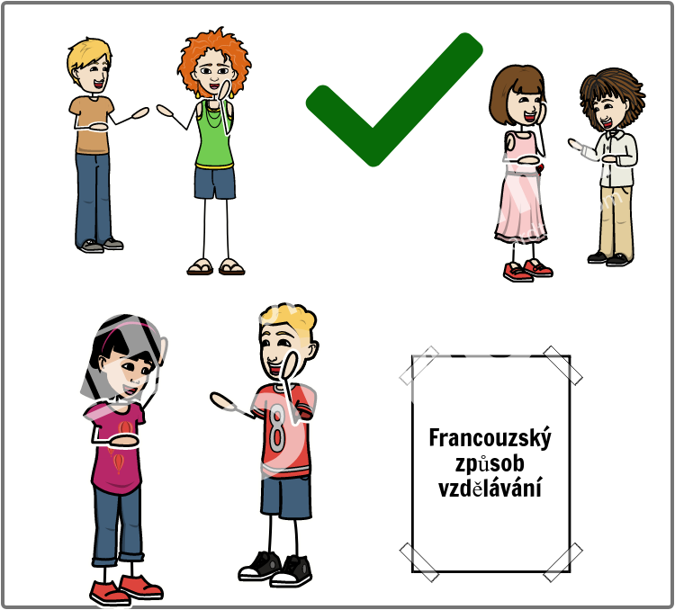
Add Title Here
Add Text Here

Slide 4
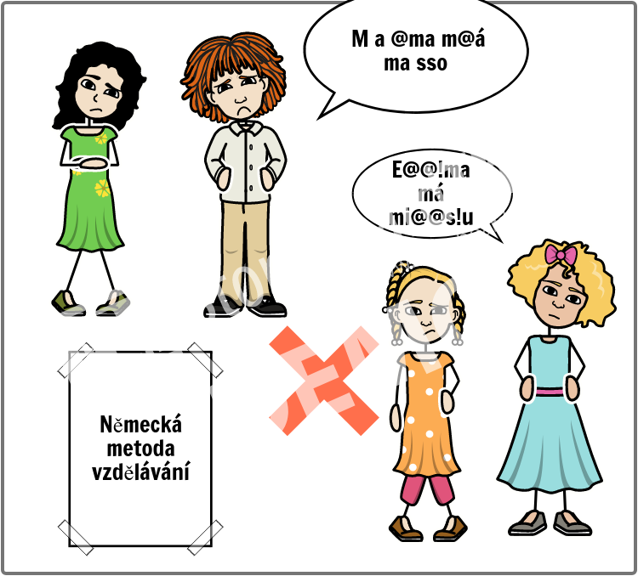
Add Title Here
Add Text Here

Slide 5
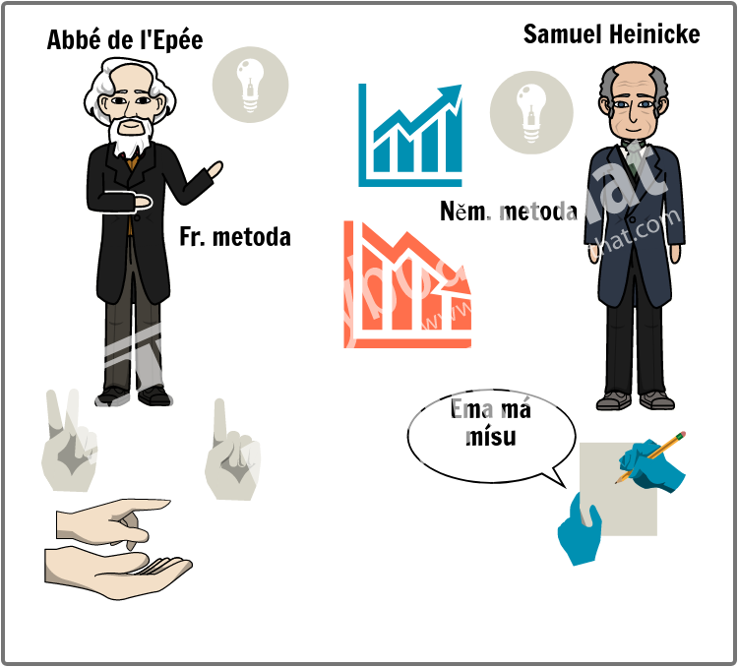
Add Title Here
Add Text Here

Slide 6
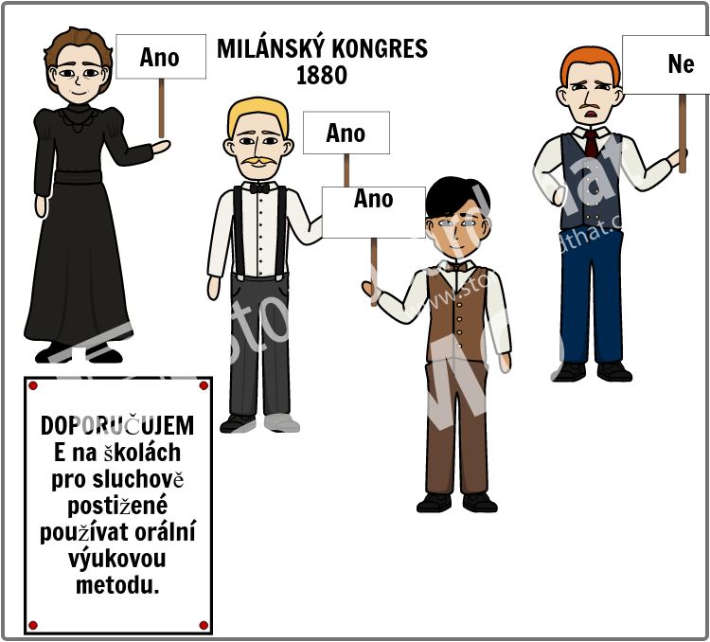
Add Title Here
Add Text Here

Slide 7
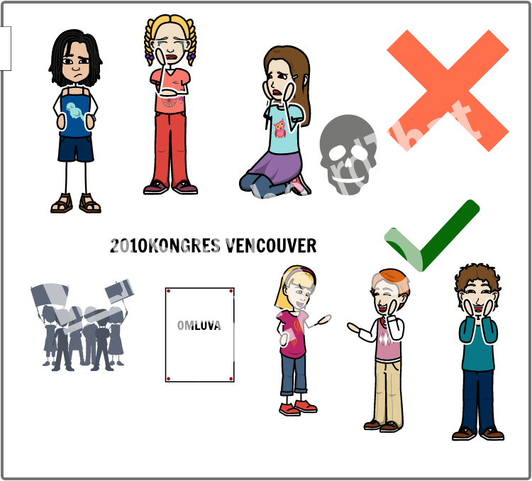
Add Title Here
Add Text Here

