Slide 1
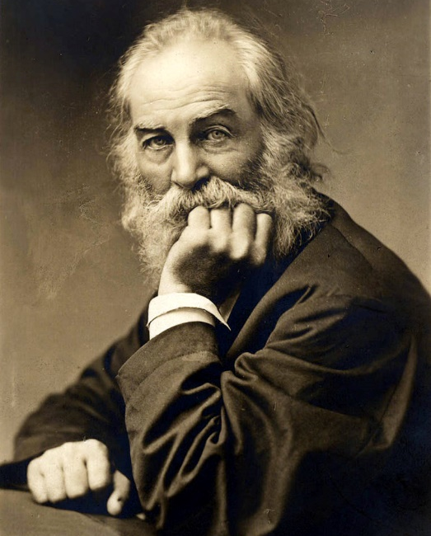
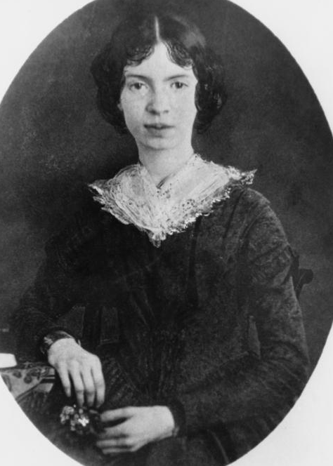
The Birth of Modern Poetry: An Introduction
Modern poetry is distinguished by a paradoxical connection of universalism and subjectivity. The more wide-ranging the projects of modern literature and philosophy, the greater the role of subjective consciousness.
The individual self of the author, reader or hero always remains in focus, although it is displaced by the fragmentation of experience or language experiments.
The boundaries between Romanticism and modern art are difficult to trace. Both Walt Whitman and Emily Dickinson often relate to the authors of European and American Romanticism and even earlier stages of literature (Coleridge, Byron and Emerson, in the case of Whitman; Puritan tradition, Wordsworth, Coleridge and Keats, in the case of Dickinson).
Whitman follows Emerson in articulating the relationship of the individual consciousness to the larger whole (all Americans, the universe, the supreme being – Whitman calls God “Camerado”) and expanding small details into universal images or everyday experiences into metaphysical symbols.
In contrast to Whitman, Dickinson‘s poetry is characterized by the condensation of meaning, opening space for the play of figurative language.
Both these features will be demonstrated on the subsequent slides and the following lecture on Dickinson.
Top: Walt Whitman (1819-92) at about 50. Bottom: Emily Dickinson (1830-86) at about 20.

Slide 2
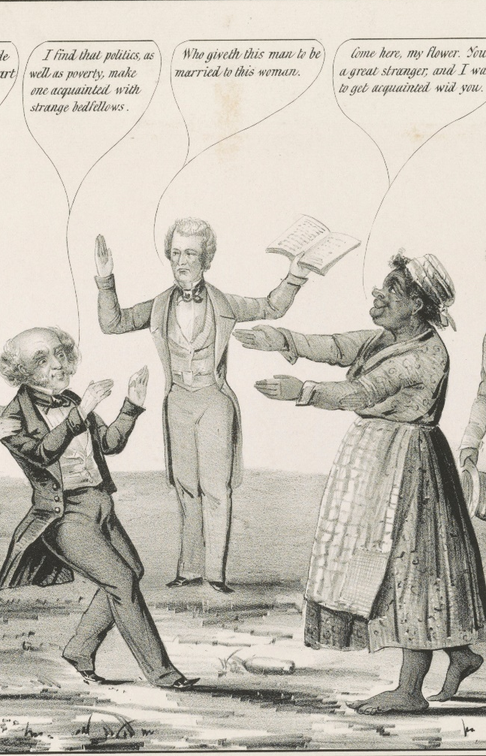
Walt Whitman (1819-92): An Introduction
Whitman was born on a farm in Long Island, but his family soon moved to the growing city of Brooklyn (now part of N.Y.C.), where his father worked as a carpenter.
He had little regular school education and soon started to work as an office boy.
Later he became a printer and a journalist, and worked for a number of local papers.
Before his twenty-third year he was appointed editor of a Manhattan daily called Aurora and later (1846-8) he was editor of the Brooklyn Eagle.
From his youth Whitman was attacked for his homosexuality (one of the first attacks was launched by the Reverend Rufus Griswold, who also created the myth of E.A. Poe as a drunk and immoral artist). Whitman defended himself pointing out the importance of gay friendships in Athenian democracy.
In 1848 Whitman was a delegate of the founding convention of the anti-slavery Free Soil Party, which seceded from the Democratic Party in protest against pro-slavery attitudes of a part of its membership.
He also became convinced that the Mexican War had been the beginning of “the irrepressible conflict” threatening the stability of the whole country.
This awareness also influenced the experimental poem he had been writing since 1847 and made him think of addressing all Americans. During the long years of work on the poem Whitman gave up his journalistic career and went to live with his parents in Brooklyn. He earned his living as a part-time carpenter.
Marriage of the Free Soil
and Liberty Parties (1848)
a caricature mocking the
presidential candidate,
Martin Van Buren, who was
not even an abolitionist.

Slide 3
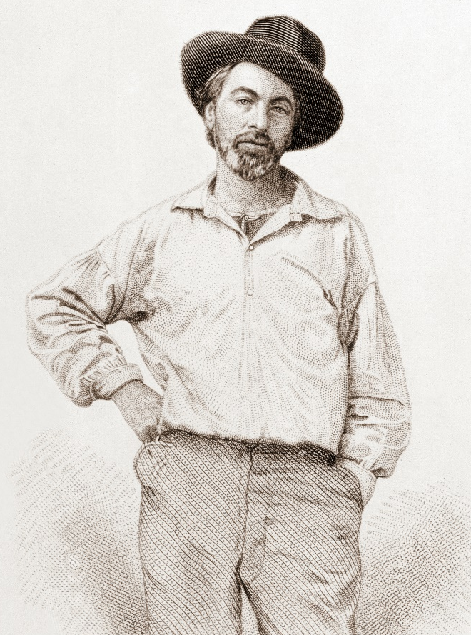

Walt Whitman: Leaves of Grass (1855-1892)
An Introduction
The first edition of Leaves of Grass appeared in 1855 and became a landmark in the development of American poetry as well as of modern art in general. This was mainly because of Whitman’s pioneering use of free verse, which does not have a metric pattern (regularly repeated sequences of stressed and unstressed syllables), but is accentuated by irregular rhythmic impulses and modulated by the different length of lines. Whitman’s free verse is rooted in the tradition of biblical (or “cadenced”) verse of the Psalms and the Song of Solomon.
Another important influence is the rhetoric of itinerant ministers, circuit preachers or evangelists who were (and still are) preaching in the streets of U.S. cities and towns.
Leaves of Grass became a lifetime work of Whitman integrating originally independent works or collections (Drum Taps). The last - “deathbed” - edition was prepared in 1891.
Leaves of Grass is a title with an ambiguous meaning: it refers both to the chief symbol of the collection – grass – but also to a phrase in publishers‘ slang meaning texts unworthy of publishing.
In dealing with Leaves of Grass we should try to understand the meaning of the word self, especially in the longest and most important poem “Song of Myself.” In his late essay “A Backward Glance o’er Travell’d Roads” (1888) Whitman wrote:
“Leaves of Grass“ [...] has mainly been […] an attempt, to put a Person, a human being (myself, in the latter half of the Nineteenth Century, in America), freely, fully and truly on record. I could not find any similar personal record in current literature that satisfied me [...].
Whitman, aged 36, from the frontispiece of the first edition of Leaves of Grass

Slide 4
“Song of Myself”: The Self as a Symbolic Link of the American Nation
“Song of Myself” is the introductory and longest poem of Leaves of Grass. Its opening lines succinctly express Whitman‘s original notion of the self.
If the poet is able to “assume” this self, or persona - that is, speaking of himself like the continent, country and its people, and also like the whole material and spiritual universe in historical time - all readers should be able to do the same.
The symbolic figure of the self thus becomes the mediator between the author and his readers and a symbol of their equality and creative potential.
Since it is “assumed” it can never be identified only with the author, or with the reader.
In this way, the self of Whitman’s poetry aspires to become a new bond of the diversified and democratic American nation, which has been divided by a political conflict leading to the Civil War.
I celebrate myself,
And what I assume you shall assume,
For every atom belonging to me as good belongs to you.
I am the poet of the Body,
And I am the poet of the Soul, […]
I am the poet of the woman the same as the man
And I say it is as great to be a woman as to be a man

Slide 5
“Song of Myself”: The Self and the Grass
In the poem, the self is symbolically connected with the image of grass. Their connection is evident in section 17 of “Song of Myself.”
The concreteness of the self and the everydayness of Whitman’s poem are symbolized by the image of the grass.
Poetry can never belong to individuals. It is a bond (“yours as much as mine”), it writes and deciphers the “riddle” of existence.
It is close as well as distant like grass and the elements giving life.
In this way, the romantic universal ideal (the world created by imagination) is transformed in Whitman’s work.
Apart from being a symbol of democratic equality, the grass symbolizes the relationship of the self to life and death and their unity in religious and cosmic terms.
17
These are the thoughts of all men in all ages and lands, they are not original with me,
If they are not yours as much as mine they are nothing or next to nothing,
If they do not enclose everything they are next to nothing,
If they are not the riddle and the untying of the riddle they are nothing,
If they are not just as close as they are distant they are nothing.
This is the grass that grows wherever the land is and water is,
This is the common air that bathes the globe.
6
A child said, What is the grass? fetching it to me with full hands;
How could I answer the child? … I do not know what it is any more than he.
I guess it must be the flag of my disposition, out of hopeful green stuff woven.
Or I guess it is the handkerchief of the Lord,
A scented gift and remembrancer designedly dropped
[…]
And now it seems to me the beautiful uncut hair of graves.
[…]
All goes onward and outward, nothing collapses,
And to die is different from what any one supposed, and luckier.

Slide 6
Walt Whitman, “A Passage to India” 1
This major poem of Leaves of Grass appeared in the 1872 edition. Whitman was fascinated by the achievements of technology, especially by the laying of the undersea cable connecting Europe and America (1866), the opening of the Suez Canal (1869), and the completion of the first transcontinental railway in the U.S. (1869).
The first section of the poem defines a specific American attitude to the past. Although the past may be infinitely great, it is neither a mere source of greatness, nor a dreamland. Unlike most Europeans in the age of Romanticism, Whitman does not regard it with nostalgia. Past is the power (like that of gunpowder) propelling the present (like a projectile), to transcend its limits. The present is “impelled by the past”.
1
SINGING my days,
Singing the great achievements of the present,
Singing the strong light works of engineers,
Our modern wonders, (the antique ponderous Seven outvied,)
In the Old World the east the Suez canal,
The New by its mighty railroad spann'd,
The seas inlaid with eloquent gentle wires;
Yet first to sound, and ever sound, the cry with thee O soul,
The Past! the Past! the Past!
The Past—the dark unfathom'd retrospect!
The teeming gulf—the sleepers and the shadows!
The past—the infinite greatness of the past!
For what is the present after all but a growth out of the past?
(As a projectile form'd, impell'd, passing a certain line, still keeps on,
So the present, utterly form'd, impell'd by the past.)

Slide 7
Walt Whitman, “A Passage to India” 2
In the second section, two contradictory movements are outlined: 1. of “modern science” and 2. of “myths and fables of eld (old)”.
Technological progress is complemented by the return to the sources of imagination: “fables immortal fashion’d from mortal dreams”.
Next to the worship of gods and heroes of the past, there arises the worship of “explorers… engineers…, architects, machinists” whose mission is not only technological and economic (“transportation only”) but to work for God’s sake.
Technological and economic globalization must become a part of the spiritual progress.
Passage O soul to India! Eclaircise the myths Asiatic, the primitive fables. Not you alone proud truths of the world, Nor you alone ye facts of modern science, But myths and fables of eld, Asia's, Africa's fables, The far-darting beams of the spirit, the unloos'd dreams, The deep diving bibles and legends, The daring plots of the poets, the elder religions; O you temples fairer than lilies pour'd over by the rising sun! O you fables spurning the known, eluding the hold of the known, mounting to heaven! You lofty and dazzling towers, pinnacled, red as roses, burnish'd with gold! Towers of fables immortal fashion'd from mortal dreams! You too I welcome and fully the same as the rest! You too with joy I sing. | Passage to India! Lo, soul, seest thou not God's purpose from the first? The earth to be spann'd, connected by network, The races, neighbors, to marry and be given in marriage, The oceans to be cross'd, the distant brought near, The lands to be welded together. A worship new I sing, You captains, voyagers, explorers, yours, You engineers, you architects, machinists, yours, You, not for trade or transportation only, But in God's name, and for thy sake O soul.

Slide 8
Walt Whitman, “A Passage to India” 3-4
Third section deals with the expansion of the poet’s self, caused by the technological progress and development of transportation. As a result, his imagination can view the whole American continent. In this way, Columbus’s (the “Genoese”) dream may be fulfilled after centuries: “the road between Europe and Asia”. A culmination of the linear progress.
The fourth section thematises (in its final lines) another pattern: the “rondure of the world” the circular and spherical shape of the Earth. Vasco da Gama was the first European who accomplished the first voyage round Africa to India. By connecting the East and the West coasts of America, the second passage to India has been opened.
3 Passage to India! Lo soul for thee of tableaus twain, I see in one the Suez canal initiated, open'd, I see the procession of steamships, the Empress Eugenie's leading the van, I mark from on deck the strange landscape, the pure sky, the level sand in the distance, I pass swiftly the picturesque groups, the workmen gather'd, The gigantic dredging machines. In one again, different, (yet thine, all thine, O soul, the same,) I see over my own continent the Pacific railroad surmounting every barrier, I see continual trains of cars winding along the Platte carrying freight and passengers, I hear the locomotives rushing and roaring, and the shrill steam-whistle, I hear the echoes reverberate through the grandest scenery in the world, I cross the Laramie plains, I note the rocks in grotesque shapes, the buttes, I see the plentiful larkspur and wild onions, the barren, colorless, sage-deserts, I see in glimpses afar or towering immediately above me the great mountains, I see the Wind river and the Wahsatch mountains, I see the Monument mountain and the Eagle's Nest, I pass the Promontory, I ascend the Nevadas, I scan the noble Elk mountain and wind around its base, I see the Humboldt range, I thread the valley and cross the river, I see the clear waters of lake Tahoe, I see forests of majestic pines, | Or crossing the great desert, the alkaline plains, I behold enchanting mirages of waters and meadows, Marking through these and after all, in duplicate slender lines, Bridging the three or four thousand miles of land travel, Tying the Eastern to the Western sea, The road between Europe and Asia. (Ah Genoese thy dream! thy dream! Centuries after thou art laid in thy grave, The shore thou foundest verifies thy dream.) 4 Passage to India! Struggles of many a captain, tales of many a sailor dead, Over my mood stealing and spreading they come, Like clouds and cloudlets in the unreach'd sky. Along all history, down the slopes, As a rivulet running, sinking now, and now again to the surface rising, A ceaseless thought, a varied train—lo, soul, to thee, thy sight, they rise, The plans, the voyages again, the expeditions; Again Vasco de Gama sails forth, Again the knowledge gain'd, the mariner's compass, Lands found and nations born, thou born America, For purpose vast, man's long probation fill'd, Thou rondure of the world at last accomplish'd.

Slide 9
Walt Whitman, “A Passage to India” 5-7
This leads to the reflections about the direction of human life in history. Where will it proceed? “Whither O mocking life?” Is not life, like history, a mere cycle, from birth to the grave? However, after all discoveries are made, after the physical travel round the globe is accomplished, one important activity of humans must still follow: the fusion of Nature and Humanity
The sixth section makes clear that this is the ultimate end of history, which runs, like a cycle from the origins of civilization in the Orient, to the West (the metaphor of Columbus’s voyage).
The seventh and eighth sections imply that Columbus’s voyage must be followed by the voyage of the soul which will be the process of finding a new identity – “thou actual Me”.
5 O vast Rondure, swimming in space, Cover'd all over with visible power and beauty, Alternate light and day and the teeming spiritual darkness, Unspeakable high processions of sun and moon and countless stars above, Below, the manifold grass and waters, animals, mountains, trees, With inscrutable purpose, some hidden prophetic intention, Now first it seems my thought begins to span thee. Down from the gardens of Asia descending radiating, Adam and Eve appear, then their myriad progeny after them, Wandering, yearning, curious, with restless explorations, With questionings, baffled, formless, feverish, with never-happy hearts, With that sad incessant refrain, Wherefore unsatisfied soul? and Whither O mocking life? Ah who shall soothe these feverish children? Who justify these restless explorations? Who speak the secret of impassive earth? Who bind it to us? what is this separate Nature so unnatural? What is this earth to our affections? (unloving earth, without a throb to answer ours, Cold earth, the place of graves.) Yet soul be sure the first intent remains, and shall be carried out, Perhaps even now the time has arrived. After the seas are all cross'd, (as they seem already cross'd,) After the great captains and engineers have accomplish'd their work, After the noble inventors, after the scientists, the chemist, the geologist, ethnologist, | Finally shall come the poet worthy that name, The true son of God shall come singing his songs. Then not your deeds only O voyagers, O scientists and inventors, shall be justified, All these hearts as of fretted children shall be sooth'd, All affection shall be fully responded to, the secret shall be told, All these separations and gaps shall be taken up and hook'd and ink'd together, The whole earth, this cold, impassive, voiceless earth, shall be completely justified, Trinitas divine shall be gloriously accomplish'd and compacted by the true son of God, the poet, (He shall indeed pass the straits and conquer the mountains, He shall double the cape of Good Hope to some purpose,) Nature and Man shall be disjoin'd and diffused no more, The true son of God shall absolutely fuse them. 6 Year at whose wide-flung door I sing! Year of the purpose accomplish'd! Year of the marriage of continents, climates and oceans! (No mere doge of Venice now wedding the Adriatic,) I see O year in you the vast terraqueous globe given and giving all, Europe to Asia, Africa join'd, and they to the New World, The lands, geographies, dancing before you, holding a festival garland, As brides and bridegrooms hand in hand. Passage to India! Cooling airs from Caucasus far, soothing cradle of man, The river Euphrates flowing, the past lit up again. Lo soul, the retrospect brought forward, The old, most populous, wealthiest of earth's lands, The streams of the Indus and the Ganges and their many affluents, (I my shores of America walking to-day behold, resuming all,) The tale of Alexander on his warlike marches suddenly dying, On one side China and on the other side Persia and Arabia, To the south the great seas and the bay of Bengal, The flowing literatures, tremendous epics, religions, castes, Old occult Brahma interminably far back, the tender and junior Buddha, | Central and southern empires and all their belongings, possessors, The wars of Tamerlane, the reign of Aurungzebe, The traders, rulers, explorers, Moslems, Venetians, Byzantium, the Arabs, Portuguese, The first travelers famous yet, Marco Polo, Batouta the Moor, Doubts to be solv'd, the map incognita, blanks to be fill'd, The foot of man unstay'd, the hands never at rest, Thyself O soul that will not brook a challenge.The mediaeval navigators rise before me, The world of 1492, with its awaken'd enterprise, Something swelling in humanity now like the sap of the earth in spring, The sunset splendor of chivalry declining. And who art thou sad shade? Gigantic, visionary, thyself a visionary, With majestic limbs and pious beaming eyes, Spreading around with every look of thine a golden world, Enhuing it with gorgeous hues. As the chief histrion, Down to the footlights walks in some great scena, Dominating the rest I see the Admiral himself, (History's type of courage, action, faith,) Behold him sail from Palos leading his little fleet, His voyage behold, his return, his great fame, His misfortunes, calumniators, behold him a prisoner, chain'd, Behold his dejection, poverty, death. (Curious in time I stand, noting the efforts of heroes, Is the deferment long? bitter the slander, poverty, death? Lies the seed unreck'd for centuries in the ground? lo, to God's due occasion, Uprising in the night, it sprouts, blooms, And fills the earth with use and beauty.) 7 Passage indeed O soul to primal thought, Not lands and seas alone, thy own clear freshness, The young maturity of brood and bloom, To realms of budding bibles. O soul, repressless, I with thee and thou with me, Thy circumnavigation of the world begin, Of man, the voyage of his mind's return, To reason's early paradise, Back, back to wisdom's birth, to innocent intuitions, Again with fair creation.

Slide 10
Walt Whitman, “A Passage to India” 8-9
The eighth section continues to describe the voyage of the soul which will be the process of finding a new identity – “thou actual Me”.
The last, ninth section shows that this “passage to more than India”, finding “the secret of the earth and sky”, is the true meaning and aim of the new historical cycle which has been triggered by the globalization caused by technological process.
America as a country and a culture has a specific role in this process: it is no mere place or land, but the process of transformation during the global “passage” or the cycle of world history.
The purpose of this transformation is a UNITY OF NATURE and HUMANS. This project of identity formation (“Passage to more than India!”) is in keeping with the thought of American Transcendentalism, especially R.W. Emerson, who had a great influence on Whitman.
8 O we can wait no longer, We too take ship O soul, Joyous we too launch out on trackless seas, Fearless for unknown shores on waves of ecstasy to sail, Amid the wafting winds, (thou pressing me to thee, I thee to me, O soul,) Caroling free, singing our song of God, Chanting our chant of pleasant exploration. With laugh and many a kiss, (Let others deprecate, let others weep for sin, remorse, humiliation,) O soul thou pleasest me, I thee. Ah more than any priest O soul we too believe in God, But with the mystery of God we dare not dally. O soul thou pleasest me, I thee, Sailing these seas or on the hills, or waking in the night, Thoughts, silent thoughts, of Time and Space and Death, like waters flowing, Bear me indeed as through the regions infinite, Whose air I breathe, whose ripples hear, lave me all over, Bathe me O God in thee, mounting to thee, I and my soul to range in range of thee. O Thou transcendent, Nameless, the fibre and the breath, Light of the light, shedding forth universes, thou centre of them, Thou mightier centre of the true, the good, the loving, Thou moral, spiritual fountain—affection's source—thou reservoir, (O pensive soul of me—O thirst unsatisfied—waitest not there? Waitest not haply for us somewhere there the Comrade perfect?) Thou pulse—thou motive of the stars, suns, systems, | That, circling, move in order, safe, harmonious, Athwart the shapeless vastnesses of space, How should I think, how breathe a single breath, how speak, if, out of myself, I could not launch, to those, superior universes? Swiftly I shrivel at the thought of God, At Nature and its wonders, Time and Space and Death, But that I, turning, call to thee O soul, thou actual Me, And lo, thou gently masterest the orbs, Thou matest Time, smilest content at Death, And fillest, swellest full the vastnesses of Space. Greater than stars or suns, Bounding O soul thou journeyest forth; What love than thine and ours could wider amplify? What aspirations, wishes, outvie thine and ours O soul? What dreams of the ideal? what plans of purity, perfection, strength? What cheerful willingness for others' sake to give up all? For others' sake to suffer all? Reckoning ahead O soul, when thou, the time achiev'd, The seas all cross'd, weather'd the capes, the voyage done, Surrounded, copest, frontest God, yieldest, the aim attain'd, As fill'd with friendship, love complete, the Elder Brother found, The Younger melts in fondness in his arms. 9 Passage to more than India! Are thy wings plumed indeed for such far flights? O soul, voyagest thou indeed on voyages like those? Disportest thou on waters such as those? Soundest below the Sanscrit and the Vedas? Then have thy bent unleash'd. Passage to you, your shores, ye aged fierce enigmas! | Passage to you, to mastership of you, ye strangling problems! You, strew'd with the wrecks of skeletons, that, living, never reach'd you. Passage to more than India! O secret of the earth and sky! Of you O waters of the sea! O winding creeks and rivers! Of you O woods and fields! of you strong mountains of my land! Of you O prairies! of you gray rocks! O morning red! O clouds! O rain and snows! O day and night, passage to you! O sun and moon and all you stars! Sirius and Jupiter! Passage to you! Passage, immediate passage! the blood burns in my veins! Away O soul! hoist instantly the anchor! Cut the hawsers—haul out—shake out every sail! Have we not stood here like trees in the ground long enough? Have we not grovel'd here long enough, eating and drinking like mere brutes? Have we not darken'd and dazed ourselves with books long enough? Sail forth—steer for the deep waters only, Reckless O soul, exploring, I with thee, and thou with me, For we are bound where mariner has not yet dared to go, And we will risk the ship, ourselves and all. O my brave soul! O farther farther sail! O daring joy, but safe! are they not all the seas of God? O farther, farther, farther sail!

