Slide 1
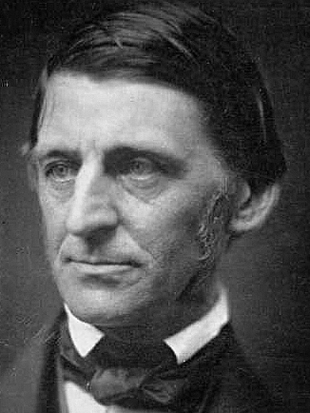
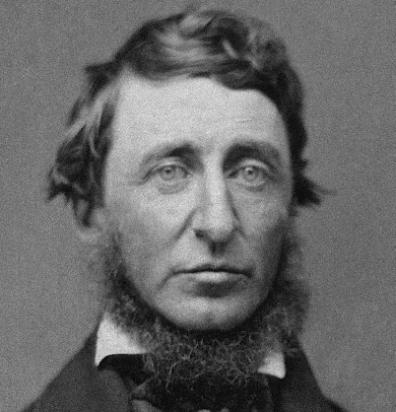
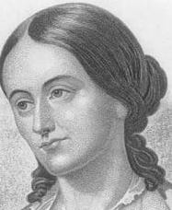
American Transcendentalism: Introduction
Transcendentalism is a romantic attempt to express the unity of the individual both in philosophical and in aesthetic terms. This unity is based on a vision of universal unity of nature and human soul. This unity is not simply given, nor can it be easily achieved. It is conditioned by radical rethinking of the individual’s relationship to religious beliefs and traditions as well as to property, society and government.
This gives a new meaning to the term “transcendental”. In the late 18th century German philosophy of Immanuel Kant this term meant an approach expanding human knowledge beyond the limits of logical reason and the senses, whereas American Transcendentalism understands human individuality in its power to overcome the limits of existence set by society, its religion, traditions, politics and economy.
In spite of these premises, expressed in philosophical essays and poems of the movement’s leader Ralph Waldo Emerson (1803-82), and in the works and political stance of its best writer, Henry David Thoreau (1817-62) and Emerson‘s close co-worker and editor of a journal, called The Dial, the feminist Margaret Fuller (1810-50), most of the Transcendentalists were peaceful, religious and academically oriented people interested in Hinduism, Buddhism, Confucianism, Christian and Muslim mysticism, German Romanticism and metaphysics, Plato’s philosophy and Neo-Platonism.
The term “transcendental” was first used by the public in a disparaging way, to refer to the Hedge‘s Club founded by Emerson in 1836 (Frederic Henry Hedge, later a Harvard professor of German literature, was one of the members).
Note: Margaret Fuller will be discussed in the lecture on American Women Literature.
Right, from top to botom: R.W. Emerson, H.D. Thoreau, Margaret Fuller

Slide 2
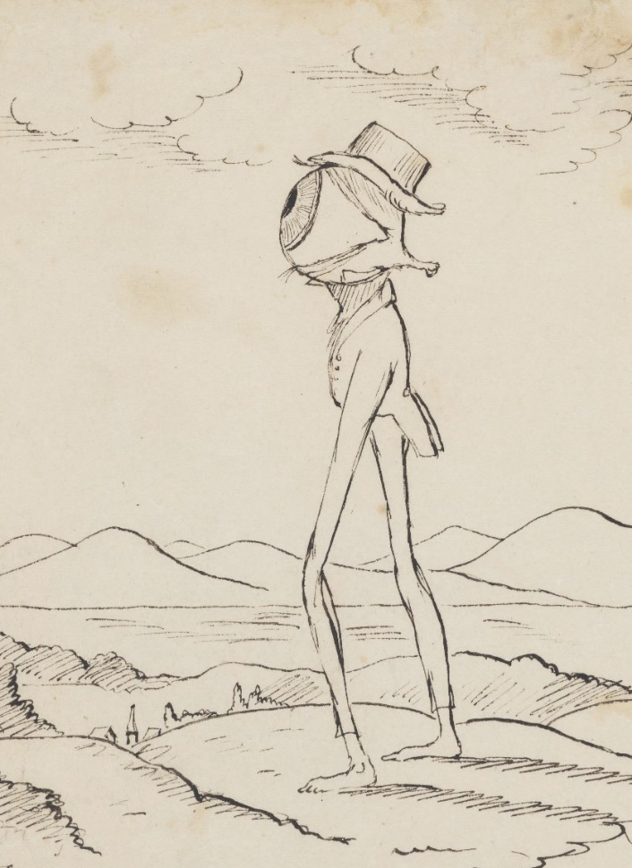
Ralph Waldo Emerson: Essays 1
Nature (1837)
This long essay investigates the purpose of Nature and its human “uses,” both actual and potential.
Though defined as “not Me,” Nature can, by virtue of its essential unity (manifested in the unity of the landscape in our vision) lead the individual soul to recognition of the great unity of being: “I become a transparent eye-ball. I am nothing, I see all. The currents of the Universal Being circulate through me; I am part or particle of God.”
However, instead of “God” Emerson often uses the term “Over-Soul” to imply the spirituality common to all major religions worldwide: “that Unity, that Over-Soul, within which every man’s particular being is contained and made one with all other.”
The “uses” of Nature bringing us to the Over-Soul are ordered from the lowest to the highest as symbolic stairs. They are:
- “commodity” - nature as a source of food, raw materials, power, and an
inspiration for human technologies,
- beauty – nature as an order reveals a purpose in itself (Immanuel Kant‘s philosophy). Beauty
of human deeds (heroism, etc.) inspires morality and ethical laws,
- language - linguistic signs depend immediately on nature, but words are no mere
“signs of natural facts” but also “symbols of spiritual facts.”
- discipline – “understanding of intellectual truths” represented by the general laws of
practical reason, the specific laws of natural sciences, and also moral laws.
- redemption of the soul - “restoring to the world original and eternal beauty.” In this way,
the religious thought of American Puritans is transformed into a new, Romantic and
Platonic natural religion which can do without churches, and aims at making the ordinary
life of people poetic.
Christopher Pearse Cranch,
grotesque illustration to the
“transparent eye-ball ”passage
from Nature, Ch. 1, 1836-38

Slide 3

Ralph Waldo Emerson: Essays 2
The American Scholar (1837, delivered to the Phi Beta Kappa society at Harvard) refused bookish learning that depended on European models (compartmentalization of knowledge into numerous disciplines). The purpose of new learning should be the “Man Thinking” (not the scholar), using the variegated intellectual power in every individual. This purpose can be achieved if the freeborn and gifted Americans rely upon their own instincts fostered by nature.
The Divinity School Address (1838, delivered at Harvard) refused the representations of Christ made by churches and theologians (Christ as a mediator between the churches and God) and historians (Ch. as a historical figure), and contrasted the church with the Soul. The belief in Christ is the belief in “the infinitude of Man” and in the spiritual (“wonder-working”) capacities of humanity.
“Self-Reliance” (1841). Individuals cannot attain freedom by accumulating property or working for political parties. The only way to freedom is a radical change of their relationships to things and social institutions, ceasing to rely on property, social relations and state power. Emerson compares society to a wave, which “moves onward, but the water of which it is composed, does not. The same particle does not rise from the valley to the ridge. Its unity is only phenomenal,” that is, a mere appearance, whereas the only actual and efficient unity is that of the individual. “The persons who make up a nation today, next year die, and their experience with them.” The self has to be discovered as the way to the ridge of the wave, the approach to the Over-Soul and to the unity of the world. Great influence on H.D. Thoreau (next slides).
Albert Bierstadt, The Wave
(1887)

Slide 4

Henry David Thoreau and “Civil Disobedience”
During his lifetime Thoreau became known as “an eccentric social experimenter” inspired by Emerson and as a radical abolitionist.
His dissident stance vis-à-vis the government became manifest when he was imprisoned for refusing to pay a state tax.
The record of this experience (Thoreau spent in prison only one night and was released on bail, paid by Emerson), as well as the statement of Thoreau’s political stance was published anonymously in 1849 under the title Resistance to Civil Government. Later it became known under the shortened title Civil Disobedience.
The essay transposes Emersonian notions of the unity of human life, spirit and activities into practical considerations of the prospects of an individual in the US political system. It begins: “That government is best which governs least.”
As all other public institutions, government is susceptible to corruption. An example is the first aggresive war led by the U.S. in 1846-8: “Witness the present Mexican war, the work of comparatively a few individuals using the standing government as their tool;” The government corruption is inherent in the political system. Because “the mass of men serve the state … as machines,” without using their moral judgement.
However, this self-destructive power of the state can be resisted by every individual who refuses to become “the agent of injustice to another.” If we are forced by the state to act like this, it is necessary to “break the law” and let one’s “life be a counter friction to stop the machine.” This thought was influential with modern dissidents (Gandhi, Martin Luther King, Václav Havel, The Power of the Powerless)
A poster with a quote
from Martin Luther King‘s
Letter from the Birmingham jail (1963), inspired by Thoreau‘s Civil Disobedience

Slide 5

Walden, or, The Life in the Woods (1854)
The basis of this extensive essay written in a aphoristic, digressive, ironic and witty style is an idea that humans do not value nature as the environment of their life and their equal partner. To transform their pernicious relationship to nature, they must start with their own deep transformation, changing not only their economic and social habits but also their perception of nature.
Walden is a pioneering work of environmental thought, whose basis is the revaluation of the notion of individual and social time. By achieving economic independence, individuals gain free time (chapters Economy, The Bean-Field). In their free time, they can become perceptive to the rhythms of nature (chapters Sounds, Visitors, Brute Neighbors, Winter Animals, The Pond in Winter, Spring) and start to enjoy their life in a way that differs from that of others who have to keep the rules and respond to the demands of society (chapters Baker Farm, House Warming).
The Conclusion of the book points out the immense meaning of the transformation of individual life for the further life of humankind. There is no mention of God or Oversoul, nor of the “uses of nature” (prominent in Emerson). Thoreau merely tells a story he heard among local farmers about a “beautiful bug” hatched from an egg lying deep in the wood of an old kitchen table. The anecdote becomes an allegory of mankind’s ability to overcome the “woodenness” of “society’s most trivial furniture”- that is, the alienation and stupor of normal social life - and to attain a freedom and superior life granted by nature.
We can ask whether Thoreau does not overrate the powers of an individual. By no means, since humans do not know yet that “a tide rises and falls behind every man which can float the British Empire like a chip.” The power of the biggest empires cannot compete with the internal power of transformed individuals living in harmony with nature. They can become the true authors of their freedom.
A replica of Thoreau‘s cabin near
Walden Pond (close to Concord, MA, where the writer lived from July 1845 to September 1847. The cabin was built on the land belonging to Emerson.
Originally it was made of the used planks from a shed, which was on the building site of the railroad line on the opposite bank of the pond. Thoreau had used even the nails from the shed.

