Slide 1
The Adaptation Phase and the Attitude of the Client to the Disease

Slide 2

Attitude
The attitude you have towards your life and its circumstances have a great deal to do with your level of success in life.
The mind can be friend or foe depending on how we decide to use it. Greek Stoic Philosopher Epictetus explained that “People are not disturbed by things, but by the way they view them” and that “It’s not what happens to you, but how you react to it that matters.”

Slide 3
Pre-diagnostic Phases
1. Pre-medical
from the outbreak of the illness to consultation with the doctor - before you visit the doctor;
lay;
there is a risk of neglect.
2. Medical
first contact with health professionals.
**The frontotemporal dementias (FTD) – pre-diagnostic phases (research in 2019) - different steps of changes in the relationship with the loved one: (a) becoming distant, (b) becoming insecure, (c) becoming devastated and (d) becoming a stranger.

Slide 4
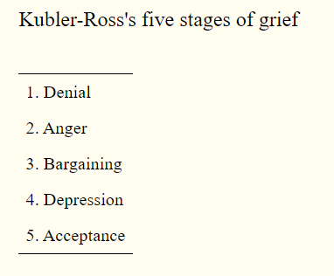
The Phase of Adaptation to Disease I.
1. Alarm response
the first reaction to pain, communication of symptoms;
diagnosis;
increasing demands on physical and psychological aspects;
need for help from the environment (lay x professional).
2. Stabilization phase
Establishing cooperation with a doctor;
adherence to doctor's advice, use of medicines;
healing or resignation may occur.
Psychological stages of illness

Slide 5
The Phase of Adaptation to Disease II.
3. Resignation, disillusionment
the condition does not improve, the symptoms do not disappear,
complications arise,
the last forces are mobilized - exhaustion of the organism
necessary psychological support.
4. Terminal phase
convalescence;
death.

Slide 6
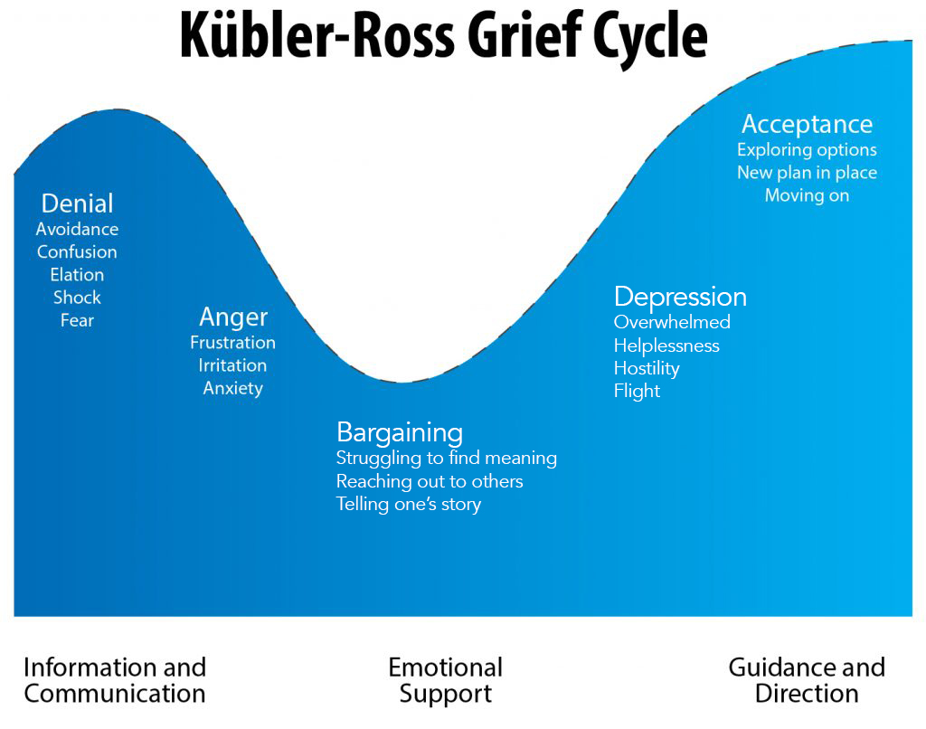
The Stage of Dying – Terminal Phase
I Phase - shock, rejection, denial sometimes leak into isolation;
II. Phase - anger, rage, aggression;
III. Phase - haggling;
IV. Phase - depression, depression;
V. Phase - acceptance and reconciliation.
Notes:
Hjumen sajki

Slide 7
Types of Attitudes to Illness I.
1. Normal attitude to illness - corresponds to the actual condition of what K has been told about the illness. K is adequately adapted to the disease.
2. Flouting attitude - underestimates the severity of the disease, does not investigate, does not comply with the proposed measures. Reason?
3. Repudiation attitude means a repudiation of disease. K ignores the disease, does not go to the doctor, suppresses thoughts about the disease. It is an unconscious dissimulation. Reason?

Slide 8
Types of Attitudes to Illness II.
4. Dissimilatory attitude - K deliberately distorts his problems, often denies them, does not inform the doctor of all problems. The reason?
5. Non-philosophical attitude - K is disproportionately afraid of illness; it overestimates its minor problems and is particularly concerned about incurable diseases. K realizes that his fears are exaggerated, but he cannot help but constantly impose on him. Reason?

Slide 9
Types of Attitudes to Illness III.
6. Hypochondriac attitude - K believes he is suffering from a serious illness or experiencing severe illness very intensely. Reason?
7. Non-philosophical attitude - tends to be associated with some satisfaction and the pleasant aspects of the disease. Reason?
8. Purpose attitude - escalated philosophical state. Reason?

Slide 10
Types of Purpose Reactions I.
Aggravation - exaggeration and exaggeration of disease symptoms.
It may be unconscious, for example, an old abandoned man agrees to get in touch with people.
Conscious, deliberate - intentional, conscious exaggeration of problems due to e.g. prolongation of incapacity for work, stay in the hospital, etc.
Who has to talk to, is questioned by a doctor and a nurse, someone is interested in him.

Slide 11
Types of Purpose Reactions I.
Simulation - the conscious presence of disease and its symptoms. Often because of getting some advantage.
They simulate people very primitive - here it is usually quickly detected.
But it is also cunning people.
Some individuals accept non-serious illness with satisfaction (see philosophical attitude).
In children, it is a feeling of greater care from close relatives, in adults the disease can be misused to realize hobbies and hobbies, which otherwise does not have time.

Slide 12

Thank you for your attention

Slide 13
References
Haškovcová, H. Thanatologie. Praha: Galén, 2000.
Kübler-Ross, E. Odpovědi na otázky o smrti a umírání. Praha: EM Reflex,1995 .
Svatošová, M. Hospice a umění doprovázet. Praha: Ecce homo,1995.
Jobánková, 1992
Křivohlavý, J. Psychologie nemoci. Praha: Portál, 2002.
Přednáška MUDr. Františka Koukolíka
Notes:
Hjumen sajki

