Slide 1
Epistemology for social professions
Epistemology is the study of knowledge and justified belief.
“True knowledge” is therefore both of philosophical and of practical significance; linked to demonstrating professional responsibility.
“ACCOUNTABILITY” is the responsibility to give “an account” (= a good reason) for your action.
Accountability results from
Working from the basis of evidence (= the regularity with which certain outcomes can be achieved)
Transparency of procedures (= letting other people know how I arrived at my position)
Ethical considerations (= relating efficiency to norms and values)
Accountability is different from
Acting on impulse
Acting out of habit
Acting according to regulations
Orientation according to “consumer satisfaction”
(→ reading suggestion: Sarah Banks, Negotiating personal engagement and professional accountability: professional wisdom and ethics work)

Slide 2
Epistemology and research
As the study of knowledge, epistemology is concerned with the following questions:
What are the necessary and sufficient conditions of knowledge?
What are its sources?
What is its structure, and what are its limits?
How are we to understand the concept of “justification”, what is the relation with “evidence”?
What makes “justified beliefs” justified?
Is justification internal or external to one's own mind (correct thinking – or correct perception)?

Slide 3
example
A 9-year old boy is showing severe behaviour difficulties in school.
Explanatory models: what makes him behave in this way? (neurological malfunction, family disruption, learned mis-behaviour, boredom at school, bullying / humiliation by other pupils …)
Ways of collecting information (“detached, from a distance, neutrality)“: neurological tests, family diagnosis, psychological assessment, educational performance testing; “involving the person(s)”: through relationship building with the boy, hearing his story, giving him control over “what counts”)
Consequences: behaviour change, circumstances change (different school), self-perception change

Slide 4
Fundamental dilemma in research as in practice between:
Attention to universal “laws”, regularities, ways of working – objectivity (generalised humanity)
Attention to individual meaning and insight – subjectivity (expressing the views of people directly involved in the situation)
Therefore there are fundamentally different
epistemological traditions

Slide 5
Some key concepts
Belief – assumption about the state of the world
Knowledge – substantiated belief
Truth – tested and hence substantiated beliefs (or falsification of wrong beliefs)
justification – the procedure whereby beliefs can be substantiated

Slide 6
Reliability of research
Read chapter in e-book “Social Work Students’ Research Handbook”
http://web.b.ebscohost.com.ezproxy.is.cuni.cz/ehost/pdfviewer/pdfviewer?vid=3&sid=a4beb883-869a-458c-acba-d169e2d06f23%40pdc-v-sessmgr03

Slide 7
justification
“What makes us cognitive beings at all is our capacity for belief, and the goal of our distinctively cognitive endeavors is truth: we want our beliefs to correctly and accurately depict the world. If truth were somehow immediately and unproblematically accessible...so that one could in all cases opt simply to believe the truth, then the concept of justification would be of little significance and would play no independent role in cognition. But this epistemically ideal situation is quite obviously not the one in which we find ourselves. We have no such immediate and unproblematic access to truth, and it is for this reason that justification comes into the picture.“ (BonJour 1985, p. 7)

Slide 8
Facts and episteme (knowing)
“we have no way of getting at the facts directly, without the epistemic detour of securing grounds and reasons for them.”
(Rescher 1988, p. 43)
Illustration: Why does a judicial court not rely purely on scientific experts and leaves the final judgement to jurors or judges?

Slide 9
Post-factual world

Slide 10
Do we live in a “post-factual world”?
Fake news is the deliberate presentation of falsehood as fact.
Read Article http://theconversation.com/post-truth-politics-and-why-the-antidote-isnt-simply-fact-checking-and-truth-87364

Slide 11
Importance of starting with a research question or hypothesis (in research and in diagnosis):
Both need to focus your study to a clear issue:
what is it I want to know?
what should I do now?
why am I looking for this here?
„proof“:
social science can never prove anything 100%, #
instead: „credible substantiations“

Slide 12
trustworthiness
Credibility relates to the question “how believable are the findings?”
Confirmability attempts to show that the findings and the interpretations of the findings do not derive from the imagination of the researchers but are clearly linked to the data
Transferability (also referred to as applicability) answers the question of “to what degree can the study findings be generalized or applied to other individuals or groups, contexts, or settings?”

Slide 13
Historical considerations: “reality” for a European around 1600
believes in werewolves, witches and the real influence of magic on life
believes ordinary metals can be turned into gold via alchemy
believes comets will bring disaster
believes a rainbow is a sign from God
believes the earth stands still and sun, moon and stars turn around it.

Slide 14
an English person of 1750
has looked through a telescope or microscope
knows no educated person who believes in witches, alchemy or unicorns
knows that earth goes around the sun, rainbows are produced by refracted light
has seen a steam engine at work
What has happened in those decades between?

Slide 15
What would make you believe that UFOs exist?
List by what criteria you would assess “evidence”:
Eye witness
Photograph
Instrumental reading
Personal encounter
...

Slide 16
Pause for questions
on topics so far

Slide 17
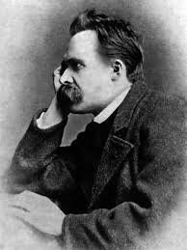
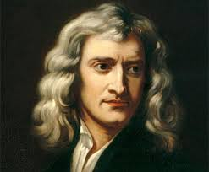
What philosophical influences shaped our modern (sceptical) mind?

Slide 18
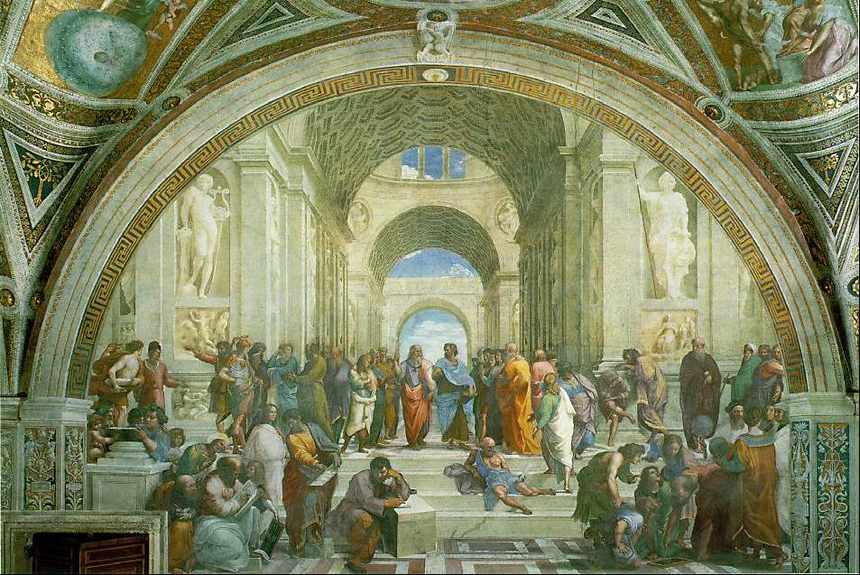
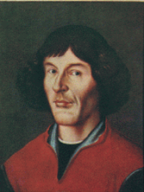
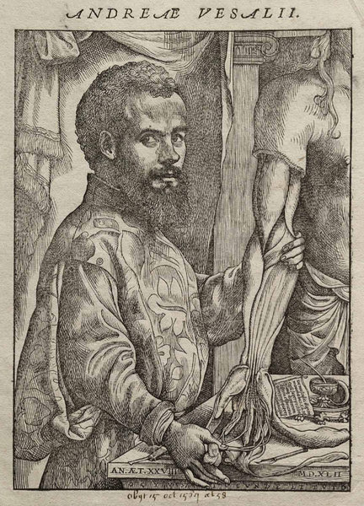
The Scientific Revolution
The Scientific Revolution
12th and 13th centuries
The Renaissance
1500s Scientific Revolution
Publication of Archimedes (287-212 BC)
Copernicus (1473-1543) A heliocentric system
Vesalius (1514-1564) Published work on dissections replaces Galen (129-200AD)
Wikipedia
Wikipedia: Copernicus
Wikipedia: Vesalius

Slide 19
Galileo Galilei (1564-1642), Law of gravity

Slide 20
Conflict: evidence or dogma?
Galileo before The Holy Office

Slide 21
triumph of objectivity:
Certainty has to be found in the objects under observation – this opens up the way for scientific discoveries, detached from the particular observer (everybody can look for themselves to verify the observation, repeat the experiment).
But: how reliable is perception???

Slide 22
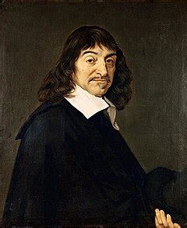
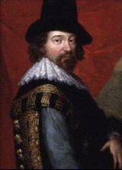
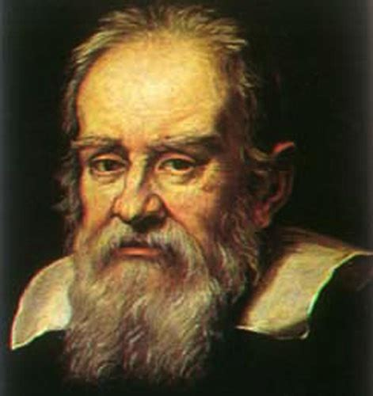
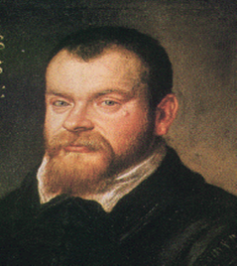
The Scientific Revolution
Science and Philosophy correspond closely in this period and enforce each other
Father of Modern Philosophy Rene Descartes (1596-1626) I think, therefore I am
Sir Francis Bacon (1561-1626)
Galileo Galilei (1564-1642)
Johannes Kepler (1571-1630)
Descartes
Bacon
Galileo
Kepler

Slide 23
Philosophical grounding of evidence: René Descartes (1596–1650)
The first and primary substance is God, whose essence is perfection. In fact, God is the only true substance, that is, the only being that is capable of existing on its own.
- Given our comparative imperfection, how can we be sure that there is any truth in our relationship with the world – and with ourselves? – centrality of doubt as heuristic key (insecurity comes with “progress”)

Slide 24
„Cogito ergo sum“
“Next I examined attentively what I was. I saw that while I could pretend that I had no body and that there was no world and no place for me to be in, I could not for all that pretend that I did not exist. I saw on the contrary that from the mere fact that I thought of doubting the truth of other things, it followed quite evidently and certainly that I existed; whereas if I had merely ceased thinking, even if everything else I had ever imagined had been true, I should have had no reason to believe that I existed. From this I knew I was a substance whose whole essence or nature is simply to think, and which does not require any place, or depend on any material thing, in order to exist.” (6:32–3)

Slide 25
Descartes emphasises Dualism: matter - mind
The essence of matter is extension in length, breadth, and depth.
Cartesian matter does not fill a distinct spatial container; rather, spatial extension is constituted by extended matter (there is no void, or unfilled space).
This extended substance possesses the further “modes” of size, shape, position, and motion.
Modes are properties that exist only as modifications of the essential (principal) and the general attributes of a substance. In addition to its essence = extension, matter also has the general attributes of existence and duration. … All the modes, of matter, including size, shape, position, and motion, can exist only as modifications of extended substance.

Slide 26
Dualism 2: mind
The essence of mind is thought. Besides existence and duration, minds have two chief powers or faculties: intellect and will. The intellectual (or perceiving) power is further divided into the modes of pure intellect, imagination, and sense perception.
Pure intellect operates independent of the brain or body; imagination and sense perception depend upon the body for their operation. The will is also divided into various modes, including desire, aversion, assertion, denial, and doubt. These always require some intellectual content (whether pure, imagined, or sensory) upon which to operate. Perhaps for that reason, Descartes describes the mind as an “intellectual substance”

Slide 27
How to re-gain certainty? Relying on facts: Francis Bacon (1561-1626) http://www.iep.utm.edu/bacon/
Scientific empiricism:
“true and perfect induction” -
One needs to proceed step by step from observation to generalisation (“general laws”), testing each step up this ladder by observation and experimentation, rather than by imagination or logical constructs;
carefully gathering and examining facts

Slide 28
induction

Slide 29
Inductive reasoning
Moves from a series of specific observations to broader generalizations and theories. Informally, we can call this a "bottom up" approach. In inductive reasoning, we begin with specific observations and measures, begin to detect patterns and regularities, formulate some tentative hypotheses that we can explore, and finally end up developing some general conclusions or theories.
Example: law of gravity (Galilei): product of repeated experimentation with variations

Slide 31
But how good are our senses? problem of sensory perception: John Locke (1632 – 1704)
Knowledge of the external world is “sensitive knowledge” (unlike mathematical or intuitive knowledge)
“It is therefore the actual receiving of ideas from without that gives us notice of the existence of other things and makes us know that something doth exist at that time without us which causes that idea in us…”
http://www.iep.utm.edu/locke-kn/#H2

Slide 32
Knowledge according to Locke
“Knowledge then seems to me to be nothing but the perception of the connection and agreement, or disagreement and repugnancy of any of our ideas. In this alone it consists. Where this perception is, there is knowledge, and where it is not, there, though we may fancy, guess, or believe, yet we always come short of knowledge.” E IV.i.2 (emphases original)
Therefore: is “thinking” a confirmation of the certainty of “reality” – or a source of uncertainty about reality?

Slide 33
Limits of experience – searching for „ideal solutions“ (G.W.Leibniz 1646-1716)
Judgments in logic and metaphysics operate with forms of necessity that reach beyond the certainty experience can provide. Similarly, judgments in morality operate with a form of obligation or value that lies beyond experience. Experience can only inform us of what is the case rather than of what ought to be.

Slide 34
Leibniz: Metaphysical idealism:
“The senses, although they are necessary for all our actual knowledge, are not sufficient to give us the whole of it, since the senses never give anything but instances, that is to say particular or individual truths. Now all the instances which confirm a general truth, however numerous they may be, are not sufficient to establish the universal necessity of this same truth, for it does not follow that what happened before will happen in the same way again. … From which it appears that necessary truths, such as we find in pure mathematics, and particularly in arithmetic, must have principles whose proof does not depend on instances, nor consequently on the testimony of the senses, although without the senses it would never have occurred to us to think of them… “
(Leibniz 1704, Preface, pp. 150–151) http://www.iep.utm.edu/leib-ove/

Slide 35
deduction

Slide 36
Deductive reasoning
It proceeds from the more general to the more specific. Sometimes this is informally called a "top-down" approach. We might begin with thinking up a theory about our topic of interest. We then narrow that down into more specific hypotheses that we can test. We narrow down these even further when we collect observations in relation to the hypotheses. This ultimately enables us to test the hypotheses with specific data -- a confirmation (or not) of our original theories.

Slide 37
The choice between induction and deduction expresses the polarity between empiricism – rationalism:
A rationalist approach to knowledge of the external world means that some external world truths can and must be known a priori, that some of the ideas required for that knowledge are and must be innate in us, and that this a priori knowledge is superior to any form of knowledge that experience could ever provide

Slide 38
empiricism – rationalism:
The empiricist (British empiricists Bacon, Locke, Hume) replies that for our knowledge of the external world outside our own minds experience is the only source of information. Reason might tell us of the relations among our ideas, but those ideas themselves can only be obtained from experience of the senses sense (seeing, hearing, feeling…). This is the only way to getting to the truth about the external world.

Slide 40
Pause for questions
on previous section

Slide 41
how can we understand reality? – what is the relationship between reality and understanding?
Only by subjecting rationality itself to a critical examination of its presuppositions can it be of practical use
senses must not be eliminated but ‘purified’ to arrive at ‘pure thought’
tradition (‘convention’) becomes a dubious source of knowledge – unless its contents can be subjected to rational critique (what remains of religion???)
is reason (rationality) the essence of our human nature – or only a small section of it in relation to, for instance, feelings, impulses, habits etc.?
Reading suggestion: Axel Honneth Enlightenment and Rationality: The Journal of Philosophy,

Slide 42
This is the avenue to „enlightenment“, the road to the „victory“ of rationality
Immanuel Kant (1784),
“what is enlightenment (Aufklärung)”?:
“Enlightenment is man's emergence from his self-imposed immaturity (“Unmündigkeit”). Immaturity is the inability to use one's understanding without guidance from another”.
See whole text: http://www.artoftheory.com/what-is-enlightenment_immanuel-kant/

Slide 43
Examples of Kantian „categories“ (they apply a priori to all objects that can be known)
Quantity:
Unity.
Plurality.
Totality
Quality:
Reality.
Negation.
Limitation
Relation:
Inherence and Subsistence (substance and accident)
Causality and Dependence (cause and effect)
Community (reciprocity)
Modality:
Possibility.
Existence.
Necessity

Slide 44
Categories are the products of „critical judgement“ (critical reflection)
for Kant the categories originate in the principles of human understanding, not in outside reality independent of the mind, and can be discovered by paying attention to the way we think, not by studying the world itself, nor by simply studying the way we speak.
Kant: Kritik der reinen Vernunft (critique of pure reason)

Slide 45
Characteristics of the “enlightenment” movement (which still influence our present thinking)
Critique of established ‚authorities‘ – trust in experimentation instead (dominance of science)
Transfer of “authority” to the individual mind
Trust in rationality as regulator of what counts as truth
Faith in the world as an orderly entity (can be understood)
Expectations of progress / optimism
Social implications: empowerment of the individual
Demands for democracy, participation, ideals of justice and equality
Development of a (critical) public sphere
Encouragement for technological applications of discoveries
Revolutions in communication and transport

Slide 46
Friedrich Nietzsche: Scepticism
“Great men, universally gifted, have contrived, with an incredible amount of thought, to make use of the paraphernalia of science itself, to point out the limits and the relativity of knowledge generally, and thus to deny decisively the claim of science to universal validity and universal aims. And their demonstration diagnosed for the first time the illusory notion which pretends to be able to fathom the innermost essence of things with the aid of causality”
“the real truth of nature and the lie of culture that poses as if [als ob] it were the only reality is similar to that between the eternal core of things, the thing-in-itself and the whole world of phenomena [Erscheinungswelt]”

Slide 47
Nihilist position
‘We cannot decide whether what we call truth is really truth, or whether it only appears to be such. If the latter is the case, then the truth we collect here is nothing upon our death, and all our efforts to procure a possession that will follow us to the grave are in vain.
“since Copernicus, man seems to have got himself on an inclined plane—now he is slipping faster and faster away from the center into—what? Into nothingness? Into a ‘penetrating sense of his nothingness”
Nietzsche, Genealogy of Morals

Slide 48
Scientific realism
a commitment to the idea that our best theories have a certain epistemic status: they produce knowledge of aspects of the world, including unobservable aspects (epistemic achievements)
realism is committed to the mind-independent existence of the world investigated by the sciences
realists are generally fallibilists, holding that realism is appropriate in connection with our best theories even though they likely cannot be proven with absolute certainty;

Slide 49
History of science
http://huntington.org/exhibitions/beautifulscience/timelines/natural_web.html

Slide 50
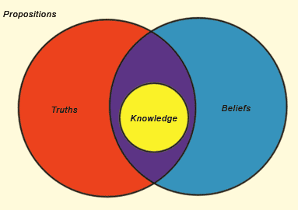
Empiricism vs Rationalism
Empiricism vs Rationalism (Induction vs Deduction)
New mathematical knowledge can be gained by from existing knowledge using logic and reason
Arrow 1: Use existing mathematical truths (axioms) to derive a preposition(s); Arrows 2: Prepositions are true if they do not contradict existing knowledge; Arrow 3: New Knowledge (axiom)
Weakness of rationalism: Only certain knowledge can be derived from logic and reason
E.g. if you want to now the distance from A to B you have to measure it, not so much reason about it
Observation(s)
Wikipedia
2
1
3

Slide 51
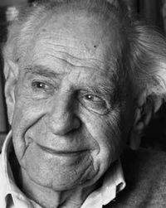
Hypothetico-deductive Method
Hypothetico-deductive Method
The natural and the physical sciences lends itself better to empiricism (induction), and less so to rationalism (deduction, the use of logic and reason alone)
Deduction and induction often work together in the natural and physical science
Sir Karl Popper developed the hypothetico-deductive method to reconcile inductive reasoning with deductive reasoning
The hypothetico-deductive method counters the natural tendency of the mind to want to verify
Wikipedia: Popper

Slide 52
„historicism“ – does natural science represent ‚absolute truth‘ or is it context (history) dependent?
Thomas Kuhn (1922-1996): The Structure of Scientific Revolutions, played a significant role in establishing a lasting interest in a form of historicism about scientific knowledge, particularly among those interested in the nature of scientific practice
Kuhn held that if two theories are incommensurable, they are not comparable in a way that would permit the judgement that one is epistemically superior to the other, because different periods of normal science are characterized by different ‘paradigms’ (commitments to symbolic representations of the phenomena, metaphysical beliefs, values, and problem solving techniques).

Slide 53
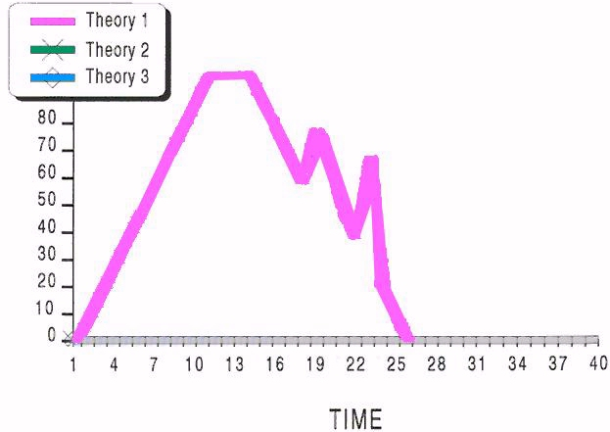
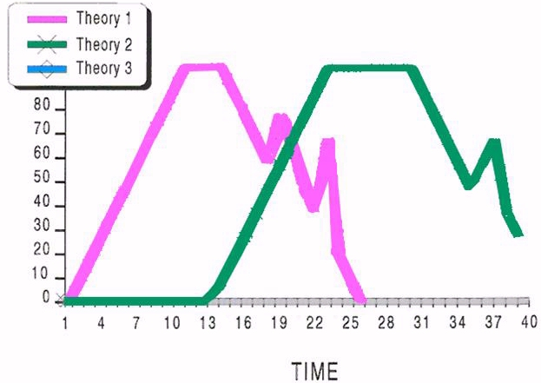
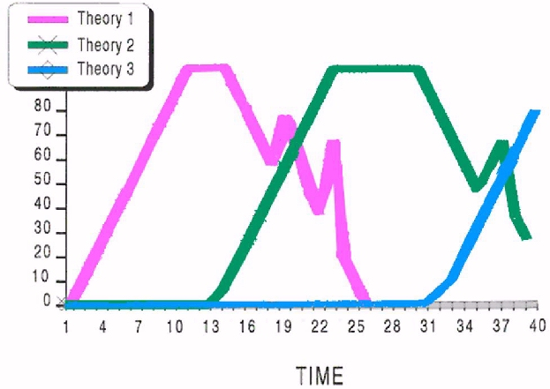
Core Science and Normal Science
Normal Science
Normal science sometimes comes up with anomalies, which does not threaten the core science, for example global dimming was explained to be a symptom of climate change
Crisis
Revolution
Prescience
However, as anomalies accumulate over time, scientists have to revisit what they previously held to be true
Eventually a crisis arises, where they can no longer ignore the anomalies, and must instead replace or modify the existing core science, e.g. Quantum Physics replaces Newtonian Physics

Slide 54
Pause for questions
on previous section

Slide 55
Can knowing about society be scientific?
Since “society” became an object of scientific interest and enquiry (19th century) the question was: is society an “object” like the moon or the rain forest – or does it differ fundamentally from natural science objects and requires therefore its own distinct epistemology?

Slide 56
Other disciplines that (may) require their own epistemology:
Philosophy
Theology
History
Literature
Anthropology
Art and Design
Economics (???)
Psychology (???)

Slide 57
Distinguishing features of societal knowledge
Observers cannot (fully) distance themselves from what they observe (they always remain members of a society);
Societies are structured in culturally divided zones of “meanings” (norms, habits, conventions, languages …); understanding is therefore always culture-specific;
People do not just perceive, but they always react to perceptions “reflexively”

Slide 58
Understanding people’s ”meaning” is different from understanding “facts” – requires an epistemology of hermeneutics
Hermeneutics is the theory and practice of interpretation.
The name ‘hermeneutics’ is derived from Hermes, the legendary Greek messenger who carried knowledge and understanding between the gods and mortals.

Slide 59
Early anti-cartesianism
Giambattista Vico (1668—1744) , a central figure in the development of early modern hermeneutics. Speaking out against the Cartesianism of his time, Vico argues that thinking is always rooted in a given cultural context. This context is historically developed, and, moreover, intrinsically related to ordinary language, evolving from the stage of myth and poetry to the later phases of theoretical abstraction and technical vocabularies. To understand oneself is therefore to understand the genealogy of one's own intellectual horizon… It offers a model of truth and objectivity that differs from those used by the natural sciences. The historian does not encounter a field of idealized and allegedly subject-independent objects, but investigates a world that is, fundamentally, her own. There is no clear distinction between the scientist and the object of her studies.

Slide 60
hermeneutics and modernity
the epistemology of modern (natural) sciences challenges ‘interpretative sciences’ to be equally exact as enquiries into natural phenomena
does the truth of a narrative account lie in the text or outside the text (in the ‘constancy of nature’)? – see ‘natural explanations of miracles’ (strong wind in the Red Sea)

Slide 61
Are Geisteswissenschaften (history, literary criticism, theology, philosophy etc .) science?
“On the one hand, there is an interest in the human sciences and a willingness to defend the integrity of these sciences as distinct from the natural sciences. On the other hand, there is a deep concern over the problem of making sense of the texts handed over to us from the past. These are the twin pillars on which modern hermeneutics is built. For, strictly speaking, it is only at the point where these two orientations merge and mutually inform one another that we encounter the first attempts at articulating a genuinely philosophical hermeneutics”

Slide 62
objectivity and subjectivity in hermeneutics
texts require a reader, not just an observer
readers have always learned how to read in a particular language, which brings with it cultural norms and ‘ways of seeing the world’ from which they cannot escape into ‘neutrality’
what methods increase therefore their ‘objectivity’ in reading (interpreting) texts?

Slide 63
Friedrich Daniel Ernst Schleiermacher (1768-1834)
According to Schleiermacher, understanding other cultures is not something we can take for granted. Understanding others involves an openness towards the fact that what seems rational, true, or coherent may cover something deeply unfamiliar.
This openness is only possible in so far as we systematically scrutinize our own hermeneutic prejudices.
Schleiermacher speaks of this as a stricter, as opposed to a laxer hermeneutic practice. Yet even a strict hermeneutic practice, Schleiermacher repeatedly emphasizes, cannot guarantee a just or fully adequate understanding.
Nevertheless, it is a commitment we have to make in order to understand other cultures, texts and persons

Slide 64
the ‘hermeneutic circle’
any given text needs to be interpreted in light of the whole text to which it belongs, and both need to be interpreted in light of
the broader language in which they are written,
their larger historical context,
a broader understanding of its genre,
the author's whole corpus,
and the author's overall psychology.
This process introduces a pervasive circularity into interpretation, for, ultimately, interpreting these broader items in turn depends on interpreting such pieces of text.

Slide 65
Hermeneutic application in social work and social research
Every interaction with others, every ‘diagnosis’ of a social situation, every social enquiry requires an act of ‘understanding’ and therefore of ‘interpretation’.
The ‘expert’ needs to ask, “do I see the situation through my prejudices or how can I understand the situation in a context that I am not necessarily familiar with or part of?”
This is the practical challenge of hermeneutics

Slide 66
particularity – universality from a hermeneutic perspective
all use of language is located somewhere between radical individuality and radical universality. Neither of these exists in an entirely pure form. All language-use refers to grammar and a common symbolic vocabulary (universal), yet we use these shared resources in more or less individual (particular) manner (“I give every sentence my individual meaning”)

Slide 67
example: understanding human life as such (‘humanities’)
Wilhelm Dilthey (1833-1911): Erlebnis (momentary experiences) is connected with the process of self-understanding, whereas Verstehen (understanding) relates to our understanding of others.
Dilthey's important point is that, Erlebnis, does not provide self-understanding. Self-understanding is obtained only to the extent that the self relates to itself as it relates to others, i.e., in a mediated way. Yet Erlebnis, remains the psychological source of all wider experience, the experiential potential that is articulated and conceptualized in understanding.

Slide 68
example: ‘existence’ (ontology)
Martin Heidegger (1889–1976): Understanding is neither a method of reading nor the outcome of a carefully conducted procedure of critical reflection. It is not something we consciously do or fail to do, but something we are. Understanding is a mode of being, and as such it is characteristic of human being, of Dasein. The pre-reflective way in which Dasein inhabits the world is itself of a hermeneutic nature. Our understanding of the world presupposes a kind of pragmatic know-how that is revealed through the way in which we, without theoretical considerations, orient ourselves in the world. We open the door without objectifying or conceptually determining the nature of the door-handle or the doorframe. The world is familiar to us in a basic, intuitive way.

Slide 69
interpretation
we do not understand the world by gathering a collection of neutral facts by which we may reach a set of universal propositions, laws, or judgments that, to a greater or lesser extent, corresponds to the world as it is. The world is tacitly intelligible to us.
Interpretation makes things, objects, the world, appear as something, as Heidegger puts it. Still, this “as” is only possible on the background of the world as a totality of practices and inter-subjective encounters, of the world that is opened up by Dasein's being understandingly there.

Slide 70
the hermeneutic circle according to Heidegger
Heidegger’s reformulation of the problem of truth gives rise to a new conception of the hermeneutic circle. In Spinoza and Schleiermacher, the hermeneutic circle was conceived in terms of the mutual relationship between the text as a whole and its individual parts, or in terms of the relation between text and tradition.
With Heidegger, however, the hermeneutic circle refers to something completely different: the interplay between our self-understanding and our understanding the world. The hermeneutic circle is no longer perceived as a helpful philological tool, but entails an existential task with which each of us is confronted.

Slide 71
Centrality of language (the “linguistic turn” of epistemology)
Hans-Georg Gadamer (1900—2002): „Wahrheit und Methode“
Human beings, Gadamer argues, are“beings in language”. It is through language that the world is opened up for us. We learn to know the world by learning to master a language. Hence we cannot really understand ourselves unless we understand ourselves as situated in a linguistically mediated, historical culture. Language is our second nature

Slide 72
Pause for questions
on previous section

Slide 73
Phenomenology (in philosophy and sociology)
phenomenology is the study of phenomena: of appearances as opposed to reality.
Phenomenology: the study of structures of consciousness as experienced from the subjective point of view.
The basic structure of a conscious experience is its intentionality, it is directed toward something – an experience of or about something.

Slide 74
phenomenological sociology
Alfred Schutz (1899—1959):
constitution of the ‚I‘ (action theory)
In planning an action that will be realized in the future, one relies on reflective acts of “projection”, like those found in reflective memory, only now oriented in a future as opposed to past direction. Through such reflectivity, one imagines a project as completed in future perfect tense, that is, what will have been realized after one's acting, and this project establishes the “in-order-to motive” of one's action.
By contrast, one's “because motives” consist in the environmental, historical factors that influenced the (now past) decision to embark upon the project and that can only be discovered by investigating in the “pluperfect tense,” that is, exploring those past factors that preceded that past decision.

Slide 75
Lebenswelt / lifeworld
may be conceived as a universe of what is self-evident or given, a world that subjects may experience together
In sociological research, social scientists develop constructs, ideal types, of the meaning-contexts of life-world actors, and they test these types to determine if they are causally adequate, that is conforming to past experience, and meaning adequate, that is, consistent with whatever else is known about the actor.

Slide 77
Where are we today in epistemology? Approaches to ‘social reality’
Looking at (social) phenomena raises the question, is there an ‘essence’ of social reality (examples: is there such a “thing” as class, society, religion, the state, race etc.?)
Answers:
These phenomena can be ‘reduced’ to structural elements (income, boundaries, genetics, institutions etc.)
The reality of such social entities lies in people acting ‘as if they existed’ (believe in their existence)

Slide 78
Critique of modernism’s ‘metaphysical’ claims (as if the world could only be understood rationally):
Post-modernism:
Faust’s dream (gaining control over nature through the advancement of scientific knowledge, leading to progress and liberation) has turned into a nightmare of control and oppression. Knowledge becomes a system of power (Foucault); therefore it is necessary to de-construct knowledge-regimes as power-regimes
Epistemology of the positivist type (“this is the true explanation of the world”, realism, Marxism, functionalism etc.) is always only one “narrative” among several equally legitimate ones (Feyerabend)
This critique of certainties corresponds to a world that has become “polycentric”, celebrating differences.

Slide 79
P. Feyerabend, “Against Method – Outline of an anarchist theory of knowledge” (1975)
No theory ever agrees with all the facts of a given context, yet it is not always the theory that is to blame. Facts are constituted by older ideologies, and a clash between facts and theories may be proof of progress.
Science is much more similar to myth than a scientific philosophy is prepared to admit. “Exact science” is one of the many forms of thought that have been developed in history by man, and not necessarily the best. It is conspicuous, noisy, and impudent, but it is inherently superior only for those who have already decided in favour of a certain ideology, or who have accepted it without having ever examined its advantages and its limits.
Consult:
https://www.marxists.org/reference/subject/philosophy/works/ge/feyerabe.htm

Slide 80
Glaser, B. G. & Strauss, A. L. (1967) The discovery of grounded theory: strategies for qualitative research
Back to (relative) certainty, against relativity (arbitrariness):
Concepts and research design must be allowed to emerge from the collected data
'Discovery' involves the disclosure of well-hidden but already-existing phenomena; it concerns things which exist, albeit that they are hard to find. By contrast, invention refers to things that exist only in an infinite universe of possibly existing things.
Interpretations are built out of what it is to be human.
Reading suggestion: Gary Thomas and David James, Reinventing Grounded Theory: Some Questions about Theory, Ground and Discovery;
watch video: https://www.youtube.com/watch?v=q8DAWa8OnqA

Slide 81
Social constructivism
Social constructivism is a sociological theory of knowledge that focuses on how individuals come to construct and apply knowledge in socially
The term ‘social construction’ refers to any knowledge generating process in which what counts as a fact is determined mostly by social factors.
notions such as truth, reference, and ontology are used only relative to particular contexts, and have no context-transcendent significance.

Slide 82
Constructivist epistemology
From an epistemology of «what do we know?» to an epistemology of «how do we know?»
The facts and the observed data are always theory-laden theory is invention-based.
The observer is conscious that he /she and his/ her knowledge practices are dynamic elements, integrated in the observation field.
The epistemological problem is not how a subject can know an object, but how he can know the process of how his mind operates:
The aim is a knowledge of knowledge
(Morin, 1986)

Slide 83
“Critical realism” (Bhaskar, 2008) as compromise?
Critical realism holds that reality can be apprehended by tracing the origins of experience through to the level of events, and then to underlying structures and processes. Firm prediction in the social sciences has to be replaced by an approach centred on the identification, analysis and explanation of psychologlical and societal mechanisms and their causal tendencies
.

Slide 84
Critical realism applied to (complex) “reality”
simply describing components of reality as discrete entities is insufficient, because real structures and processes come about through the internal and external interactions between these components.
reality is contingent. This means that any explanation is temporal in time and local in place.
while reduction or compression (universalism) may be inevitable given the limits of human cognition and for practical research purposes, such a reduction or compression implies the loss of some of reality’s properties such that any explanation is reductionist.
Probabilistic causality: We learn from past research and experience that given a certain configuration of conditions, some future states are more probable than others.

Slide 85
Hyper- complexity / super-diversity

