Slide 1
Public Management for 21st Century
Vladimír Kváča, Ph.D. October 2022 – January 2023
#5 November 29, 2022

Slide 2
Outline for today:
Conclusion of Topic 4: Human Learning Systems – The Systems element element
Reading reflection
Recap of the key ideas
Homework reflection
Q&A
Short break
Intro to Topic 5: Human Learning Systems – The Learning element
Q&A

Slide 3
Public Management for 21st Century
Human Learning Systems

Slide 4
Human Learning Systems
Real outcomes cannot be “delivered” by public service - they are created by whole systems: all the relationships and factors in someone’s life. Real outcomes are made by healthy systems - systems in which all the actors involved can collaborate and learn together.

Slide 5
Reading reflections
Split into groups
As usual, discuss within groups the most interesting things you have read. Also share what was your „extra chapter“ to read.

Slide 6
System
A part of reality that shares a purpose
Made of elements (parts – people, organisations, services…) and relations between these elements
All (human) systems are open systems – they interact with other systems (incl. higher-level systems)

Slide 7
“95% of variation in workers’ performance is governed by the
system”
Command and control thinkers work on the 5% (people), system thinkers on the 95%!
Errors will be stable and predictable unless the system is changed!
The problem is NOT motivation or competence.
If the system is properly designed and workers trained for predictable high frequency demand, they will be motivated, be their own inspectors and do the best possible job.
But to design the system properly, managers need to think differently…
W. Edwards Deming
Do you spend 19x more on creating a healthy system than on HR?

Slide 8
System
System performance should be judged from the perspective of its purpose.
What matters is the end-to-end perspective (the whole purpose), not performance of individual parts.
Optimalization of a part of the system ofted leads to harming the system as a whole.

Slide 9
System – group task
Optimalization of a part of the system often leads to harming the system as a whole.
Discuss in your group – can you offer an example?

Slide 10
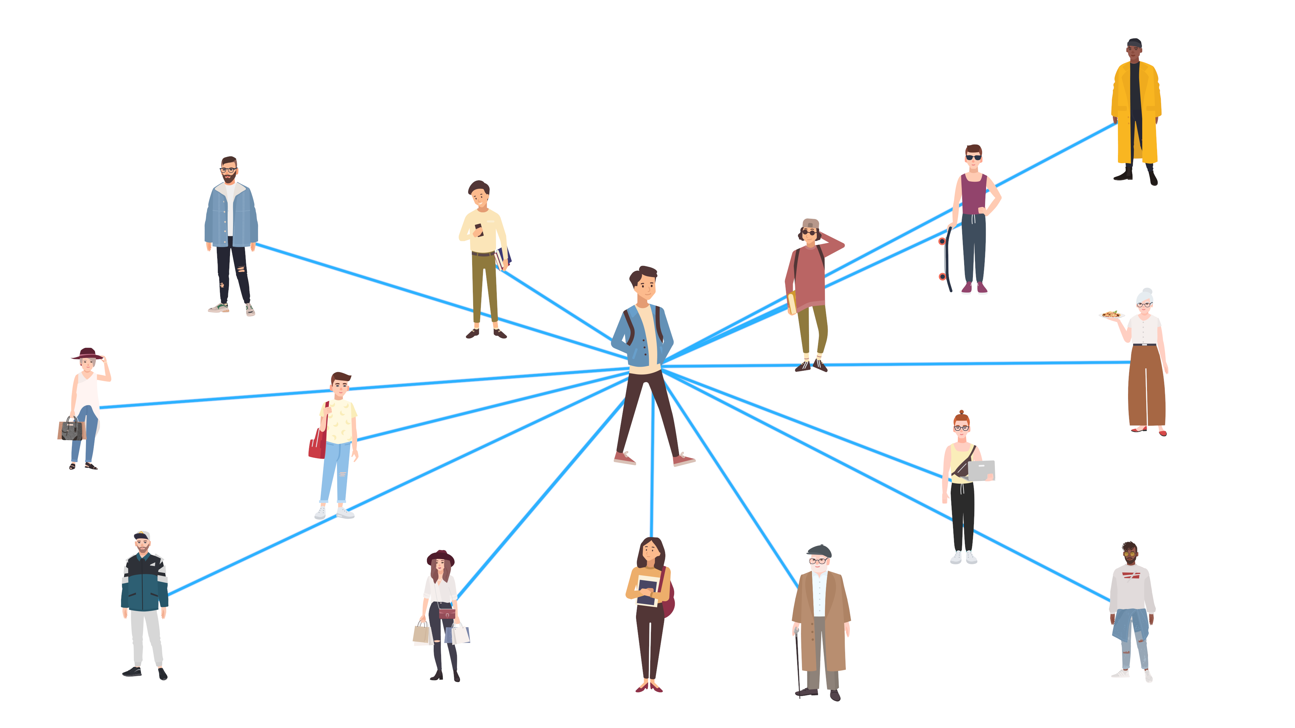
A person as a system
For many public services it is useful to understand a person (client) as a system:
To help someone to change, help to change the relations with other parts of the system.
The key for success is the ability to align as much as possible the system into desired direction – other services, informal networks…

Slide 11
A service as a system
Job 1: A good service does what is necessary to meet the purpose.

Slide 12
Value work:
Diagnose
Access
Repair

Slide 13
A service as a system
Job 1: A good service does what is necessary to meet the purpose.
Job 2: Learning (being able to meet the purpose even better)
Anything else is waste.

Slide 14
Three types of waste
Type I – We can simply stop doing it => stop it.
Type II – We are able to avoid it, but we have to rearrange more processes => experiment to avoid it.
Type III – We cannot stop doing it because of the part of the system beyond our control (eg. Legislation, other organisation) =>
make it clear to yourself that it is still waste
make minimal necessary effort to satisfy what it necessary, try to compensate negative effects on your performance
collect the evidence why current setup is harmful and try to negotiate (don‘t tell, show!)

Slide 15
System stewardship
A feature of the system – the ability of parts of the system to understand the system perspective, incl. understading relations between different parts…
… and behaviour leading to improvement of the performance of the whole system.
Requires empathy to different parts of the system.
Who should be the system steward?

Slide 16
Recursive nature of systems
Many systems tend to have recursive properties:
What explains part of the system, often explains the whole.
What works in subsystems, often works in the system.

Slide 17
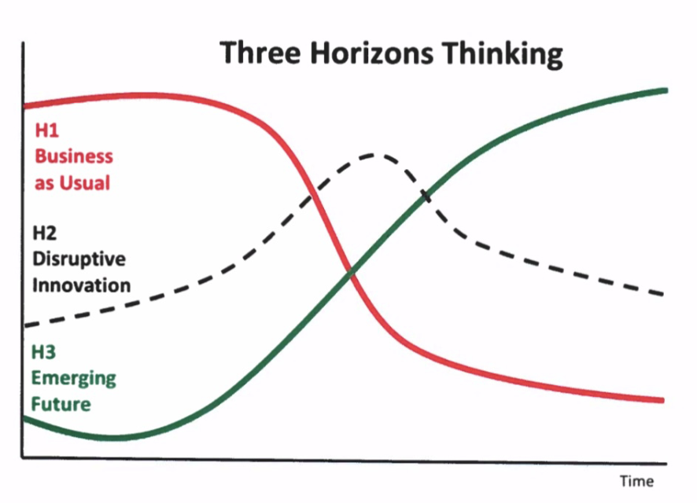
Working on the system change
H1 – helping the old system die (hospicing), keeping what is good
H2 – innovation – looking for better solutions
H3 – helping the new system to be born
=> Perfect work on H2 will not do H1 and H3

Slide 18
^{Reflection}
What are your feelings about the facts you have seen so far?
Photo by Luke Leung on Unsplash

Slide 19
Break - be back at 15:30

Slide 20
Public Management for 21st Century
Topic 5: Human Learning Systems:

Slide 21
Human Learning Systems
Public service should be a process of ongoing exploration and learning: workers, clients and other actors exploring and learning together. Learning is the management strategy - the primary task of public managers and leaders is to create effective learning environments.

Slide 22
Task for your group:
Imagine you are a group of senior teachers at the university (Head of department and guarantors of the study programmes offered by the department).
You want to invite a group of current students to get a feedback on the courses they attend in order to get inputs for revision of the study programmes.
(This seems to be a case of shared sensemaking / shared learning exercise.)
How would you arrange the meeting to enable student to fully participate and speak freely?
(Which possible barriers you have to overcome and how?)

Slide 23
Social and technical aspect of change
Social
Technical
Change starts with RELATIONAL work, before TECHNICAL work
The bridge from relational to technical work is shared sense-making, the strategy for change is LEARNING
Social dimension is typically neglected

Slide 24
Social and technical aspect of change
LEARNING
HUMAN
SYSTEMS
Change starts with HUMAN work, before SYSTEMS work
The bridge from relational to technical work is shared sense-making, the strategy for change is LEARNING

Slide 25
Foundation for relation (and shared learning) is psychological safety.
Conditions for psychological safety
Inclusion safety
Learning safety
Contribution safety
Challenger safety

Slide 26
Psychological safety is linked to intrinsic motivation
Conditions for psychological safety
Inclusion safety
Learning safety
Contribution safety
Challenger safety
Conditions for Intrinsic motivation
Content (Purpose)
Collaboration (Relatedness)
Competency (Mastery)
Control (Choice / Autonomy)

Slide 27
Learning within the systems

Slide 28
The caretaker of four dialogues
What experiments to run?
Service design
(subsystem)
System design (system)
Innovation – conscious experimenting
Shared sensemaking on what does it mean
How to change the system to enable more of what is good? (And more learning)

Slide 29
The caretaker of four dialogues
Psychologically safe environment
What experiments to run?
Service design
(subsystem)
System design (system)
Innovation – conscious experimenting
Shared sensemaking on what does it mean
How to change the system to enable more of what is good?

Slide 30
The caretaker of four dialogues

Slide 31
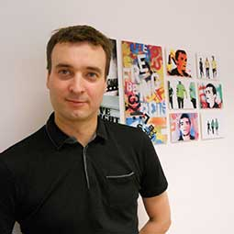
Your companions for the next two weeks
Toby Lowe, Visiting Professor - Centre for Public Impact
QUINN, Robert E and SONENSHEIN, Scott,

Slide 32
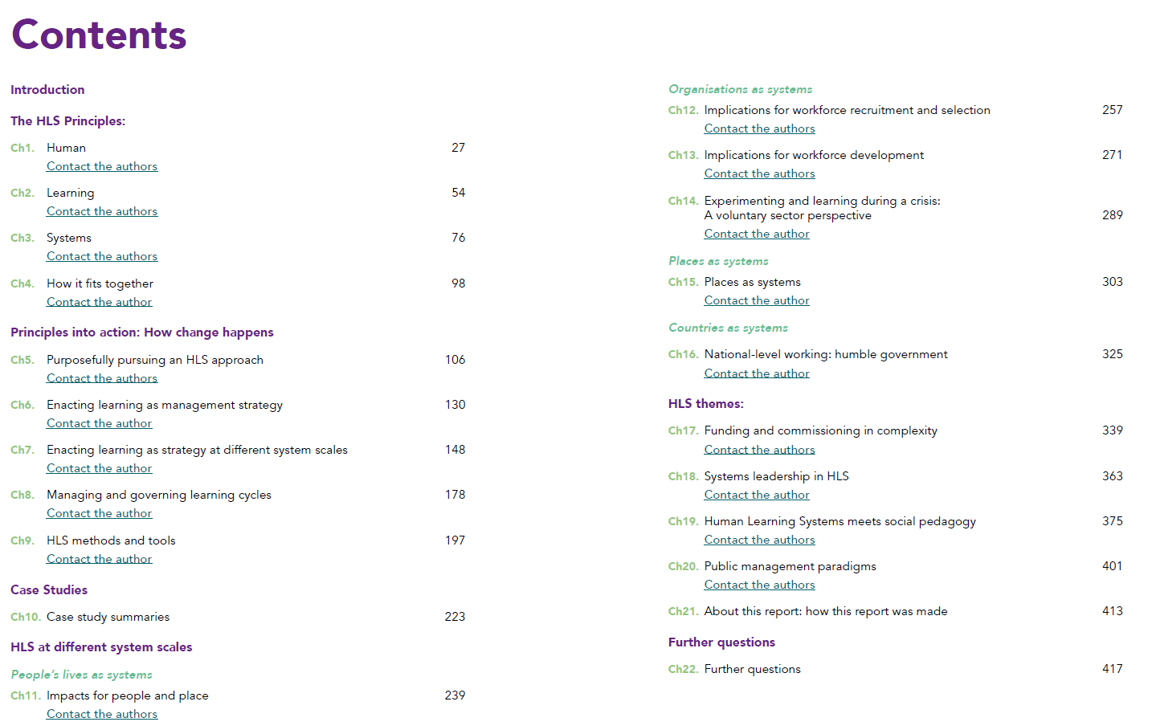
Reading list
Moodle: https://dl1.cuni.cz/course/view.php?id=12328

Slide 33
Homework #5
As an HLS expert and consultant you have been just hired to help a local Public Employment Service in one of the Prague districts to improve their services. You can work on it on average 2 days per week for 2 years. PES agenda is mainly to (i) provide various social benefits (unemployment, housing, child care, care for elderly…), (ii) help job seeker to find a suitable jobs, (iii) requalify them if considered necessary. The structure of the organisation is: Director, 3 heads of unit (Benefits, Labour market, Requalification), 30 of staff in functionally specialized units (8-12 in each).
Alternatively, think about a similar public organisation in your country.
Write a short (2 pages = 550 - 650 words) essay following this outline:
What would you do in the first steps? (Say in the first month.)
Why would you do that?
How would you do that?
Deadline: Monday, Dec 12 , 23:59 CEST

Slide 34
Course overview – How to pass
No problem if you miss up to 2 meetings
Activity / task | Points available
Preparation and participation at the seminars | 4 points per meeting, max. 20 points in total
(Bi-)weekly homework tasks | 6 x 10 points, max. 60 points in total
Quality of contribution to final group discussion. | max. 20 points.
Late submisson = 0 score
But, you may re-do 2 HW tasks to get a better score. (Or submit 2 HW any time later by the end of December 2022.)
Tests how you can apply what we discussed

Slide 35
Course overview - Structure
Paradigm shifts 1: The Environment, The People we Serve, The Way of Management
Paradigm shifts 2: The Nature of Public Organisations, Motivation of Staff, Accountability
Human Learning Systems 1: Introduction and Human element
Human Learning Systems 2: Systems element
Human Learning Systems 3: Learning element
New Synthesis, Metagovernance and conclusions
Questions
(Tentative) answers

Slide 36
Final group discussion: suggestion dates
Wednesday, January 11th 2023
Online (zoom) 10:30
Offline (Pekařská) 14:00
Offline (Pekařská) 14:30
Wednesday, January 25th 2023
Online (zoom) 10:30
Offline (Pekařská) 14:00
Max. 3 students per session.
Content: You are presented a case study and you are suppossed to suggest possible solutions based on HLS
(Similar to assignment #5)

Slide 37
Time for your questions…

Slide 38
Thank you and
see you in two weeks.

