Slide 1
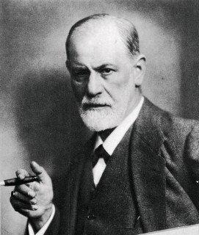
Sigmund Freud
Father of Psychoanalysis

Slide 2
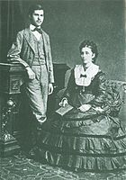
Sigmund Freud
born in Příbor, Moravia, in 1856 to Jewish family, moved to Vienna in 1860
brilliant student, qualified as Doctor of Medicine at the University of Vienna in 1881
1882- began as medical researcher at Vienna General Hospital
1885- left Vienna for a neurology fellowship in Paris
1886- set up his own clinical practice
developed theories about the unconscious mind and the mechanism of repression
created psychoanalysis as a therapeutic method of dialog between a patient and a psychoanalyst which uncovers thoughts that patients had at an unconscious level
developed various therapeutic techniques: free association (patients reporting their uncensored thoughts as they spontaneously come to their mind), hypnosis as a mean of drawing out repressed or latent memories and thoughts, interpretation of dreams
other famous concepts: transference, defense mechanisms, infantile sexuality (incl.Oedipus complex, castration complex, penis envy etc.), libido, „Freudian slip“, Eros and Thanatos…
Notes:
Treating psychopatology (esp. Neurosis) through a dialogue btw patient and a psychoanalyst – inspired development of many other forms of psychotherapy, diverging from original Freud´s ideas.
Proposed crucial role of dreams – consequently the unconscious contents are to be found also in poetry, mythology
Libido – in popular psychology sexual drive, in psychoanalysis psychic drive or energy present in any instinctual drives
Freudian slip – parapraxis - a verbal mistake that we make, but also it can be a memory mistake, or faulty action, sth that we say or make wrong and that shows /it reveals what we deeply think or feel.
Eros/Thanatos – forces of life and death

Slide 3
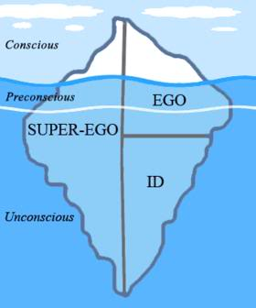
Conscious Mind
the tip of an iceberg above the water surface - clear and visible
everything that we are aware of and can be discussed rationally and logically
thoughts that the conscious mind does not want to explore are repressed into the uconscious

Slide 4
Preconscious Mind
the part of the iceberg just beneath the water surface, visible from above but obscured and not directly observable
latent information or ideas that we are not aware of at the moment, but that can be retrieved and brought to consciousness readily
also known as memory

Slide 5
Unconscious Mind
the very bottom of the iceberg that we can never see
repository for socially unacceptable ideas, wishes or desires, traumatic memories, urges and painful emotions put out of mind by mechanism of psychological repression
they are not accesible to ordinary introspection, but can be reached by special techniques
Notes:
They are mostly unpleasant (pain, anxiety, hatred…), we are unaware of them but they guide our behavior
INTERETSING: The unconscious, in Freudian terms, doesn´t include everything that is not conscious, but rather what is actively repressed from conscious or what a oerson is averse to knowing consciously.
The techniques: meditation, free association, dream analysis, verbal slip

Slide 6
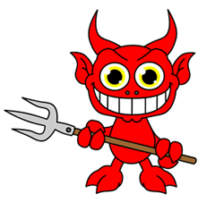
Id
The pleasure principle: aims for immediate gratification of wants and needs, or impulses.
The unorganized part of our personality that contains primitive instincts. It is completely in the unconsciouss.
These impulses are often sexual or aggressive.

Slide 7
Superego
The authority principle: holds our sense of right and and wrong (internalized moral standards).
It is both conscious and unconscious
It strives to suppress the inappropriate impulses of the Id.
The Superego aims for perfection and causes feelings of guilt as punishment for bad behavior and.
Notes:
Authority, morality, responsibility

Slide 8
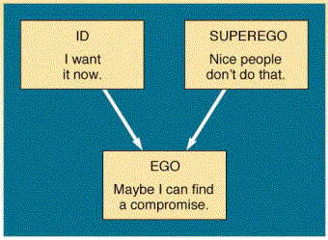
Ego
The reality principle: represents common sense.
The organized part of our personality that deals with reality and the regulation of the desires of the Id and Superego.
The Ego works for long term benefits rather than instant gratification.
Notes:
The ego ensures that the impulses of the Id can be expressed in a manner acceptable in the real world through defense mechanisms.

Slide 9
Psychosexual Development
Series of five stages in early childhood.
In each stage the child´s behavior is oriented towards certain part of his/her body.
Wrong or not completed passage through a stage (overgratification or undergratification) can cause fixation on that part and adult neuroses or other disorders.
Each has a crisis point regarding a particular erogenous zone
Notes:
Psychosexual development – a central element of the psychoanalytic sexual drive theory: Human beings, from birth, have an instinctual libido (sexual energy) that develops in 5 stages. In each stage the child´s behavior is oriented towards certain part of his/her body – the mouth during breast-feeding, the anus during toilet training. (Each has a crisis point regarding a particular erogenous zone.)
The right passage through each stage is constantly being endangered by undergratification or overgratification.
UNDERGRATIFICATION: if a child desires are not fulfilled, the libido is not followed, a child becomes fixated on that desire.
OVERGRATIFICATION: But also. if a child follows her/his libido only, he can experience parental and societal dissaproval - and thus failure – and thus anxiety with the given erogenous zone. To avoid anxiety, the child becomes also fixated, preoccupied with the given erogenous zone, which persist into adulthood, and underlie personality as neurosis, hysteria, personality disorders.

Slide 10
Oral Stage
Birth - 1 year
Mouth-focused
Id dominates
Crisis point: weaning
Oral fixation: chewing pencils, smoking, excessive eating,
passivity, gullibility, immaturity, manipulativeness
Notes:
POUŽÍVAT MATERIÁL FREUD – BASIC CONCEPTS +
Weaning – a child´s first feeling of loss consequent to losing the physical intimacy of feeding at mother breast. Thwarting of the oral stage (too much or too little gratification) – may lead to oral fixation…
In case of too much gratification – the child doesn´t learn that he/she does not control the environment and that gratification is not always immediate, thereby forming an immature personality.
In case of too little gratification – the infant learns that gratification is not coming despite his/her gratifying behavior and thus becomes passive.

Slide 11
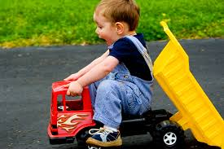
Anal Stage
1 - 3 years
Anus-focused
Id-Ego conflict
Crisis point: toilet training
Anal retentive: obsessively organized or excessively neat
Anal expulsive: careless, disorganized
Notes:
If parents are too demanding and emphasize toilet training , it may lead to a compulsive personality, too much concerned with neatness and order. In opposite case (parents too easy-going about that), a careless, slovenly personality can develop.

Slide 12
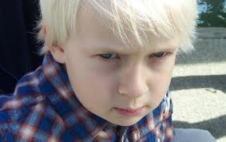
Phallic Stage
3 - 6 years
Genital-focused
Superego forms
Crisis point: Oedipus/Electra complex
penis envy, castration anxiety
Phallic fixation: aggressiveness, vanity, seductiveness, submissiveness
Notes:
In this phase, children become aware of their bodies, other children bodies and the bodies of the parents, they becone physically curious and exploring, so they notice the diferences.
The term Oedipus complex is derived from Greek mythological character Oedipus who unwittignly killed his father, Laius, and sexually possessed his mother, Iocasta. It is used for son-father competition for possession of mother.
Analogically, a term Electra complex was introduced for a girl´s competeng with mother for father. (However Freud was only using the O.c. – at first he applied it to both boys and girls, later, when Jung (!) suggested E.c., Freud says that the term Oedipus complex should be „with complete strictness“ applied to the male child only.
Girls develop penis envy (Freud even says that with that penis envy Electra complex starts: without a penis, a girl can not posses mother so she redirects her desire for sexual union to father…)
Boys feel castration anxiety – a fear that father, who is physically stronger in the competition, will castrate them…
ANTHROPOLOGICAL STUDIES ON TOTEMISM: a ritualized enactment of a tribal Oedipal comflict.
Totem and taboo proposes that society and religion begins with patricide and eating of the powerful paternal figure, who then becomesa revered collective memory.
Roman catholic rite is interpreted as cultural evidence of the killing and devouring of the sacred father.

Slide 13
Latency Stage
6 - Puberty
Dormant sexual feelings
Character traits consolidated
Crisis point: none
Potential negative outcomes stem from unresolved conflict in previous stages.

Slide 14
Genital Stage
Puberty - Death
Genital-focused
Ego established
Independence from parents
Formation of relationships, family, responsibility
Sexuality is consensual and adult

Slide 15
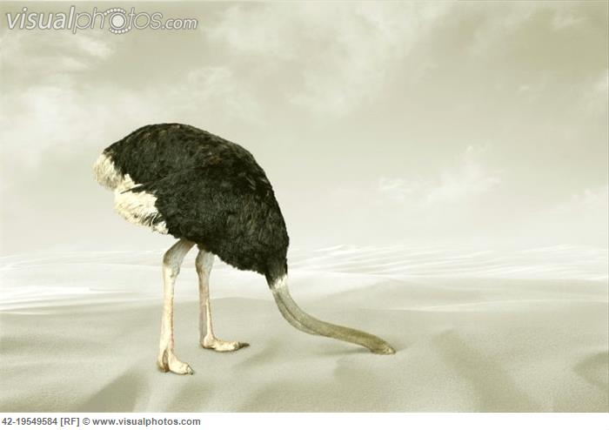
Defense Mechanisms
Unconscious mind’s strategies to distort reality in order to defend against anxiety and unacceptable impulses.
1. Denial
2. Repression
3. Regression
4. Projection
5. Sublimation
6. Splitting, Identification, Compensation, Rationalization…

