Slide 1
3rd Lecture – Natural World as a Philosophical problem
Ondřej Švec
31. 3. 2020

Slide 2
Phenomenology „to the things themselves“
a return to the perceptual world that is prior to any scientific conceptualization and articulation.
a criticism of scientism,
Cf. „science is the measure of all things, of what is that it is, and of what is not that it is not“ (W. Sellars, Science, Perception and Reality, Routledge, London, 1963, p. 173).
not a rejection of scientific rationality, but a rejection of certain inflated self-interpretation of science
there is a more original relation to the world than the one manifested in scientific rationality.

Slide 3
Eddington's Two Tables
1927 - Arthur Eddington - the Gifford Lectures at the University of Edinburgh - The Nature of the Physical World
“I have settled down to the task of writing these lectures and have drawn up my chairs to my two tables. Two tables! Yes; there are duplicates of every object about me - two tables, two chairs, two pens. (...)
One of them has been familiar to me from earliest years. It is a commonplace object of that environment which I call the world. How shall I describe it? It has extension; it is comparatively permanent; it is coloured; above all it is substantial By substantial I do not merely mean that it does not collapse when I lean upon it; I mean that it is constituted of "substance" and by that word I am trying to convey to you some conception of its intrinsic nature. It is a thing; not like space, which is a mere negation; nor like time, which is - Heaven knows what! (...)
Table No. 2 is my scientific table. It is a more recent acquaintance and I do not feel so familiar with it. It does not belong to the world previously mentioned that world which spontaneously appears around me when I open my eyes (...). My scientific table is mostly emptiness. Sparsely scattered in that emptiness are numerous electric charges rushing about with great speed; but their combined bulk amounts to less than a billionth of the bulk of the table itself. Notwithstanding its strange construction it turns out to be an entirely efficient table. It supports my writing paper as satisfactorily as table No. 1; for when I lay the paper on it the little electric particles with their headlong speed keep on hitting the underside, so that the paper is maintained in shuttlecock fashion at a nearly steady level. If I lean upon this table I shall not go through; or, to be strictly accurate, the chance of my scientific elbow going through my scientific table is so excessively small that it can be neglected in practical life. (...)
There is nothing substantial about my second table. It is nearly all empty space.”

Slide 4
Life-world : world given prior to all theoretization
In our pre-scientific perceptual encounter with the world, the world is given concretely, sensuously, and intuitively. In daily life, we do not interact with ideal theoretical objects, but with tools and values, with pictures, statues, books, tables, houses, friends, and family (Husserl Ideas II, 1952/1989, p. 27)
our knowledge of the world, including our scientific knowledge, arises from a first-person perspective,
science would be meaningless without this experiential dimension.

Slide 5
The split between the two worlds
Is it an over-intellectualized problem?
Not so much, when it comes to our self-conception.
„We became neuro-chemical selves“ (Nicolas Rose, 2003)

Slide 6
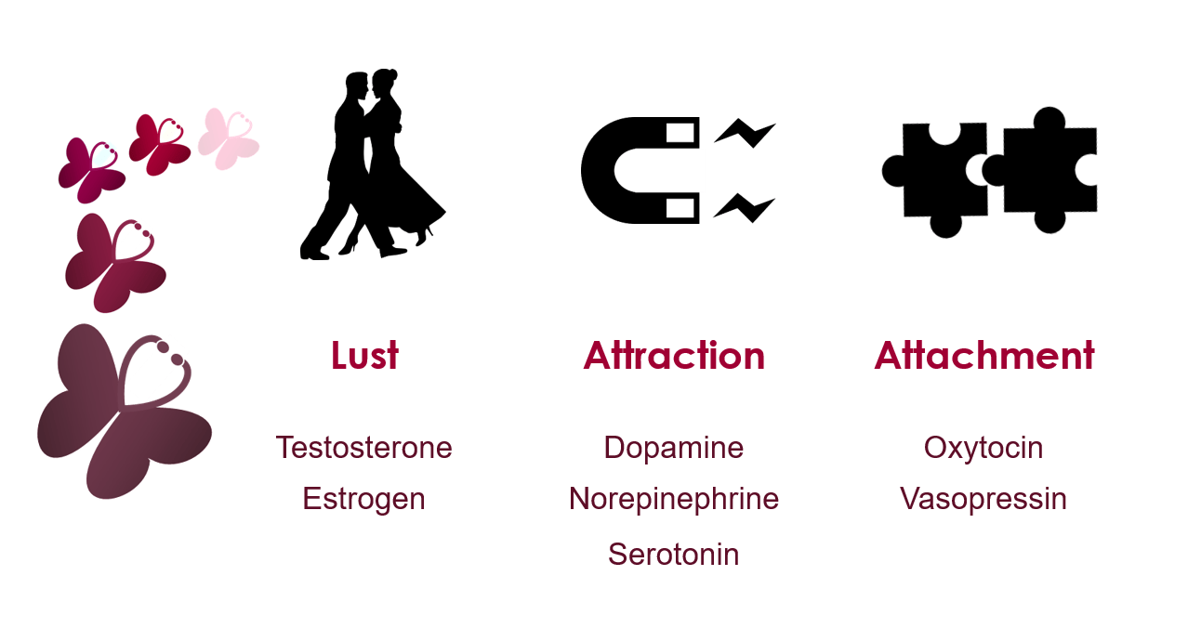
What is love?

Slide 7
Husserl´s critique of objectivism
The starting point cannot be objectivity, but rather the activity of objectification.
This rationalizing, objectifying practice, this art, then comes to be understood as an access to the true reality itself because it lacks the vision of the life out of which it grew.
Husserl does not deny the legitimacy of this objectivation, but opposes its metaphysical hypostatization, for which mathematically conceived objectivity is reality, and the only reality that there is.

Slide 8
Husserl´s main claim in Crisis
The objectifying practice of science loosed the sight of the Life-World, because it is wholly absorbed, fascinated with objectivities.
Main thesis: it is precisely this “subjective-relative lifeworld”, that provides the “grounding soil” of the more objective world of science.
Scientific conceptions owe their content and thus their reference to reality to the prescientific notions they are supposed to “naturalize“.

