Slide 1
Evaluation of sustainable development on a local level (ORP) using indicators
Hodnocení environmentální udržitelnosti na místní úrovni s využitím indikátorů
Ing. Michaela Horníková Supervisor: Doc. PaedDr. Tomáš Hák, Ph.D.

Slide 2
Overview
Motivation
Research basis
Methodology
Current situation - what has changed?
Summary
Literature

Slide 3
RESEARCH BASIS
Why are some ORP developing differently than others?
Is it caused by the level of attractivity?
How is the attractivity of the city connected with the concept of SD?
If the city is attractive, does it mean that it is also sustainable?
Is the attractivity of the city a condition or a factor?
….Migration is a fact and attractivity relays on environemtnal sustainability .

Slide 4
Finding issues
What is the„right“ set of indicators?
How to evaluate them?
Any research dedicated to the topic of attractivity
Define the frame of attractivity of the local level
Subjective approach, more into „What do people think about it?“

Slide 5
NEW HYPOTHESIS
Ability of EPI index to evaluace Sustainable development on local leveL
Results will remain the same even if adjusted (global vs. Local)

Slide 6
METHODOLOGY
Based on approach dedicated to EPI index
Set up the indicators‘ dataset
From global to local
Using EPI index as a method for the evaluation of indicators
Distance to target measurement
Data analysis based on time

Slide 7
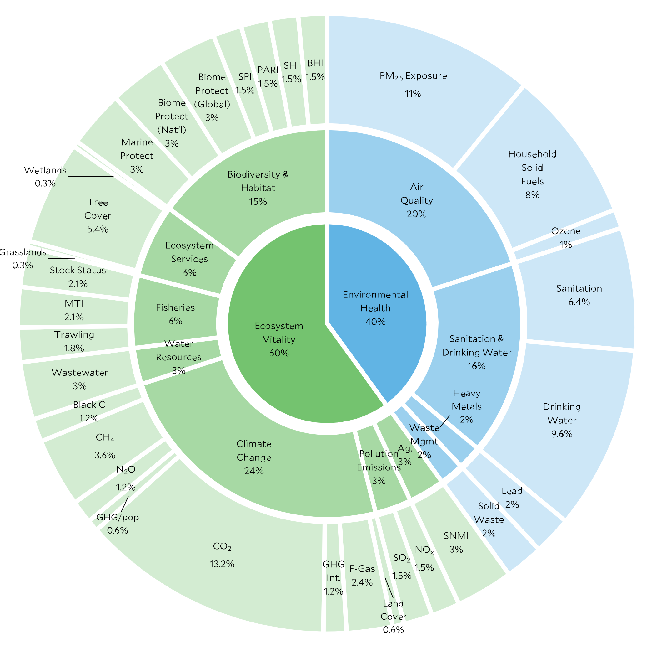
CURRENT SITUATION
Research of EPI index topic
Philosophy of „think global, act local“
Adjustment and transformation of EPI index indicators
2 objectives remain the same
11 policy categories reduced to 10
32 indicators reduced to 28
Transformation indicators which meet national targets

Slide 8
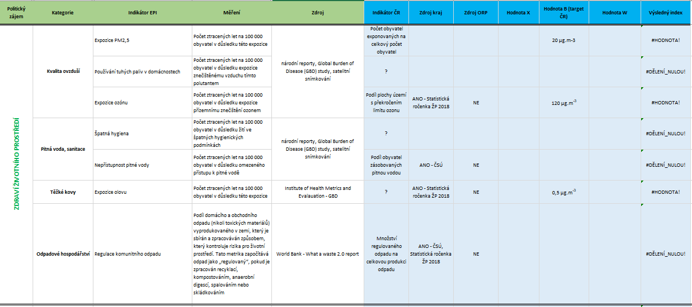
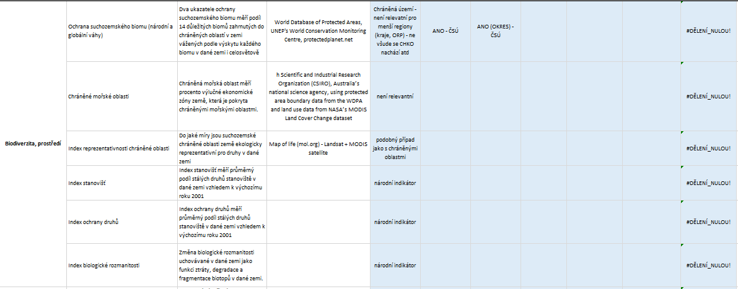
FURTHER STEPS
Using EPI indicators across 205 municipalities
Discussion about the definition of „local level“ > moving to 13 (14) regions
Extension the theory of EPI through local level
Analysis and overall evaluation of sustainable development of administrative districts of the Czech Republic
Clarification of results

Slide 9
LITERATURE
Zákon č. 201/2012 Sb., o ochraně ovzduší
Wendling, Z. A., Emerson, J. W., de Sherbinin, A., Esty, D. C., et al. (2020). 2020 Environmental Performance Index. New Haven, CT: Yale Center for Environmental Law & Policy. epi.yale.edu
Environmental Performance Index: EPI [online]. New Haven, CT: Yale Center for Environmental Law & Policy, 2020 [cit. 2021-01-23]. Dostupné z: epi.yale.edu
Environmental Performance Index Dashboard. Environmental Performance Index: EPI [online]. New Haven, CT: Yale Center for Environmental Law & Policy and the Center for International Earth Science Information (CIESIN) at Columbia University's Earth Institute, 2020, 2020 [cit. 2021-01-23]. Dostupné z: https://www.arcgis.com/apps/dashboards/8dd0d10f07544331888ecc2a406d1825
Hsu, A., J. Emerson, M. Levy, A. de Sherbinin, L. Johnson, O. Malik, J. Schwartz, and M. Jaiteh. (2014). The 2014 Environmental Performance Index. New Haven, CT: Yale Center for Environmental Law & Policy. Available: www.epi.yale.edu.
Hsu, A., D. Esty, M. Levy, A. de Sherbinin, et al. 2016. The 2016 Environmental Performance Index Report. New Haven, CT: Yale Center for Environmental Law and Policy. http://dx.doi.org/10.13140/RG.2.2.19868.90249.
Janoušková, S., Moldan, B., Hák, T. “Pět Klíčových Indikátorů Udržitelného Rozvoje: Nástroj pro Vzdělávání a Osvětu Veřejnosti.” Envigogika, no. 1 (2017). doi:10.14712/18023061.536.
Janoušková, S.; Hák, T.; Nečas, V.; Moldan, B. Sustainable Development—A Poorly Communicated Concept by Mass Media. Another Challenge for SDGs? Sustainability 2019, 11, 3181.
JANOVSKÁ, Alena. Hodnocení udržitelného rozvoje ČR na regionální i místní úrovni [online]. 2013 [cit. 2020-02-01].
NOVÁČEK, Pavel. Udržitelný rozvoj / Pavel Nováček. 2011. ISBN 9788024427959.
MORRISON-SAUNDERS, Angus. Advanced introduction to environmental impact assessment. Cheltenham, UK: Edward Elgar Publishing, [2018], ©2018. x, 174 stran. Elgar advanced introductions. ISBN 978-1-78536-969-8.
Petríková, D.: Trvalo udržatelná mestá a obce, Životné prostredie 3, str. 161, 1997, Bratislava ISSN 0044-4863
VRBOVÁ, Pavlína. Udržitelný rozvoj / [autoři Pavlína Vrbová ... et al.]. 2012. ISBN 9788090534735.
Hák, T., Kovanda, J., & Weinzettel, J. (2012). A method to assess the relevance of sustainability indicators: Application to the indicator set of the Czech Republic’s Sustainable Development Strategy. Ecological Indicators 17: 46-67.
BUTTON, Kenneth a BUTTON. City management and urban environmental indicators: Indicators, complexity and the politics of measuring cities. Ecological Economics. 2002, 40(2), 217-233. DOI: 10.1016/S0921-8009(01)00255-5. ISSN 09218009. Dostupné také z: https://linkinghub.elsevier.com/retrieve/pii/S0921800901002555
Environmentální politika a udržitelný rozvoj. 2005. ISBN 9788073670030.

Slide 10
Thank you for your attention.

