Slide 1
LOCAL GOVERNMENT IN ROMANIA
resilience
growth
quality
sustainability
INSPIRATIONAL
LEADERS
ENTREPRENEURIAL SPIRITS
EFFECTIVE MANAGERS
INNOVATION
DRIVERS
change agents
competitive services
performance driven
smart investments
On Reform Reversal, Smart Tales and Strategic Developments

Slide 2
Contents
Local Government in Romania: facts and figures
Reforms (avenues, challenges, perspectives)

Slide 3
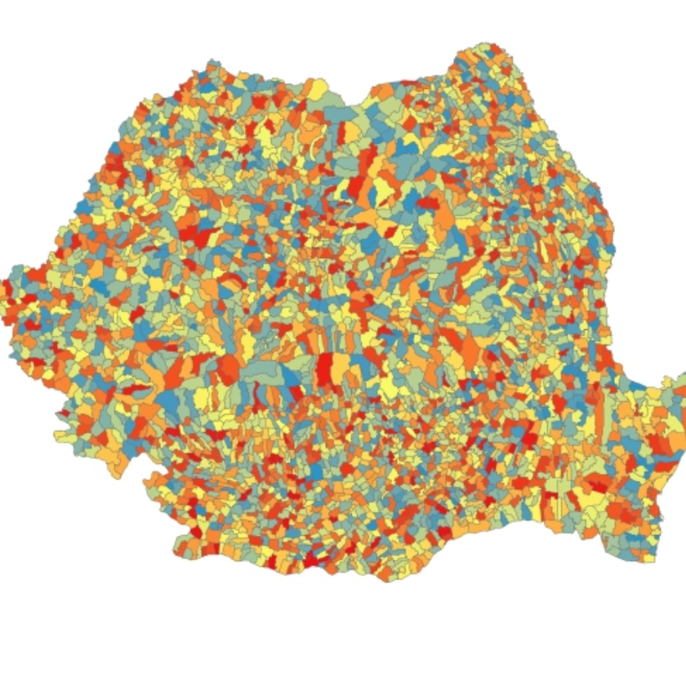
Facts and figures
Romania (map) I Country context (link) I County statistics (link) I Political statistics (link)
3 administrative tiers (national – county – local) I 3228 administrative – territorial units
41 counties
County councils
Presidents of the County councils
103 municipalities
216 towns
2862 commune
Local councils
Mayors
12.957 villages (2016)

Slide 4
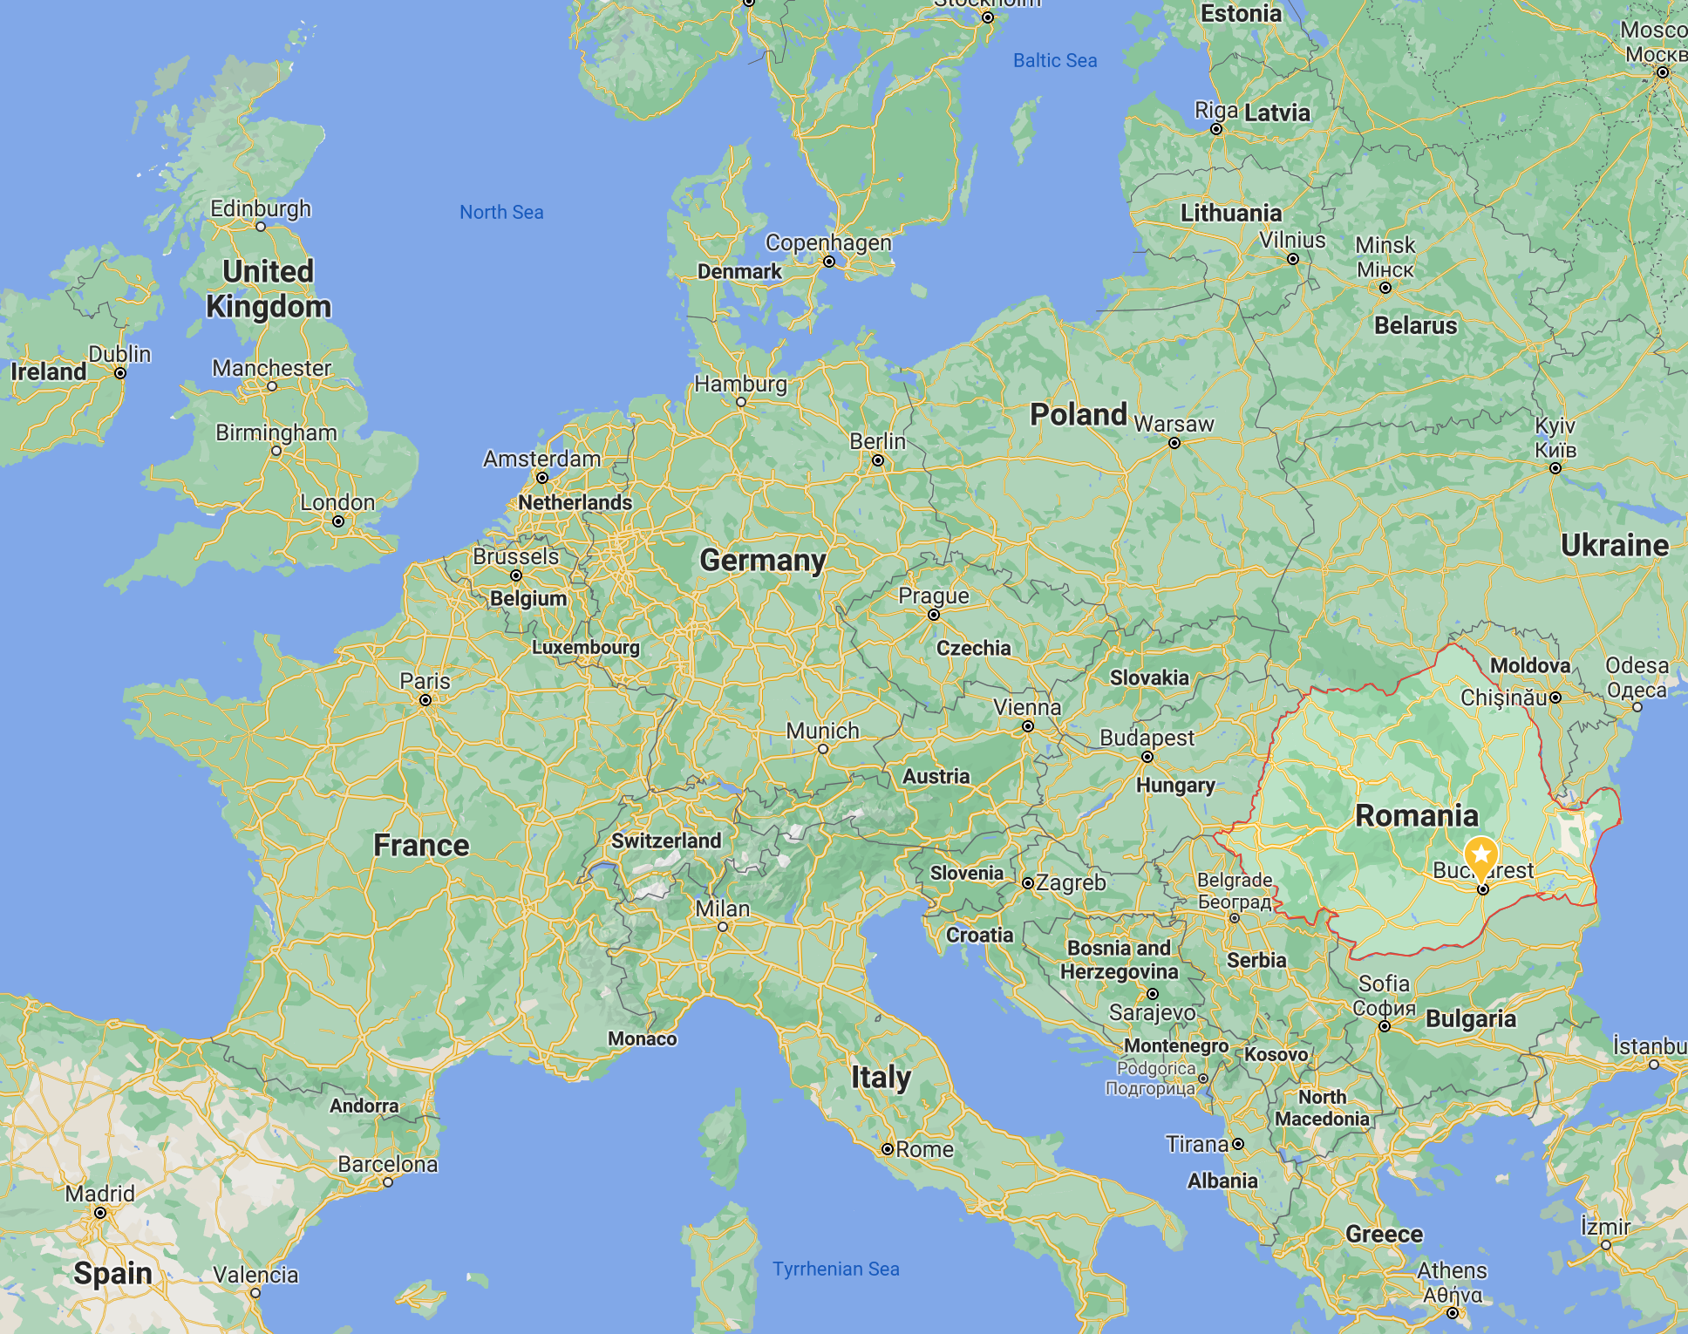
Facts and figures
1990: Romanian Association of Municipalities (109 members, approx. 10 million inhabitants)
1991: adoption of the (new) Romanian Constitution (revision: 2003) (link)
1991: (new) legal framework on local government (35 amendments until 2019; 9 after 2019)
1994: Romanian Association of Towns (216 members)
1997: Romania ratifies the European Charter of Local Self Government (link)
1997: Romanian Association of Communes (1750 members, approx. 9 million inhabitants)
1998: 8 development regions are enacted (not administrative units) (5 amendments until 2021) (link)
2004: first Romanian law on decentralization (3 amendments until 2019; 9 after 2019)
2005: mandatory consultation of local governments’ associations in the policy making process
2007: Romania joins the EU (NUTS levels - link)

Slide 5
Reforms
Local government principles
local self-government, decentralisation, consultation, cooperation, accountability, budgetary restraint
Europeanisation
administrative capacity building; good governance; regional development; sectoral policies

Slide 6
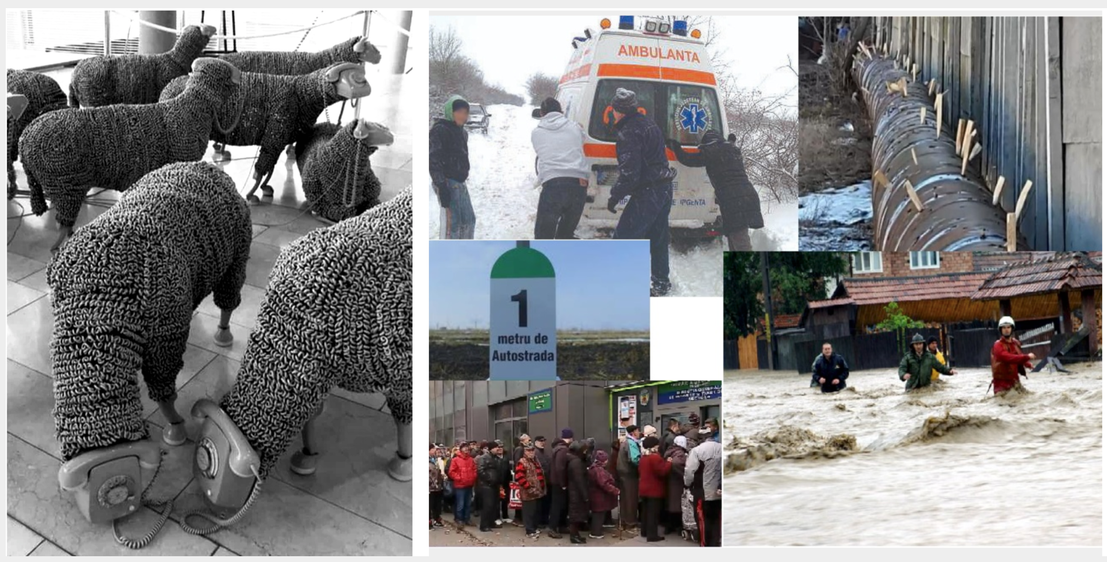
Reforms
Organisational challenges
Financial constraints
Scarcity of professional human resources
Politicization
….

Slide 7
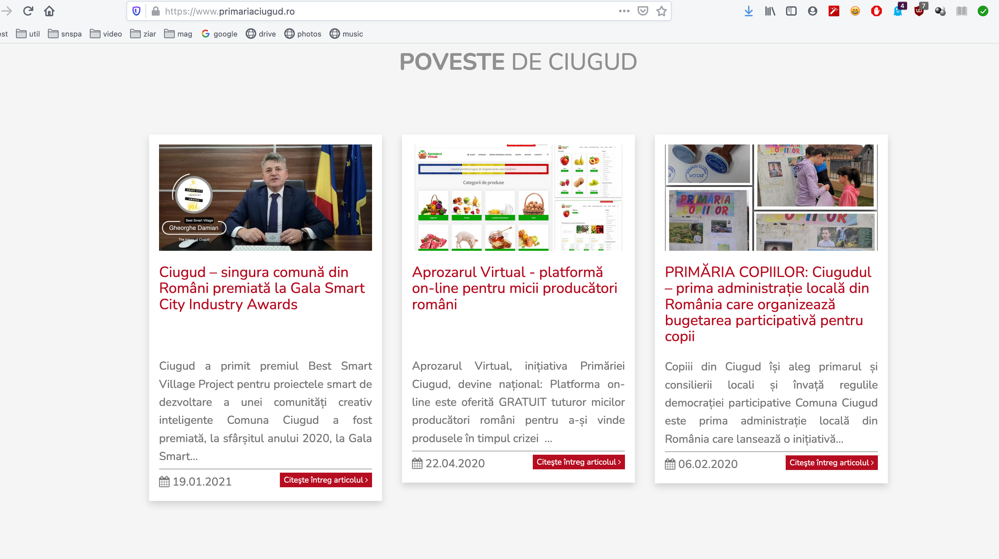
Reforms
Ciugud: link

Slide 8
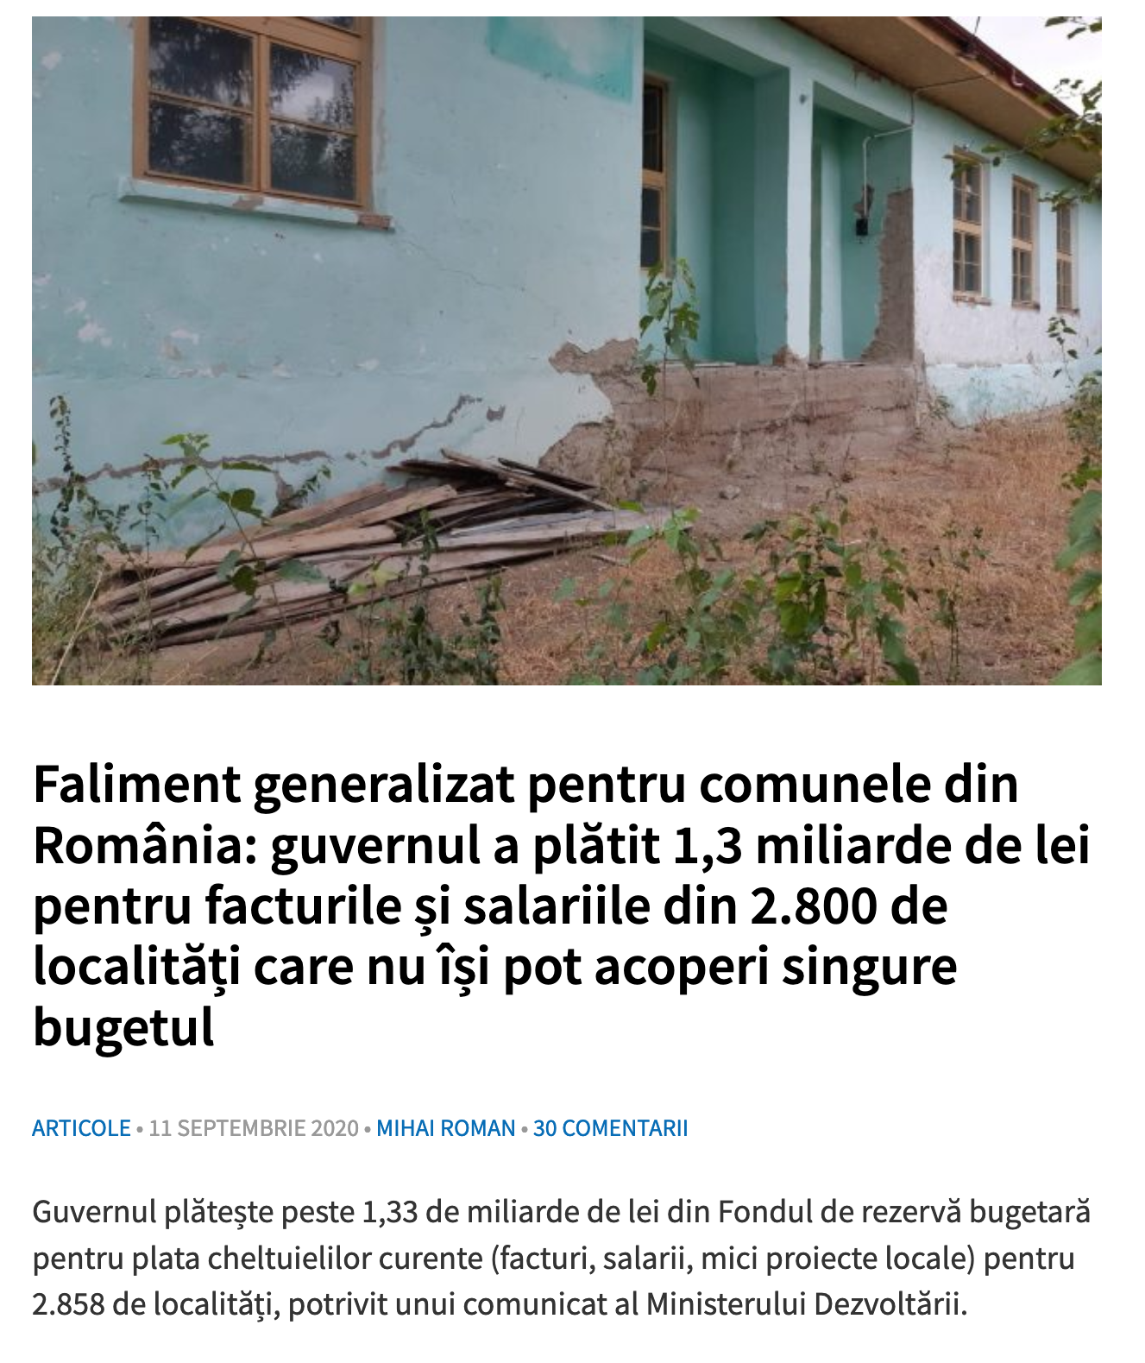
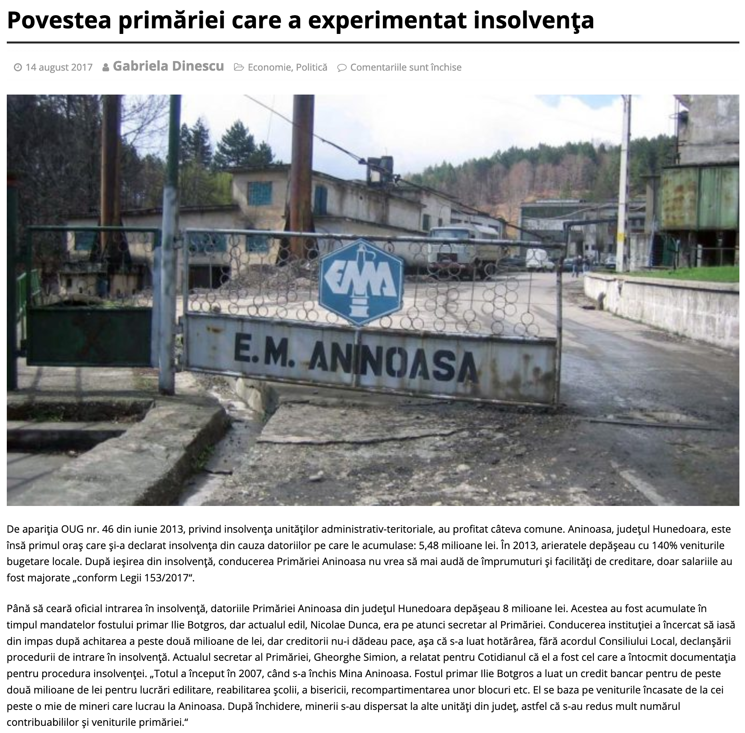
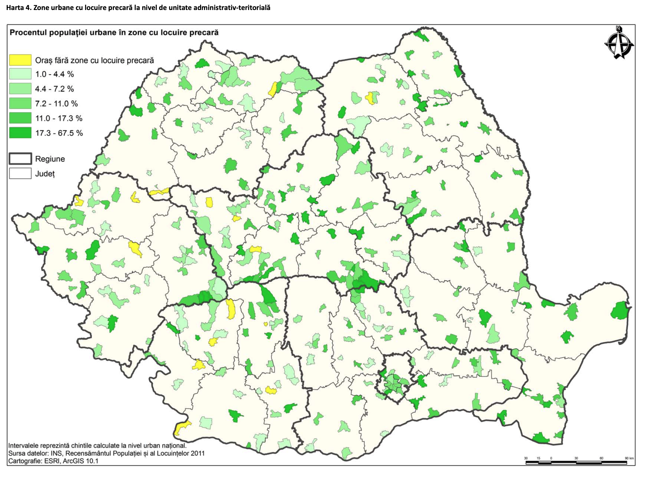
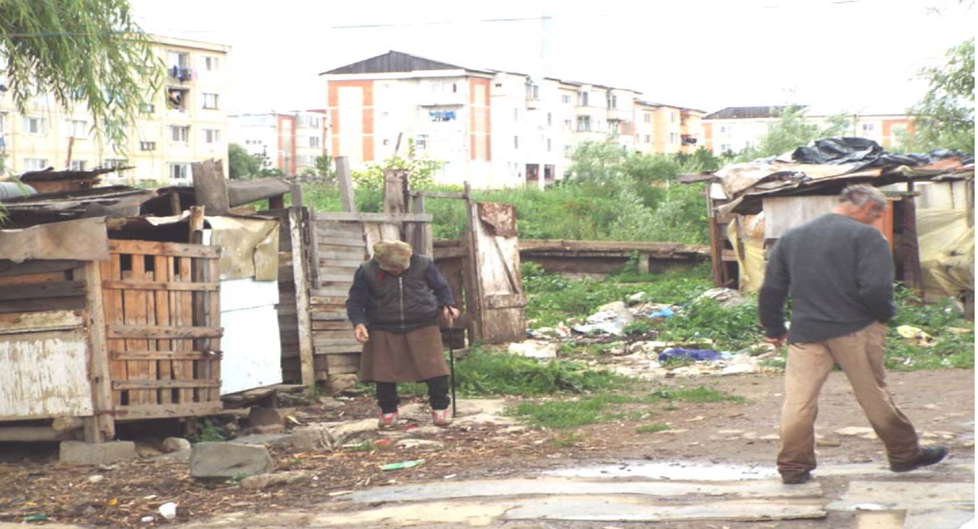
(link)
(link)
(link)
(link)

Slide 9
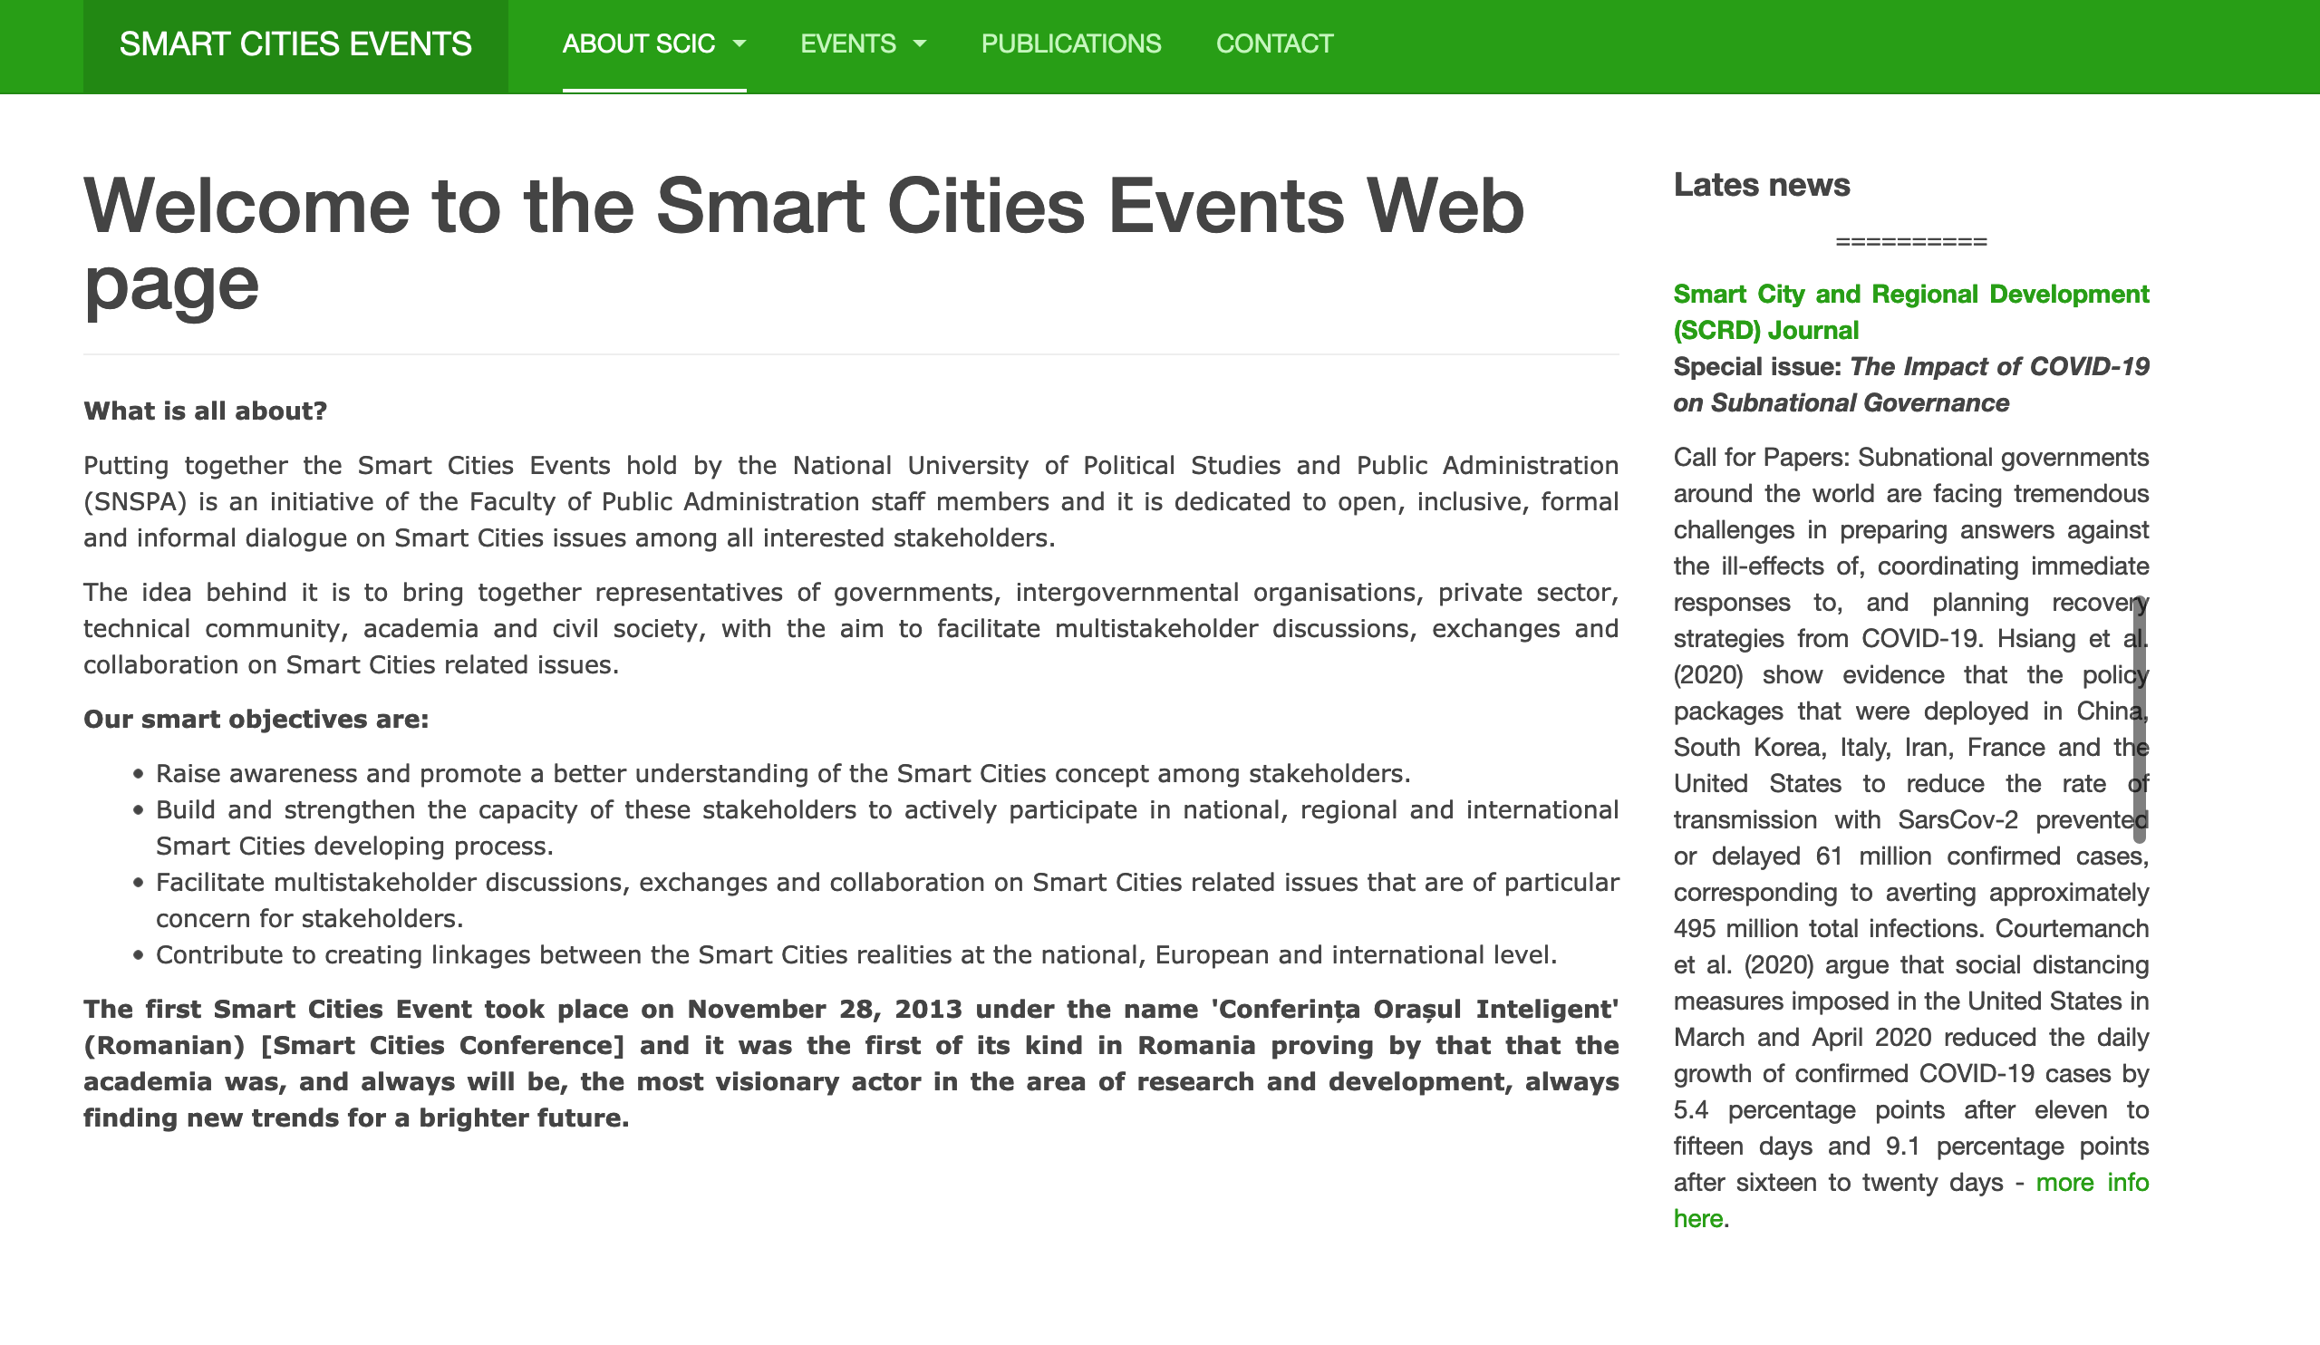
http://smartcitiesevents.eu/
Thank you for your attention!
Diana – Camelia Iancu
Faculty of Public Administration, SNSPA
(National University of Political Studies and
Public Administration, Bucharest, Romania)
Email: diana.iancu@snspa.ro
http://snspa.ro/en/

