Slide 1
Sociology of European Integration
Moodle page: https://dl1.cuni.cz/course/view.php?id=7256

Slide 2
10. Social movements and critical Europeanist discourses

Slide 3
Social movements
Social movements as actors:
important agents of social critique and change
crucial for the democratic process because of their capacity to formulate innovative claims
Social movements as (transnational) communicative spaces:
action contexts for new styles of communication that might herald new kinds of transnational identity or integration processes
backstage regions of the public sphere where public opinion less strongly pre-structured by institutional discourses: potential for cognitive, affective and interactive innovation
Haug (2008) Public spheres within movements
calls for organisational sociology approach to study of social movements;
employs public sphere theory to study the inside of social movements

Slide 4
European Social Forum
Example of new type of social movement
valuing communicative action over social action capacity (constituted through communication)
valuing internal dialogue and debate over unified claims-making
enacting rather than demanding alternatives (laboratories of democracy)
preparatory meetings institutionalised and routinised transnational ties between activists
Adaptation to high relevance of the EU institutions - an interlinked series of ‘assembly publics’ which mirrors the transnational architecture of EU
Creation of spaces where rights-based European integration debated, opposed to market-based integration
What are the structural conditions which facilitate or constrain a Europeanisation of the communication within and between these spaces?
What do their meetings, conferences or mailing lists look like?
What do they do when they are not protesting / making demands but enduring / reflecting?

Slide 5
EuroMayday 2005-08
Street parades and local protests, originating in Italy within a transnational network for a "free, open and radical Europe” and against “precarity” - hundreds of thousands of participants
Small, resource-poor, locally-rooted protest groups became catalysts for imagination of a different European integration - e.g. inclusive of social rights for undocumented immigrants
“Critical Europeanist” political discourse framed in opposition to official EU campaigns - e.g. 2006 European Year of Workers’ Mobility
Ref: Doerr, N. (2010) Politicizing Precarity, Producing Visual Dialogues on Migration: Transnational Public Spaces in Social Movements, Forum: Qualitative Social Research 11(2).

Slide 6
Discourse and counter-discourse
Euromayday publicity parodied the language of a contemporary EU campaign promoting worker mobility
Both promoted/defended right to free movement across borders within EU, but
EU documents refer to “mobility”,
protesters refer to “migration” and “immigration”, thus including non-EU citizens
Some local organisers found the term “Europe” too restrictive, preferring a broader transnational identity (MondoMayday) in opposition to “fortress Europe” and the restrictive immigration policies then pursued by European leaders like Sarkozy and Merkel

Slide 7
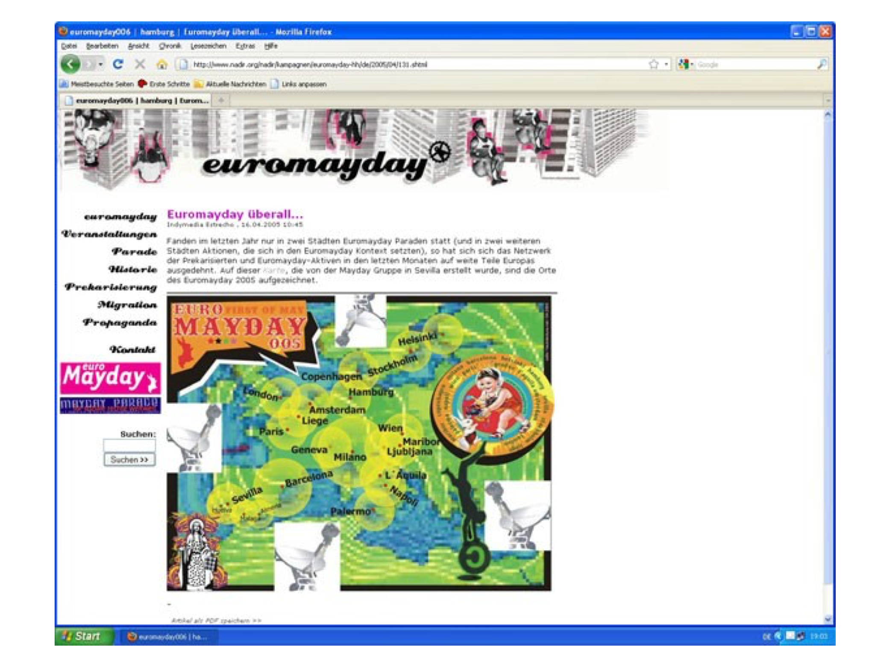
Reimagining Europe through maps

Slide 8
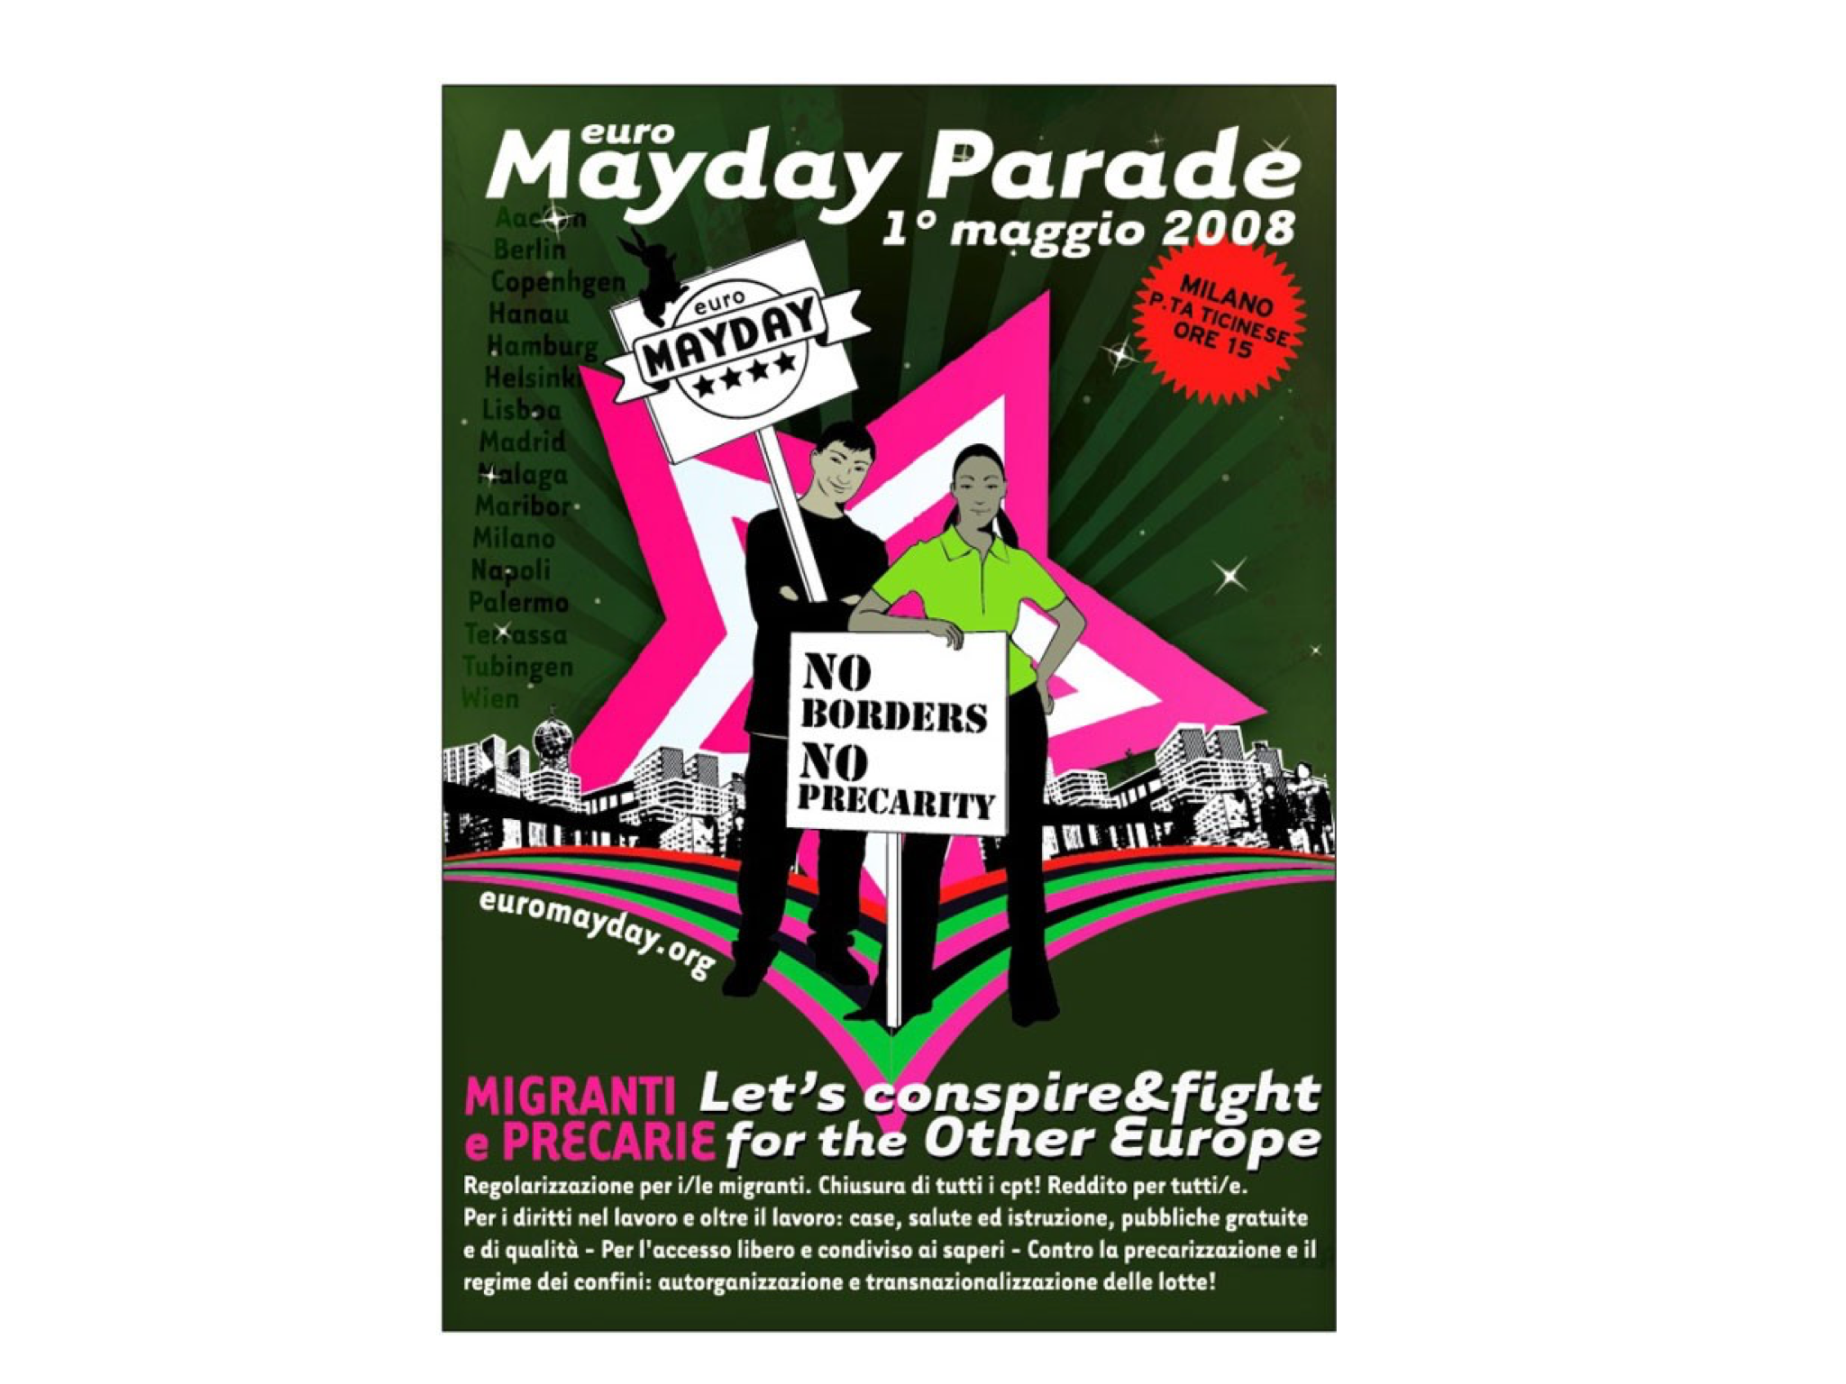
Visual dialogue between Milan and Aachen
Who are the protagonists of European integration?

Slide 9
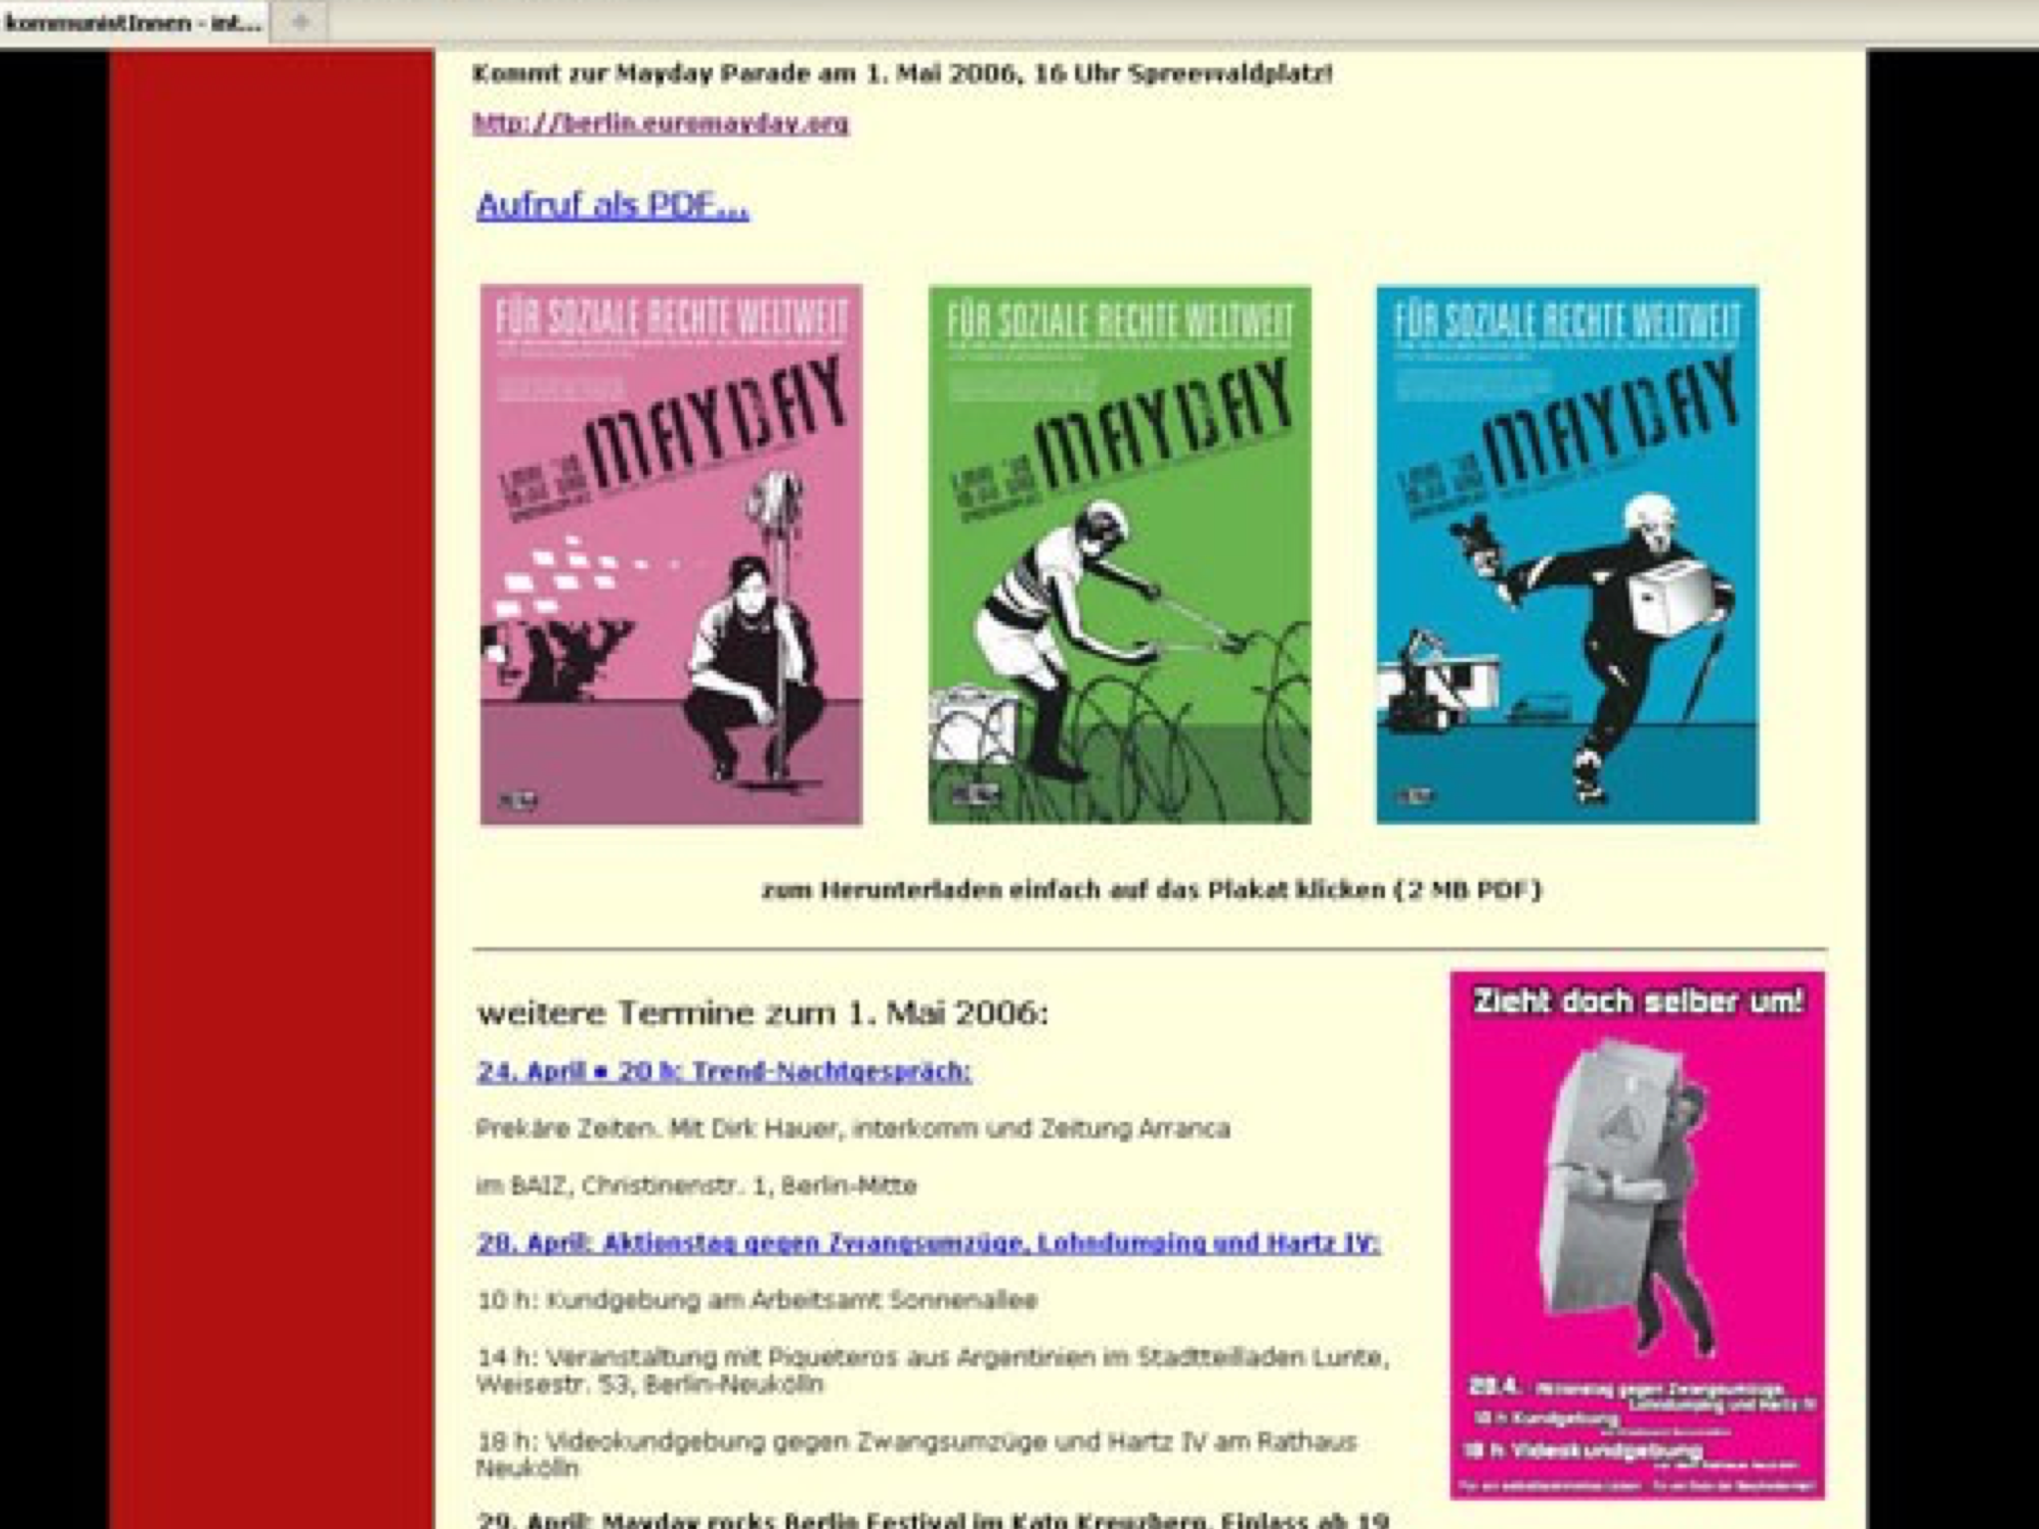
Counter-images of migration: Berlin

Slide 10
What did EuroMayday represent?
Transnationalist citizenship in these movement networks is expressed through a culture of sharing/borrowing/translation:
the dialogue is conflictual (not all images, ideas and tactics are equally transferable between local cultures)
Dutch cities failed to mobilise large parades: the Netherlands lacks a strong first of May tradition or a culture of mass demonstrations
journals important instruments because in many countries certain terms, e.g. “precarity” needed explanation; Italian theories about immaterial labour needed contextualization (Scholl)
but productive (the dialogues about image sharing helped generate visual cultures that widened the political meaning of what citizenship in Europe may be today)

Slide 11
Diffusion in European counterglobalisation networks
Europe is a space for diffusion of frames, tactics and ideas among activists - a political space for “contagion” (Scholl on EuroMayday and climate camps)
Diffusion theory traditionally studies the take-up of innovations:
not a phenomenon unique to the current global era: 1848 upheavals, civil rights, and the 1960s student movements, for example, demonstrated similar dynamics
Never just intra-European: inspiration from 1999 Seattle protests, Mexican Zapatistas
#occupy label used in US, North Africa (Arab Spring) and Europe (Indignados)
but current wave of diffusion connects national contention to transnational conflicts or international institutions
Diffusion seems to be selective and with diminishing effectiveness
no country repeated EuroMayDay or climate justice camps as successfully as the innovating countries

