Slide 1
Care of the Soul: In Antiquity and Today 4 Theatre as a manifestation of care of the soul
Zuzana Svobodová, Adhip Rawal

Slide 2
Basic information
In SIS: CVOL0376
Title: Care of the Soul: In Antiquity and Today
Guaranteed by: Department of Medical Ethics and Humanities, Third Faculty of Medicine, Charles University
Points, E-Credits: 5
Guarantor: doc. PhDr. Zuzana Svobodová, Ph.D.: zuzana.svobodova@lf3.cuni.cz
Annotation: The care of the soul is a phenomenon of cultivation, of human culture. The course focuses on the exemplifications of care of the soul from the earliest times of mankind to the present day. From the ancient times, examples of material culture with symbols and signs will be presented, and their interpretation will be based on different methodological principles. Course participants will also seek their own interpretive approaches within the expression of the human possibility, which is the care of the soul. The course is taught in tandem with Dr. Adhip Rawal from the University of Sussex School of Psychology, alongside the course supervisor.
Course completion requirements: Students upload written text, 4-6 pages (1800-2700 words). The content of the written work: Students will choose a short text/picture/movie/… describing the process of caring for the soul and write an interpretation.
Literature to the course at: https://www.citacepro.com/slozka/bpKEWhZf

Slide 3
Basic information
Syllabus:
Examples of the oldest remains of material culture, their symbols and interpretations.
The seeking for personality and integrity in different cultures.
Critical periods in life, examples of ritualization and symbolic expressions.
Theatre as a manifestation of care of the soul.
Spa as an expression of care for a good and beautiful life.
Learning resources - Moodle: https://dl1.cuni.cz/course/view.php?id=16377
MS Teams: https://teams.microsoft.com/l/team/19%3aW70bEVcamrlLOG6V9FgovqmNVQo-Wf8uff3vIal8ZGw1%40thread.tacv2/conversations?groupId=2b9b36ce-8617-449e-b3dd-9cc70566e7ec&tenantId=e09276da-f934-4086-bf08-8816a20414a2
Schedule for the winter semester 2024–2025:
October 22, 18-19:30
November 5, 18-19:30
November 19, 18-19:30
December 10, 18-19:30
January 7, 18-19:30
In these days and hours (at least 3 of them), connect to:
https://teams.microsoft.com/l/meetup-join/19%3aW70bEVcamrlLOG6V9FgovqmNVQo-Wf8uff3vIal8ZGw1%40thread.tacv2/1718882985968?context=%7b%22Tid%22%3a%22e09276da-f934-4086-bf08-8816a20414a2%22%2c%22Oid%22%3a%22da59b418-9bdf-4c0e-b401-2e81c8f22ed6%22%7d
Minimal requirements, prerequisites, conditions for selection and enrolment of students: Students can use the internet for MS Teams video meetings, have English as a spoken language - minimum level: B1 - "Can understand the main points of clear standard input on familiar matters regularly encountered in work, school, leisure, etc. Can deal with most situations likely to arise whilst travelling in an area where the language is spoken. Can produce simple connected text on topics which are familiar or of personal interest. Can describe experiences and events, dreams, hopes & ambitions and briefly give reasons and explanations for opinions and plans."

Slide 4
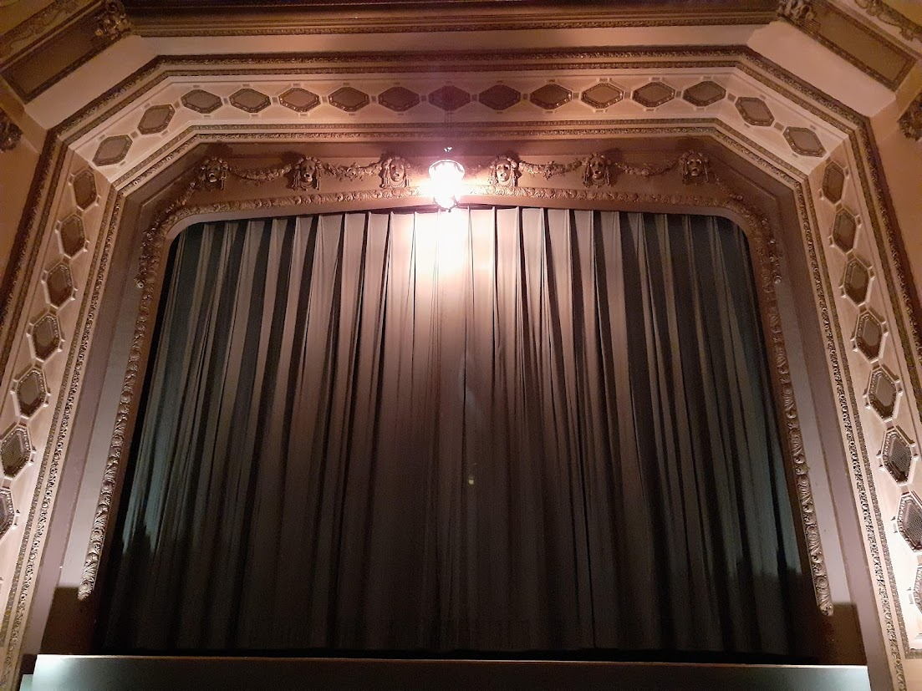

Slide 5
Critical periods in life
natural factum
cultural re-action
reason
habit
social tradition
take – carry – give
…

Slide 6
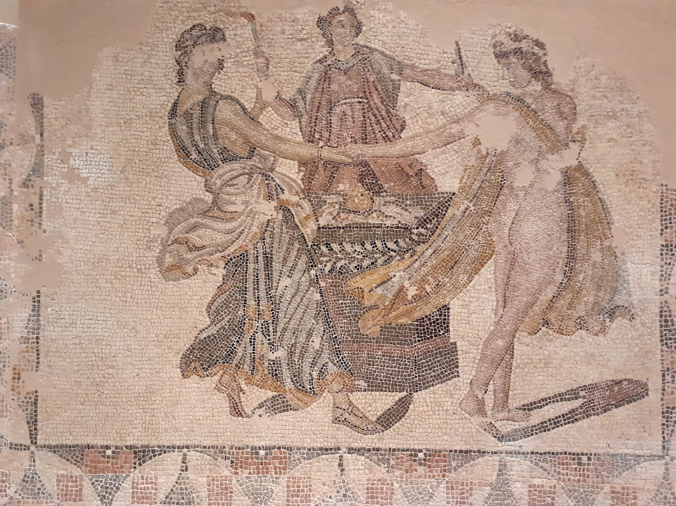
museum in Patras
Entertainment?

Slide 7
Reality and aim. Changes. Past-Present-Future
Reflection of the present state.
The role of art: true or false?

Slide 8
Aeschylus:
https://www.gutenberg.org/ebooks/author/2825
https://librivox.org/author/478?primary_key=478&search_category=author&search_page=1&search_form=get_results&search_order=alpha
Sophocles:
https://www.gutenberg.org/ebooks/author/26
https://librivox.org/author/1157?primary_key=1157&search_category=author&search_page=1&search_form=get_results&search_order=alpha
Euripides
https://www.gutenberg.org/ebooks/author/1680
https://librivox.org/author/1247?primary_key=1247&search_category=author&search_page=1&search_form=get_results&search_order=alpha

Slide 9
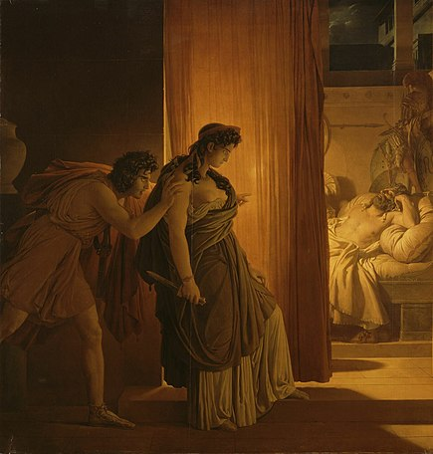
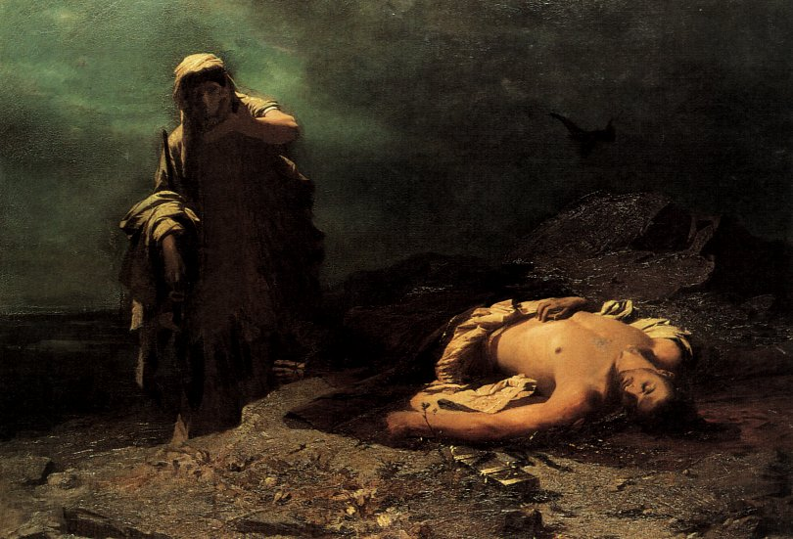
Origin of ancient tragedy
Changes in society (polis) from aristocratic to democratic
Tragic hero, tragic heroine
Aeschylus (525–456)
Sophocles (497/496 – 406/405)
Euripides (480 – 405)
After two centuries, Aristotle (384–322 BC) no longer understands what a tragic hero means
External justice (of law, nomos), internal justice (natural, phusis)
The Murder of Agamemnon by Pierre-Narcisse Guérin (1817)
Antigone in Front of the Dead Polynices by Nikiforos Lytras, National Gallery, Athens, Greece (1865)

Slide 10
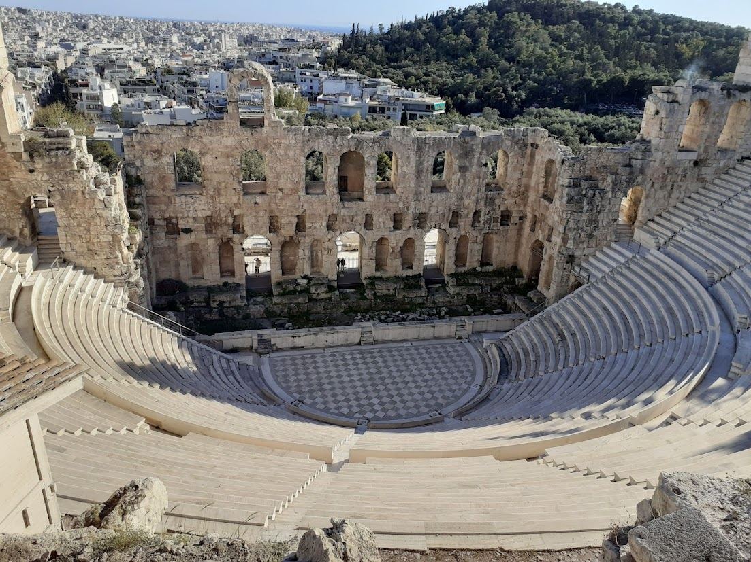
Notes:
Athens

Slide 12
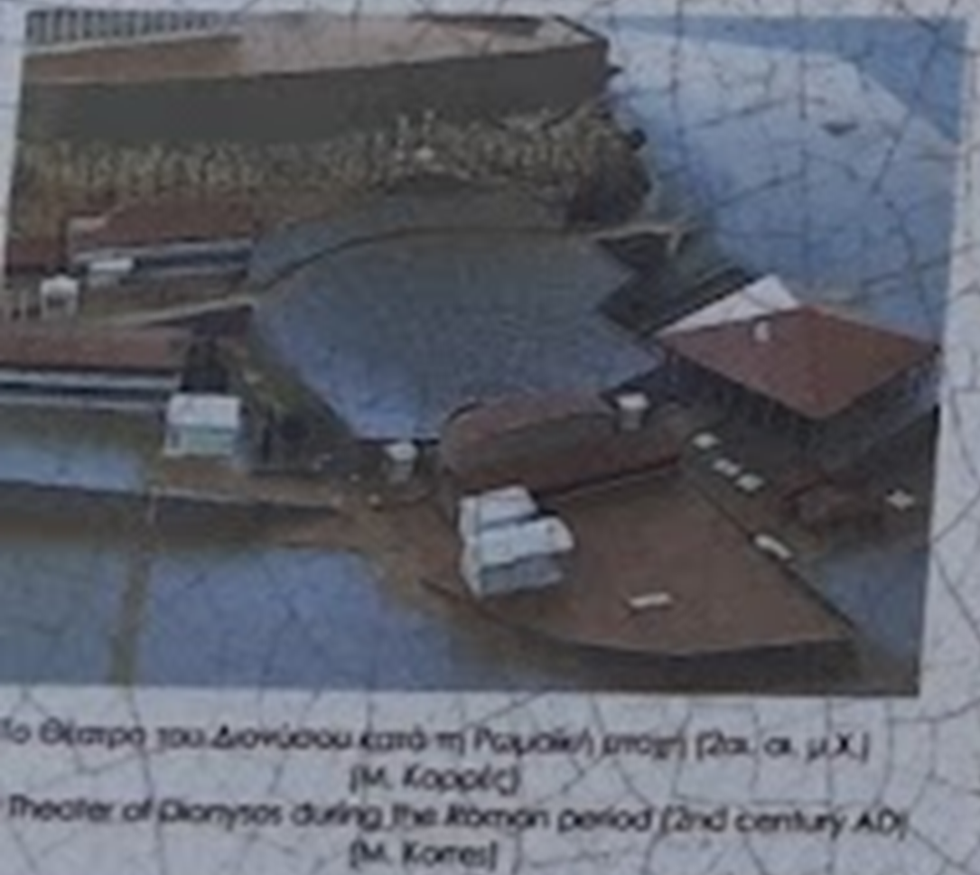

Slide 13
Reasons to visit a theatre

Slide 14
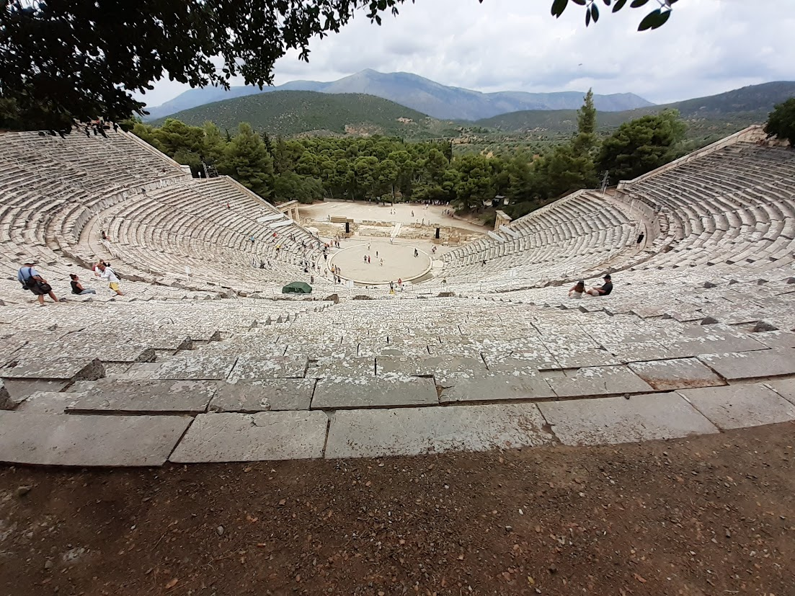

Slide 15
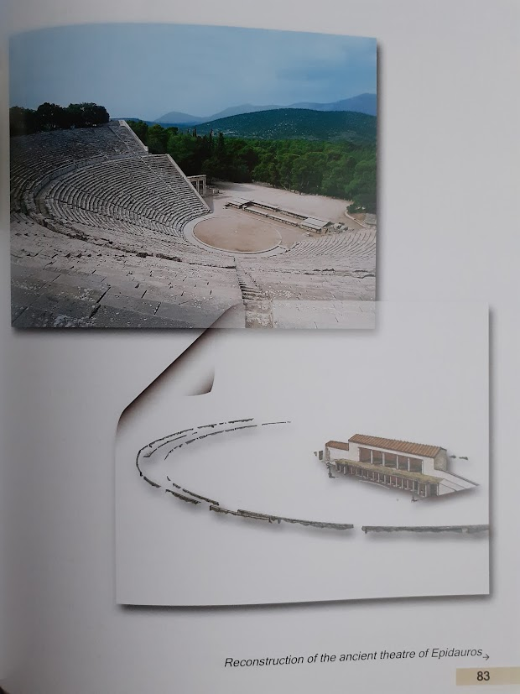
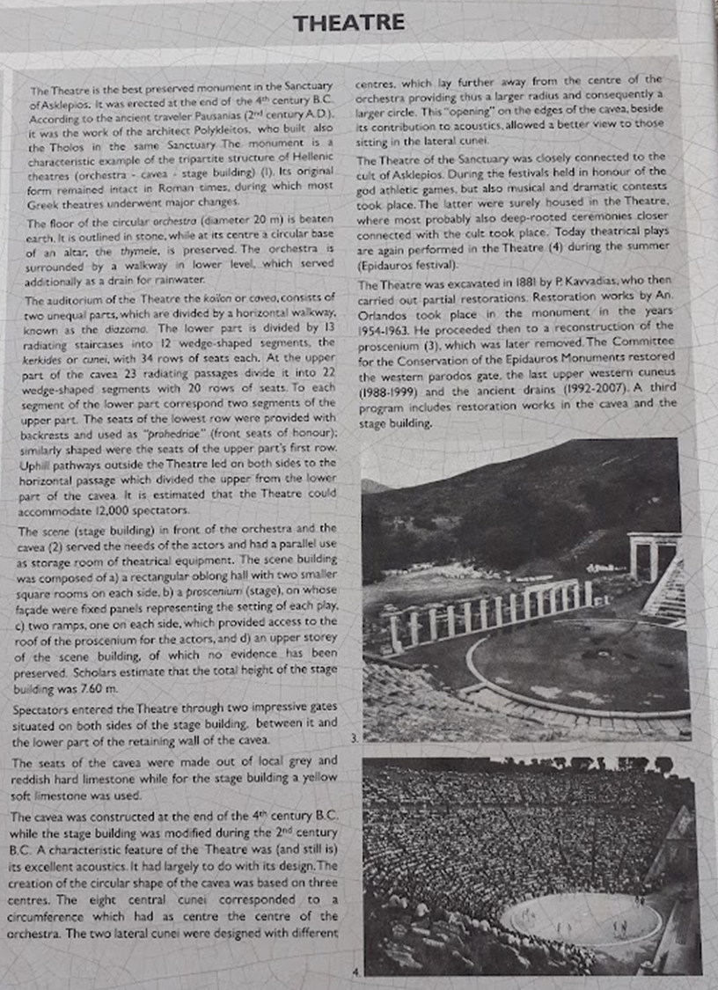

Slide 16
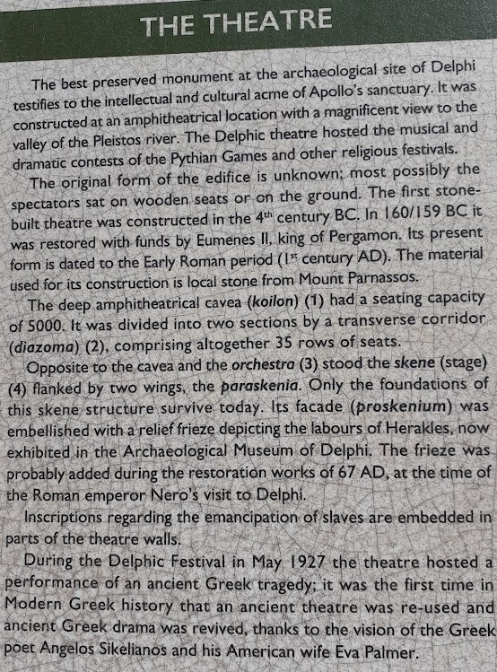
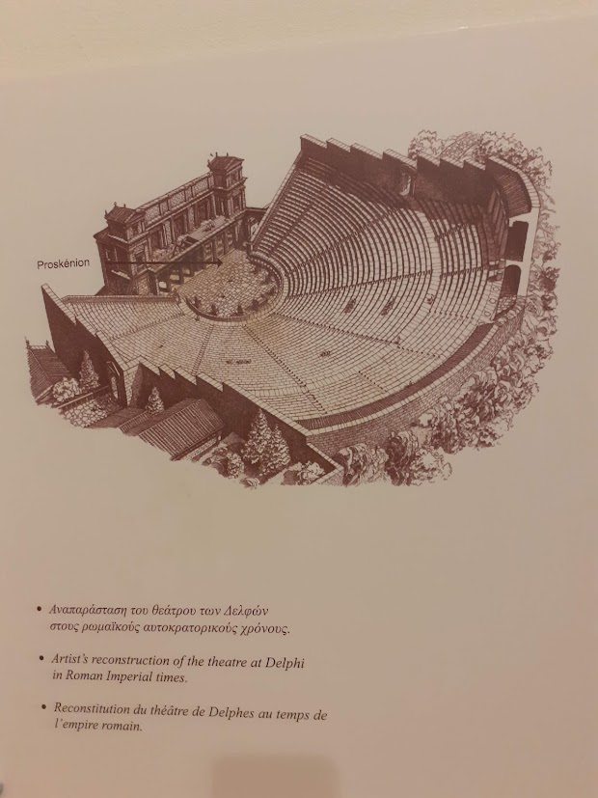

Slide 17
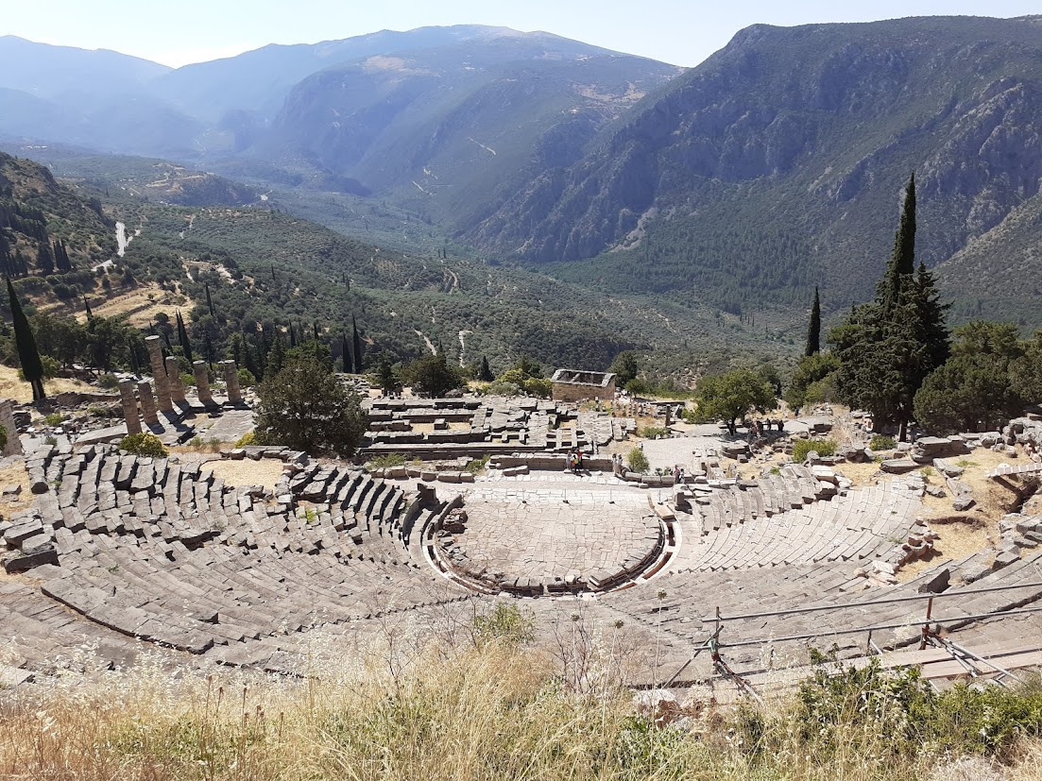

Slide 18
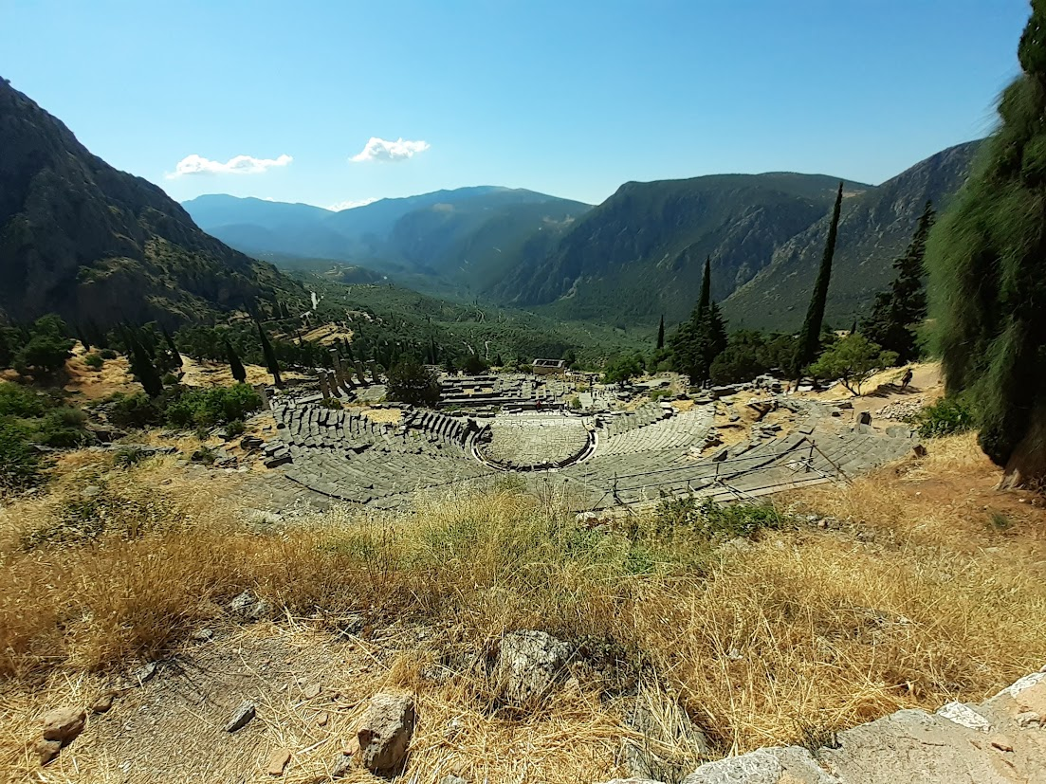

Slide 19
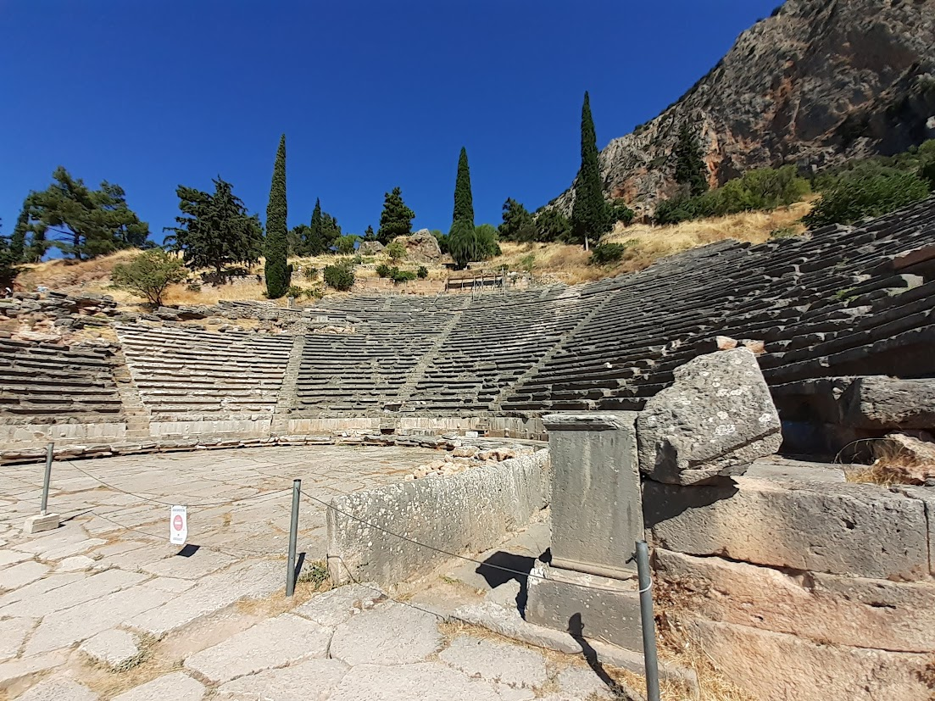

Slide 20
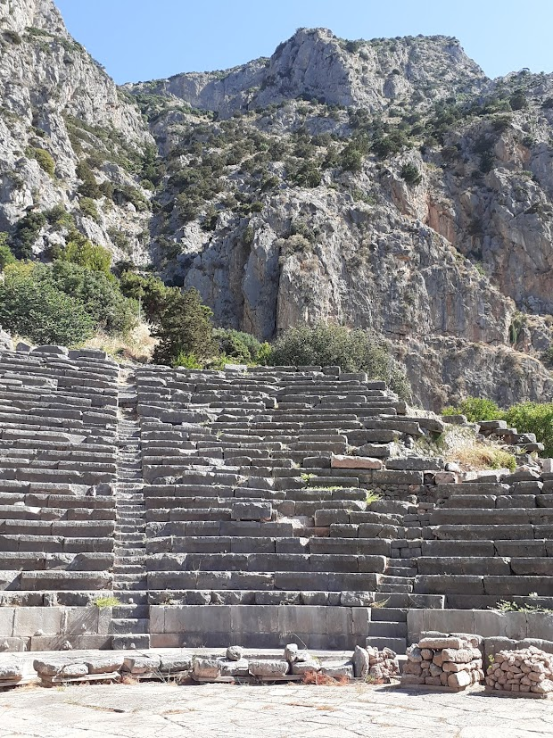
Notes:
Dephi

Slide 21
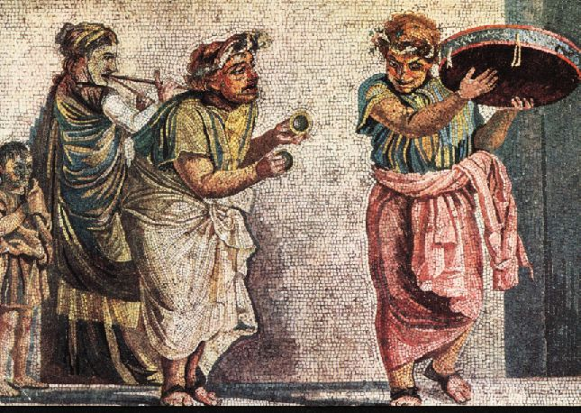

Slide 22
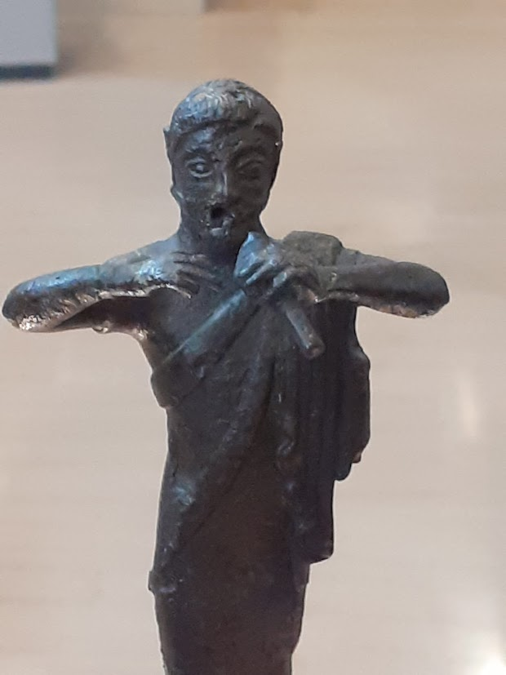
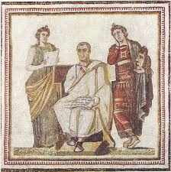

Slide 23
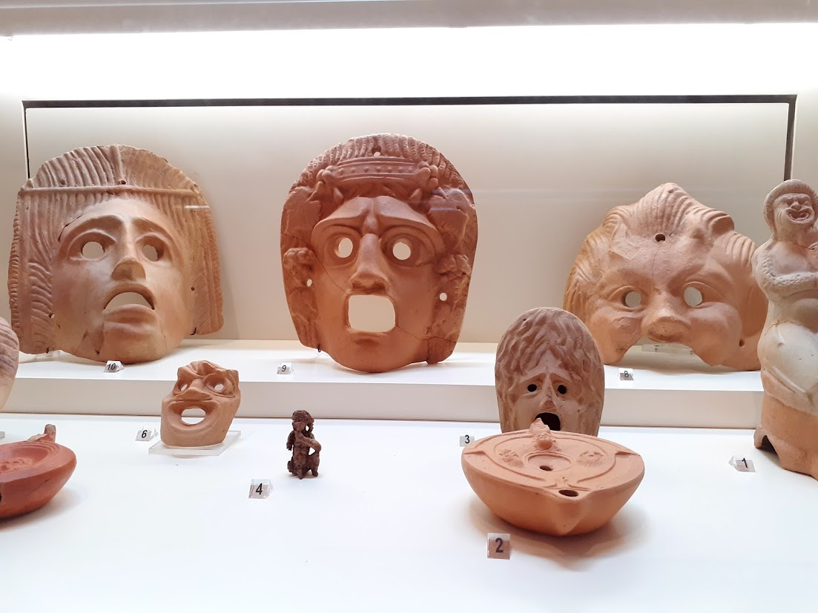

Slide 24
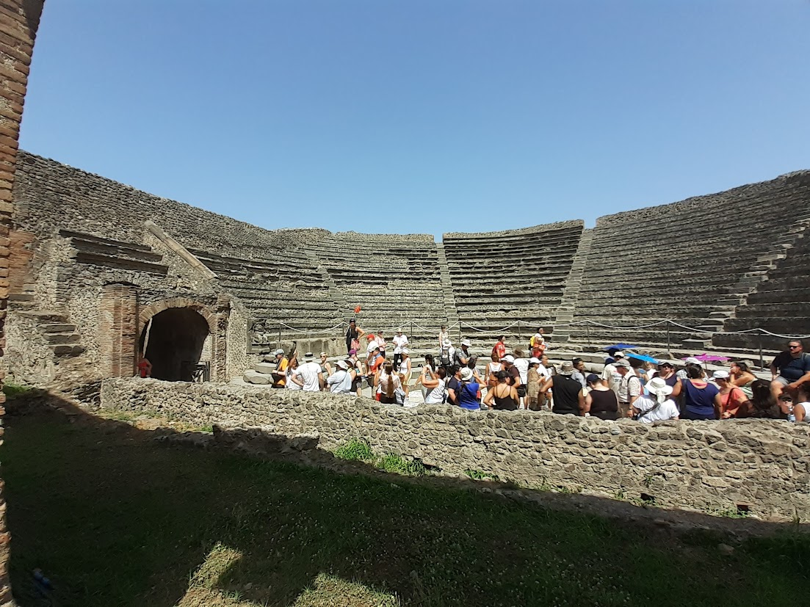
Notes:
Pompei

Slide 25
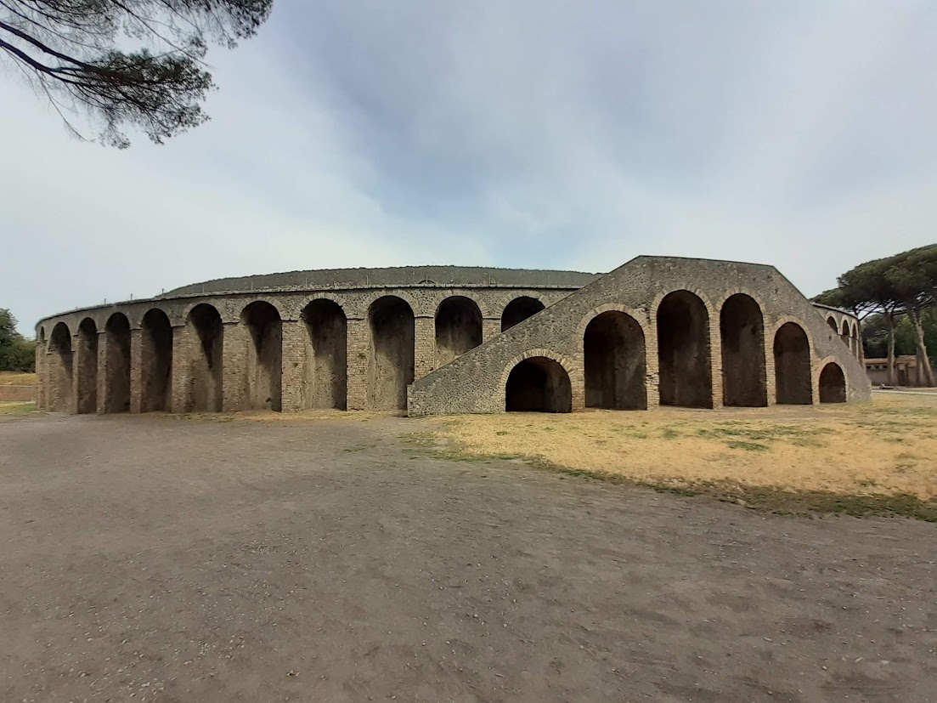
Notes:
Pompei

Slide 26
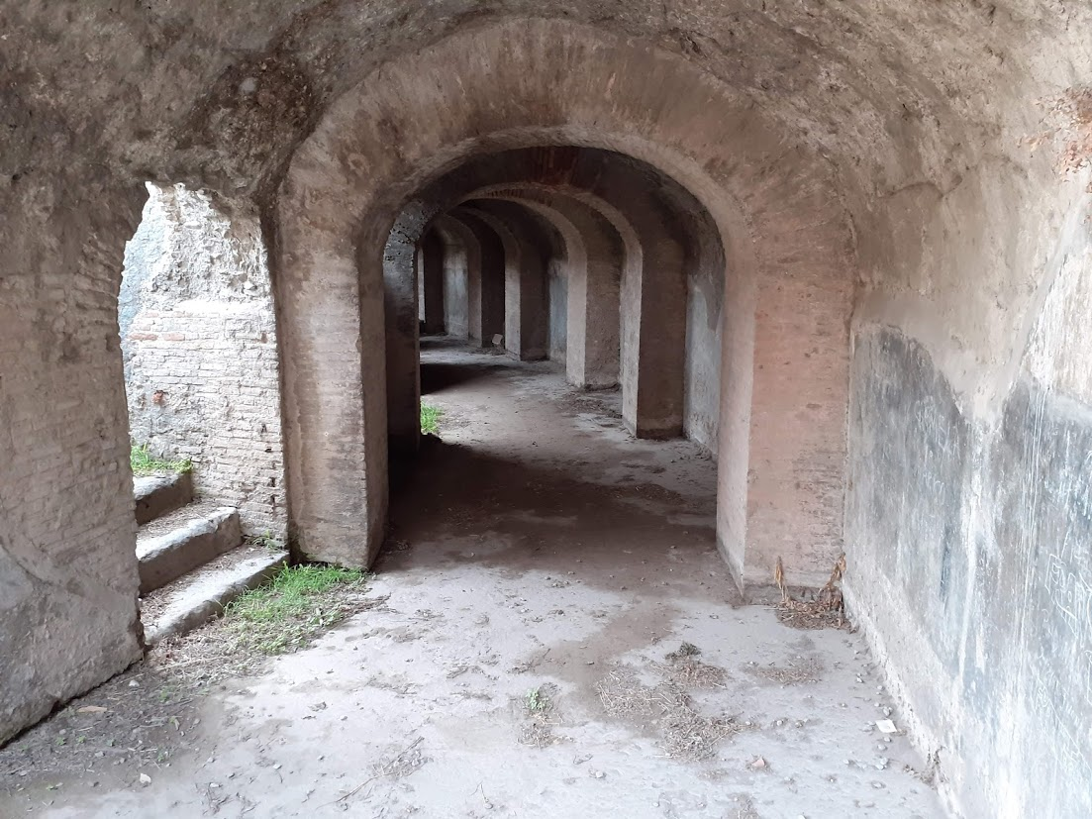

Slide 27
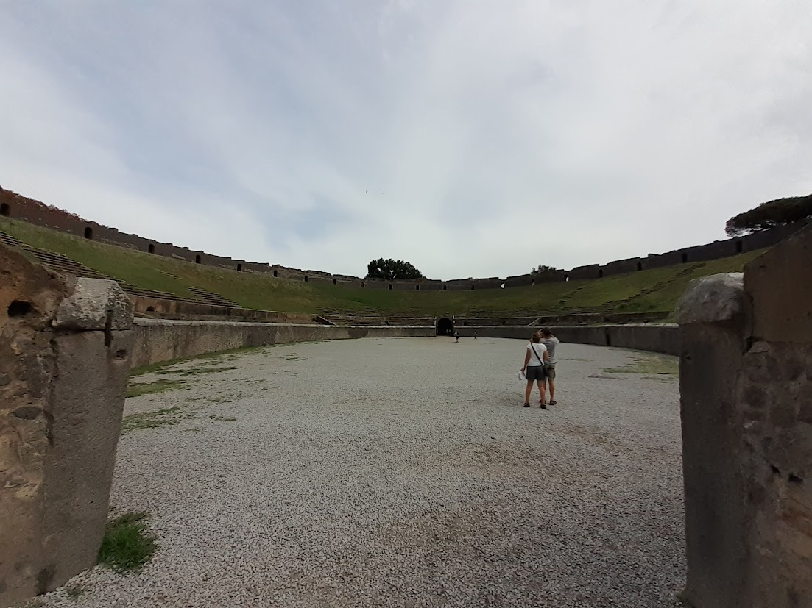
Notes:
Pompei

Slide 28
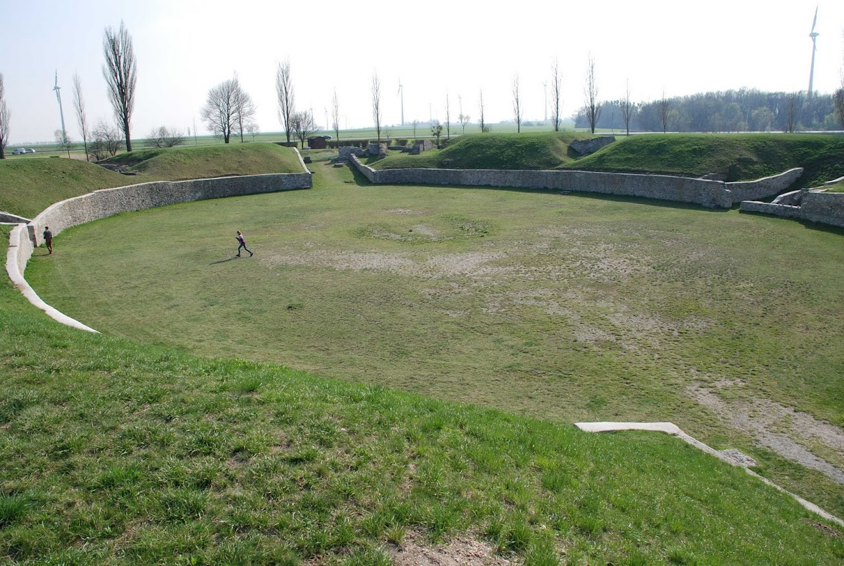
Notes:
Carnuntum

Slide 29
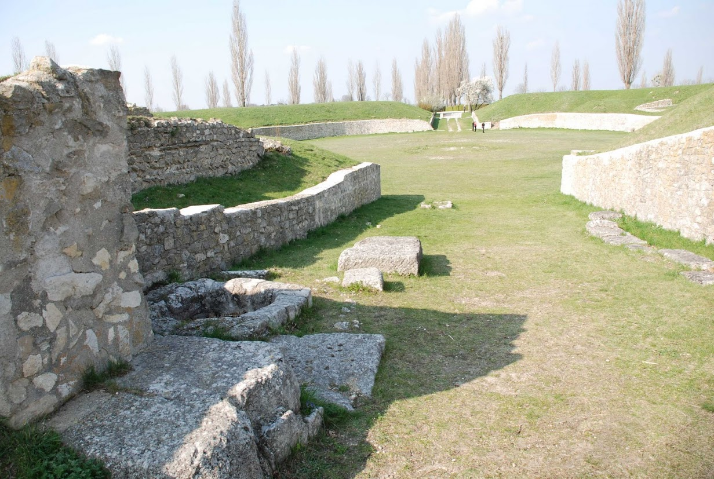

Slide 30
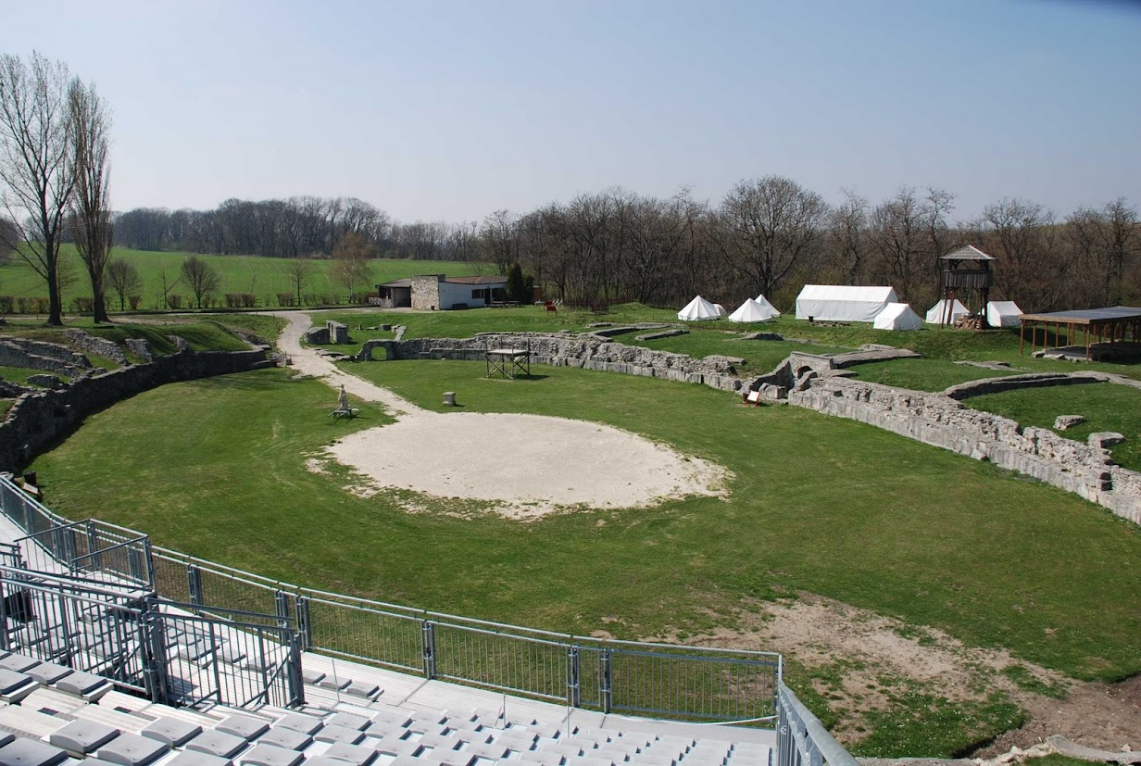
Notes:
Carnuntum

Slide 31
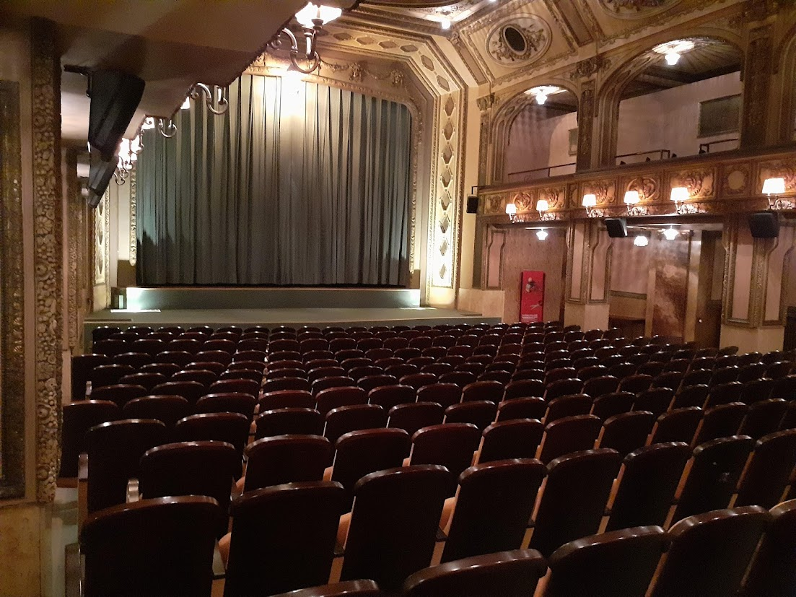

Slide 32
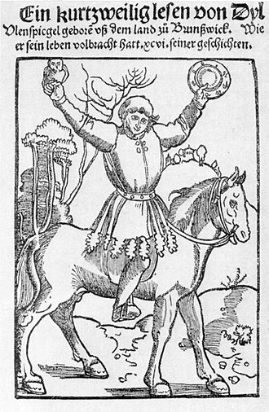
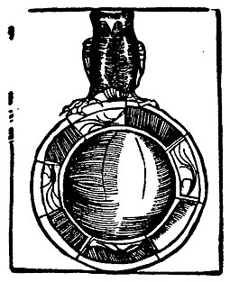
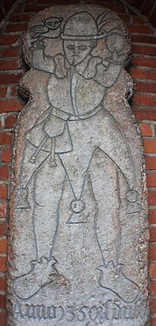
Role of…

Slide 33
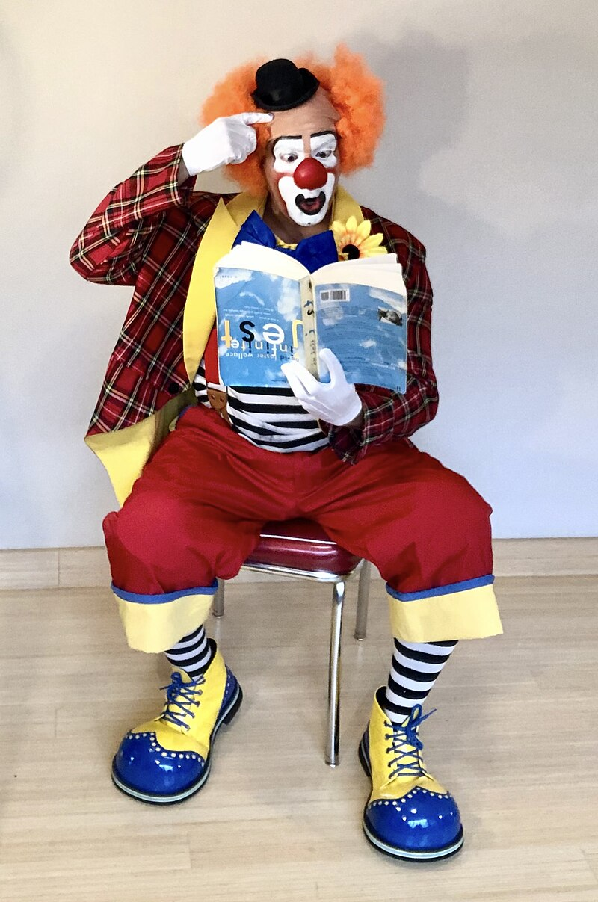
Role of…

Slide 34
Tchantchès from Belgium, Pulcinella from Italian commedia dell'arte, Punch from England, Czech Kašpárek, German Kasperl, French Guignol and Turkish Karagoz

Slide 35
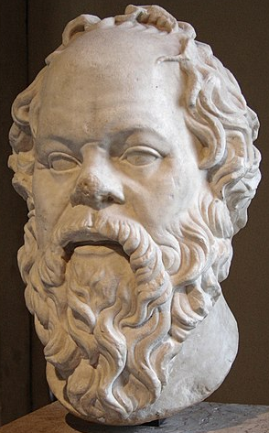
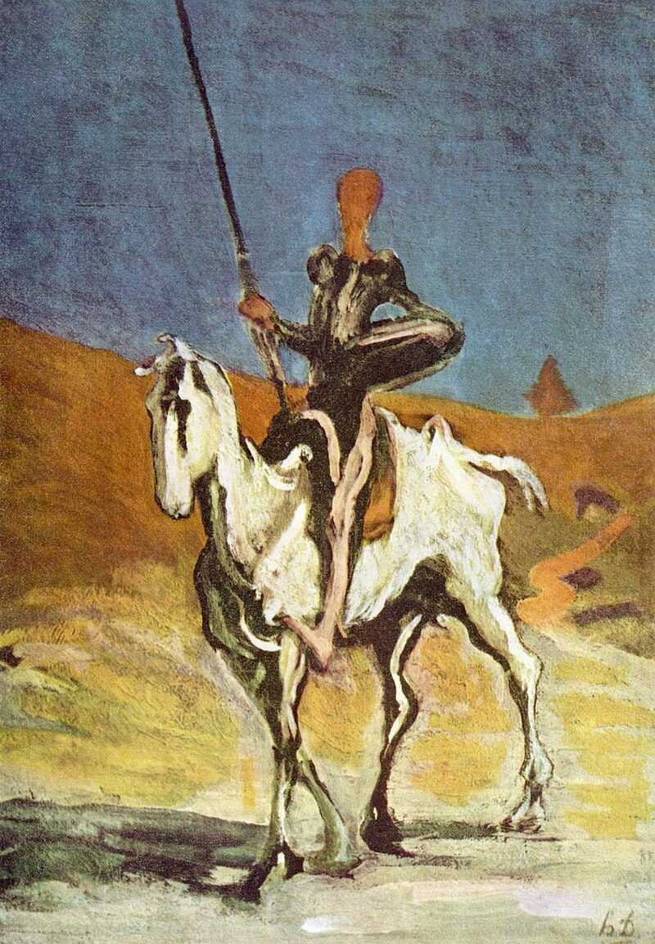
The Praise of Folly
Erasmus: Moriae encomium (The Praise of Folly, wr. 1509, publ. 1511), Stultitia – the goddess of folly, and a wise fool herself; all people are fools

Slide 36
Critique of the morals of society
Lat. Stultifera Navis
The ship of fools (a ship without a pilot, ignorant of their own direction)
ἀλληγορία –
ἄλλος - another, different / + ἀγορεύω -- to harangue, to speak in the assembly from ἀγορά - assembly

Slide 37
Faust
a pact with the Devil (at a crossroads), exchanging soul for unlimited knowledge and pleasures

Slide 38
Faust
every notable historical era will have its own Faust
(Kierkegaard)

Slide 39
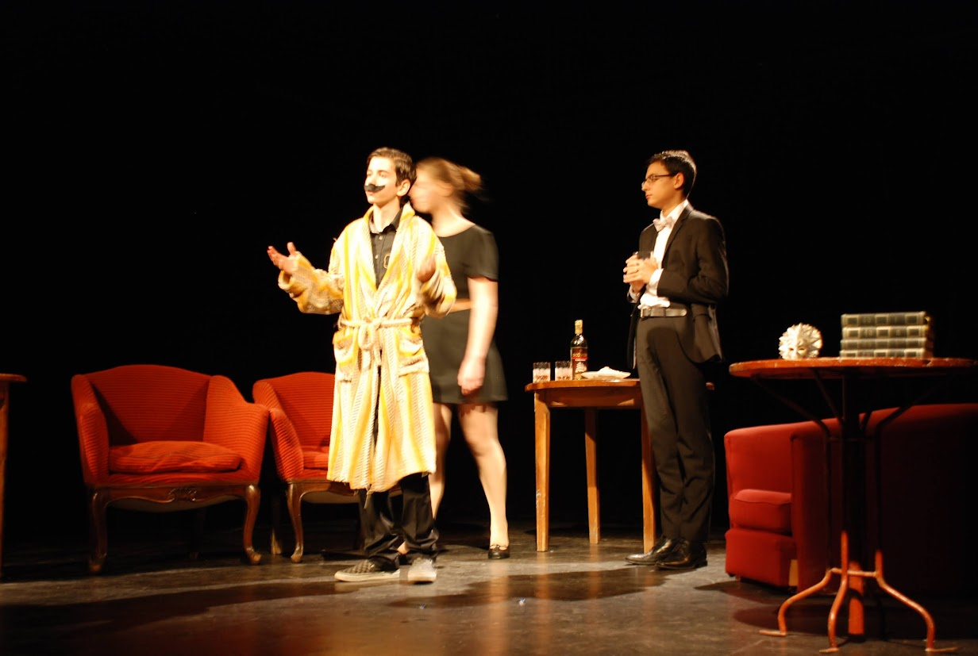
Notes:
Václav Havel´s play Unveiling (Ondřej Svoboda – school theater)
https://www.vaclavhavel.cz/en/vaclav-havel/works/plays
https://archive.vaclavhavel-library.org/Bibliography/#15328

Slide 40
Václav Havel – selection of theatre plays
The Garden Party (Zahradní slavnost), 1963
The Memorandum (or The Memo), 1965, (Vyrozumění)
The Increased Difficulty of Concentration, 1968, (Ztížená možnost soustředění)
Butterfly on the Antenna, 1968, (Motýl na anténě)
Guardian Angel, 1968, (Anděl strážný)
Conspirators, 1971, (Spiklenci)
The Beggar's Opera, 1975, (Žebrácká opera)
Audience, 1975, (Audience) – a Vanӗk play
Unveiling, 1975, (Vernisáž) – a Vanӗk play
Mountain Hotel 1976, (Horský hotel)
Protest, 1978, (Protest) – a Vanӗk play
Mistake, 1983, (Chyba)
Largo desolato 1984, (Largo desolato)
Temptation, 1985, (Pokoušení)
Redevelopment, 1987, (Asanace)
https://www.vaclavhavel.cz/en/

