Slide 1
Mechanisms of success and failure of conservation programs in developing countries
Mgr. Barbora Nohlová

Slide 2
THE INTRODUCTION OF THE DISSERTATION TOPIC (a brief review)
YUS conservation area (YUS CA) and the Tree Kangaroo conservation program (TKCP)
WHAT DID I DO DURING THE LAST YEAR
ANALYSES OF INTERVIEWS
ANALYSES OF PARTICIPATIVE OBSERVATION
ARTICLE PUBLISHED IN OCTOBER 2020
Limits of conservation
Benefits/potentials of conservation
Findings of research
FUTURE PROSPETS

Slide 3
Analyses of interviews and participative observation
52 INTERVIEWS
FIELD DIARIES
OPEN CODING
MENTAL MAPS

Slide 4
YUS conservation area (YUS CA) and the Tree Kangaroo conservation program (TKCP)

Slide 5
760 km²; 35 villages
The TKCP establishment in 2009
Tree kangaroos
Lisa Dabeck

Slide 6
Raising the Effectiveness of Conservation Programs: A Case Study of TKCP Environmental and Developmental Activities in the YUS Area, PNG: The article
Published in October 2020
Development of the “green thinking”concept in PNG
Threats to biodiversity
YUS conservation area and the TKCP
Limits and benefits of conservation
Findings of research

Slide 7
Limits of conservation
Criticism of conservation efforts
Non-used potentials
Community based projects
Cargo mentality

Slide 8
Benefits/potentials of conservation
Ecotourism
Social/developmental programs
Education and job opportunities
Coffee business

Slide 9
Understanding the conservation “business”
The social science pilot research and regular evaluation
Conservationists point of view – ethnography of a conservation project?
“Conservation: a business as any other”
Community feedback and local communities involvement

Slide 10
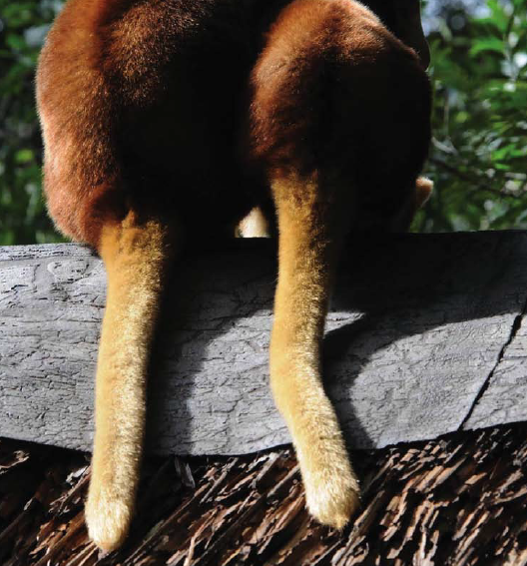
Prospects of future
Change of topic
Nonfunctional communication with the project partner
Opportunity to broaden the topic of european areas
Project Just-Scapes

Slide 11
JUST-SCAPES
Environmental justice analysis to advance rural landscape transformations in the face of climate change
RQ: The project aims to better understand (1) the acceptance of transformation changes in the countryside by the Czech public; (2) how can be this acceptance promoted; (3) which changes are environmentally and socially optimal.
LOCALITIES:
Cairngorms, Scotland, UK. A consortium of partners working on the ‘East-West Wild’ initiative are consulting over proposed transition from a livestock to a forest dominated landscape. This links to a Scotland-wide debate about the future of highland landscapes.
French Pyrénées Ariégeoises. Strong local consensus for maintaining extensive livestock farming is threatened by emerging climate discourse that criticises livestock farming and advocates woodland expansion.
Šumava Mountains UNESCO Biosphere Reserve, Czech Republic. Rapid and large-scale deforestation of forest ecosystems due to bark beetle infestation has been induced by climate-change and by historical preference for spruce monocultures. The Czech society is now polarized in its attitude towards prospective response measures.

Slide 12
Thank you for your attention!
Mgr. Barbora Nohlová
barbora.nohlova@gmail.com

