Slide 1
Populism and Nationalism – A Threat to European Democracy
What is populism, how does it work and is it really a threat to liberal European regimes?

Slide 2
What is populism?
Drunken guest at the party (Arditi 2004)
Indicating dysfunction of democracy
Appealing to the interest of the people against the elite
Thin-centered ideology (Mudde 2004)
Key role of the leader

Slide 3
Conceptualization
Populism is a chameleonic, often unclear buzzword used by not only academia but also by journalists, politicians and intellectuals
„populism considers society to be ultimately separated into two homogeneous and antagonistic groups, ‘the pure people’ versus ‘the corrupt elite’, and which argues that politics should be an expression of the volonté générale of the people“ (Mudde 2004)

Slide 4
Thin-centered ideology
Populism has the internal coherence of a distint ideology but „it lacks the capacity to put forward a wide-ranging and coherent programme for the solution to crucial political questions“ (Stanley 2008)
Populism is most commonly found operating in tandem with ‘thicker’ ideologies such as liberalism, socialism, conservatism or even illiberalism

Slide 5
Trigger factors
Crises of political parties
Personalization of power
Role of the media
Structural problems of the society

Slide 6
Charismatic leader
Concept of Max Weber
His existence is basic precondition for the existence of populism
Direct exercise of power
Rigid control of the party or movement

Slide 7
Examples of charismatic leaders I.

Slide 8
Examples of charismatic leaders II.

Slide 9
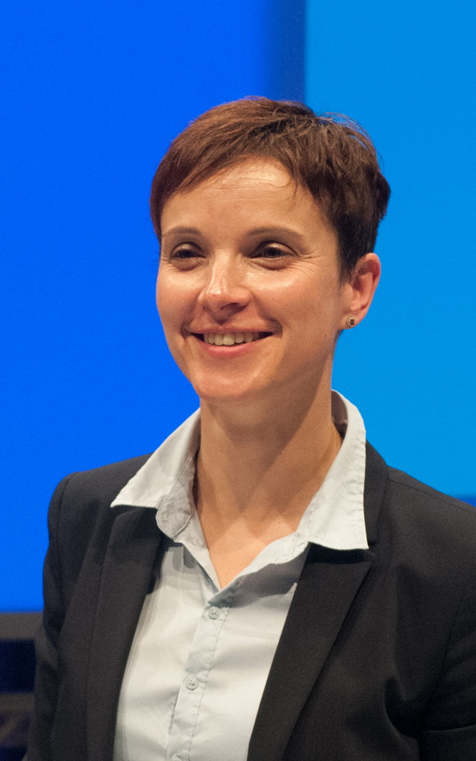
Examples of charismatic leaders III.

Slide 10
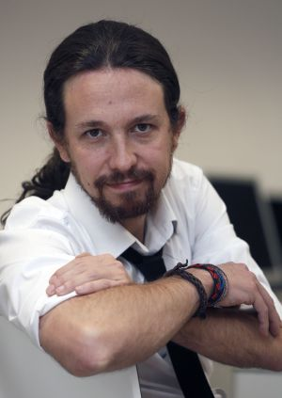
Examples of charismatic leaders IV.

Slide 11
Key issues of populism
Refusing “old politics” responsible for the crisis
Refusing political parties as an obstacle against the will of the people
Resistance against representative democracy
Principle of equality of chosen
Creating permanent feeling of threat

Slide 12
Enemy from below I.

Slide 13
Enemy from below II.

Slide 14
Enemy from above

Slide 15
Typical supporter
Socially isolated from secluded locality
Apolitical – low interest of participation
Passive or non-voter
Admirer of authorities
Influenced by “bad mood”

Slide 16
Deception

Slide 17
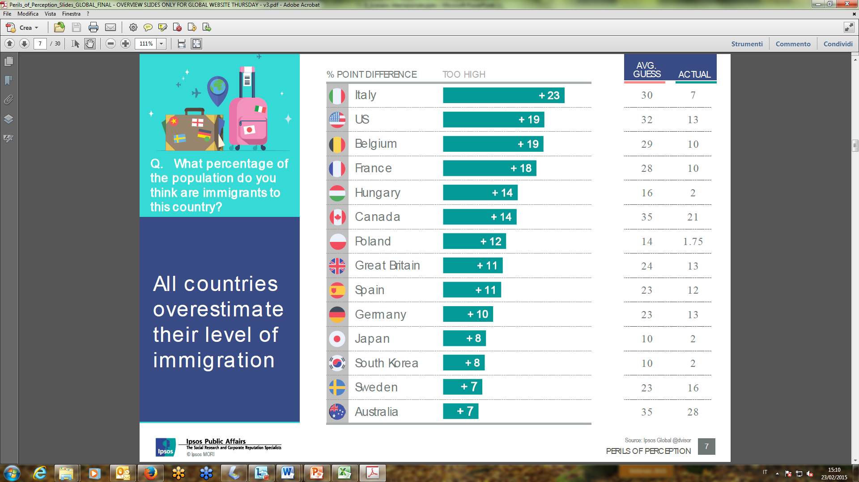
17

Slide 18
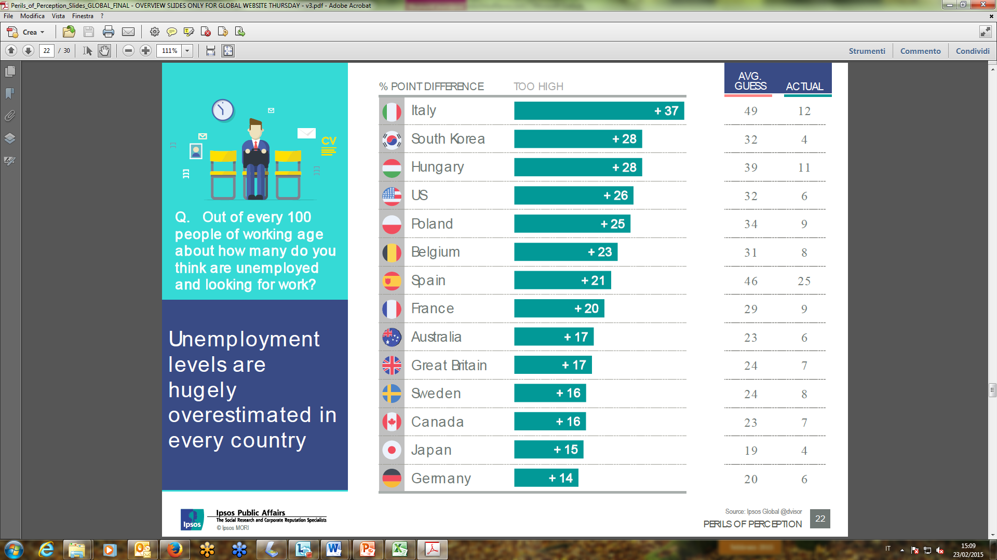
18

Slide 19
Attitudes of the people

Slide 20
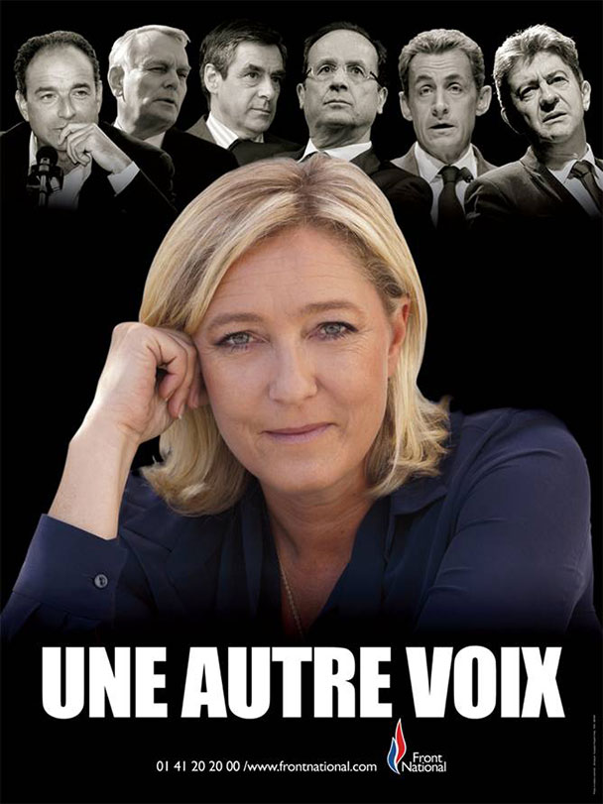
Case of the Front National

Slide 21
Support of the Front National

Slide 22
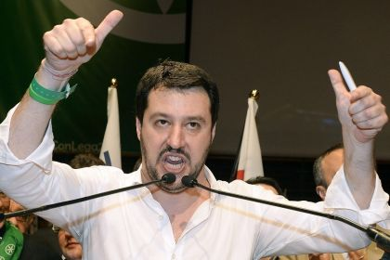
Case of the Northern League
Matteo Salvini

Slide 23
Original rhetoric

Slide 24
Shift towards migration/muslim issues

Slide 25
Low interest in participation

Slide 26
Reaction of the mainstream
Confrontation – South America
Isolation – Belgium
Adaptation – Austria
Socialization - Italy

Slide 27
Positives and negatives
Positives
Negatives
Point out on dysfunction in the system
Highlight issue subsequently adopted by the mainstream
Destabilization of the system
Polarization and vulgarization of politics
Mainstream adopts similar rhetorics
More disappointed people

