Slide 1
Public Management for 21st Century
Vladimír Kváča, Ph.D. October 2022 – January 2023

Slide 2
Public Management for 21st Century
#1 – October 12, 2022
Introductions

Slide 3
Outline for today:
Introductions – about us
Course overview
Short break
Intro to Topic 1: Paradigm shifts in the public sector 1
The Environment,
The People we Serve,
The Way of Management.

Slide 4
About us
Vladimír Kváča, Ph.D.
Freelance consultant (design of public services and evaluations)
Former Director General at Ministry of Labour and Social Affairs (CZ)
Former European Commission‘s Public Administration and Governance Network facilitating expert
Michaela Ditrych Lenc
Ph.D. student of Public and Social Policy at the Faculty of Social Sciences, where she also completed her master’s degree in Public Policy; above that, she holds a master’s degree in Economic Policy and Development Studies.
She is professionally and academically interested in development policy, particularly in the role of the private sector in development cooperation from a metagovernance perspective.

Slide 5
About us
Meet an unknown stranger
Be ready to introduce your new friend in 10 minutes:
She/He is ………. from ……….. studying ………
Why is he/she interested in public management?
What are the main challenges of the public administration in her/his country?

Slide 6
Course overview - meetings
7 x Wednesdays 14:00 – 16:50,
October 12 room JPEK212
October 19 room JPEK212
November 9 room JPEK212
November 16 room JPEK212
November 30 room JPEK212
December 14 room JPEK212
December 21 room JPEK212
+ Final discussion in January 2022, tbc. and

Slide 7
Course overview - communication
Moodle: https://dl1.cuni.cz/course/view.php?id=13837
Consultations:
Wednesdays after the seminars: 16:50 – 17:20 or as agreed, to be booked in advance: vladimir.kvaca@gmail.com

Slide 8
Course overview – How to pass
Score | Mark
91 – 100 points | A – Excellent
81 – 90 points | B – Excellent
71 – 80 points | C – Very Good
61 – 70 points | D – Very Good
51 – 60 points | E – Good
50 or less points | F – Fail

Slide 9
Course overview – How to pass
No problem if you miss up to 2 meetings
Activity / task | Points available
Preparation and participation at the seminars | 4 points per meeting, max. 20 points in total
Homework tasks between meetings | 6 x 10 points, max. 60 points in total
Quality of contribution to final group discussion. | max. 20 points.
You may re-do 2 HW tasks to get a better score
Deadline is always evening of Monday before the meeting
Late submisson = 0 score
Tests how you can apply what we discussed

Slide 10
Course overview - Workload
5 credits equal to 150 hours of work. This is made up from:
25 hours of direct teaching (3h x 7 weeks + consultations and examinations)
50 hours of reading/watching resources and preparation for course meetings
60 hours of work on homework tasks (6 x 10h)
15 hours of preparation for final group discussion

Slide 11
Course overview - Structure
6 topics, each divided into 4 parts:
Evocation of the topic on the basis of what you already know (At the seminar N)
Your individual immersion in the topic – readings, videos, homework (Between seminar N and seminar N+1)
Discussion and a short lecture (At the seminar N+1)
Your reflection of what you‘ve learnt (At the seminar N+1)

Slide 12
Course overview - Structure
Paradigm shifts 1: The Environment, The People we Serve, The Way of Management
Paradigm shifts 2: The Nature of Public Organisations, Motivation of Staff, Accountability
Human Learning Systems 1: Introduction and Human element
Human Learning Systems 2: Learning element
Human Learning Systems 3: Systems element
New Synthesis, Metagovernance and conclusions
Questions
(Tentative) answers

Slide 13
Time for your questions…
Photo by Emily Morter on Unsplash

Slide 14
Program kurzu – formy výuky a technické nástroje
Přednáška, výklad
Diskuze v plénu
Práce ve skupinách
Samostatná práce
Zoom
Zoom
Break - be back at 15:30
Prostředí google classroom
Zoom (break-out rooms) a sdílený skupinový google dokument

Slide 15
Public Management for 21st Century
#1 – October 12, 2022
Paradigm shifts 1: The Environment, The People we Serve, The Way of Management.

Slide 16
Three key concepts:
Public service
Double-loop learning
Paradigm

Slide 17
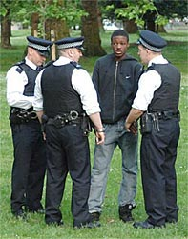
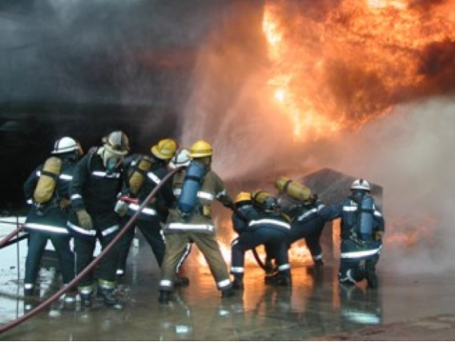
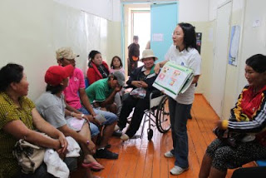
Public service
Public service = „purposeful activities that support human freedom and flourishing. Public service is one human being saying to another – I support your quest to live the good life“.
Toby Love in Human Learning Systems: Public Service for the Real World, 2021.

Slide 18
Public service
Services like education, health care, justice, social services, active labour market policies etc.
Who provides the service is not important here.
Private school, social work performed by a charity, municipal police, government operated prison – all provide public service.

Slide 19
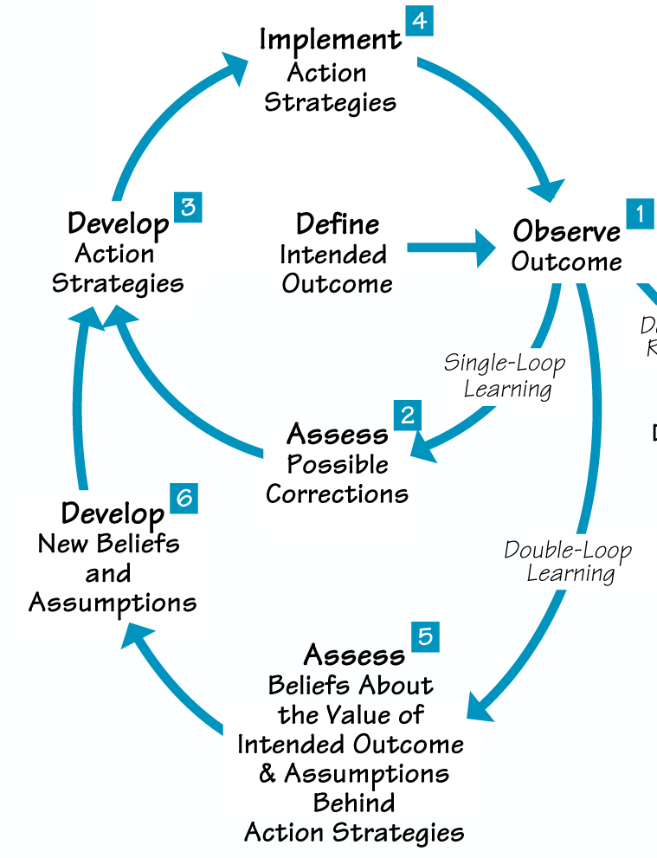
Double-loop learning
When looking for a solution of a problem, we are limited by our own assumptions (frequently even unconscious ones) about what is good and how things work.
Double-loop learning is a process when we challenge and update these assumptions.

Slide 20
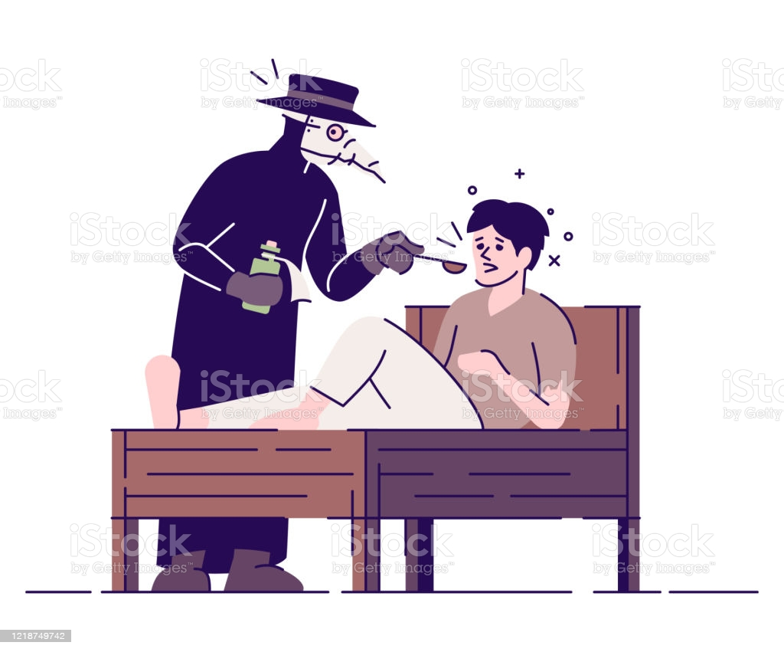
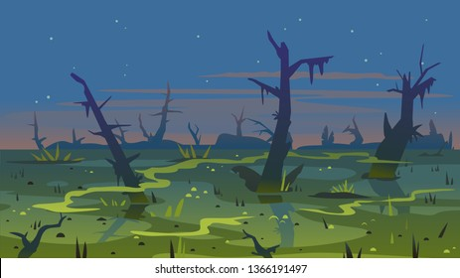
Double-loop learning – Malaria example
Malaria = „Bad air“ theory
Solutions:
Perfume
Drying wetlands
Mosquito theory
Solutions:
Mosquito net

Slide 21
Paradigm, paradigm shifts
In science and philosophy, a paradim is a distinct set of concepts or thought patterns, including theories, research methods, postulates, and standards for what consitutes legitimate contributions to a field.
1543 – The transition in cosmology from a Ptolemaic cosmology to a Copernican one.
1859 – The revolution in evolution from goal-directed change to Charles Darwin‘s natural selection
1920 – The transition between the worldview of Newtonian physics and the Einsteinian relativistic worldview.
Paradigm shift = double-loop learning situation

Slide 22
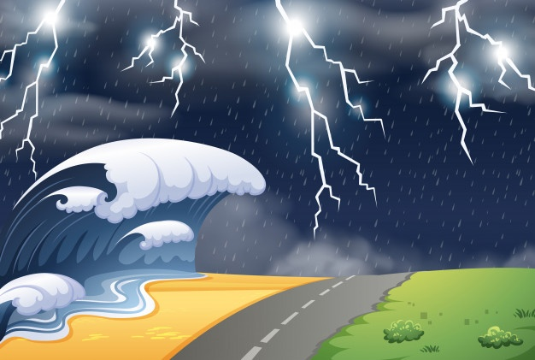
Shift #1: The environment we operate in
From relatively stable and predictable world …
… to V. U. C. A. (volatile, uncertain, complex and ambiguous) world

Slide 23
Quick brainstorming:
What are the major changes in our societies that happened since you were born?
How these affect the governments or public organisations in general?
Environmental degradation
Hybrid warfare
Migration
Robots in manucaturing
Internet
AI
Cryptocurrencies
Global village
Social media
Fake news
Aging populations

Slide 24
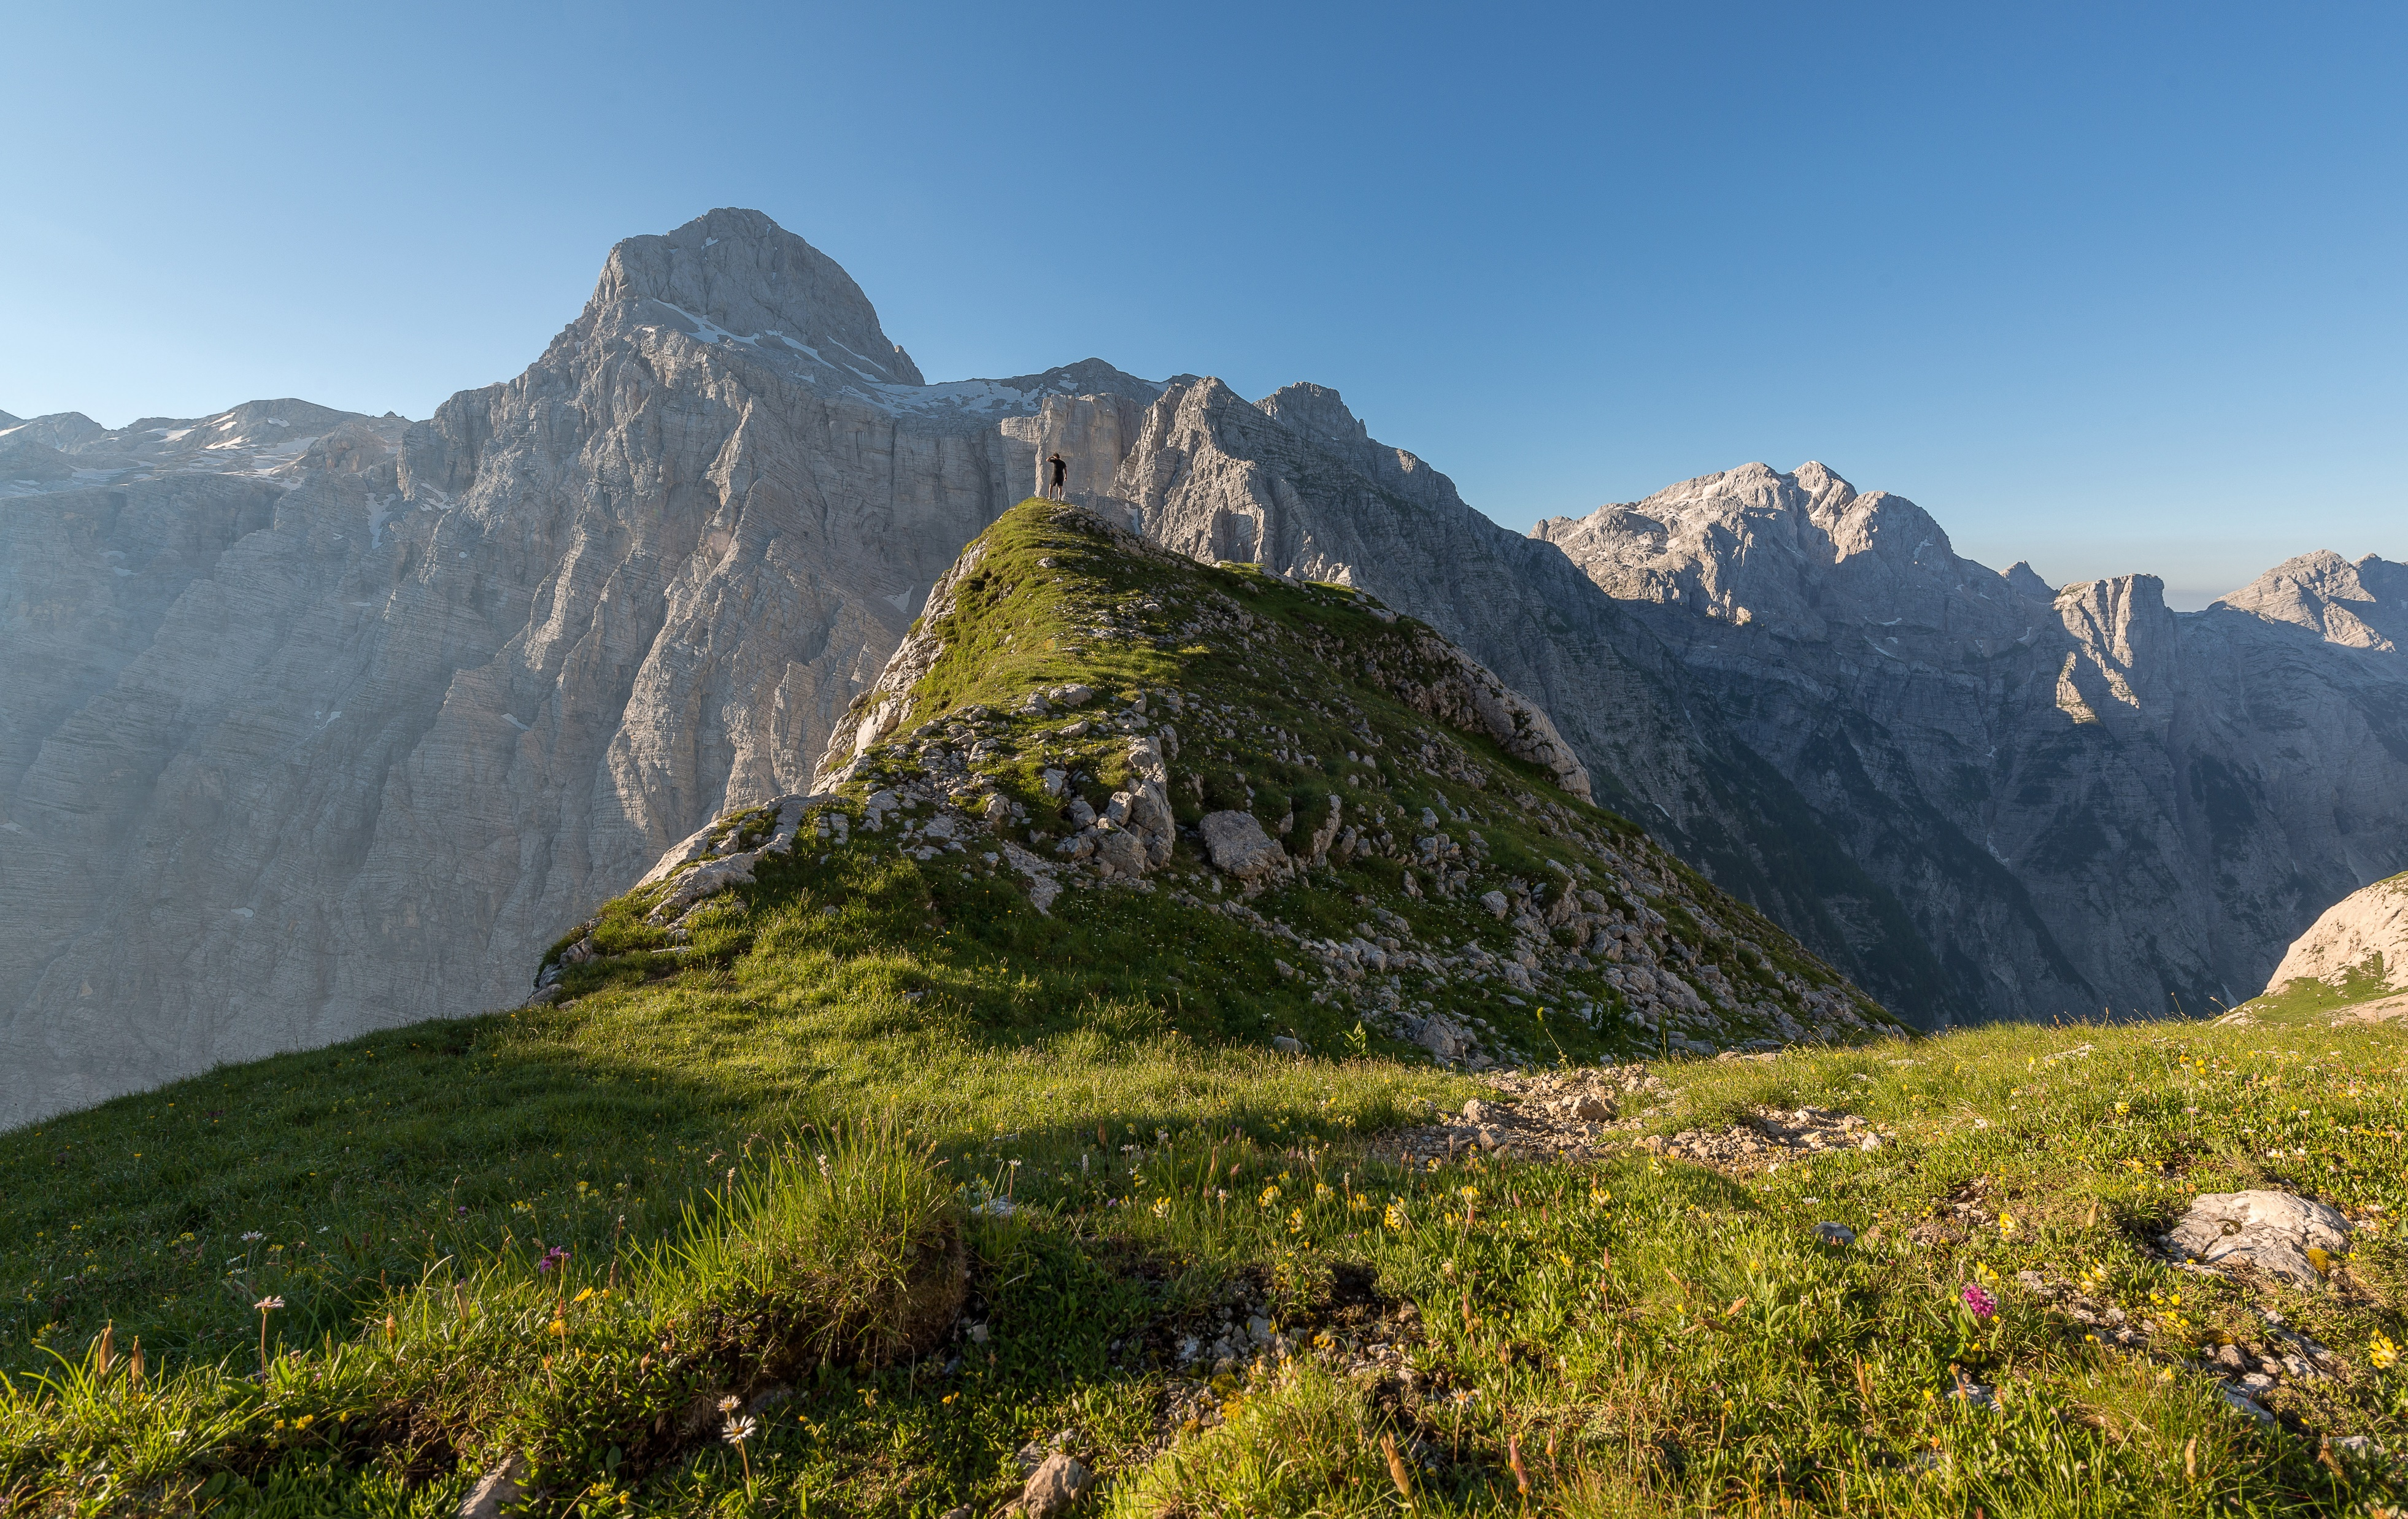
Group task – 5 min
Imagine you are somewhere in a mountain region. You task is to climb as high as possible within the 5 km radius. It is sunny day, you have a map, GPS and good outdoor equipment with you.
What would you do to accomplish your mission?
Imagine you are a controller/auditor of this task. How would you control it?
Photo by Ales Krivec on Unsplash

Slide 25
Group task – 10 min
Imagine the same task again.
Imagine you are somewhere in a mountain region. Your task is to climb as high as possible within the 5 km radius. Just this time, you don’t have a map nor GPS. It is a foggy day and the visibility is 5 meters. (And there are no local guides).
What would you do to accomplish your mission?
Imagine you are a controller/auditor of this task. How would you control it?

Slide 26
Shift #1: The environment we operate in
From relatively stable and predictable world …
… to V. U. C. A. (volatile, uncertain, complex and ambiguous) world
Most public policies implicitly assume the world is relatively stable and predictable. Patterns repeat. Causalities are known. We know what we are facing and we can agree with each other about it. V.U.C.A. world is different: determined by Volatility – Fast unpredictable changes without clear patterns or trends; Uncertainty – Frequent disruptive changes where the past is not a good predictor of the future; Complexity – Multiple, complex, interwined technological, societal, geopolitical and ecological evolutions; and Ambiguity – Little clarity on what is real or true and difficult to predict the impact of actions or initiatives. The environment is constantly changing. Now even with experties we are able to analyze it towards the future. How can public organisations face these challenges?

Slide 27
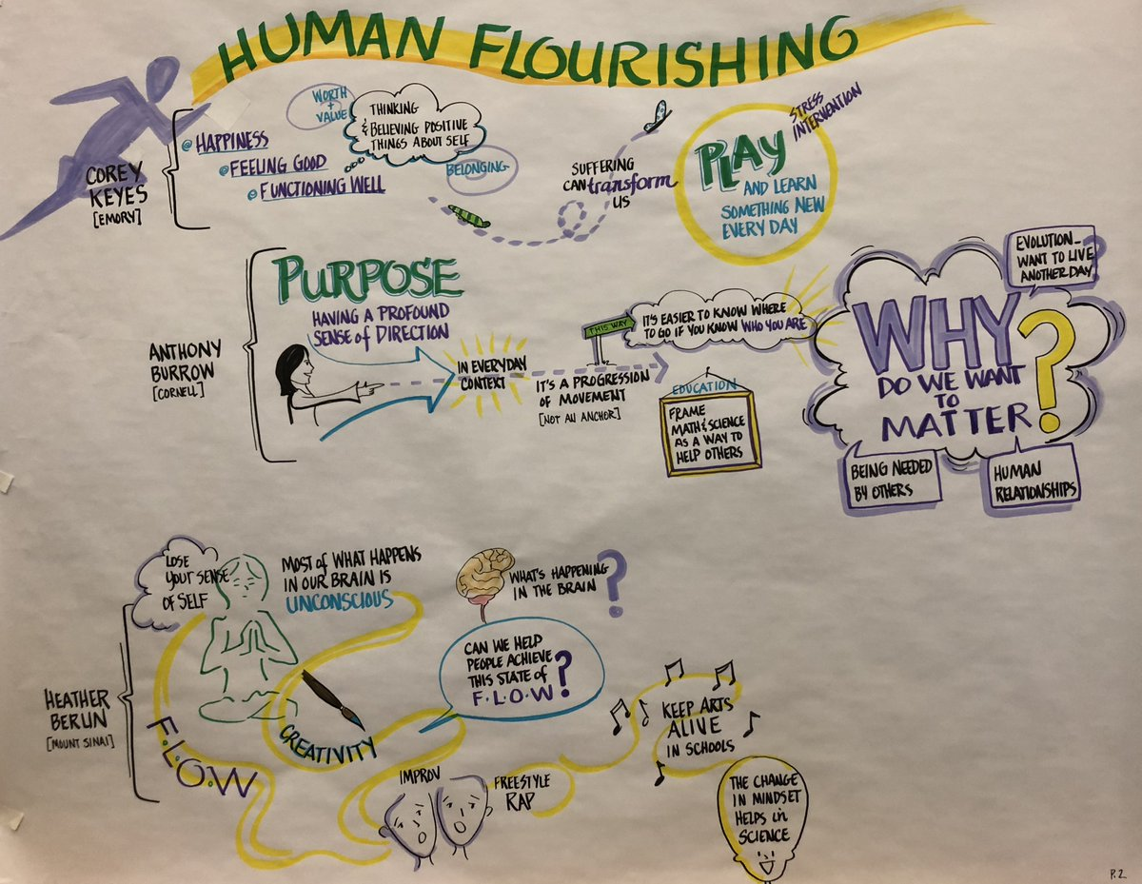
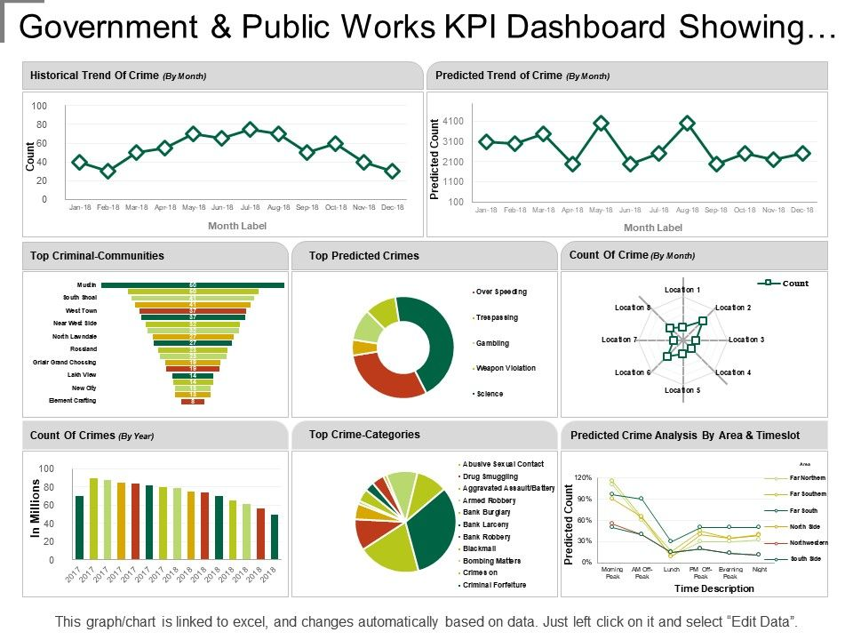
Shift #2: Purpose: human development
From selecting measures of human well-being from the point of view of policy-makers…
… to understanding human development from the point of view of a diversity of citizens.

Slide 28
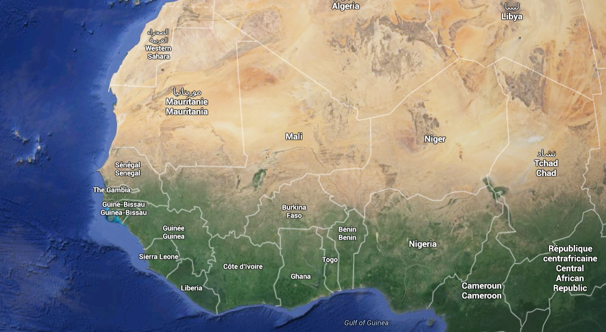
A story of a well in Africa…

Slide 29
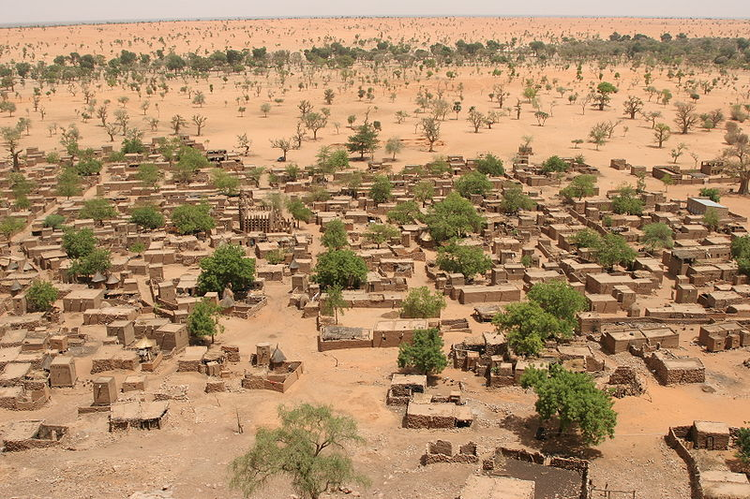
Ferdinand Reus from Arnhem, Holland - The village of Telly CC BY-SA 2.0

Slide 30
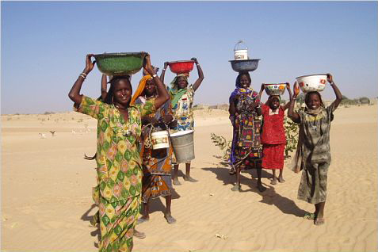
"Mao Women". Licensed under CC BY-SA 2.5 via Commons - https://commons.wikimedia.org/wiki/File:Mao_Women.jpg#/media/File:Mao_Women.jpg

Slide 32
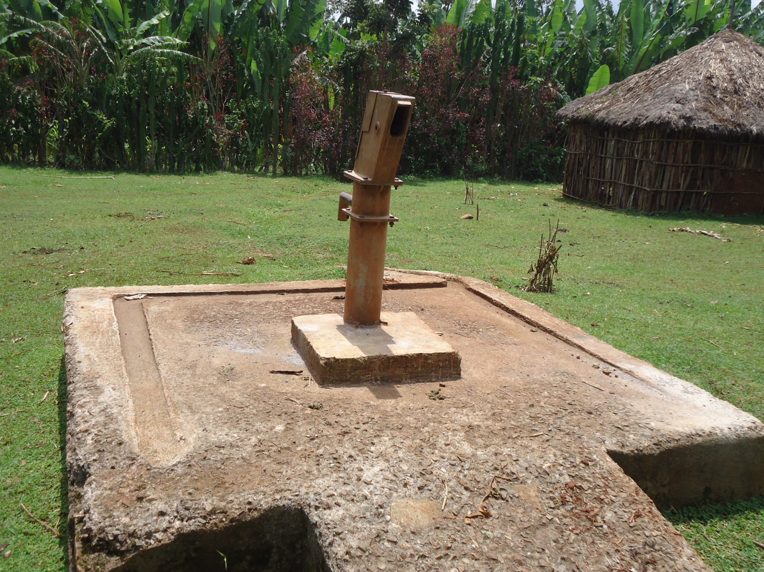

Slide 33
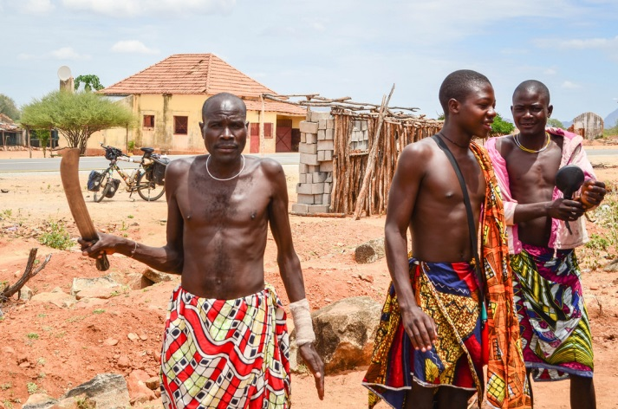
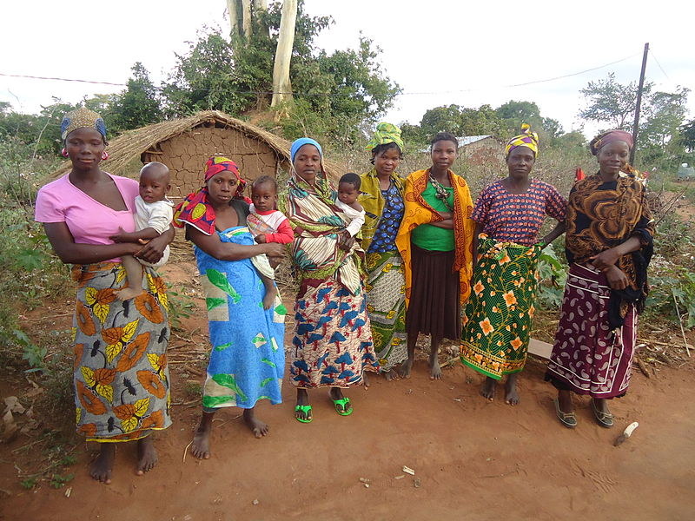
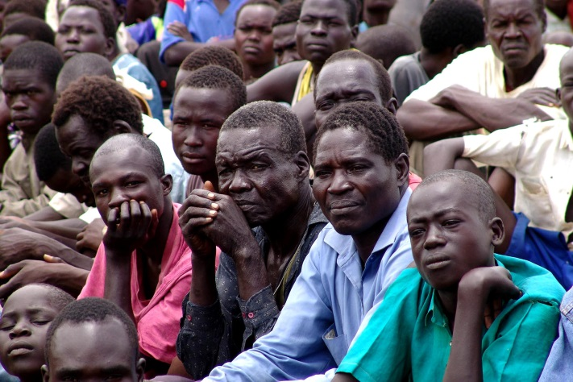
Let‘s interrogate the usual suspects
Kids of the village
Men of the village
Women of the village
People from a nearby village
"Women Farmers in Itoculu, Monapo District, Mozambique" by Diksha41 - Own work. Licensed under CC BY-SA 3.0 via Commons - https://commons.wikimedia.org/wiki/File:Women_Farmers_in_Itoculu,_Monapo_District,_Mozambique.JPG#/media/File:Women_Farmers_in_Itoculu,_Monapo_District,_Mozambique.JPG
Notes:
Discussion – Why did the project fail?
Maybe it was not expecting that african children will not understand importance of well and destroy it in a game
Maybe it didn‘t took into account gender aspects – women now had more time and were able to be more active in village affaires and this has challenged the position of men
Maybe it didn‘t fully understand the importance of water fetching ritual for women
Maybe it failed to secure equity, as the well was destroyed by envious people from nearby village where no well was drilled

Slide 34
Shift #2: Purpose: human development
From selecting measures of human well-being from the point of view of policy-makers…
… to understanding human development from the point of view of a diversity of citizens.
The purpose of any public service is positive change in the well-being of people and an expansion of their freedom to do what they value. These are the results we look for, not indicators or targets.

Slide 35
Well-being and progress for people
Amartya Sen
1998 Economics Nobel Price winner for his work in welfare economics
His Capability approach is theoretical fundament for „ supporting human freedom and flourishing“

Slide 36
Shift #3: What the public sector delivers (and how it manages the delivery)
From products…
… to services

Slide 37
Group task – 10 min
Exercise Product vs. Service.
Discuss within the group terms Product and Service. Try to agree the definition of these terms:
Products are …..
Services are …..
Discuss within the group terms Product and Service. Try to formulate the main differences between Products and Services

Slide 38
Shift #3: What the public sector delivers (and how it manager the delivery)
From products…
… to services
Public services are often managed in product manufacturing style. Production and consumption of products is separated in time and space and variety of products is relatively limited. But public services are services, not products. Each service is co-produced in interaction between user and provider and consumed at the moment of its provision. As people have different needs, this leads to enormous variety in demand on services. Thus, service provision should be managed in a way different from manufacturing in order to cope with the variety and complexity of demand.

Slide 39
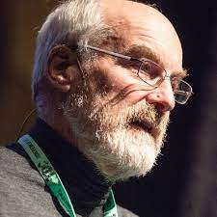
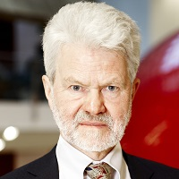
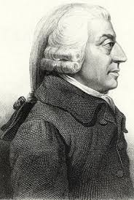
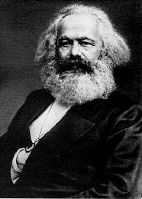
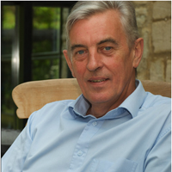
Your companions for the rest of the week
Hilary Cottam
Dave Snowden
Gwyn Bevan
John Seddon
Adam Smith
Karl Marx

Slide 40
Reading and watching list
Moodle: https://dl1.cuni.cz/course/view.php?id=13837

Slide 41
Homework #1
Moodle: https://dl1.cuni.cz/course/view.php?id=13837
As we meet again already next week and you need to read a lot, this week's assignment is simple: Just write a short (200 - 300 words) reflection of what you read and watched from the reading list. Write what was new to you, what you find surprising, what you find important or interesting and also what you find confusing at the moment.
Deadline: Monday, Oct 17, 23:59 CEST

Slide 42
Thank you and
see you next week
Same time
Same room

