Slide 1
Reconciling Ecology & Economy
Germany’s position on the European Green Deal
David Shin, Yannick Scharf, Sofia Zambrano, Irékani Alarcón Acosta

Slide 2
Content
Why is Germany's position relevant
Mainstreaming sustainability in all EU policies
On Energy
4. Climate Change as a global responsibility

Slide 3
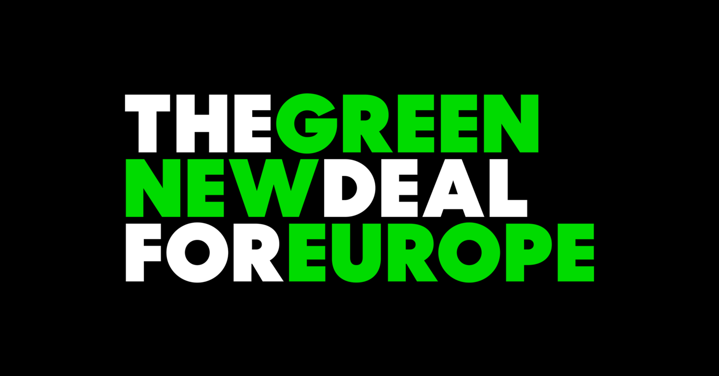
Why is Germany's position relevant?
Source:www.gndforeurope.com

Slide 4
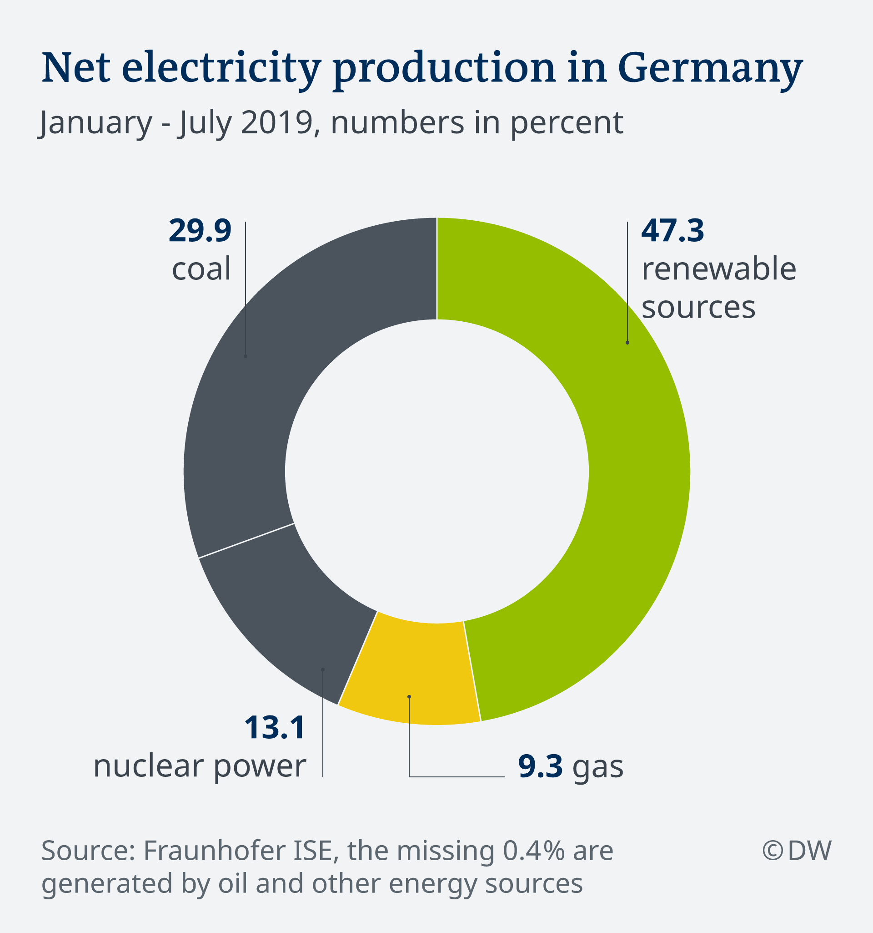
Germany towards sustainable energy

Slide 6
Mainstreaming sustainability in all EU policies
Budget GNI and subject to development of plan = Incentives for alternative ways of financing
Tax reform

Slide 7
On energy
Agree on need for urgent change towards sustainable economy
Accelerating wind power energy, replacing natural gas with decarbonized and green gas
Changing consumers perspective: from disposing to reusing as stated the EUGD

Slide 8
Climate change as a global responsibility
Multilateralism = Key
Tackling the challenge of carbon leakage without lapsing into protectionism
Trade policy as an instrument to fight global climate change
Removing barriers to trade in the green energy sector

Slide 9
Sources
Aichele, R., & Felbermayr, G. (2015). Kyoto and Carbon Leakage: An Empirical Analysis of the Carbon Content of Bilateral Trade. Review of Economics and Statistics, 97(1), 104–115. https://doi.org/10.1162/REST
Arlt, Dorothee; HOPPE, Imke; WOLLING, Jens, 2011. Climate change and media usage: Effects on problem awareness and behavioural intentions. International Communication Gazette, 2011, 73.1-2: 45-63.
Camino Gonzalez, Jenipher, 2020. Climate change: Germany cuts carbon emissions by 6.3% in 2019. DW [online]. 16.03.2020 [cit. 2020-03-28]. Retrieved from: https://www.dw.com/en/climate-change-germany-cuts-carbon-emissions-by-63-in-2019/a-52791753
Clark, Daniel, 2019. Share of total contributions to the European Union budget in 2018, by Member State. Statista[online]. 03.12.2019 [cit. 2020-03-28]. Retrieved from: https://www.statista.com/statistics/316691/european-union-eu-budget-share-of-contributions/
DW, 2019. EU greenlights mega subsidies for electric batteries. DW [online]. 09.12.2019 [cit. 2020-03-28]. Retrieved from: https://www.dw.com/en/eu-greenlights-mega-subsidies-for-electric-batteries/a-51588076

Slide 10
EC, 2019. COMMUNICATION FROM THE COMMISSION TO THE EUROPEAN PARLIAMENT, THE EUROPEAN COUNCIL, THE COUNCIL, THE EUROPEAN ECONOMIC AND SOCIAL COMMITTEE AND THE COMMITTEE OF THE REGIONS:
The European Green Deal. Europa.eu [online]. 11.12.2019 [cit. 2020-03-28]. Retrieved from: https://ec.europa.eu/info/sites/info/files/european-green-deal-communication_en.pdf
Garton Ash, Timothy, 2020. Europe (and yes, that includes Britain) can still be a superpower: The key to European power projection isn’t institutional reform, it’s a shift in attitude and a willingness to cooperate. The Guardian[online]. 02.03.2020 [cit. 2020-03-28]. Retrieved from: https://www.theguardian.com/world/commentisfree/2020/mar/02/europe-britain-superpower-european
Green New Deal - the German Perspective, 2012. GREEN EUROPEAN JOURNAL [online]. 01.03.2012 [cit. 2020-03-28]. Retrieved from: https://www.greeneuropeanjournal.eu/green-new-deal-the-german-perspective/
Harstad, B. (2019). Trade deals could combat Brazil’s Amazon deforestation. Retrieved March 26, 2020, from https://www.ft.com/content/5f123000-bf5e-11e9-9381-78bab8a70848
Jha, V. (2013). Removing Trade Barriers on Selected Renewable Energy Products in the Context of Energy Sector Reforms: Modelling the Environmental and Economic Impacts in a General Equilibrium Framework. International Centre for Trade and Sustainable Development (ICTSD).
Kang, S. (2010). Carbon Border Tax Adjustment from WTO Point of View. In Society of International Economic Law (SIEL), Second Biennial Global Conference, University of Barcelona. https://doi.org/10.2139/ssrn.1628718

Slide 11
Kuhn, T., Pestow, R., & Zenker, A. (2019). Building Climate Coalitions on Preferential Free Trade Agreements. Environmental and Resource Economics, 74(2), 539–569. https://doi.org/10.1007/s10640-019-00331-0
Kunzig, Robert; LOCATELLI, Luca, 2015. Germany Could Be a Model for How We’ll Get Power in the Future: The European nation’s energy revolution has made it a leader in replacing nukes and fossil fuels with wind and solar technology. NATIONAL GEOGRAPHIC [online]. 11.2015 [cit. 2020-03-28]. Retrieved from: https://www.nationalgeographic.com/magazine/2015/11/germany-renewable-energy-revolution/
Mattoo, A., Subramanian, A., van der Mensbrugghe, D., & He, J. (2013). Trade effects of alternative carbon border-tax schemes. Review of World Economics, 149(3), 587–609. https://doi.org/10.1007/s10290-013-0159-0
Schulz, Florence, 2019. ‘Green’ jobs see slight rise in Germany. EURACTIV [online]. 22.10.2019 [cit. 2020-03-28]. Retrieved from: https://www.euractiv.com/section/energy/news/green-jobs-see-slight-rise-in-germany/
Thompson, Mark, 2019. Germany unveils $60 billion plan to fight the climate crisis. CNN BUSINESS [online]. 20.09.2019 [cit. 2020-03-28]. Retrieved from: https://edition.cnn.com/2019/09/20/economy/germany-climate-crisis-package/index.html
Walker, Tamsin, 2020. German LNG terminal plans fuel anger among environmentalists. DW [online]. 14.02.2020 [cit. 2020-03-28]. Retrieved from: https://www.dw.com/en/liquefied-natural-gas-controversial-terminals-european-green-deal-climate-change-lng/a-52377555
Wehrmann, Benjamin, 2020. Germans want their country to take climate leadership during EU presidency - survey. CLEAN ENERGY WIRE [online]. 26.03.2020 [cit. 2020-03-28]. Retrieved from: https://www.cleanenergywire.org/news/germans-want-their-country-take-climate-leadership-during-eu-presidency-survey
Wettengel, Julian, 2020. EU and Germany hold pivotal role to drive global climate ambition 2020. CLEAN ENERGY WIRE [online]. 07.01.2020 [cit. 2020-03-28]. Retrieved from: https://www.cleanenergywire.org/news/eu-and-germany-hold-pivotal-role-drive-global-climate-ambition-2020

Slide 12
Questions?
Thanks for your attention!

