Slide 1
Literatures on the British Isles 1: Renaissance – Restoration 2. Humanism and Renaissance Prose
Martin Procházka

Slide 2
Lecture Outline
Introduction to European Humanism (Italy and Transalpine Movements)
Erasmus of Rotterdam and Sir Thomas More, Utopia
The Importance of Translation: Religious and Secular
Rhetoric (George Puttenham) and Euphuism (John Lyly, George Petty, William Painter)
Defence of Poetry against Puritan Critics (Sir Philip Sydney).
Beginnings of Novel, Pastoral Novel (Sidney’s Arcadia).
Book Marketing
Pamphlets and Pamphlet Wars

Slide 3
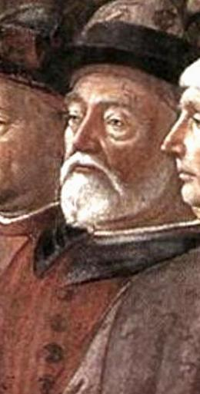
Italian Humanism
Origin of the Term: litterae humaniores (Lat.) – “more human” learning – in contrast to medieval theology. Focus on ancient Greek and Roman philosophy, philology, rhetoric.
Two major sources:
Greek Platonism and Neo-Platonism: cultivated in Constantinople before the fall of the Byzantine Empire (1453). Byzantine philosophers Georgius Gemistos Pletho(n) (ca. 1355-60 – 1452-54) and Ioannis Argyropoulos (ca. 1415-1487). They influenced Marsilio Ficino (1433-1499), the pioneer of Italian Renaissance Neo-Platonism.
2. Roman Influences:
Discovery of essential ancient Roman manuscripts, Quintilian’s Institutes of Oratory and Lucretius’ De rerum natura (On the Nature of Things), by Poggio Bracciolini
Critical study of Latin texts by Lorenzo Valla
Right top: Georgius Gemistos Plethon (a fresco by Benozzo Gozzoli in Palazzo Medici Ricardi, Florence)
Right bottom: Ioannis Argyropoulos (a fresco by Domenico Ghirlandaio in Sistine Chapel, Rome)

Slide 4
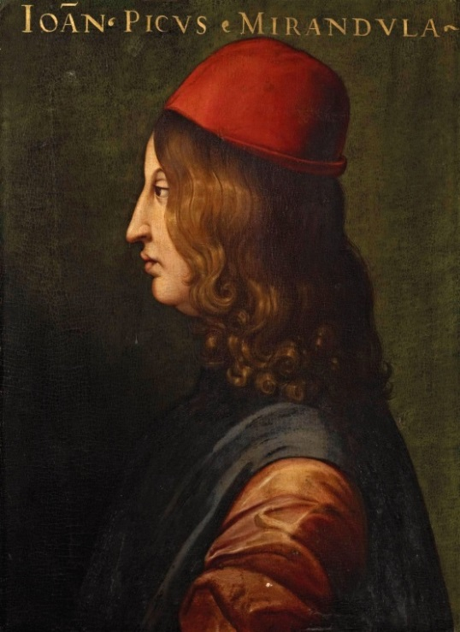
Marsilio Ficino and Pico della Mirandola
Marsilio Ficino (1433-1499) founded the Platonic Academy (Academia) in Florence and started to translate Plato‘s works into Latin.
His student, Giovanni Pico della Mirandola (1463-1494), the author of the Oration on the Dignity of Man (1486) discussing the human nature in relation to the Great Chain of Being (human beings do not have a fixed place in this chain: they can either ascend towards angels or descend towards animal and vegetable life). Pico was the first European thinker who accomplished a complex synthesis of Judaic mysticism (The Kabbalah), Hermeticism (cultivated also by Ficino), Neo-Platonic philosophy and Christian theology (900 Theses).
Right: Marsilio Ficino portrayed by Domenico Ghirlandaio and Pico della Mirandola by Cristofano dell‘ Altissimo

Slide 5
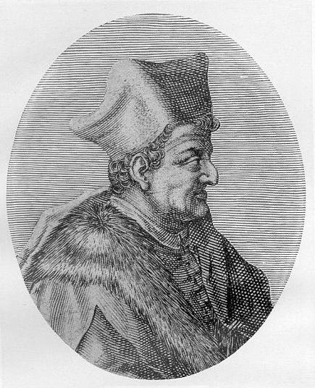
Poggio Bracciolini and Lorenzo Valla
Poggio Bracciolini (1380-1459) Italian scriptor and secretary of Pope Martin V. During the Council of Constance (Konstanz) he travelled in the area and explored libraries of neighbouring monasteries. At St Gallen in Switzerland he discovered a complete manuscript of Quintilian‘s Institutes of Oratory, which radically changed the teaching of rhetoric and became an impulse for the transformation of university curricula. Possibly in Fulda in Germany he found the text of Lucretius‘ philosophical poem De Rerum Natura (On the Nature of Things), which revived the philosophy of Epicurus and initiated a new view of human existence opposed to Platonism, especially to the doctrine of the Ideas. The immense importance of this discovery has been discussed in Stephen Greenblatt‘s Pulitzer Prize winning book The Swerve (2011).
Lorenzo Valla (ca 1407 – 1457) Italian rhetorician and priest. Author of the treatise On the Elegance of Latin Language, where he established the norm of humanistic Latin. Critic of falsified religious texts and secular documents (using his knowledge of Latin grammar and stylistics): the most important was his proof that Constantine‘s Donation, a document that claimed that the Emperor Constantine donated the whole Western Roman Empire to the Catholic Church, was a forgery. His insistence on examining the authenticity of religious, “sacred” texts provoked an attack of Poggio Bracciolini, who was for the restriction of humanistic study to secular texts only.

Slide 6
Transalpine Humanism (north of the Alps)
Flourishes after 1500, 80-100 years later than Italian humanism. One of its most important features is an international network of scholars, including Erasmus of Rotterdam, Sir Thomas More (London), Hieronymus van Busleyden (Leuven), Publio Fausto Andrelini (Paris), Johann Froben (Basel), Johann Reuchlin (Heidelberg, Ingolstadt). Their focus was the reform of university curricula (based on teaching of three languages – Latin, Greek and Hebrew) and of Biblical scholarship and translation (grounded in the critical study of texts) and the study of Judaism including its mystical traditions (the Kabbalah - Reuchlin). Conflicts with fundamentalist approaches typical of Reformation theology: Martin Luther, Jean Calvin.
Hans Holbein, Jr., the drawing of Folly
on the margin of the first edition
of Erasmus’Praise of Folly (1515)

Slide 7
Desiderius Erasmus of Rotterdam (1466-1536)
Life
Driven by poverty he became a canon of St Augustine in the Netherlands.
In his youth he distinguished himself as a Latin scholar and was a secretary of the Bishop of Cambrai.
Before his invitation to teach in England (Oxford, Cambridge) he studied at Paris and Leuven.
In England he befriended John Colet (Oxford), John Fisher (President of Queen’s College, Cambridge) and Thomas More.
In 1506 he graduated as Doctor of Divinity at Turin in Italy.
A portrait of Desiderius Erasmus of Rotterdam by Hans Holbein the Younger (1523)

Slide 8
Erasmus of Rotterdam: Works
Early work:
The critical translation of the New Testament into Latin and the edition of the Greek New Testament - seminal for the translations of the Bible by William Tyndale and later for the Geneva Bible and for the King James Version.
Debate with Martin Luther:
The meaning of free will (De libero arbitrio) is the freedom of choice and the pursuit of religious toleration.
Most popular:
The Praise of Folly, the satire in the manner of the Greek satirist Lucian of Samosata (Lúkianos), attacking
corrupt practices of the Catholic Church,
abuses of its doctrine and
human self-delusion of all kinds.
The Greek title Morias Enkomion may also refer to Erasmus‘ friend, Thomas More (“the praise of More”).
Hans Holbein, Jr., a drawing on the
margin of the edition of The Praise
Of Folly. Folly descending from the
pulpit, and her audience.

Slide 9
Sir Thomas More (1478-1535)
The leading personality of English Humanism.
A son of a London lawyer and judge; studied at Oxford under the Humanists Thomas Linacre and William Grocyn.
Although he was destined for a legal career, at the beginning of the 16th century he wanted to become a monk and spent some time in a monastery. He preserved ascetic habits until his death (ascribing a great value to privacy).
Despite this, he was twice married and a great family-man.
Political career:
the Parliament - the Speaker of the House of Commons
the court of Henry VIII - the Lord Chancellor (1529).
against Reformation, the annulment of the King‘s marriage with Catherine of Aragon and the separation of the Church of England from the Roman Catholic Church.
In 1532 he resigned as Lord Chancellor and in 1533 he refused to attend the coronation of Ann Boleyn. He also refused to sign the oaths supporting Henry VIII‘s supremacy as the Head of the Church of England and Ann Boleyn‘s succession as the Queen.
In 1535 he was sentenced for high treason and beheaded.
Thomas More by Hans Holbein, Jr. (1527)

Slide 10
Thomas More: Utopia
Published in Latin in Leuven in 1516 and then in Basel (revised edition supervised by Erasmus).
1551 the English translation of Ralph Robinson.
A foundation work of the new literary genre (Tommaso Campanella, Francis Bacon, William Morris).
It contrasts contemporary European society and its life (the city of Antwerp taken as an example) with an ideal, ordered and well-organized state at an imaginary island close to the South American coast.
The name means both “nowhere” (u-topia - no place) and “a good place” (eu-topia).
The ideal features of the utopian society are established at the expense of the loss individual freedom and privacy (the influence of More‘s monastic life).
Utopia rather anticipates modern dystopian representations of society fully controlled by a multi-layered system of surveillance and exposure of individuals to public shame.
The narrator, Raphael Hythloday (“the speaker of nonsense”) adds to the fictional dimension of the story, which is both confirmed and contradicted by letters of More‘s friends Pieter Gillis, Hieronymus van Busleyden.
The most penetrating interpretation of the book is in Stephen Greenblatt’s Renaissance Self-fashioning (1980).

Slide 11
Translation: Religious and Secular
The first phase of Humanism and Renaissance is focused on the languages of the Antiquity and the Bible: Latin, Greek and Hebrew. Especially Latin gets codified following the newly discovered texts from the Antiquity. The biblical textual scholarship of Erasmus of Rotterdam paves the way for a number of important translation projects, both religious and secular. Among the former, there is:
William Tyndale‘s translation of the Bible from Hebrew and Greek (published posthumously in 1537)
The Geneva Bible (1575-6) translated by Protestant emigrants under the supervision of William Whittingham
The King James Version/Authorized Version of the Bible (1611)
Among the latter, the most important works are:
Thomas North‘s translation of Plutarch‘s Lives of the Noble Greeks and Romans,from French (1595),
John Florio‘s translation of Michel de Montaigne‘s Essays (1603)
Both religious and secular translations increase the prestige of the vernacular language, which gradually starts to substitute Latin as the language of intellectual elite. The first theory of translation was developed by George Chapman (ca 1559 – 1634), who was also the leading translator of Homer, Hesiod and Virgil.

Slide 12
Rhetoric and Euphuism
George Puttenham‘s (ca 1529 – 1590) The Arte of English Poesie (1589) concentrates on three major aspects: 1. the personality and art of the poet, 2. the proportions in poetry and prose (including not only sentence structure, punctuated by commas, columns and periods, but also the length of a poem's line, its metre, rhythm and rhyme) and 3. ornaments of poetic language. The third part discusses rhetorical figures, and attempts to anglicize their names. The book opens with the praise of the ancient and mythical art of poets, and poetry in English, which is equal in its perfection to that in the ancient languages.
Complex rhetorical structure is typical of an early Baroque style of prose modelled on Latin period and called Euphuism, according to John Lyly‘s didactic novel Euphues: The Anatomy of Wit (1578) and its sequel Euphues and His England (1580). However, Lyly did not invent this style, which had been anticipated in William Painter‘s Palace of Pleasure (1566-7) and George Pettie‘s romances, collected in A Petite Palace of Pettie His Pleasure (1576).

Slide 13
Defence of Poesie (1595): Sir Philip Sidney‘s Answer to Puritan Detractors
A response to an attack on poetry and stage plays by the Puritans: Stephen Gosson: The Schoole of Abuse (1579). Another edition of Sidney’s essay appeared under the title An Apologie for Poetrie.
Poetry is an activity whose aim is to produce images of virtues and vices, which can have a beneficient influence on the morals and minds of the audience.
It is the primary and original power of human cultivation, more efficient than philosophy or history. While these must provide true representations of reality, poetry makes people better by means of emotional and moral power of fictions.
The importance of individual imagination: the poet is the "maker of images”.
The art of poetry does not consist in verse or rhyme : "One may be a Poet without versing, and a versefier without Poetrie,"
The poet’s “self-love ” is no selfishness but participation in the creation of beautiful things, and the fulfilment of his "unelected vocation”.
Sir Philip Sidney (1554-1586)

Slide 14
Early Novels - Sidney‘s Arcadia
Early novels develop from:
medieval chivalrous narratives, adapted for non-aristocratic readership, and, more generally, from entertainment literature, the so-called chapbooks (wide range of genres - ballads, folk tales, children‘s literature), sold in pubs, market-places, etc.
ancient Greek adventurous novel, e.g., Heliodorus‘ Aethiopica (or Theagenes and Charicleia, 3rd-4th century AD) which influenced Renaissance pastoral novel, Sidney‘s The Countess of Pembroke‘s Arcadia
Sidney’s novel exists in two versions:
- the “Old Arcadia” in several manuscripts, combining a linear narrative with the structure of the five-act drama and the stories of the pastoral retirement of Basilius, the Duke of Arcadia, his wife and daughters, with a narrative of the destabilisation of his state leading almost to a disaster, which gives way to a happy ending.
- the “New Arcadia” expanded and revised by Sidney before his death (1586) taking the old story as the frame. This version was published; being edited first by Fulke Greville and John Florio (1590), later by Mary Herbert, the Countess of Pembroke (1593), and then by several other authors. Widely influential: e.g. , a model of Gloucester’s subplot in King Lear.
A transcript of the first page of
the Old Arcadia

Slide 15
Book Marketing
The appearance of the printing-press opened a new way of communication and started to shape a new audience. “Print capitalism” (Benedict Anderson): the first book fair was held in Frankfurt in 1454, right after the invention of the printing-press. Literature emerges as modern entertainment business. Adding attractive titles to the poems of Thomas Wyatt and Earl of Surrey established the popularity of Tottel‘s Miscellany (7 editions between 1557 and 1600).
The transformation of the author and the trade: the texts begin to reveal a great problem for writers in the era of the printing press, namely the anonymity of the readers and their change from a cluster of sympathetic or noble listeners to the users of the author's works as his products and - indeed - commodities. A preface by Austen Saker, a minor Elizabethan novelist.
and he must write well that shall please all minds: but he that planteth trees in a Forest, knoweth not how many shall taste the Fruit, and he that soweth in his garden divers Seeds, knoweth not who shall eat of his Sallets. He that planteth a Vine, knoweth not who shall taste his Wine: and he that putteth any thing in Print, must think that all will peruse it: If then amongst many blossoms, some prove blasts, no marvel if amongst many Readers, some prove Riders.
Table of Contents: Tottel‘s Miscellany

Slide 16
Pamphlets and Pamphlet Wars
Broadsheets – cheap publications on current events, (war, religious controversies, violence, crime, witchcraft…), primary source of news in early modern western Europe.
Pamphlets – no mere accounts of events but texts concerning political or religious controversies or disputes, often with satirical or derogatory bias.
Elizabethan Pamphlets:
Martin Marprelate controversy/pamphlet war (1588 – 89): Puritan attacks on the dignitaries of the Church of England, printed at the secret press of John Penry. John Lyly, Thomas Nashe and Robert Greene were secretly commissioned to respond to these pamphlets. Penry was finally arrested in Scotland and executed.
Robert Greene (1558-92) Elizabethan dramatist, romance writer (Pandosto – a source of The Winter‘s Tale by Shakespeare) and pamphleteer: Author of “coney catching” pamphlets about rascals duping inexperienced people of their money. The pamphlet Groats-Worth of Wit Bought with a Million of Repentance (1592) contains the first mentions of Shakespeare (“upstart crow”, “Johannes fac totum”) and his dramatic art. (“Tyger‘s heart wrapt in a player‘s hide”).
Robert Greene risen from the grave and
writing in a shroud,
a woodcut from John Dickenson‘s pamphlet Greene in Conceipt (1598)

