Slide 1
Walt Whitman (1819-1892)
And the „Whitmanesque line“ in American poetry

Slide 2
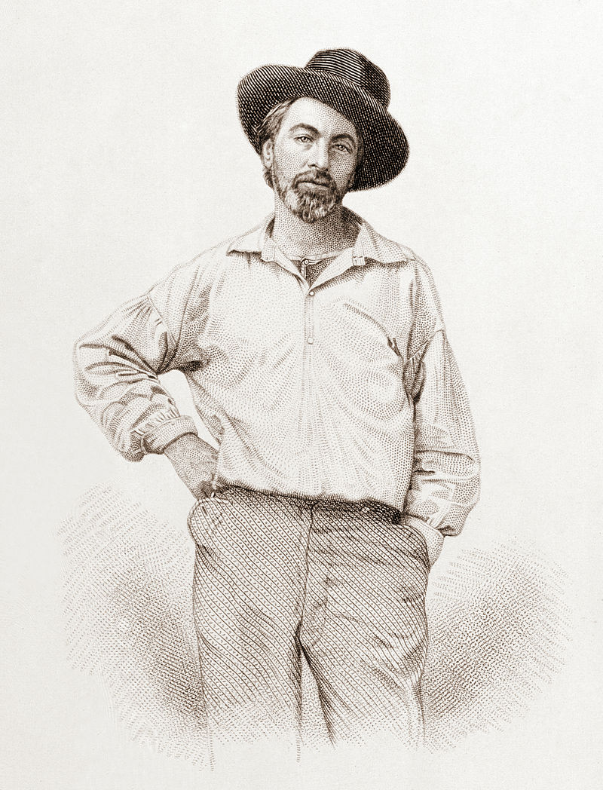
The engraving (a potrait of himself) that Whitman published in the first, unsigned edition of Leaves of Grass, 1855.

Slide 3
Undeniable Influences of Transcendentalism
Upon Whitman, a free-minded, intellectually curious young man, journalist, from a poor family from Long Island, New York state; later an original poet with a great influence upon European and American literary imagination in the 20th century.
Upon the individual self-confidence of important American women writers in the 19th century:
Sarah Margaret Fuller (1810-1850), an early American woman literary critic, translator, journalist and feminist (essay „Woman in the the 19th century“, 1845).
Louisa May Alcott (1832-1888), daughter of a transcendentalist educator, Bronson Alcott. She is the author of Little Women (1868).
Elizabeth Palmer Peabody, who opened the first English-language kindergarten in the USA (with a lasting influence), was the editor of the transcendentalist journal The Dial (the 1840s), translator and owner of a Boston bookshop, a meeting place of transcendentalists (sister of Sophia Peabody, the wife of Nathaniel Hawthorne).
Upon abolitionism…
Upon Nietzsche (esp. the writings of Ralph Waldo Emerson), and thus upon international modernism…
Upon many movements of the 20th century, especially Henry David Thoreau´s essay "On Civil Disobedience

Slide 4
Whitman´s carreer
Was full of odd jobs including manual work, teaching jobs (though he was self-educated), and mainly editorial jobs. In the late 1840s he was editor-in-chief of Brooklyn Daily Eagle. He had also worked as a printer in various positions. During the Civil War he served as a nurse in Washington, D. C.
Whitman had published poetry and prose pieces before the publication of the first edition of Leaves of Grass (this he published at his own expense). Most of this book was taken by the central poem “Song of Myself“.
Whitman endeavored to write an “epic poem“ capturing the present and the future of America in Leaves of Grass; he advocated the free verse as the only medium suitable for that purpose. That became essential for the liberation of poetic imagination at the turn of the centuries and in modern poetry in general, internationally: HIS INVENTION OF FREE VERSE FREED THE SPEED OF POETRY, ADAPTED IT TO THE WORKINGS OF MODERN IMAGINATION overwhelmed by the increasingly complex experience of being and the need of associative freedom.
Unlike Poe´s poetry whose objective (confirmed by his essay The Philosophy of Composition in 1846) was to serve beauty, Whitman´s poetry served to ideas.

Slide 5
Whitman´s carreer continued
In thought and imagination he was influenced (among others) by Emerson, who praised the first edition of Leaves of Grass (published anonymously, just with the engraving of the poet – see above) – his letter of praise was published in the 2nd edition. Whitman published several editons of Leaves of Grass, always being enlarged; the tenth being the „death-bed edition“, in 1892.
Emerson thought that Whitman was the coming American bard that was able to capture the greatness of the country, its nature and civilization and its future potential. Whitman shared Emerson´s OPTIMISM.
However, the real core of Whitman´s INDIVIDUALISM was not in any ambitious individualist tour de force, but in the stressed importance of physical, sensual enjoyment of life (of any person). He asserts himself as one of the common people of America, his vision is democratic and also GENDER-EQUAL.

Slide 6
Whitman´s poetic influence, in America, can be traced in modernist and modern poetry:
Ezra Pound´s Cantos (cca 1915-1962);
Carl Sandburg´s (1878-1967) poetry of Chicago and its urban culture including working class, black culture and jazz music. (A prominent figure of the so-called Chicago Renaissance, a poetic movement of American modernism in the 2nd and 3rd decades of 20th c. that deliberately focused on and drew upon truly American reality, esp. of the Midwest and Chicago itself.) E.g. Chicago Poems (1916);
Hart Crane´s (1899-1932) concept of poetry that was inspired (mainly) by the urban and technological growth of the beginning 20th century – see his poetic project The Bridge and the poem ″To Brooklyn Bridge“.

Slide 7
Whitman´s poetic influence can be further traced in modernist and modern literature:
Henry Miller (1891-1990), of poor German immigrant family, grew up in Brooklyn. A counter-cultural writer and artist. Continued the modernist tradition of American expatriation in Paris; he lived in the Great Depression-era Paris. Tropic of Cancer was published by half-official, avantgarde press in Paris 1934 (in Czech Obratník raka,1938!; in America banned, could be published only in 1961). His frequent existential anger tended to flow into his intense, unrestrained sexual life and into his writing about it. All his writing was autobiographic - he let himself pour directly into his prose. A complicated personality for whom it was a necessity "to write himself out" in a wild flow of uncensored text. The result was a specific stream-of-consciousness writing often bearing surrealist qualities. Miller hated America (but still belonged to it with his immigrant experience of poverty and difference), its establishment, its main-stream culture making him always feel somehow inferior. He was critical of its narrowmindedness, its consumerism - in this, and in breaking taboos in literature, he became inspiring for the Beats. In his book of high surrealist literary quality, Black Spring (Paris 1936; in Czech Černé jaro, 1995;), he offers powerful visionary insights - negative and critical insights - into American reality: from his specific perspective he inverts the all-embracing Whitmanesque optimism into deep scepticism (or even disgust), that is characteristic of the development of the Whitmanesque tradition in the 2nd half of 20th c.

Slide 8
The Beats
Lawrence Ferlinghetti, Allen Ginsberg, Jack Kerouac, Neal Cassady (alias Dean Moriarty in Kerouac's On the Road), Keneth Rexroth, Gregory Corso and others; of women writers working close to the Beats e.g. Ann Waldman, Diane di Prima, ruth weiss.
Also W. Burroughs (1914-1997) was in some respects close to the Beats. Another great magnet for the Beats was Gary Snyder (1930 - ), one of the most remarkable American poets of the post-WW-II decades, practising Zen Buddhist with a deep knowledge of Eastern (i.e. Asian) culture, an environmentalist.
The main achievement of the Beats may be found in poetry, the most remarkable Beat poets being Allen Ginsberg (1926 -1997) and Lawrence Ferlinghetti (1919 - ), Gregory Corso (1930-2001); from younger followers Ann Waldman (1945-).
The most famous "beat" book of poetry by Ferlinghetti is A Coney Island of the Mind (1958); the most famous and acclaimed books of poetry by Ginsberg (out of his approximately 30 volumes of verse and prose) are Howl and Other Poems (1956) and Kaddish and Other Poems (1961). A remarkable poetic work by Ann Waldman is Fast Speaking Woman (1980).

Slide 9
What is ″Whitmanesque″ about the Beats?
Often, especially in Ginsberg´s free verse (also in On the Road by Kerouac) – writing as direct self-expression: the reality is overwhelming and everything has to be captured. However, Ginsberg´s “Supermarket in California” IS DIFFERENT!
Poetry is directly related to society, it is embracing it although it is a means of criticism of America, even its rejection.
Poetry of ideas (pointing to desirability of change; poetry as provocation – which was also present in Whitman).
Poetry as shared experience: Whitman wanted to relate to contemporaries (though he wasn´t very successful in that) and to future generations (in which he was successful). The Beats, especially in public poetry readings, wanted to establish poetry as a means of communication (as we can notice if we listen to the recording of "America" read ironically by Ginsberg to a laughing crowd). In this context, the real sound of poems, and poetry as performance became newly important.

