Slide 1
cONSUMPTION

Slide 2
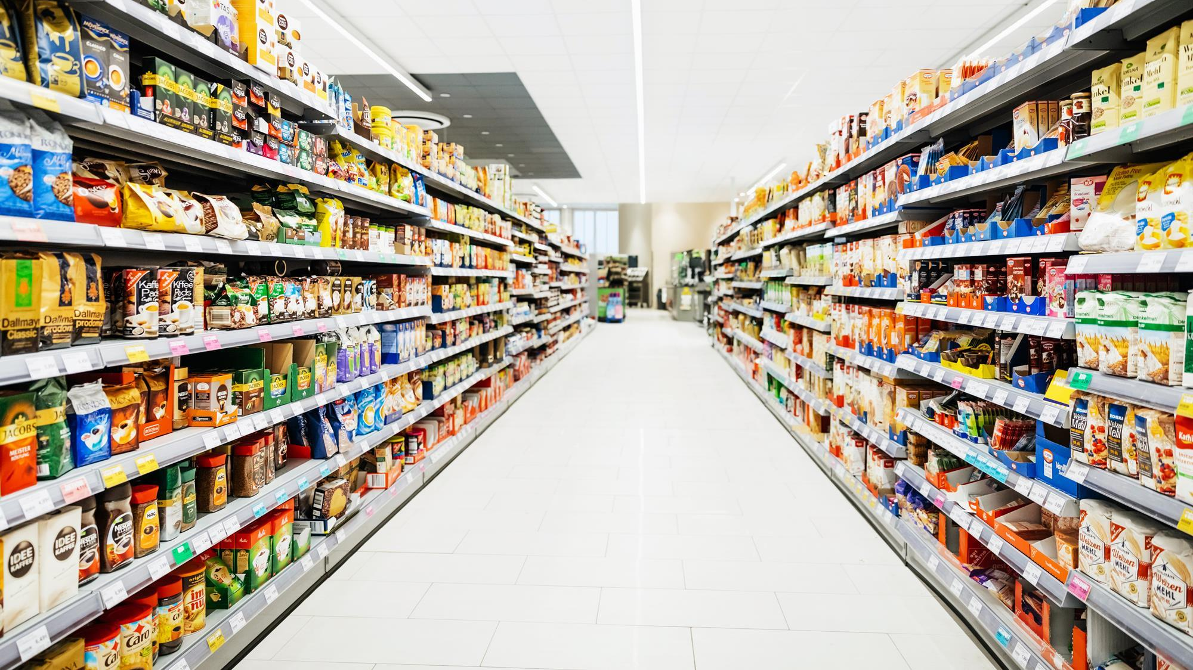
Consumption
Post-modernism – consumption as production – cultural process
Consumption as practice
Certeau –creativity of individuals inventing everyday life
City level- "the dominant theme of legendary politicians"
Studies of consumer culture: fragmentation, plurality, fluidity and hybridisation of consumption and lifestyle
Individual as a consumer and a producer of meaning

Slide 3
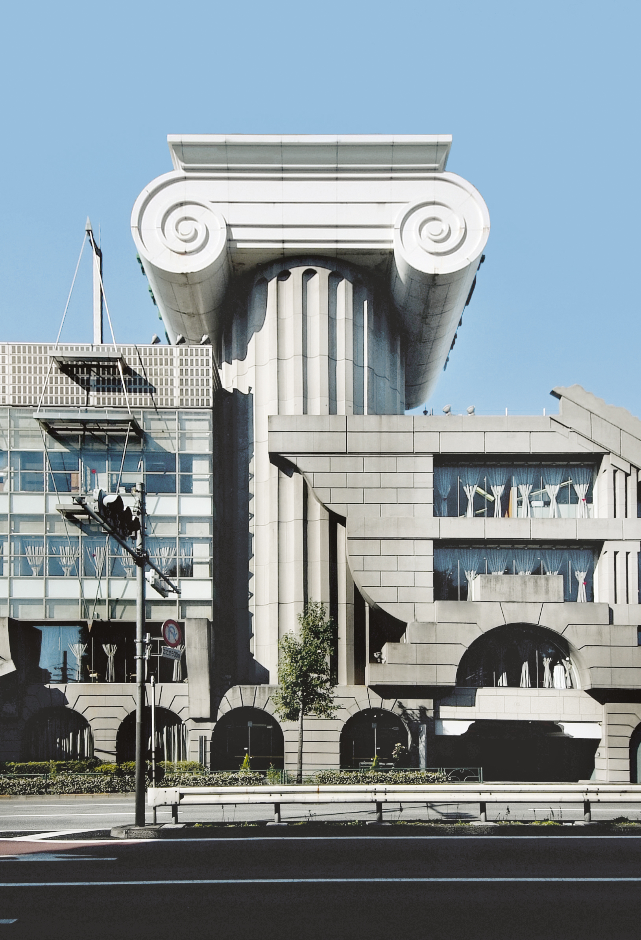
Post-modernism
Symbolic consumption configures identity and life goals
Meaning from conditions of consumption practices
Post-modernity: a product or service will be increasingly more a process to provide inputs
Continuous production and reproduction of symbolic images and meanings
Daily activity - "processes of interactions between subjects, artifacts and other material and symbolic aspects of society"

Slide 4
Mcdonaldization – George Ritzer
Rationalization of production work and consumption – efficiency, calculability, predictability and standardization and control
Update to Weber’s theory of scientific rationality producing bureaucracy
Efficiency entails a managerial focus on minimizing the time required to complete individual tasks as well as that required to complete the whole operation or process of production and distribution.
Calculability is a focus on quantifiable objectives (counting things) rather than subjective ones (evaluation of quality).
Predictability and standardization are found in repetitive and routinized production or service delivery processes and in the consistent output of products or experiences that are identical or close to it (predictability of the consumer experience).
Finally, control within McDonaldization is wielded by the management to ensure that workers appear and act the same on a moment-to-moment and daily basis. It also refers to the use of robots and technology to reduce or replace human employees wherever possible.

Slide 5
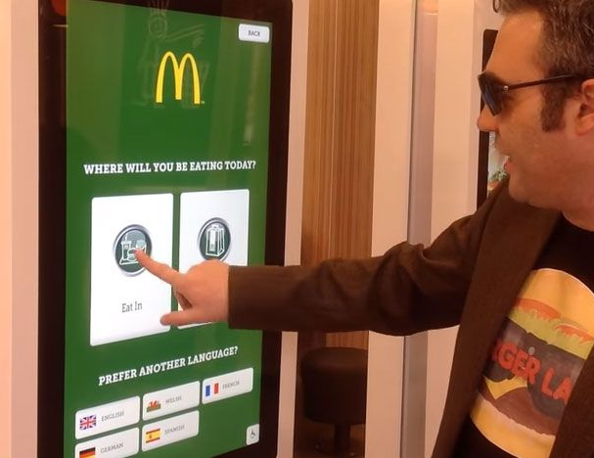
Mcdonaldization – George Ritzer cont.
Affects our values, preferences, goals, and worldviews, our identities, and our social relationships.
Narrow focus on rationality is irrational – deny basic humanity
Do not require skilled workers and devalues labour
Free consumer labour incorporated

Slide 6
Media Consumption
Katz and Lazarfield: Two-step flow of communication- opinion leaders evaluate and disseminate information to less dominant members
Social and psychological ‘needs’ shapes media consumption
David Morley – Audiences use social knowledge to accept, negotiate or oppose media content
Interpret media through collective ‘frames’
Cultural understandings shape consumption
Technological blurring of producers and consumers

Slide 7
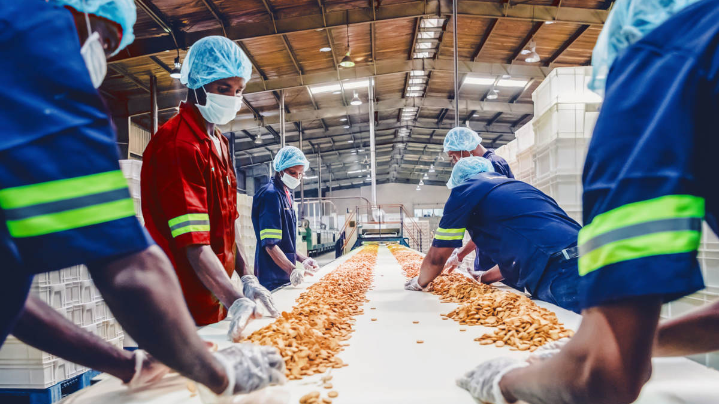
Anthropology of food
Food studies have illuminated broad societal processes such as political-economic value-creation, symbolic value-creation, and the social construction of memory
Cultural materialism vs structuralist/symbolic explanations of human behaviour
Claude Levi-Strauss, Mary Douglas and Jack Goody
Food systems – technological and social structures involved in feeding
Holistic approach –understanding combinations that depend on related factors
(i) food cultivation, (ii) the process of production in final production, (iii) the cooking process, (iv) consumption and (v) cleaning of the workstation

Slide 8
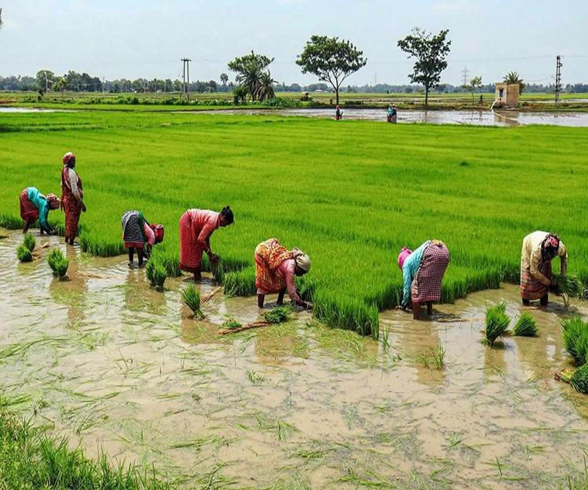
Anthropology of food cont.
Sánchez Parga defines the system as national economic; Fischer indicates it as related to techniques and ingredients associated with culture; Khare analysed the food system as a complex of cultural communication caring for food security and collective survival
Food systems dependent of social and cultural actions
Food when produced is culture – byproduct of human activity
Culinary – elements of tradition as recognisable cuisines and culturally acceptable tastes
Diversification versus monocultures resulting from economic and political interests
Invention from luxury, power and also necessity and poverty
Technology makes process rationalised, industrialised and functional for food however brings context , enviro contamination and vertical market relationships.

Slide 9
Questions: Paul Fieldhouse – Food and Nutrition
1. How is food connected to social prestige and status? Give an example from history.
2. What is meant by "Food as reward and punishment", give an example.

Slide 10
Questions: MARK PATERSON – Consumption and everyday life
1. How did Weber and Simmel see a major characteristic of modernity?
2. How do you understand McDonaldization and what effect did it have from your country's perspective?
3. What are four key features of Disneyization and please describe them.

