Slide 1
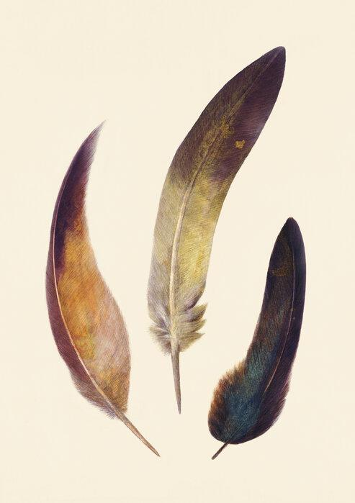
The
Three Feathers
Chapter V
K. Fišerová, M. Dolgushina, T. Mašek, K. Burýšková,
T. Muricová, A. G. Holušková, Z. Laskowska

Slide 2
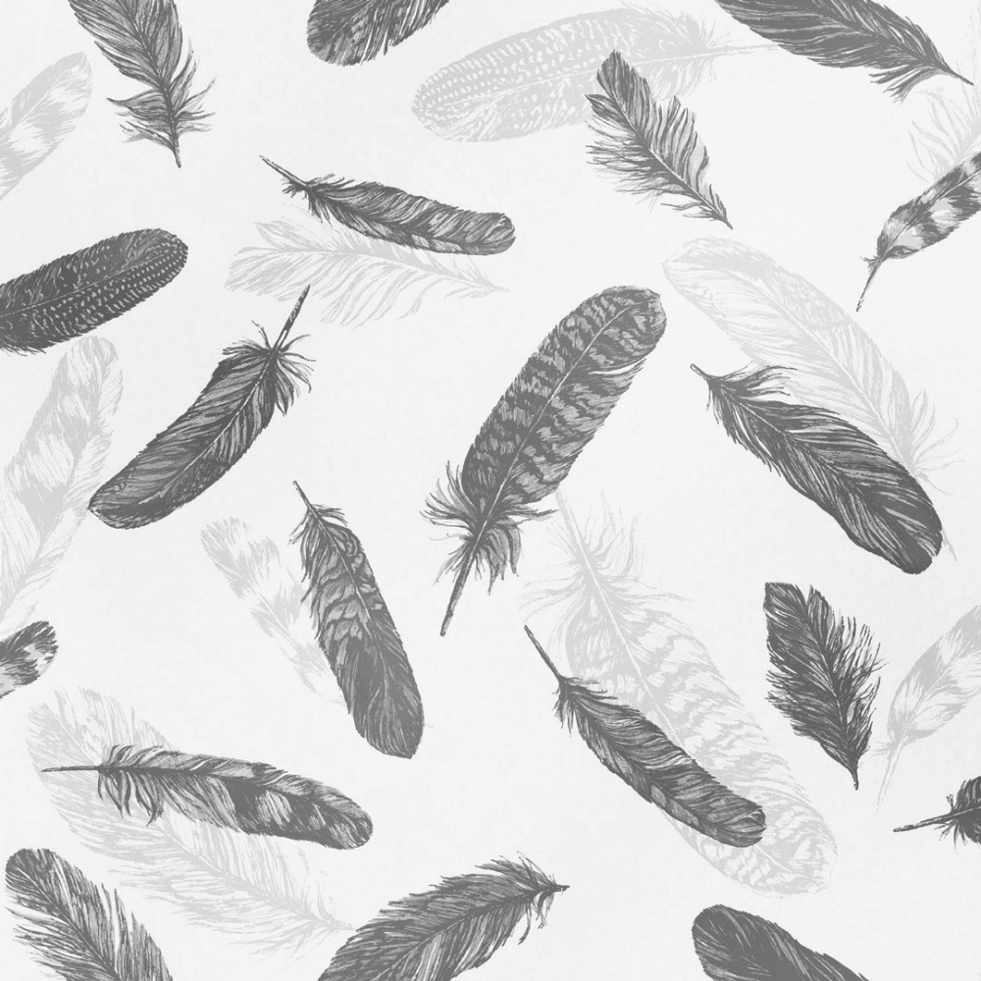
The Feather
represents thoughts/fantasies
pars pro toto: representation of a bird
symbol for spiritual quality of consciousness
wandering of thoughts/imagination
irrational feminine element
losing the feather: becoming too rational and organized

Slide 3
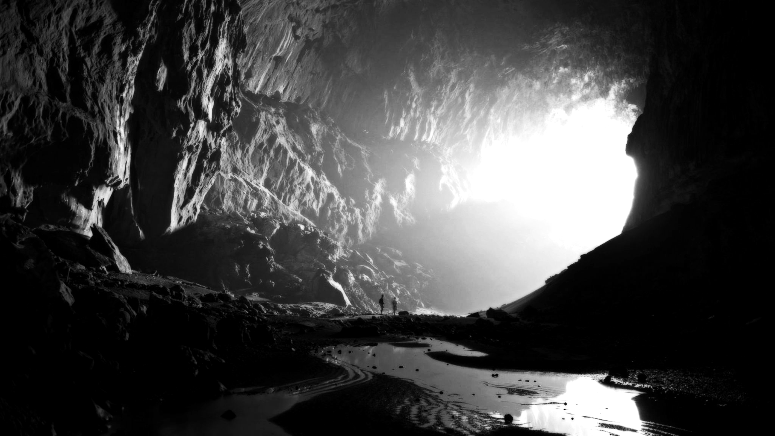
The Underground
the underworld = depths of the unconscious
trapdoor and steps = human creation, not virginal nature
human creation - traces of former way of life?
formerly conscious elements - sunk in the unconscious
Dummling doesn’t fall - supported by the steps

Slide 4
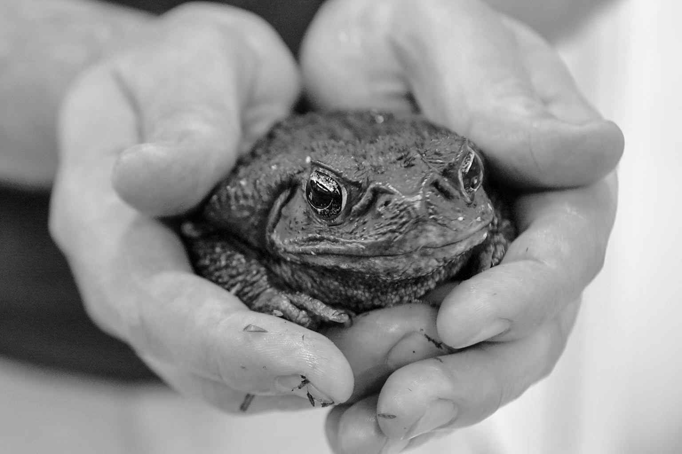
Frogs and Toads
different versions: toad replaced with a frog
toad: feminine element
frog: masculine element
toad represents Mother Earth - uterus
in the story: toad = missing royal mother

Slide 5
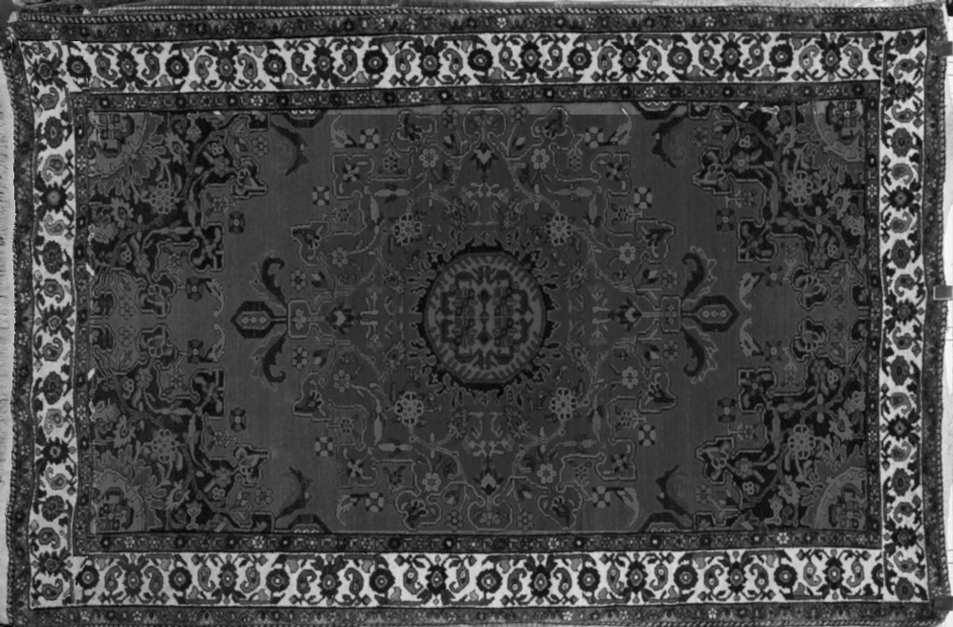
The Carpet
represents continuity of earth, basis, mothers body
protection from the evil influences
connection with Mother Earth: territory = mother
symbolic patterns of the carpet = patterns of life
finding a beautiful a carpet = finding the pattern of life

Slide 6
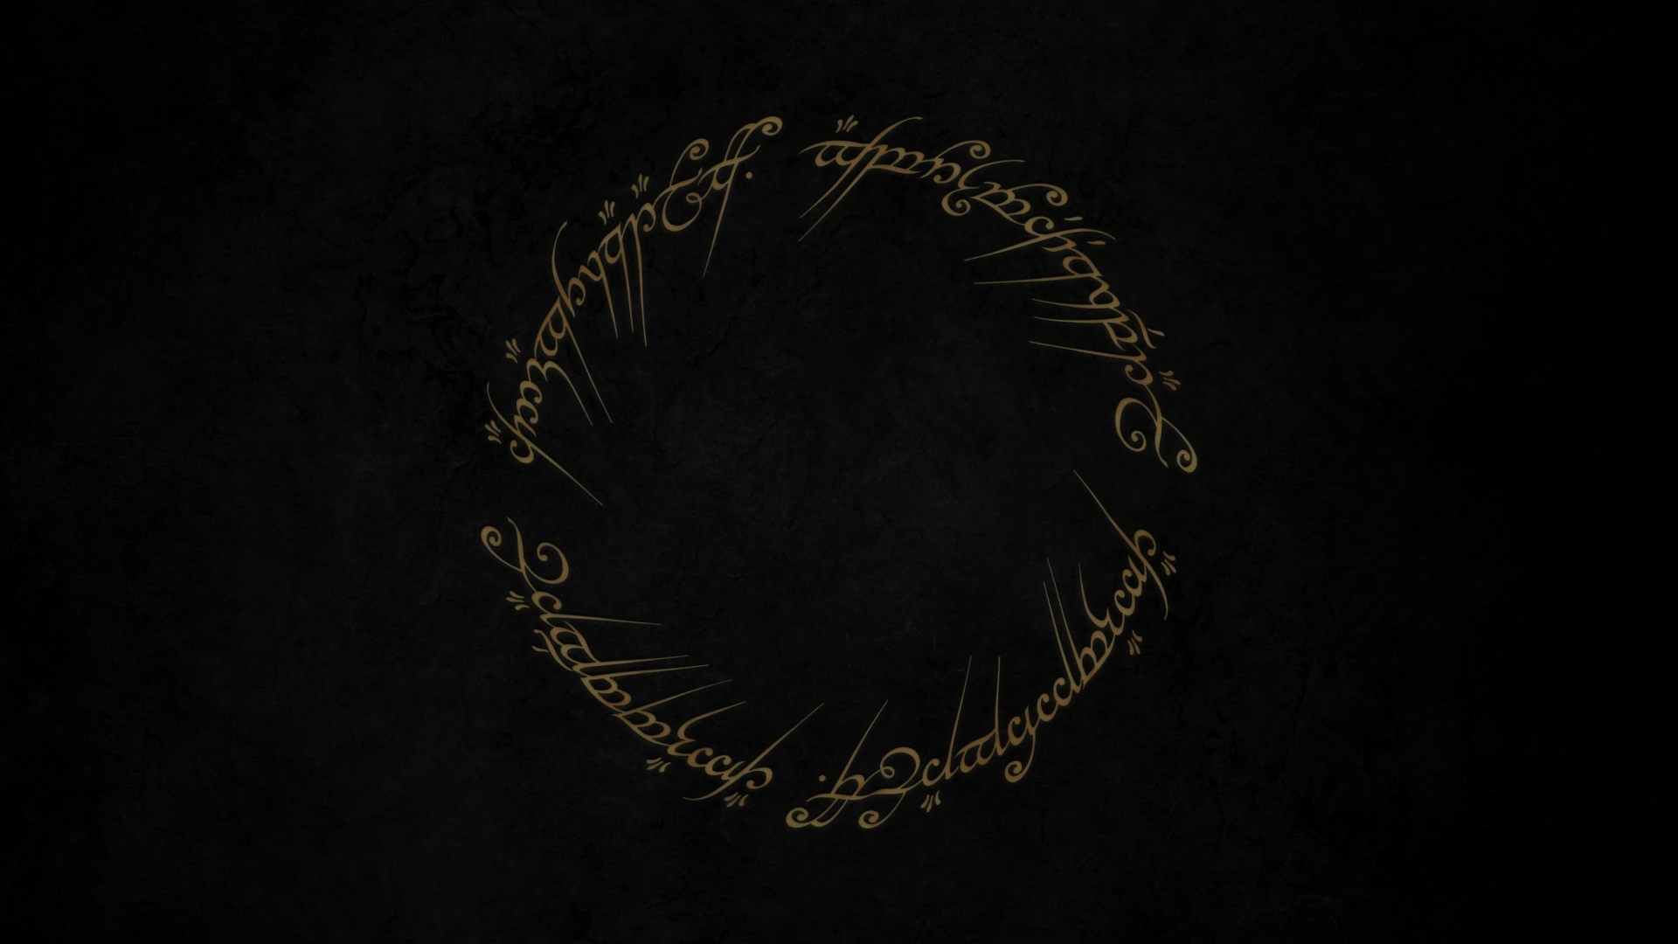
The Ring
circular object = symbol of The Self
represents connection (for ex. marriage ring)
in mythology: negative aspect - being tied to something (demons)
doesn’t have to be jewelry: temenos, witch’s ring
in the story: golden ring
gold: symbol of the Sun, eternity, immortality

Slide 7
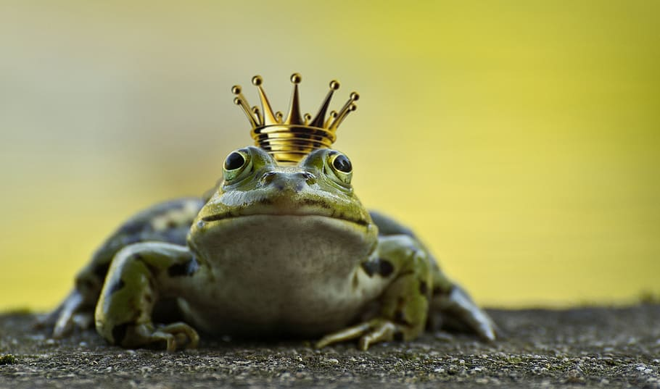
The Chariot & The Animal Bride
mother principle in the underground = unconscious
accepting the animal bride = accepting the anima
carrot: phallic symbol, sexual meaning
the anima transferred by sex/sexual fantasy
mice = soul, unconscious personality
mice + the carrot = substructure of the anima

Slide 8
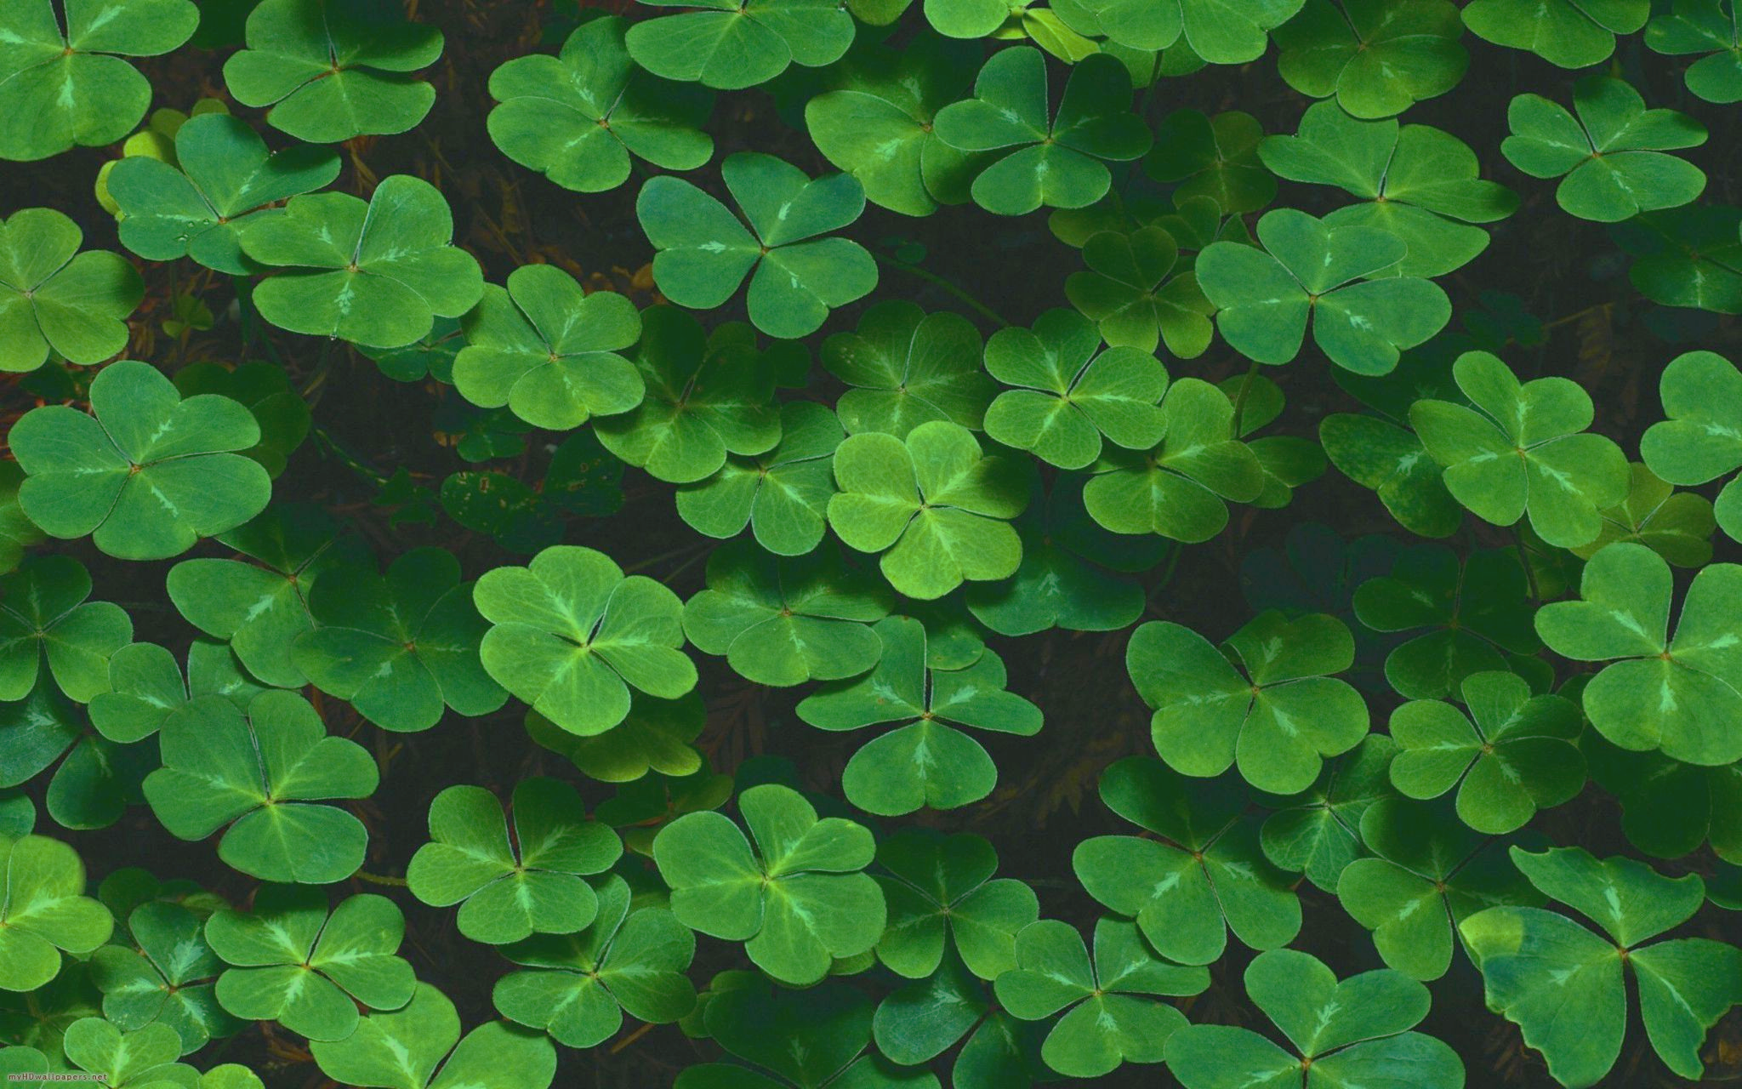
III & IV
Three: traditional masculine number
associated with movement and time
triadic gods of time - past, present, future
three phases of fairy tales: represents movement and time
Four: 4th phase - lysis or catastrophe
leads to a new dimension - different than the previous steps

Slide 9
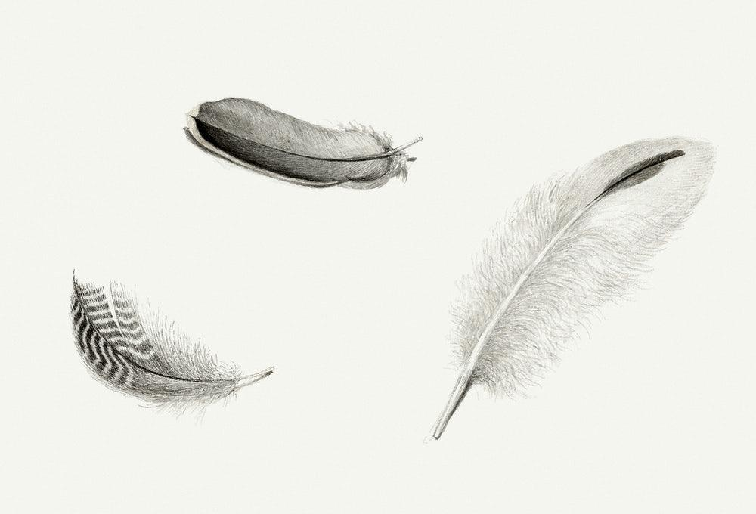
Thanks for your attention!

