Slide 1
Revenue Management& Marketing
Roman Slezacek

Slide 2
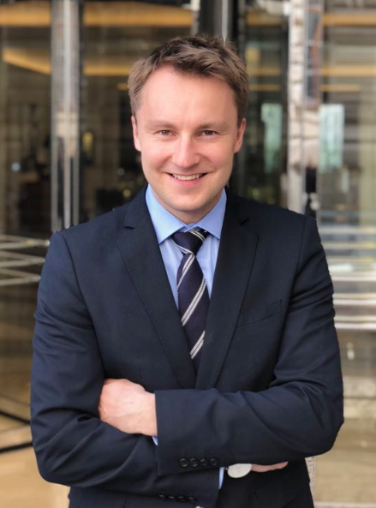
Introduction
Roman Slezáček
2015 – Senior Director of Revenue Management, Four Seasons Prague
2014 – Cluster Market Revenue Manager Munich, Marriott Hotels
2012 – Revenue Manager, Boscolo Hotel, Autograph Collection by Marriott
2011 – Revenue Analyst/Supervisor, Cluster Hotels Marriot in Prague
- 2018 – RM Coach for EMEA region
- 2017 Award Management hotel of the year in EMEA
Provided orientation training for 8 DORM at Four Seasons
6 months support for 3 FS properties in London
Graduated from Economics and Management from Newton College
Notes:
30 min – intro for all participants

Slide 3
Definition of Revenue Management
“Revenue Management ensures that companies sell the right product to the right customer at the right time for the right price“
(Source: book Revenue Management hard core tacktics for market domination)

Slide 4
Retail/Discount/Wholesaler/Negotiated/Special
Customers / guests
$500
$350
$250
$150

Slide 5
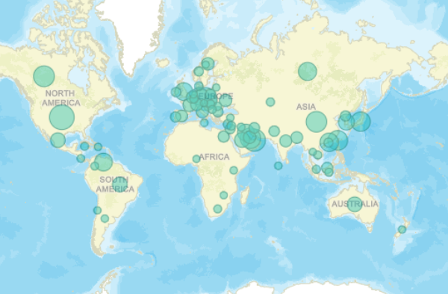
What do we know about customers?
Country?
Average lead time?
Room rate?
Room Revenue?
Ancillary Revenue?
Rooms/Suites?

Slide 6
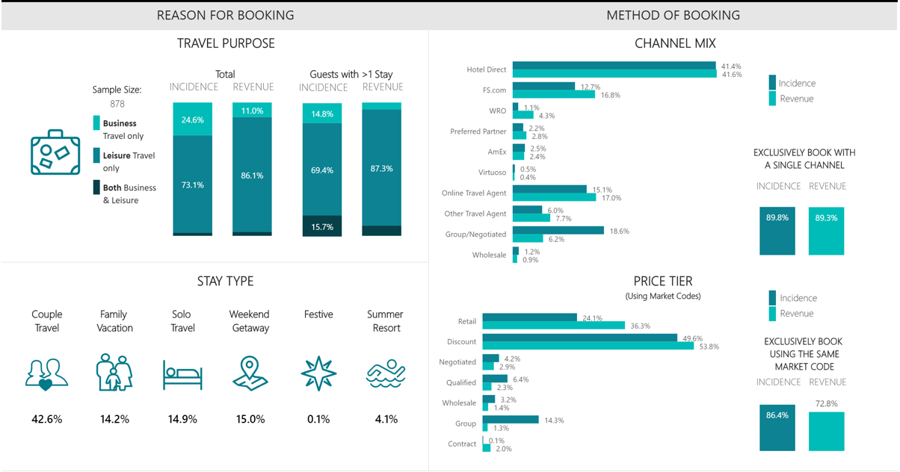
Customers / guests

Slide 7
An example – US customer
USA:
Average booking window : 120 days
Highest spenders/suite buyers
Average length of stay 3 – 4 nights
Willing to spend extra money for additional services

Slide 8
Create a package => tag a price => booking channel => digital communication => evaluate results => share results
Communication of a special offer

Slide 9
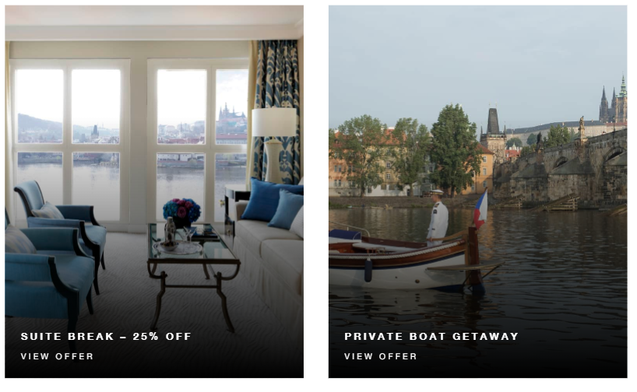
Special Offers displayed on FS.com
High res. pics
Videos
Storytelling
Engaging mark. material

Slide 10
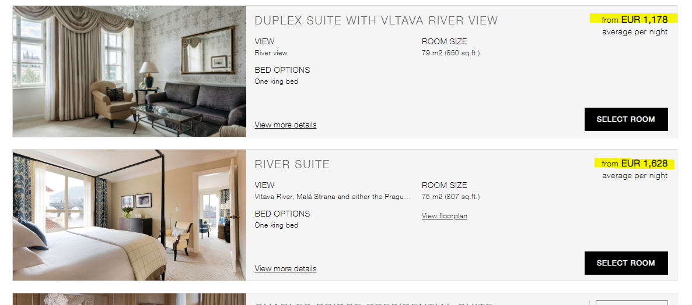
Special Offers – room categories & pricing

Slide 11
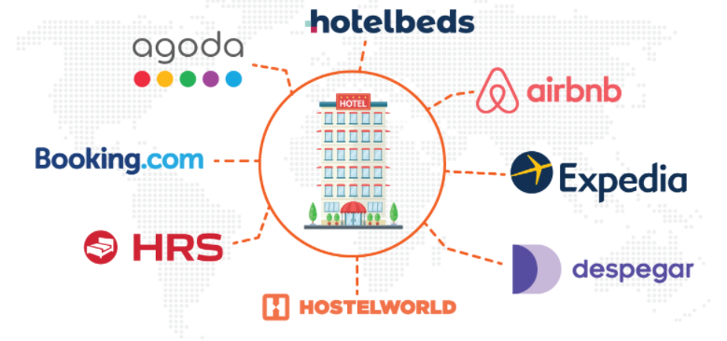
Special Offers – booking channels

Slide 12
Special Offers – digital communication
Facebook
Instagram
PPC/SEO
Journalist
Reservation department
Email communication
FS App / Website

Slide 13
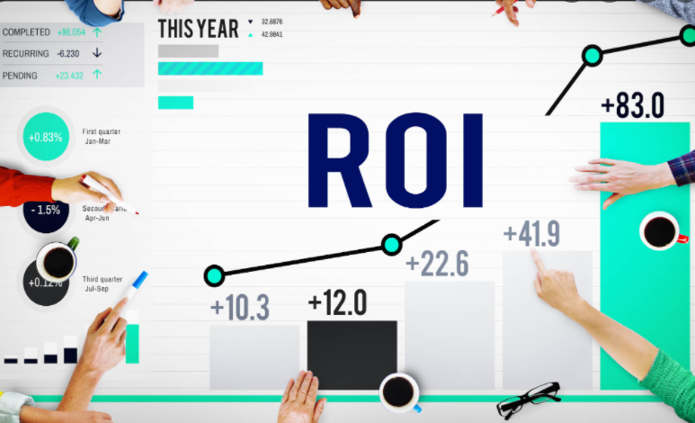
Special Offers – ROI for each campaign is a must

Slide 14
Q&A

