Slide 1
On the Run: Fugitive Life in an American City
Emma Monk

Slide 2
Alice Goffman

Slide 4
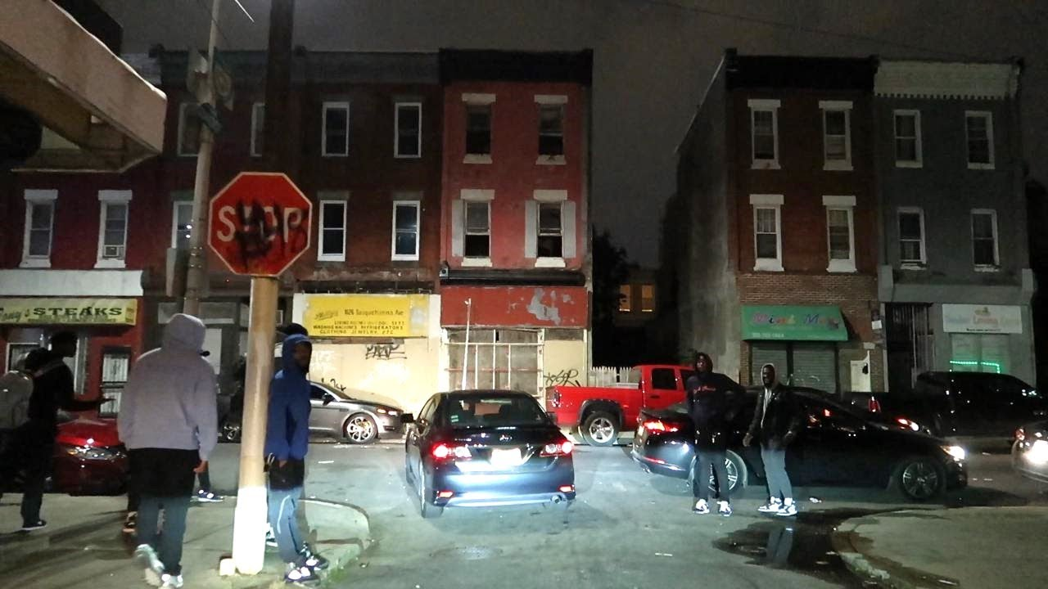

Slide 18
Závěr
Zdroj:
GOFFMAN, Alice. 2014. On the Run: Fugitive Life in an American City. Chicago: University of Chicago Press. 1-90.

