Slide 1
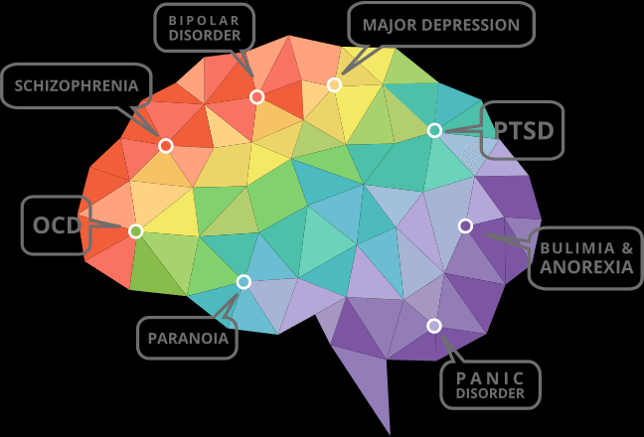
Mental disorders

Slide 2
Classification of Mental Disorders
What are mental disorders?
Mental disorders (or mental illnesses) are conditions that affect your thinking, feeling, mood, and behaviour. They may be occasional or long-lasting (chronic). They can affect your ability to relate to others and function each day.
Classification of mental diseases:
Neuroses, psychoses (schizophrenia), affective disorders, personality disorders. Formerly called psychopathy.
According to the latest revision of the International Classification of Diseases (ICD-10), neuroses are listed as neurotic disorders, stress-induced disorders and somatoform disorders.
These are various disorders that have several common features. There are currently two widely established systems that classify mental disorders:
ICD-10 Chapter V: Mental and behavioural disorders, since 1949 part of the International Classification of Diseases produced by the WHO,
the Diagnostic and Statistical Manual of Mental Disorders (DSM-5) produced by the American Psychiatric Association (APA) since 1952.

Slide 3
International Statistical Classification of Diseases and Related Health Problems (ICD)
1 Organic, including symptomatic, mental disorders (F00–F09)
2 Mental and behavioural disorders due to psychoactive substance use (F10–F19)
3 Schizophrenia, schizotypal and delusional disorders (F20–F29)
4 Mood (affective) disorders (F30–F39)
5 Neurotic, stress-related and somatoform disorders (F40–F48)
6 Behavioural syndromes associated with physiological disturbances and physical factors (F50–F59)
7 Disorders of adult personality and behaviour (F60– F69)
8 Mental retardation (F70–F79)
9 Disorders of psychological development (F80–F89)
10 Behavioural and emotional disorders with onset usually occurring in childhood and adolescence (F90–F98)
11 Unspecified mental disorder (F99)
Notes:
Hjumen sajki

Slide 4
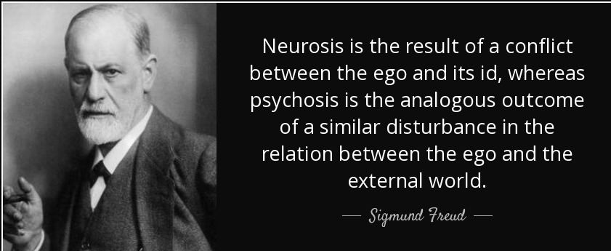
Notes:
Hjumen sajki

Slide 5
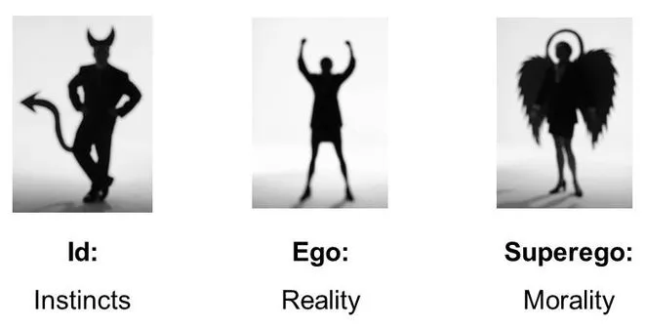
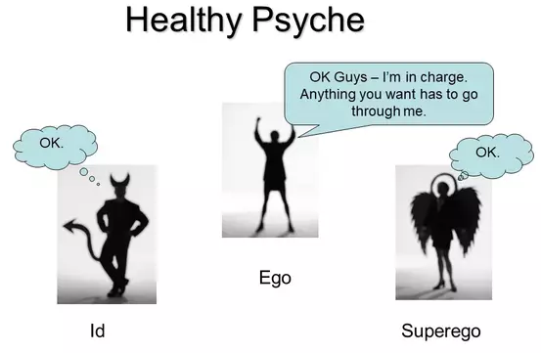
Freud´s Theory

Slide 6
Neuroses vs. Psychoses
Neuroses - less severe mental disorders (anxiety, depressed moods).
Affected everyday life, but the personality is relatively intact.
The ability to recognize and adequately assess reality, a neurotics is aware of his/her illness and usually wants to recover.
Neurotic symptoms - reminiscent of the defence mechanisms used by healthy people to cope with common life problems, but in neurotics these reactions to external stress are overly strong or last for a disproportionately long time.
Notes:
Hjumen sajki

Slide 7
Neurotic Disorders
Common Signs of Neurotic Disorders
Types of Anxiety Disorders
Chronic excessive anxiety;
anxiety is accompanied by physical manifestations (sleep disorders, tremor, palpitations, fatigue, sweating);
a high level of difficulty limits the client in different life roles (at work, in the family, in partnerships);
a large share of the origin has the environment;
the client is aware of his/her disproportionate reactions but is unable to control them.
Generalized anxiety disorder
Panic disorder
Phobia
Obsessive-compulsive disorder
Dissociative Disorders (Conversion)
Somatoform disorders
Depersonalization and derealisation disorder
Post-traumatic stress disorder
Notes:
Hjumen sajki

Slide 8
Symptoms of Anxiety Disorders

Slide 9
Neurotic Disorders
Occurrence
Causes
Currently an increase, the incidence of 30-40%, more often in women.
More accurate data only on individual cases, e.g. :
specific phobia 15%, social phobia 14%,
generalized anxiety disorder 8%,
post-traumatic stress disorder 8%,
agoraphobia 6%,
obsessive compulsive disorder / behaviour (OCD) 5%.
Mostly multifactorial:
partially inborn disposition,
high environmental impact - excessive punishment, child refusal, criticism, abuse, premature separation from parents (carers), frequent disruption between parents, problems in the child's collective;
the trigger can then be long-term stress, stressful life situations or excessive work demands.
Notes:
Hjumen sajki

Slide 10
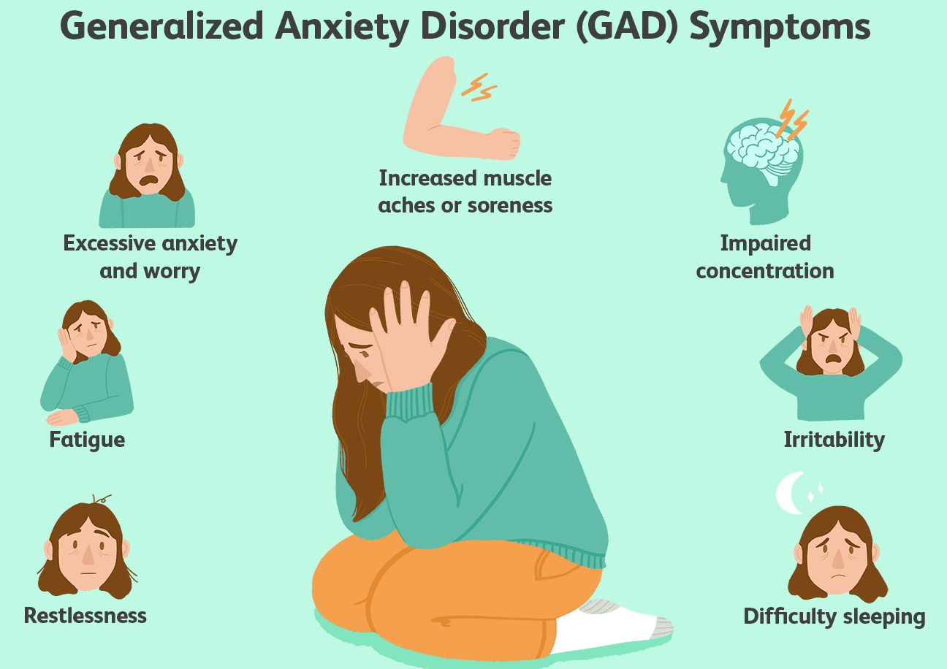
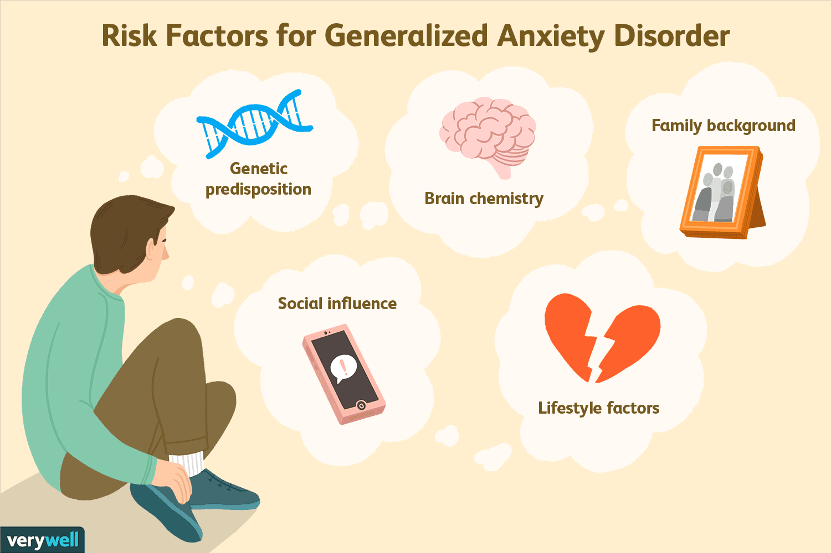
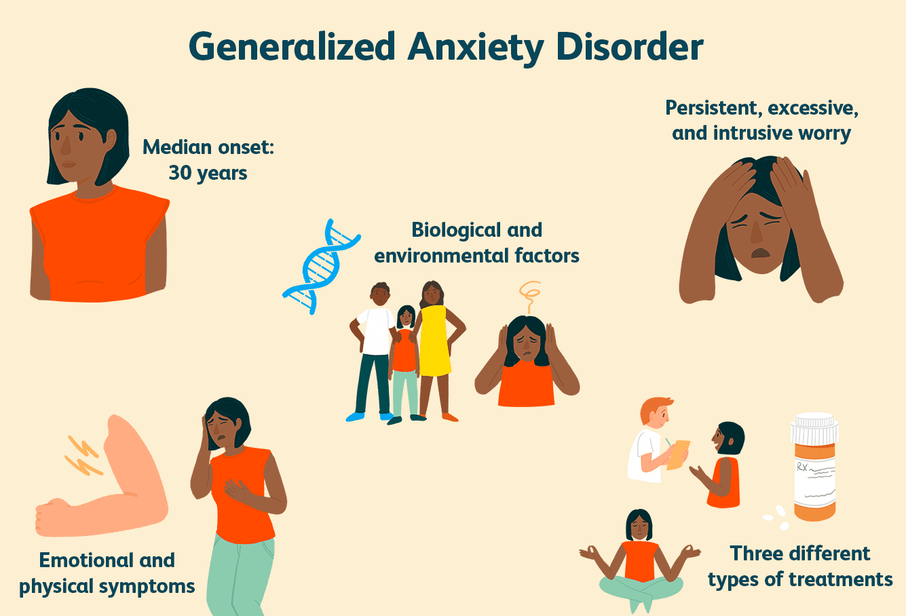
Generalised Anxiety Disorder (GAD)
GAD may affect up to 5% of the general population. The classical syndrome of generalised anxiety disorder involves both psychological and somatic symptoms.
Psychological symptoms include free-floating anxiety (i.e. anxiety not attached to any particular object or event) and a fearful preoccupation with the future.
Somatic symptoms include tachycardia, palpitations, essential tremor, muscular tension, hypertension, dizziness, sweating, hyperventilation, and epigastric discomfort. Anxiety is often a presenting symptom of depressive illness, and it is sometimes difficult to disentangle the two.
This may result in accented reactions (escape, crying explosion, inability to respond, etc.)
Notes:
Hjumen sajki

Slide 11
Phobias
Defined as an excessive and somewhat irrational fear of some object or situation which is usually so disturbing that it leads to avoidance of that object or situation (avoidance behaviour). Avoiding the feared thing only makes further contact with it even more anxiety-provoking. About 8% of the general public have some kind of phobia.
Most people have fears of specific things like a fear of the dark or spiders, but rarely do these fears dominate their lives. When the fears become preoccupying and the individual takes special steps to avoid the feared thing (like a mother asking her son to read through all her magazines first to ensure that there are no pictures of spiders) then a minor fear becomes a specific phobia.
Ninety per cent of sufferers are women.
Psychological treatment is based on two principles: reducing the anxiety associated with the feared object and practising exposure to the feared object or situation.
Notes:
Hjumen sajki

Slide 12
Phobias
Agoraphobia
A fear of the market place, of crowds, of travelling on public transport, and an avoidance of social situations and a marked tendency to stay at home, rarely, if ever, venturing outside. Three quarters of sufferers are women.
Behavioural therapy can be very successful, based on exposing the patient to a graded hierarchy of situations ranging say, from a walk of ten yards away from the front door to a day out in town. Often the patient's partner can be enrolled as a co-therapist. Antidepressants, including MAOIs, may be particularly useful. Some patients may reluctant to give up their illness behaviour, because there may be considerable psychological rewards attached to it eg making the partner more attentive.
Social phobias
These involve the fear of meeting people, or the fear of behaving in an out of the ordinary way in company. Whereas the agoraphobic is frightened of people in the mass, the social phobic is also often afraid of one-to-one interactions with others. Alcohol or benzodiazepines are often abused to reduce anxiety ahead of the event. Anticipatory anxiety impairs performance in the feared situation leading to a cycle of reduced confidence and increased anxiety before the next meeting and so on.
Notes:
Hjumen sajki

Slide 13
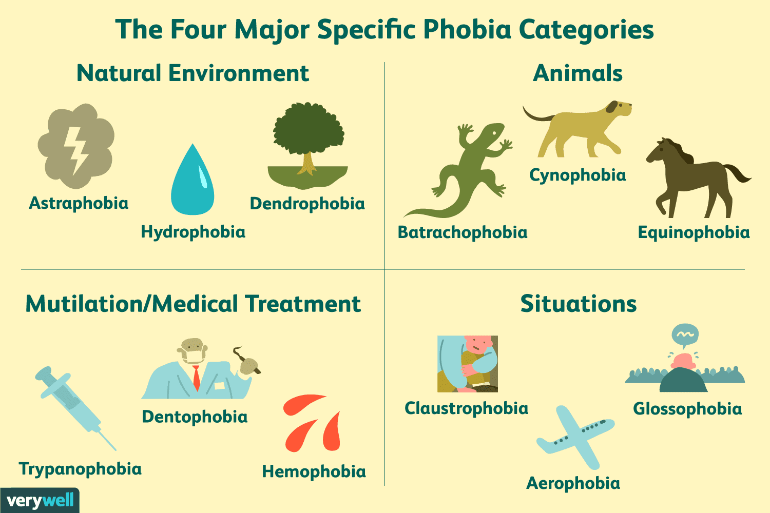
Notes:
Hjumen sajki

Slide 14
Panic Disorder
Anxiety is felt in separate recurrent bouts (panic attacks) in which somatic symptoms of palpitations and dizziness may predominate. Sufferers often feel that they are about to die during an attack.
Depersonalisation and derealisation may accompany the attack.
The sufferer tends to avoid the places where such attacks have occurred in the past. Thus a series of panic attacks may precipitate agoraphobia. Sometimes sufferers overcome their fear by misusing alcohol or benzodiazepines.
Organic causes for anxiety and panic disorders must be excluded. Thyrotoxicosis often presents with anxiety. Mitral valve prolapse and cardiac arrhythmias are also associated.
Cognitive therapy has been shown to be of benefit in addition to the psychological and drug treatments.
Notes:
Hjumen sajki

Slide 15
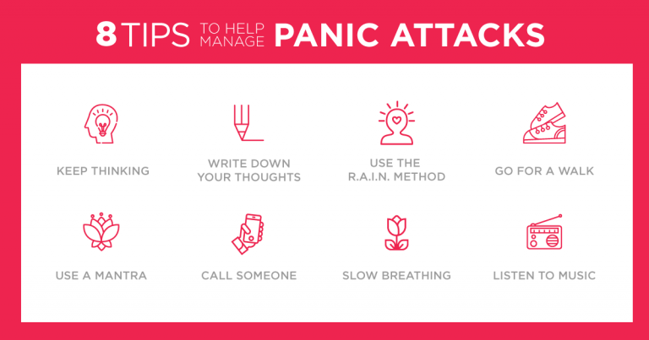
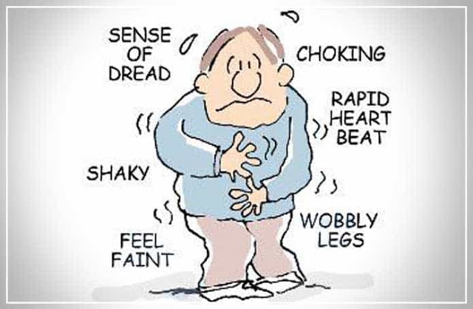
Panic Disorder
Notes:
Hjumen sajki

Slide 16
Obsessive-Compulsive Disorder (OCD)
Beginnings in childhood often persist into adulthood.
The child is not able to experience joy, anxiety, tension and threat prevail,
difficulty concentrating and simple thought operations.
In adulthood - repeated obsessive thoughts (obsessions) followed by uncontrollable impulses for excessive action (compulsion).
OCD
Types of OCD:
compulsive need for repeated cleansing ritual (hands, clean linen, showering,…),
compulsive need for control (door lock, window closing, switching off,…),
the compulsive need for order (matched laundry according to a certain rule, compliance with nonsense rules,…),
unavoidable thoughts of unacceptable nature (e.g. with sexual or aggressive content) that the client tries to prevent by constantly repeating a certain activity.
Notes:
Hjumen sajki

Slide 17
Notes:
Hjumen sajki

Slide 18
Psychotic Disorders
Psychotic disorders are a group of serious illnesses that affect the mind. They make it hard for someone to think clearly, make good judgments, respond emotionally, communicate effectively, understand reality, and behave appropriately.
When symptoms are severe, people with psychotic disorders have trouble staying in touch with reality and often are unable to handle daily life. But even severe psychotic disorders usually can be treated.
There are different types of psychotic disorders, including:
Schizophrenia: People with this illness have changes in behaviour and other symptoms -- such as delusions and hallucinations -- that last longer than 6 months. It usually affects them at work or school, as well as their relationships.
Notes:
Hjumen sajki

Slide 19
Causes of Schizophrenia
It occurs most often between the ages of 15 and 35 (later in women).
Multifactorial causes: heredity, changes in the structure and function of brain cells, psychosocial factors (prenatal, perinatal, postnatal influences).
Risky family environment: closed families (isolated from the environment), conflicting or cold family relationships, disrupted communication, inability to solve problems and manage negative emotions.
Schizophrenia
To be diagnosed with schizophrenia, a person must have two or more of the following symptoms occurring persistently in the context of reduced functioning:
Delusions
Hallucinations
Disorganized speech
Disorganized or catatonic behaviour
Negative symptoms (often include being emotionally flat or speaking in a dull, disconnected way)
Notes:
Hjumen sajki

Slide 20
Types of Schizophrenia
Paranoid schizophrenia
This is the most common form of schizophrenia. It may develop later in life than other types of schizophrenia. Symptoms include hallucinations and/or delusions, but your speech and emotions may not be affected.
Simple schizophrenia
With simple schizophrenia, the negative symptoms (for example; slow movement, poor memory, lack of concentration and poor hygiene) are most prominent early and will get worse. It is rare to experience positive symptoms (hallucinations, delusions, disorganised thinking). Gradually, thinking deteriorates to dementia.
Hebephrenic schizophrenia
Also called ‘disorganised schizophrenia’, this type of schizophrenia usually develops when you are 15-25 years old. Symptoms include disorganised behaviours and thoughts, alongside short-lasting delusions and hallucinations. You may have disorganised speech patterns and others may find it difficult to understand you.
People with disorganised schizophrenia often show little or no emotions in their facial expressions, voice tone, or mannerisms. At times they have inappropriate emotional responses to the situation, such as laughing at something sad.
Notes:
Hjumen sajki

Slide 21
Types of Schizophrenia
Catatonic schizophrenia
This is the rarest schizophrenia diagnosis, characterised by unusual, limited and sudden movements. You may often switch between being very active or very still. You may not talk much, and you may mimic other’s speech and movement. It takes two forms:
productive - with disproportionately increased motor activity - constant repetition of certain movements or words (echopraxia, echolalia).
stuporous - total motor attenuation. The client remains motionless for a long time, is negativistic, often acts paradoxically (the opposite of the desired one). Typical here is the so-called wax flexibility, where the client remains in the position to which he was placed for a longer time.
Notes:
Hjumen sajki

Slide 22
Symptoms of Schizophrenia
Schizophrenia is sometimes described as having ‘positive symptoms’ and ‘negative symptoms’.
Positive symptoms are experienced in addition to reality whereas negative symptoms affect your ability to function.
Positive symptoms of schizophrenia
Hallucinations – Seeing, feeling and hearing things that aren’t there. Hearing voices is the most common type of hallucination
Delusions – Believing things that others don’t
Disorganised thinking – The things you say might not make sense to other people. You may switch topics without any obvious link.
Negative symptoms of schizophrenia
Lack of motivation
Slow movement
Change in sleep patterns
Poor grooming or hygiene
Reduced range of emotions
Becoming withdrawn – Not saying much, change in body language, less interest in things you used to enjoy
Low sex drive
Unable to concentrate
Poor memory
Poor decision making
Notes:
Hjumen sajki

Slide 23
Symptoms of Schizophrenia
Other symptoms include disorders of the pace of thought - bradypsychia (slowed thinking, clinging to one thought) or vice versa. The decline in cognitive functioning is manifested by a general decline in intellectual functions. Psychomotor retardation (Parkinson‘s, Alzheimer‘s disease)
tachypsychia - fast thinking, not enough pace of speech, which becomes incomprehensible (verbal salad - logical discontinuity of words).
The formal aspect of thinking is also disrupted - thinking is fragmented, without a logical structure.
Another typical manifestation is withdrawal into isolation (psych. Autism).
Emotional disorders (initially hypersensitivity, later emotional numbness).
Tachypsychia

Slide 24
Phases of Schizophrenia
Prodromal symptoms - conspicuous introversion, increased vulnerability, reduced ability to become independent, increased criticality in interpersonal relationships, lower performance, higher fatigue.
The disease may take the form of repeated alternations of attacks with periods of remission.
The course can also be episodic - just one attack and then adjusting health.
Malignant course - rapid onset of personality defect.
Chronic course - the persistence of some symptoms, gradual loss of competences.

Slide 25
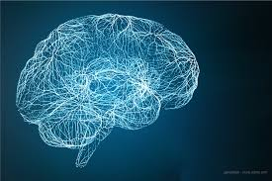
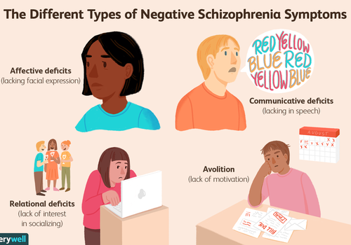

Slide 26
Affective disorders
Affective disorder, mental disorder characterized by dramatic changes or extremes of mood.
Affective disorders may include manic (elevated, expansive, or irritable mood with hyperactivity, pressured speech, and inflated self-esteem) or depressive (dejected mood with disinterest in life, sleep disturbance, agitation, and feelings of worthlessness or guilt) episodes, and often combinations of the two.
Persons with an affective disorder may or may not have psychotic symptoms such as delusions, hallucinations, or other loss of contact with reality.

Slide 27
Causes of affective disorders
The causes are multifactorial: heredity, developmental changes, psychosocial stress factors.
Climatic conditions also have an impact - depression is more common in areas where there is less light and more cold days.
The dependence on the season is also proven - less occurrence in the summer months.
The basic manifestation is a sick mood that does not correspond to the situation the client is in.
Bad mood disrupts the thinking, acting and somatic functions of the client.
Affective disorder affects women twice as often and affects up to 25% of the population (with depression up to 20%) at least once in a lifetime.
Bipolar affective disorder is characterized by mood changes between depression and mania.

Slide 28
Depression
Depression is classified as a mood disorder. It may be described as feelings of sadness, loss, or anger that interfere with a person’s everyday activities.
Depression is an ongoing problem, not a passing one. It consists of episodes during which the symptoms last for at least 2 weeks. Depression can last for several weeks, months, or years.
Depression may be classified as:
mild
moderate
severe, also called “major”

Slide 29
What does mild depression feel like?
Mild depression involves more than just feeling blue temporarily. The symptoms can go on for days and are noticeable enough to interfere with usual activities. Mild depression may cause:
irritability or anger
hopelessness
feelings of guilt and despair
self-loathing
a loss of interest in activities you once enjoyed
difficulties concentrating at work
a lack of motivation
a sudden disinterest in socializing
aches and pains with seemingly no direct cause
daytime sleepiness and fatigue
insomnia
appetite changes
weight changes
reckless behaviour, such as abuse of alcohol and drugs, or gambling

Slide 30
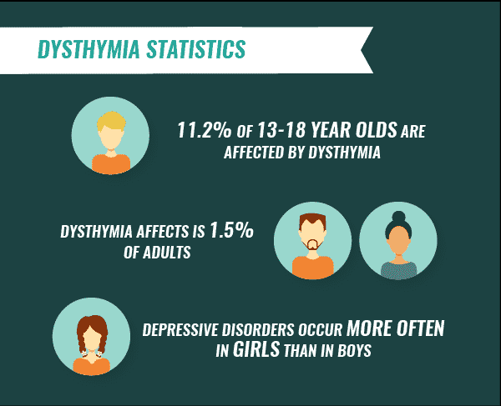
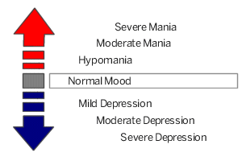
Mild Depression
If symptoms persist for most of the day, on an average of four days a week for two years, the person would most likely be diagnosed with persistent depressive disorder. This condition is also referred to as dysthymia.
Dysthymia

Slide 31
What does moderate depression feel like?
In terms of symptomatic severity, moderate depression is the next level up from mild cases. Moderate and mild depression share similar symptoms. Additionally, moderate depression may cause:
problems with self-esteem
reduced productivity
feelings of worthlessness
increased sensitivities
excessive worrying
The greatest difference is that the symptoms of moderate depression are severe enough to cause problems at home and work. You may also find significant difficulties in your social life.
Moderate depression is easier to diagnose than mild cases because the symptoms significantly impact your daily life

Slide 32
What does severe (major) depression feel like?
Episodes of major depression last an average of six months or longer. Sometimes severe depression can go away after a while, but it can also be recurrent for some people.
Major forms of depression may also cause:
delusions
feelings of stupor
hallucinations
suicidal thoughts or behaviours
A depressed person may gain or lose weight, eat more or less than usual, have difficulty concentrating, and have trouble sleeping or sleep more than usual. He or she may feel tired and have no energy for work or play. Small burdens or obstacles may appear impossible to manage. The person can appear slowed down or agitated and restless. The symptoms can be quite noticeable to others.

Slide 33
Mania
Mania is a psychological condition that causes a person to experience unreasonable euphoria, very intense moods, hyperactivity, and delusions. Mania (or manic episodes) is a common symptom of bipolar disorder.
Mania can be a dangerous condition for several reasons. People may not sleep or eat while in a manic episode. They may engage in risky behaviours and harm themselves. People with mania have a greater risk of experiencing hallucinations and other perceptual disturbances.
To diagnose manic episode the following symptoms must be present:
Inflated self-esteem or grandiosity
Decreased need for sleep (e.g., one feels rested after only 3 hours of sleep)
More talkative than usual or pressure to keep talking
Flight of ideas or subjective experience that thoughts are racing
Attention is easily drawn to unimportant or irrelevant items
Increase in goal-directed activity (either socially, at work or school; or sexually) or psychomotor agitation
Excessive involvement in pleasurable activities that have a high potential for painful consequences (e.g., engaging in unrestrained buying sprees, sexual indiscretions, or foolish business investments)
mania-quiz

Slide 34
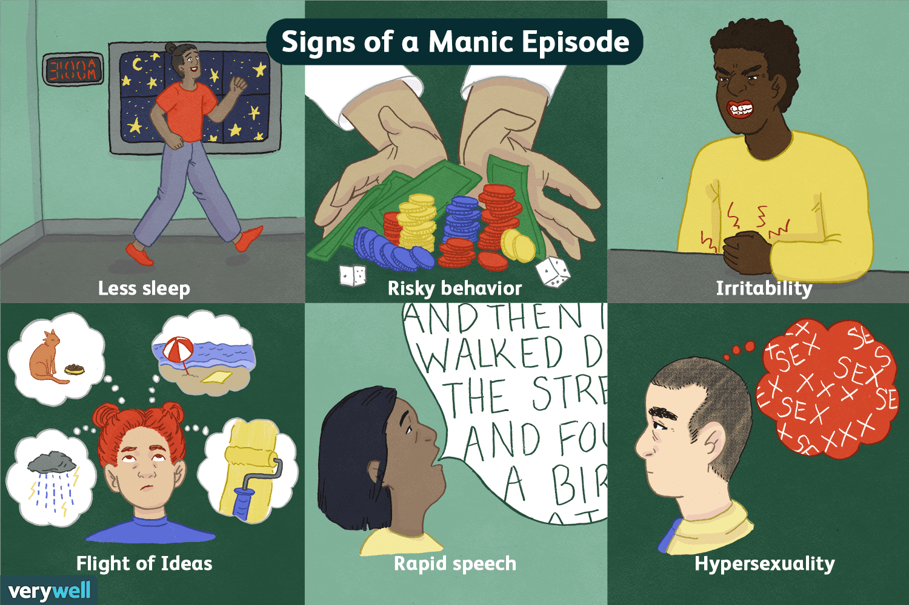
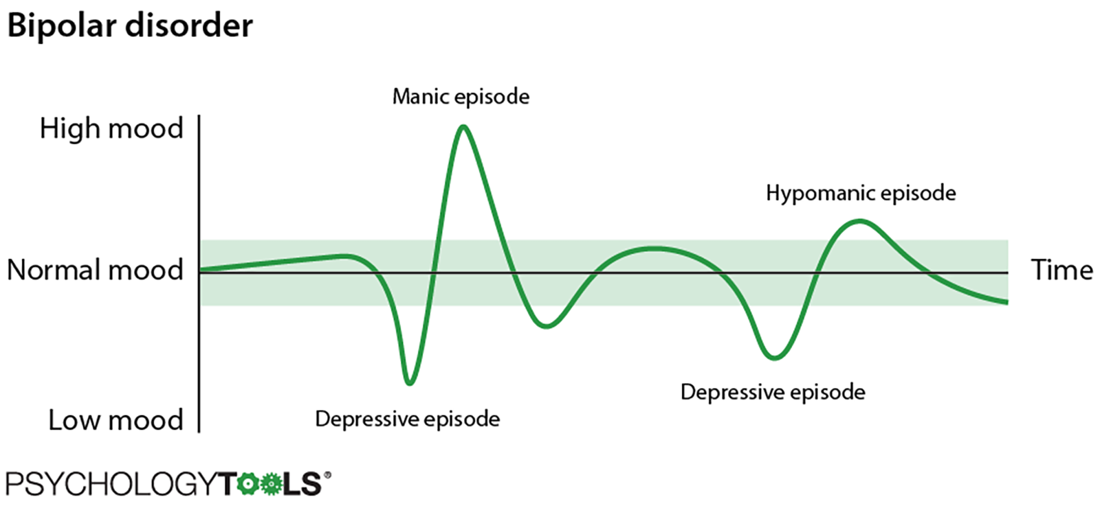
Mania - Degrees
Hypomania - lower degree of mania, persistent mood increase, activity, sexual appetite, decreased need for sleep; without disrupting normal activities. Interview with a patient
Mania - disproportionately ↑ mood, grandeur, unrealistic plans, individual loses common social inhibitions.
Mania with psychotic symptoms - escalated manic symptoms, irritability, suspicion and delusions.

Slide 35
Classification of Affective Disorders
Manic phase - if there is one manic attack lasting at least two weeks, then no more affective nor dep. f. does not appear.
Bipolar affection. disorder - repeated episodes of depression and mania (occurrence of male x female the same).
Depressive phase - isolated occurrence of dep. episodes.
Periodic (recurrent) dep. disorder - recurrence of dep. phases that last 3-12 months.
Persistent mood disorders - not as severe as depressive and manic phases. (ICD 1992)

Slide 36
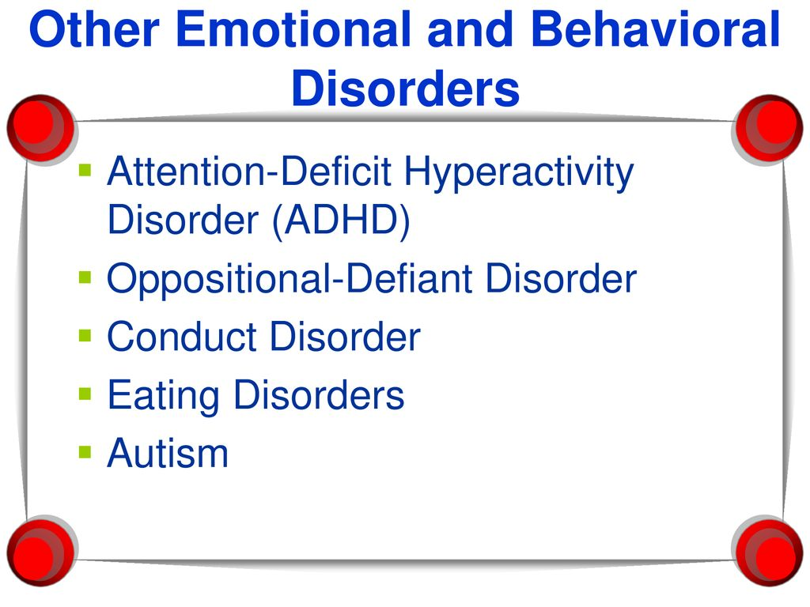
Other Emotional Disorders
Idiosyncrasies - marked hypersensitivity to insurmountable resistance to something or someone (people, perceptions, situations,…).
Anetic psychopathy - sociopathy, imorality, personality disorder characterized by lack of emotion and indifference to social norms, often results in unscrupulous asocial behaviour.

Slide 37
Thank you for your attention

