Slide 1
The Quotidian
From the perspective of Historical Social Sciences

Slide 2
Introductions
Names, pronouns, home country, studies and research interests
Class procedure –lecture, discussions, class presentation
Exam procedure –missed classes, contribution and final exam (in-person)
Assign class topics

Slide 3
Class Topics for questions
2 Tuning terms
3 Preliminary Considerations
4 Practices and Tactics
5 Phenomenology
6 Symbolic interactionism
7 Non verbal communication -
8 Fashion
9 Consumption
10 Things theory
11 Lifestyles of marginal groups
12 Everyday violence

Slide 4
The quotidian
Ethnographic sources, analysis and researchers
Ethnographies from around the world
Core focus of anthropology – in sociology after postmodern turn
Empirical studies extremely varied –descriptions of human behaviour
Participant observation and behaviour analysis

Slide 5
Macrosociology vs Microsociology
Macro: classical sociologists –Marx, Durkheim etc.
Society as a whole greater than the sum of individuals
Micro: individualist methodology –Mead, Blumer, Goffman etc.
Individual as a social being
Sociology of culture

Slide 6
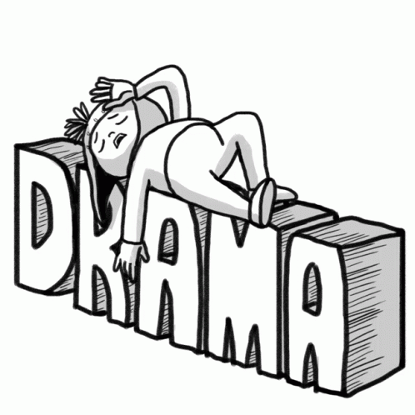
Micro-Macro link
Blumer: individuals create social reality through continuous collective and individual action
Goffman: dramaturgy of social interaction
1966 TLS ‘New Ways in History’
‘new microhistory’ as ‘exceptional typical’

Slide 7
George Herbert Mead
Pragmatist and behaviourist:
To pragmatists, true reality does not exist “out there” in the real world. It “is actively created as we act in and toward the world. “
People remember and base their knowledge of the world on what has been useful to them, and are likely to alter what no longer “works. “
People define the social and physical “objects” they encounter in the world according to their use for them.
If we want to understand actors, we must base that understanding on what people actually do.

Slide 8
German Sociologists
Simmel – rules for people ‘being together’ (sociation)
Groups act as units, individuals establish uniqueness
Walter Benjamin – everyday life understanding of historical events
Everyday is area of human action and thought
Language about history: image of world+body in familiar space
Habermas – ‘lifeworld’ = space in person’s reach
Connection between language and structure = discourse
Lifeworld surrenders to regulation – bureaucracy, capitalism and mass consumption

Slide 9
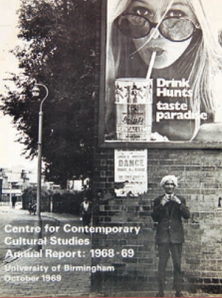
British Sociologists
Norbert Elias – everyday life is civilizing process
Expressing emotional/rational impulses – inderdependent
Unplanned patterened order – self and social regulation
Social historians: E.P. Thomson (workers) and Raymond Williams (culture)
Centre for Contemporary Cultural Studies (CCCS) Uni of Birmingham
Critiques – racism, genderism, classism

Slide 10
French sociologists
Henri Lefebvre and Michel de Certeau – Marxist theory
Lefebvre: EL is urban –site of victimisation and realisation
Language to impose rules. Regulating action = terrorism
Tension between EL structured and how it is creates ‘natural’
De Certeau –EL diverse outcomes. Strategies (capitalists) and tactics (working)
Foucault and Bourdieu = EL on the body
Foucault: Power networks and discipline
Bourdieu: habitus

Slide 11
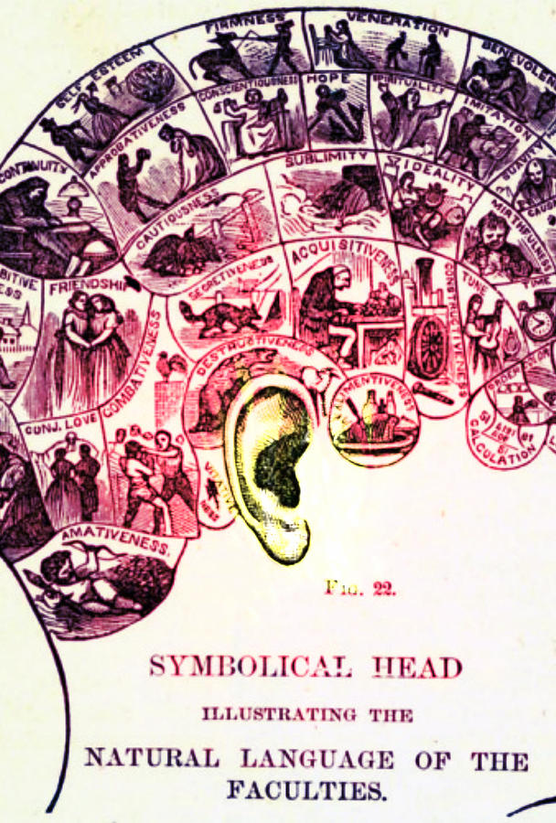
American sociologists
Mead: self formed in interaction
Schutz, Berger and Luckman: symbolic interaction
Goffman – ‘front stage’ ‘back stage’ behaviour
Garfinkel – rules of everyday life
Maffesoli – epistemological elements of EL – focus on banalities

Slide 12
minorities
Work orientated to race and gender
Fanon – language preserves relationships of master and slave
Persistent EL outcomes of colonised in westernised world
Collins: social conditions determine position of black women
Knowledge of everyday vs intellectuals
Social from women’s perspective problematises the world
Cope - EL of different places: women can create spaces for political action

Slide 13
Anthropology of Experience
Victor Turner: 1980’s ‘rebellion against structural functionalism’
Wilhelm Dilthey 19thC ‘Erlebnis’ = ‘lived through’
Individuals’ experience of culture
Differs from behaviour
Experience structures expressions: expressions structure experience
Reality versus expressions –problem of ethnography

