Slide 1
Nationalism and politicization of EU
2nd May 2019

Slide 2
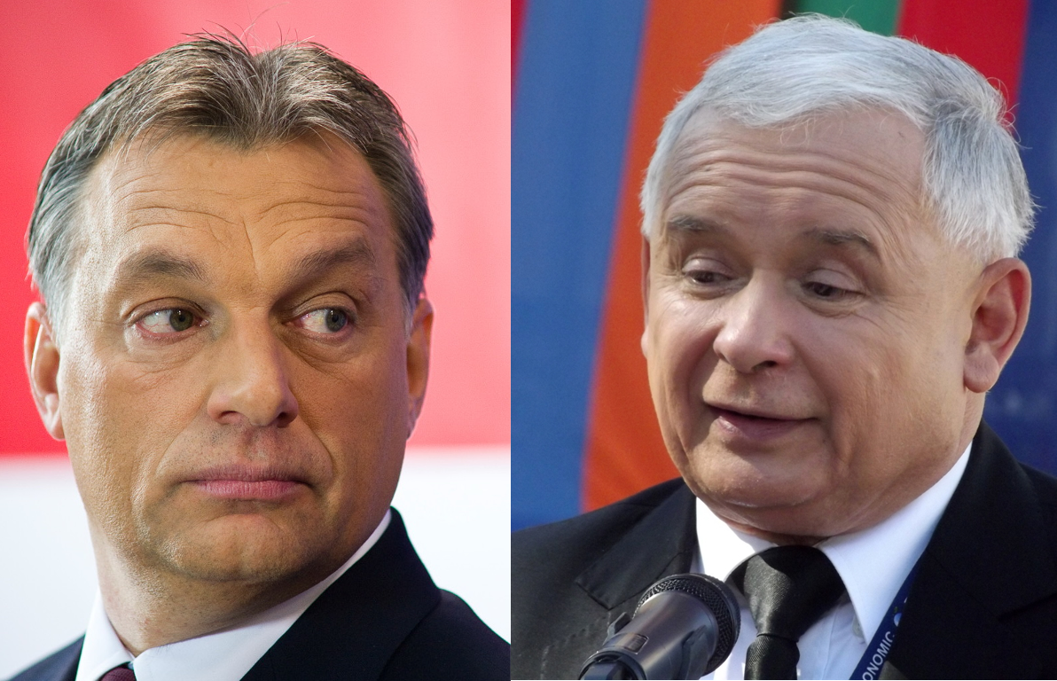
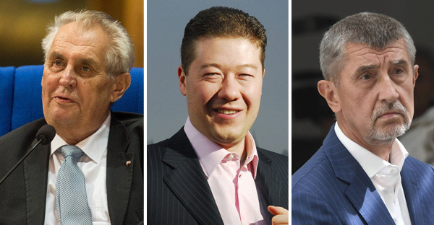
How and why is the Czech republic different?
Topic for today: Nationalism and Euroscepticism in the CEE
Topics for last two lectures: Populism & Gender and Black Protest
Notes:
Why the Czech republic is different?
Watch Andrej Babis, the Czech Republic’s own ‘Donald Trump’:
https://www.youtube.com/watch?v=uU5wsrTspS4 (1:32)

Slide 3
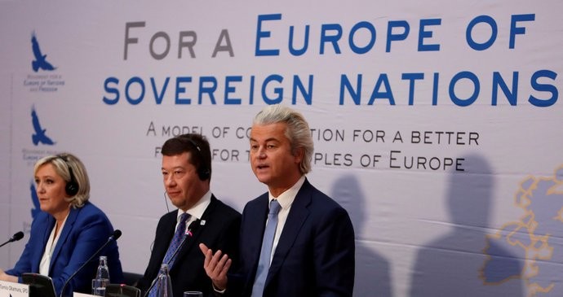
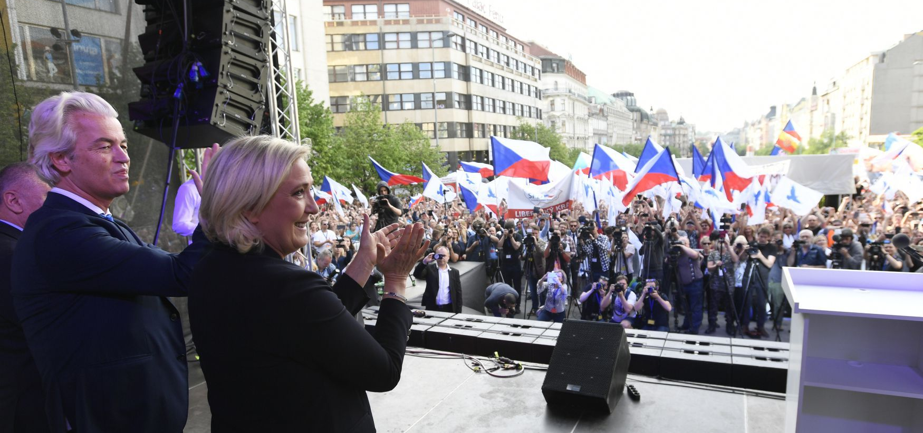
Le Pen and Wilders meet Okamura in Prague
Freedom and Direct Democracy (SPD), a Czech right-wing, nationalist and Eurosceptic party led by Tomio Okamura (10 % in parliament)
meeting and protest in Prague (25th April) with Marine Le Pen (France), Geert Wilders (Netherlands) to support Okamura ahead of EU elections
pro-EU protesters pushed back by riot police
Notes:
https://www.youtube.com/watch?v=Jz6E0h8UB7U (1:00)
https://www.facebook.com/MENLeuropa/videos/240002766865647/?v=240002766865647
https://www.youtube.com/watch?v=X8PuQ5WPnIg https://www.radio.cz/en/section/curraffrs/czexit-cheerleader-tomio-okamura-rallies-help-of-far-right-leaders-le-pen-wilders-ahead-of-eu-elections
https://www.theguardian.com/world/2017/dec/17/geert-wilders-calls-for-trump-style-muslim-travel-ban-in-europe

Slide 4
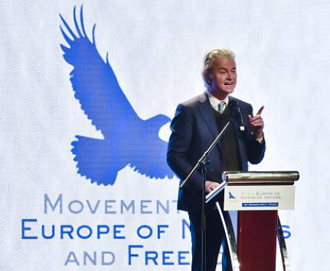
“My friends, you Czechs are an example to all of us. Because you are opposing the asylum policy that is a disaster of the European Union. You are opposing the Islamisation of Europe. You say: Ne, Nikdy. (No, never) And your resistance inspires us!”
Geert Wilders

Slide 5
The paradox of transnational nationalism
Nationalist anti-immigration parties plan to join forces looking to create a new bloc to shake up the EU: the European Alliance for People and Nations
composed of German AfD, the Finns Party, rightist Danish People’s Party, Marine Le Pen’s National Rally in France, Salvini's right-wing League etc.
it was not clear if two of Europe’s biggest national conservative forces — Poland’s governing Law and Justice party (PiS, currently European Conservatives and Reformists) and Hungarian Prime Minister Viktor Orban’s Fidesz party (currently European People's Party) — would join the group

Slide 6
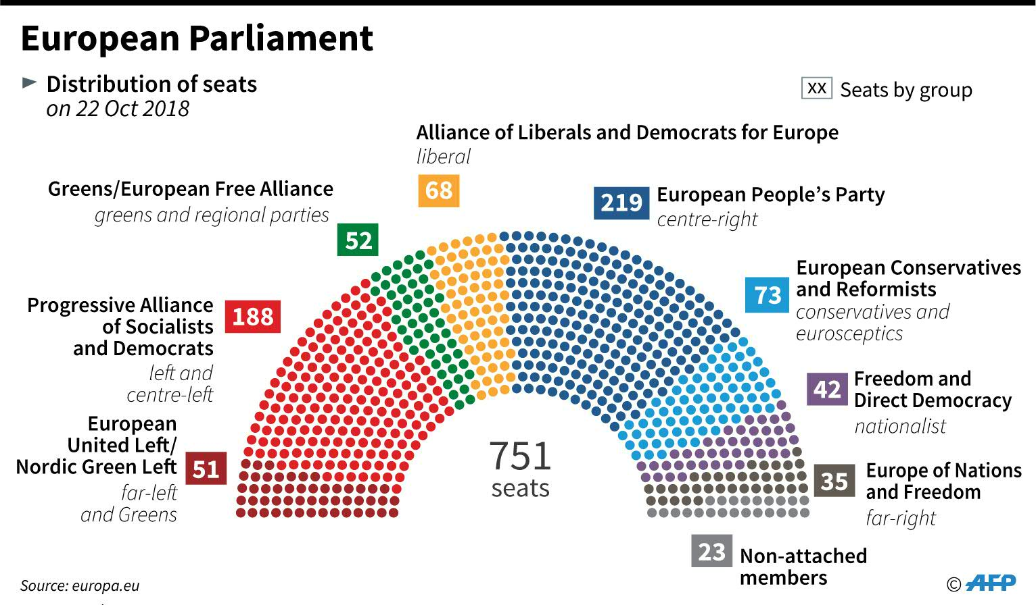

Slide 7
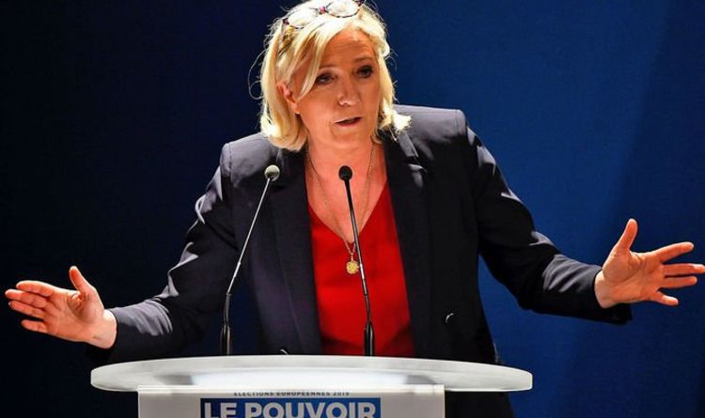
“We can legitimately envision today to change Europe from inside, to modify the very nature of the European Union, because we consider ourselves powerful enough. We look to change the EU from within.”
Marine Le Pen

Slide 8
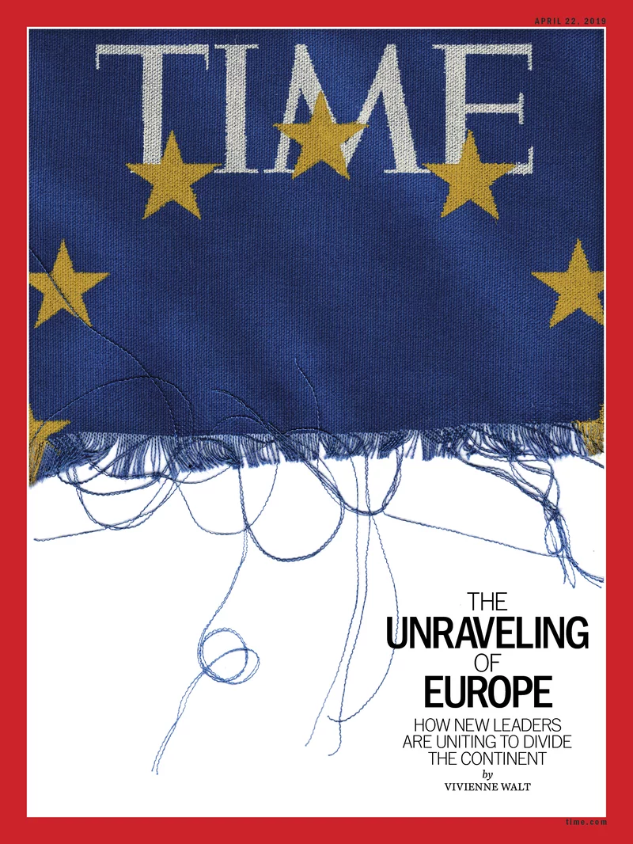
Notes:
http://time.com/5568322/nationalism-in-europe/

Slide 10
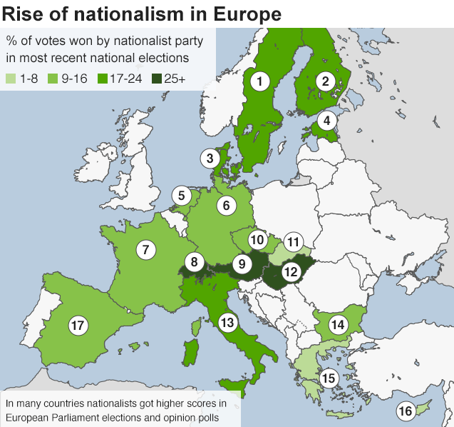
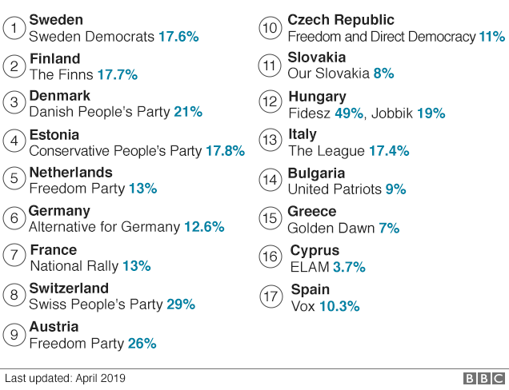
Poland is missing!
Law and Justice (PiS) 37.6%

Slide 11
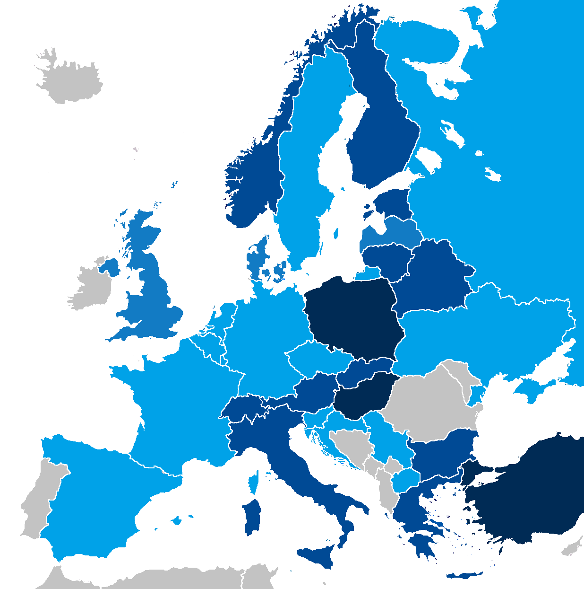
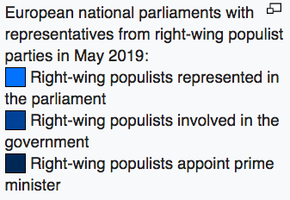

Slide 12
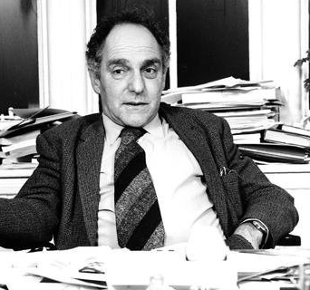
What is nationalism?
“Nationalism is primarily a political principle which holds that the political and the national unit should be congruent.”
Ernest Gellner

Slide 13
What is a nation?
nation as a socially constructed, “imagined community” (Anderson 1983)
often constructed from “invented traditions” (Hobsbawm, Ranger 1983)
result of modernisation, the transition from agrarian to industrial society
“It is an imagined political community
- and imagined as both inherently limited and sovereign.“
It is imagined because the members of even the smallest nation will never know most of their fellow-members, meet them, or even hear of them.
It is limited because even the largest nation has finite, if elastic, boundaries, beyond which lie other nations

Slide 14
Who belongs to a nation?
Civic (state-nation) | Ethnic (cultural-nation)
Western | Eastern
inclusive | exclusive
voluntary | ascriptive
ius soli (territory) | ius sanguinis (ancestry)
will and consent | culture (religion)
political institutions | language

Slide 15
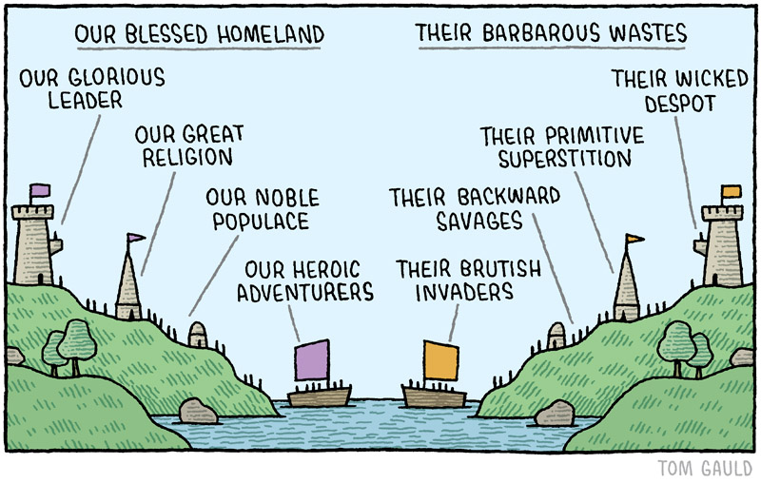
Relational nationalism
State-building (majority) | Peripheral (minority)
Nationalisms differ not only in their response to the question, “Who are we?” but also in their understanding of the threat posed by “them.”
a wide range of nationalisms may emerge within a single country

Slide 16
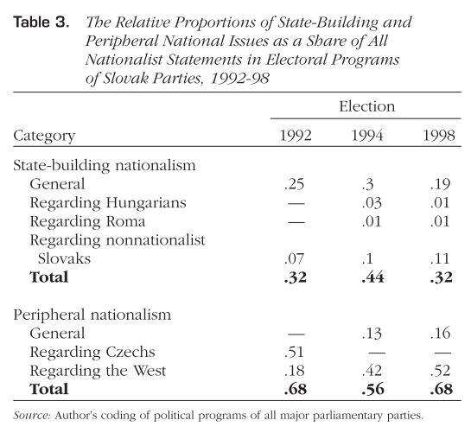
Deegan-Krause (2004)
Notes:
Peripheral nationalism against a domestic majority: Czechs. Some Slovaks viewed the position of Slovaks within the common Czechoslovak state as peripheral and subordinate to the position of Czechs. Some of these Slovaks sought a formal renegotiation of the relationship between the two republics or even the dissolution of the common Czechoslovak state.22
• Peripheral nationalism against regional or global institutions: The West. Some Slovaks believed that Slovakia’s territorial and cultural integrity stood at risk in the face of closely interrelated threats from the European Union, NATO, and their member states as well as by their foreign economic actors.
• Peripheral nationalism against a foreign state: Hungary. Some Slovaks sought to combat what they perceived to be a threat of Hungarianization faced by Slovaks in the Hungarian-majority areas near the country’s southern border and by Slovaks still living in Hungary.
• State-building nationalism against a homeland minority: Hun- garians. Some Slovaks supported state-building efforts to expand the use of Slovak as an official language in the realms of adminis- tration, education, and culture primarily at the expense of offer- ings in the Hungarian language.25
• State-building nationalism against a nonhomeland minority: Roma. Some Slovaks saw the country’s large Roma population as a barrier to an integrated Slovak state. Proposed solutions ranged from the assimilation of Roma into Slovak society through lan- guage and cultural instruction to the formal dissimilation of Roma and their isolation away from Slovaks and other groups.26
• State-building nationalism against conationals: Nonnationalist Slovaks. Some Slovaks argued that the process of building of a truly Slovak state faced its greatest danger from those members of the Slovak group who were insufficiently conscious of or loyal to the Slovak nation. These suspicions of disloyalty led to calls for a variety of measures that ranged from the increase of national con- sciousness to withdrawal of “anti-Slovak Slovaks” from public life.

Slide 17
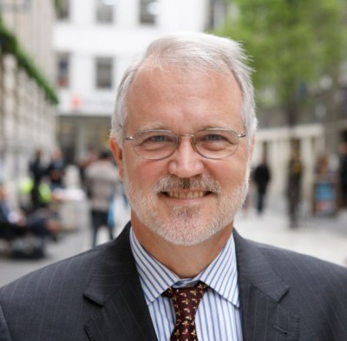
“If nationalism is over,
we shall miss it.”
„We are poorly prepared to theorize democracy if we cannot theorize the social solidarity of democratic peoples.“
Craig Calhoun

Slide 18
Nationalism and democracy (Craig Calhoun 2007)
Nations were the primary political structures in which liberal individuals would be equals
Liberal cosmopolitanism dismissed nationalism from their theories of democracy, pushed equality among individuals at the scale of humanity
But! Imagining democracy requires thinking of „the people“. Nationalism is a reminder that democracy depends on solidarity. And solidarity is never achieved outside of history and culture.
Nations bridge a variety of differences among people (economic, religious, ethnic, generational, urban vs. rural etc)

Slide 19
Nationalism - liberalism divorce (Krastev 2018)
appealing to national sentiment was critically important as a way of mobilising society against the communist regimes
The Yugoslav wars made it impossible for liberals to define liberalism as anything but anti-nationalism
fear that strong ethnically-exclusive nationalism in the region might lead to Yugoslavia-style violence
moderate, centralist political powers disqualified nationalist discourses and swore allegiance to liberalism
Notes:
Jacques RUpnik: Rupnik, Jacques. "Explaining Eastern Europe: The Crisis of Liberalism." Journal of Democracy, no. 3 (2018): 24-38.
If the European liberal project cannot avoid becoming confounded with open borders and multiculturalism, there is a real risk that Central Europe will opt for the “closed society.
The post-1989 liberal cycle is exhausted. In Central Europe, it represented a triple transition: democracy, the market economy, and Europe. These three objectives were successfully attained, but all three are now in crisis. Democracy faces the populist wave; the market economy has been confronted since 2008 with a global crisis; and Europe is divided within while being challenged in its own neighborhood.
do have such a project—a return to the nation and the values of the Church
Krastev:
https://www.theguardian.com/commentisfree/2018/jul/11/central-europe-lesson-liberals-anti-nationalist-yugoslavia-poland-hungary
Critique: https://visegradinsight.eu/just-another-sin-of-liberalism/
the divorce between liberalism and nationalism
Remember how nationalists and liberals were allies in the overthrow of communism in 1989
Appealing to national sentiment was critically important as a way of mobilising society against the communist regimes. Poland’s Solidarity movement was not liberal, but a mixed – social and nationalist – coalition that endorsed the values of liberal democracy.
This alliance between nationalists and liberals came to an end during the Yugoslav wars. The violent breakup of the country persuaded liberals that nationalism was the very heart of darkness, and that flirting with it could only be sinful
The Yugoslav wars made it impossible for liberals to define liberalism as anything but anti-nationalism
It eroded electoral support for liberal parties, making them totally dependent on the success of economic reforms and depriving them of powerful nationalist symbols
Postwar German democracy was built on the assumption that nationalism leads ineluctably to nazism. But the attempt to transfer this to central Europe was bound to backfire.
most Poles felt it absurd to stop honouring nationalist-minded leaders who had risked their lives to defend Poland against Hitler or Stalin
The EU’s fear that strong ethnically-exclusive nationalism in the region might lead to Yugoslavia-style violence is clear from the document that first laid out the conditions under which the countries of post-Communist Europe would be allowed to join the EU, the Copenhagen Criteria of 1993.
https://www.theguardian.com/commentisfree/2018/may/08/nationalism-positive-case-immigration-counter-narrative-nhs

Slide 20
What is Euroscepticism?
Euroscepticism as element of party politics (party-based)
Euroscepticism in public opinion (Eurobarometer)
Euroscepticism as a discursive practice of political opposition to the EU (de Wilde, Trenz 2012)
These aspects are interlinked in the public sphere.

Slide 21
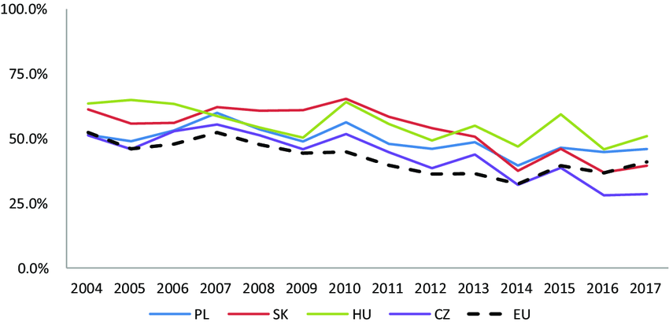
Eurobarometer: Emotions and Political Engagement Towards the EU

Slide 22
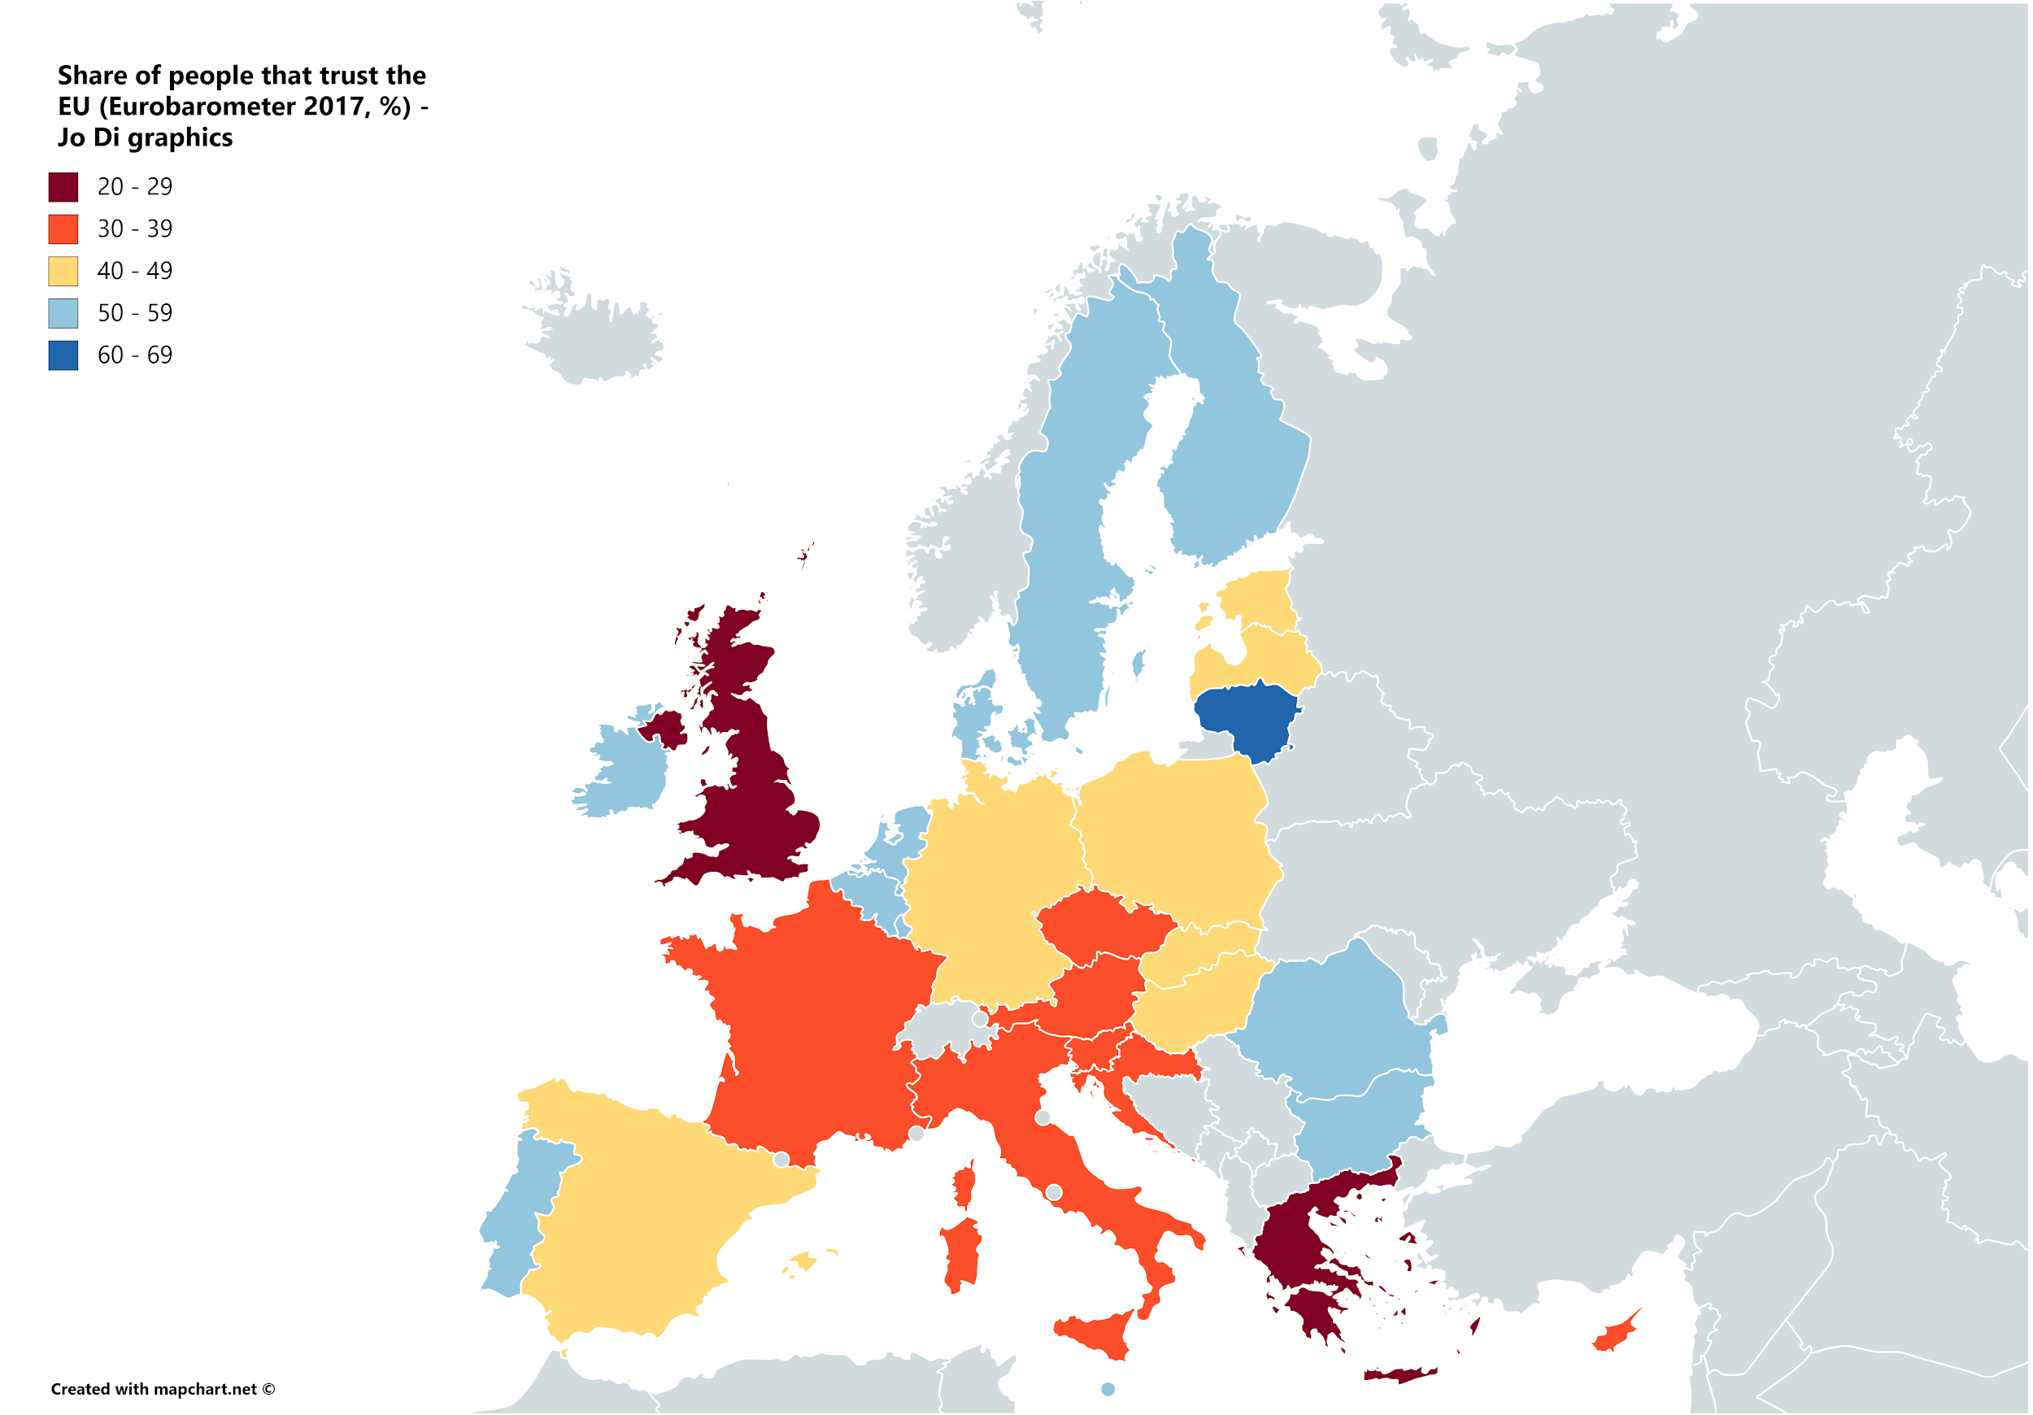

Slide 23
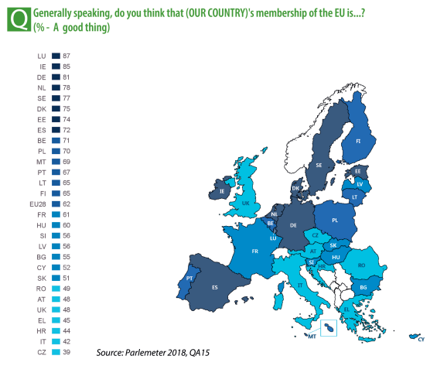
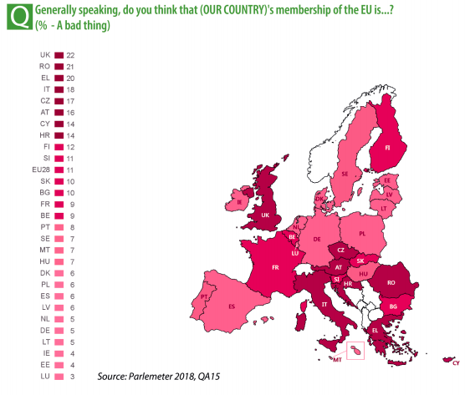

Slide 24
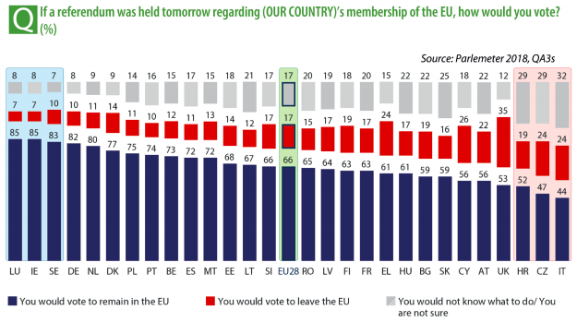

Slide 25
Euroscepticism: polity contestation (de Wilde, Trenz)
Euroscepticism does not oppose particular policies, i.e. the contents of actions taken by the EU, but the polity, i.e. the competencies and constitutional settlement of the EU
The unfinished nature of the EU makes Euroscepticism possible, and likely.
Euroscepticism is unfolding as the counterpart of EU legitimation discourse and its attempts to lay down the basic purpose and rationale for the Union. (responsive Eurosceptiscism)
Euroscepticism is, in this sense, part of the democratisation of the EU

Slide 26
Making of Euroscepticism in the public sphere
the narrative elements;
the performance;
the competitive field: relate the ‘players’ of Euroscepticism (the challengers of EU legitimacy) to the pro-European ‘players’ (the defenders of EU legitimacy)
the public resonance of Eurosceptic discourse
the mediating effects through which actors’ performances are interlinked and meaning is transmitted to the potential audiences (how established media reflect values and views on European integration)
Notes:
an analytical framework of the ‘making’ of Euroscepticism in terms of contents, performance and resonance of public debates.
the narrative elements;
the performance;
the public resonance of Eurosceptic discourse.
firstly, recall that Euroscepticism should be understood foremost as an element of public discourse. We speak of discourse in the sense of ideas, inter- pretations and narrative contents that are arranged around a common target—in our case around the the legitimacy of the EU
Secondly, we propose to shed light on the competitive field, in which Euroscepticism is ‘performed’. This implies the need to relate the ‘players’ of Euroscepticism (the challengers of EU legitimacy) to the pro-European ‘players’ (the defenders of EU legitimacy).
Thirdly, we assume that Euroscepticism is performed in public. It is expressed for others in a public forum and often with the explicit intention to draw media attention. We therefore sustain that these performances aimed at establishing the legitimacy of European integration can only be understood by taking into account the mediating effects through which actors’ performances are interlinked and meaning is transmitted to the potential audiences that pay attention and that applaud or jeer such performances.
How Eurosceptic elements of discourse unfold in the public sphere?
we do not intend to provide a single definition of Euroscepticism but a comprehensive understanding of the particular constellation of Euroscepticisms (in the plural) as the variety of narratives that become salient and that are variably linked to the performances of collective actors within a particular context
deviates from the common approaches, which treat Euroscepticism as a personal attitude or as strategic behaviour, in significant ways. The analytical task is to treat single expressions of Euroscepticism (for instance, as elements of an ongoing debate) as a performance, which is part of a more encompassing narrative that denies the legitimacy of the EU-polity. As such, it is intrinsically linked to the presence of other performances and can, in fact, only be made in direct linkage to the arguments and narratives mobilised to defend the legitimacy of the polity
By providing public jus- tification, the legitimation discourse is not limited to the dispute of competing actors. It is not primarily aimed at convincing alter in a debate, but always includes an unknown audience. This anonymous public is included in the critical test of the legitimacy of the polity.
The contestation of EU legitimacy is therefore inherently linked to the media logics of representing European integration to a wider audience. Instead of analysing communica- tion strategies of particular actors (e.g. how Eurosceptic parties address their voters), we propose to investigate how established media reflect values and views on European inte- gration, how particular performances and narratives unfold and resonate with the wider public.

Slide 27
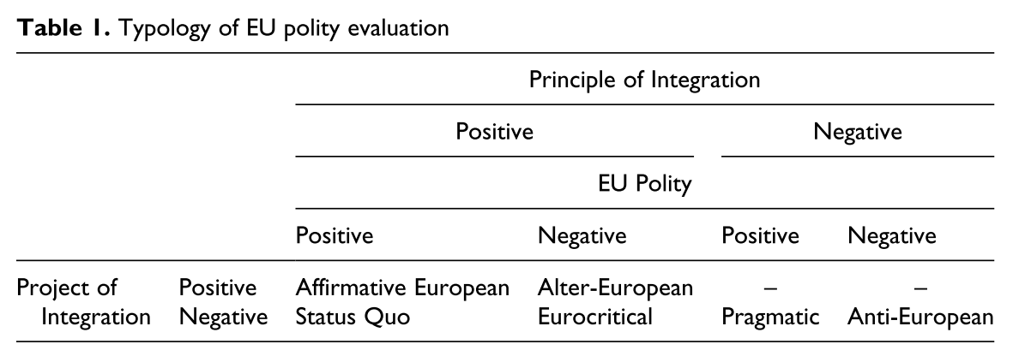
Notes:
We find affirmative European contributions that defend the principle of integration, the current EU polity, and further plans for integration on the one side of polity evaluation.
On the other side, we find anti- European performances that denounce the principle, the polity, and the project of integration.
In between these two poles, we find status quo performances in which the principle of integration and the current polity is defended, but further integration denounced on the more pro-European side,
and Eurocritical performances supporting the principle of integration but denouncing both the current polity and further plans on the Eurosceptic side. These four categories of performances can thus be understood as scaled from complete legitimation of integration to complete de-legitimation. Two other categories of performances do not fit this linear scale.
Pragmatic performances indicate the seemingly paradoxical position of supporting the current EU institutional set-up, while at the same time denouncing integration in principle. In practice, these performances often understand the EU as a fait accompli, which might be undesirable in principle, but deserves support nevertheless, as other alternatives are either unrealistic or too costly.
Alter-Europeanism is characterised by a denunciation of the current polity combined with a favourable stance towards further integration. These performances often criticise certain characteristics of the polity, while at the same time offering a pro-European ‘solution’ to perceived problems. Statements criticising the EU as neoliberal combined with an argument in favour of a European-wide welfare state would fit this category. Another example would be criticism of the EU as undemocratic, combined with an argument supporting the extension of European Parliament powers or a direct election of the President of the European Commission. Their criticism is often founded in ideologies well known from politics as usual, targeting ‘neoliberal Europe’, ‘secular Europe’, ‘elitist Europe’, ‘socialist Europe’, etc.

Slide 28
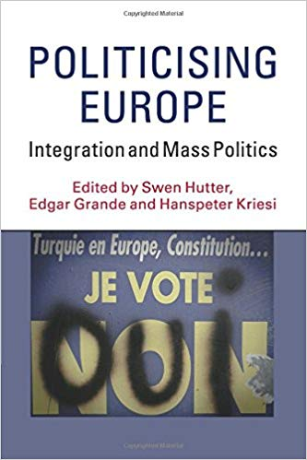

Slide 29
Conflicts over European integration
conflicts over national sovereignty.
identity conflicts resulting from membership of the EU: the conflict about whether a country fits into the EU is no longer fought within an accession state only, it has moved to the centre of the Community (Turkey).
problems of solidarity - resulting from decisions on the distribution and redistribution of financial resources between member states.
“Integration steps” and the European crises (Euro-crisis, Refugee crisis) constitute the perfect occasions for the politicization of the European integration process.
(Grande, Hutter 2016)

Slide 30
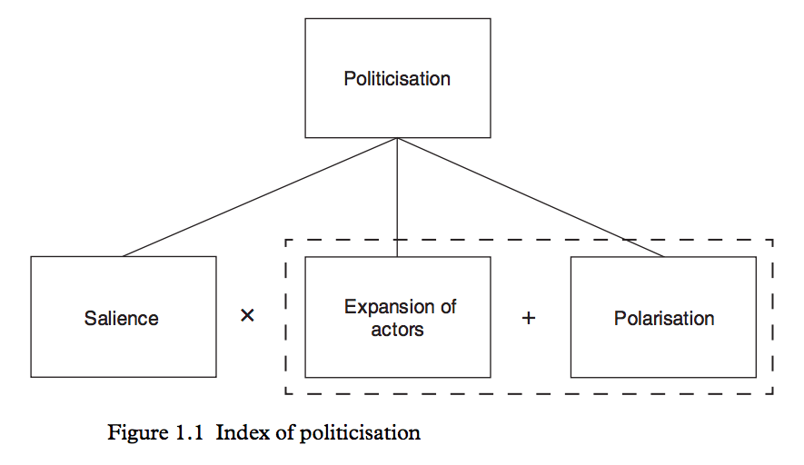

Slide 31
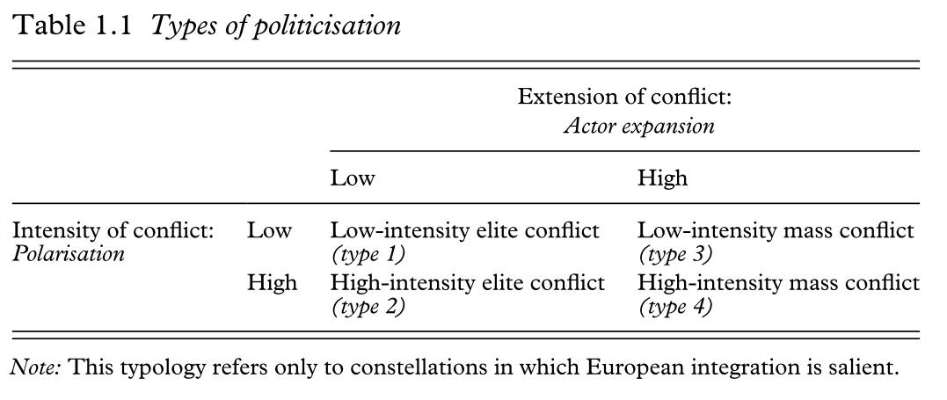

Slide 32
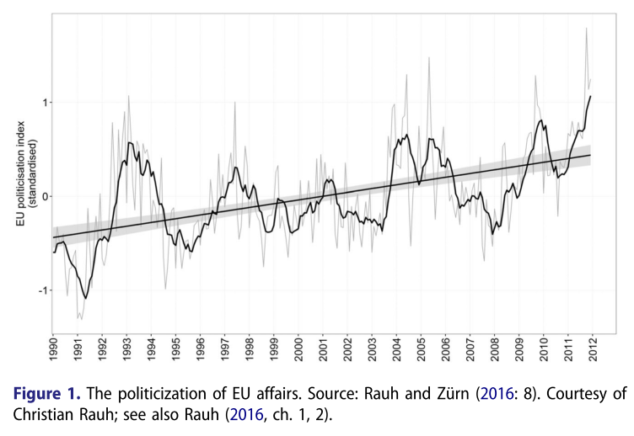

Slide 33
Three integration theories and politicization
Intergovernmentalism | Neofunctionalism | Postfunctionalism
European integration enables effective governance by insulating policy-making from politicization at the domestic level (circumventing domestic resistance against the loss of national sovereignty)
 | Politicization - feedback, a shift from élite-driven interest politics to mass politics, political mobilization of collective identities
 | positive | negative
 | collective identities are Europeanized | “Constraining dissensus” (paralyzing)

Slide 34
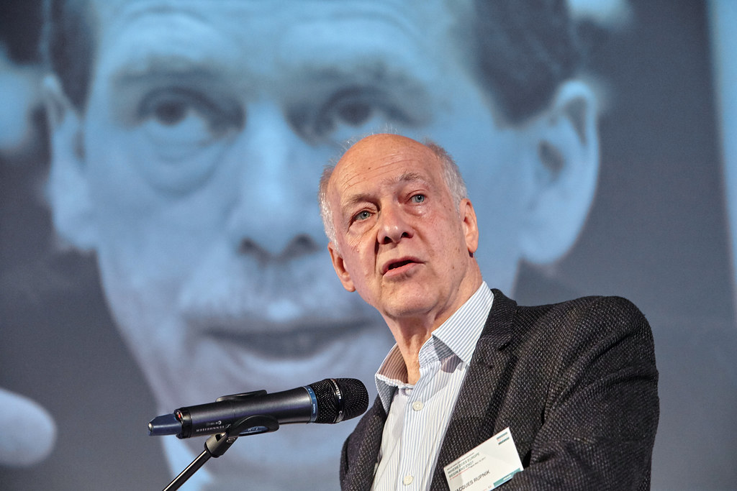
“Market globalization and unchecked migration, both associated with the EU, have been the two main sources of the politics of fear and resentment that is undermining the liberal consensus associated with European integration. Neither of those sources, of course, is affecting the CEE region alone. This is a pan-European crisis.“
Jacques Rupnik

Slide 35
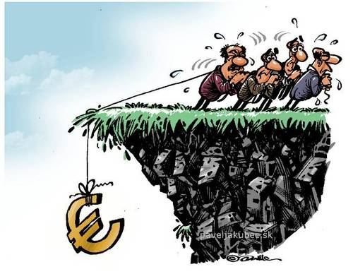
Euro crisis (Borzel, Risse 2018)
member states transferred competencies to the EU (supranational delegation)
attempt to minimize conflict and domestic opposition (the Commission was tasked to transform decisions into technical proposals)
strategy of depoliticization of controversial issues drove integration forward
questions of order, i.e., what constitutes Europe as a community and how much solidarity members owe to each other

Slide 36
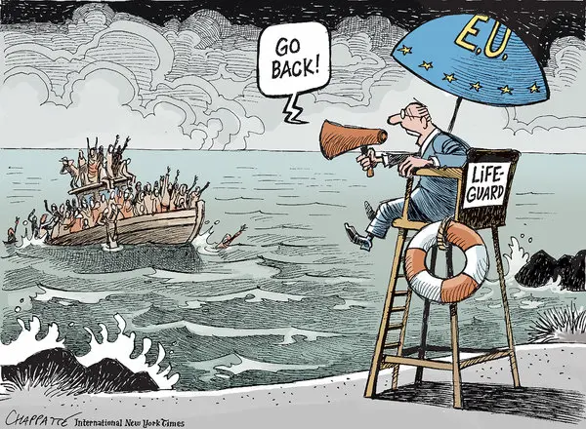
Refugee crisis (Borzel, Risse 2018)
the Commission – once again – pushed for supranational centralization (relocation scheme), but was not successful (constraining dissensus)
Why?
Eurosceptic parties have succeeded in mobilizing exclusive national identities
politicization shifted towards identity issues of borders rather than order
cultural frames focusing on the ‘self/other’ or ‘ingroup/outgroup’ distinction

Slide 37
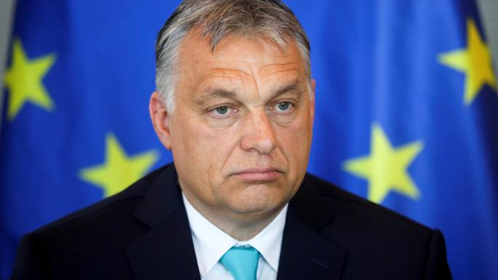
Competing visions of Europe
a multicultural, open and cosmopolitan Europe
‘nationalist Europe’ or ‘Fortress Europe’ is exclusionary, anti-migrants and contains religious undertones (e.g., anti-Islam)
the V4 countries appear to have succeeded in pulling the EU towards their “flexible” version of solidarity (relocation scheme dismissed)
“Twenty-seven years ago here in Central Europe we believed that Europe was our future; today we feel that we are the future of Europe."
Victor Orbán

Slide 38
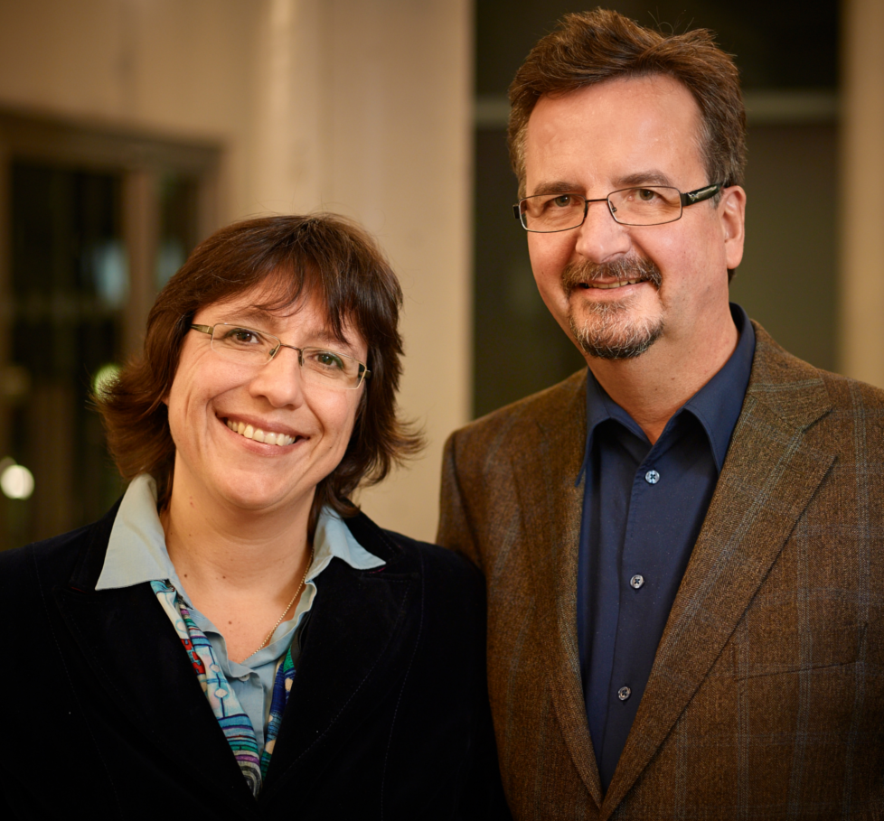
“The liberal élites did little to start a counter-discourse to the right-wing populist framing. They have largely abstained from engaging in a ‘communicative discourse’ with a counter-vision of a pluri-cultural Europe. Take Angela Merkel, for example. The all-powerful German chancellor largely remained silent.”
Tanja Borzel, Thomas Risse

Slide 39
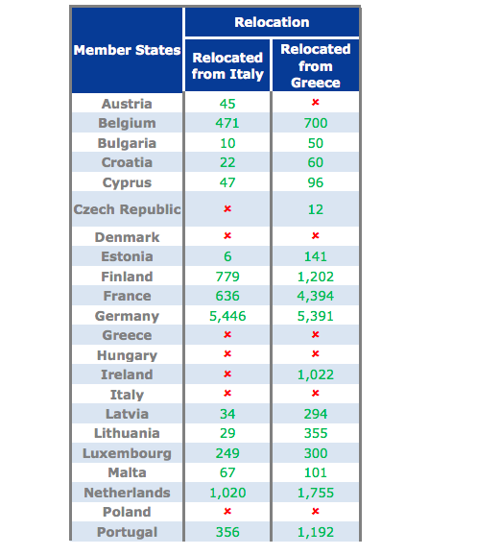
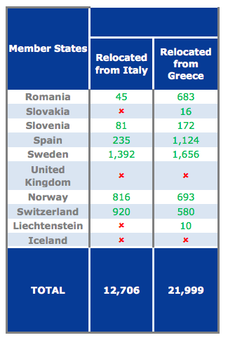
Relocation quota
Member States' Support to Emergency Relocation Mechanism (As of 30 October 2018)
160 000 promisedpromised 160,000

Slide 40
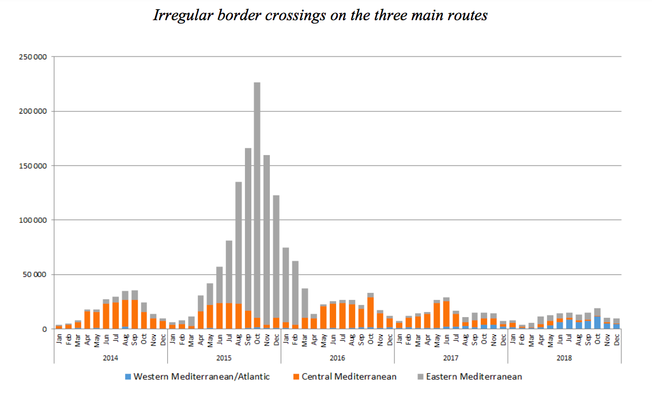

Slide 41
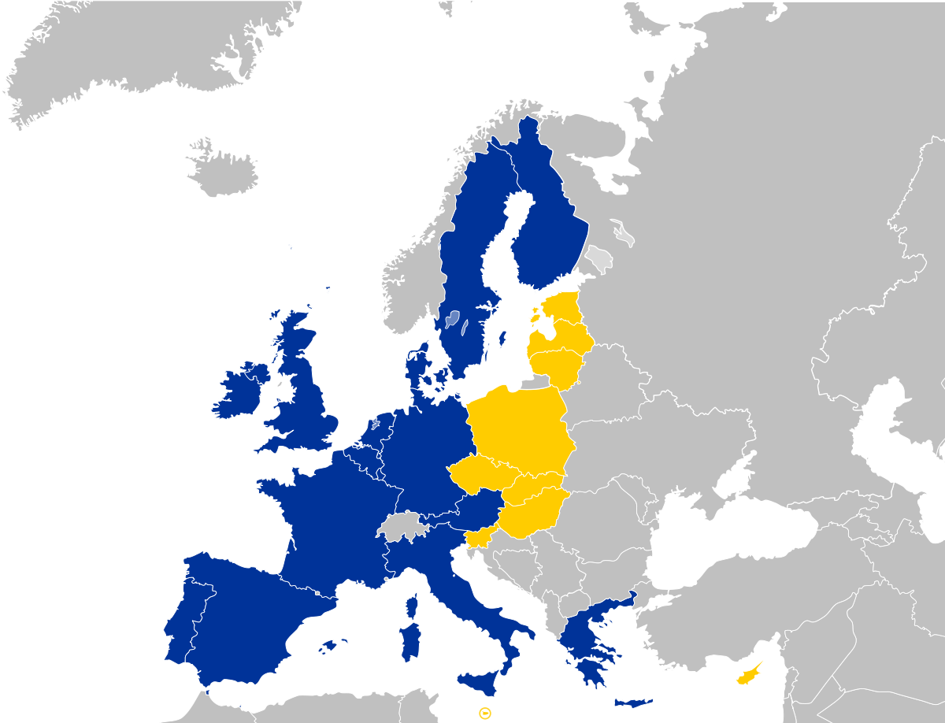
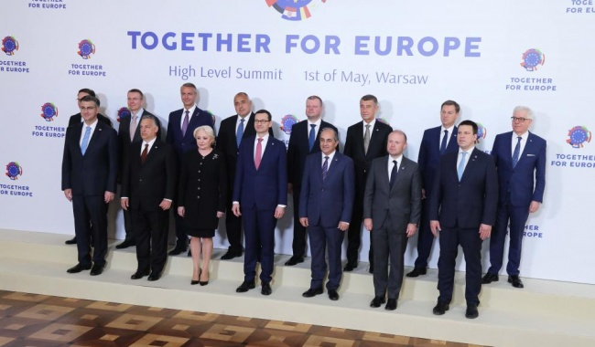
15 years in the European Union
“Together for Europe. High Level Summit” in Warsaw on the 1st May
Notes:
https://www.euractiv.com/section/enlargement/news/juncker-looks-back-on-15-years-of-big-bang-eu-enlargement/1336123/

