Slide 1
Náboženství

Slide 2
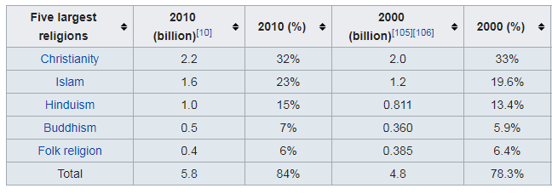

Slide 3
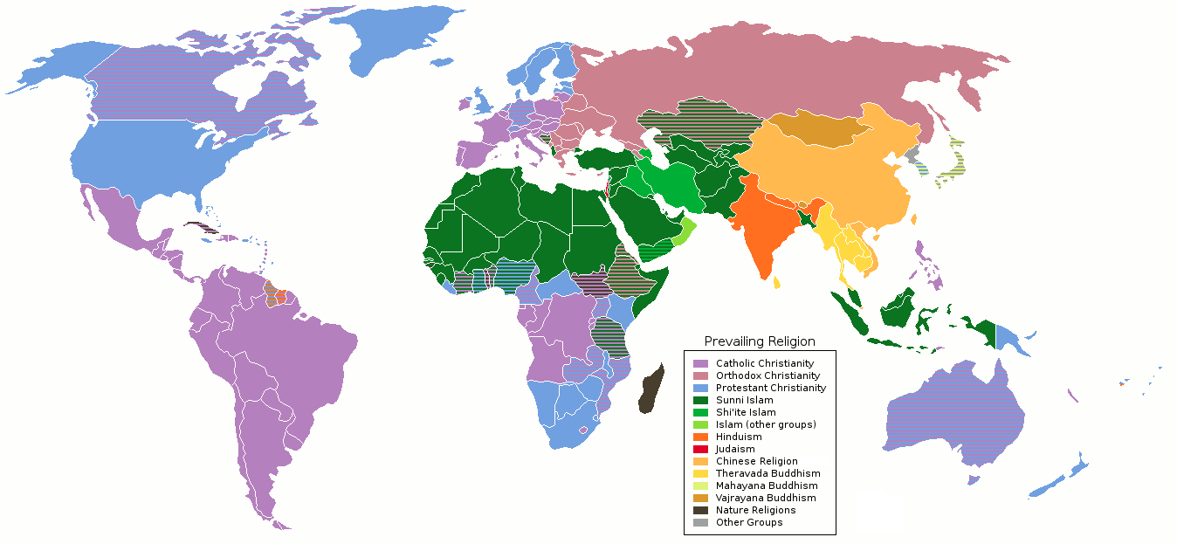

Slide 5
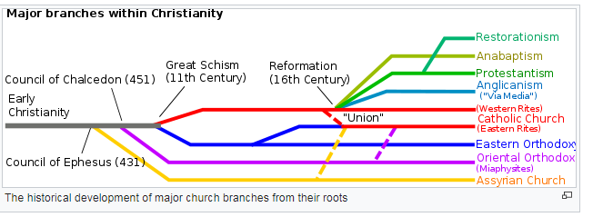

Slide 6
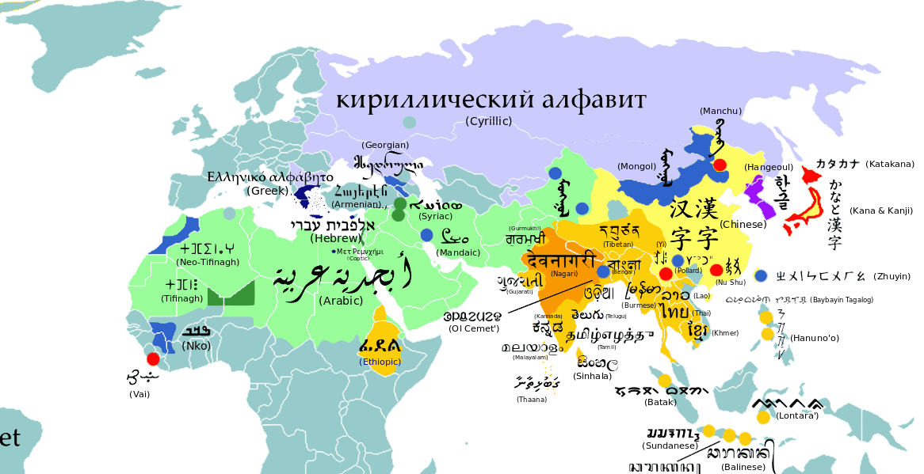

Slide 7
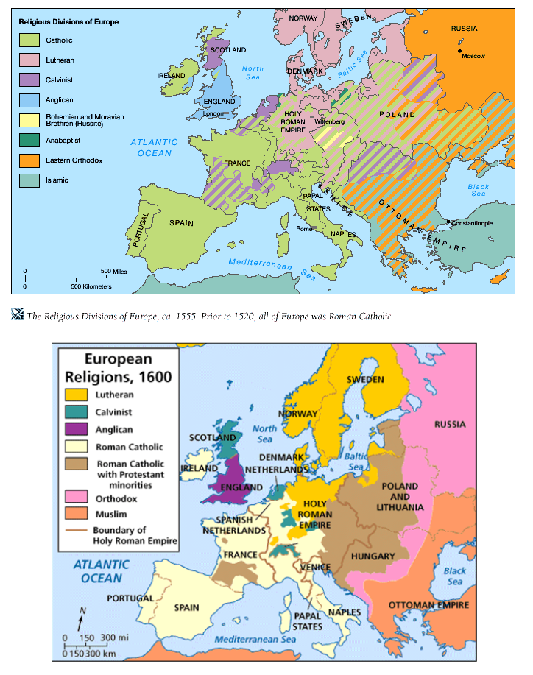

Slide 8
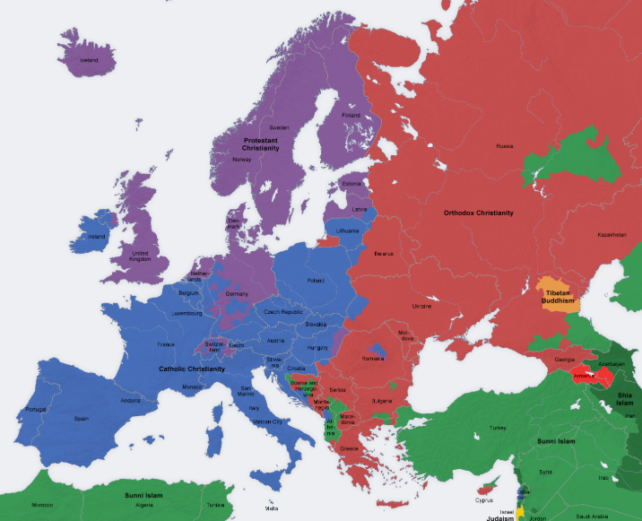

Slide 9
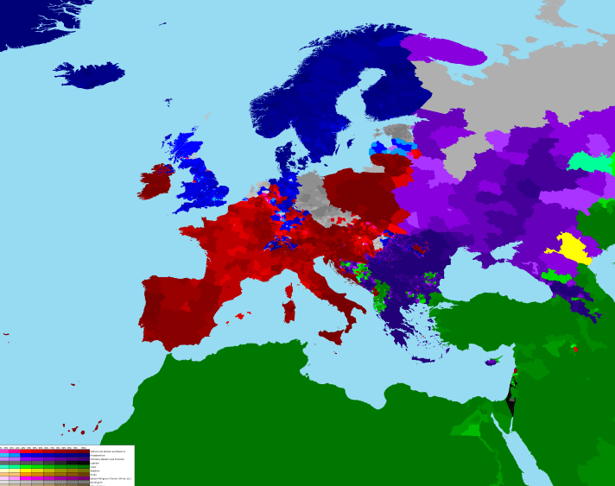

Slide 10
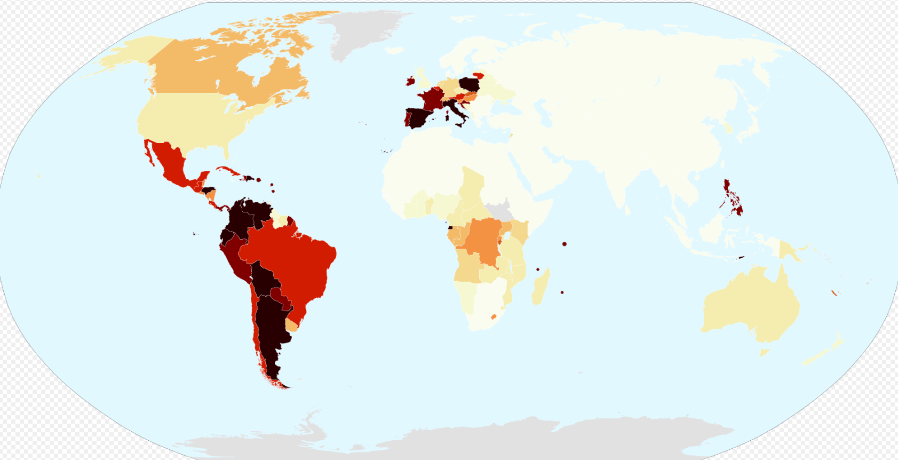

Slide 11
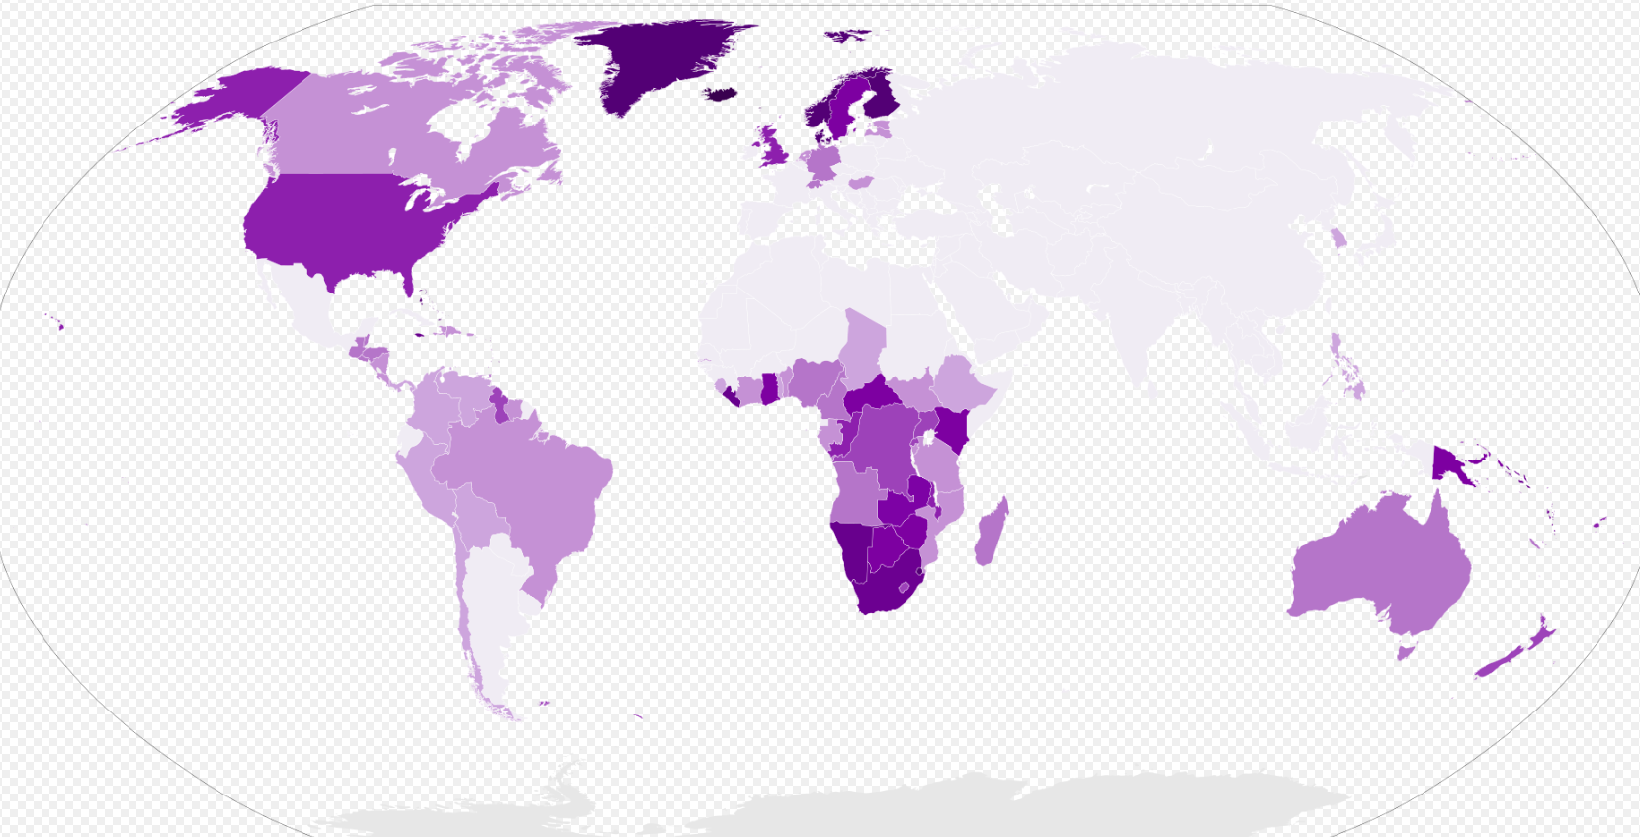

Slide 12
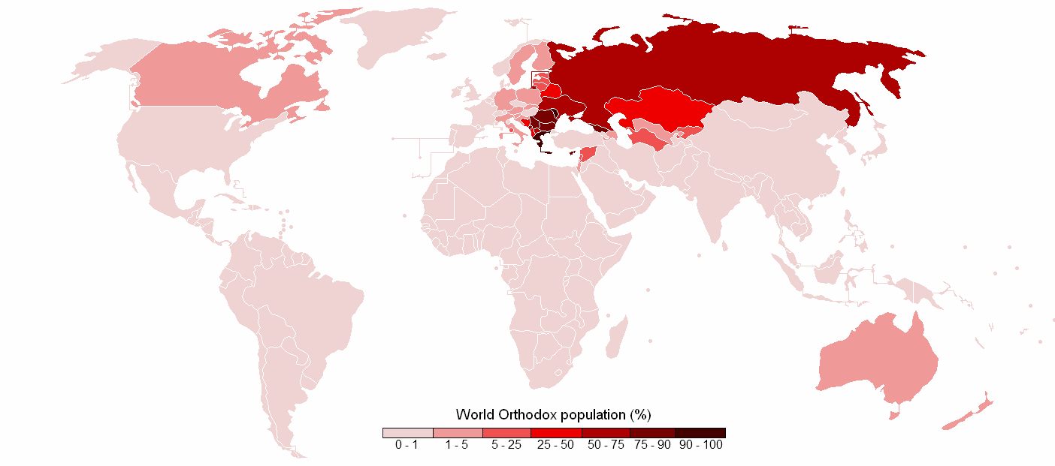

Slide 13
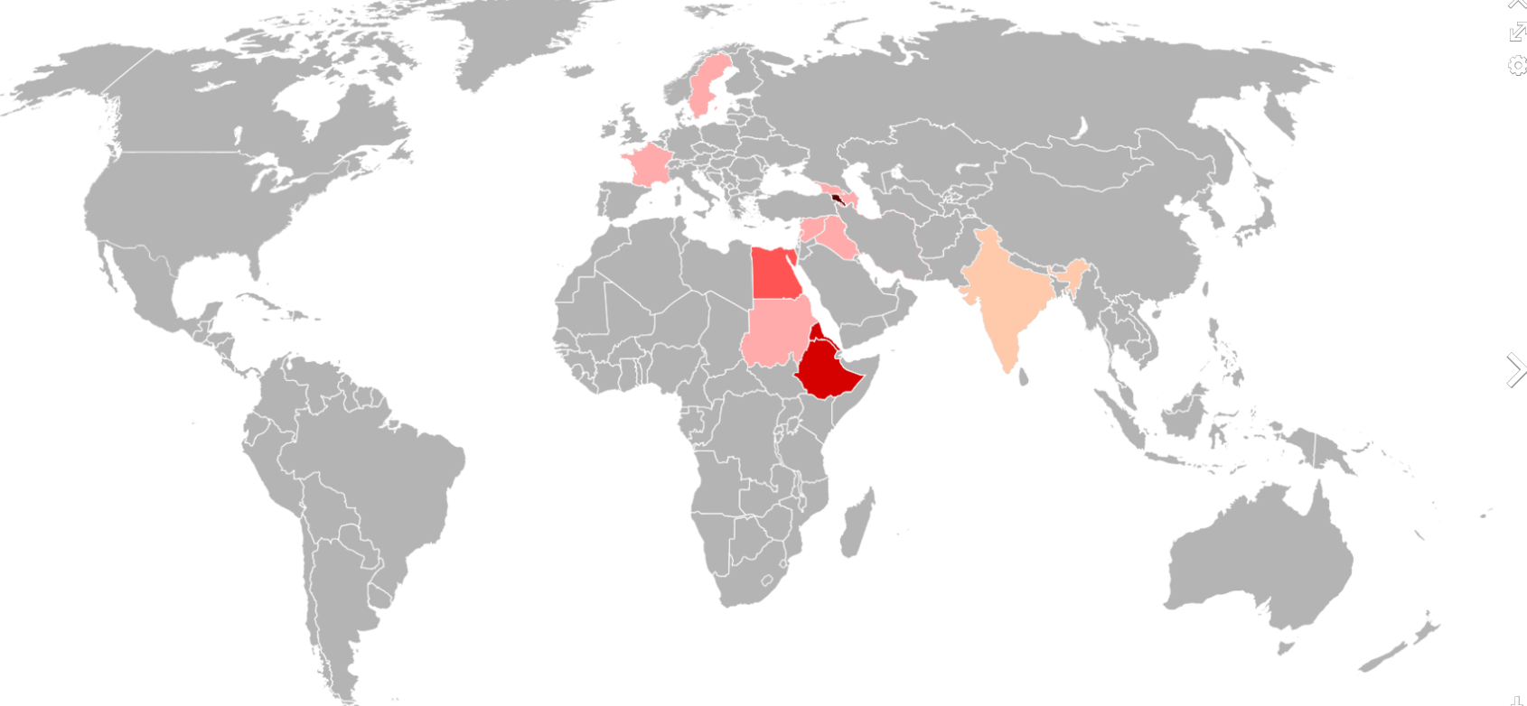

Slide 14
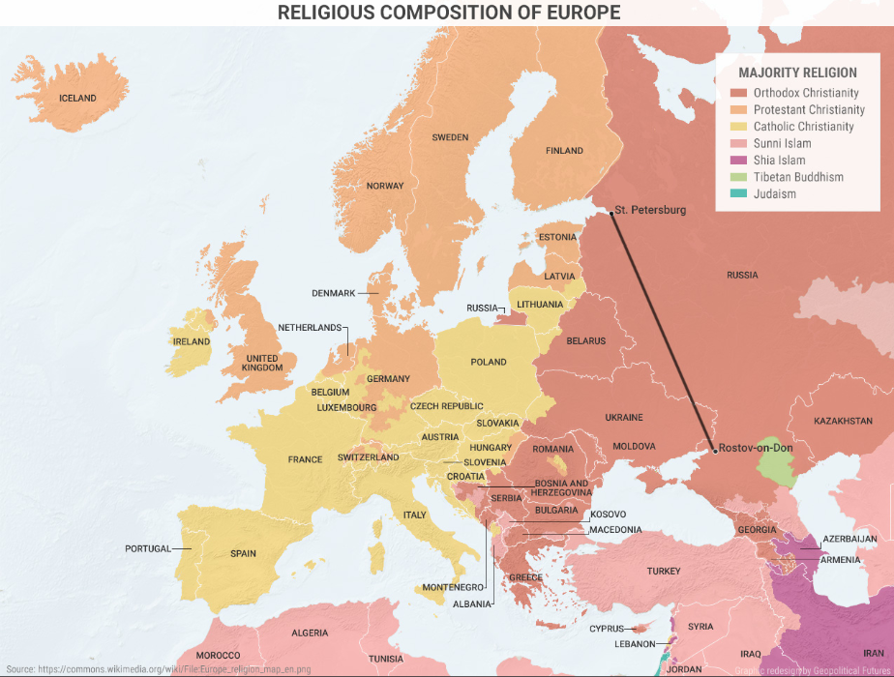

Slide 15
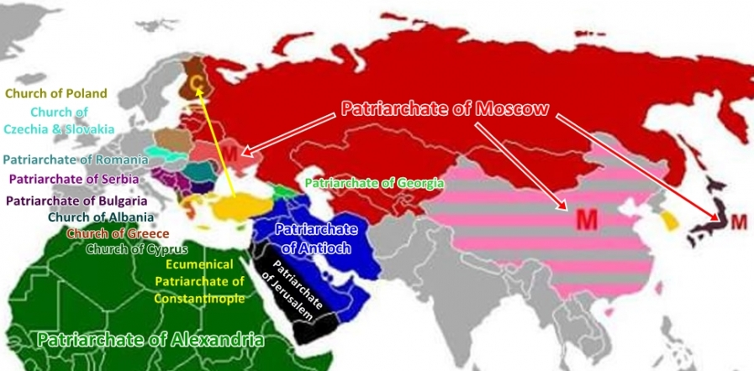

Slide 16
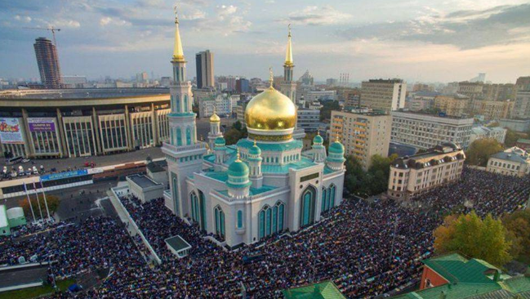

Slide 17
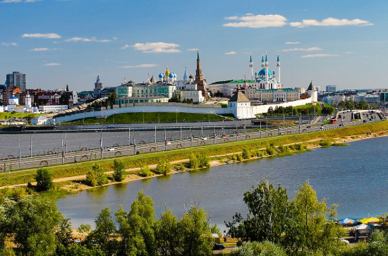

Slide 18
Státní náboženství
A state religion (also called an established religion or official religion) is a religious body or creed officially endorsed by the state. A state with an official religion, while not secular, is not necessarily a theocracy, a country whose rulers have both secular and spiritual authority. State religions are official or government-sanctioned establishments of a religion, but the state does not need be under the control of the religion (as in a theocracy) nor is the state-sanctioned religion necessarily under the control of the state.
Many Christians not only live under, but also have an official status in, a state religion of the following nations: Armenia(Armenian Apostolic Church),^{[77]} Costa Rica (Roman Catholic Church),^{[78]} Denmark (Church of Denmark),^{[79]} El Salvador(Roman Catholic Church),^{[80]} England (Church of England),^{[81]} Georgia (Georgian Orthodox church), Greece (Church of Greece), Iceland (Church of Iceland),^{[82]} Liechtenstein (Roman Catholic Church),^{[83]} Malta (Roman Catholic Church),^{[84]}Monaco (Roman Catholic Church),^{[85]} Romania (Romanian Orthodox Church), Norway (Church of Norway),^{[86]} Vatican City(Roman Catholic Church),^{[87]} Switzerland (Roman Catholic Church, Swiss Reformed Church and Christian Catholic Church of Switzerland).

Slide 19
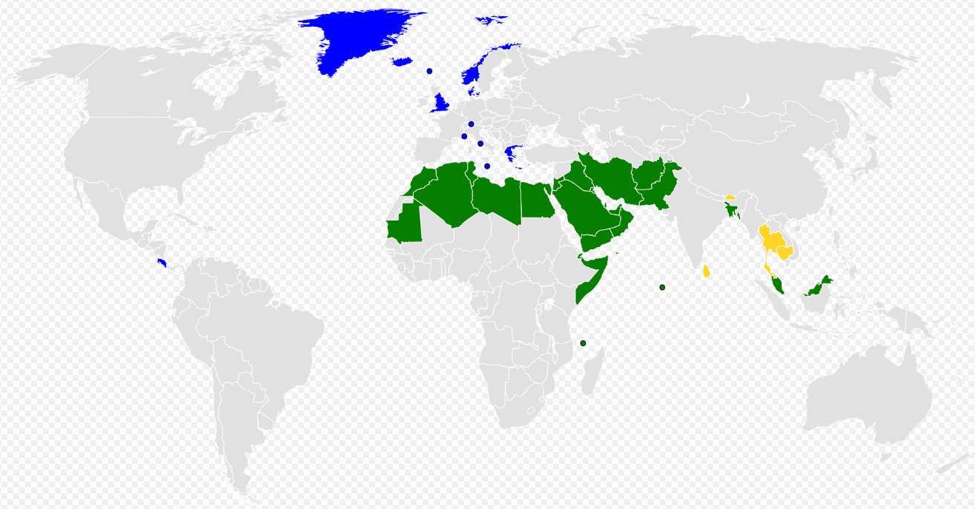

Slide 20
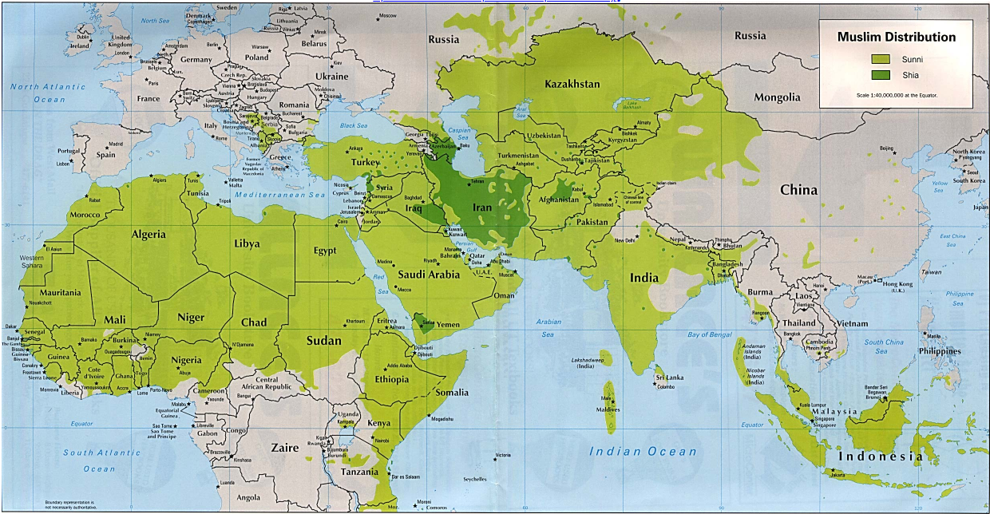

Slide 21
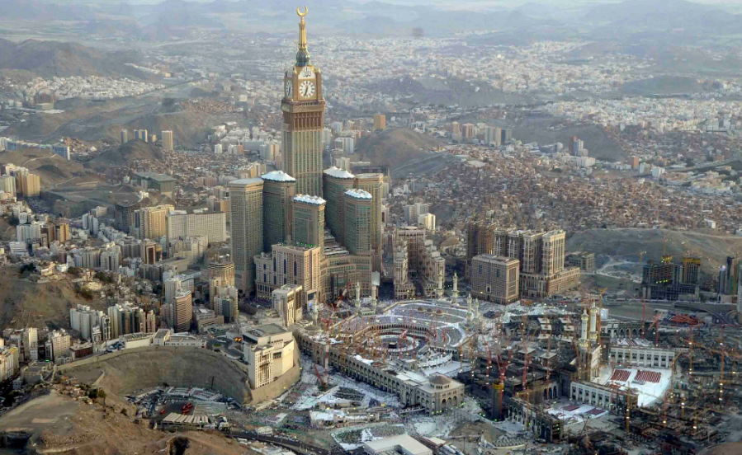

Slide 22
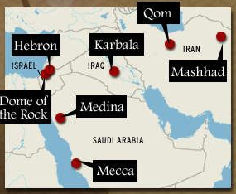

Slide 23
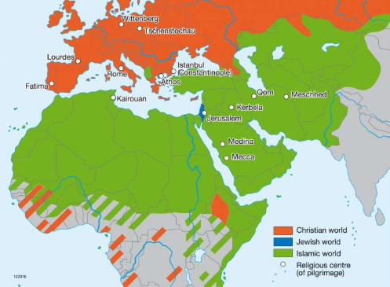

Slide 24
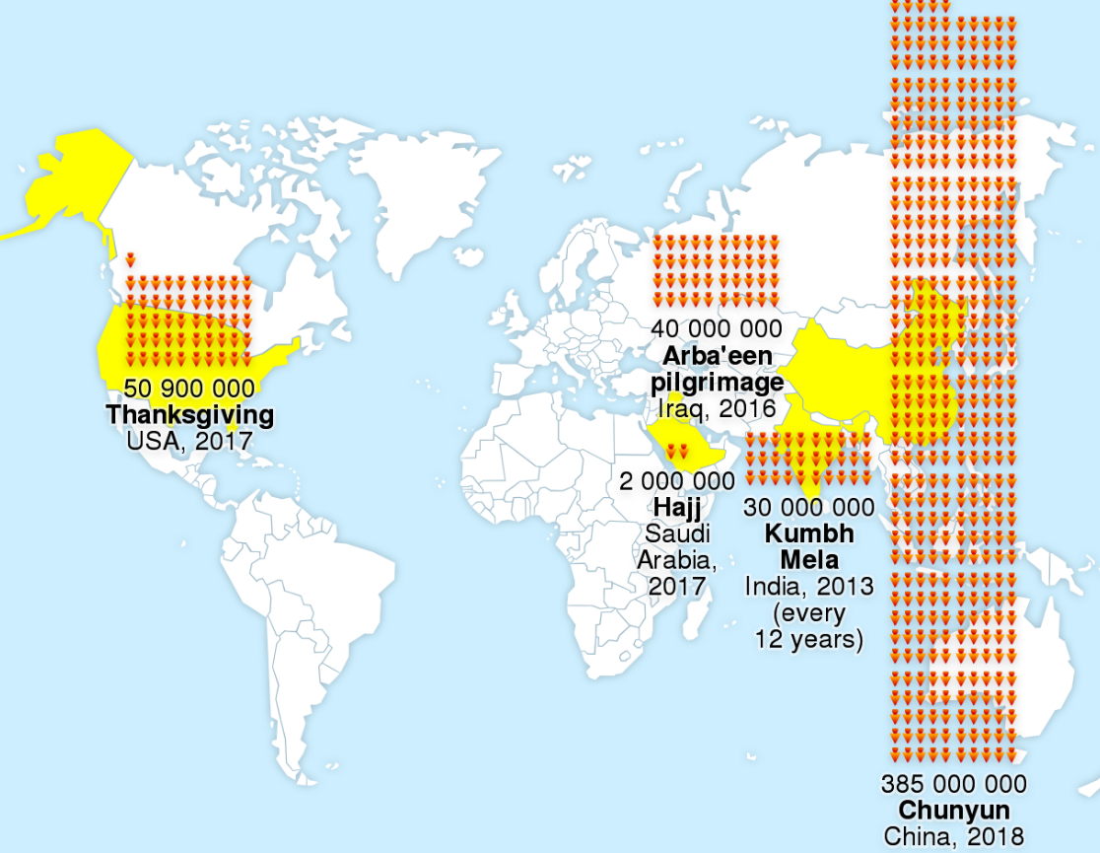

Slide 25
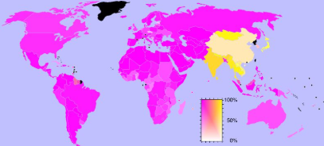

Slide 26
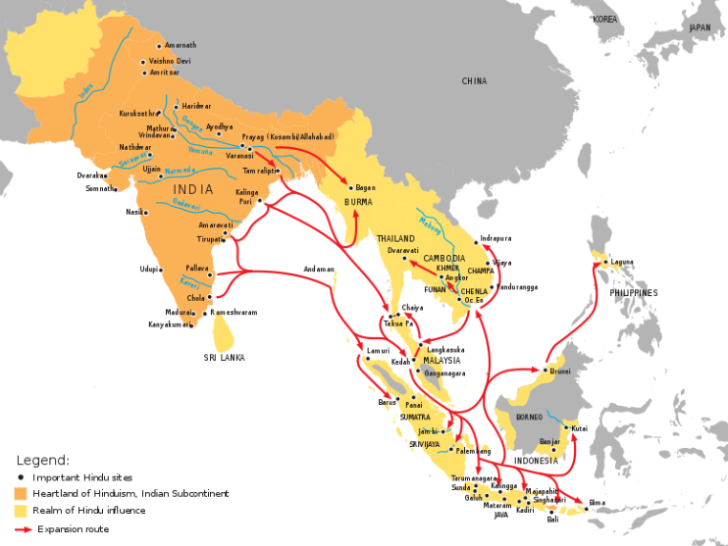

Slide 27
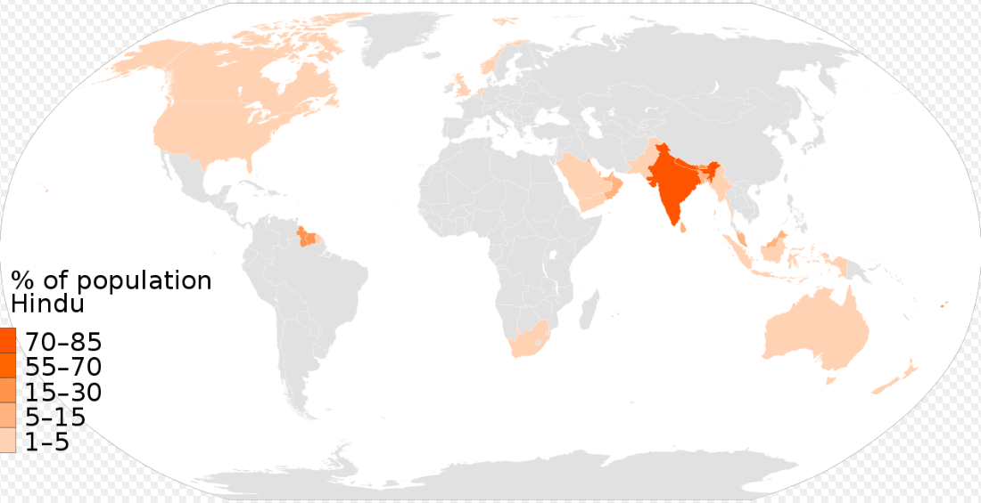

Slide 28
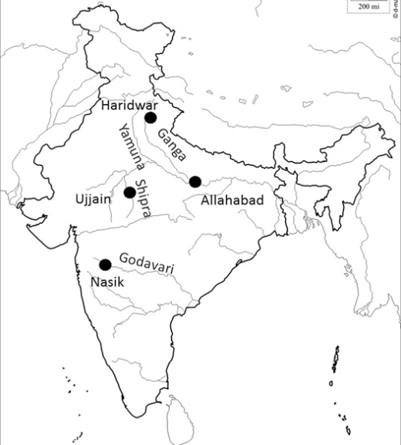

Slide 29
