Slide 1
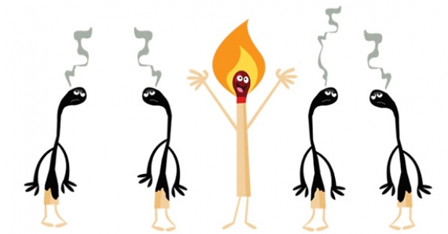
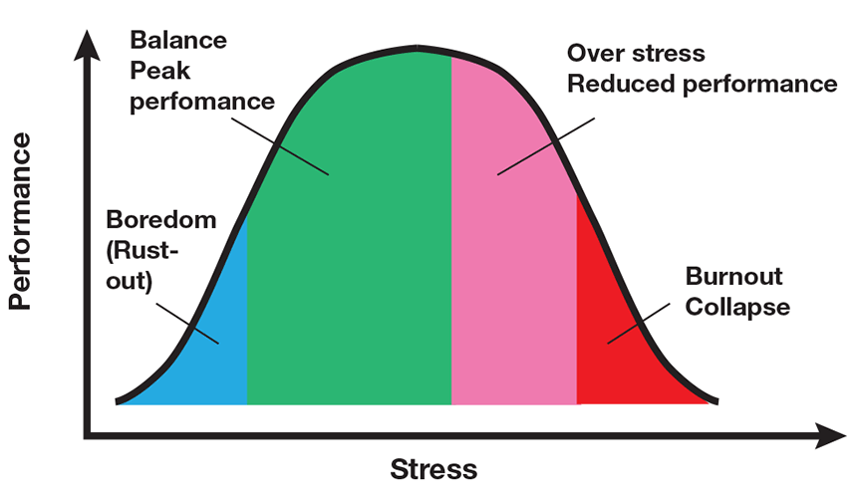
Stress & Burnout

Slide 2
Stress
Stress is a natural feeling of not being able to cope with specific demands and events. However, stress can become a chronic condition if a person does not take steps to manage it.
Stress is the body's reaction to any change that requires an adjustment or response. The body reacts to these changes with physical, mental, and emotional responses. Stress is a normal part of life. You can experience stress from your environment, your body, and your thoughts. Even positive life changes such as a promotion, a mortgage, or the birth of a child produce stress.
Challenging and stressful situations - in almost every profession, workers in helping professions are most at risk of psychosocial stress.
The difficulty of the profession - necessity of preventive measures in terms of - employer, workers themselves, family.
STRESS
Notes:
Hjumen sajki

Slide 3
Types of Stress
Acute stress: It’s the body’s immediate reaction to a new and challenging situation. Once the danger passes, your body systems should return to normal. Severe acute stress - when you’ve faced a life-threatening situation, can lead to post-traumatic stress disorder (PTSD) or other mental health problems.
Episodic acute stress: is when you have frequent episodes of acute stress. If you’re often anxious and worried about things you suspect may happen. You might feel that your life is chaotic and you seemingly go from one crisis to the next. episodic acute stress can affect your physical health and mental well-being.
Chronic stress: high-stress levels for an extended period of time, It may contribute to: anxiety; cardiovascular disease; depression; high blood pressure; a weakened immune system
Chronic stress can also lead to frequent ailments such as headaches, an upset stomach, and sleep difficulties.

Slide 4
How Does Stress Affect Health?
Stress can be positive, keeping us alert, motivated, and ready to avoid danger.
Stress becomes negative when a person faces continuous challenges without relief or relaxation between stressors.
The body's autonomic nervous system has a built-in stress response that causes physiological changes to allow the body to combat stressful situations. This stress response, also known as the "fight or flight response", is activated in case of an emergency. However, this response can become chronically activated during prolonged periods of stress. Stress that continues without relief can lead to a condition called distress – a negative stress reaction.
Distress can disturb the body's internal balance or equilibrium, leading to physical symptoms such as headaches, an upset stomach, elevated blood pressure, chest pain, sexual dysfunction, and problems sleeping.
Notes:
Hjumen sajki

Slide 5
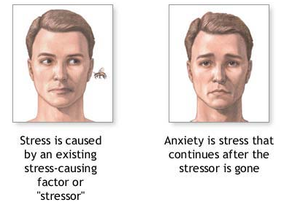
How Does Stress Affect Health?
Emotional problems can also result from distress. These problems include depression, panic attacks, or other forms of anxiety and worry. Research suggests that stress also can bring on or worsen certain symptoms or diseases. Stress is linked to 6 of the leading causes of death: heart disease, cancer, lung ailments, accidents, cirrhosis of the liver, and suicide.
Stress also becomes harmful when people engage in the compulsive use of substances or behaviours to try to relieve their stress. These substances or behaviours include food, alcohol, tobacco, drugs, gambling, sex, shopping, and the Internet.
What are the warning signs of stress?
Dizziness or a general feeling of "being out of it."
General aches and pains.
Grinding teeth, clenched jaw.
Headaches.
Indigestion or acid reflux symptoms.
Increase in or loss of appetite.
Muscle tension in neck, face or shoulders.
Problems sleeping.
Racing heart.
Cold and sweaty palms.
Tiredness, exhaustion.
Trembling/shaking.
Weight gain or loss.
Upset stomach, diarrhoea.
Sexual difficulties.

Slide 6
Symptoms of Stressful Mental Load
ambiguity, confusion → a person is not able to confess in a situation, he/she lacks a view of the situation, does not recognize relationships (misunderstandings to work);
actual insolvability → man understands the situation but does not find a solution, strategy;
unmanageability → man has an overview of the situation and an idea of how to solve it, but he/she lacks the resources, he/she is not in his power to solve things (study - time, way - money);
danger, threat → resolving a given situation may mean a direct or consequent threat to an individual, other persons or values, pushing us to the limits of our possibilities;
non-controllability → we really cannot influence the situation, or we have the feeling (the belief that we can influence the course of events reduces our anxiety);
unpredictability → the possibility to predict a stressful situation usually reduces the intensity of stress, even if one cannot influence it (preparation of the cadastre scenario).
Notes:
Hjumen sajki

Slide 7
Causes of Mental Stress
A) causes of working nature
high demands on concentration and attention;
high need to use different kinds of memory;
high need for flexible and logical thinking;
constant work with people, communication with people;
high requirements for positive personality traits;
B) causes in personal life → personal worries
diseases of the child or family member;
escalated partnerships;
own health problems;
taking care of an elderly or sick relative;
child's problems at school;
problematic transport to work, etc.
Notes:
Hjumen sajki

Slide 8
Stages of Stress
1. Alarm reaction stage: refers to the initial symptoms the body experiences when under stress. You may be familiar with the “fight-or-flight” response, which is a physiological response to stress. This natural reaction prepares you to either flee or protect yourself in dangerous situations. Your heart rate increases, your adrenal gland releases cortisol (a stress hormone), and you receive a boost of adrenaline, which increases energy. This fight-or-flight response occurs in the alarm reaction stage.
2. Resistance stage: After the initial shock of a stressful event and having a fight-or-flight response, the body begins to repair itself. It releases a lower amount of cortisol, and your heart rate and blood pressure begin to normalize. Although your body enters this recovery phase, it remains on high alert for a while. If you overcome stress and the situation is no longer an issue, your body continues to repair itself until your hormone levels, heart rate, and blood pressure reach a pre-stress state. If the resistance stage continues for too long of a period without pauses to offset the effects of stress, this can lead to the exhaustion stage. Signs of the resistance stage include:
Irritability; frustration; poor concentration
Notes:
Hjumen sajki

Slide 9
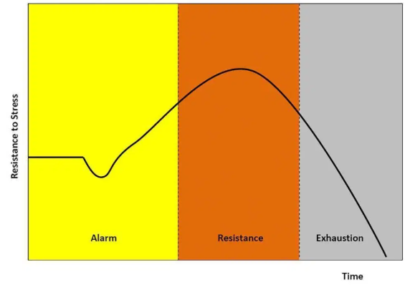
Stages of Stress
3. Exhaustion stage: is the result of prolonged or chronic stress. Struggling with stress for long periods can drain your physical, emotional, and mental resources to the point where your body no longer has strength to fight stress. You may give up or feel your situation is hopeless.
Signs of exhaustion include:
fatigue
burnout
depression
anxiety
decreased stress tolerance
The physical effects of this stage also weaken your immune system and put you at risk for stress-related illnesses.
Notes:
Hjumen sajki

Slide 10
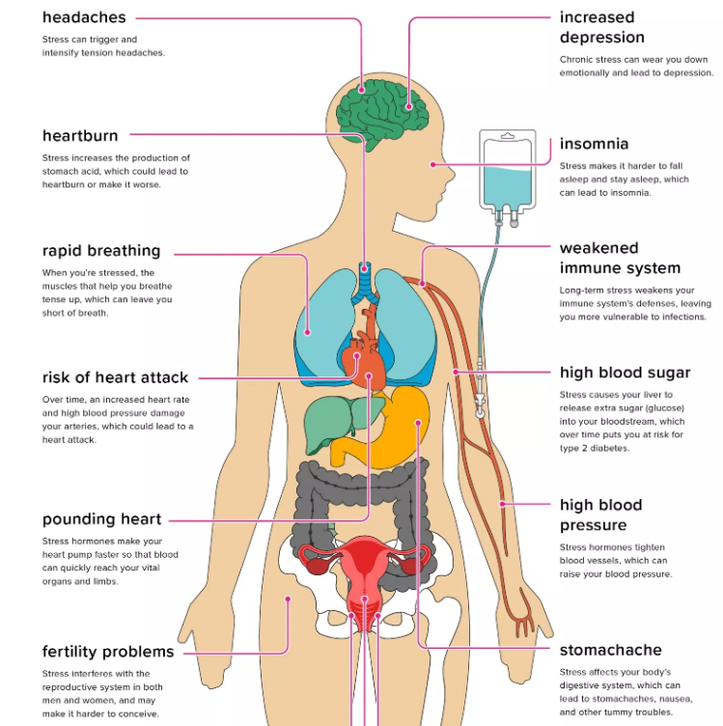
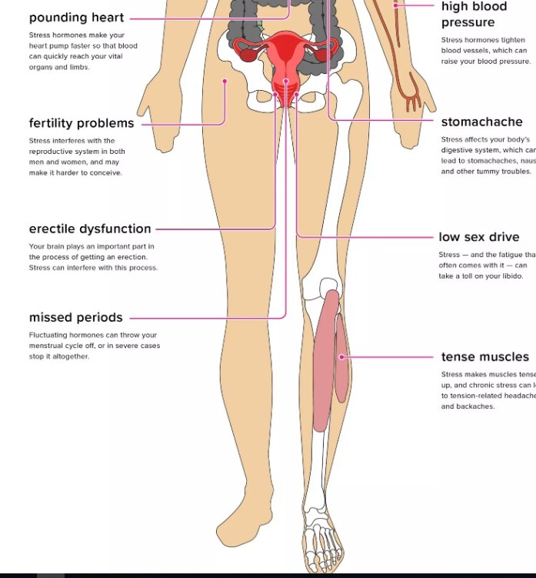
Symptoms of Distress
Notes:
Hjumen sajki

Slide 11
Symptoms of Distress
Shaking hands, increased sweating,
dry mouth, tics,
increased response to sounds,
irritability, quarrelsomeness,
nervousness, anxiety, depression,
Difficulty making decisions
problems with people,
forgetting appointments, commitments, information,
decreased sexuality, sleep problems,
loss of appetite or overeating,
the urge to cry, hiding, escaping,
sudden change in usual behaviour (good work becomes careless, who likes to work in a team becomes a loner, extrovert shuns people,…),
increased distrust towards colleagues and family members,
fatigue, weakness, headache, pain in the shoulders, backache.
Notes:
Hjumen sajki

Slide 12
Psychological Reactions to Stress
People's reactions to a stress event vary widely:
some have mental or physical problems,
others are without any difficulty,
or are encouraged to higher performance.
The same burden can be perceived, interpreted and handled differently for different persons.
The internal key factor is the individual's personality.
Social network and social support are considered external key factors.
Anxiety - it is characterized as worry, fear, tension.
Rage and aggression - often associated with a situation of frustration;
aggression is aimed at an object or person; it can be physical or verbal, direct or indirect (shifting aggression to someone or something else).
Apathy and depression - self-closing and apathy is a different reaction from aggression, if stress conditions persist, depression may occur.
The weakening of cognitive functions - difficulty concentrating and reasoning, deteriorating performance.
Notes:
Hjumen sajki

Slide 13
Social Network
The social network is a community of people who will help us if necessary.
A person who values other people gives them more value than things; he/she creates a social network of friendly relationships around them.
Social support:
A system of social relationships and ties that a person creates in his / her social environment and which can be used if needed.
People with positive relationships and close ties to other people are better able to withstand various stressors in life and at work.
Social support - stress prevention: It is important to believe that loved ones are ready to help us if necessary.
To be effective, the support obtained must meet the needs of the addressee.
In the work process - social support from the supervisor is most effective (more effective than support from co-workers or people outside the working environment).
Notes:
Hjumen sajki

Slide 14
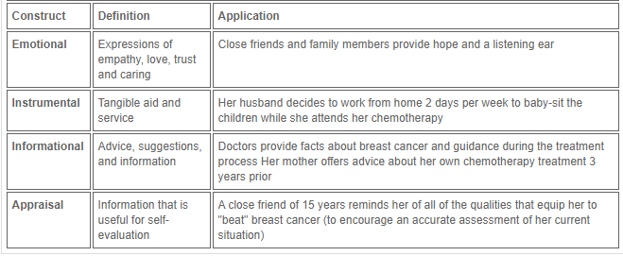
Types of Social Support
Notes:
Hjumen sajki

Slide 15
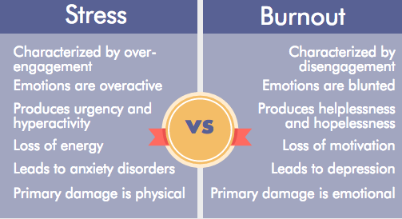
Stress vs Burnout
Burnout is loosely defined as a result of prolonged stress, it can be very difficult to distinguish between the two. There are, however, a few key differences:

Slide 16
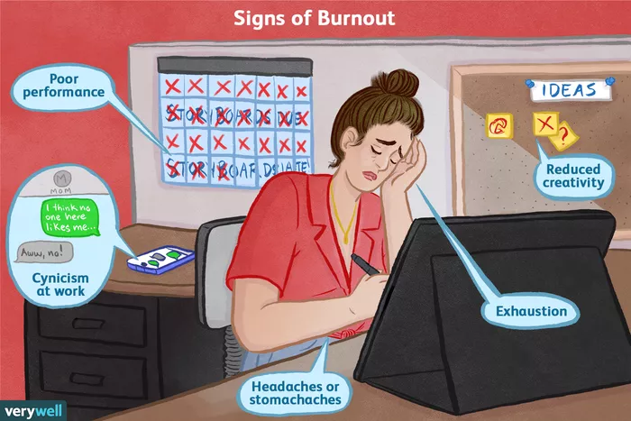
What Is Burnout?
Burnout is a reaction to prolonged or chronic job stress and is characterized by three main dimensions: exhaustion, cynicism (less identification with the job), and feelings of reduced professional ability.
Notes:
Hjumen sajki

Slide 17
Signs and Symptoms
Alienation from work-related activities: Individuals experiencing burnout view their jobs as increasingly stressful and frustrating. They may grow cynical about their working conditions and the people they work with. They may also emotionally distance themselves and begin to feel numb about their work.
Physical symptoms: Chronic stress may lead to physical symptoms, like headache and stomachache or intestinal issues.
Emotional exhaustion: Burnout causes people to feel drained, unable to cope, and tired. They often lack the energy to get their work done.
Reduced performance: Burnout mainly affects everyday tasks at work—or in the home when someone's main job involves caring for family members. Individuals with burnout feel negative about tasks. They have difficulty concentrating and often lack creativity.
Notes:
Hjumen sajki

Slide 18
Risk Factors
Unreasonable time pressure. Employees who say they have enough time to do their work are 70 percent less likely to experience high burnout. Individuals who are not able to gain more time, such as paramedics and firefighters, are at a higher risk of burnout.
Lack of communication and support from a manager. Manager support offers a psychological buffer against stress. Employees who feel strongly supported by their manager are 70 percent less likely to experience burnout on a regular basis.
Lack of role clarity. Only 60 percent of workers know what is expected of them. When expectations are like moving targets, employees may become exhausted simply by trying to figure out what they are supposed to be doing.
Unmanageable workload. When a workload feels unmanageable, even the most optimistic employees will feel hopeless. Feeling overwhelmed can quickly lead to burnout.
Unfair treatment. Employees who feel they are treated unfairly at work are 2.3 times more likely to experience a high level of burnout. Unfair treatment may include things such as favouritism, unfair compensation, and mistreatment from a co-worker.
Notes:
Hjumen sajki

Slide 19
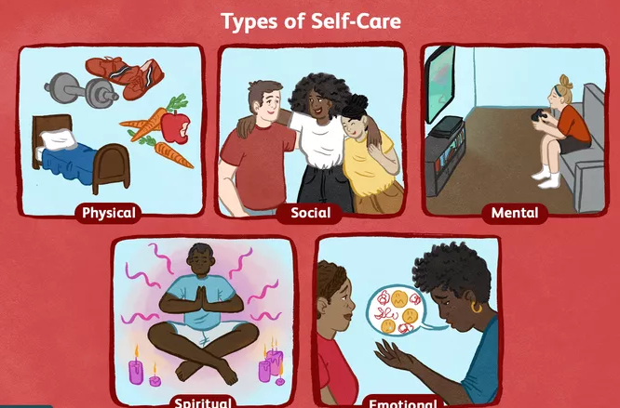
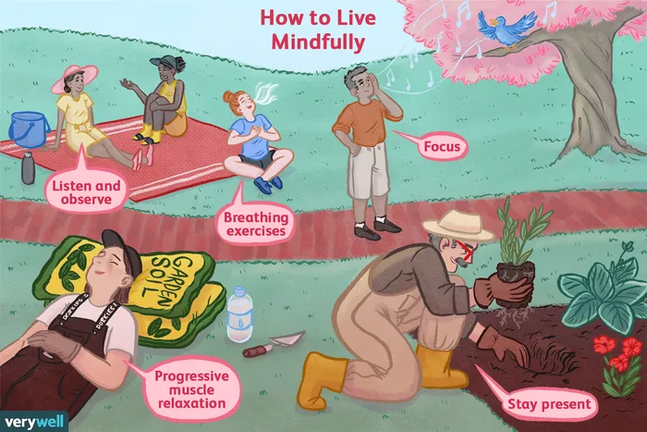
Prevention and Treatment
Notes:
Hjumen sajki

Slide 20
Burnout Syndrome Phases
Notes:
Hjumen sajki

Slide 21
Burnout
12-stages-of-burnout
Notes:
Hjumen sajki

Slide 22
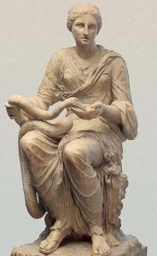
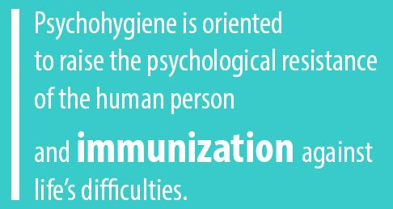
Mental Hygiene: Psychohygiene
Our recent history has created the concept of Psychohygiene, it is called Mental Hygiene and deals with the care of people’s mental health.
Ancient Greeks idea of an ideal person was a man who is equally mentally balanced, physically resistant and constitutionally proportionate with healthy emotions, a powerful body and a healthy constructive psyche.
Everything that happens in the human person is manifested in behaviour. It is an external reflection of the inner psychic life of man.
Statue of Hygeia the Greek goddess of health
Notes:
Hjumen sajki

Slide 23
Mental Hygiene
Mental health_WHO
meaningfulness - problems and solutions to tasks must be seen as meaningful, the possibility to choose the pace and direction of work progress;
adequate social recognition - evaluation of society, importance, mission;
clarity - Understanding your position as a whole, in society, a certain order, order, rules you can rely on;
manageability - awareness of one's strengths and possibilities, the strengths and possibilities of those around them;
setting not only goals but also tools - to know in advance how (even in a catastrophic scenario) planning;
well-functioning feedback - positive self-esteem, belief in one's abilities, a feeling that I can influence events in my life;
Notes:
Hjumen sajki

Slide 24
Mental Hygiene
atmosphere - calm and encouraging, to reduce all disturbances;
enough time to work, not to act rashly, under stress;
regular daily routine - rest is important (active, passive), good quality sleep, proper lifestyle in general (not forgetting music, laughter, dancing,…);
increasing self-confidence;
strengthening friendships, strengthening ties in the workplace;
eliminate concerns about the psychologist's visit and use his help.
(In the early 1900s, psychologist Clifford Wittingham Beers started a mental hygiene movement after experiencing mistreatment while at mental institutions for anxiety and depression.)
Examples of mental hygiene
Notes:
Hjumen sajki

Slide 25
Common disorders - Anxiety Disorders
The most common types of mental illness are anxiety disorders, mood disorders, and schizophrenia disorders. Anxiety disorders are the most common types of mental illness. Examples of anxiety disorders include:
Panic disorder – the person experiences sudden paralyzing terror or a sense of imminent disaster.
Phobias – these may include simple phobias (a disproportionate fear of objects), social phobias (fear of being subject to the judgment of others), and agoraphobia (dread of situations where getting away or breaking free may be difficult).
Obsessive-compulsive disorder (OCD) – the person has obsessions and compulsions. In other words, constant stressful thoughts (obsessions), and a powerful urge to perform repetitive acts, such as hand washing (compulsion).
Post-traumatic stress disorder (PTSD) – this can occur after somebody has been through a traumatic event – something horrible or frightening that they experienced or witnessed. During this type of event, the person thinks that their life or other people’s lives are in danger. They may feel afraid or feel that they have no control over what is happening.
Notes:
Hjumen sajki

Slide 26
Common Disorders - Mood Disorders
These are also known as affective disorders or depressive disorders. Patients with these conditions have significant changes in mood, generally involving either mania (elation) or depression. Examples of mood disorders include:
Major depression – the individual is no longer interested in and does not enjoy activities and events that they previously liked. There are extreme or prolonged periods of sadness.
Bipolar disorder – previously known as manic-depressive illness, or manic depression. The individual switches from episodes of euphoria (mania) to depression (despair).
Persistent depressive disorder – previously known as dysthymia, this is mild chronic (long term) depression. The patient has similar symptoms to major depression but to a lesser extent.
SAD (seasonal affective disorder) – a type of major depression that is triggered by lack of daylight. It is most common in countries far from the equator during late autumn, winter, and early spring.
Notes:
Hjumen sajki

Slide 27
Common Disorders - Schizophrenia Disorders
Whether or not schizophrenia is a single disorder or a group of related illnesses has yet to be fully determined. It is a highly complex condition. Schizophrenia normally begins between the ages of 15 and 25. The individual has thoughts that appear fragmented; they also find it hard to process information.
Schizophrenia has negative and positive symptoms. Positive symptoms include delusions, thought disorders, and hallucinations. Negative symptoms include withdrawal, lack of motivation, and a flat or inappropriate mood.
Notes:
Hjumen sajki

Slide 28
Treatment
Treatments can include:
Psychotherapy (talking therapies) – this is a psychological approach to treating mental illness. Cognitive behavioural therapy (CBT), exposure therapy, and dialectical behavior therapy are examples.
Medication – although it can not cure mental disorders, some medications can improve symptoms.
Self-help – including lifestyle changes such as reducing alcohol intake, sleeping more, and eating well.
Notes:
Hjumen sajki

Slide 29
Mental Health Tests - Advice Eventually
Depression test
Anxiety-test
Stress-test
Social-anxiety-test
Get away from worries - tree, meadow, sun, ...
Smile, let joy come to you.
Look for something positive in every situation.
Upon coming from work (school) wash away your worries, fatigue, exhaustion - the positive effects of the shower.
Learn to solve worries and problems - don't run away from them.
Relax → take a day just for yourself.
Eat regularly, sleep regularly.
Search for contacts with nice people.
Notes:
Hjumen sajki

Slide 30
Thank you for your attention

