Slide 1
Bacterial Pathogenesis Part 1
See Baron’s Textbook at:
http://www.md.huji.ac.il/microbiology (especially chapter 7: http://www.md.huji.ac.il/microbiology/book/ch07.htm)

Slide 2
What are infectious diseases?
Microorganism factors
NON-SPECIFIC IMMUNITY
Microorganism
HOST FACTORS
AMOUNT
TRANSFER
ENTRY
IMMUNE SYSTEM
VIRULENCE
PHYSIOLOGY
RISK FACTORS

Slide 3
Examples of Host-Organism encounters
toxins
Adherence, multiplication on surface, toxin production, little or no penetration
Pertussis, diphtheria, cholera, enterotoxigenic E. coli
+/-
toxins
Adherence, multiplication on surface, invasion of epithelial cells, +/- toxins
Shigella, enteroinvasive E. coli, gonococci
+/-
toxins
Adherence, multiplication on surface, invasion of deeper tissues or even systemically , +/- toxins
Salmonella, Streptococcus pyogenes, meningococci

Slide 4
Examples of Host-Organism encounters - 2
Break in epithelium (trauma, surgery)
Wound infection, gas gangrene, tetanus
+/-
toxins
toxins
Pre-formed toxin; no adherence
Botulism, staphylococcal and clostridial food poisoning

Slide 5
Examples of Host-Organism encounters - 3
Obstruction of a hollow organ⇨stasis
Urinary tract, biliary tract, glands, sinuses, Eustachian tube, etc
Reflux
Ureter

Slide 6
BASIC DEFINITIONS
Pathogenicity
- the ability of a microorganism to cause infectious disease
Pathogenesis
mechanisms of infection and disease development
Virulence
a measure of pathogenicity

Slide 7
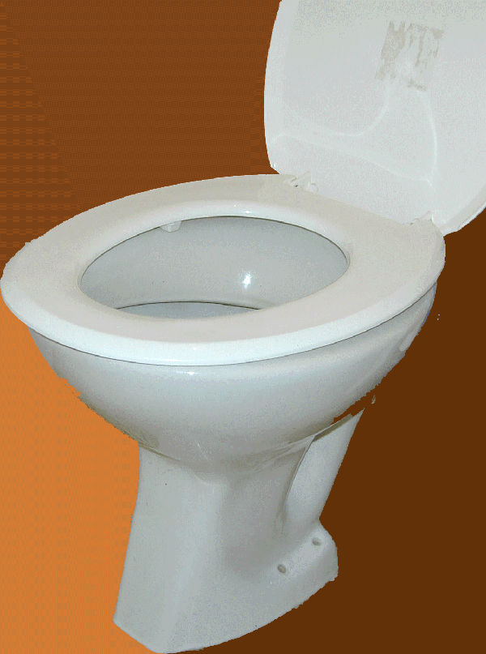
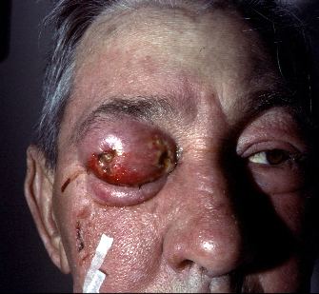
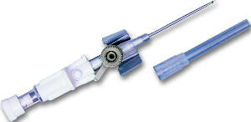
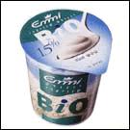
Pathogenicity
Shigella
Staphylococcus aureus
Staphylococcus epidermidis
Lactobacillus

Slide 8
Patogenesis - mechanisms of infection and disease development
host sensitivity/resistance
host-mediated damage
bacterial virulence factors

Slide 9
Pathogenesis - 2
host susceptibility/resistance
physical barriers (intact skin, mucosae, tight junctions, mucin layer)
clearance mechanisms (cough, ciliary action, peristalsis, emptying/flushing)
local antimicrobial action (lysozyme, pH, fatty acids)
immune status; underlying diseases; foreign bodies
normal microbiota

Slide 10
Exterior host defences
expulsion of organisms by rapid air movement over turbinates (e.g. nose-blowing, sneeze!) or larynx (cough)
mucosae
mechanical barrier
lysozyme in secretions
commensals
skin
mechanical barrier
fatty acids
commensals
ciliary action, mucus
commensal microbiota
low pH
flushing of urinary tract
commensal microbiota
vaginal pH

Slide 11
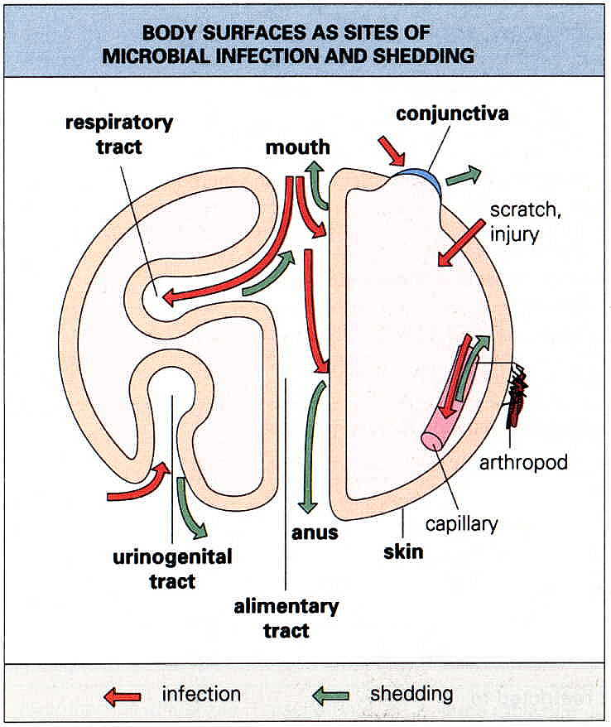
“Exterior” defenses?
C.A. MIMS’s model

Slide 12
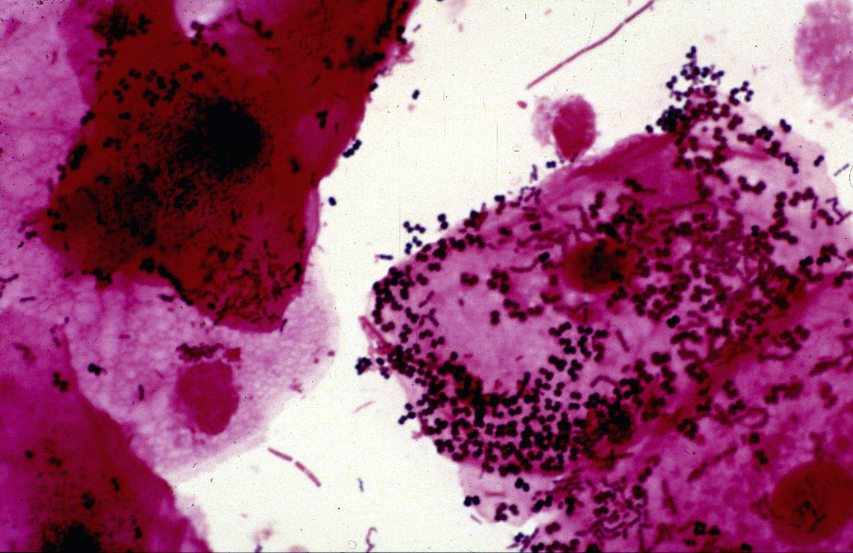
Commensal microbiota
Gram stain of saliva from a healthy individual - note many bacterial morphotypes in association with squamous epithelial cells

Slide 13
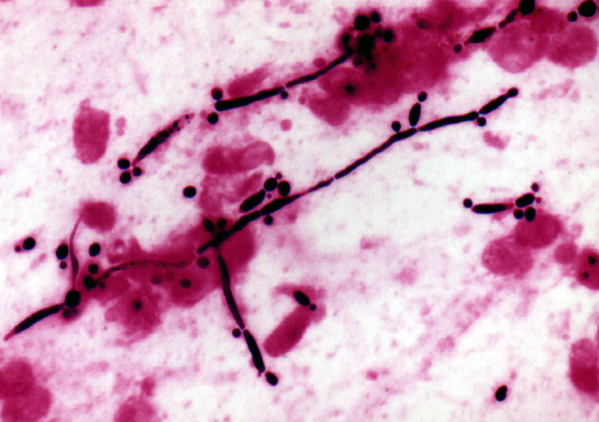
When commensals are disrupted …...
Gram stain of mouth swab in oral candidosis
Note that no bacteria are visible
Fungal overgrowth occurs after elimination of commensal bacteria by antibiotic therapy

Slide 14
?
A “germ’s eye” view of a patient in Intensive Care
Credit to Dennis G Maki

Slide 15
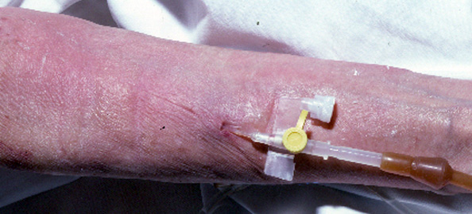
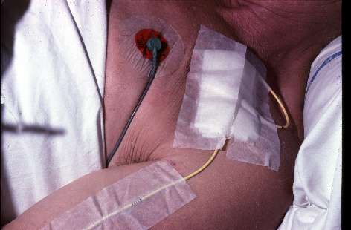
Destroying physical barriers
Intravascular devices
a gateway into the patient’s bloodstream

Slide 16
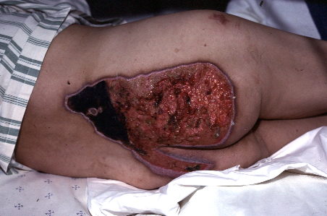
Destroying physical barriers - 2
Skin integrity disrupted in this burn - caused by a hot-water bottle in a bed-ridden patient

Slide 17
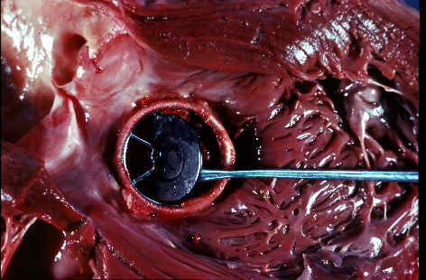
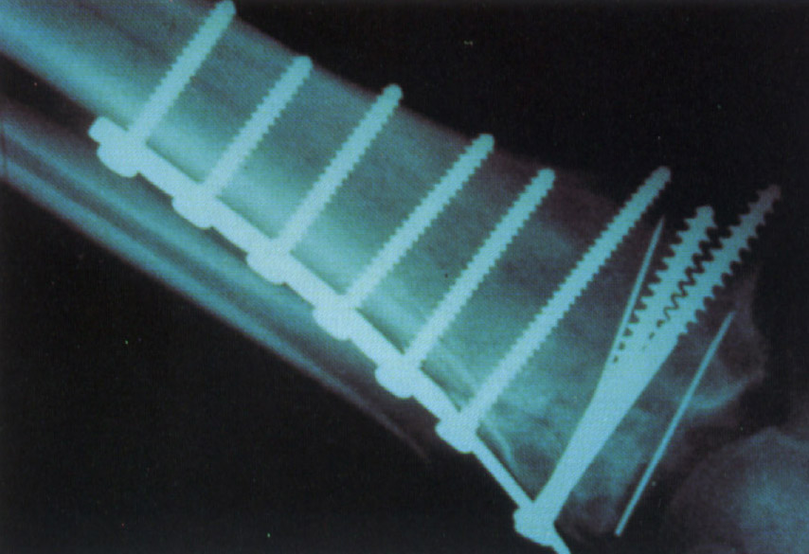
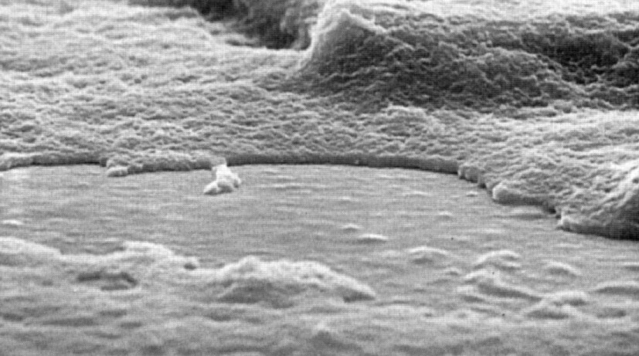
Foreign bodies
Endocarditis on an artificial valve caused by a usually non-pathogenic bacterium, Bacillus cereus
Foreign material used in fracture fixation - relative non-pathogens e.g. Staphylococcus epidermidis are frequent causes of infection in this setting
“Slime” from Staphylococcus epidermidis coating part of central venous catheter

Slide 18
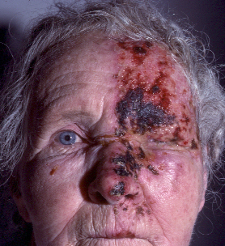
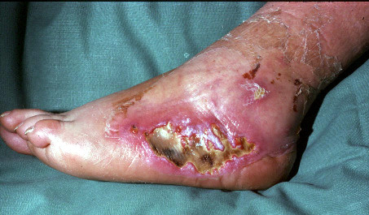
Underlying diseases
Chronic lymphocytic leukaemia - secondary bacterial infection of herpes zoster in the ophthalmic distribution
Diabetes mellitus - severe soft tissue infection and often osteomyelitis secondary to microvascular disease

Slide 19
Pathogenesis - 3
host-mediated damage
inflammation (cytokines, other mediators)

Slide 21
Pathogenesis - 4
bacterial virulence factors
adherence and colonization factors
invasion factors
capsules
endotoxins
exotoxins
siderophores

Slide 22
Host Protein
Pili (fimbriae)
POLYSACCHARIDE
PILUS
A major mechanism for bacterial attachment to host cells
BACTERIUM

Slide 23
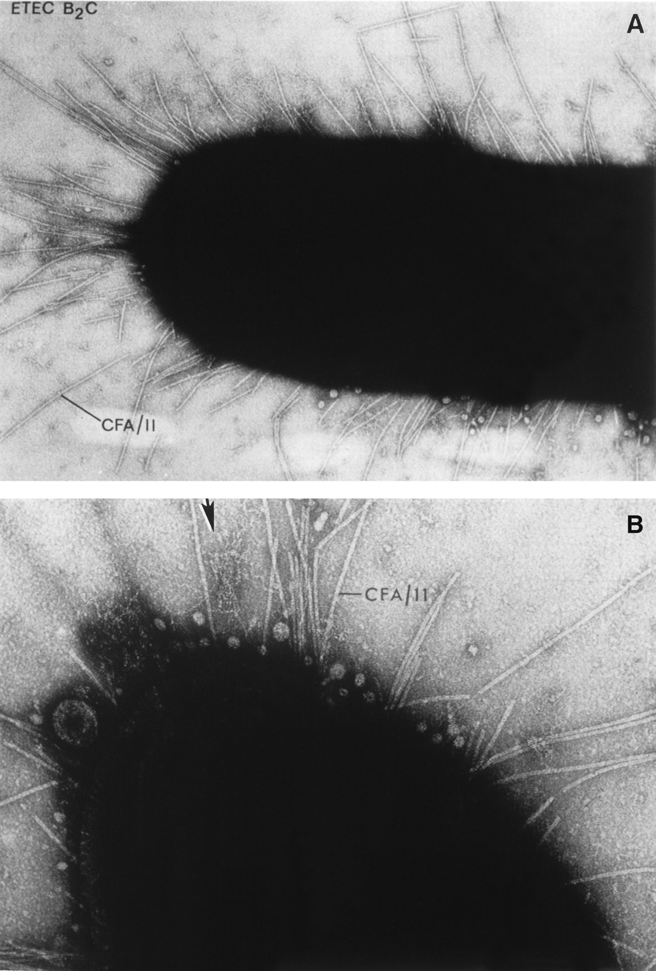
Pili on the cell surface of E. coli
Electron microscopy with negative staining

Slide 24
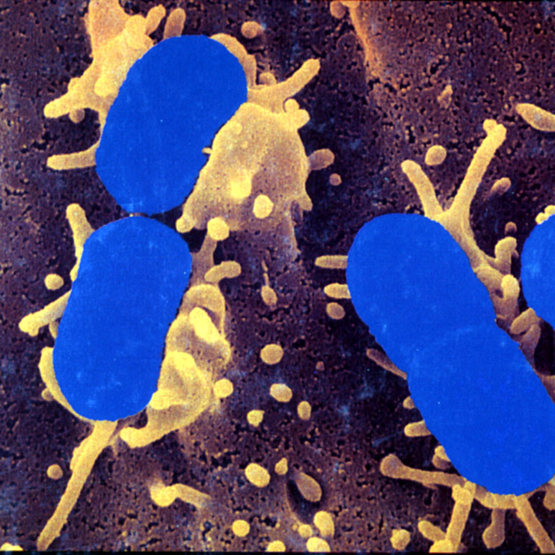
Invasiveness
Endocytosis:
Scanning electron micrograph of bacteria in early stages of engulfment by protrusions of mucosal cell membranes which are produced by rearrangements of the cytoskeleton in response to bacterial attachment

Slide 25
Shigella virulence factors
Plasmid coded
120 or 140 mD plasmid
Invasion plasmid antigens (Ipa)
complex of IpaB and IpaC ⇨ endocytosis of organisms
IpaB ⇨ lysis of endocytic vacuoles in epithelial cells or macrophages
Ipa also ⇨ IL-1 production and macrophage apoptosis

Slide 26
Role of Ipa
Sansonetti P. Shigella plays dangerous games. ASM News 1999;65:611-617

Slide 27
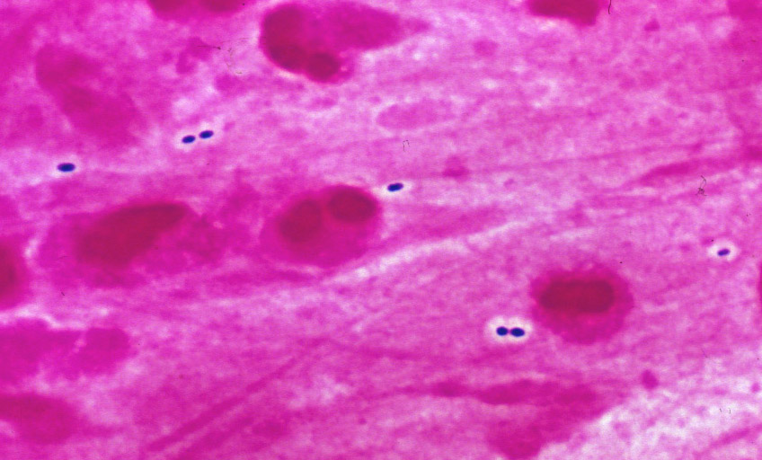
Capsules
Encapsulated Gram-positive diplococci in sputum: Streptococcus pneumoniae
Note extracellular location - the capsule has antiphagocytic properties

Slide 28
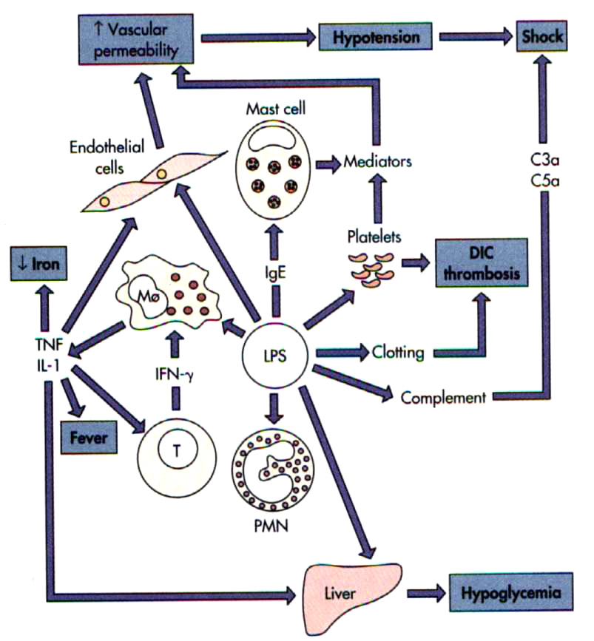
Endotoxin effects

Slide 29
LIPOPOLYSACCHARIDE
ENDOTOXIN
TOXIC
CORE
IMMUNOGENIC
LIPID A
KDO
SIDE CHAIN
POLYSACCHARIDES
COMMON TO ALL GRAM NEGATIVE BACTERIA

Slide 30
LPS
LPS BINDING PROTEIN
Macrophage
CD14
TNFa, IL1, IL6, IL8, PAF
ARDS
Activation of
Coagulation
Prostaglandins
leukotrienes
Activation
of C’
DIC
Endothelial damage
Multiple Organ System Failure

Slide 31
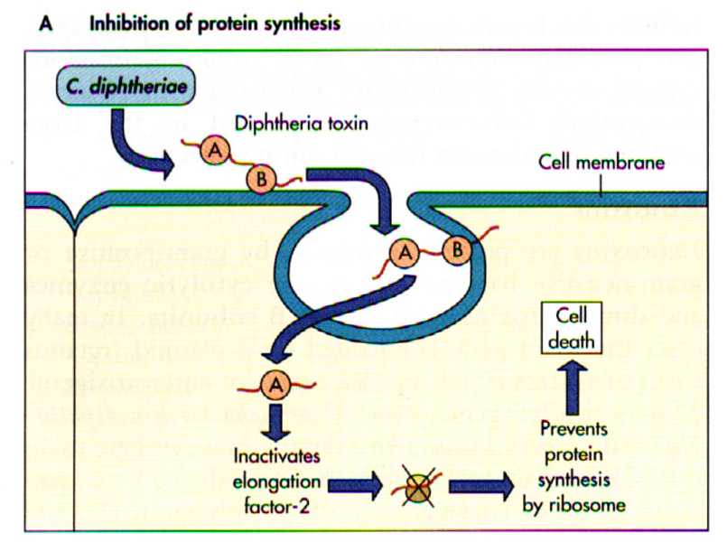
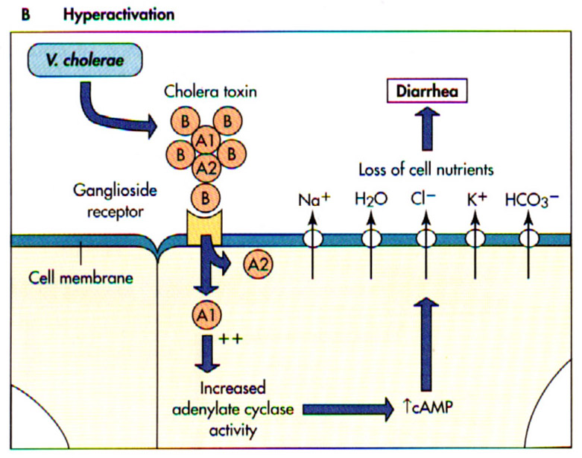
Exotoxins
Corynebacterium diphtheriae
Vibrio cholerae

Slide 32
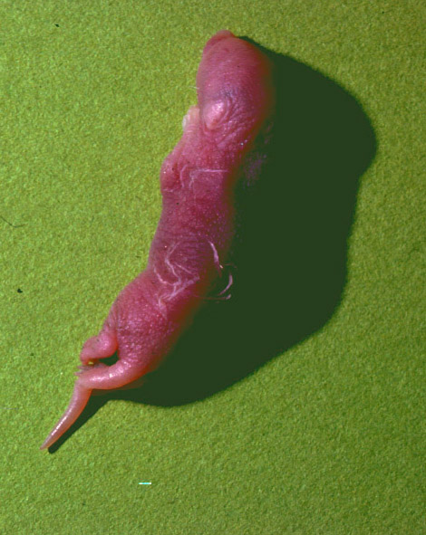
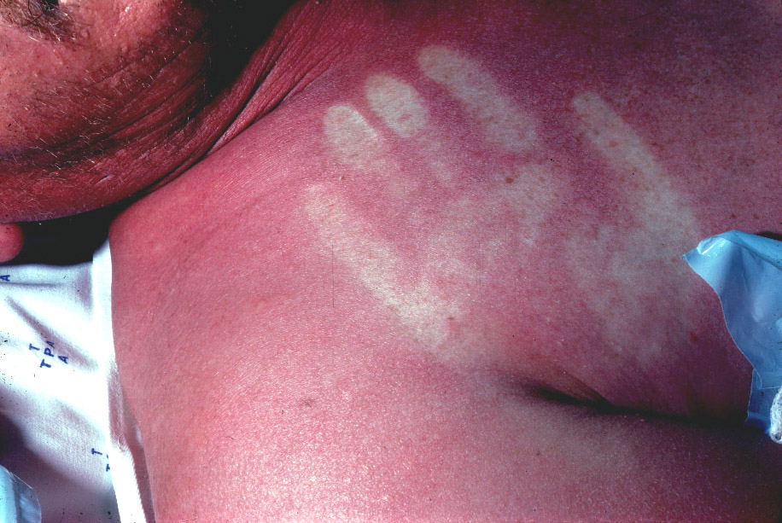
Exotoxins - 2
Staphylococcus aureus produces the Staphylococcal Scalded Skin Syndrome (SSSS)
Injection of culture supernatant from toxin-producing S. aureus in newborn mouse results in separation of epidermis from dermis with characteristic epidermal folds produced by gentle rubbing (Nikolsky sign)
Streptococcus pyogenes may produce streptococcal pyrogenic toxins (Spe) resulting in in rash of scarlet fever (scarlatina, שנית) which blanches on pressure

Slide 33
Siderophores
Little iron is available in host tissue fluids and secretions - bound to Hb, transferrin, lactoferrin etc
Bacteria require iron. Some have evolved specialized systems for scavenging iron from the host
Siderophores are compounds with a sufficiently high affinity for iron to “steal” it from transferrin and lactoferrin
E.g. Salmonella mutants which have lost their ability to produce their siderophore (enterochelin) are non-virulent in animal experiments

Slide 34
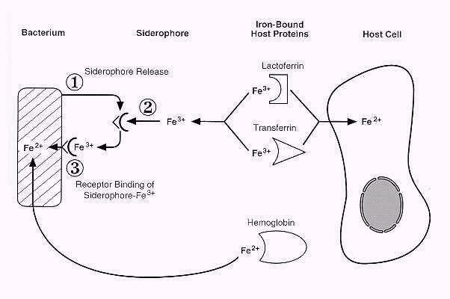
Bacteria and host cells compete for iron

Slide 35
Some factors influencing pathogenesis
Bacteria that multiply
Extracellularly
Bacteria that multiply
Intracellularly
OBLIGATE or FACULTATIVE
Adhesion
Colonization
Local damage
Systemic damage
Evade immune system
IgA protease
Protein A
Capsule
Antigenic Variation
Mimicry
Invasin
Recruit phagocytes
Prevent
oxidative burst
C3b phagocytosis
Resist oxidative burst burst
SOD-catalase-host
Abort phago-lysosome fusion
Granuloma
TNF damage

Slide 36
Some factors influencing pathogenesis
Bacteria that multiply
Extracellularly
Bacteria that multiply
Intracellularly
OBLIGATE or FACULTATIVE
Adhesion
Colonization
Local damage
Systemic damage
Evade immune system
IgA protease
Protein A
Capsule
Antigenic Variation
Mimicry
Invasin
Recruit phagocytes
Prevent
oxidative burst
C3b phagocytosis
Resist oxidative burst burst
SOD-catalase-host
Abort phago-lysosome fusion
Granuloma
TNF damage

Slide 37
Virulence - the degree of pathogenicity of an organism
Depends on
number of infecting bacteria (inoculum)
route of entry into the body
quantity and nature of the bacterial virulence factors
(state of the host)

Slide 38
Virulence - 2
Measures of virulence (experimental)
LD₅₀ - inoculum resulting in death in 50% of animals inoculated
(LD = Lethal Dose)
ED₅₀ - inoculum resulting in infection in 50% of animals inoculated
(ED = Effective Dose)

Slide 39
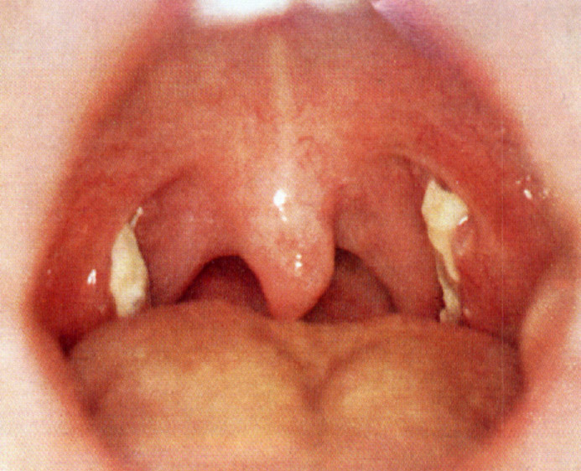
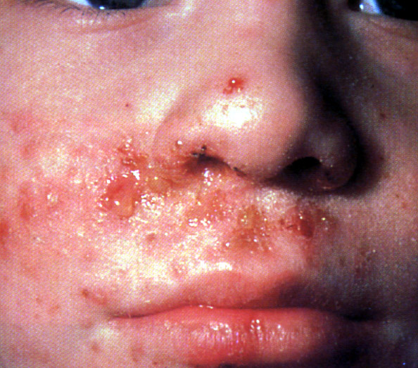
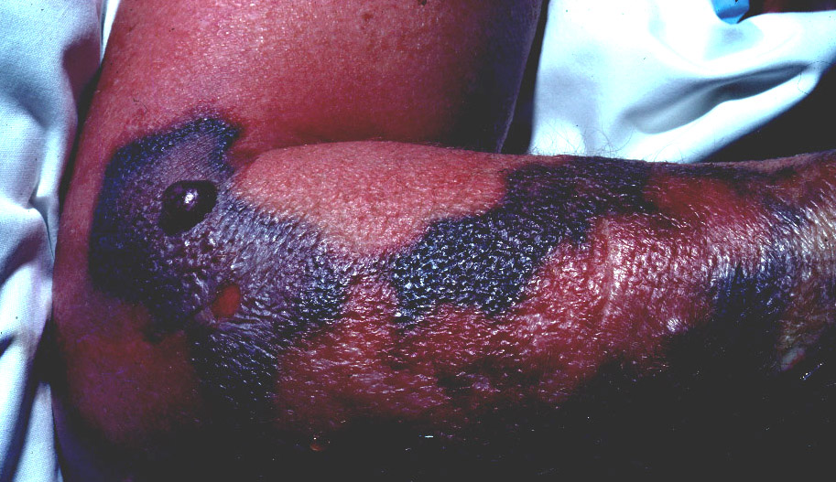
Examples of organisms with different expressions of virulence
S. pyogenes pharyngitis
1. Streptococcus pyogenes (group A)
“strep sore throat”
impetigo
necrotizing fasciitis (“flesh-eating”)
impetigo
Necrotizing fasciitis

Slide 40
Examples of organisms with different expressions of virulence
2. Escherichia coli
asymptomatic carriage
urinary tract infection, mild to severe
gastroenteritis, mild to lethal
invasion
toxins
Outbreaks of severe foodborne disease
+
E. coli O157:H7

Slide 41
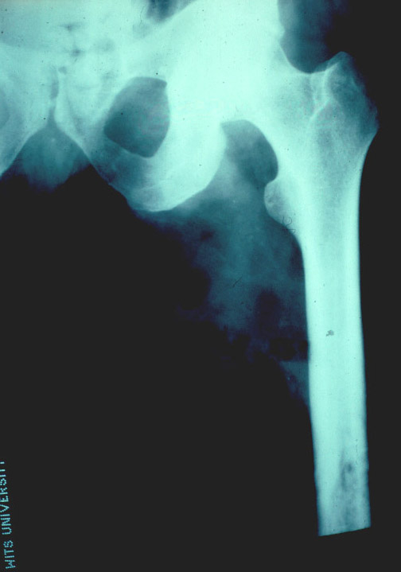
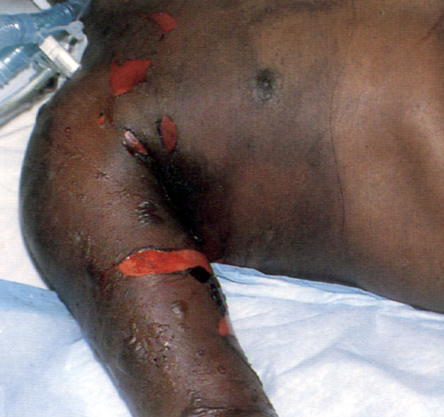
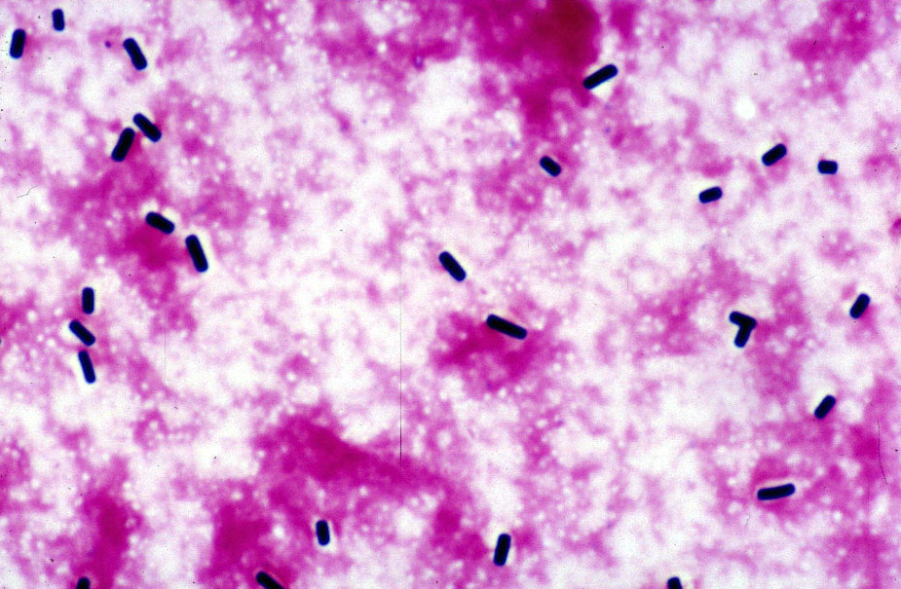
Examples of organisms with different expressions of virulence
X-ray showing gas in soft tissues
3. Clostridium perfringens
asymptomatic carriage
wound contamination/infection
gas-gangrene (Clostridial myonecrosis)
toxins
host factors!
Clostridium perfringens in fluid from necrotic tissue - Gram stain. Note absence of leukocytes due to effect of α toxin, also known as phospholipase C
Clinical picture of gas gangrene

Slide 42
When the balance is upset in favour of the organism, INFECTIOUS DISEASE results
Organism
factors
HOST FACTORS
HOST-MEDIATED DAMAGE

