Slide 1
Civil Rights Movement
Nikola Samcová

Slide 2
Basic information
mass popular movement with the goal of enforcing constitutional and legal rights for African Americans
it peaked in the 1950s and 1960s
African Americans participated along with many whites
it addressed primarily education, social segregation and voting rights – the main three areas of discrimination
the movement was mostly nonviolent and eventually achieved equal rights legislation
the largest social movement of the 20th century in the United States, it influenced other movements too

Slide 3
Jim Crow segregation
during the Reconstruction, the 14th and 15th Amendments to the US Constitution established a legal foundation for the political equality of African Americans
in the late 19th century, segregation laws, known as Jim Crow laws, were passed in the South
blacks couldn’t use the same public facilities, go to the same schools, interracial marriage was illegal, most blacks couldn’t vote
in northern states, blacks still experienced discrimination at their jobs, when they tried to buy a house or get an education, laws were passed in some states to limit their voting rights

Slide 4
The emergence of the movement
the movement emerged as a response to the unfulfilled promises of emancipation, partly as a result of the experiences of black soldiers in the Second World War
blacks fought in a segregated military while being exposed to US propaganda emphasizing liberty, justice and equality
African American veterans returned from the war determinded to achieve the rights and prerogatives of full citizenship
on July 26, 1948, president Harry Truman issues an executive order to end segregation in the Armed Services

Slide 5
Main events overview

Slide 6
May 17, 1954
December 1, 1955
the U.S. Supreme Court rules in the case Brown v. Board of Education of Topeka that racial segregation in public schools is unconstitutional
Rosa Parks refuses to give up her seat to a white man on a Montgomery, Alabama bus
her subsequent arrest prompts a year-long Montgomery bus boycott, led by M. L. King
the Supreme Court rules that segregated seating is unconstitutional

Slide 7
September 4, 1957
February 1, 1960
nine blacks students known as the „Little Rock Nine“ are blocked from integrating into Central High School in Little Rock, Arkansas
president Dwight D. Eisenhower sends federal troops to escort the students
four college students known as the „Greensboro Four“ refuse to leave a Woolworth’s „whites only“ lunch counter in Greensboro, North Carolina, without being served
their nonviolent demonstration sparks similar „sit-ins“ throughout the city and in other states -> the Sit-In Movement

Slide 8
April 3, 1963
August 28, 1963
M. L. King and the SCLC lounch a campaign in Birmingham, Alabama, to undermine the city’s system of racial segregation
the demonstrations eventually lead the municipal government to change the discrimination laws
approximately 250,000 people take part in The March on Washington for Jobs and Freedom
M. L. King addresses the crowd with an eloquent and uplifting message that becomes known as the „I Have a Dream“ speech

Slide 9
July 2, 1964
February 21, 1965
president Lyndon B. Johnson signs the Civil Rights Act of 1964 into law, preventing employment discrimination
the U.S. Equal Employment Opportunity Commission is established
black religious leader Malcolm X is assassinated during a rally by members of the Nation of Islam

Slide 10
March 7, 1965
August 6, 1965
around 600 civil right marchers walk from Selma to Montgomery in protest of black voter suppression
local police block and brutally attack them
M. L. King fights in court for their right to march and they finally reach Montgomery on March 25
president Johnson signs the Voting Rights Act of 1965 to prevent the use of literacy tests as a voting requirement

Slide 11
June 12, 1967
April 4, 1968
the U.S. Supreme Court declares the Virginia statuses prohibiting interracial marriage unconstitutional in the case Loving v. Virginia
the ruling thus invalidates laws against interracial marriage in Virginia and 15 other states
Martin Luther King is assassinated on the balcony of his hotel room in Memphis, Tennessee
his murder sets off riots in hundreds of cities and pushes Congress to pass the stalled Fair Housing Act in King’s honor, providing equal housing opportunity regardless of race, religion or national origin

Slide 12
Martin Luther King Jr. (1929-1968)
American Baptist minister and activist and the most visible spokersperson and leader in the civil rights movement
inspired by Thoreau and Gandhi, he advanced civil rights through nonviolence and civil disobediance
in 1964, he won the Nobel Piece Prize for combating racial ineqality through nonviolent resistance
his assassination in Memphis, Tennessee in 1968 was followed by riots in many U.S. cities
he was posthumously awarded the Presidential Medal of Freedom and the Congressional Gold Medal

Slide 13
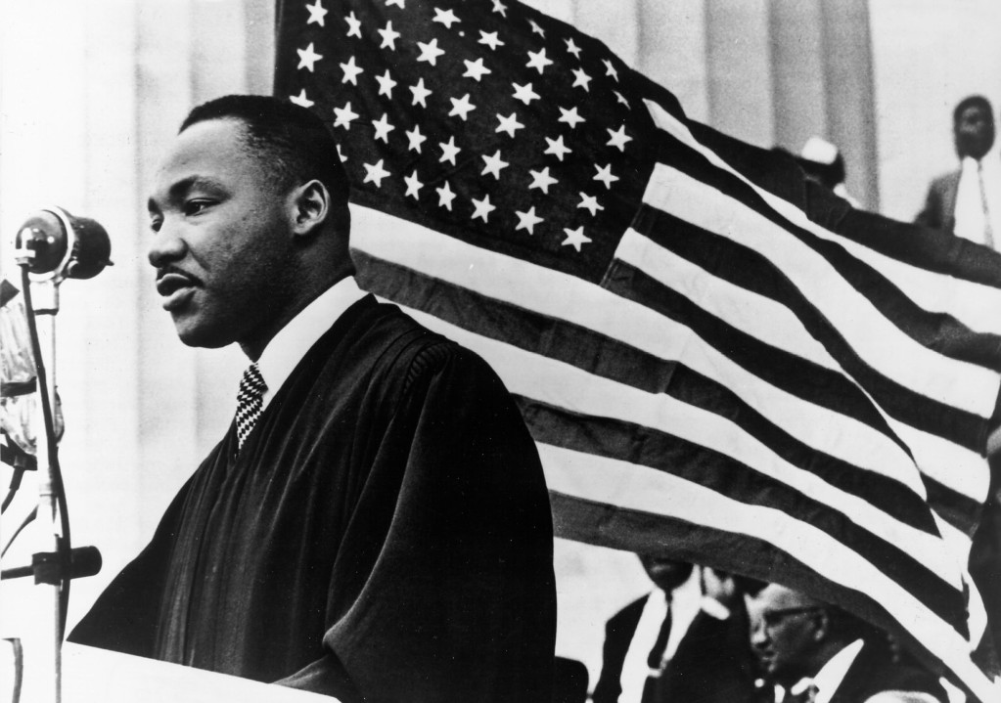

Slide 14
Sources
https://www.britannica.com/list/timeline-of-the-american-civil-rights-movement
https://www.history.com/topics/civil-rights-movement/civil-rights-movement-timeline
https://www.history.com/topics/black-history/civil-rights-movement
https://www.khanacademy.org/humanities/us-history/postwarera/civil-rights-movement/a/introduction-to-the-civil-rights-movement
https://www.scholastic.com/teachers/articles/teaching-content/civil-rights-movement-overview/
https://en.wikipedia.org/wiki/Martin_Luther_King_Jr.

