Slide 1
Theory construction
Lecture 7 The (post-)positivist approach II
Causal explanations
Dina Abdelhafez

Slide 2
The (post-)positivist approach Building Blocks
Concepts (Covered in Lecture 5).
Typologies Gerring, J. (2012), Social Science Methodology. A Unified Framework, Cambridge: Cambridge University Press, pp. 141-166.
Measuring

Slide 3
3. Typologies
Classifying the variety of social life is an important sociological research objective.
Categorizing a group of events, institutions or countries into a ‘typology’ enables us to observe ‘differences’ and ‘similarities’ between different subtypes.
Hence, it helps us to gain a better analytic insight into that phenomenon.
E.g. The main types/forms of democracy are:
Direct democracy.
Representative democracy.
Presidential democracy.
Parliamentary democracy.
Authoritarian democracy.
Participatory democracy.
Islamic democracy.
Social democracy.
Notes:
Enable us to explore the broad variety

Slide 4
Typologies
Types or categories can be constructed inductively (from data), but also deductively (from theories and logic to data).
Typologies can help you to distinguish different elements and “cases”.
Varieties
Simple typology
Matrix
Taxonomy
Configurational typology
Sequential typology

Slide 5
Simple typologies
Mutually exclusive, exhaustive, and discrete categories
E.g. polities: monarchy (one ruler), oligarchy (a few rulers), democracy (rule of many)
E.g. Esping Andersen’s welfare regimes: liberal, corporatist and social democratic.
E.g. Max Weber argues that political authority draws on three main sources of legitimacy: tradition, charisma, legality
Notes:
*understood as both the acceptance of authority and of the need to obey its commands.
Combination of two variables u put ur countries in each variable

Slide 6
Matrix typology: Robert Dahl’s typology of political regimes
Participation
Contestation |  | Low | High
 | Low | Closed hegemony | Inclusive hegemony
 | High | Competitive oligarchy | Polyarchy
Notes:
Contestation: an action of disputing or arguing

Slide 7
Taxonomy: polities
Notes:
Go on branching out you concepts

Slide 8
Configurational typology
Ideal-type: a superordinate construct that combines all possible elements, with sub-types that only contain some elements.
E.g. attributes of democracy:
Competitive elections
Rule of law
Majority rule
Popular participation
Consultative bodies
Equality

Slide 9
Configurational typology

Slide 10
Sequential typology
Structured through time (sequences).
E.g. premodern, modern and postmodern
E.g. T.H. Marshall argues that democratic development is characterized by three phases:
civil rights (e.g. freedom of religion)
political rights (e.g. right to association)
social rights (e.g. right to housing)

Slide 11
4. Measuring
Reading Materials
J. Gerring (2012), Social Science Methodology. A Unified Framework, Cambridge: Cambridge University Press, pp. 141-165.
Bryman (2005), Social research methods, p65-70.
The merits and difficulties of measuring.
Indicators, indexes and correlations.
Criteria of measuring.
Strategies.
Caveats or conditions.

Slide 12
The merits of measuring
“Assigning numbers to objects or events according to rules”.
Why measure? See Bryman (2005, pp65-70).
Allows us to indentify fine differences between people, instead of large/extreme differences
Provides us with a consistent device for making distinctions.
Allows for more precise estimates of the degree of relationship between concepts.

Slide 13
The difficulties of measuring
However, measuring is particularly challenging in the social sciences.
Most important concepts are not directly observable (latent concepts)
E.g., charisma, culture, power, democracy, depression, civil society, equality, hegemony, ideology, legitimacy, nationalism, sovereignty,…
As opposed to e.g. gravity, income through labor, or air pollution”.
Individuals have their own perceptions of the social world (including their descriptions of reality and causality).
E.g. measuring “corruption”: people are almost by definition not open about being corrupt + people understand different things under corruption…
E.g. happiness, human rights, identity, intelligence, wellbeing, economic output, racism, discrimination,…

Slide 14
Indicators
Indicators “describe one feature of a population”.
Also referred to as an “attribute, dimension, property, factor, measure, parameter, property-variable, and unidimensional description”.
Some indicators require little or no interpretation.
E.g. “Infant Mortality Rate”: the number of deaths prior to age one per 1000 live births.
Some are more abstract and controversial.
E.g. Infant Mortality Rate as one of many indicators for “human health”.

Slide 15
From indicators to indexes
Multiculturalism Policy Index: widely cited source to compare multicultural policies cross-nationally
Based on eight indicators, examining the adoption of the following policies:
constitutional, legislative or parliamentary affirmation of multiculturalism;
The adoption of multiculturalism in school curriculum;
The inclusion of ethnic representation/sensitivity in the mandate of public media or media licensing;
exemptions from dress-codes, Sunday-closing legislation etc;
allowing dual citizenship;
the funding of ethnic group organizations to support cultural activities;
the funding of bilingual education or mother-tongue instruction;
affirmative action for disadvantaged immigrant groups.
Notes:
It is effected by multi-dimensional measures/indicators

Slide 17
Criteria in measuring
Reliability: are the measures of a concept consistent?
Stability: if we measure the “political participation of youths” at a given point in time, does their score remain the same if we conduct the survey again one month later?
Internal reliability: do the different indicators of one concept relate to the same thing?
E.g. measuring political participation by: political news consumption, party membership, reading party manifestos, participating in elections,…
In statistical software: “Cronbach Alpha”: ranges between 0 and 1, and needs to be higher than 0.7
Inter-observer reliability: do different researchers conducting the same survey with the same respondents come up with the same results?

Slide 18
Criteria in measuring
Validity: are you drawing the right conclusions from your data?
Measurement, construct or conceptual validity: does the measure reflect the concept that it is supposed to be noted?
Does the IQ test really measure variations in intelligence?
Is GDP an adequate indicator of the strength of a national economy?
Internal validity: is X effectively causing Y? (e.g. instead of Z causing Y).
External validity: can the results of this study be generalized beyond this specific research context?
E.g. if you find a correlation between students’ alcohol usage and gender: is it applicable across different countries, or is it just local?
Ecological validity: are socio-scientific findings applicable to people’s everyday, real-life settings.
e.g. if a researcher asks people what they think of homosexuality, they may respond something different than when they actually find out their son or daughter is homosexual.
Notes:
Are we really observing what we want to observe?

Slide 19
Strategies of measuring
The term (a linguistic label: the word itself):
Stigma
Democracy
Attributes that define those phenomena (= intension or properties of a concept)
Social distance
Open or ‘constested’ elections ( what are the features of democracy, e.g. the role of law)
Indicators that help to locate the concept in an empirical space (=measurement or operationalization of a concept).
Perception of social distance (item ‘people treat me differently because I have a different skin color’)
‘a country that has recently held a contested election’
The phenomena to be defined (= the referents or extension of a concept)
Existing democratic political systems that correspond to the concept defined as above.
Processes of stigmatization that correspond to the concept defined as above.
Notes:
How to move up and down the ladder of abstraction

Slide 20
Strategies of measuring
Formulating or reformulating a concept means that one or all of the features is adjusted:
Choose a different term
Alter the defining attributes contained in the intension
Adjust the indicators by which the concept is operationalized
Redraw the phenomenal boundaries of the ‘extension’

Slide 21
Strategies of measuring
Moving up and down the ladder of abstraction
E.g. democracy (latent concept)
Electoral democracy (particular definition of the concept)
Free and fair elections (a key component of electoral democracy)
Validation of an election by international observers (indicator of free and fair elections)
Notes:
To make it more concerete indicators u want to focus on by moving down taxinomy

Slide 22
Strategies of measuring
Moving up and down the ladder of abstraction
E.g. democracy (latent concept)
The more precise and concrete, the more reliable. And the greater the difficulty of maintaining its validity for the general concept of democracy
E.g. if international observers say that an election was free and fair, does that mean that we are dealing with a democracy, even if there is no free press, no freedom of speech, and no real competing parties are allowed?
And vice versa: the more general your definition, the higher its chances that it adequately represents your phenomenon
E.g. democracy is a form of political governance where the people (demos) rule themselves

Slide 23
Strategies of measuring
Set-theoretical approach
Necessary-and-sufficient conditions: a free election as verified by international observers is enough to consider a particular nation-state a democracy
Necessary: it must have this attribute, otherwise it is not a democracy
Sufficient: this attribute suffices, but others may be sufficient as well (e.g. free press, multiple independent parties,…)
E.g. Przeworksi et al propose a minimal definition of democracy. A regime needs to fulfil three necessary conditions before it can be called a democracy.
Chief executive and legislature must be elected
There must be more than a single party competing in these elections
At least one alternation in power under identical rules must take place

Slide 24
Caveats of measuring
Indicators are not “real” but proxies for gaining access to reality. They are constructs, and hence they are almost inherently political. Any choice for operationalising a concept has consequences for how you interpret reality.
We see this not only in research, but in social policy and social work as well
E.g. organisations where poor people take the word
They try to give people a “voice”, broadening and deepening their social networks and general skills
Yet how can governments assess the success of such an organisation?
E.g. the local urban governments is focused on how many people they activate” (help find work). This is an important measure for these organisations’ success, of course, but their goal and impact may be more diffuse. Does this mean that their work is not useful or necessary? Can their merits be measured at all?
Notes:
What is I am trying to measure exactly and How to measure it?
Quantitative: Standardized survey

Slide 25
In Lecture 5
Description:
Answers a “what question” (who, how, when, what,…)
Describes “how things really are”
E.g. What is democracy? How does it vary across time and space?
Explanation
Answers a why question.
Causality: an implicit or explicit claim that a factor generates variation in an outcome (a change in A causes a change in B).
E.g. Why is people’s life expectancy higher in democratic states? Why do democratic regimes emerge in particular countries, rather than others?

Slide 26
Overview
Introduction (causality in everyday life)
Causal explanation in the social sciences (Elster; Pettigrew)
The process of causal reasoning (Elster)
Causal models (Jaccard & Jacoby)
Notes:
Causality, do we construct a causal model

Slide 28
Fundamental attribution error
The tendency to overestimate the impact of personal disposition and to underestimate the impact of situations in analyzing the behaviors of others.
E.g. we see Joe as quiet and shy most of the time, but with his friends, he is talkative, and loud.

Slide 29
Why do people make the fundamental attribution error?
People are in the foreground of our attention and thus they impress us as causal agents. By contrast, situational factors are usually in the background, out of view
The situation is not visible when people make attributions for the behavior of others, but the situation is visible when making attributions for one’s own behavior
Hence people are more inclined to take the situation into account when explaining their own behavior

Slide 30
Why do people make the fundamental attribution error?
2. Self-serving bias
In order to maintain and enhance self-esteem, we attribute personal success our individual dispositions, while we attribute our failures to situational factors .

Slide 31
Why do people make the fundamental attribution error?
3. Group-serving bias
We usually grant those we identify with (in-group) the benefit of doubt.
If someone from the ingroup acts negatively, we typically attribute it to temporary situational causes (“Oh, she just lost her temper because she’s very tired after a frustrating day at work”).
If however, the act is positive, we attribute it dispositionally (“What a thoughtful thing to do – she is such a sweet person”)

Slide 32
Why do people make the fundamental attribution error?
3. Group-serving bias
With members of disliked ‘out-groups’, we often reverse our causal reasoning.
Following a negative act by an outgroup member, we attribute it dispositionally (“that’s the way those people are – always pushy and aggressive”).
If the outgroup member commits a positive act (holding the door open) we explain it situationally or regard it as a special case (‘exception that proves the rule’)
Notes:
Where do we locate reasons in social life? Where we attribute reasons?

Slide 33
Public debates
This also happens in social and policy debates! Discussions in the media, at family meetings, in bars, sport clubs, the parliament,…etc
E.g. explaining poverty
Poor people are lazy and undisciplined
Poverty is a mental problem
Social work and the welfare state “spoils” people, makes them dependent
Socio-economic explanations only provide “excuses”

Slide 34
Public debates
Instead of taking into account:
Intergenerational poverty
Segmented labor markets (e.g. exclusion of newcomers without Belgian degrees or experience)
Economic climate
Neoliberal policies creating a class of working pour
Systems of debt-creation
No shortage of easy explanations
Mentality or culture
Welfare benefits stimulate passivity
European people are racists

Slide 35
Public debates
Individuals, personalities and mentalities are not irrelevant in sociology
But: the sociological imagination is all about finding connections between individual troubles and public issues…
Especially if you’re using a post-positivist approach: you will usually try to explain phenomena through (meso and macro) social structures and institutions
E.g. success on the labour market through “institutional racism”, rather than “racist personalities”

Slide 36
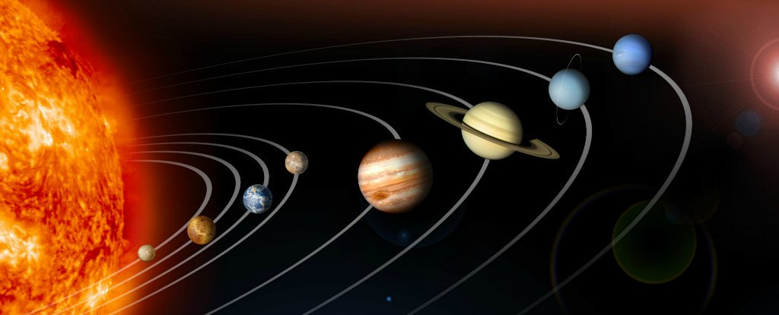
Causal explanations in the social sciences
Natural sciences: laws determine the outcome
From general laws you can explain singular events
Deterministic explanation: only one outcome is possible
E.g. when we know the positions and velocity of planets, the laws of planetary motion enable us to deduce and predict their positions at any later time
Social sciences: offer few such law-like explanations
Statistical models and probabilities
Ultimately have to rely on inferring plausible causal mechanisms

Slide 37
Causal explanations in the social sciences
The success of an explanation is largely measured in terms of the variance, so it helps to account for.
E.g. 65% of Americans are pro death penalty
Social scientists don’t try to understand how these individuals came to their conclusions (meeting others, media reports, preachers,…)
But they focus on explaining differences between nations, regions or throughout time
Why do more Americans than French people support the death penalty?
What differences can we find in terms of gender, age, class, state,…

Slide 38
Causal explanations in the social sciences
In other words: rather than explaining specific events or effects, social scientists want to understand how changes occur over time, or how differences across populations occur
They want to explain differences in the “dependent variable”
“Under which conditions does a change in X result in a change in Y?”

Slide 39
Causal explanations in the social sciences
Strictly speaking, there is no causality in the social sciences
“Causality” requires that you can explain individual facts and events
E.g. if I spill coffee over my computer, than it will break down…
In the social sciences: we try to “explain” variances between social phenomena
E.g. early school-leaving increases the probability that a person commits crime.
You need at least two elements:
Causal factor: independent or exogeneous variable, condition, explanans, input, “X”
Effect: outcome, endogenous or dependent variable, explanandum, output, “Y”

Slide 40
Multiple causalities
See also: Pettigrew, How to think like a social scientist, pp11-12 (lecture 1)
Few events in the social world are caused by only one factor
Popular analyses often point to one key factor explaining a phenomenon
E.g. high US crime rates are perceived to be caused by a “breakdown in family values”
Yet in social reality, one phenomenon is usually caused by many factors.
To make it even more complicated, these independent variables are usually strongly interrelated themselves

Slide 41
Multiple causalities
Social sciences: have to test in open systems
Conduct research in settings where the key variables that are being tested, are not the only ones operating…
E.g. examine the impact of drug abuse on labor market success…
“R²” in statistics:
Coefficient of determination
The variance that is explained by one particular independent variable or several independent variables comprising a model
Between 0 and 1

Slide 42
Multiple causalities
E.g. immigration to Europe is not due to one but to many (interrelated) causes (Hooghe et al 2008)
Push factors: economic, political, social and climatological conditions in country of origin
Pull factors: economic (employment, social policies, climate for starting up your own business), cultural (language, colonial heritage) and social factors (existence of social networks, ethnic-religious communities,…)
They all have an impact, although some more than others…
R² is 26.7% (explains 26.7% of the variance in destination countries), which they consider “more than satisfying” (Hooghe et al 2008, p500)

Slide 43
Summing up so far: social scientists…
Try to explain variance, rather than explaining specific events
Have to deal with multiple causalities, rather than one specific cause
(Positivist) social scientists try to calculate the probability that a change in X would lead to a change Y, under the condition that all other independent factors remain the same.
This is an imaginary but necessary assumption to explain social behavior
Strictly speaking there is no causality in the social sciences. But social scientists do try to explain social phenomena!

Slide 44
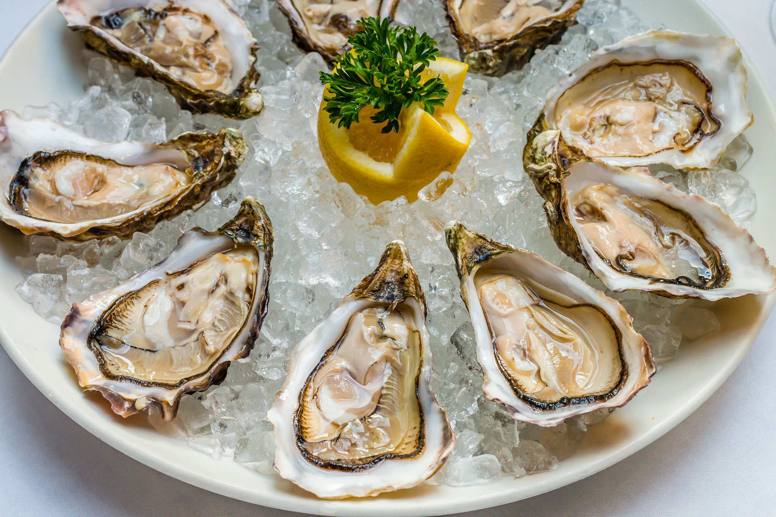
What explanations are not?
Elster, J. (2007) Explaining Social Behavior. More Nuts and Bolts for the Social Sciences, Cambridge: Cambridge University Press, p.7-31.
To cite a cause is not enough: the ‘causal mechanism’ must also be provided.
E.g. If I would state that ‘Bram died because of eating a bad oyster’, we suppose the causal mechanism is ‘food poisoning’.
But suppose that he actually died because he was allergic to oysters.
In other words: you need to specify the causal chain of events in between ‘eating an oyster’ and ‘that person dying’: including whether it was a food poisoning, an allergic reaction or something else…
Notes:
How to construct a causal model? And how to apply this theory mentioned before? Because u have to come up with the mechanisms, which mechanism is underlying this infleuence, so if u come up with why.

Slide 45
What explanations are not
1. Correlations
If we say that A and B correlate, we only know that the two factor change together or co-variate.
Yet, correlation leaves us uncertain about the direction of causality.
Only when we have some insight into the temporal sequence (A changes before B, and B changes subsequently), can we say there is an ‘effect from A on B’ (effect relation: A (education) => B (profession).
Notes:
Correlation is not the same as causality, what is fisrt, check the sequence of the variables in order of time.

Slide 46
What explanations are not
1. Correlations
E.g. children in “contested custody” have more problems at school than children whose parents reach a custody agreement
It may be that the custody dispute causes problems
But it can also be that custody disputes arise with parents who are already bitterly hostile towards each other, which makes it more likely that their children will face school problems
And: maybe difficult children with pre-existing behavioral problems contribute to a hostile relation between their parents… (direction of causality)
To assess which one is (more) true, you need to test the correlations before and after the custody agreement…

Slide 47
What explanations are not
2. Necessity or determination
E.g. children growing up in poor households have a lower chance of obtaining a university degree. Yet this does not mean that it is impossible for them to achieve one. It’s just that the probabilities that they will do so, are lower.

Slide 48
What explanations are not
2. Prediction
We may have predictive power without explanatory power:
E.g. night always follows day and the correlation is complete (r= +1,0), yet day does not cause night.
And we may be able to explain without being able to predict
E.g. Syrian conflict: some of the explanatory causes are the strongly militarized nature of Assad’s regime, climate (severe droughts between 2006 and 2010), a failed liberalization policy (retreating welfare systems), economic corruption, intense urbanization and a demographic youth bulge. Yet it was impossible to actually predict that a war would break out.

Slide 49
What explanations are not
Statistical explanations are not causal explanations (strictly speaking)
Statistical explanations cannot account for individual events.
E.g. “men tend to be more aggressive than women” is a statistical fact that can be generally explained by male hormones (e.g. testosteron). But this does not mean that you can explain the angry behavior of one individual man as being caused by hormones.
E.g. what is the role of the particular situation in which this man became angry? How has he been raised? Does his aggression serves a social goal?
The intellectual fallacy is to assume that a generalization valid for a category of people is valid in individual cases.
Notes:
Statistical explanations cannot account for individual events, one case can’t explain the whole situation , a man hit his wife does not mean that all men do so. Overgeneralization intellectual falasy

Slide 50
What explanations are not
Statistical explanations are not causal explanations (strictly speaking)
In statistical explanations, you always need to (theoretically) control for other variables.
E.g. citizens in industrialized, democratic societies live longer than citizens of less developed societies.
To establish whether it is industrialization or democracy that has a positive effect on life expectancy, we have to compare the life expectancy of democratic and nondemocratic regimes at the same level of industrialization….
And/or compare the life expectancy of (non-)industrialized states at the same level of democracy…

Slide 51
Summing up…
Before we can speak of a (causal) explanations in the social sciences, we should establish:
‘Covariation’ between A and B: a change in A increases the probability that B will change
The temporal sequence of A and B must be determined: in principle a cause precedes an effect
(Theoretically) control for other independent variables that cause the effect
Notes:
To stablish a causal relationship take in ur account
1- previous condition, covariation, 2-what cause what in which temporal order/ sequence
3- control for other independent variables

Slide 52
Overview
Introduction (causality in everyday life)
Causal explanation in the social sciences (Elster; Pettigrew)
The process of causal reasoning (Elster)

Slide 53
The process of causal reasoning
Elster, J. (2007) Explaining Social Behavior. More Nuts and Bolts for the Social Sciences, Cambridge: Cambridge University Press, p.7-31.
What Elster refers to as the “hypothetico-deductive” method
Remember: this is causal reasoning in the (post-)positivist approach

Slide 54
The process of causal reasoning
Before you begin: (double or triple) check that your facts are indeed facts (e.g. that an X percentage of the population is indeed pro death penalty)
Choose an explanatory theory
Specify a guiding and additional hypotheses (support from below and above)
Think of alternative explanations
Refute those alternative explanations (lateral support)
Derive additional testable implications
Notes:
2- deduce from this theory

Slide 55
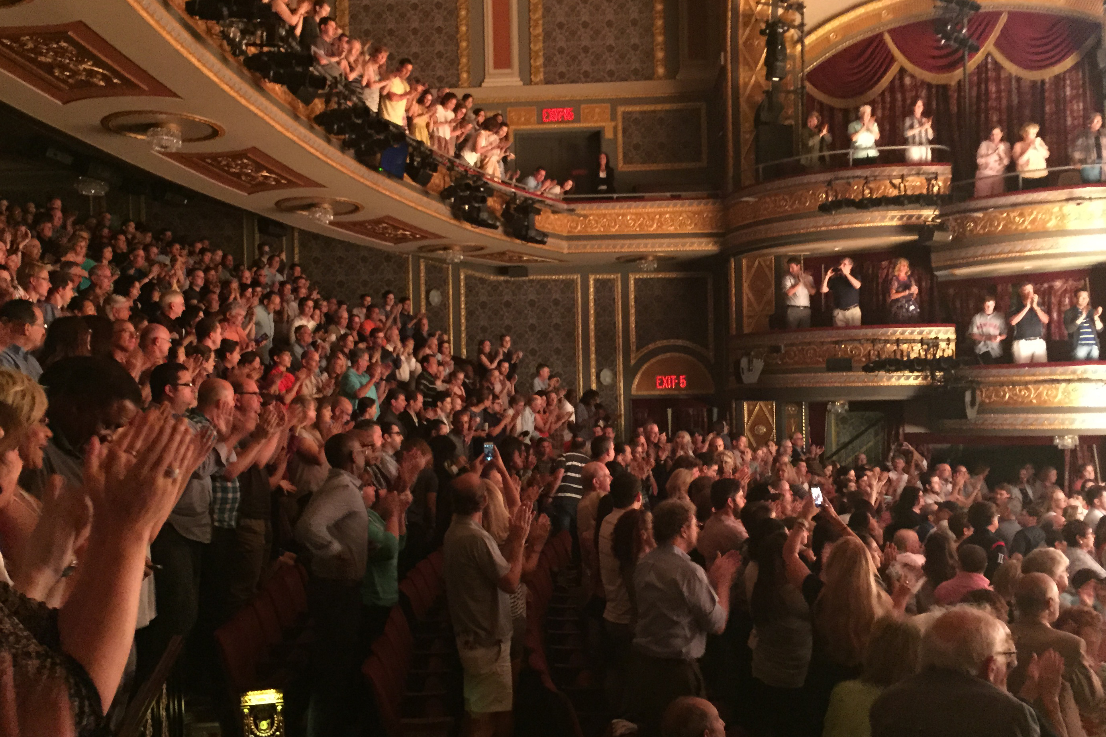
The process of causal reasoning
E.g. the increasing frequency of standing ovations/applause on Broadway show.
Choose an explanation
Rising prices: “When people have paid 75$ for a seat, many cannot admit to themselves that the show was poor or mediocre, and that they have wasted their money.”
H1: “When people have paid a great deal of money or effort to obtain a good, they tend (other things being equal) to value it more highly than when they paid less for it.”
Notes:
Get up an Explanatory theory deductive postivistic way for causal relationships

Slide 56
The process of causal reasoning
2. Strengthen your hypotheses
2.1 Support H1 from below: deduce and verify other facts, besides the rising number of standing ovations in Broadway shows
E.g. if H1 is true, we would expect fewer standing ovations in shows whose prices for some reason have not gone up.
H2: “In shows whose prices have not gone up, there are fewer standing ovations.”
E.g. if H1 is true, we would expect fewer standing ovations if large numbers of tickets to a show are sold to firms and given by them to their employees.
H3: “In shows where a large number of tickets are sold to firms, there are fewer standing ovations.”

Slide 57
The process of causal reasoning
2.2 Support H1 from above: demonstrate how H1 can be deduced from a more general theory, that has been widely tested.
Leon Festinger’s theory of cognitive dissonance may support H1.
“when a person experiences an internal inconsistency or dissonance among her beliefs and values, we can expect some kind of mental readjustment that will eliminate or reduce the dissonance.” This theory has been widely tested and re-affirmed in a lot of cases
E.g. a person who has just bought a car will seek out ads that portray that brand positively. And may thus help to make your argument/hypothesis more convincing.
But: such support from above is never decisive, unless you can test it in this particular case of course.

Slide 58
The process of causal reasoning
3. and 4. Think of alternative explanations and refute these explanations. This means that H1 receives lateral support.
E.g. perhaps there are more standing ovations because today’s audiences are less sophisticated than the traditional audiences.
H3: “the frequency of standing ovations is higher when the audiences have a lower class background.”
E.g. maybe shows have simply become better.
H4: “the frequency of standing ovations is higher with shows that receive better reviews and/or are performed over a longer period of time (H4a), and there are more of these successful shows than before.
The better you can refute alternative explanations, the more convincing your explanation becomes!
Notes:
Coming up with concrete testable hypothesis, support from above and below.
Get alternative explanation

Slide 59
The process of causal reasoning
5. Derive testable implications
E.g. If H1 is correct (and broadway shows receive more standing ovations because of rising prices), what are the implications for other types of entertainment (e.g. free television shows, rising cinema tickets, museum entrance,…)
This helps to show the more general relevance of your hypothesis

