Slide 1
The Constitutional Sociology of Europe:
Politics, Law and Society
Paul blokker, PhD
Institute of Sociological studies, Charles University
11 April, 2017

Slide 2
Constitutional Sociology
Summary last class
Many constitutions in Europe:
a. different ‘jurisdictions’: national, supranational (EU), international (CoE)
b. functional: economic, legal, political, security
c. cultural: different understandings
Jan Komarek: Role of different courts in constitutional systems, and special role of constitutional courts; changes due to prominence EU law in domestic situations
2
Notes:
2

Slide 3
Constitutional Sociology
Final Exam
-The student will be evaluated at the end of the course by means of a written essay, to be handed in at the end of the semester (exact date will be stipulated);
The written essay will be of
BA: a minimum of 2.000 words, and needs to contain a bibliography with at least 5 academic resources.
MA: a minimum of 3.000 words, and needs to contain a bibliography with at least 10 academic resources.
3
Notes:
3

Slide 4
Constitutional Sociology
Final Exam
-Possible topics:
Citizen participation in constitutional reform processes;
Constitutions as vehicles of democratic innovation;
The European Union’s Democratic Deficit and Citizen Participation
4
Notes:
4

Slide 5
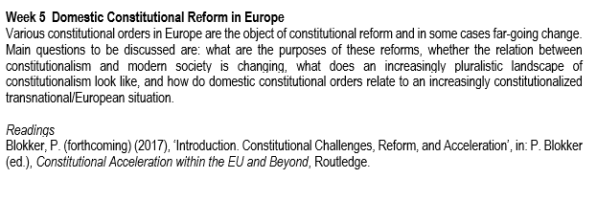
Readings
Constitutional Sociology

Slide 6
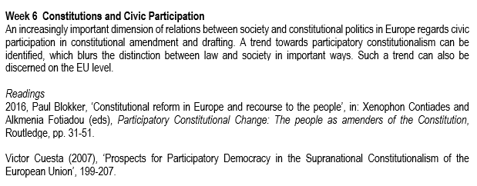
Readings
Constitutional Sociology

Slide 7
Objectives 1. Contemporary challenges to domestic constitutional orders; 2. Civic participation in constitutional politics: 1. Iceland; 2. Ireland; 3. Romania; 4. EU
Constitutional Sociology

Slide 8
Constitutional Sociology
What is happening to constitutional democracy?

Slide 9
Challenges to constitutional democracy - Many scholars discuss new forms of constitutionalism, in particular beyond the state; - There is relatively little attention for the complex changes that affect national or domestic constitutions
Constitutional Sociology

Slide 10
Challenges to constitutional democracy - A set of challenges informs a general tendency in domestic contexts towards ‘constitutional acceleration’; constitutional acceleration: the increased propensity of different actors to engage in (formal) reform of the constitutional order
Constitutional Sociology

Slide 11
Challenges to constitutional democracy Key reasons/motivations for change include: 1. economic reasons, related to the recent economic crisis; 2. reasons of modernization, obsoleteness; 3. reasons of redefinition of political units, in particular due to calls for extensive autonomy of distinctive regions; 4. reasons of identity and national self-rule; 5. reasons of participation and popular sovereignty, calls for more robust participation; 6. reasons of post-sovereignty, adaptation of constitutions to realities of shared sovereignty;
Constitutional Sociology

Slide 12
Constitutional Acceleration Modern constitutionalism is caught in the tension between rigidity/endurance (eternity) and the need for change and reform; Constitutional acceleration – changing constitutional norms frequently – can be understood as a reaction to ‘societal acceleration’ and ‘high-speed society’;
Constitutional Sociology

Slide 13
Constitutional Acceleration Modern constitutions seek to freeze time or to institutionalize and stabilize characteristics of present society into the future; But with fast changing societies, there is increased constitutional anomie, that is, an increasing gap or discrepancy between the formal-institutional dimension of constitutional orders and societal relations, forms of interaction, and related norms;
Constitutional Sociology

Slide 14
Constitutional Acceleration In Durkheimian terms, anomie emerges in a context of an ‘absence or defect of a social regulation capable of insuring cooperation between specialized functions’ (Besnard); Rigid constitutions face the danger of being out of touch with current developments (internet, abortion, gay marriage);
Constitutional Sociology

Slide 15
Constitutional Acceleration A danger is, however, that under the banner of necessity of change, constitutional reform leads to evermore power of the executive (to bypass slow parliamentary, deliberative processes) and partisan reforms, rather than consensual ones; ‘Rapid fire agere’ versus ‘slow-going deliberare’ (Scheuerman 2002)
Constitutional Sociology

Slide 16
Modes of constitution-making and reform Constitutional reform includes a range of procedures that involve elite appointment, direct election, or indirect selection of constitutional reform bodies; Reform process can be either open or closed, and indirectly legitimated (by elites) or directly (by the citizens);
Constitutional Sociology

Slide 17
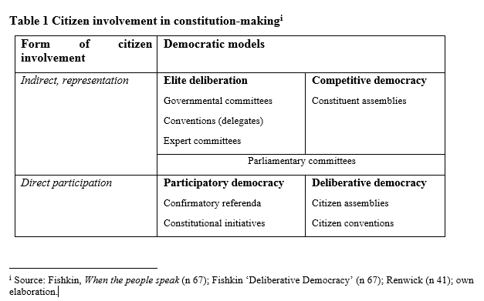

Slide 18
Amendment rules Who can initiate amendment, what procedures are to be followed, which parts of the constitution are immune to change, how is an amendment to be adopted or ratified?; Distinction: Amendment and Revision (clearly identified in Austrian Constitution, not so in Italian Constitution)
Constitutional Sociology

Slide 19
Amendment rules Amendment includes: Scope (comprehensive, restricted, exceptional) Single- or multi-track (one or various procedures) Operational restrictions (e.g. quora)
Constitutional Sociology

Slide 20
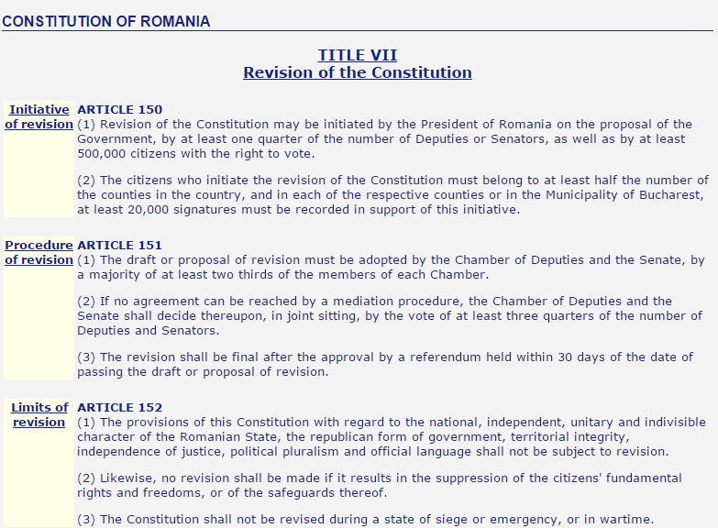
Constitutional Sociology

Slide 21
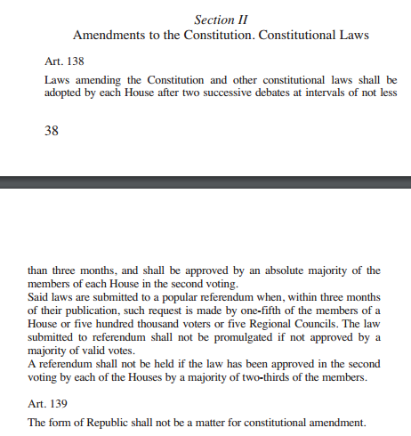
Constitutional Sociology

Slide 22
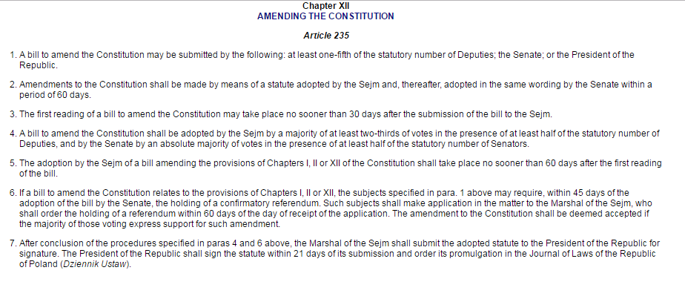
Constitutional Sociology

Slide 23
Constitutional Mindsets ‘[M]odern law does not follow a developmental telos of ever more rational, inclusive, and liberal formation, but faces social conflicts and struggles between social groups and classes, which are always struggles over material and ideological interests’ (Brunkhorst 2014); Different actors hold different mindsets regarding change, indicating different views of why change is necessary, what the nature of the constitutional order is, and how constitutions ought to operate;
Constitutional Sociology

Slide 24
Constitutional Mindsets Two key mindsets can be identified: The Kantian mindset: autonomy, egalitarian self-determination, representative government, and universal rights; The managerial mindset: the rule of law, judicial review, possessive individualism and competition;
Constitutional Sociology

Slide 25
Constitutional Mindsets The Kantian mindset: ‘not just the rule of law – but the emancipation from any law that is not the law to which we have given our agreement’; The managerial mindset: ‘designed to preserve the evolutionary advances of the structural coupling of law and other functional systems’;
Constitutional Sociology

Slide 26
Constitutional Mindsets The Kantian mindset: universal language of democratizers The managerial mindset: technocratic language of elites
Constitutional Sociology

Slide 27
Participatory constitutionalism One recent tendency in constitutional change regards the recourse to popular or citizen participation in reforms It appears increasingly difficult not to involve the citizenry when constitutional reforms are being proposed or new constitutions designed An important aspect is that of legitimacy, that is, the idea is that if citizens are not involved, it is difficult to argue that the reforms are underpinned by popular support and the idea of popular sovereignty
Constitutional Sociology

Slide 28
Participatory constitutionalism One important argument is that constitutional reform touches upon fundamental questions of a political community, and hence needs some kind of citizen confirmation A further significant argument is that some questions (e.g. same sex marriage) cannot be resolved by legal means and need to reflect widespread civic attitudes and support
Constitutional Sociology

Slide 29
Participatory constitutionalism In significant ways, participatory constitutionalism is different from the ‘legal constitutonalism‘ that became predominant after WWII Sociologically speaking, participatory constitutionalism is of great interest, as it explicitly links society with constitutional norms and constitutional change
Constitutional Sociology

Slide 30
Participatory constitutionalism Participatory constitutionalism can be understood as a form of democratic innovation, in an attempt to (re-)connect citizens to the democratic process
Constitutional Sociology

Slide 31
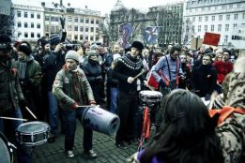
Participatory Constitutionalism Example Iceland
Constitutional Sociology

Slide 32
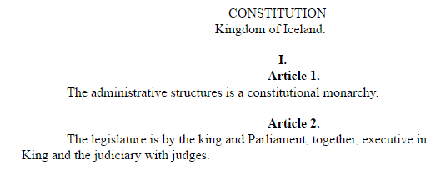
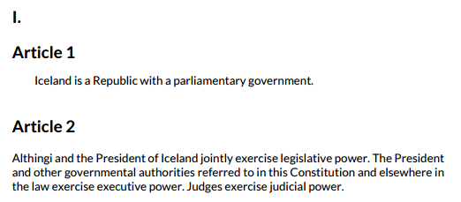
Example Iceland Icelandic Constitutions (1920 - 1944)
Constitutional Sociology

Slide 33
Example Iceland - The collapse of the financial system in Iceland in 2008 led to a deep political crisis - Intense protests in front of Althingi (the Parliament) led to the resignation of PM Geir H. Haarde and a call for new elections - One of the most drastic outcomes was the set-up of a Constitutional Council, made up of ‘ordinary citizens’, to reform the Icelandic Constitution
Constitutional Sociology

Slide 34
Example Iceland - Internationally, Iceland became well-known for its ‘crowd-sourced’ constitution-making process, in which the 25 citizens of the Constitutional Council interacted with the wider public through Facebook, Twitter, YouTube and e-mail; - The whole process encountered a lot of domestic resistance, however, by both the traditionally largest political parties, and others, skeptical of constitutional change;
Constitutional Sociology

Slide 35
Example Iceland - .
Constitutional Sociology
Icelandic Constitutional Reform Process
Financial Collapse 2008
Protests leading to resignation government early 2009
First deliberative meeting with ca. 1000 citizens (Anthill) end of 2009
Second deliberative meeting with ca. 1000 citizens (Constitution) end of 2010
Election of 25-member Constitutional Council November 2010
Drafting new Icelandic Constitution Summer 2011
Referendum October 2012 on new Constitution
General elections April 2013: constitutional reform stalled
2013-2016: Parliamentary commission works on four constitutional issues
October 2016: General elections

Slide 36
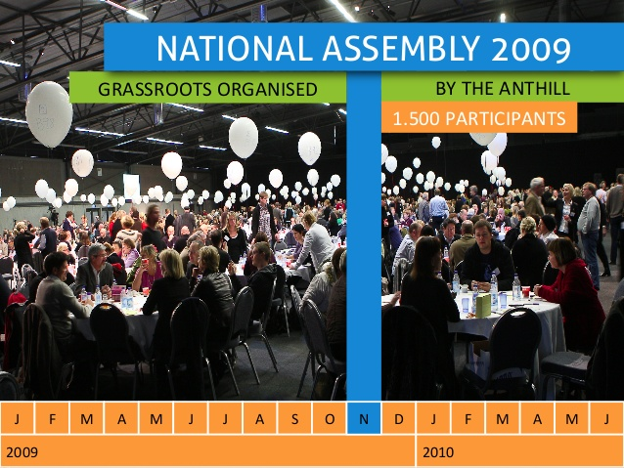
Constitutional Sociology

Slide 37
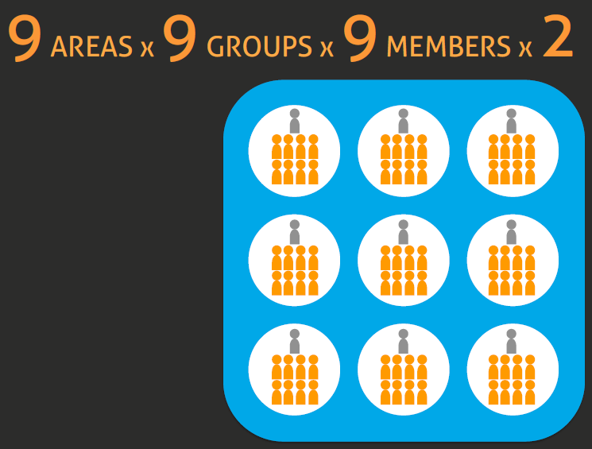
Constitutional Sociology

Slide 38
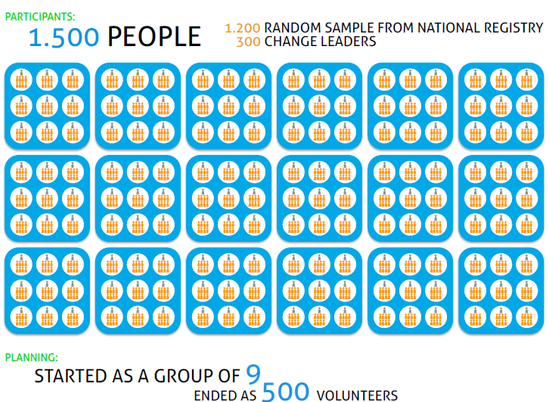
Constitutional Sociology

Slide 39
Constitutional Sociology

Slide 40
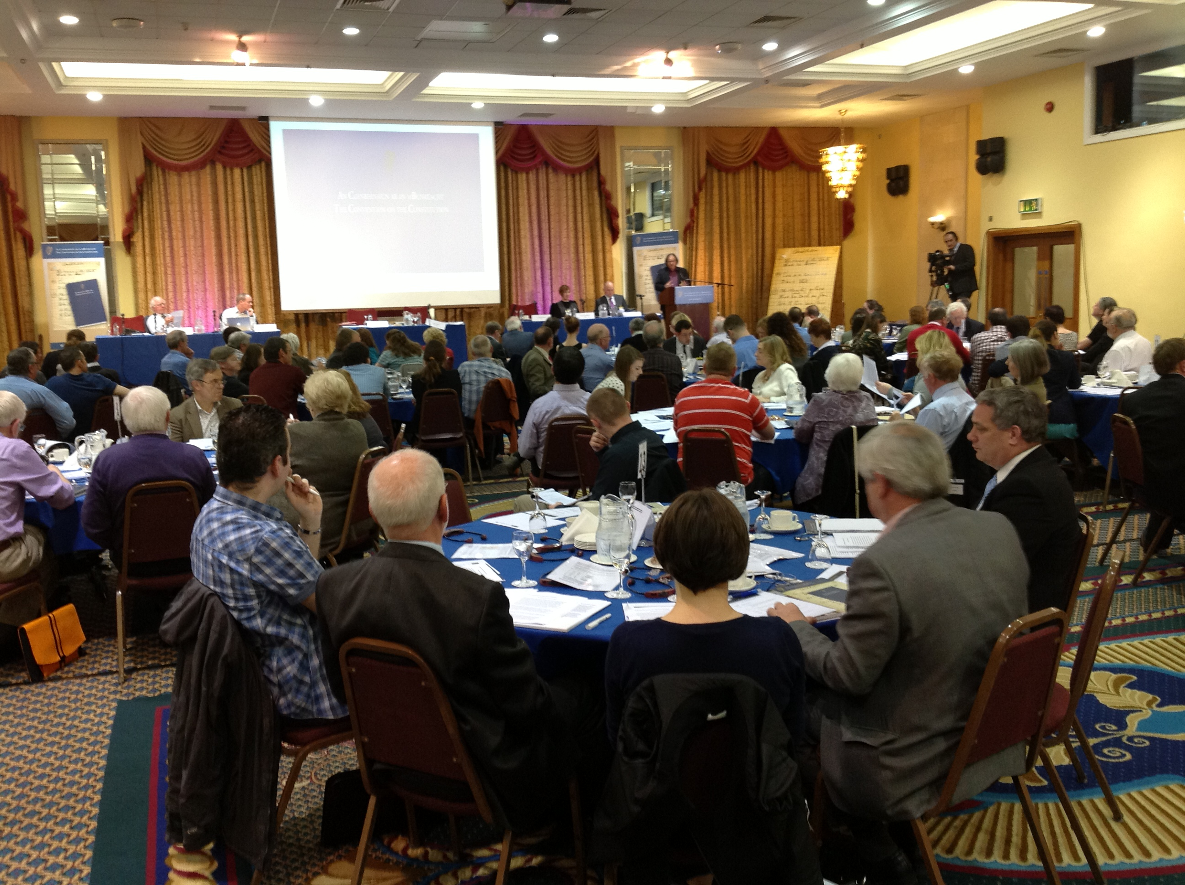
Constitutional Sociology
Participatory Constitutionalism Example Ireland

Slide 41
Example Ireland - The economic crisis of 2008 led to calls for constitutional reform, including from major political parties (Fine Gael and Labour party);
Constitutional Sociology

Slide 42
Example Ireland - In Dec. 2012, a Constitutional Convention was set up, along the lines of earlier experiences in British Columbia and the Netherlands; - The Convention includes 66 randomly selected citizens (taking into account age, gender, region, education and socio-economic status), 33 politicians, plus an independent chair, as well as experts (political scientists) as mediators and advisors;
Constitutional Sociology

Slide 43
Example Ireland - 8 matters were to be discussed: - review of the Dail electoral system - reducing the presidential term to five years; - marriage equality; - clause on women in the home; - greater participation women in politics and public life; - removing blasphemy from the Constitution; - votes for emigrants in presidential elections
Constitutional Sociology

Slide 44
Example Ireland - The Convention consisted of 13 deliberative weekends over more than a year time; - The Convention adopted 38 recommendations (inter alia on voting age and same-sex marriage); - The Convention was consultative, but the government promised to hold referenda on some of the proposals (incl. age for eligibility to run for president and same-sex marriage, May 2015);
Constitutional Sociology

Slide 45
Example Ireland - In October 2016, a follow-up Citizens’ Assembly was set up (An Tionól Saoránach), in order to further discuss constitutional change (inter alia regarding abortion (8th amendment) and referendums); - The Citizens’ Assembly consists of 99 randomly selected citizens;
Constitutional Sociology

Slide 46
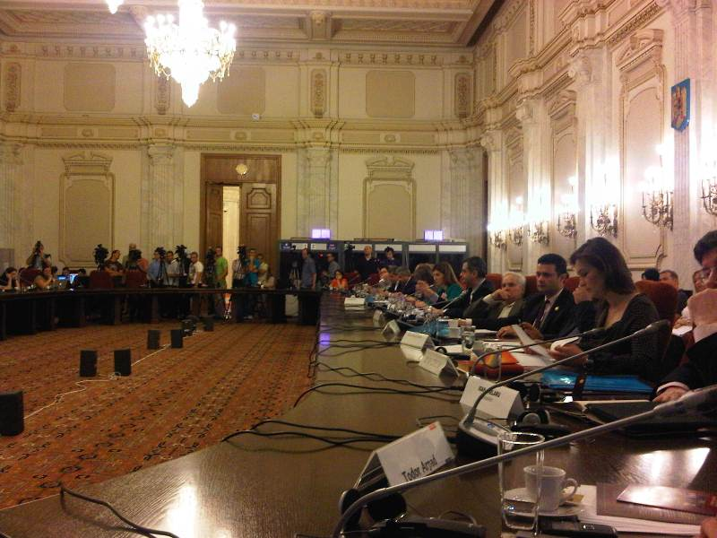
Constitutional Sociology
Participatory Constitutionalism Example Romania

Slide 47
Example Romania - Romania experienced (once again) a constitutional crisis in the summer of 2012, due to conflict between the President (Basescu) and the government (PM Ponta); - In late 2012, Ponta and his PSD party won a large majority in the general elections and started a constitutional reform process; - An innovative part of this process was the set up of a Forum Constitutional, in which citizens engaged with constitutional reform and proposed their own ideas for the reform process;
Constitutional Sociology

Slide 48
Example Romania - A Forum Constitutional had already been experimented with in 2002-3 , with the first major post-communist constitutional reform; - The Forum was organized by the NGO Asociatia Pro Democratia (APD) and the Romanian Parliament, and consisted of a series of deliberative meetings and conferences in major Romanian cities, the organization of an online form, and the production of a sizeable final report with citizen proposals;
Constitutional Sociology

Slide 49
Example Romania - Forty-two debates were held with around 1600 participants, online proposals from more than 400 people were received, and a conference was organized with the Venice Commission. The final outcome consisted in a comprehensive report, edited by the president of the Forum, and presented to the parliamentary commission;
Constitutional Sociology

Slide 50
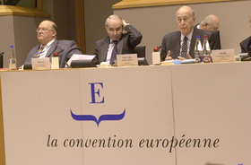
Constitutional Sociology
Participatory Constitutionalism Example The European
Union

Slide 51
Example EU - The famous democratic deficit of the EU has been predominantly approached from the perspective of representative democracy, and hence attempts have been made to strengthen the European Parliament; - But significant attempts to involve the citizens/civil society in a more direct way have been equally undertaken: - Convention for the Eur. Charter of Fundamental Rights (1999) - European Commission Civic Dialogue - Convention on the Future of Europe (2003-2005) - European Citizens’ Initiative
Constitutional Sociology

