Slide 1
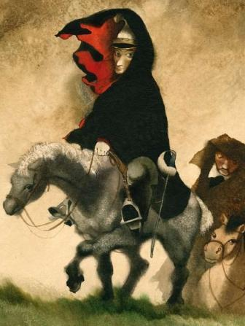
RITUALISTIC/ Initiation THEORY ON Fairytales
Notes:
1

Slide 2
RITUALISTIC/ Initiation THEORY ON Fairytales
Conceptual background:
A.van Gennep: The Rites of Passage (1909)
V. Propp: Historical Roots of the Wondertale (1946)
J. Campbell: The Hero with a Thousand Faces (1949)
M. Eliade: Rites and Symbols of Initiation (1958)
Shamanism: Archaic Technique of Ecstasy (1964)
Notes:
2

Slide 3
SHAMANIC RITUALS/ INITIATION RITES /RITES OF PASSAGE | FAIRY TALES
RITUALISTIC/ Initiation THEORY OF Fairytales
Notes:
3

Slide 4
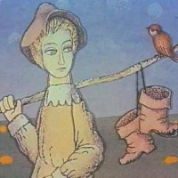
SHAMANIC RITUALS/ INITIATION RITES /RITES OF PASSAGE | FAIRY TALES
I. First phase: SEPARATION/ ISOLATION/ DEPARTURE
Notes:
4

Slide 5
SHAMANIC RITUALS/ INITIATION RITES /RITES OF PASSAGE | FAIRY TALES
I. First phase: SEPARATION/ ISOLATION/ DEPARTURE
 | Hero leaves his/her kingdom, family, everyday life (Bayaya, Long, Wide and Sharpeyes, The Fire Bird…, The Twins...)
Notes:
5

Slide 6
SHAMANIC RITUALS/ INITIATION RITES /RITES OF PASSAGE | FAIRY TALES
I. First phase: SEPARATION/ ISOLATION/ DEPARTURE
 | Hero leaves his/her kingdom, family, everyday life (Bayaya, Long, Wide and Sharpeyes, The Fire Bird…, The Twins...) frequent motif of forest (The Sorcerer´s Apprentice, The Twins… …Little Red Cap, Hansel and Grethel, Snowhite…)
Notes:
6

Slide 7
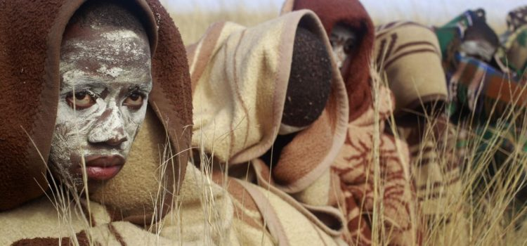
SHAMANIC RITUALS/ INITIATION RITES /RITES OF PASSAGE | FAIRY TALES
I. First phase: SEPARATION/ ISOLATION/ DEPARTURE
Young man/woman leaves his community (goes to a special hut, to the forest or climbs up a mountain) | Hero leaves his/her kingdom, family, everyday life (Bayaya, Long, Wide and Sharpeyes, The Fire Bird…, The Twins...) frequent motif of forest (The Sorcerer´s Apprentice, The Twins… …Little Red Cap, Hansel and Grethel, Snowhite…)
Notes:
7

Slide 8
SHAMANIC RITUALS/ INITIATION RITES /RITES OF PASSAGE | FAIRY TALES
I. First phase: SEPARATION/ ISOLATION/ DEPARTURE
Notes:
8

Slide 9
SHAMANIC RITUALS/ INITIATION RITES /RITES OF PASSAGE | FAIRY TALES
I. First phase: SEPARATION/ ISOLATION/ DEPARTURE
 | Hero is lured, invited, appealed
Notes:
9

Slide 10
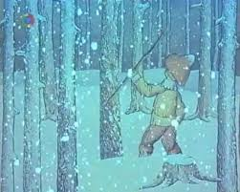
SHAMANIC RITUALS/ INITIATION RITES /RITES OF PASSAGE | FAIRY TALES
I. First phase: SEPARATION/ ISOLATION/ DEPARTURE
 | Hero is lured, invited, appealed - The Sorcerer´s Apprentice, The Fire Bird, The Twins
Notes:
10

Slide 11
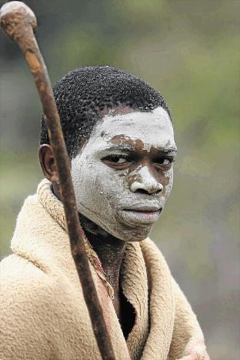
SHAMANIC RITUALS/ INITIATION RITES /RITES OF PASSAGE | FAIRY TALES
I. First phase: SEPARATION/ ISOLATION/ DEPARTURE
An initiand is chosen by the community - someone who needs to make transition | Hero is lured, invited, appealed - The Sorcerer´s Apprentice, The Fire Bird, The Twins
Notes:
11

Slide 12
SHAMANIC RITUALS/ INITIATION RITES /RITES OF PASSAGE | FAIRY TALES
I. First phase: SEPARATION/ ISOLATION/ DEPARTURE
An initiand is chosen by the community - someone who needs to make transition - „call to adventure“ (Campbell) | Hero is lured, invited, appealed - The Sorcerer´s Apprentice, The Fire Bird, The Twins
Notes:
12

Slide 13
SHAMANIC RITUALS/ INITIATION RITES /RITES OF PASSAGE | FAIRY TALES
I. First phase: SEPARATION/ ISOLATION/ DEPARTURE
An initiand is chosen by the community - someone who needs to make transition - „call to adventure“ (Campbell) | Hero is lured, invited, appealed - The Sorcerer´s Apprentice, The Fire Bird, The Twins hero is usually different from the others: often the youngest son, orphan, cursed sometimes a special sign or extraordinary way of birth (The Twins, Three Golden Hairs)
Notes:
13

Slide 14
SHAMANIC RITUALS/ INITIATION RITES /RITES OF PASSAGE | FAIRY TALES
I. First phase: SEPARATION/ ISOLATION/ DEPARTURE
An initiand is chosen by the community - someone who needs to make transition - „call to adventure“ (Campbell) a novice (= future shaman) different from others chosen by the gods or spirits by natural calling - „shaman´s vocation“ (Eliade) | Hero is lured, invited, appealed - The Sorcerer´s Apprentice, The Fire Bird, The Twins hero is usually different from the others: often the youngest son, orphan, cursed sometimes a special sign or extraordinary way of birth (The Twins, Three Golden Hairs)
Notes:
14

Slide 15
SHAMANIC RITUALS/ INITIATION RITES /RITES OF PASSAGE | FAIRY TALES
I. First phase: SEPARATION/ ISOLATION/ DEPARTURE
An initiand is chosen by the community - someone who needs to make transition - „call to adventure“ (Campbell) a novice (= future shaman) different from others chosen by the gods or spirits by natural calling - „shaman´s vocation“ (Eliade) destined to participate in more intense religious experience | Hero is lured, invited, appealed - The Sorcerer´s Apprentice, The Fire Bird, The Twins hero is usually different from the others: often the youngest son, orphan, cursed sometimes a special sign or extraordinary way of birth (The Twins, Three Golden Hairs)
Notes:
15

Slide 16
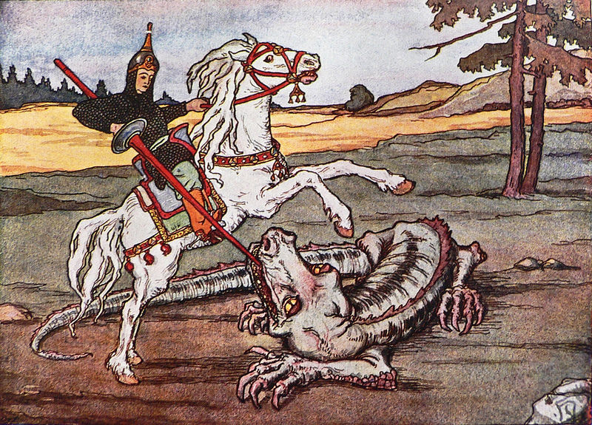
SHAMANIC RITUALS/ INITIATION RITES /RITES OF PASSAGE | FAIRY TALES
II. Second phase: INITIATION/ TRANSITION/ ADVENTURE
Notes:
16

Slide 17
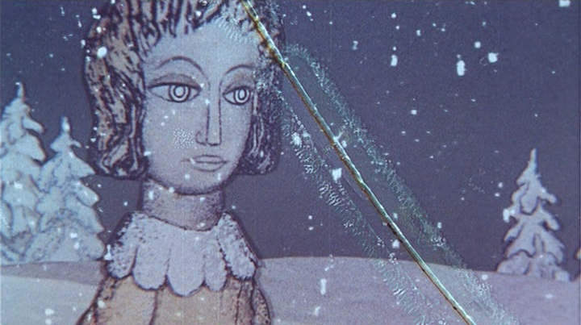
SHAMANIC RITUALS/ INITIATION RITES /RITES OF PASSAGE | FAIRY TALES
II. Second phase: INITIATION/ TRANSITION/ ADVENTURE Difficulties and suffering
Notes:
17

Slide 18
SHAMANIC RITUALS/ INITIATION RITES /RITES OF PASSAGE | FAIRY TALES
II. Second phase: INITIATION/ TRANSITION/ ADVENTURE Difficulties and suffering
Notes:
18

Slide 19
SHAMANIC RITUALS/ INITIATION RITES /RITES OF PASSAGE | FAIRY TALES
II. Second phase: INITIATION/ TRANSITION/ ADVENTURE Difficulties and suffering
 | Fairytale hero suffers physically:
Notes:
19

Slide 20
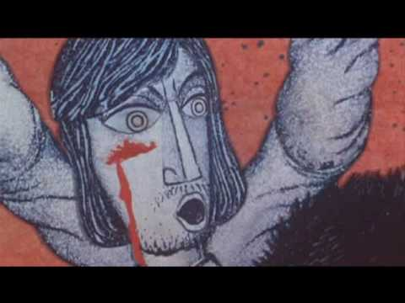
SHAMANIC RITUALS/ INITIATION RITES /RITES OF PASSAGE | FAIRY TALES
II. Second phase: INITIATION/ TRANSITION/ ADVENTURE Difficulties and suffering
 | Fairytale hero suffers physically: beating or torture
Notes:
20

Slide 21
SHAMANIC RITUALS/ INITIATION RITES /RITES OF PASSAGE | FAIRY TALES
II. Second phase: INITIATION/ TRANSITION/ ADVENTURE Difficulties and suffering
 | Fairytale hero suffers physically: beating or torture (The Sorcerer´s Apprentice, When the Leaves Will Fall from the Oaks)
Notes:
21

Slide 22
SHAMANIC RITUALS/ INITIATION RITES /RITES OF PASSAGE | FAIRY TALES
II. Second phase: INITIATION/ TRANSITION/ ADVENTURE Difficulties and suffering
 | Fairytale hero suffers physically: beating or torture (The Sorcerer´s Apprentice, When the Leaves Will Fall from the Oaks) being chopped to pieces
Notes:
22

Slide 23
SHAMANIC RITUALS/ INITIATION RITES /RITES OF PASSAGE | FAIRY TALES
II. Second phase: INITIATION/ TRANSITION/ ADVENTURE Difficulties and suffering
 | Fairytale hero suffers physically: beating or torture (The Sorcerer´s Apprentice, When the Leaves Will Fall from the Oaks) being chopped to pieces (The Fire Bird)
Notes:
23

Slide 24
SHAMANIC RITUALS/ INITIATION RITES /RITES OF PASSAGE | FAIRY TALES
II. Second phase: INITIATION/ TRANSITION/ ADVENTURE Difficulties and suffering
 | Fairytale hero suffers physically: beating or torture (The Sorcerer´s Apprentice, When the Leaves Will Fall from the Oaks) being chopped to pieces (The Fire Bird) hunger (Hansel and Grethel…)
Notes:
24

Slide 25
SHAMANIC RITUALS/ INITIATION RITES /RITES OF PASSAGE | FAIRY TALES
II. Second phase: INITIATION/ TRANSITION/ ADVENTURE Difficulties and suffering
Initiation rites involve various ordeals: | Fairytale hero suffers physically: beating or torture (The Sorcerer´s Apprentice, When the Leaves Will Fall from the Oaks) being chopped to pieces (The Fire Bird) hunger (Hansel and Grethel…)
Notes:
25

Slide 26
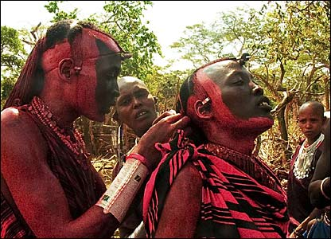
SHAMANIC RITUALS/ INITIATION RITES /RITES OF PASSAGE | FAIRY TALES
II. Second phase: INITIATION/ TRANSITION/ ADVENTURE Difficulties and suffering
Initiation rites involve various ordeals: - woundings, beatings, | Fairytale hero suffers physically: beating or torture (The Sorcerer´s Apprentice, When the Leaves Will Fall from the Oaks) being chopped to pieces (The Fire Bird) hunger (Hansel and Grethel…)
Notes:
26

Slide 27
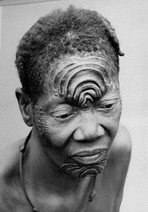
SHAMANIC RITUALS/ INITIATION RITES /RITES OF PASSAGE | FAIRY TALES
II. Second phase: INITIATION/ TRANSITION/ ADVENTURE Difficulties and suffering
Initiation rites involve various ordeals: - woundings, beatings, scarification, | Fairytale hero suffers physically: beating or torture (The Sorcerer´s Apprentice, When the Leaves Will Fall from the Oaks) being chopped to pieces (The Fire Bird) hunger (Hansel and Grethel…)
Notes:
27

Slide 28
SHAMANIC RITUALS/ INITIATION RITES /RITES OF PASSAGE | FAIRY TALES
II. Second phase: INITIATION/ TRANSITION/ ADVENTURE Difficulties and suffering
Initiation rites involve various ordeals: - woundings, beatings, scarification, circumsision, teeth extractions | Fairytale hero suffers physically: beating or torture (The Sorcerer´s Apprentice, When the Leaves Will Fall from the Oaks) being chopped to pieces (The Fire Bird) hunger (Hansel and Grethel…)
Notes:
28

Slide 29
SHAMANIC RITUALS/ INITIATION RITES /RITES OF PASSAGE | FAIRY TALES
II. Second phase: INITIATION/ TRANSITION/ ADVENTURE Difficulties and suffering
Initiation rites involve various ordeals: - woundings, beatings, scarification, circumsision, teeth extractions Resistance to physical suffering = proof of will and spiritual strenght | Fairytale hero suffers physically: beating or torture (The Sorcerer´s Apprentice, When the Leaves Will Fall from the Oaks) being chopped to pieces (The Fire Bird) hunger (Hansel and Grethel…)
Notes:
29

Slide 30
SHAMANIC RITUALS/ INITIATION RITES /RITES OF PASSAGE | FAIRY TALES
II. Second phase: INITIATION/ TRANSITION/ ADVENTURE Difficulties and suffering
Initiation rites involve various ordeals: - woundings, beatings, scarification, circumsision, teeth extractions Resistance to physical suffering = proof of will and spiritual strenght | Fairytale hero suffers physically: beating or torture (The Sorcerer´s Apprentice, When the Leaves Will Fall from the Oaks) being chopped to pieces (The Fire Bird) hunger (Hansel and Grethel…) or psychically - solitude, diferrent restrictions
Notes:
30

Slide 31
SHAMANIC RITUALS/ INITIATION RITES /RITES OF PASSAGE | FAIRY TALES
II. Second phase: INITIATION/ TRANSITION/ ADVENTURE Difficulties and suffering
Initiation rites involve various ordeals: - woundings, beatings, scarification, circumsision, teeth extractions Resistance to physical suffering = proof of will and spiritual strenght Various restrictions and prohibitions: | Fairytale hero suffers physically: beating or torture (The Sorcerer´s Apprentice, When the Leaves Will Fall from the Oaks) being chopped to pieces (The Fire Bird) hunger (Hansel and Grethel…) or psychically - solitude, diferrent restrictions
Notes:
31

Slide 32
SHAMANIC RITUALS/ INITIATION RITES /RITES OF PASSAGE | FAIRY TALES
II. Second phase: INITIATION/ TRANSITION/ ADVENTURE Difficulties and suffering
Initiation rites involve various ordeals: - woundings, beatings, scarification, circumsision, teeth extractions Resistance to physical suffering = proof of will and spiritual strenght Various restrictions and prohibitions: solitude, vow of silence fasting sleeping restriction sight supression | Fairytale hero suffers physically: beating or torture (The Sorcerer´s Apprentice, When the Leaves Will Fall from the Oaks) being chopped to pieces (The Fire Bird) hunger (Hansel and Grethel…) or psychically - solitude, diferrent restrictions
Notes:
32

Slide 33
SHAMANIC RITUALS/ INITIATION RITES /RITES OF PASSAGE | FAIRY TALES
II. Second phase: INITIATION/ TRANSITION/ ADVENTURE Difficulties and suffering
Initiation rites involve various ordeals: - woundings, beatings, scarification, circumsision, teeth extractions Resistance to physical suffering = proof of will and spiritual strenght Various restrictions and prohibitions: solitude, vow of silence fasting sleeping restriction sight supression | Fairytale hero suffers physically: beating or torture (The Sorcerer´s Apprentice, When the Leaves Will Fall from the Oaks) being chopped to pieces (The Fire Bird) hunger (Hansel and Grethel…) or psychically - solitude, diferrent restrictions) - The Twins, Bayaya
Notes:
33

Slide 34
SHAMANIC RITUALS/ INITIATION RITES /RITES OF PASSAGE | FAIRY TALES
II. Second phase: INITIATION/ TRANSITION/ ADVENTURE Difficulties and suffering
Initiation rites involve various ordeals: - woundings, beatings, scarification, circumsision, teeth extractions Resistance to physical suffering = proof of will and spiritual strenght Various restrictions and prohibitions: solitude, vow of silence fasting sleeping restriction sight supression | Fairytale hero suffers physically: beating or torture (The Sorcerer´s Apprentice, When the Leaves Will Fall from the Oaks) being chopped to pieces (The Fire Bird) hunger (Hansel and Grethel…) or psychically - solitude, diferrent restrictions) - The Twins, Bayaya - Long, Wide and Sharpeyes
Notes:
34

Slide 35
SHAMANIC RITUALS/ INITIATION RITES /RITES OF PASSAGE | FAIRY TALES
II. Second phase: INITIATION/ TRANSITION/ ADVENTURE Difficulties and suffering
Initiation rites involve various ordeals: - woundings, beatings, scarification, circumsision, teeth extractions Resistance to physical suffering = proof of will and spiritual strenght Various restrictions and prohibitions: solitude, vow of silence fasting sleeping restriction sight supression | Fairytale hero suffers physically: beating or torture (The Sorcerer´s Apprentice, When the Leaves Will Fall from the Oaks) being chopped to pieces (The Fire Bird) hunger (Hansel and Grethel…) or psychically - solitude, diferrent restrictions) - The Twins, Bayaya - Long, Wide and Sharpeyes - The Fire Bird
Notes:
35

Slide 36
SHAMANIC RITUALS/ INITIATION RITES /RITES OF PASSAGE | FAIRY TALES
II. Second phase: INITIATION/ TRANSITION/ ADVENTURE Difficulties and suffering
Initiation rites involve various ordeals: - woundings, beatings, scarification, circumsision, teeth extractions Resistance to physical suffering = proof of will and spiritual strenght Various restrictions and prohibitions: solitude, vow of silence fasting sleeping restriction sight supression | Fairytale hero suffers physically: beating or torture (The Sorcerer´s Apprentice, When the Leaves Will Fall from the Oaks) being chopped to pieces (The Fire Bird) hunger (Hansel and Grethel…) or psychically - solitude, diferrent restrictions) - The Twins, Bayaya - Long, Wide and Sharpeyes - The Fire Bird - The Sorcerer´s Apprentice, …
Notes:
36

Slide 37
SHAMANIC RITUALS/ INITIATION RITES /RITES OF PASSAGE | FAIRY TALES
II. Second phase: INITIATION/ TRANSITION/ ADVENTURE Heroic deeds
Notes:
37

Slide 38
SHAMANIC RITUALS/ INITIATION RITES /RITES OF PASSAGE | FAIRY TALES
II. Second phase: INITIATION/ TRANSITION/ ADVENTURE Heroic deeds
Notes:
38

Slide 39
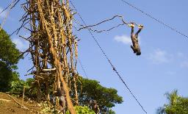
SHAMANIC RITUALS/ INITIATION RITES /RITES OF PASSAGE | FAIRY TALES
II. Second phase: INITIATION/ TRANSITION/ ADVENTURE Heroic deeds
Notes:
39

Slide 40
SHAMANIC RITUALS/ INITIATION RITES /RITES OF PASSAGE | FAIRY TALES
II. Second phase: INITIATION/ TRANSITION/ ADVENTURE Heroic deeds
Notes:
40

Slide 41
SHAMANIC RITUALS/ INITIATION RITES /RITES OF PASSAGE | FAIRY TALES
II. Second phase: INITIATION/ TRANSITION/ ADVENTURE Heroic deeds
Notes:
41

Slide 42
SHAMANIC RITUALS/ INITIATION RITES /RITES OF PASSAGE | FAIRY TALES
II. Second phase: INITIATION/ TRANSITION/ ADVENTURE Heroic deeds
- to save the kingdom, to gain the princess
Notes:
42

Slide 43
SHAMANIC RITUALS/ INITIATION RITES /RITES OF PASSAGE | FAIRY TALES
II. Second phase: INITIATION/ TRANSITION/ ADVENTURE Heroic deeds
- to leave childhood, to prove manhood
- to save the kingdom, to gain the princess
Notes:
43

Slide 44
SHAMANIC RITUALS/ INITIATION RITES /RITES OF PASSAGE | FAIRY TALES
II. Second phase: INITIATION/ TRANSITION/ ADVENTURE Magic Guide or Helper
Notes:
44

Slide 45
SHAMANIC RITUALS/ INITIATION RITES /RITES OF PASSAGE | FAIRY TALES
II. Second phase: INITIATION/ TRANSITION/ ADVENTURE Magic Guide or Helper
In every religious systems: shaman, guru, priest... - who knows the way
Notes:
45

Slide 46
SHAMANIC RITUALS/ INITIATION RITES /RITES OF PASSAGE | FAIRY TALES
II. Second phase: INITIATION/ TRANSITION/ ADVENTURE Magic Guide or Helper
In every religious systems: shaman, guru, priest... - who knows the way |  | Hero´s helpers:
Notes:
46

Slide 47
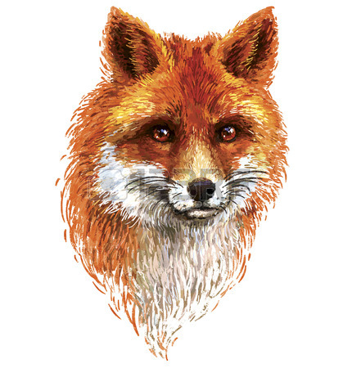
SHAMANIC RITUALS/ INITIATION RITES /RITES OF PASSAGE | FAIRY TALES
II. Second phase: INITIATION/ TRANSITION/ ADVENTURE Magic Guide or Helper
In every religious systems: shaman, guru, priest... - who knows the way |  | Hero´s helpers a fox in The Fire Bird
Notes:
47

Slide 48
SHAMANIC RITUALS/ INITIATION RITES /RITES OF PASSAGE | FAIRY TALES
II. Second phase: INITIATION/ TRANSITION/ ADVENTURE Magic Guide or Helper
In every religious systems: shaman, guru, priest... - who knows the way |  | Hero´s helpers a fox in The Fire Bird, a horse in Bayaya
Notes:
48

Slide 49
SHAMANIC RITUALS/ INITIATION RITES /RITES OF PASSAGE | FAIRY TALES
II. Second phase: INITIATION/ TRANSITION/ ADVENTURE Magic Guide or Helper
In every religious systems: shaman, guru, priest... - who knows the way |  | Hero´s helpers a fox in The Fire Bird, a horse in Bayaya The Long, Broad and Sharpeyes figures
Notes:
49

Slide 50
SHAMANIC RITUALS/ INITIATION RITES /RITES OF PASSAGE | FAIRY TALES
II. Second phase: INITIATION/ TRANSITION/ ADVENTURE Magic Guide or Helper
In every religious systems: shaman, guru, priest... - who knows the way |  | Hero´s helpers a fox in The Fire Bird, a horse in Bayaya The Long, Broad and Sharpeyes figures - the godmother in The Three Golden Hairs
Notes:
50

Slide 51
SHAMANIC RITUALS/ INITIATION RITES /RITES OF PASSAGE | FAIRY TALES
II. Second phase: INITIATION/ TRANSITION/ ADVENTURE Magic Guide or Helper
In every religious systems: shaman, guru, priest... - who knows the way |  | Hero´s helpers a fox in The Fire Bird a horse in Bayaya The Long, Broad and Sharpeyes figures - the godmother in The Three Golden Hairs - The Sorcerer´s Apprentice…
Notes:
51

Slide 52
SHAMANIC RITUALS/ INITIATION RITES /RITES OF PASSAGE | FAIRY TALES
II. Second phase: INITIATION/ TRANSITION/ ADVENTURE Magic Guide or Helper
In every religious systems: shaman, guru, priest... - who knows the way |  | Hero´s helpers a fox in The Fire Bird a horse in Bayaya The Long, Broad and Sharpeyes figures - the godmother in The Three Golden Hairs - The Sorcerer´s Apprentice… they advice and help the hero, lead him/her to win
Notes:
52

Slide 53
SHAMANIC RITUALS/ INITIATION RITES /RITES OF PASSAGE | FAIRY TALES
II. Second phase: INITIATION/ TRANSITION/ ADVENTURE Magic Guide or Helper
In every religious systems: shaman, guru, priest... - who knows the way = who has the acces to the spiritual world (world of ancestors, world of demonic powers) |  | Hero´s helpers a fox in The Fire Bird, a horse in Bayaya The Long, Broad and Sharpeyes figures - the godmother in The Three Golden Hairs - The Sorcerer´s Apprentice… they advice and help the hero, lead him/her to win
Notes:
53

Slide 54
SHAMANIC RITUALS/ INITIATION RITES /RITES OF PASSAGE | FAIRY TALES
II. Second phase: INITIATION/ TRANSITION/ ADVENTURE
Notes:
54

Slide 55
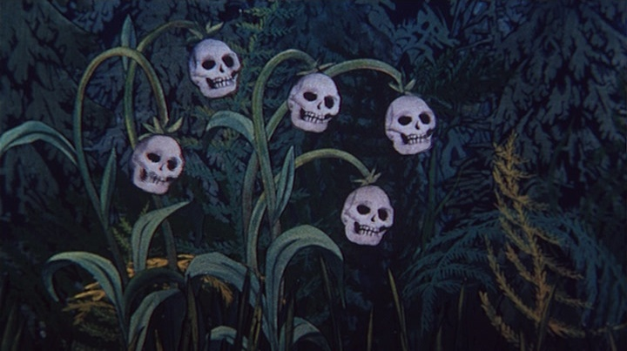
SHAMANIC RITUALS/ INITIATION RITES /RITES OF PASSAGE | FAIRY TALES
II. Second phase: INITIATION/ TRANSITION/ ADVENTURE Brink of death
Notes:
55

Slide 56
SHAMANIC RITUALS/ INITIATION RITES /RITES OF PASSAGE | FAIRY TALES
II. Second phase: INITIATION/ TRANSITION/ ADVENTURE Brink of death
 | Hero experiences threat of death
Notes:
56
Your life is not the highest value

Slide 57
SHAMANIC RITUALS/ INITIATION RITES /RITES OF PASSAGE | FAIRY TALES
II. Second phase: INITIATION/ TRANSITION/ ADVENTURE Brink of death
 | Hero experiences threat of death The Golden Hill, The Three Golden Hairs
Notes:
57
Your life is not the highest value

Slide 58
SHAMANIC RITUALS/ INITIATION RITES /RITES OF PASSAGE | FAIRY TALES
II. Second phase: INITIATION/ TRANSITION/ ADVENTURE Brink of death
 | Hero experiences threat of death The Golden Hill, The Three Golden Hairs or metaphorical death
Notes:
58
Your life is not the highest value

Slide 59
SHAMANIC RITUALS/ INITIATION RITES /RITES OF PASSAGE | FAIRY TALES
II. Second phase: INITIATION/ TRANSITION/ ADVENTURE Brink of death
 | Hero experiences threat of death The Golden Hill, The Three Golden Hairs or metaphorical death Till the Leaves Will Fall from the Oaks
Notes:
59
Your life is not the highest value

Slide 60
SHAMANIC RITUALS/ INITIATION RITES /RITES OF PASSAGE | FAIRY TALES
II. Second phase: INITIATION/ TRANSITION/ ADVENTURE Brink of death
 | Hero experiences threat of death The Golden Hill, The Three Golden Hairs or metaphorical death Till the Leaves Will Fall from the Oaks or real death
Notes:
60
Your life is not the highest value

Slide 61
SHAMANIC RITUALS/ INITIATION RITES /RITES OF PASSAGE | FAIRY TALES
II. Second phase: INITIATION/ TRANSITION/ ADVENTURE Brink of death
 | Hero experiences threat of death The Golden Hill, The Three Golden Hairs or metaphorical death Till the Leaves Will Fall from the Oaks or real death The Fire Bird
Notes:
61
Your life is not the highest value

Slide 62
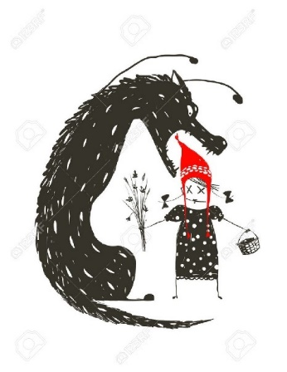
SHAMANIC RITUALS/ INITIATION RITES /RITES OF PASSAGE | FAIRY TALES
II. Second phase: INITIATION/ TRANSITION/ ADVENTURE Brink of death
 | Hero experiences threat of death The Golden Hill, The Three Golden Hairs or metaphorical death Till the Leaves Will Fall from the Oaks or real death The Fire Bird
Notes:
62
Your life is not the highest value

Slide 63
SHAMANIC RITUALS/ INITIATION RITES /RITES OF PASSAGE | FAIRY TALES
II. Second phase: INITIATION/ TRANSITION/ ADVENTURE Brink of death
 | Hero experiences threat of death The Golden Hill, The Three Golden Hairs or metaphorical death Till the Leaves Will Fall from the Oaks or real death The Fire Bird Hero is devoured (Little Red Cap) or almost devoured (Hansel and Grethel)
Notes:
63
Your life is not the highest value

Slide 64
SHAMANIC RITUALS/ INITIATION RITES /RITES OF PASSAGE | FAIRY TALES
II. Second phase: INITIATION/ TRANSITION/ ADVENTURE Brink of death
 | Hero experiences threat of death The Golden Hill, The Three Golden Hairs or metaphorical death Till the Leaves Will Fall from the Oaks or real death The Fire Bird Hero is devoured (Little Red Cap) or almost devoured (Hansel and Grethel) (any mythological/Biblical paralels?)
Notes:
64
Your life is not the highest value

Slide 65
SHAMANIC RITUALS/ INITIATION RITES /RITES OF PASSAGE | FAIRY TALES
II. Second phase: INITIATION/ TRANSITION/ ADVENTURE Brink of death
 | Hero experiences threat of death The Golden Hill, The Three Golden Hairs or metaphorical death Till the Leaves Will Fall from the Oaks or real death The Fire Bird Hero is devoured (Little Red Cap) or almost devoured (Hansel and Grethel) (any mythological/Biblical paralels?) Heroine falls into death-like sleep Briar Rose, Snow White)
Notes:
65
Your life is not the highest value

Slide 66
SHAMANIC RITUALS/ INITIATION RITES /RITES OF PASSAGE | FAIRY TALES
II. Second phase: INITIATION/ TRANSITION/ ADVENTURE Brink of death
Shamanic visions/ experiences of the initiands: | Hero experiences threat of death The Golden Hill, The Three Golden Hairs or metaphorical death Till the Leaves Will Fall from the Oaks or real death The Fire Bird Hero is devoured (Little Red Cap) or almost devoured (Hansel and Grethel) (any mythological/Biblical paralels?) Heroine falls into death-like sleep Briar Rose, Snow White)
Notes:
66
Your life is not the highest value

Slide 67
SHAMANIC RITUALS/ INITIATION RITES /RITES OF PASSAGE | FAIRY TALES
II. Second phase: INITIATION/ TRANSITION/ ADVENTURE Brink of death
Shamanic visions/ experiences of the initiands: trance, ecstasy, unconscious | Hero experiences threat of death The Golden Hill, The Three Golden Hairs or metaphorical death Till the Leaves Will Fall from the Oaks or real death The Fire Bird Hero is devoured (Little Red Cap) or almost devoured (Hansel and Grethel) (any mythological/Biblical paralels?) Heroine falls into death-like sleep Briar Rose, Snow White)
Notes:
67
Your life is not the highest value

Slide 68
SHAMANIC RITUALS/ INITIATION RITES /RITES OF PASSAGE | FAIRY TALES
II. Second phase: INITIATION/ TRANSITION/ ADVENTURE Brink of death
Shamanic visions/ experiences of the initiands: trance, ecstasy, unconscious cutting or slicing one´s body into pieces, being devoured („initiatory death“) | Hero experiences threat of death The Golden Hill, The Three Golden Hairs or metaphorical death Till the Leaves Will Fall from the Oaks or real death The Fire Bird Hero is devoured (Little Red Cap) or almost devoured (Hansel and Grethel) (any mythological/Biblical paralels?) Heroine falls into death-like sleep Briar Rose, Snow White)
Notes:
68
Your life is not the highest value

Slide 69
SHAMANIC RITUALS/ INITIATION RITES /RITES OF PASSAGE | FAIRY TALES
II. Second phase: INITIATION/ TRANSITION/ ADVENTURE Brink of death
Shamanic visions/ experiences of the initiands: trance, ecstasy, unconscious cutting or slicing one´s body into pieces, being devoured („initiatory death“) - meeting ancestors, being dead | Hero experiences threat of death The Golden Hill, The Three Golden Hairs or metaphorical death Till the Leaves Will Fall from the Oaks or real death The Fire Bird Hero is devoured (Little Red Cap) or almost devoured (Hansel and Grethel) (any mythological/Biblical paralels?) Heroine falls into death-like sleep Briar Rose, Snow White)
Notes:
69
Your life is not the highest value

Slide 70
SHAMANIC RITUALS/ INITIATION RITES /RITES OF PASSAGE | FAIRY TALES
II. Second phase: INITIATION/ TRANSITION/ ADVENTURE Brink of death
Shamanic visions/ experiences of the initiands: trance, ecstasy, unconscious cutting or slicing one´s body into pieces, being devoured („initiatory death“) - meeting ancestors, being dead MEANING: | Hero experiences threat of death The Golden Hill, The Three Golden Hairs or metaphorical death Till the Leaves Will Fall from the Oaks or real death The Fire Bird Hero is devoured (Little Red Cap) or almost devoured (Hansel and Grethel) (any mythological/Biblical paralels?) Heroine falls into death-like sleep Briar Rose, Snow White)
Notes:
70
Your life is not the highest value

Slide 71
SHAMANIC RITUALS/ INITIATION RITES /RITES OF PASSAGE | FAIRY TALES
II. Second phase: INITIATION/ TRANSITION/ ADVENTURE Brink of death
Shamanic visions/ experiences of the initiands: trance, ecstasy, unconscious cutting or slicing one´s body into pieces, being devoured („initiatory death“) - meeting ancestors, being dead MEANING: mystical death and ressurection | Hero experiences threat of death The Golden Hill, The Three Golden Hairs or metaphorical death Till the Leaves Will Fall from the Oaks or real death The Fire Bird Hero is devoured (Little Red Cap) or almost devoured (Hansel and Grethel) (any mythological/Biblical paralels?) Heroine falls into death-like sleep Briar Rose, Snow White)
Notes:
71
Your life is not the highest value

Slide 72
SHAMANIC RITUALS/ INITIATION RITES /RITES OF PASSAGE | FAIRY TALES
II. Second phase: INITIATION/ TRANSITION/ ADVENTURE Brink of death
Shamanic visions/ experiences of the initiands: trance, ecstasy, unconscious cutting or slicing one´s body into pieces, being devoured („initiatory death“) - meeting ancestors, being dead MEANING: mystical death and ressurection = death of childhood, death of the profane experience of the sacred | Hero experiences threat of death The Golden Hill, The Three Golden Hairs or metaphorical death Till the Leaves Will Fall from the Oaks or real death The Fire Bird Hero is devoured (Little Red Cap) or almost devoured (Hansel and Grethel) (any mythological/Biblical paralels?) Heroine falls into death-like sleep Briar Rose, Snow White)
Notes:
72
Your life is not the highest value

Slide 73
SHAMANIC RITUALS/ INITIATION RITES /RITES OF PASSAGE | FAIRY TALES
II. Second phase: INITIATION/ TRANSITION/ ADVENTURE Brink of death
Shamanic visions/ experiences of the initiands: trance, ecstasy, unconscious cutting or slicing one´s body into pieces, being devoured („initiatory death“) - meeting ancestors, being dead MEANING: mystical death and ressurection = death of childhood, death of the profane experience of the sacred GAINING: - personal responsibility - broader responsibility (your life is not the highest value) | Hero experiences threat of death The Golden Hill, The Three Golden Hairs or metaphorical death Till the Leaves Will Fall from the Oaks or real death The Fire Bird Hero is devoured (Little Red Cap) or almost devoured (Hansel and Grethel) (any mythological/Biblical paralels?) Heroine falls into death-like sleep Briar Rose, Snow White)
Notes:
73
Your life is not the highest value

Slide 74
SHAMANIC RITUALS/ INITIATION RITES /RITES OF PASSAGE | FAIRY TALES
II. Second phase: INITIATION/ TRANSITION/ ADVENTURE Brink of death
Notes:
74
Your life is not the highest value

Slide 75
SHAMANIC RITUALS/ INITIATION RITES /RITES OF PASSAGE | FAIRY TALES
II. Second phase: INITIATION/ TRANSITION/ ADVENTURE Brink of death Any mythological parallels?
Notes:
75
Your life is not the highest value

Slide 76
SHAMANIC RITUALS/ INITIATION RITES /RITES OF PASSAGE | FAIRY TALES
II. Second phase: INITIATION/ TRANSITION/ ADVENTURE Brink of death Any mythological parallels? Odysseus, Orpheus, Theseus, Heracles…
Notes:
76
Your life is not the highest value

Slide 77
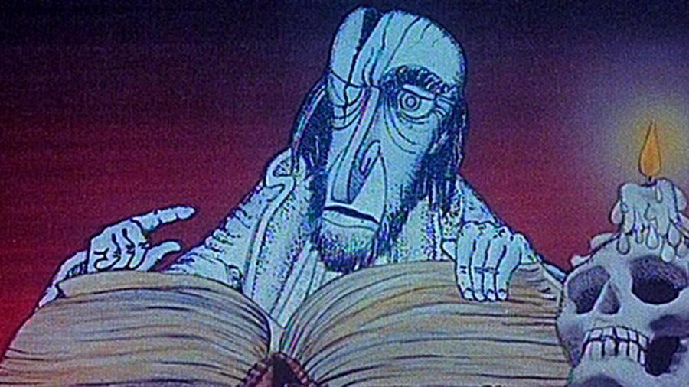
SHAMANIC RITUALS/ INITIATION RITES /RITES OF PASSAGE | FAIRY TALES
!!! RISK OF NOT COMPLETING THE THIRD PHASE
Notes:
77

Slide 78
SHAMANIC RITUALS/ INITIATION RITES /RITES OF PASSAGE | FAIRY TALES
!!! RISK OF NOT COMPLETING THE THIRD PHASE
Notes:
78

Slide 79
SHAMANIC RITUALS/ INITIATION RITES /RITES OF PASSAGE | FAIRY TALES
!!! RISK OF NOT COMPLETING THE THIRD PHASE
 | The hero´s mission is risky - it is not for anyone there is a risk of not coming back
Notes:
79

Slide 80
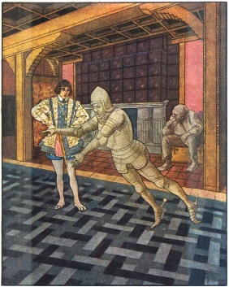
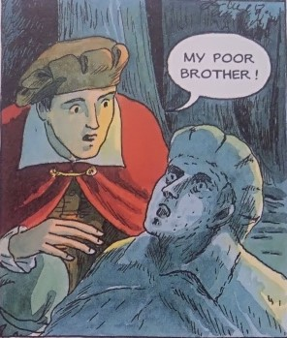
SHAMANIC RITUALS/ INITIATION RITES /RITES OF PASSAGE | FAIRY TALES
!!! RISK OF NOT COMPLETING THE THIRD PHASE
 | The hero´s mission is risky - it is not for anyone there is a risk of not coming back
Notes:
80

Slide 81
SHAMANIC RITUALS/ INITIATION RITES /RITES OF PASSAGE | FAIRY TALES
!!! RISK OF NOT COMPLETING THE THIRD PHASE
 | The hero´s mission is risky - it is not for anyone there is a risk of not coming back
the previous rescuers in
Long, Wide and Sharpeyes
- the first brother in The Twins
Notes:
81

Slide 82
SHAMANIC RITUALS/ INITIATION RITES /RITES OF PASSAGE | FAIRY TALES
!!! RISK OF NOT COMPLETING THE THIRD PHASE
 | The hero´s mission is risky - it is not for anyone there is a risk of not coming back
the previous rescuers in
Long, Wide and Sharpeyes
- the first brother in The Twins
the other apprentices in The Sorcerer´s Apprentice who died in the Black Mill
Notes:
82

Slide 83
SHAMANIC RITUALS/ INITIATION RITES /RITES OF PASSAGE | FAIRY TALES
!!! RISK OF NOT COMPLETING THE THIRD PHASE
 | The hero´s mission is risky - it is not for anyone there is a risk of not coming back
the previous rescuers in
Long, Wide and Sharpeyes
- the first brother in The Twins
the other apprentices in The Sorcerer´s Apprentice who died in the Black Mill
the King in The Three Golden Hairs
Notes:
83

Slide 84
SHAMANIC RITUALS/ INITIATION RITES /RITES OF PASSAGE | FAIRY TALES
!!! RISK OF NOT COMPLETING THE THIRD PHASE
 | The hero´s mission is risky - it is not for anyone there is a risk of not coming back - this threatens also the hero – the right hero risks death
the previous rescuers in
Long, Wide and Sharpeyes
- the first brother in The Twins
the other apprentices in The Sorcerer´s Apprentice who died in the Black Mill
the King in The Three Golden Hairs
Notes:
84

Slide 85
SHAMANIC RITUALS/ INITIATION RITES /RITES OF PASSAGE | FAIRY TALES
!!! RISK OF NOT COMPLETING THE THIRD PHASE
Shaman´s/initiand´s mission can be devastating – if not accomplished well, you stay in the power of demons | The hero´s mission is risky - it is not for anyone there is a risk of not coming back - this threatens also the hero – the right hero risks death
the previous rescuers in
Long, Wide and Sharpeyes
- the first brother in The Twins
the other apprentices in The Sorcerer´s Apprentice who died in the Black Mill
the King in The Three Golden Hairs
Notes:
85

Slide 86
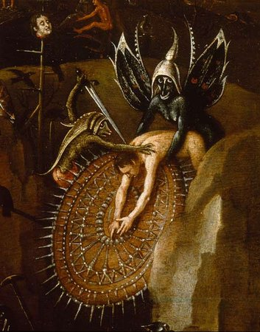
SHAMANIC RITUALS/ INITIATION RITES /RITES OF PASSAGE | FAIRY TALES
!!! RISK OF NOT COMPLETING THE THIRD PHASE
Shaman´s/initiand´s mission can be devastating – if not accomplished well, you stay in the power of demons | The hero´s mission is risky - it is not for anyone there is a risk of not coming back - this threatens also the hero – the right hero risks death
the previous rescuers in
Long, Wide and Sharpeyes
- the first brother in The Twins
the other apprentices in The Sorcerer´s Apprentice who died in the Black Mill
the King in The Three Golden Hairs
Notes:
86

Slide 87
SHAMANIC RITUALS/ INITIATION RITES /RITES OF PASSAGE | FAIRY TALES
!!! RISK OF NOT COMPLETING THE THIRD PHASE
Shaman´s/initiand´s mission can be devastating – if not accomplished well, you stay in the power of demons Meaning: it is risky to go across the border (liminality is an unstable state) | The hero´s mission is risky - it is not for anyone there is a risk of not coming back - this threatens also the hero – the right hero risks death
the previous rescuers in
Long, Wide and Sharpeyes
- the first brother in The Twins
the other apprentices in The Sorcerer´s Apprentice who died in the Black Mill
the King in The Three Golden Hairs
Notes:
87

Slide 88
SHAMANIC RITUALS/ INITIATION RITES /RITES OF PASSAGE | FAIRY TALES
!!! RISK OF NOT COMPLETING THE THIRD PHASE
Any psychological parallels?
Notes:
88

Slide 89
SHAMANIC RITUALS/ INITIATION RITES /RITES OF PASSAGE | FAIRY TALES
!!! RISK OF NOT COMPLETING THE THIRD PHASE
Any psychological parallels?
risk of desintegration - be careful when exploring your unconscious
„wounded healer“ concept (C.G. Jung)
Notes:
89

Slide 90
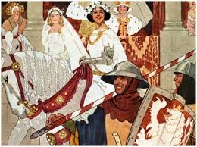
SHAMANIC RITUALS/ INITIATION RITES /RITES OF PASSAGE | FAIRY TALES
III. Third phase: REINCORPORATION/ RETURN
Notes:
90

Slide 91
SHAMANIC RITUALS/ INITIATION RITES /RITES OF PASSAGE | FAIRY TALES
III. Third phase: REINCORPORATION/ RETURN
Notes:
91

Slide 92
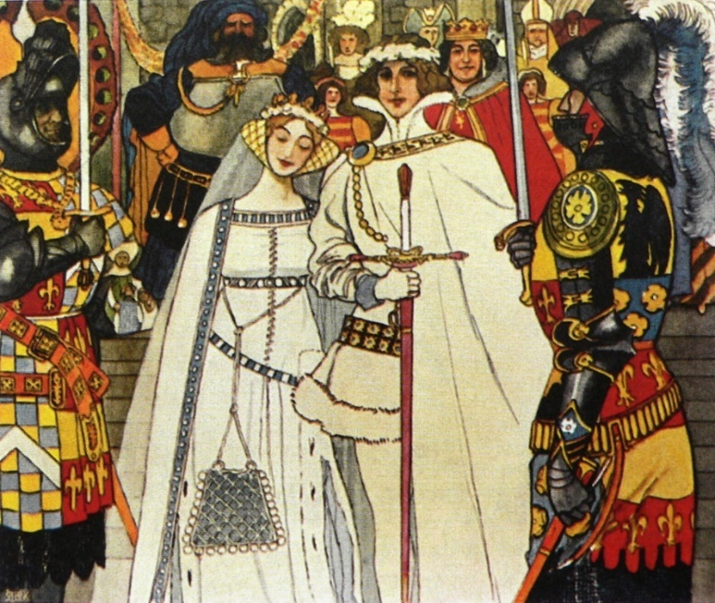
SHAMANIC RITUALS/ INITIATION RITES /RITES OF PASSAGE | FAIRY TALES
III. Third phase: REINCORPORATION/ RETURN
 | A fairytale hero is coming back and starts his adult life.
Notes:
92

Slide 93
SHAMANIC RITUALS/ INITIATION RITES /RITES OF PASSAGE | FAIRY TALES
III. Third phase: REINCORPORATION/ RETURN
After experiencing the mystery of death, one can become truly mature and responsible. | A fairytale hero is coming back and starts his adult life.
Notes:
93

Slide 94
SHAMANIC RITUALS/ INITIATION RITES /RITES OF PASSAGE | FAIRY TALES
III. Third phase: REINCORPORATION/ RETURN
After experiencing the mystery of death, one can become truly mature and responsible. | A fairytale hero is coming back and starts his adult life. Typical symptom = changed status (marriage).
Notes:
94

Slide 95
SHAMANIC RITUALS/ INITIATION RITES /RITES OF PASSAGE | FAIRY TALES
III. Third phase: REINCORPORATION/ RETURN
After experiencing the mystery of death, one can become truly mature and responsible. - the community is regenerated | A fairytale hero is coming back and starts his adult life. Typical symptom = changed status (marriage).
Notes:
95

Slide 96
SHAMANIC RITUALS/ INITIATION RITES /RITES OF PASSAGE | FAIRY TALES
III. Third phase: REINCORPORATION/ RETURN
After experiencing the mystery of death, one can become truly mature and responsible. - the community is regenerated | A fairytale hero is coming back and starts his adult life. Typical symptom = changed status (marriage). - the kingdom is saved
Notes:
96

