Slide 1
Week 2 Morpheme-based approaches
Current perspectives on word-formation
Jakub Sláma
February 22, 2021

Slide 2
Topics covered in the course
Morphology, word-formation & morphemes
Morpheme-based theories of word-formation
Problems with the morpheme
Word-based theories of word-formation
Word-formation in Cognitive Grammar
Word-formation in Construction Grammar
Relational Morphology
Word-formation in language acquisition
Word-formation in psycholinguistics
Word-formation in aphasia and dementia
Word-formation in dyslexia
Word-formation and slips of the tongue & spelling errors
Word-formation and Naive Discriminative Learning

Slide 3
Topics covered in the course
Morphology, word-formation & morphemes
Morpheme-based theories of word-formation
Problems with the morpheme
Word-based theories of word-formation
Word-formation in Cognitive Grammar
Word-formation in Construction Grammar
Relational Morphology
Word-formation in language acquisition
Word-formation in psycholinguistics
Word-formation in aphasia and dementia
Word-formation in dyslexia
Word-formation and slips of the tongue & spelling errors
Word-formation and Naive Discriminative Learning
traditional, mainstream approach

Slide 4
Topics covered in the course
Morphology, word-formation & morphemes
Morpheme-based theories of word-formation
Problems with the morpheme = problems with the traditional approach
Word-based theories of word-formation
Word-formation in Cognitive Grammar
Word-formation in Construction Grammar
Relational Morphology
Word-formation in language acquisition
Word-formation in psycholinguistics
Word-formation in aphasia and dementia
Word-formation in dyslexia
Word-formation and slips of the tongue & spelling errors
Word-formation and Naive Discriminative Learning
traditional, mainstream approach

Slide 5
Topics covered in the course
Morphology, word-formation & morphemes
Morpheme-based theories of word-formation
Problems with the morpheme = problems with the traditional approach
Word-based theories of word-formation
Word-formation in Cognitive Grammar
Word-formation in Construction Grammar
Relational Morphology
Word-formation in language acquisition
Word-formation in psycholinguistics
Word-formation in aphasia and dementia
Word-formation in dyslexia
Word-formation and slips of the tongue & spelling errors
Word-formation and Naive Discriminative Learning
traditional, mainstream approach
alternative approaches

Slide 6
Topics covered in the course
Morphology, word-formation & morphemes
Morpheme-based theories of word-formation
Problems with the morpheme = problems with the traditional approach
Word-based theories of word-formation
Word-formation in Cognitive Grammar
Word-formation in Construction Grammar
Relational Morphology
Word-formation in language acquisition
Word-formation in psycholinguistics
Word-formation in aphasia and dementia
Word-formation in dyslexia
Word-formation and slips of the tongue & spelling errors
Word-formation and Naive Discriminative Learning
traditional, mainstream approach
alternative approaches
can these subfields tell us which frameworks work better?

Slide 7
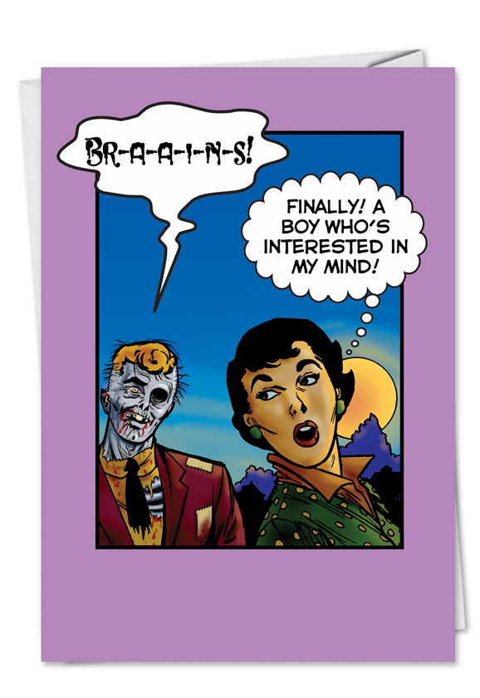
Why?
Cognitive Linguistics
~
Cognitive Commitment
“a commitment to make one’s account of human language accord with what is generally known about the mind and the brain, from other disciplines as well as our own” (Lakoff, 1990: 40)

Slide 8
Why?
current debates in science – issues such as
replicability
reproducibility (for linguistics: Berez-Kroeker et al. 2018)
triangulation
→ the strategic use of multiple approaches to address one question (Haspelmath 2018)
→ results “that agree across different methodologies are less likely to be artefacts” (Munafò & Smith 2018)
→ cf. McEnery & Brezina (2019): corpus analyses + experiments

Slide 9
Morpheme-based approaches
words exhaustively analyzed into morphemes
mother, father, brother × mo-, fa-, bro- = -ther not a morpheme

Slide 10
Morpheme-based approaches
words exhaustively analyzed into morphemes
mother, father, brother × mo-, fa-, bro- = -ther not a morpheme
empowerments
~ several actions of putting someone into a position of power

Slide 11
Morpheme-based approaches
words exhaustively analyzed into morphemes
mother, father, brother × mo-, fa-, bro- = -ther not a morpheme
empowerments
~ several actions of putting someone into a position of power
morphemes combined on the basis of rules
to form a causative verb, add em- to a noun
to form a plural, add -s to a noun
to form an action nominalization, add -ment to a verb

Slide 12
Inflectional vs. derivational morphology
em-, -ment vs. -s ~ intuitively different? but how?

Slide 13
Inflectional vs. derivational morphology
em-, -ment vs. -s ~ intuitively different? but how?
Assignment 1: Read pages 14–17 of Plag (2003) on inflection vs. derivation. Choose two of the following (or any other interesting example), and using the criteria discussed in Plag, show whether the affixes count as (more) inflectional or (more) derivational:
e.g., re- / -ess / -ment – or its equivalent in your mother tongue
a diminutive suffix
an adverb forming suffix (Cz -e/-ě, -y; En -ly; Sp -mente etc.)
Czech nej- (lepší 'better‘ → nejlepší 'best‘)

Slide 14
Various (parts of) rules
phonological restriction: the suffix attaches only to verbs with stress on the final syllable (cf. Plag 2003: 3.5.2)

Slide 15
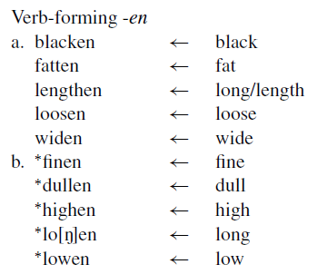
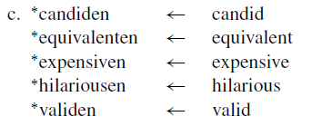
Various (parts of) rules
phonological restriction: the suffix attaches only to monosyllabic verbs ending in obstruents (cf. Plag 2003: 3.5.2)

Slide 16
Various (parts of) rules
colonization
*colonizal
*colonizement
*colonizage
readable
*sleepable
*dieable
morphological restriction: verbs in -ize take -ation (cf. Plag 2003: 3.5.2)
syntactic restriction: -able usually attaches to transitive verbs

Slide 17
Lexicalist hypothesis
Chomsky (1970): Remarks on Nominalization
before: Caesar destroyed the city → Caesar’s destruction of the city
Chomsky → not a transformation, word-formation is a separate component of grammar, and syntactic rules cannot change the internal structure of words
see, for instance: Newmeyer, F. (2009): Current challenges to the lexicalist hypothesis: An overview and a critique. In: W. Lewis, S. Karimi & H. Harley (eds.), Time and Again: Theoretical Perspectives on Formal Linguistics, 91–117. Amsterdam: John Benjamins Publishing Company.

Slide 18
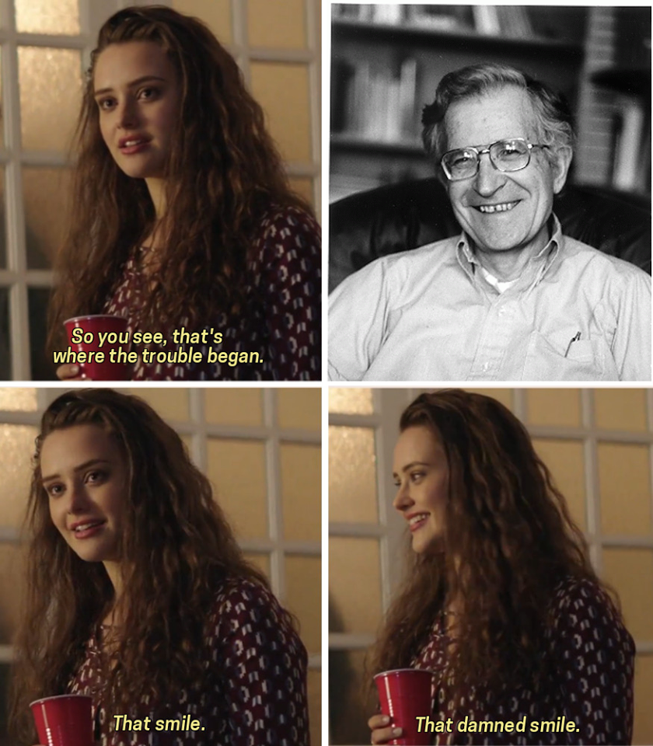

Slide 19
Anti-lexicalist approaches
there are some problems with lexicalism – for example:
She had that don’t-you-dare! look.
He had on an “I’m your superior” face.
his I love yous, a thank you, knowitallism
see, for instance: 48. Bruening, B. (2018): The lexicalist hypothesis: Both wrong and superfluous. Language 94(1): 1–42.

Slide 20
Anti-lexicalist approaches
there are some problems with lexicalism
“syntactic” or “transformationalist” approaches → there is only syntax, and syntax generates words from categoryless roots
e.g., Distributed Morphology (Alec Marantz), the Exo-Skeletal model (Hagit Borer), generally minimalist generativist approaches
root √destroy (neither a verb nor a noun)
→ combines with nominal projections → the noun destruction
→ combines with verbal projections → the verb destroy

Slide 21
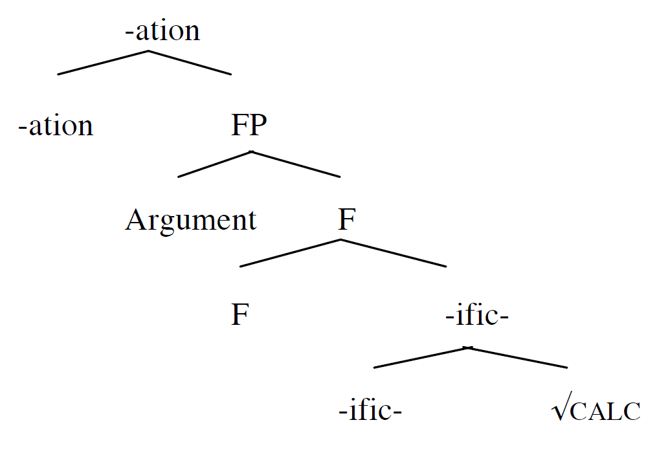
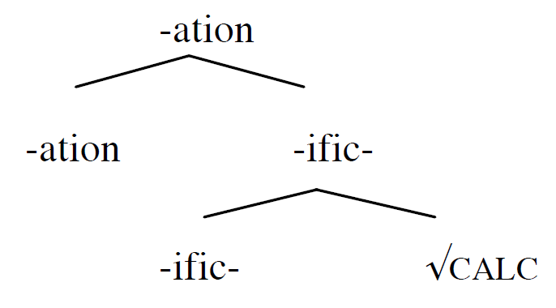
Anti-lexicalist approaches
calcification
(denoting result)
the calcification of…
(denoting the process)

Slide 22
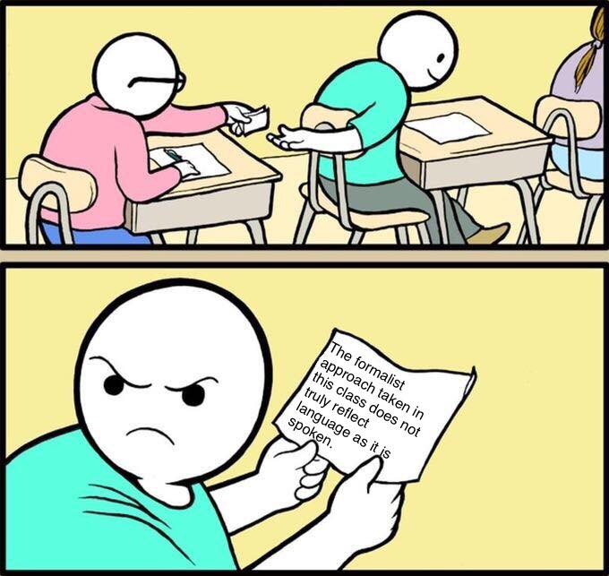

Slide 23
Single vs. dual route models
dual route = a multimorphemic word processed in two ways at the same time
one conducts a morphological analysis
the other processes the word as a whole
single route = only one way of processing
either: all words decomposed into morphemes (full-parsing theories)
or: all words are processes as wholes (full-listing theories)
full-listing – impossible, we would not be able to process new words
full-parsing – impossible, we do not decompose frequent words

Slide 24
Summary
cognitive commitment (aka “why we care”)
traditional account: morphemes + rules (with various kinds of restrictions); words can be exhaustively decomposed into morphemes
lexicalist vs. syntactic approaches (word-formation is / is not an independent & pre-syntactic component of grammar)
single vs. dual route models
single route models: full-parsing vs. full-listing theories

