Slide 1
The Digital Market
In the EU
By Jami and Pouran

Slide 2
Introduction
EU
Digital Market
EU has pushed for economic integration through measures that make trade barriers unnecessary. This is partially done through regulations on quality control, etc. since 1970s
Digital marketing refers to the use of digital channels, platforms, and technologies to promote and advertise products, services, or brands. Visibility to search engine, social media marketing, and data analytics being some of the key components. Big tech either sells to you or sells you.

Slide 3
Why should we care about digital market regulation?
monopoly
data collection
By exercising monopoly, big tech (e.g. Google and Facebook) are detrimental to the health of market economy
Violation of privacy (type of data: link)
Sale of aggregated data to third parties
Government request on the rise
highly targeted ads (Bubbles)
legality and finance
content
Price fixing (for employees: link), Copyright: harvesting revenue off other’s work (Google)
Hate speech and info bubbles

Slide 4
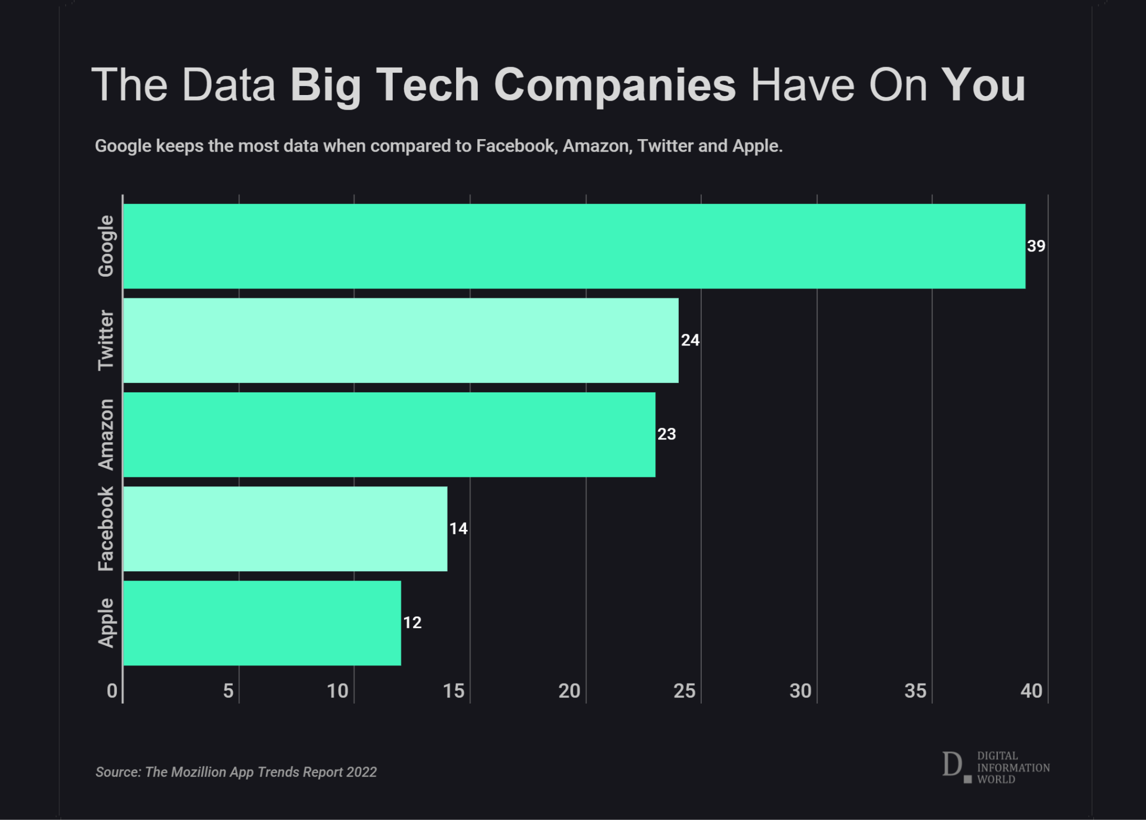
Data Collection
Data collection is the act of scraping data from users of a platform, usually performed by the platform provider or third parties. This data could include basic demographic information all the way to interests. This data can be extracted through information you voluntarily surrendered to the platform, or it may be scraped through less than ethical means such as through behavioural analysis.
example:Instagram profiling of users. The data is mostly used for advertising products that the algorithm suggests.
Through the collection of users private data and behaviours, Instagram is able to earn an estimated $20 billion in advertising revenue per year.

Slide 5
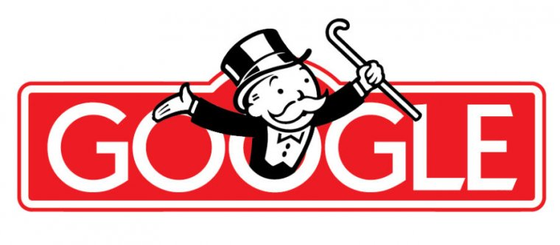
Case Study: Google
Advertisement
EU and Google
57% of the revenue while holding globally over 90% monopoly
The European Commission (EC) focuses on antitrust cases involving Google. Google faces multiple investigations related to its search engine dominance, advertising practices, and Android operating system. The EC imposes fines on Google for antitrust violations.(2010-2017)
10 bn
Paid to other companies for maintaining monopoly on default browser.
R&D
actively “discourages” research and development

Slide 6
What is Digital single market?
The Digital Single Market (DSM) is a European Union (EU) initiative aimed at creating a unified digital market across EU member states. The goal is to remove barriers to digital trade and ensure the free movement of digital goods, services, and data. The goal being:
Removing Geographical Barriers
Enhancing Cross-Border E-Commerce
Digital Content Portability
Data Protection and Privacy
Promoting Innovation and Competition

Slide 7
The Digital Market Act + Digital Services Act
WHAT are they?
The latest EU-level legislation
Started in 2015 with “A Digital Single Market Strategy for Europe”.
Businesses have needed to comply with these acts since the 1st of January 2024.
WHAT are the supposed to do?
Harmonise the digital world with the real world.
Identify and protect vulnerable groups (e.g. minors) and protect consumer rights.
Ensure that companies cannot share just any information.
https://www.retailconsumerproductslaw.com/2020/12/new-eu-proposals-to-regulate-digital-markets-what-to-expect/

Slide 8
The Digital Market Act + Digital Services Act
The DMA…
The DSA….
Together…
…imposes obligations on so-called gatekeepers, or online players that determine how other companies interact with online users, to ensure that they don't stop other companies from competing for users.
…ensures that online platforms will have to do more to limit the spread of illegal content and goods.
…the DMA and DSA form a single set of rules that apply across the whole EU.

Slide 9
The Goals of the DMA and DSA
Establishing a level playing field in the market by ensuring competition, both in the European Single Market and globally.
2. Create a safe space where digital consumers’ rights, data and information are protected.

Slide 10
Antitrust legislation
1951 | The first competition law in Europe is The Treaty Establishing the European Coal and Steel Community or Paris treaty.
1957 | Thereafter, the Treaty of Rome, enacted on March 25 1957, included Article 101 and 102.*
90-2000s | The EU begins to use antitrust laws to address competition concerns in the technology sector. Notably, Microsoft faces investigations and legal actions related to its operating system and Internet Explorer bundling. (The Lisbon Treaty 2009 stance on article 101 and 102)
2016 | The EU introduces the General Data Protection Regulation (GDPR), which addresses data protection and privacy concerns, impacting big tech companies' data-handling practices.
2017-2018 | The EU fines Google €2.4 billion for abusing its dominant position in online shopping services. This marks one of the largest antitrust fines imposed by the EU at that time./The European Commission issues a €4.34 billion fine against Google for illegal practices regarding Android mobile devices to strengthen the dominance of its search engine.
2019: | The EU launches a formal antitrust investigation into Amazon's use of data from independent retailers using its platform. The investigation aims to assess whether Amazon's dual role as a marketplace and retailer creates an unfair advantage.

Slide 11
Antitrust legislation
2020 | The European Commission opens two antitrust investigations into Apple—one regarding the App Store's rules and the other focusing on Apple Pay. It explores concerns related to competition and potential unfair practices. The European Commission proposes the Digital Services Act (DSA) and the Digital Markets Act (DMA) as part of its strategy to regulate digital markets. The DMA specifically targets large online platforms, including big tech companies, with new rules aimed at promoting fair competition and preventing market abuse.
2021 | The EU introduces the Digital Markets Act (DMA), which proposes a set of rules for large online platforms, including obligations to ensure fair competition, limit gatekeeper power, and prevent anti competitive practices.
* | It prohibits anti-competitive agreements, decisions, and concerted practices. This includes agreements that directly or indirectly fix prices, limit or control production, share markets or sources of supply, or engage in other practices that may prevent, restrict, or distort competition./ It prohibits companies with a dominant position from abusing that position by engaging in practices that may harm competition, such as imposing unfair purchase or selling prices, limiting production or technical development to the detriment of consumers, or applying dissimilar conditions to equivalent transactions with other trading parties.

Slide 12
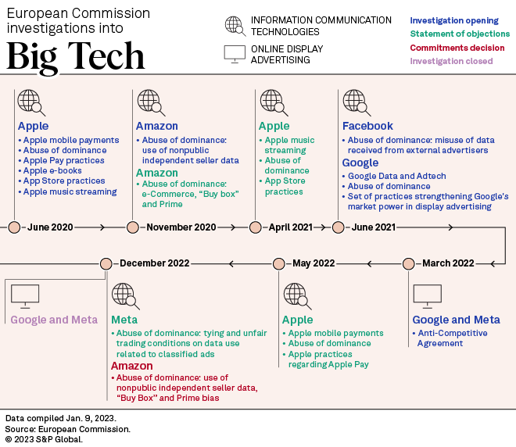

Slide 13
Declaration on European Digital Rights and Principles (2022)
Europe needs to modernise and adapt due to the power of technology and the internet in the digital age.
“The draft declaration on digital rights and principles aims to give everyone a clear reference point about the kind of digital transformation Europe promotes and defends. It will also provide a guide for policy makers and companies when dealing with new technologies. The rights and freedoms enshrined in the EU's legal framework, and the European values expressed by the principles, should be respected online as they are offline. Once jointly endorsed, the Declaration will also define the approach to the digital transformation which the EU will promote throughout the world.”
https://www.istockphoto.com/cs/vektor/vlajka-eu-gm946604370-258494470

Slide 14
The EU and AI
The EU’s AI Act is the world’s first comprehensive AI law.
The benefits of AI include “better healthcare; safer and cleaner transport; more efficient manufacturing; and cheaper and more sustainable energy”.
However, AI does pose some risks to users and the EU’s AI Act will assess different applications which use AI and classify them according to the risk they pose to users. “The different risk levels will mean more or less regulation.”
On 2 February 2024, the EU's Artificial Intelligence Act was unanimously approved by the Council of EU Ministers.

Slide 15
Obstacles and Implementation
Complexity of Regulation
International Scope and Coordination
Adaptability to Evolving Technology
Compliance Measures by Companies
Local Enforcement Variability

