Slide 1
The Recession of European Democracy: from Democratic Consolidation to Backsliding?

Slide 2
What is democracy?
Polyarchy (Dahl, 1971) is collectively defined by the combination of seven attributions and is considered the procedural conditions as the requirement of the presence of modern democracy

Slide 3
Polyarchy
Free and fairly conducted elections
Universal Suffrage and rights to run for public office
Freedom of expression and speech
Freedom of media and press with ability to access alternative sources of information
Accountability of government (and parties) to election outcomes and government
Responsiveness of government (and parties) to voters
Right to form and join autonomous associations

Slide 4
Polyarchy plus
Schmitter and Karl (1991) argued that the seven attributions might capture the essence of procedural of democracy but fail to capture some contemporary elements, thereby adding that two additional attributions.
“Polyarchy plus” consists of seven classic attributes with two additional elements
Ability of popularly elected officials to exercise their constitutional power without being subjected to overriding opposition from unelected officials
Self-governing polity, acting independently of constrains imposed by overarching political system

Slide 5
Democracy Index

Slide 6
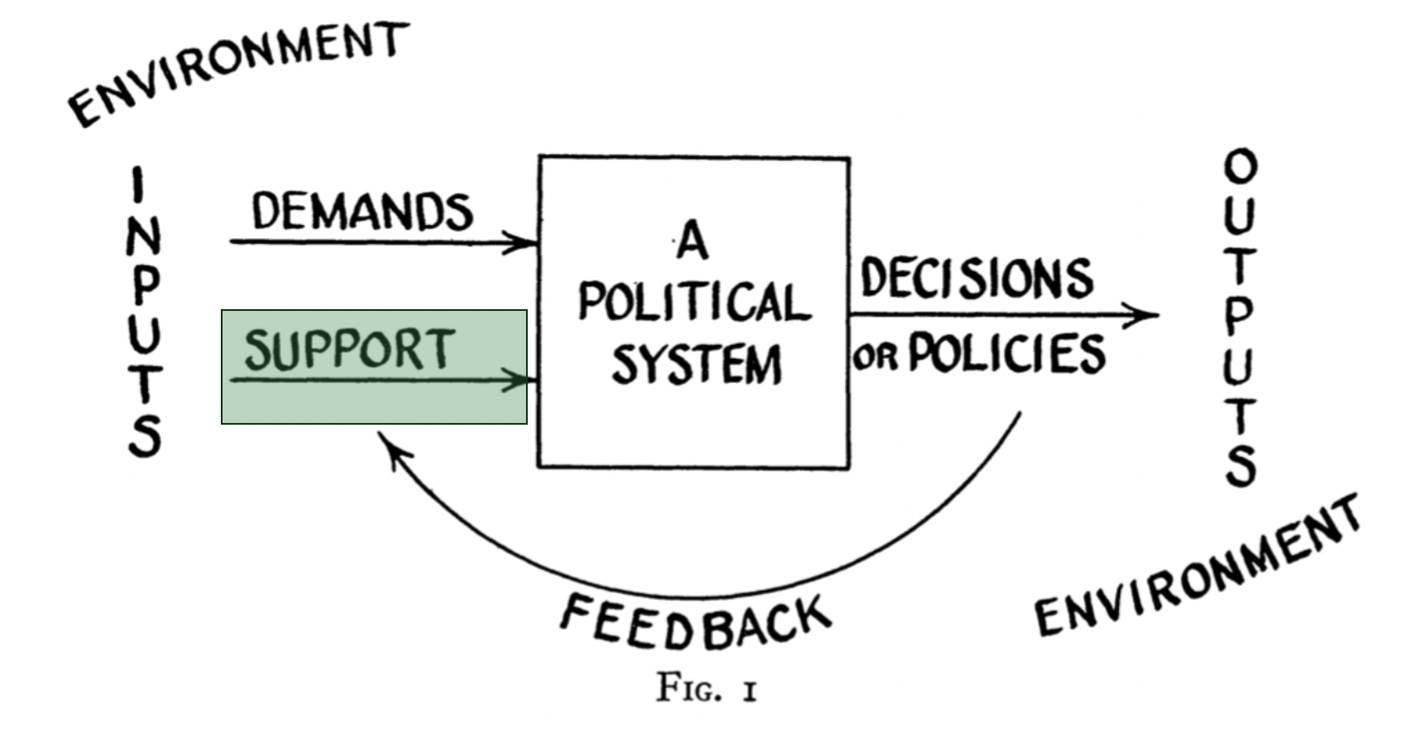
Democratic Consolidation
Democracy Consolidation means democracy has become “the only game in town” (Linz & Stepan, 1996)

Slide 7
Democratic Consolidation
To maintain democracy the only game in town depends on three dimensions (Linz & Stepan, 1996)
Behavioural dimension = Behavioural elements
No significant political group seriously attempts to overthrow the democratic regime or to promote domestic or international violence in order to secede from the state
Attitudinal dimension = Cultural elements
Even under critical time with severe political and economic crisis, the overwhelming majority of the people believe that any further political change must emerge from within the parameters of democratic procedures
Constitutional dimension = Constitutional elements
All of the actors in the polity become habituated to the fact that political conflict within the state will be resolved according to established norms, and the violation of these norms are likely to be ineffective and costly
The consolidation of democracies refers to “a mature stage when regimes prove resilient even under periods of severe crisis and electoral turbulence” (Norris, 2017)

Slide 8
Stable situation?

Slide 9
Democratic Backsliding
Democratic Backsliding means a deliberate turning away from an ideal form of democracy
Forms of backsliding change and vary over time and contexts, but are usually legitimated through democratic institution
“Backsliding can take us to different endpoints at different speeds”, covering both forms of rapid and radical change to gradual transformation
Although military coups and other violent seizure of power are rare, democracies still die through different means" (Levitsky and Ziblatt, 2018)
"Backsliding today begins at the ballot box” and can be led by electoral officials not generals.
“Backsliding is neither inevitable nor irreversible”, the phenomenon is dynamic - not a one way no return
The process of democratic backsliding is how elected autocrats subtly undermine institutions. The subversion of democratic institutions are proceeded through sidelining the referees, rewriting the rules of the game, and tilting the playing field to rule out opponents (Levitsky and Ziblatt, 2018)
A symptom of democratic backsliding is a situation where "leaders with autocratic tendencies are coming to power through democratic elections and attacking norms and institutions from within, typically with support from some portion of the electorate" (Haggard and Kaufman, 2021)

Slide 10
Democratic Backsliding

Slide 11
Eroding democracies

Slide 12
Hybrid regimes

Slide 13
Hybrid regimes
Hybrid regimes are characterised by:
weak checks and balances on executive powers
flawed or even suspended elections
fragmented opposition forces
state restrictions on media freedoms, intellectuals, and civil society organizations
curbs on the independence of the judiciary and disregard for rule of law
the abuse of human rights by the security forces; and
tolerance of authoritarian values

Slide 14
Connected with GDP

