Slide 1
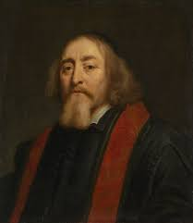
DIDACTIC PRINCIPLES
Based on long-term experience, it can be concluded that under certain circumstances the training process is more successful.
These principles can help you:
• preparation of training - setting goals, preparation of teaching aids, etc.
• coach activities - styles, methods, forms
• interact with athletes

Slide 2
The principle of adequacy and individual approach consists in adapting the content, scope and difficulty of training activities to the individual and age peculiarities of athletes, the degree of their mental development and physical abilities.
The principle of consciousness/understanding and activity is based on understanding the meaning and essence of the performed activity and identification with the set training or educational goals.
The principle of clarity/practicality expresses the requirement to create ideas and concepts based on the immediate perception of objects and phenomena of objective reality. (direct, indirect example)

Slide 3
The principle of succession, its essence is that the practice of each skill is tied to the athlete's past movement experience.
The principle of consistency (systematicity) and purposefulness lies in a thoughtful (logical, systematic) and purposeful order of activities.
The principle of permanence aims to memorize knowledge and skills to a level that will allow their equipment and practical use at any time.
The principle of all-round development (versatility) monitors the development of all motor skills (but also personality) of the athlete. The younger the athlete, the more emphasis is placed on his versatility. Premature specialization in sport often leads to health problems and early termination of a sports career.

Slide 4
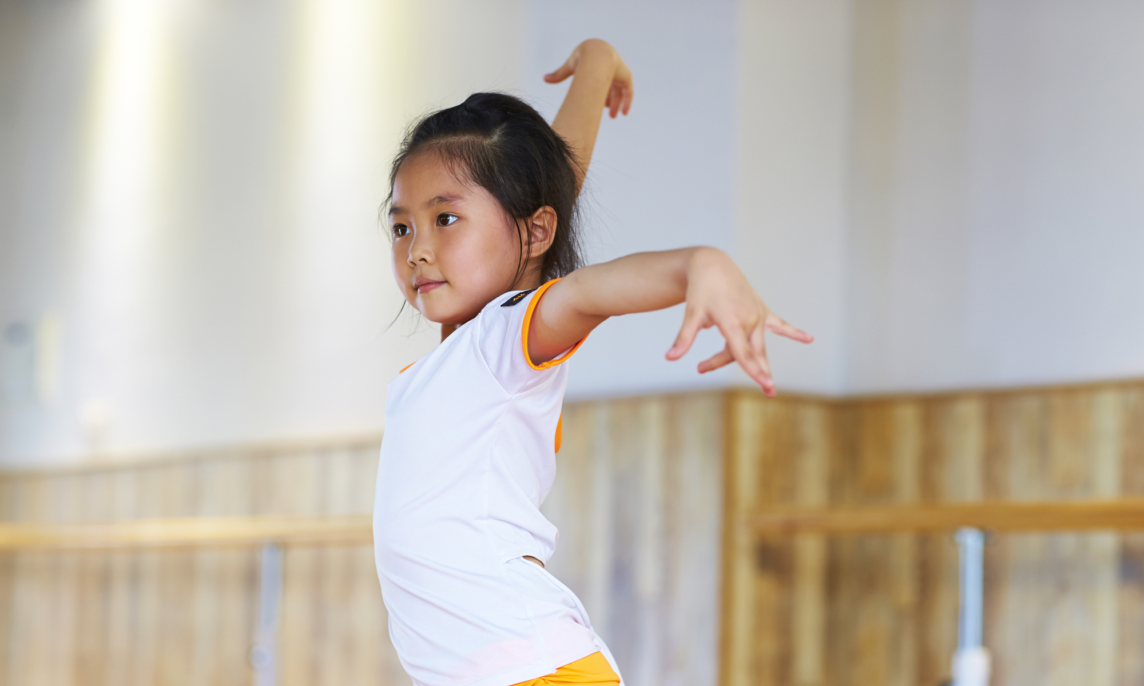
"Cultivation of motor skills is related to building self-concept, self-confidence, responsibility,respect for others, the ability to cooperate and compete."
Thank you for your attention!

