Slide 1
Jazyky

Slide 2
World language
A world language is spoken internationally and is learned and spoken by a large number of people as a second language. A world language is characterized not only by the total number of speakers (native and second language speakers), but also by its geographical distribution
a large number of speakers
a substantial fraction of non-native speakers (function as lingua franca)
official status in several countries
use across several regions in the world
a linguistic community not defined strictly along ethnic lines
one or more standard registers which are widely taught as a foreign language
association with linguistic prestige
use in international trade relations
use in international organizations
use in the academic community
significant body of literature

Slide 3
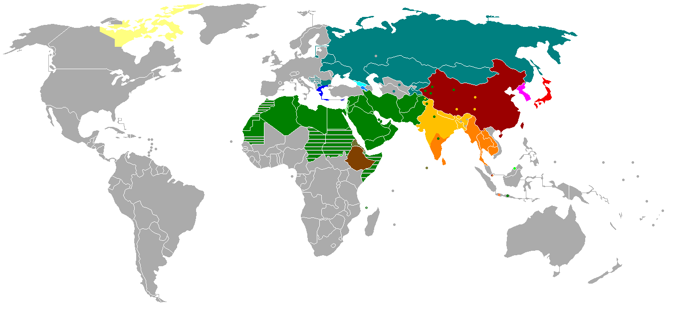

Slide 4
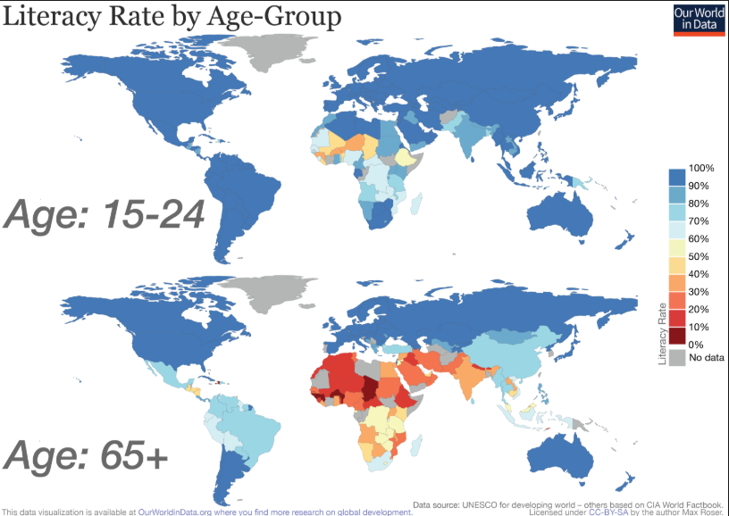

Slide 6
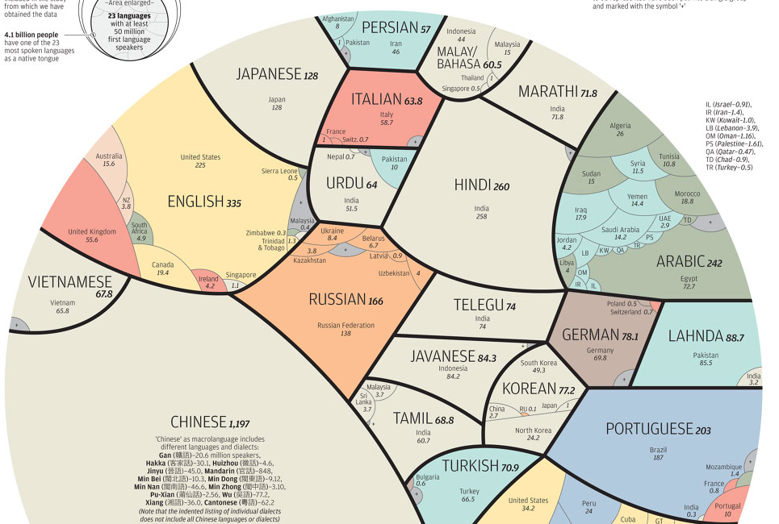

Slide 7
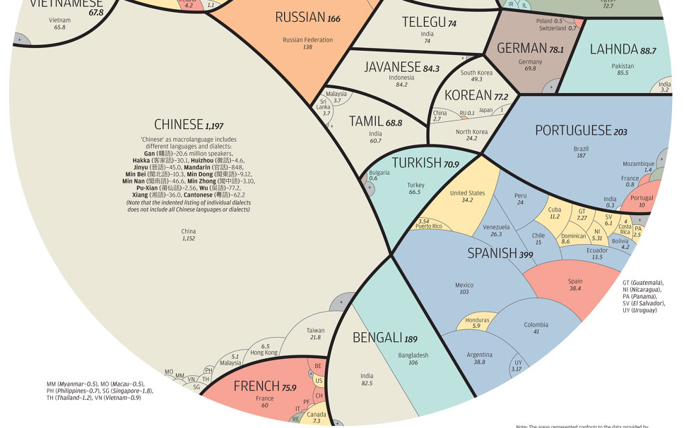

Slide 8
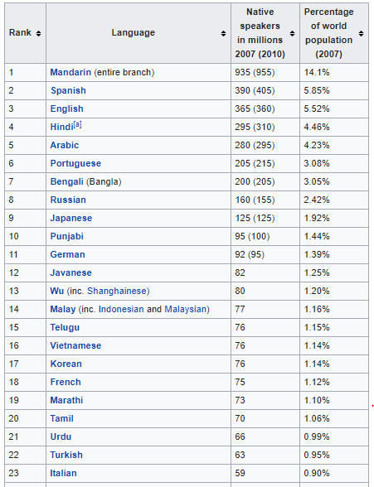

Slide 9
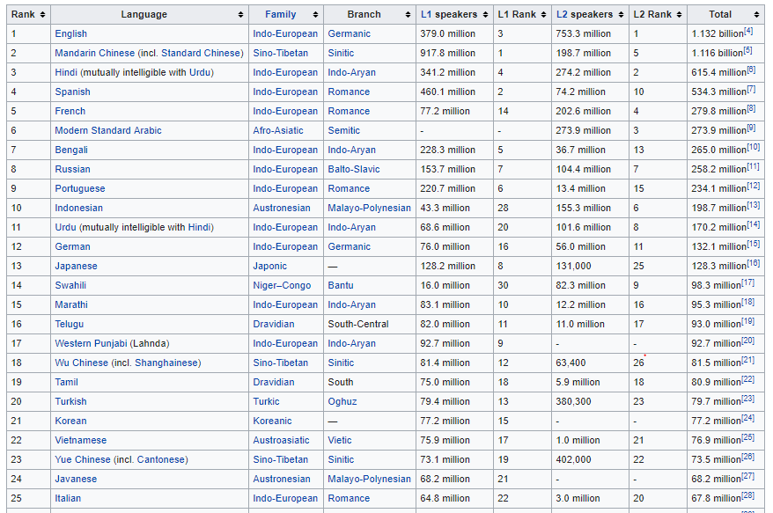

Slide 10
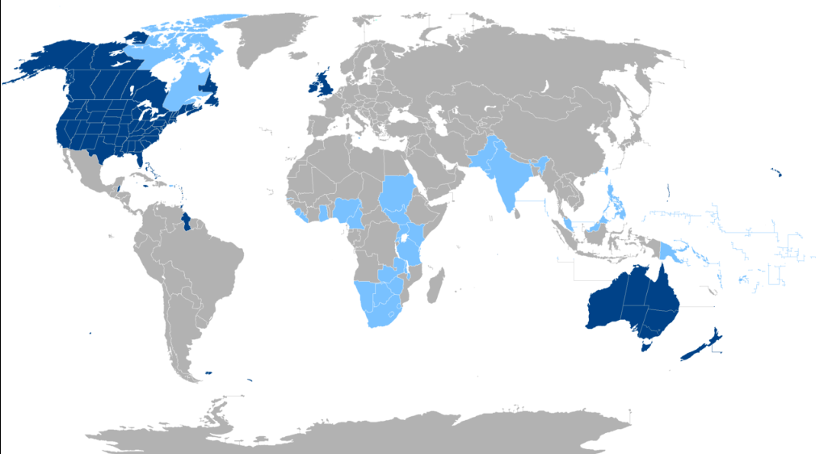

Slide 11
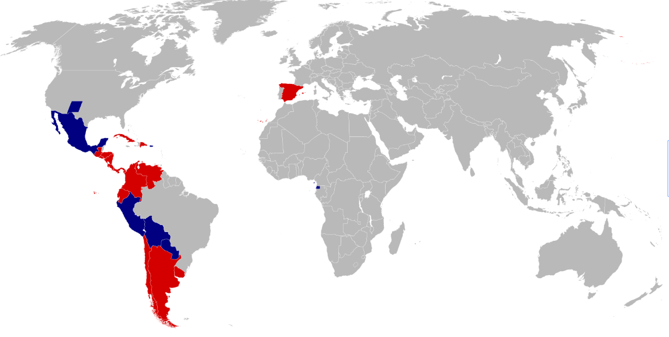

Slide 12
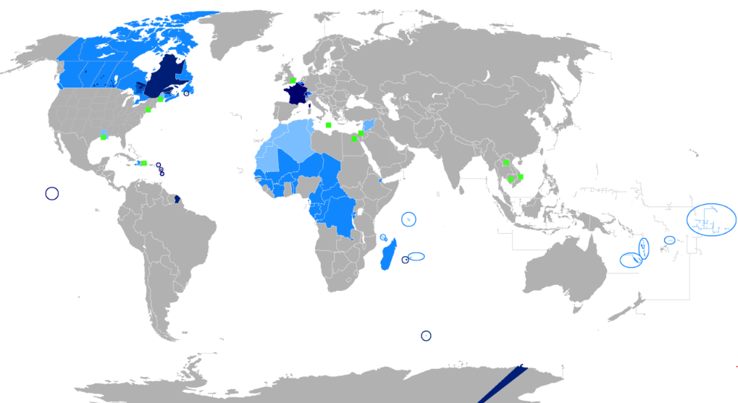

Slide 13
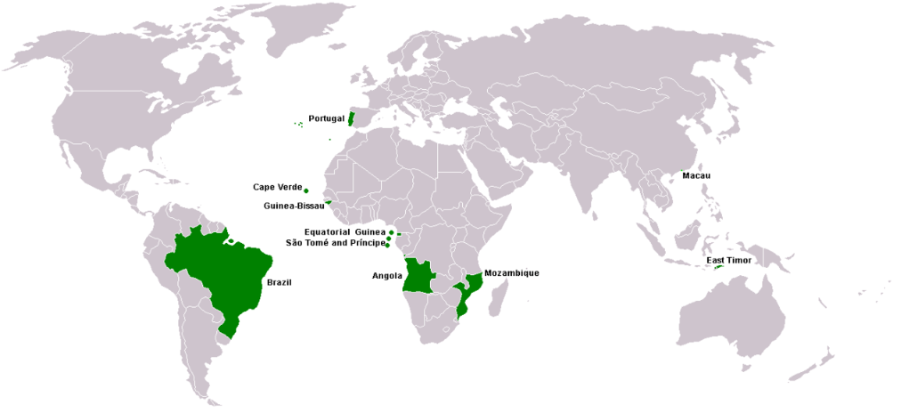

Slide 14
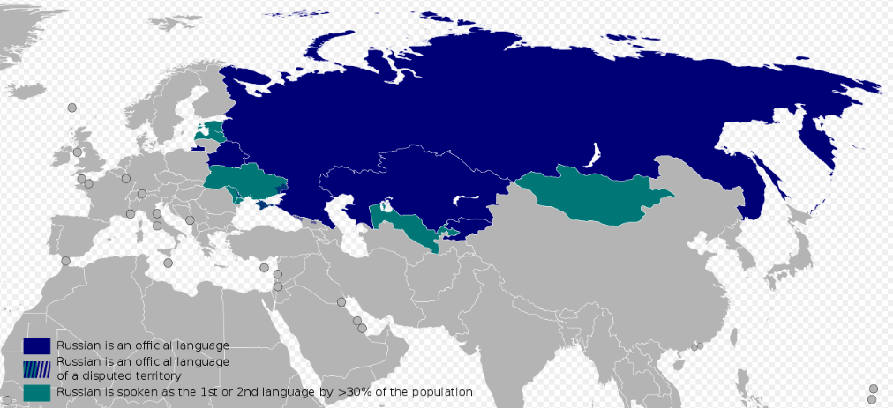

Slide 15
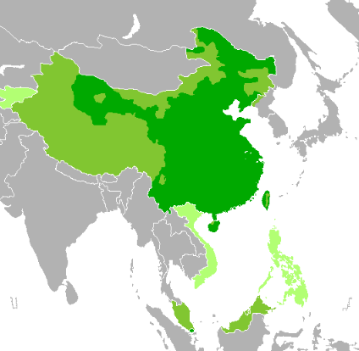

Slide 16
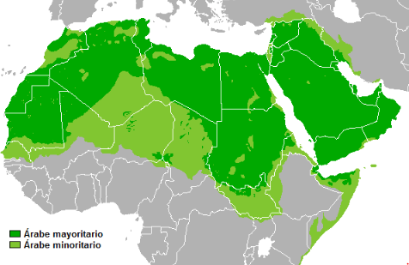

Slide 17
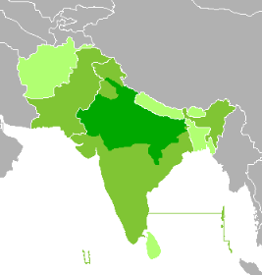

Slide 18
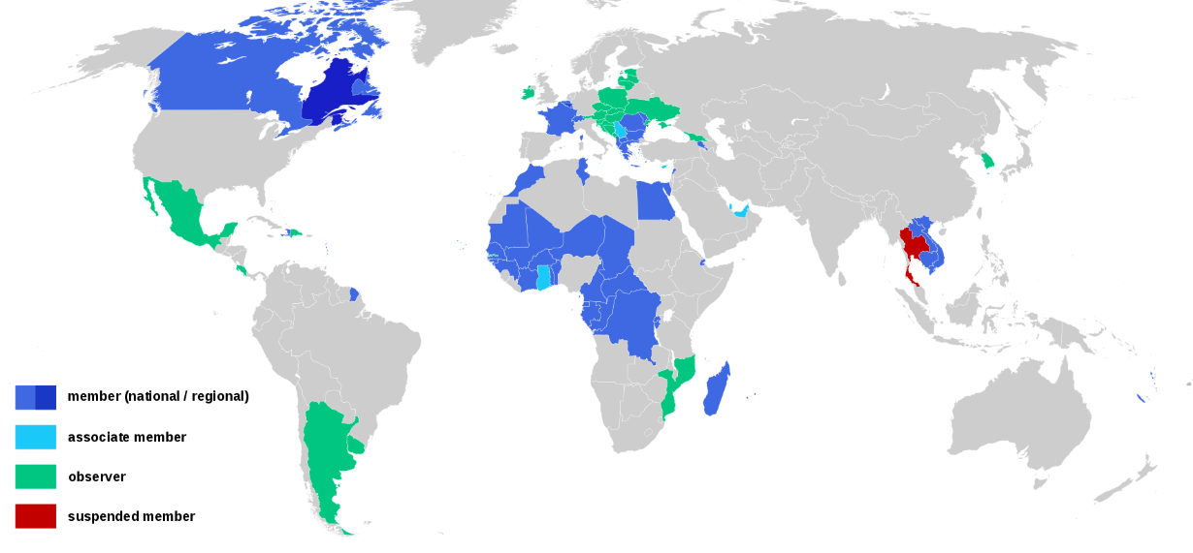

Slide 19
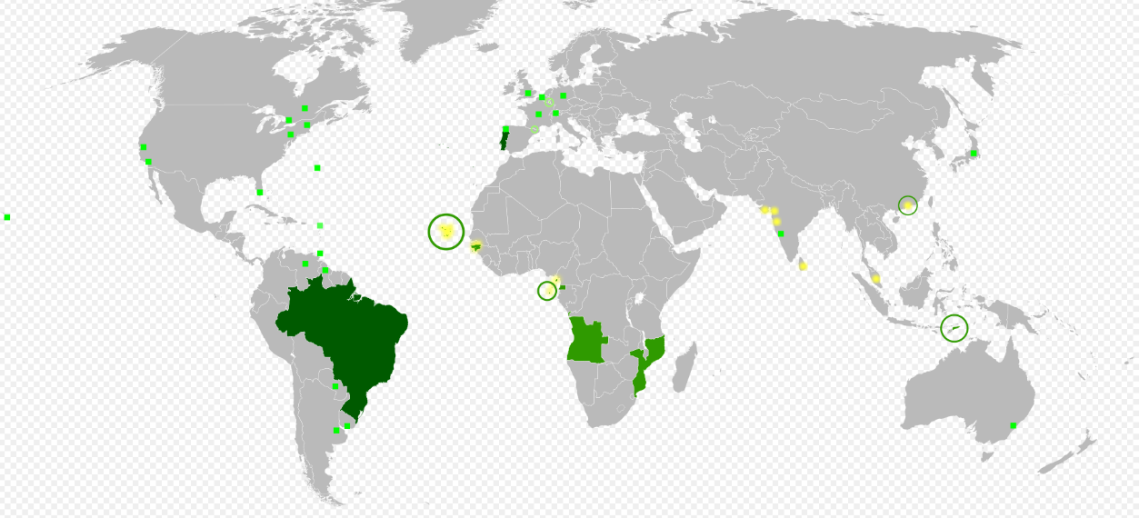

Slide 20
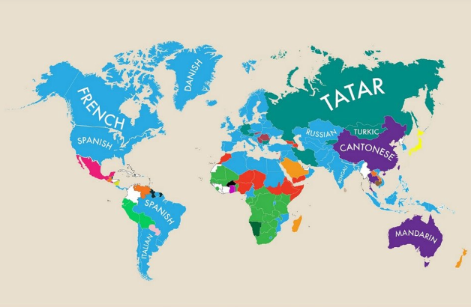

Slide 21
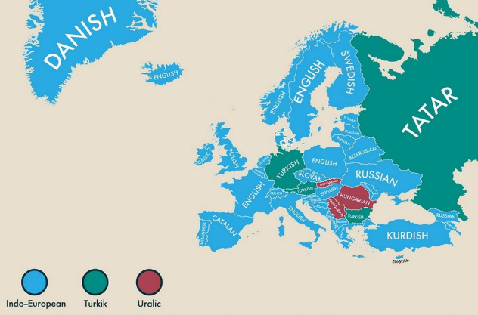

Slide 22
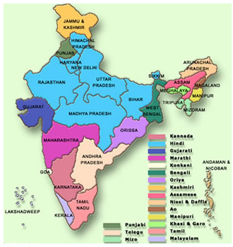

Slide 23
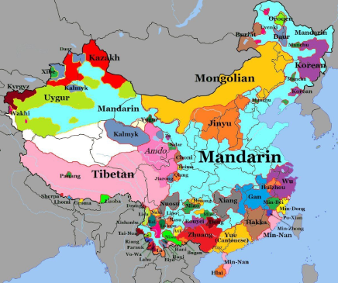

Slide 24
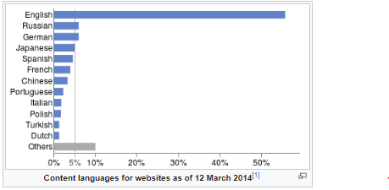

Slide 25
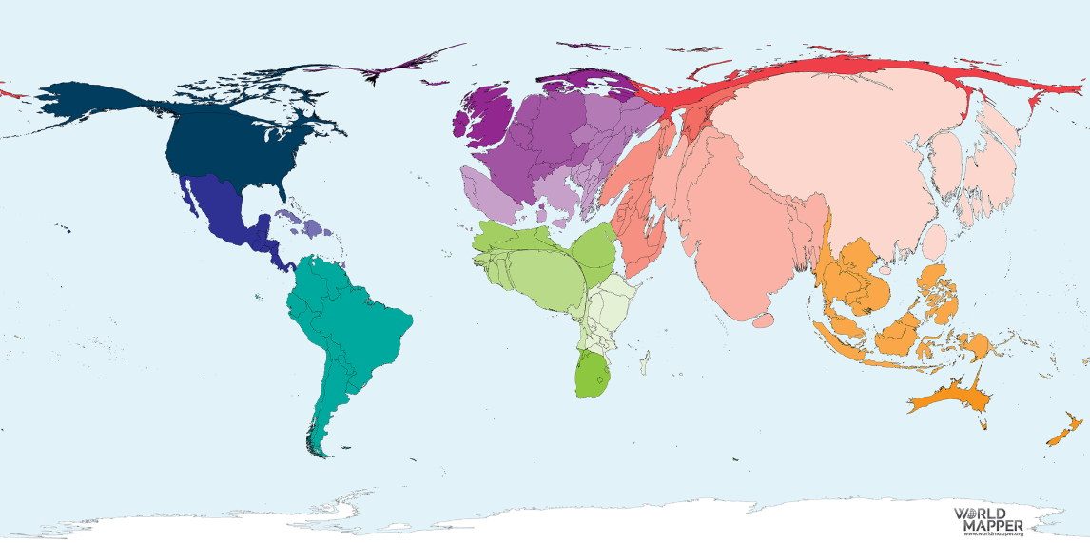

Slide 27
