Slide 1
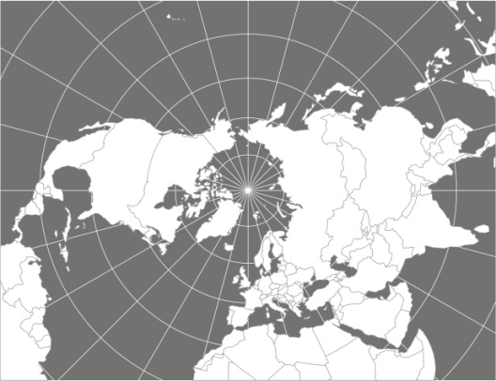
Climate security and europe
Eliška Ullrichová, November 25, 2022

Slide 2
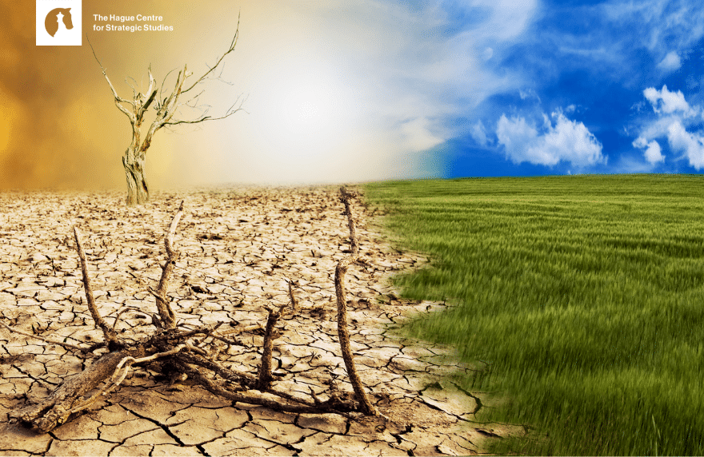

Slide 3
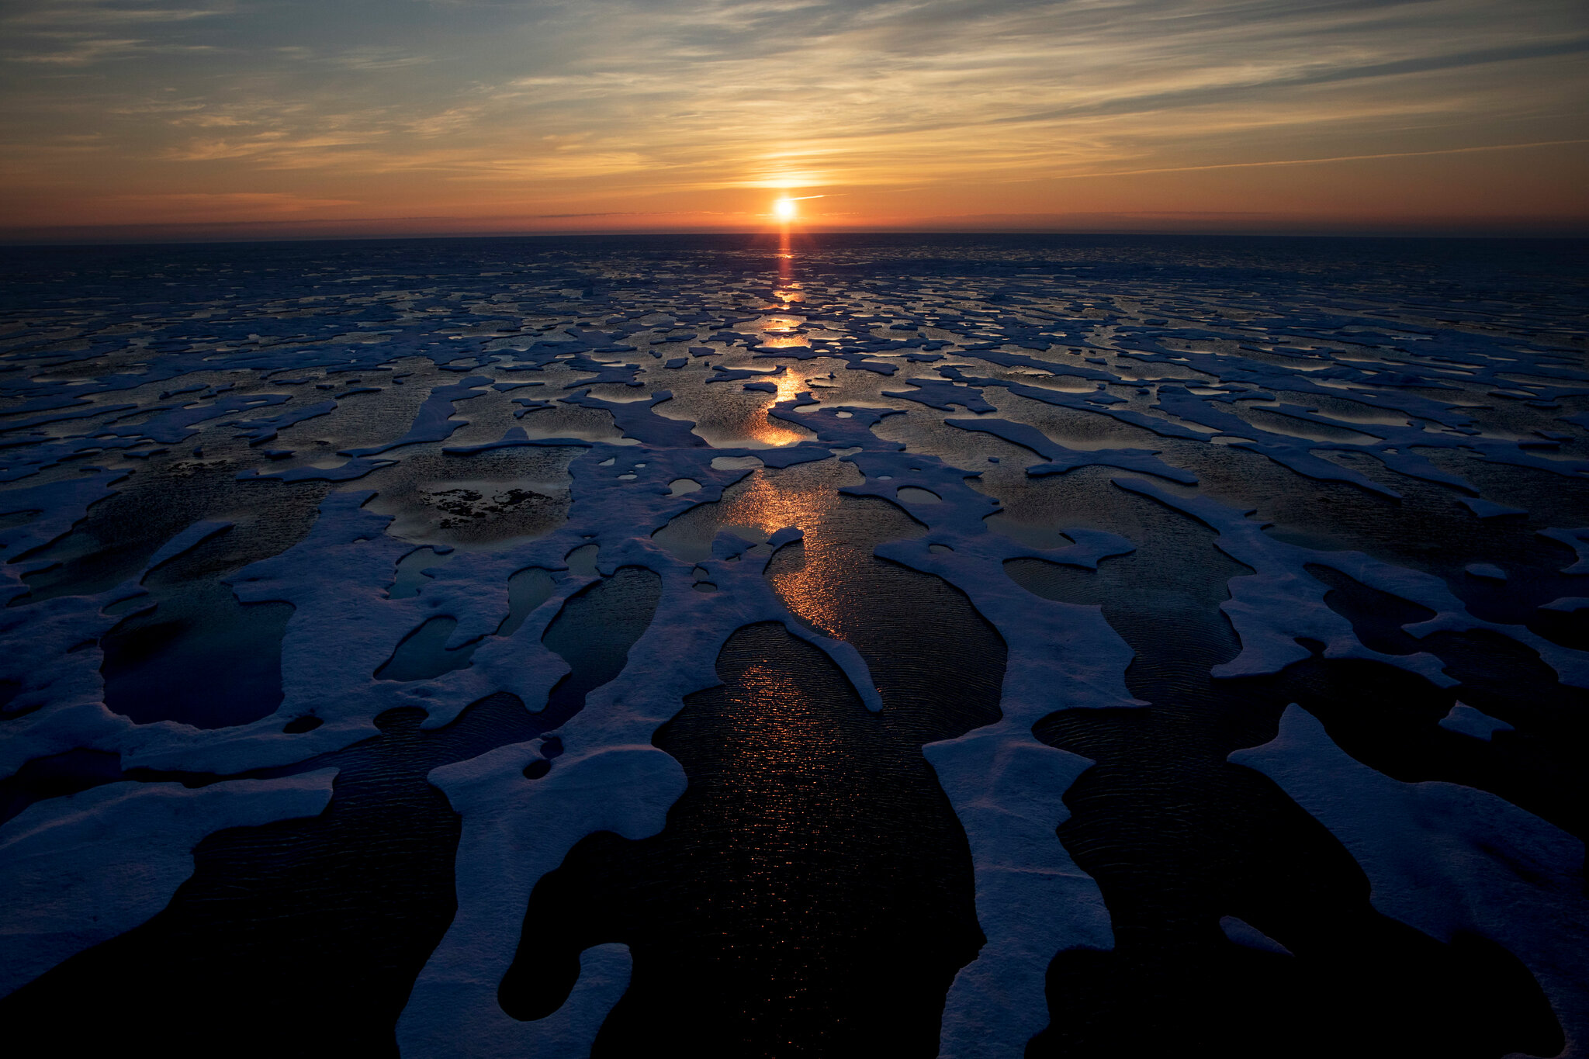
Carbon map
Climate security
Source: Shutterstock

Slide 4
Source: Washington Times

Slide 5
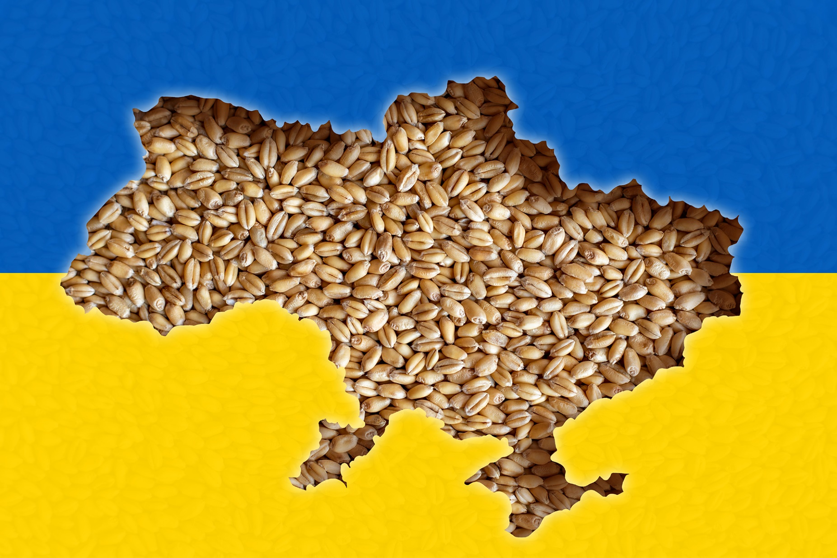
Source: Shutterstock

Slide 6
Climate diplomacy

Slide 7
Source: Fair Observer

Slide 8
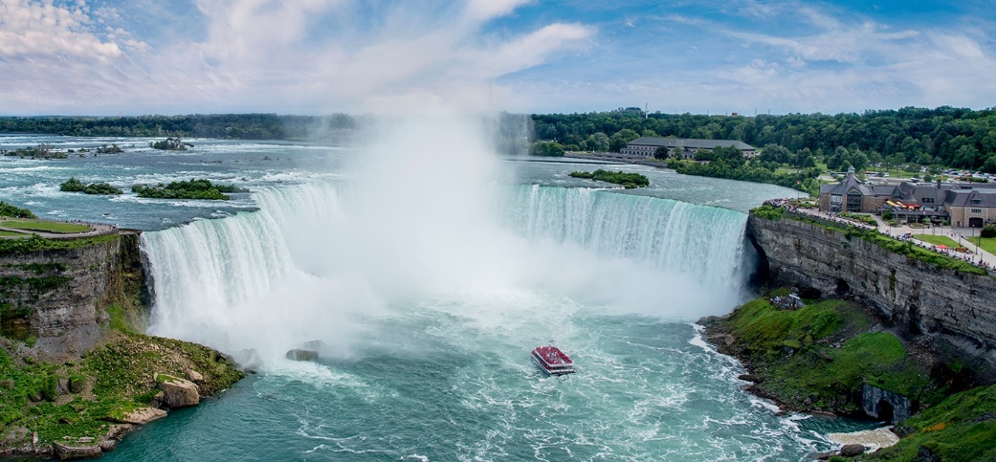
Water security
“The capacity of a population to safeguard sustainable access to adequate quantities of acceptable quality water for sustaining livelihoods, human well-being, and socio-economic development, for ensuring protection against water-borne pollution and water-related disasters, and for preserving ecosystems in a climate of peace and political stability“ (UN Water, 2013).

Slide 9
Water diplomacy
„using diplomatic instruments with the aim to solve, mitigate, or prevent disagreements over shared water resources for the sake of cooperation, regional stability and peace.“ (Global Water Forum 2018)

Slide 10
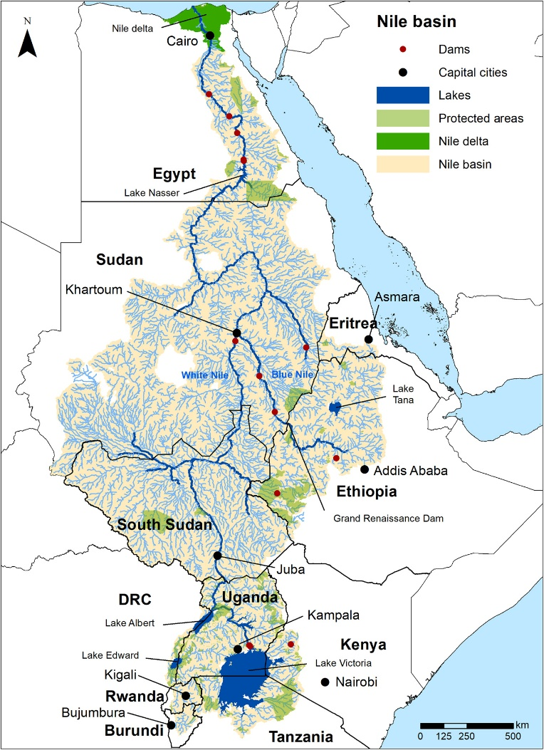
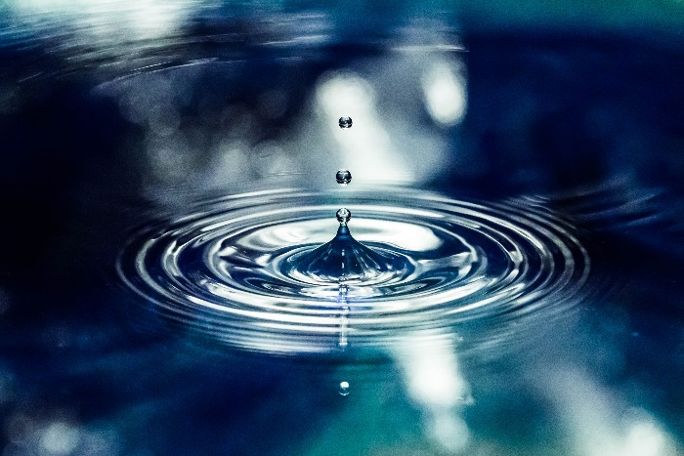
Nile River Basin
Egypt vs. Ethiopia
Grand Ethiopian Renaissance Dam (GERD)

Slide 11
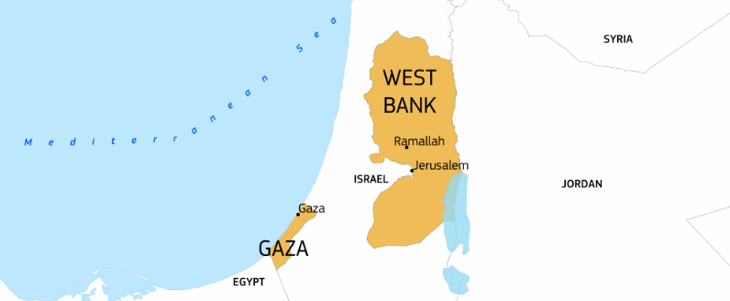
Gaza humanitarian water crisis
Economic blockage of Israel and Egypt since 2007
5 % of water resources fit for human consumption
Limited hygiene practise
Insufficient sewage treatment
Water scarcity
2018 mobilization of financial support of €456 million for a desalination plant
2018-2022 construction
55 m³ capacity
Sea Water Reverse Osmosis
EU humanitarian funding: Close to €35million in 2021 More than €827 million since 2000

Slide 12
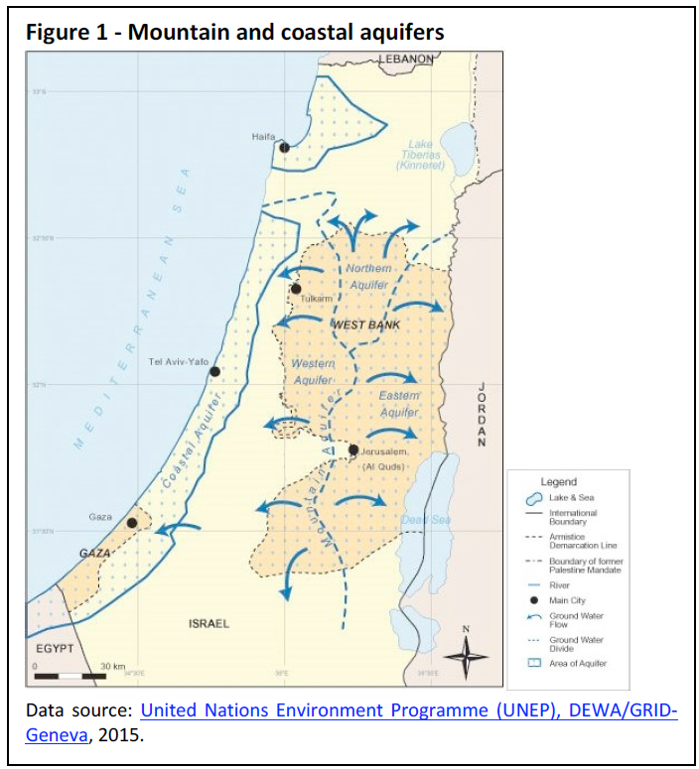
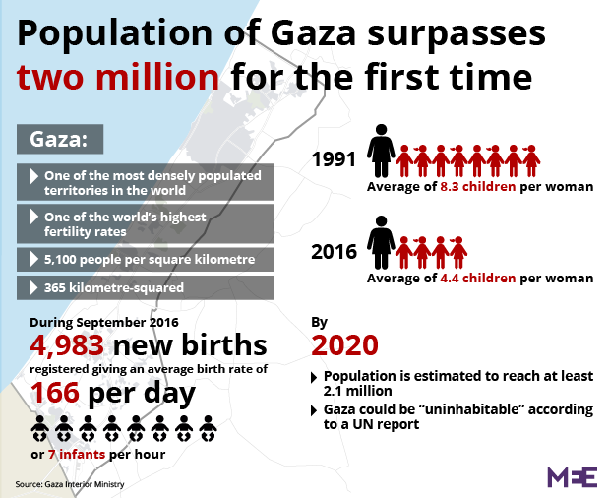
Gaza water crisis

Slide 13
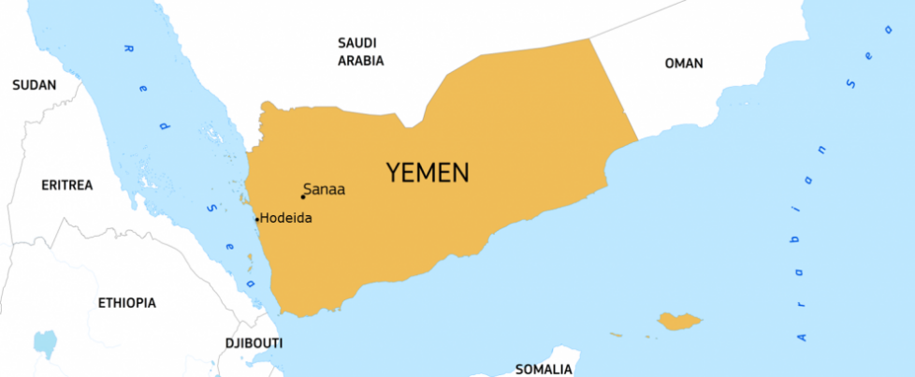
Jemen humanitarian water crisis
More than 20.7 million people need humanitarian assistance
16.2 million people face crisis levels of food insecurity
20.1 million people need health assistance
15.4 million people lack access to safe water and sanitation
EU humanitarian funding:
€692 million since 2015
€134 million in 2021

Slide 14
Questions?

