Slide 1
Review of Germany & France’s Policy Proposal
29/04/2019
Charlier F., Mainka P., Wiesenthal D, Hazaryan G.

Slide 2
General review
Overall, Germany and France’s policy proposal is in line with the position of the EU.
“The incapacity to elaborate a common solution to migration based on balanced responsibilities is the main problem at the moment. In other words, the situation is not one about numbers and migrants but one about trust and mistrust.” - we strongly agree
However, this is the reason why we do not agree with the statement that the EU Commission has given up on completing the reform of the CEAS – it is still a priority.

Slide 3
Proposal 1: “adopt the exact definitions and clear distinctions between the terms describing illegal economic migrants and asylum seekers”
Good idea but difficult to put this in practice
Many obstacles such as absence of ID cards, fake country of origin

Slide 4
Proposal 2: Stronger readmission policy
Depending on the scope of what France & Germany define as “territories afflicted by persecution” (2)
Must respect the human rights i.e. political and sexual orientation persecution should be included
Proposal 3: Exact definition of all appropriate procedures
The European Commission is in favour of proposal 3
Proposal 4: “Broaden the scope of “family members” so as to include siblings and any further widening of this scope should be discussed collectively” – agree

Slide 5
Proposal 5:
Further integration of the asylum seekers by taking into account their previous experience, language or other skills
Need for further clarification
Additional EU financial assistance to frontline states such as Greece and Italy
Such assistance is already present where needed (FRONTEX and the Asylum Agency)
Further financial assistance – not possible without increasing the GNI contribution to the EU budget
EXCEPT if France & Germany have another clear proposal

Slide 6
Proposal 6: Development of common automated computer system
Will be of great help to tackle with the migration flows. However, the implementation of it might be more complicated
Proposal 7: Reduce disappearances + Help to identify illegal migrants, who need to be returned either to a regional haven country or to their country of origin
Agree - effective way to improve our return policy
Proposal 8: Cancel the reintroduced Schengen internal border controls until 31/12/2019
Agree

Slide 7
Proposal 9: “the creation of hotspots, bilateral deals with transit countries or FRONTEX strengthening need an urgent evaluation from the side of the Commission”
Such steps have already been analysed (check all factsheets on https://ec.europa.eu/home-affairs/what-we-do/policies/european-agenda-migration/background-information_en)
Proposal 10: “consistent distinguishing and differentiation (…) in a combination with the protection status and more effective integration of those in need”
Agree

Slide 8
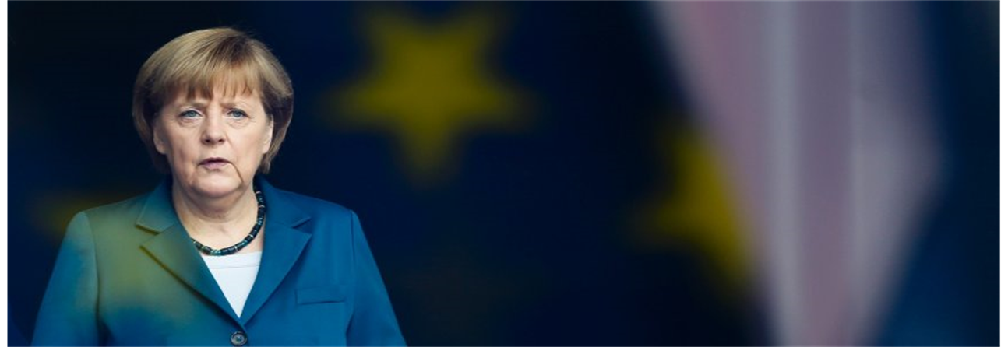
What is missing:
No reference to the issue of the rule of law
“Rule of law is a cornerstone of the EU. Without it, the bloc would no longer be the EU”
No clear solution for the future and already-there migrants.
“Sharing a fair burden is needed for those who can permanently stay with us as they're entitled to asylum or a civil war refugee status”

Slide 9
In conclusion
Good and reasonable proposals that we would implement or we are already implementing.
However, must not remain silent over the issue of migrants relocation and the issue of the rule of law.

