Slide 1
Czech Philosophy of the XXth Century in Context - Introduction -
Ondřej Švec

Slide 2
Credits
The credits for the course will be delivered based on two categories of assessment:
(1) Engaged Involvement:
This is generally a matter of preparation, attendance, attention, and participation in the course.
and:
(2a) Oral presentation with critical assessment of strong points and weaknesses of presented texts
or:
(2b) Written Work:
A paper based on critical assessment of already exiting interpretations of Masaryk, Kosík and Patočka with regards to the primary texts. This means: You must consult primary sources and compare or critically assess their different interpretations.
Deadline: May 30, 2020

Slide 3
Difficulties to delineate something as a „nationally specific“ philosophy
The pitfall of reconstructing an identity of Czech Philosophy in forceful and artificial manner
Examples of dubious national specifications of philosophical thought:
François Cusset, French Theory: Foucault, Derrida, Deleuze & Cie et les mutations de la vie intellectuelle aux États-Unis (Paris: La Découverte, 2005)
Roberto Esposito, Living Thought: The Origins and Actuality of Italian Philosophy (Stanford University Press, 2012)

Slide 4
Difficulties to delineate something as a „nationally specific“ philosophy
2) What do we mean by such an identity?
“Denkstil” or “Style of thought” (L. Fleck)
a certain tradition (Anglosaxon analytical philosophy, German hermeneutics, French deconstruction…)
some oddity, some overarching tendencies, a distinctive feature that can be found nowhere else:
Cf. NOVÝ, Lubomír, GABRIEL, Jiří, HROCH, Jaroslav (eds.), Czech philosophy in the XXth century, Washington: 1994

Slide 5
Particular features of 20th c. Czech Philosophy ?
1) „continuous attention has been paid to the philosophy of man and society...”„All the main streams of Czech thought want to have a „human face“
2) a tendency to view history from the point of view of philosophy
3) constituting the Weltanschauung of the modern Czech person“???
4) the frequency with which the issues of „practical philosophy are discussed are sometime
NOVÝ, Lubomír, GABRIEL, Jiří, HROCH, Jaroslav (eds.), Czech philosophy in the XXth century, Washington: Council for research in values and philosophy, 1994
None of such identification is convincing !

Slide 6
Particular features of 20th c. Czech Philosophy ?
Conclusion by Nový, Gabriel & Hroch:
“For having had concrete experience with authoritative, totalirian systems, in reflecting upon specific intellectual challenges Czech philosophy tends to develop an ability to blend unbending criticism with responsible tolerance.”
(Czech philosophy in the XXth century, op. cit., p. 218)
There are many reasons to consider such generalization with suspicion.

Slide 7
The uncertain purpose of such an endeavor
Does a knowledge of Czech philosopher “help us to understand the mentality of the Czech people”, as René Wellek claims?
(from J. Novák (ed.), On Masaryk, 1988, p. 17)

Slide 8
What is the task of Czech people in the universal concert of nation?
Concert of nations (XIXth century)
How to make one´s voice to be heard, if one acknowledges its marginal position?
since XIXth century, many rather mythological and mythomaniac proposals
to be the bridge between the West and the East?
an exaggerated emphasis on some moments of Czech history
Cf. F. Palacký
the Hussit movement: Urkundliche Beitrage zur Geschichte des Hussitenkriegs (2 vols., Prague, 1872-1874).
the myth about the special role that Slavic people would play in the history of mankind. In hist “Přehled dějin krásovědy a její literatury” (An Historical Survey of the Science of Beauty and the Literature on the Subject

Slide 9
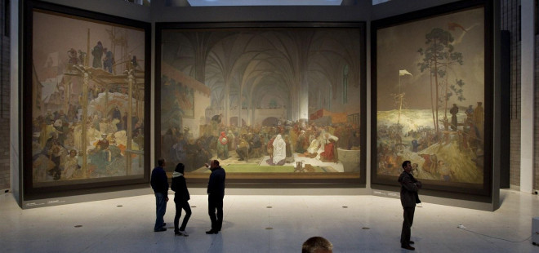
Slovanská epopej

Slide 10
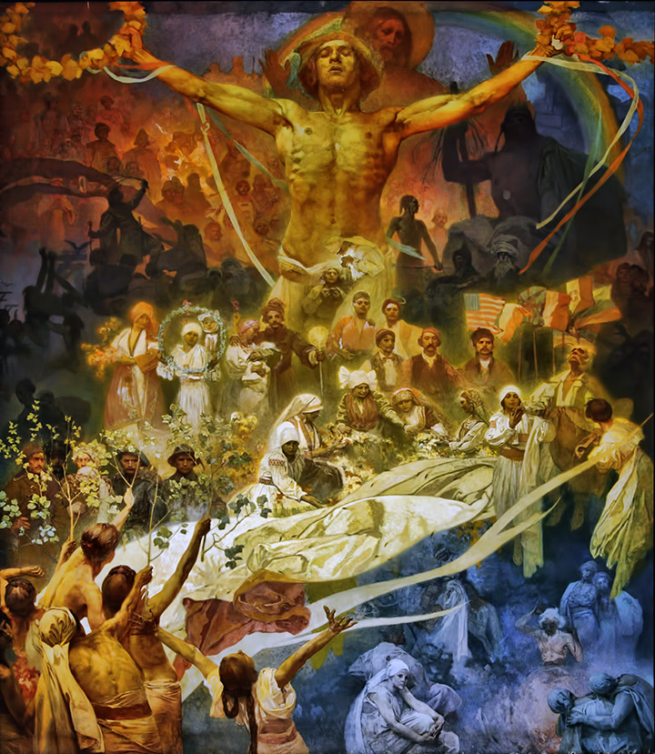

Slide 11
Readings for the next two sessions
March 10, 2020:
Thomas G. Masaryk ; Suicide and the meaning of civilization, Chicago ; London : University of Chicago Press, [cop. 1970]
March 17, 2020:
Jan Patočka: Spiritual Crisis of European Humanity in Husserl and Masaryk
+ optional reading allowing for a better understanding of Husserl´s concept of the "crisis“: Edmund Husserl - The Crisis of European Sciences - §§1-2

