Slide 1
Theme: Dreams, Drives and Desires. Freudian Look at Fairytales
Sleeping Beauty, Snowhite, Cinderella, Beauty and the Beast
Freudian analysis
Based on: Bruno Bettelheim: The Uses of Enchantement: The Meaning and Importance of Fairy Tales, 1976

Slide 2
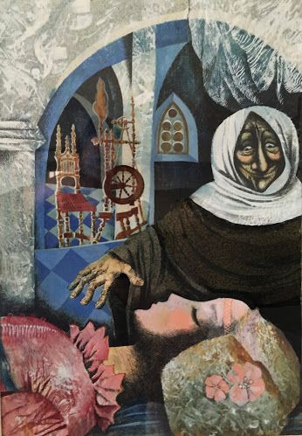
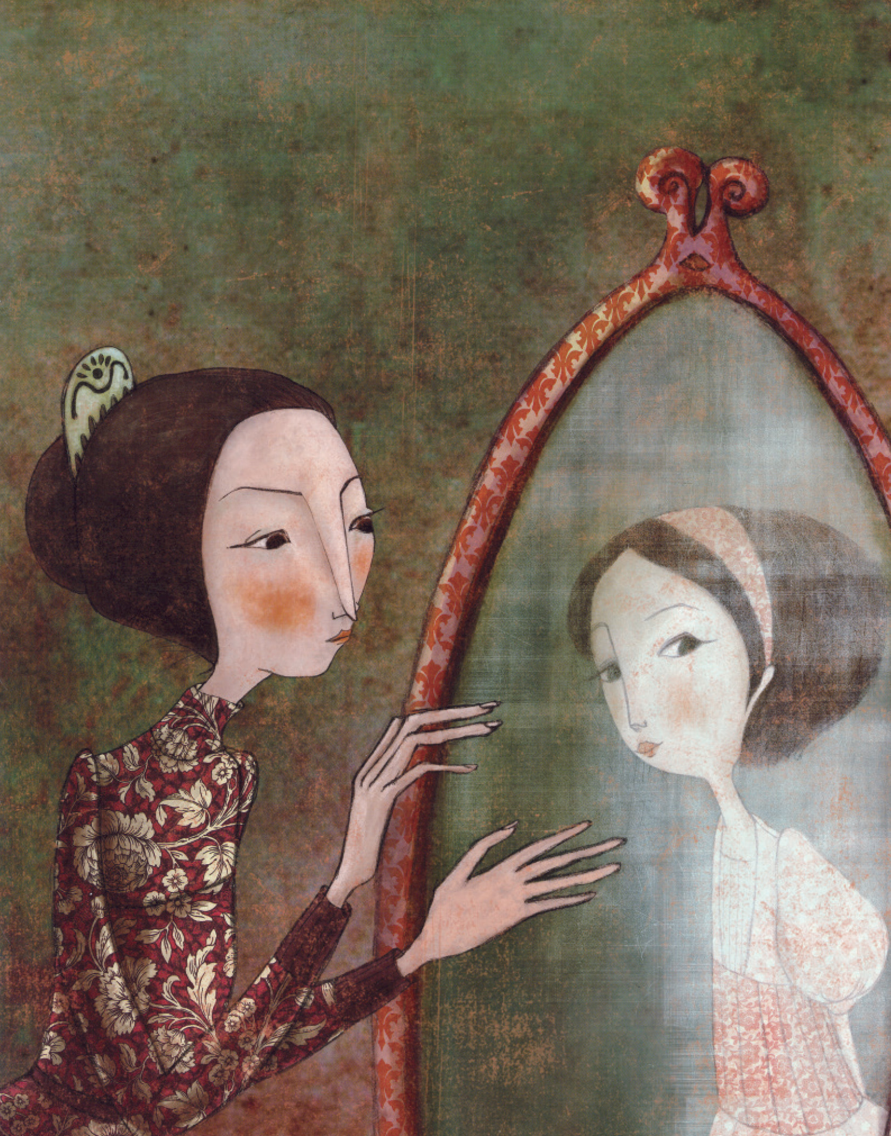
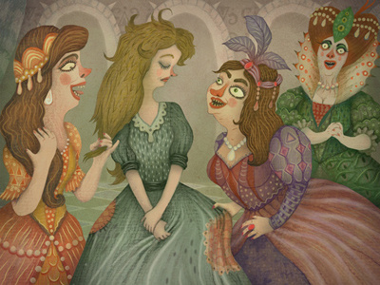
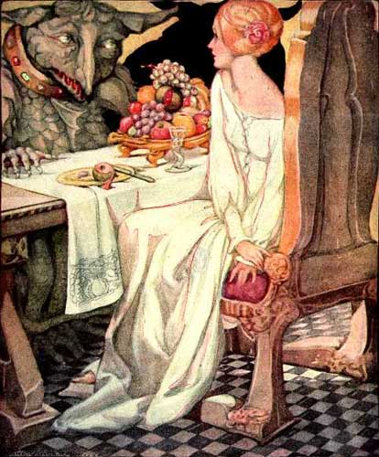
a story about girls´ maturation

Slide 3
Snowhite
Cinderella
Sleeping Beauty (Briar Rose)
Beauty and the Beast
a story about girls´ maturation

Slide 4
Snowhite
Sleeping Beauty (Briar Rose)
Cinderella
Beauty and the Beast
sibling rivalry + Oedipal rivalry (the both projected)
a girl´s ambivalent approach to sexuality
symbolic castration to reach missing feminity
accepting of "dirtiness"
awakening of mature sexuality
initial colour symbolism: innocence vs. desire
Oedipal rivalry reversed (because of projection)
parental narcissism, denial
queen: late (incorporative) oral fixation
(even regression to orality)
latency period
asexual (childlike) mode of existence
mothers´ ambivalence towards daughters
temptations and conflicts of puberty
awakening of mature sexuality (genital stage arrival)
animal aspect of sexuality
a girl´s change of approach to sexuality
(from immature to mature)
menstruation + defloration predicted ("women curse", "women mission")
latency period
awakening of sexuality/genital stage (defloration)
phallic symbollics
a story about girls´ maturation

Slide 5
Snowhite
Cinderella
Sleeping Beauty (Briar Rose)
sibling rivalry + Oedipal rivalry (the both projected)
a girl´s ambivalent approach to sexuality
symbolic castration to reach missing feminity
accepting of "dirtiness"
awakening of mature sexuality
Beauty and the Beast
initial colour symbolism: innocence vs. desire
Oedipal rivalry reversed (because of projection)
parental narcissism, denial
queen: late (incorporative) oral fixation
(even regression to orality)
latency period
asexual (childlike) mode of existence
mothers´ ambivalence towards daughters
temptations and conflicts of puberty
awakening of mature sexuality (genital stage arrival)
animal aspect of sexuality
a girl´s change of approach to sexuality
(from immature to mature)
menstruation + defloration predicted ("women curse", "women mission")
phallic symbollics
latency period
awakening of sexuality/genital stage (defloration)
a story about girls´ maturation

Slide 6
Sleeping Beauty (Briar Rose)
menstruation + defloration predicted ("women curse", "women mission")
phallic symbollics
latency period
awakening of sexuality/genital stage (defloration)

Slide 7
Snowhite
initial colour symbolism: innocence vs. desire
Oedipal rivalry reversed (because of projection)
parental narcissism, denial
queen: late (incorporative) oral fixation
(even regression to orality)
latency period
asexual (childlike) mode of existence
mothers´ ambivalence towards daughters
temptations and conflicts of puberty
awakening of mature sexuality (genital stage arrival)

Slide 8
Cinderella
sibling rivalry + Oedipal rivalry (the both projected)
a girl´s ambivalent approach to sexuality
symbolic castration to reach missing feminity
accepting of "dirtiness"
awakening of mature sexuality

Slide 9
Beauty and the Beast
animal aspect of sexuality
a girl´s change of approach to sexuality
(from immature to mature)

Slide 10
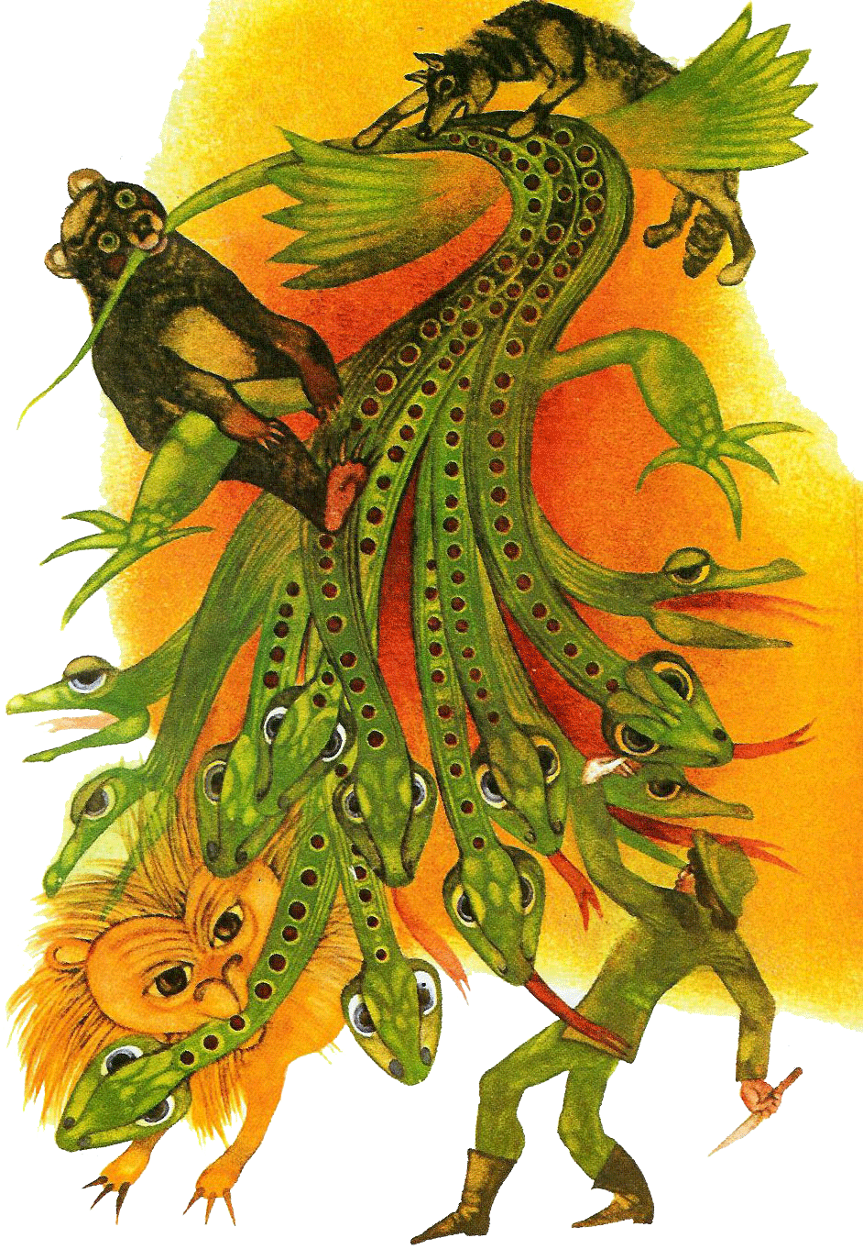
motif of a hero fighting with masculine antagonist - Bayaya; Long, Wide and Sharp Eyes; Three Golden Hairs...

Slide 11
motif of a hero fighting with masculine antagonist - Bayaya; Long, Wide and Sharp Eyes; Three Golden Hairs...
a boy fighting with his father (for mother)

Slide 12
Sleeping Beauty (Briar Rose)
- a story about girls´ maturation
a story about girls´ maturation

Slide 13
Snowhite
Sleeping Beauty (Briar Rose)
- a story about girls´ maturation
a story about mothers and daughters
a story about girls´ maturation

Slide 14
Snowhite
Cinderella
a story about siblings
Sleeping Beauty (Briar Rose)
- a story about girls´ maturation
a story about mothers and daughters
a story about girls´ maturation

Slide 15
Snowhite
Cinderella
a story about siblings
Sleeping Beauty (Briar Rose)
- a story about girls´ maturation
Beauty and the Beast
a story about mothers and daughters
a story about men and women
a story about girls´ maturation

Slide 16
Snowhite
Cinderella
a story about siblings
Sleeping Beauty (Briar Rose)
- a story about girls´ maturation
Beauty and the Beast
a story about mothers and daughters
a story about men and women
Bayaya;
Long, Wide and Sharp Eyes; Three Golden Hairs...
- a story about boys and fathers
a story about girls´ maturation

