Slide 1
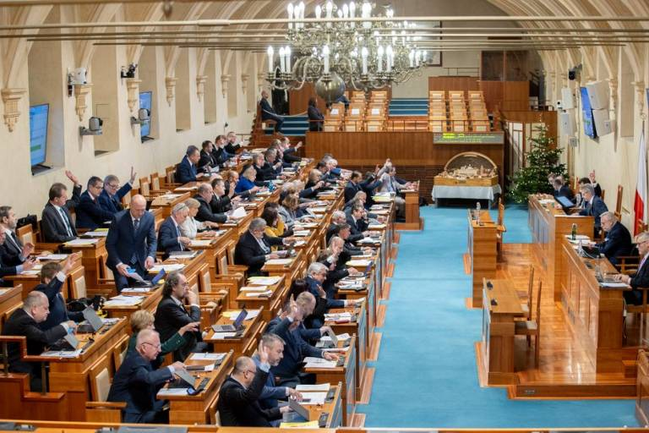
Can Czech senators advocate constituency interests without the formal power to do so
_____________________
Jan Hruška
Faculty of Social Studies Masaryk University
Jakub Čapek
Faculty of Social Sciences Charles university
6.12.2024 NEW FRONTIERS IN SOCIAL SCIENCES Prague
This research was supported by the Specific University Research Grant provided by the Ministry of Education, Youth and Sports of the Czech Republic (MUNI/A/1488/2023)

Slide 2
The rationale of the territorial upper chambers
Upper chambers as a traditional way how to represent territories
Primarily in federations, but also in “regional states”
In contrast, not assumed in small, unitary, centralised or homogeneous states (= states without strong territorial identities)
The Czech Republic is exactly this type of country

Slide 3
Research questions and the case selection
Indications that the Czech Senate actually serves for territorial representation even though it has no formals powers to do so
The Czech Senate as a deviant case → the least likely case study with the potential to complement the existing theory of bicameralism
Can the role of territorial representation actually be performed by the Czech upper chamber
How (with what tools) do the Senate and individual senators perform such a role, given that the Senate does not have constitutional powers in this regard

Slide 4
How upper chambers may represent territorial interests
Legislative influence
Amendments beneficial to specific territories
Powers over territorial legislation
Influencing the budget
Pork barrel
Debates and committees
Specialized committees bring more attention to the regional interests
Informal tools

Slide 5
The Czech Senate and its potential role(s)
Stabilising and revising role
Senate constituencies do not always correspond to territorial units
The Czech Senate has no formally established powers to represent the interests of regional groups
Senators often engage in solving individual or local problems (role of regional patron)

Slide 6
Methods and data
Elite interviewing with 14 senators (diversity of the senators – stratified sampling – interviewing till the point of saturation)
Content analysis of semi-structured interviews
April – July 2023
Each interview lasted around 30 minutes, in person interviews
Abductive research logic

Slide 7
Results – do they do it?
Territorial representation is one of the potential roles
For some the reason being a senators
For some only pragmatic activity
Critics of advocacy of territorial interests exist as well
Influence of nature of the constituency (urban vs. rural)
Influence of distance from Prague?

Slide 8
Results – how do they do it?
Influence and authority in informal processes → lobbing the state authorities, but also communicate within their own constituencies
Agenda setting
Using formal powers as well: legislation
Situation in the constituency as a inspiration
Amending the annexes of the bills
Range of issues senators advocate – often engaged in micro-management (e.g., legal clinics)

Slide 9
Conclusion and discussion
The findings broaden the existing theory of bicameralism, which had linked territorial upper chambers predominantly with federations or regional states
Positive perception of territorial representation
Importance not to rely only on powers and legal anchoring
Problem of practices not aligning with statutes
Problem of uneven representation across the country

