Slide 1
Deaf identity, language, communication, culture and rights in the Czech Republic
Mgr. Andrea Hudáková, Ph.D.
illustration Bc. Kateřina Holubová
25th July 2018, Prague
IACAPAP 2018, Symposium: Cultural diversity and mental health care of deaf and hard of hearing youth

Slide 2
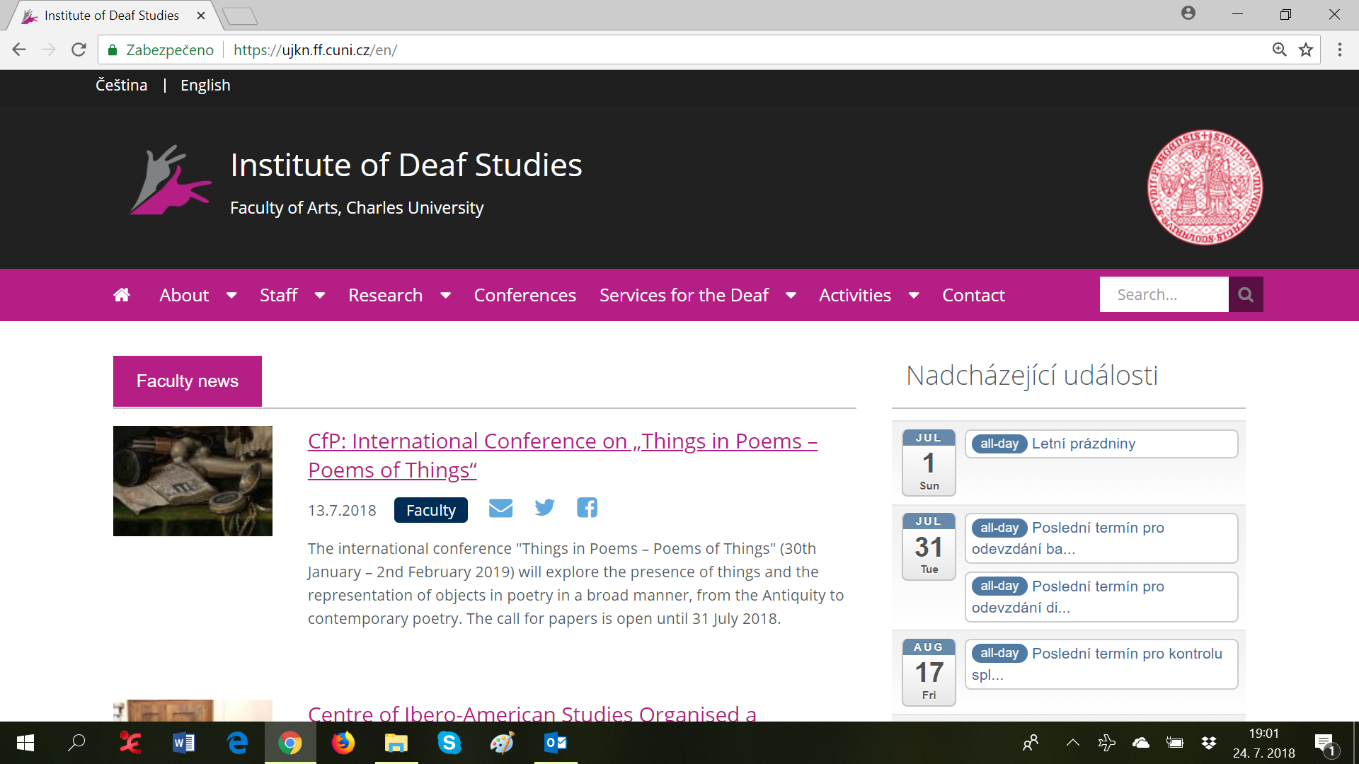

Slide 3
Faculty of Arts
*1348
Institute of Deaf Studies
*2013
Study program: Deaf Studies
*1998
Charles University
*1348

Slide 4
Institute of Deaf Studies
It is the only department focusing on the linguistics of Czech Sign Language and Deaf Studies in the Czech Republic
Very wide scope
Deaf communication (in Czech Sign Language, in Czech) and relevant linguistics
Deaf culture, history and community
Education of the Deaf; beside research we prepare future educators of the Deaf
Interpreting for the Deaf; beside research we prepare future interpreters of the Deaf
Workaday providing support study service for Deaf and hard of hearing students across the university

Slide 5
Structure of my talk
Deaf
Deafness
Deaf life in the Czech Republic – system, law
Deaf life in the Czech Republic – reality
Outcomes for the mental health professionals

Slide 6
Deaf
Deaf/hard of hearing
Prelingual deaf/hard of hearing
Postlingual deaf/hard of hearing
One-sided deafness
Tinnitus
Using hearing aid/s, cochlear implant/s, other device, no device
Other specifics (psychiatric illness, ADHD, exceptionally talent, blindness….)

Slide 7
Deaf
Preferring Czech Sign Language/Czech spoken or written language in communication face-to-face
Deaf/hearing parents/families
Graduated in the schools for the deaf/mainstreams schools
Insiders/outsiders of Deaf community
Deaf identity
Identity of person with disability
…

Slide 8
Deaf
Many different characters, situations, variables…
… everybody is an original with his/her unrepeatable life story
Is it green, or is it blue? What color is it?
Like it is so hard exactly descript turquoise color… It is so hard descript a typical deaf/Deaf person

Slide 9
Deafness

Slide 10
Deafness

Slide 11
Deafness

Slide 12
Deafness

Slide 13
Deafness – medicine point of view
Help overpower barriers
Early detection of deafness, accurate diagnostician
Early, effective, holistic and long-term healing: hearing devices, speech therapy, therapies targeting to overcome/clear abnormalities and problems caused by deafness
Support: strategies how to fit in mainstream, despite of deafness

Slide 14
Deafness – medicine → social point of view
Deafness – medicine point of view
To help overpower barriers
Life of deaf is full of difficulties and troubles and we have to make it easier and more comfortable to them
In comparison with us, they live hard, we must be kind to them a help them
Variability of social advantages and benefits

Slide 15
Deafness – culturally linguistic point of view
It is not based on vision of hearing persons about living without sounds (deficit model) but on linguistically and culturally focused research
Regardless, sign and spoken languages are different in their modality and structures, the are equal in functions of communication, they have similar stages of acquisition and they share the same neural substrates
Sign languages are fully valid languages with all features of natural languages
As each sign language stick together people in the region, sign languages are like roots of individual Deaf communities

Slide 16
Deafness – culturally linguistic point of view
Sign languages are real languages
Visual world without sounds is a real world
Development in sufficiently saturated visual world and language is comparable to typical development in hearing world and spoken language
*1960: Stokoe, William C. Sign Language Structure: An Outline of the Visual Communication Systems of the American Deaf
Sign languages are not systems of nonverbal communication
Sign languages are not alternative systems to spoken languages
Sign languages are not addition to spoken communication realized by deaf

Slide 17
Deafness – culturally linguistic point of view
Using sign language, adopting principles of „visual living“ and social rules of the Deaf community, deaf person can to identify himself/herself as Deaf, he/she can take up Deaf identity
In this perspective it is irrelevant if he/she is good enough in comparison with hearing persons

Slide 18
Deafness – culturally linguistic point of view
Partnership with the respect to diversity of ways of life
Arrange conditions for maximal realization the human potential of Deaf in all spheres
Arrange conditions for living in visual world and sign language throughout all the life
UN Convention on the Rights of People with Disabilities

Slide 19
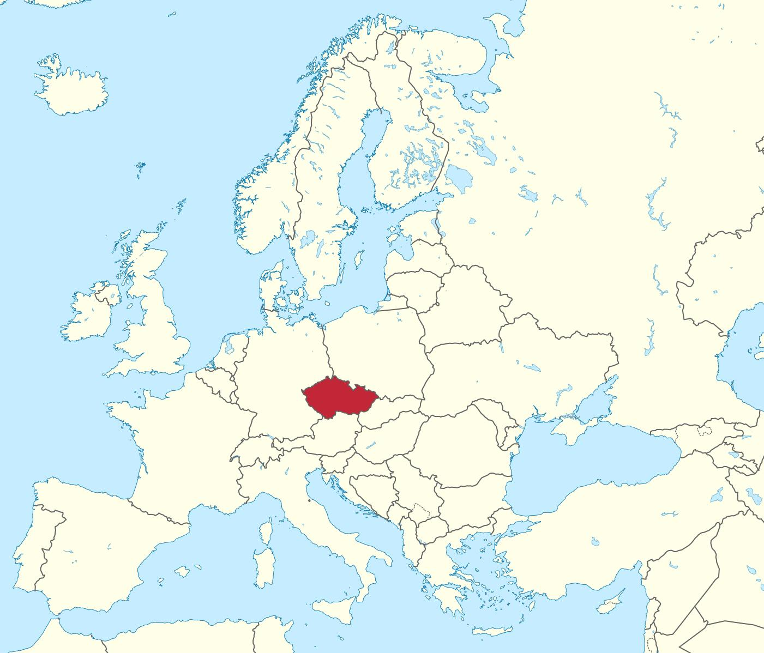
Czech Republic
>10,5 mil.

Slide 20
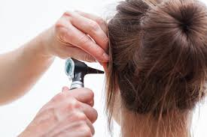
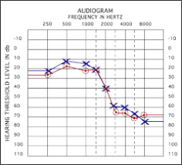
Deaf in the Czech Republic → 1998
Pedagogical care: speech therapy (next to the education)
Special schools for the deaf: therapy preferred over education → low level of education → manual professions
Social system
Disability pensions
Various advantages in the everyday life (traffic transport, housing etc.)
Medicine view of point
Medical care
Detection
Diagnostic
Treatment
Hearing aids

Slide 21
Deaf in the Czech Republic 1998
Deaf Studies
Culturally linguistic point of view at the first time in our area
Starting the emancipation process of Czech Deaf community
Changes across all domains of Deaf life around all the Czech Republic

Slide 22
Deaf in the Czech Republic 2018
From birth to adulthood
Nationwide neonatal screening of hearing loss
World-level medical care and treatment, devices service
Early intervention service for families with deaf babies
Variations of study support provided in schooling in kindergartens, elementary schools, secondary schools and universities (interpreting, speech-to-text service, note-taking service, assistants of pedagogues, individual study plans, technical aids…); choice to attend both mainstream schools and special schools for the deaf (exc. universities)
Czech Sign Language users should be educated bilingually, i.e. in both Czech Sign Language and in Czech in written form, where Czech language learning should be designed on second language teaching principles
Pedagogical counseling service for the deaf, their parents and educators throughout all education process

Slide 23
Deaf in the Czech Republic 2018
Everyday life
Interpreting and/or speech-to-text service in daily situations, incl. police and court proceedings
Special subtitles for the deaf in the most of broadcasts in public TV channels and many broadcasts in private TV channels, interpreting in some TV broadcasts and daily news once a day, special everyday TV news in Czech Sign Language and two-weak TV magazine about events of the Czech Deaf
Special subtitles for the deaf accompanying all Czech movies on DVDs and some movie shows at the cinema
Interpreting and/or special subtitles for the deaf in some theatre performances
Interpreting and/or speech-to-text service in some museums, culture actions etc.
Deaf are active in various domains of society (incl. „top professions“, policy etc.)

Slide 24
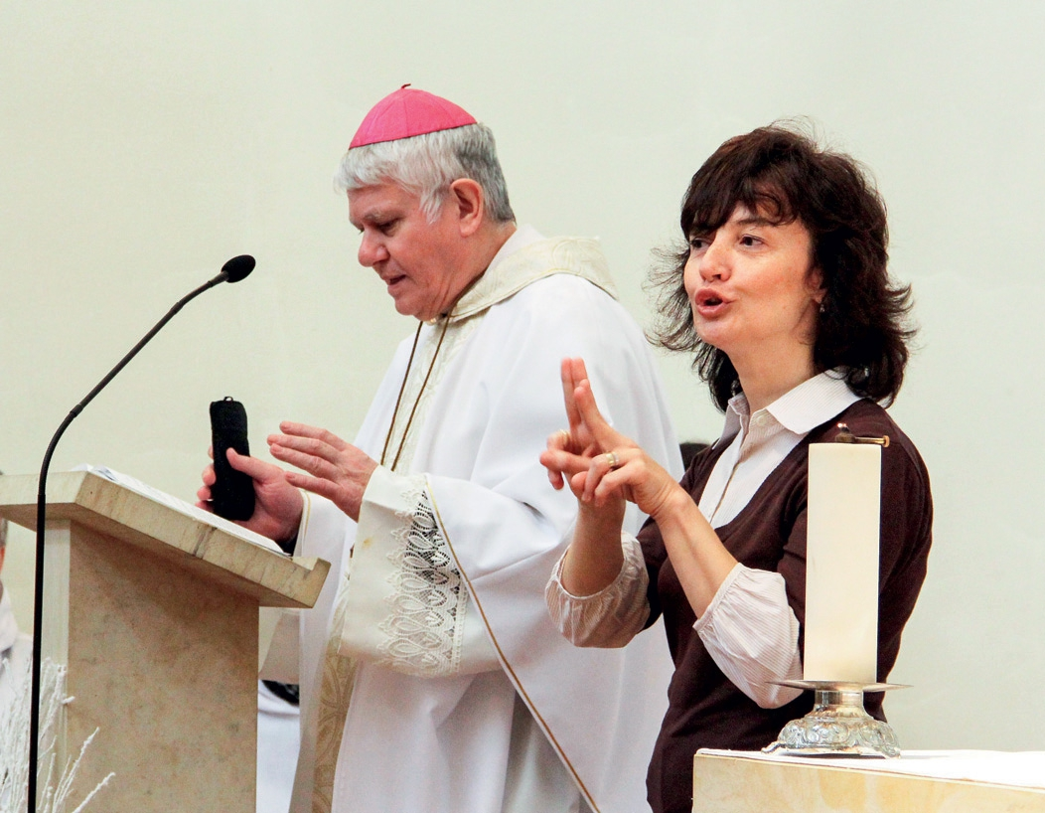
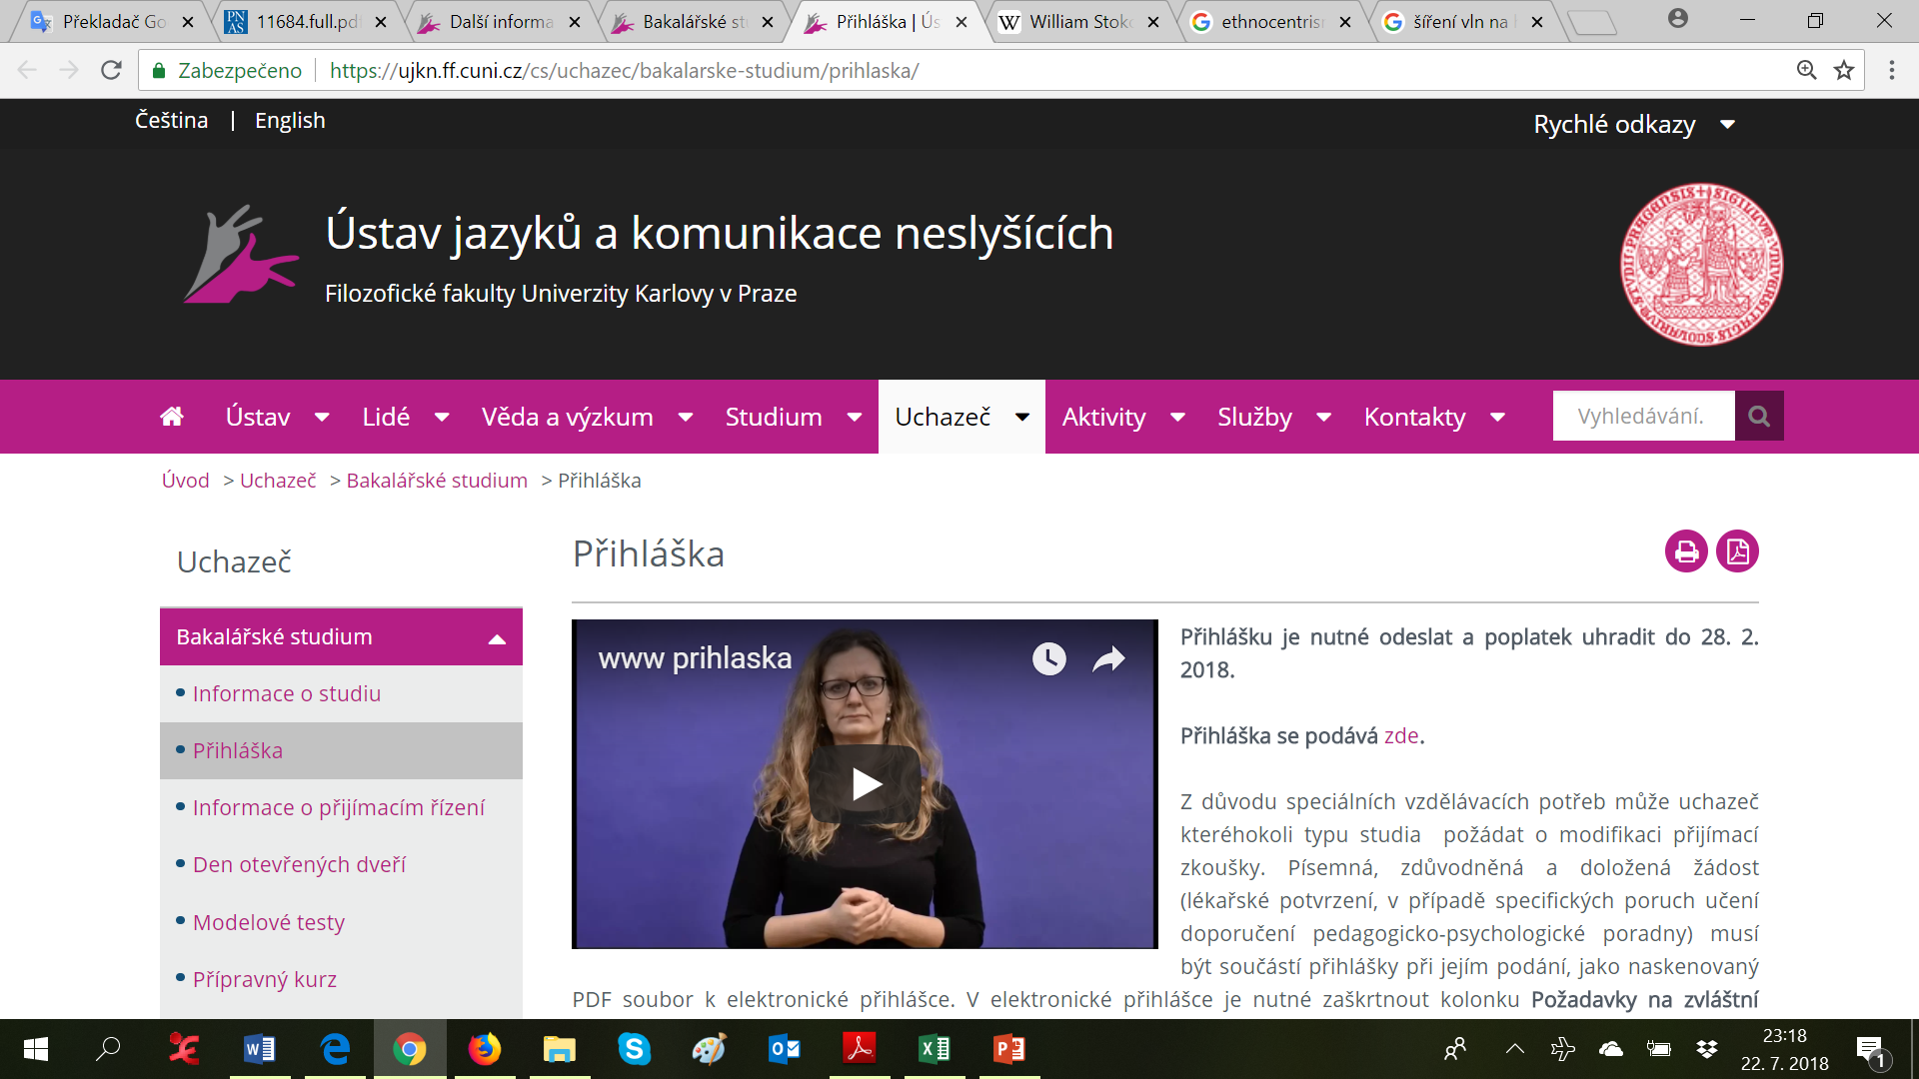
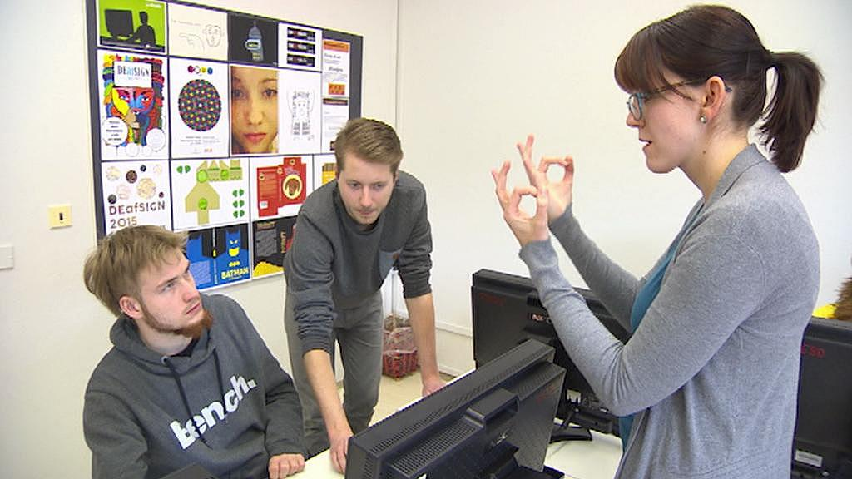
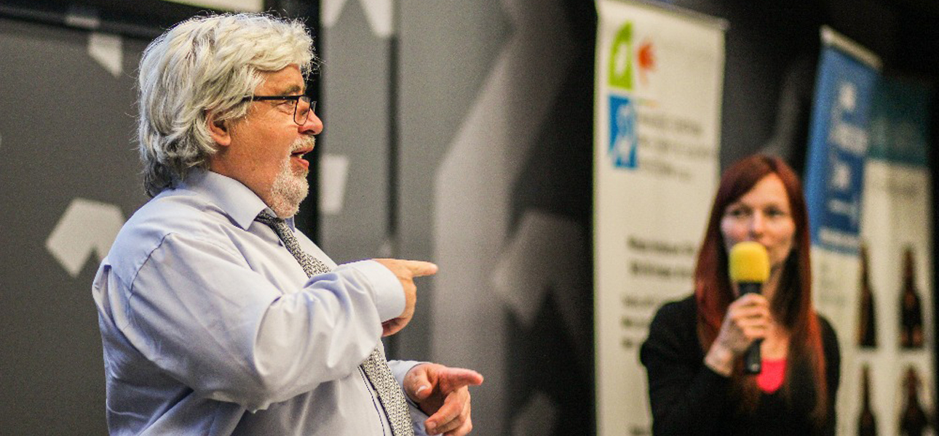
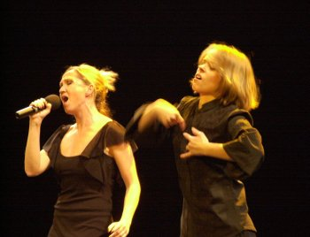
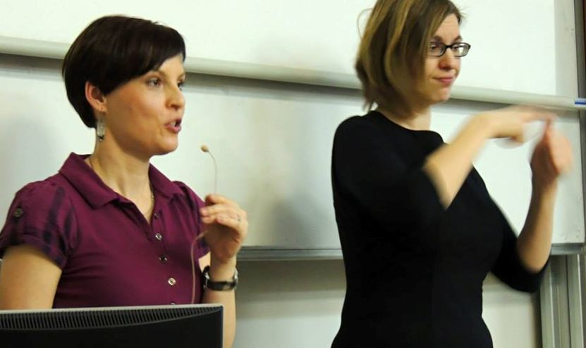
Deaf in the Czech Republic 2018
Interpreting

Slide 25
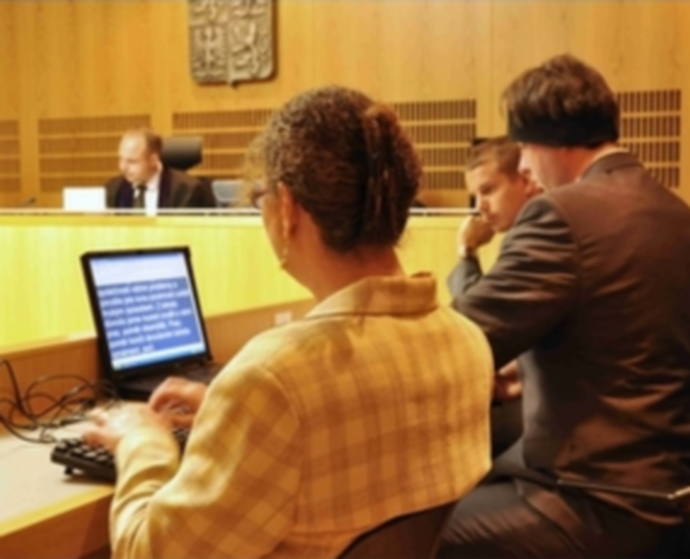
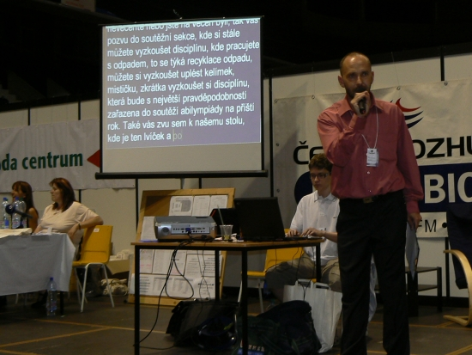
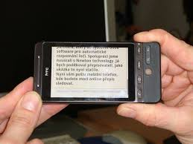
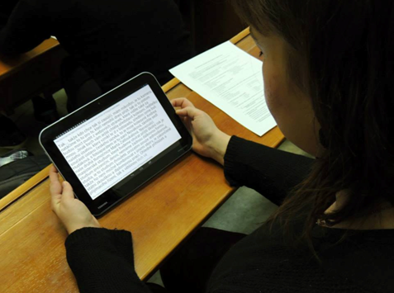
Deaf in the Czech Republic 2018
Speech-to-text service

Slide 26
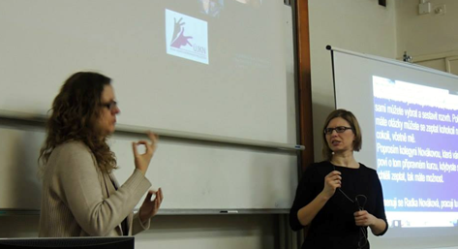
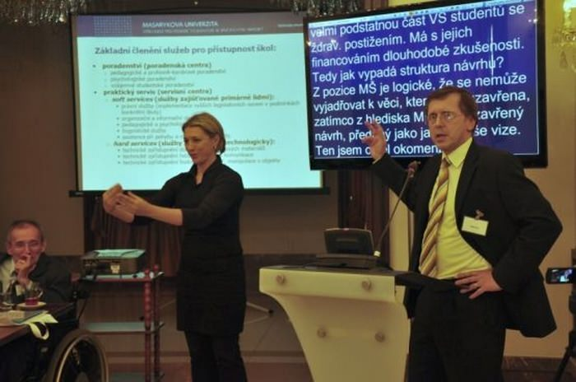
Deaf in the Czech Republic 2018
Interpreting + Speech-to-text service

Slide 27
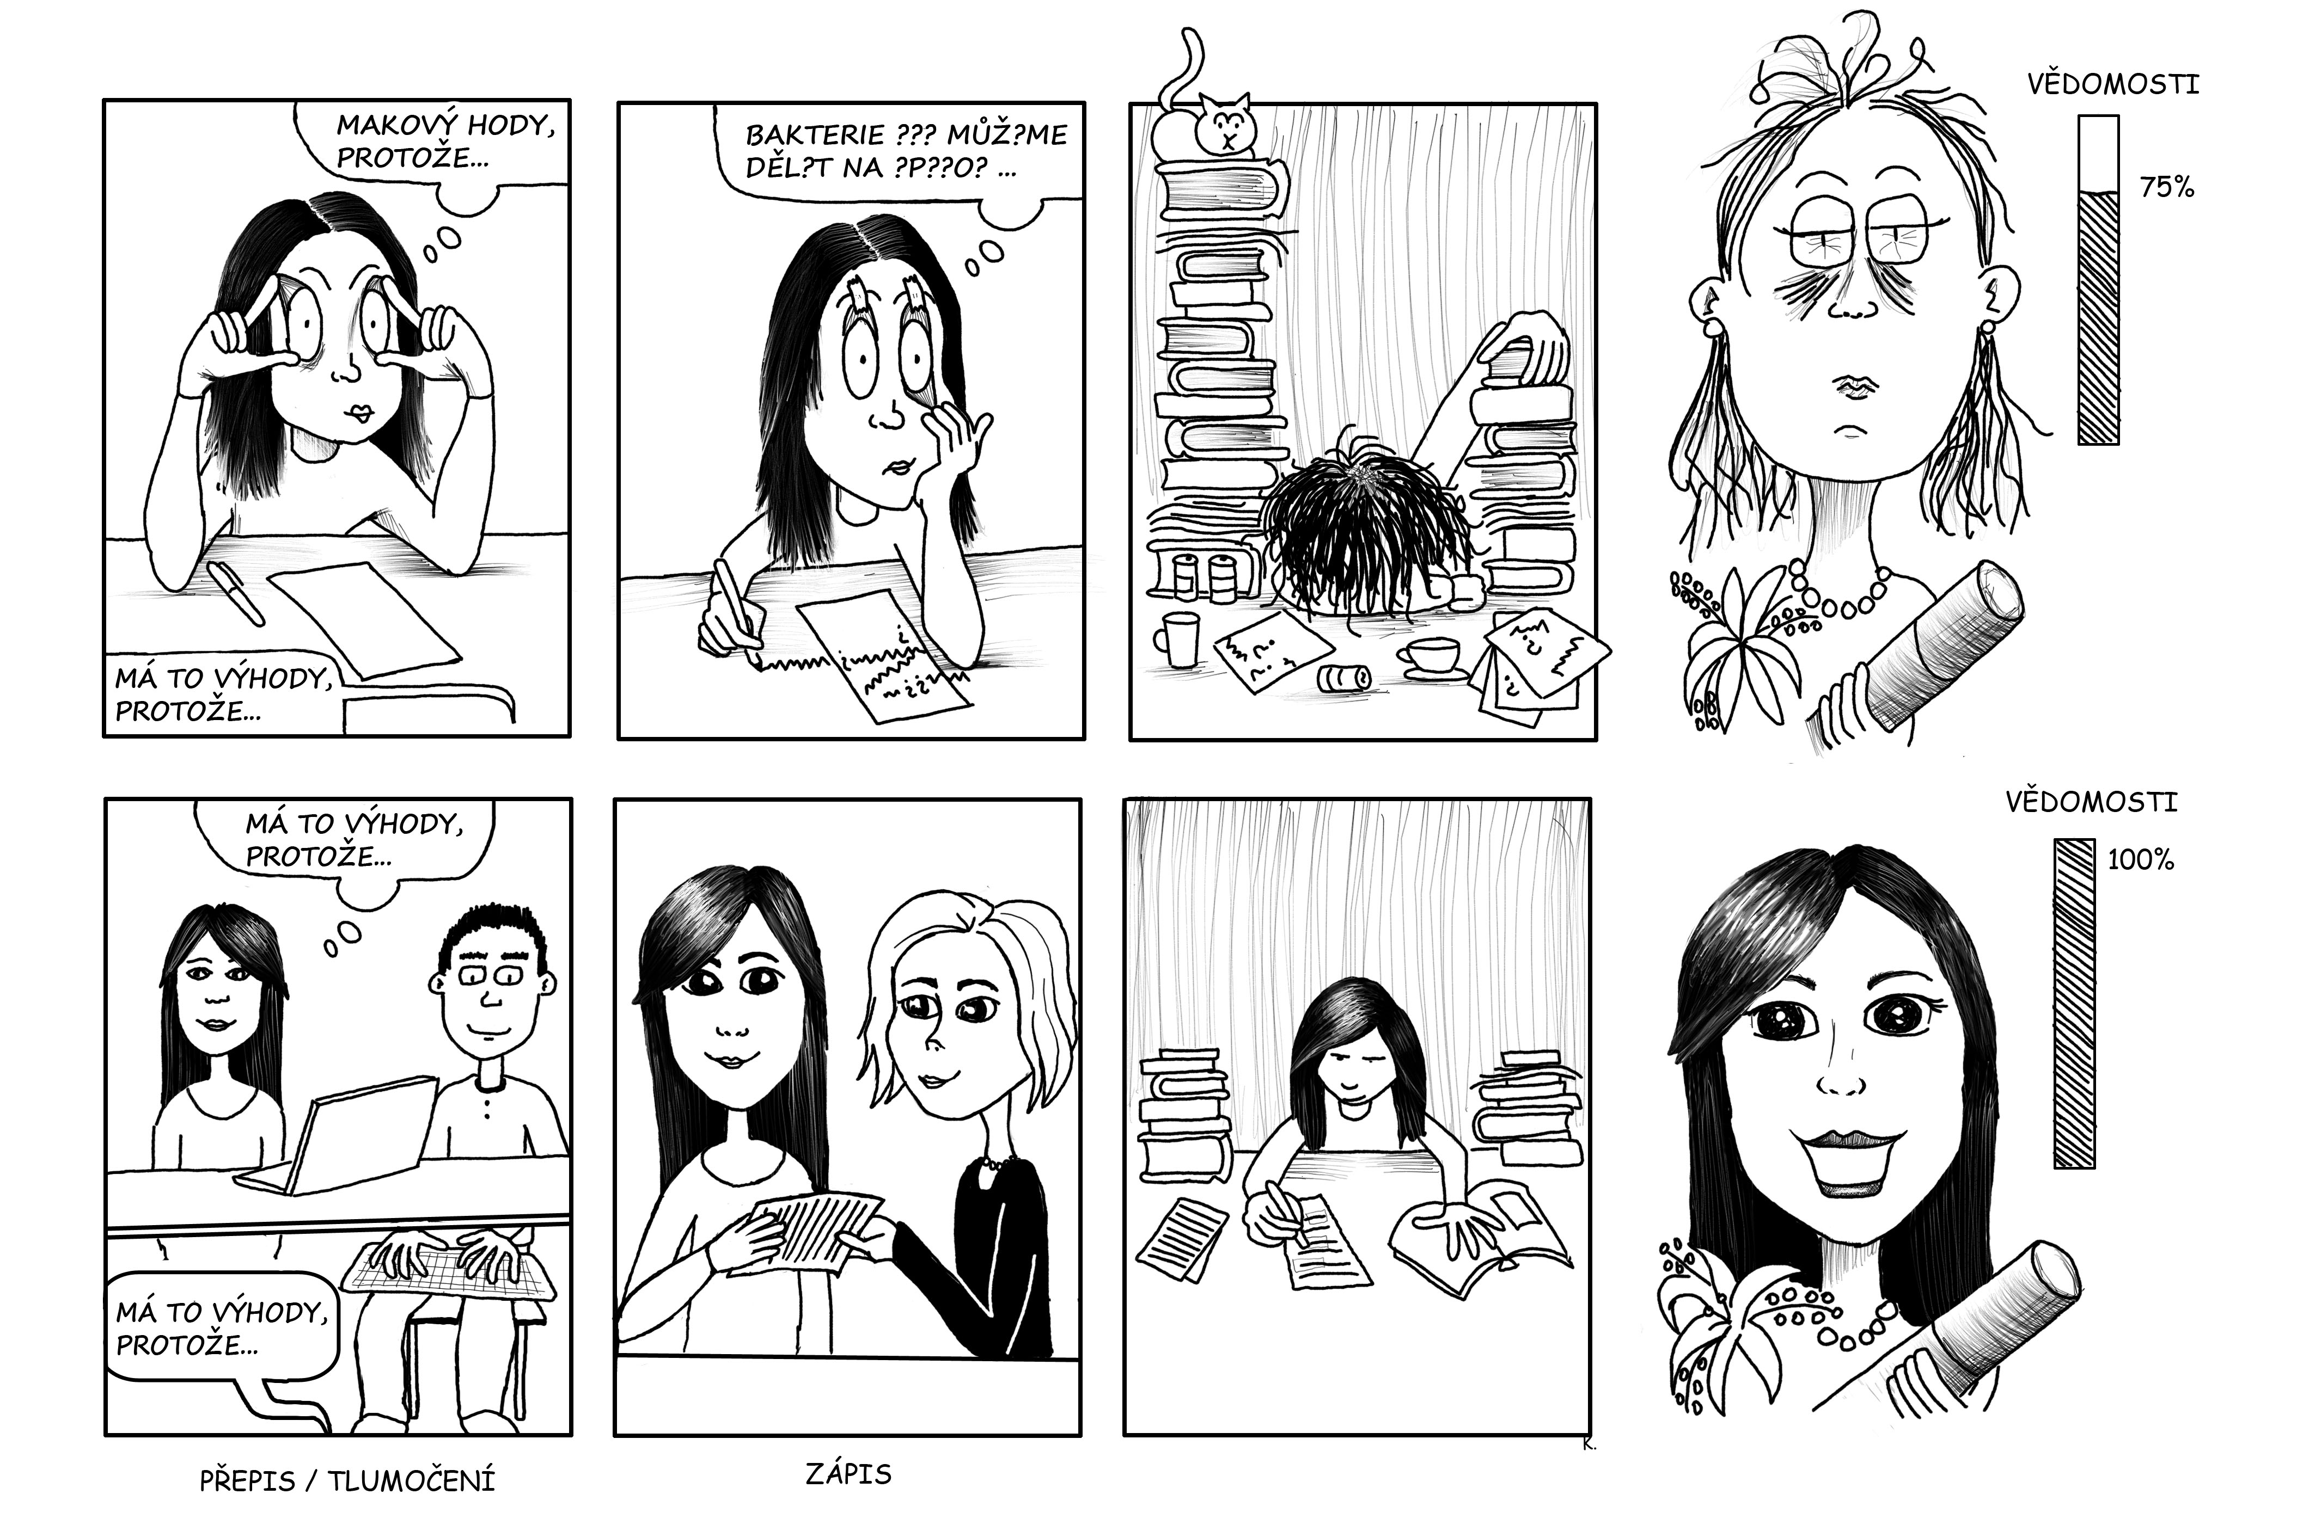

Slide 28
Deaf in the Czech Republic 2018
Legislative Framework, Laws
Common human rights, no discrimination…
Law about sign language (1998) → Law about Communication Systems of Deaf and Deafblind Persons (2008)
The Education Act…
UN Convention on the Rights of People with Disabilities (2007)

Slide 29
Deaf in the Czech Republic 2018
Legislative Framework, Laws
Deaf are full citizens of the Czech Republic
Legislative framework provides to them appropriate conditions allowing full application in all dimensions of life
Everything is gratis

Slide 30
Deaf in the Czech Republic 2018
Reality
Medicine point of view (followed by social point of view) is still predominant in the current Czech society, more precisely in minds of general public, incl. professionals from various kinds of science
Culturally linguistic point of view is still significantly minor in the peoples minds but it spreads little by little and gradually penetrates legislative framework and state structures (mainly thanks UN Convention on the Rights of People with Disabilities)

Slide 31
Deaf in the Czech Republic 2018
Reality
Mixture of old (before 1998) and new (after 1998)
Nobody of deaf/Deaf doesn´t want to give up benefits of medical and social points of view and most of them demand benefits of culturally linguistic point of view in the same time
It can not work!

Slide 32
Deaf in the Czech Republic 2018
Reality
No multidisciplinary, no cooperation across sectors (heathy, social affairs, education…), no professional collaboration
Confused, unclear and often inefficient funding
Absolute deficiency of any conception, any wider, longer-term and systematic vision
Strong deficiency of evidence based data

Slide 33
Deaf in the Czech Republic 2018
Reality – From birth to adulthood
Bilingually education is not realized in the vast majority of cases
Czech Sign Language is not accepted as a real language but as some type of support, compensation or substitution
In the same way, Deaf community, culture, history etc. are not taken into account in the education of the deaf children. Thus, Deaf identity is not accepted, even built or supported
Only significant minority of deaf children is included to the system of „guiding“
No system of guiding/counseling/social supporting… for adults

Slide 34
Deaf in the Czech Republic 2018
Reality – From birth to adulthood
Huge lack of tools for assessment deaf child development. We can´t test them, even assess language competencies, social skills, cognitive abilities, psychic processes etc.
Enormous lack of research
A few research probes show essential problems in reading competencies, language knowledge, socio-cognitive skills etc.

Slide 35
Deaf in the Czech Republic 2018
Reality – From birth to adulthood
Some deaf children think, there are only the one „broken“ around the world. Some of them assume, that deafness is a development stage and all adults can hear
Many deaf children live isolated in their families, schools, peers groups etc. due their disability to share common (spoken) language
They grow up in social, emotional and cognitive poorness, whereas they can´t receive information randomly, as obviously children do

Slide 36
Deaf in the Czech Republic 2018
Reality – Everyday life
In despite of fair legislative framework, it is necessary to demand to fulfill the law, e.g. in „bagatelle issue“ like interpreting in daily situations
Considering synergy of all former factors, a lot of deaf can´t do it
„Deaf power“ or „Deaf proud“ is rather weak in the Czech Republic
Deaf community is rather a narrow group of Deaf, consists of Czech Sign Language users, mostly youngers with higher graduation and appropriate self-esteem rate
Many deaf is excluded from mainstream society in the fact, they are low educated and due to it they have limited knowledge, competencies and in most of case self-esteem rate based on a sense of inadequacy to hearing people

Slide 37
Deaf in the Czech Republic 2018
Outcomes for the mental health professionals
In all probability, mental problems are more prevalent in deaf children compared with their hearing peers
Every development deviations use to be attributed to deafness. Thus, it seems deaf children are indicated for psychiatric care less then others
There is significant shortage of mental health professionals focused on children in the Czech Republic. None of them is specialized in deaf children
Education of doctors is exclusively base on medical point of view on deafness, consequently these doctors have not competencies to provide culturally and linguistically affirmative mental health care

Slide 38
Deaf in the Czech Republic 2018
Outcomes for the mental health professionals
Well recognize patient „life story“, identity, communication, competencies etc. and then provide personalized care with respect to his/her communication needs and decision (languages, devices, rules…)
It is so complicated to do differential diagnostics, because of high variability of factors with influence to deaf children
Deaf people behave differently than hearing people in conversation, due their different visual perception, e. g. keeping up constant eye contact, impossibility to look at communication partner, interpreter and pictures etc. simultaneously

Slide 39
Deaf in the Czech Republic 2018
Outcomes for the mental health professionals
Communication can be problematic due to potential language deprivation, eventually deprivation in other areas
It is recommended to communicate with patients with interpreters or speech-to-text providers, but it can not be successfully in every cases; it depends on many factors
Interpreters etc. must respect the codex with preserving confidentiality
It is not advisable to use parents as communication mediators

Slide 40
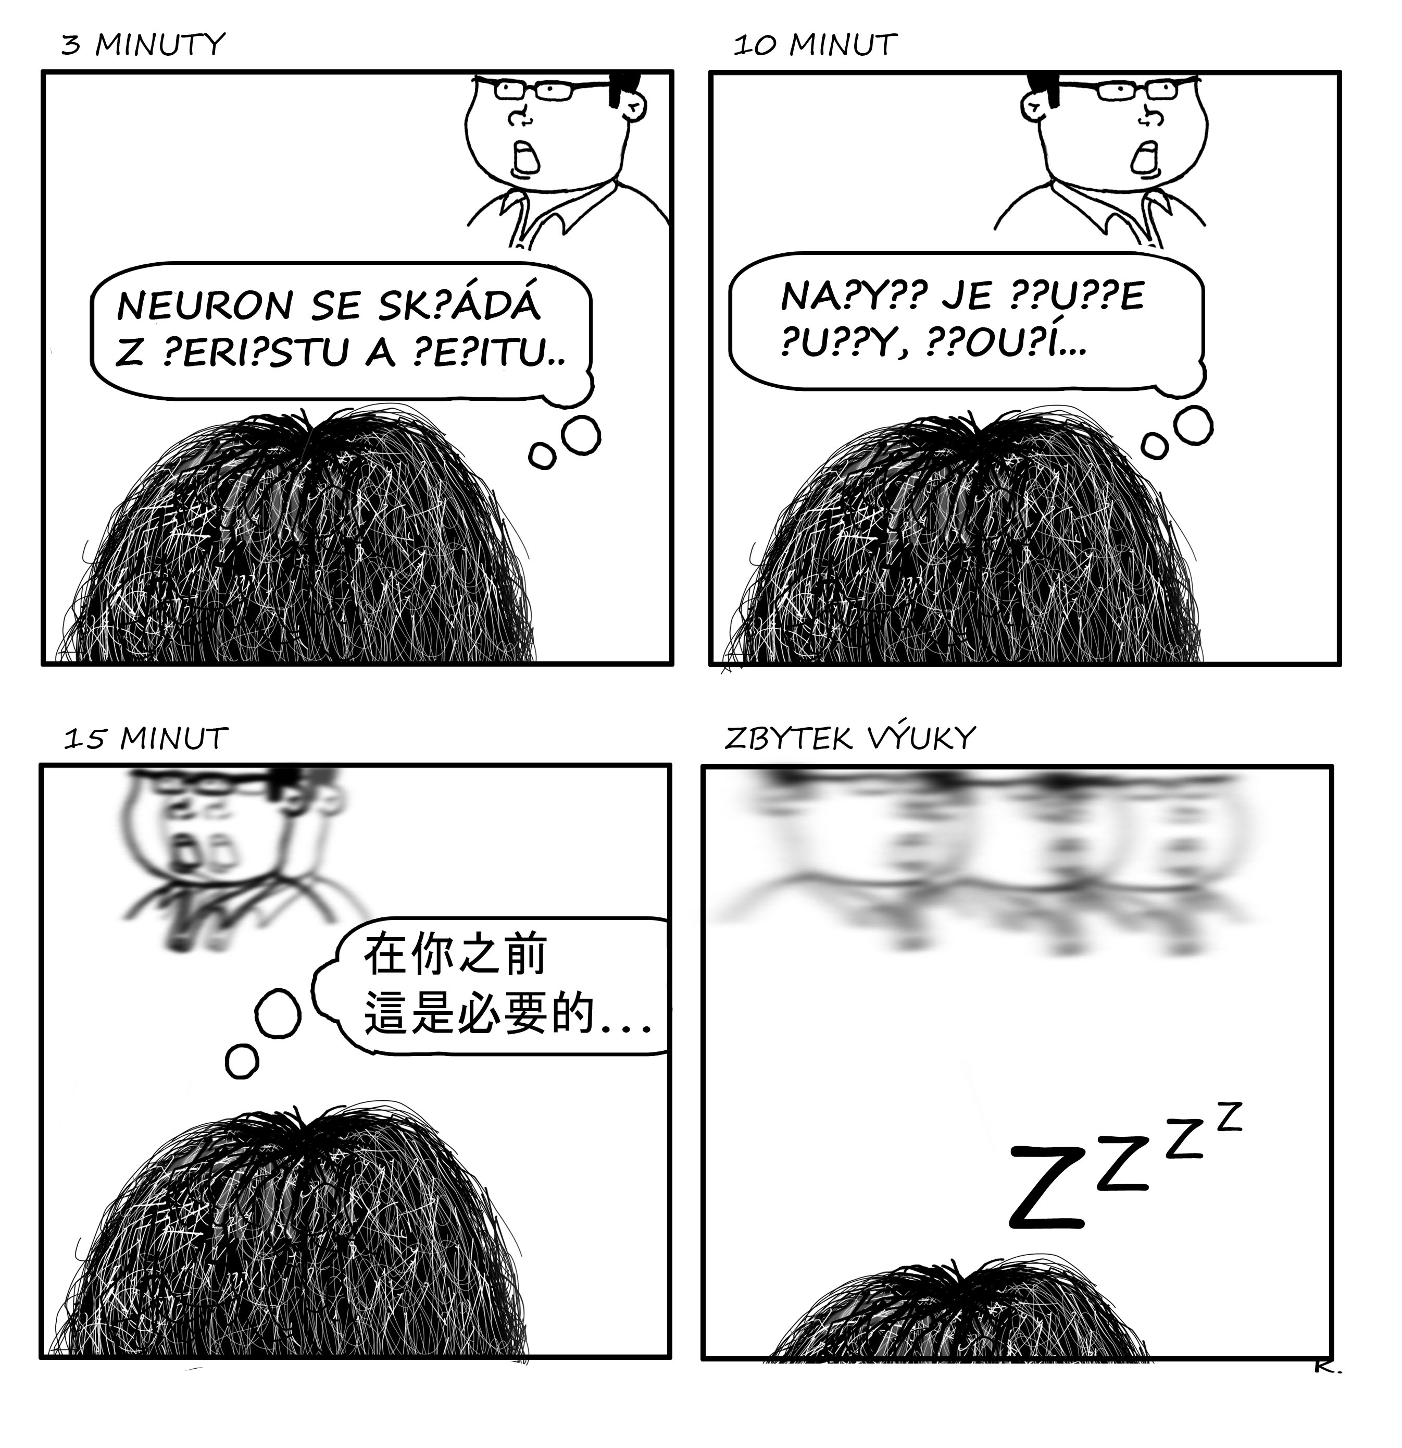

Slide 41
Thank you for your attention
andrea.hudakova@ff.cuni.cz

