Slide 1
Art and Politics
conclusion

Slide 2
Aesthetics as a Guiding Principle
The relation of art and politics examined from the point of view of aesthetics
Aesthetics provides vocabulary and theoretical frame for understanding the relation of art and politics, contribution of art to politics and the borderline between art and politics
Art understood aesthetically can maintain its independence and its own value => political significance of art gained by aesthetic means (i.e. art need not be propaganda or have a political content, to by significant)

Slide 3
What Is the Aesthetic?
How is the aesthetic defined? What does it say about art? In what sense can the aesthetic and art have political significance?
Line of thought from the end of 18th – beginning of 19th century

Slide 4
Schiller and Romantics
Beauty as cultivation of morality and humanity
Ability of art to reconcile sensuality and reason
Freedom experienced in the aesthetic encounter with art opposed to the un-freedom of the actual political state
ideas on the aesthetic and art closely connected with political critique
the aesthetic experience of art as a redemption of society, means of a real political change and new political regime

Slide 6
Ideology
Three ways of understanding ideology:
1. Descriptive meaning
set of ideas, perspectives, attitudes, rituals, values of a certain community, social practices, including non-discursive (behavior, gestures)
ideology as a worldview
2. Pejorative meaning
false conciousness => interests of a certain group are presented as interests of the society as a whole
justification or legitimization of institutions or social practices, disguise of social contradictions

Slide 7
3. Positive meaning
necessary for coherence of society
Inevitable part of social life and social practices

Slide 9
Critical Theory
Oppresive character of modern (capitalist) societies
Critique of culture industry (Adorno)
mass mediated art is subject to the same economic processes as other commodities => the main purpose is to be sold with as much profit as possible
mass art duplicates rather than challenges social reality
culture industry is ideological => it reinforces the political system and helps to conceal the inequalities in society

Slide 11
The Affirmative Character of Culture
Herbert Marcuse
Culture as a sphere seemingly equally available to everyone, but in fact only reflect the social inequalities
Preservation of the ideal of happiness, hope, emancipation, freedom
Emancipation and happiness in the sphere of art mutes the need of emancipation and happiness in the social sphere
Culture and art contributes to the social un-freedom and coercion by „affirmating“ the status quo

Slide 12
Ai Wei Wei: The Law of the Journey

Slide 13
Aura and Technology
Walter Benjamin, The Work of Art in the Age of Mechanical Reproduction
Positive view of modern technologies and popular, mass culture – mainly film and photography
Change in perception of the world
Technology not as a tool of control over nature, but as a medium of establishing the relation of nature and human
Influence on a huge number of people – political impact of mass art
Aura – mode of reception of the (traditional) artwork with its authority of the „here and now“

Slide 14
Adorno‘s Aesthetic Theory
Artworks are free and autonomous objects in the world where nothing and no one is free and autonomous
Autonomy of art is at the same time enabled by historical and social conditions
Specific character of art determined by the aesthetic synthesis, i.e. the non-violent unity of elements, preserving their particularity and contradictions amongst them

Slide 15
Social and political significance of art
disclosure of the oppresive, violent character of the social order
art is a rare glimpse of reconciliation and prefigures a reconciled society
art can have only indirect and mediated effect on the social reality
art has a power to intervene in the conciousness of the recipient

Slide 16
Pablo Picasso: Guernica

Slide 17
The Aesthetic Judgment
Roots of general understanding of judgment in the aesthetic judgment
attitude of subject towards the object, which is either positive or negative
distinction of value
we expect others to agree with our judgments, including aesthetic judgments

Slide 18
Political Significance of Aesthetic Judgment in Hannah Arendt‘s Conception
What is necessary for good judgment (based on the aesthetic judgment)
we imagine the attitudes of others and supress our personal interests => the enlargment of our limited perspective enables a better, more just judgment
we perceive, reflect and judge from distance
we do not participate in action
necessity of distance, detachment, disinterestedness
such judgment can be impartial

Slide 19
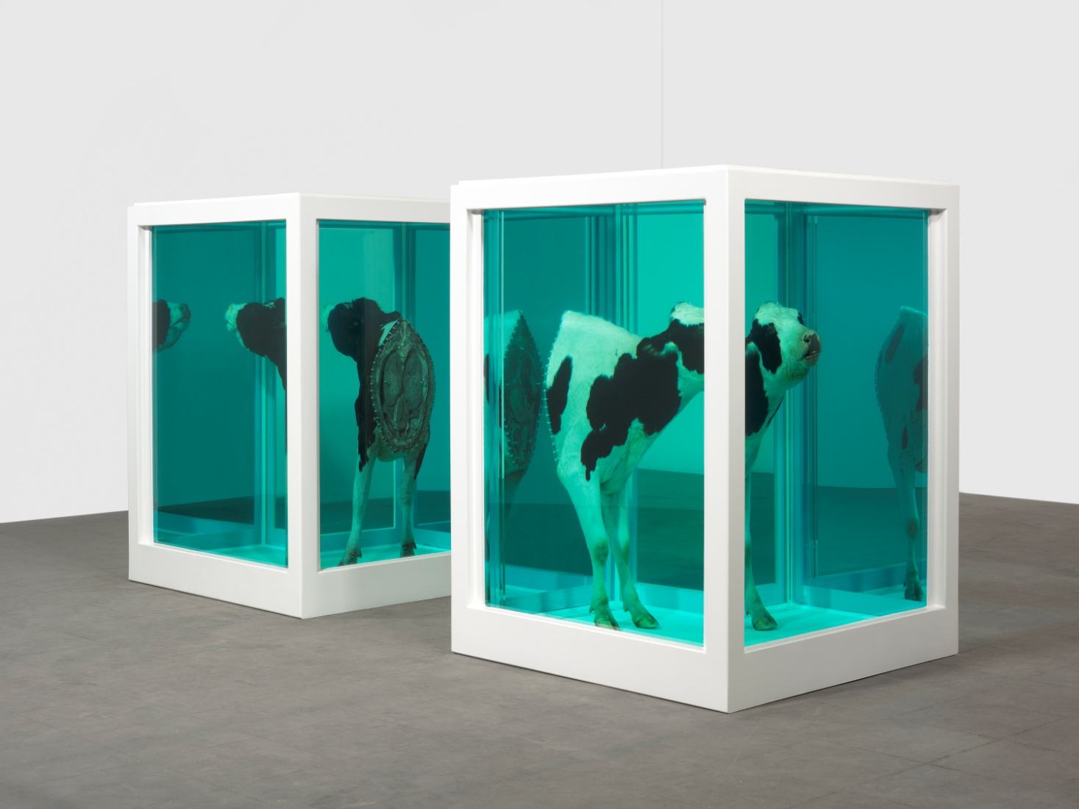
Damien Hirst: Love's Paradox (2007)

Slide 20
Jacques Rancière
Three Regimes of „Art“/Images
1. The Ethical Regime
not art in our, modern sense
artistic representations judged by their truthfulness and ethical import
2. The Representative Regime
special sphere of imitating representations
norms for discerning good imitations from bad ones
representations governed by rules, hierarchy

Slide 21
3. The Aesthetic Regime
- 18th century (romanticism, realism)
- unity of concious and unconcious, acting and passivity, intentional and unintentional
- everything can be equally representable, no means of representation are more or less adequate
- no boundaries between art and non-art, between high art and the ordinary objects
- re-interpretation of art, including art of the past

Slide 22
The Distribution of the Sensible
aesthetic act of reconfiguration of what is available to the senses
political act by the abolition of the fixed hierarchy and power relations based on determing who can (and cannot) act or perceive
politics suggests the re-distribution of the sensible, i.e. of what is visible, represented in society => the aesthetic dimension of politics as collapse of the regulative laws of representation
political dimension of art => artwork (in aesthetic regime) is a singular perspective, intervention into the configurations of the sensible

Slide 23
Taryn Simon: The Picture Collection

Slide 24
Taryn Simon: Contraband

