Slide 1
Feminist Criticism on Fairytales
Readings:
Andrea Dworkin: The Fairy Tales, 1974
Ellen Pandolfo: Feminist Critique to Walt Disney’s
Cinderella, 2006

Slide 2
https://www.youtube.com/watch?v=VeZXQf77hhk
https://www.youtube.com/watch?v=gcrQvoCzs80

Slide 3
Andrea Dworkin: The Fairy Tales, 1974
Notes:
The culture predetermines who we are, how we behave, what we are able to feel…
Although not being conscious of this content, children internalize the substratum of the fairytales which defines the gender roles…FT are shaping the world – in a wrong way

Slide 4
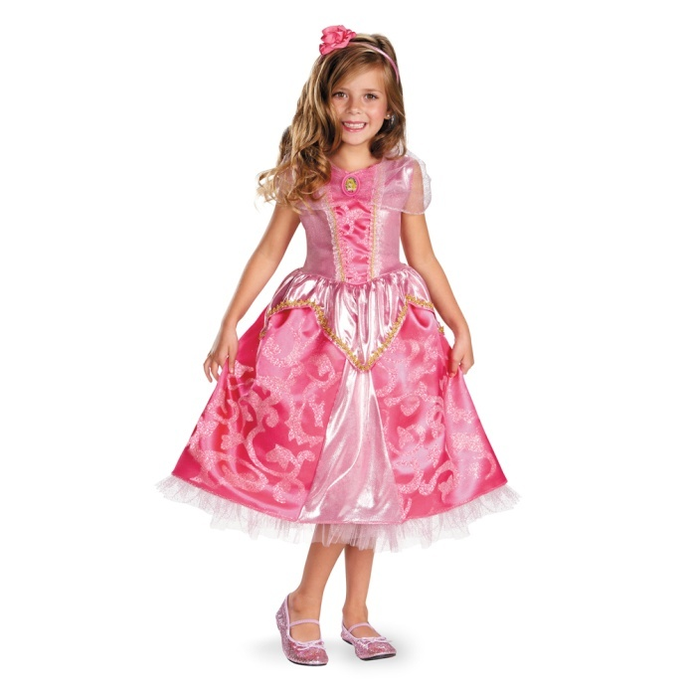
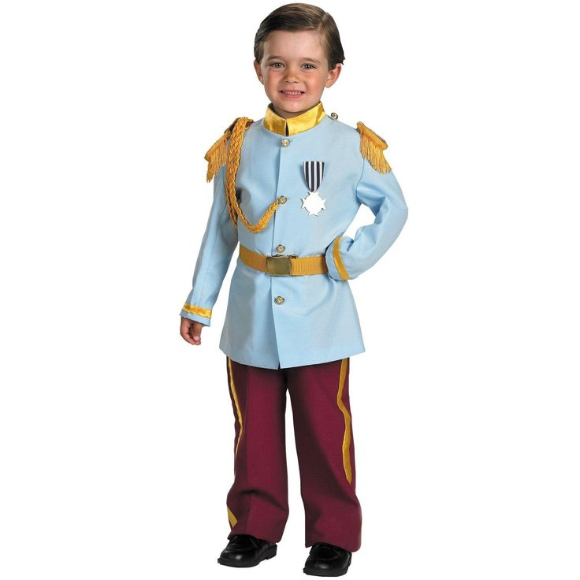
Andrea Dworkin: The Fairy Tales, 1974
fairytales – primary information about the world acquired in childhood
girls and boys aspire to become and act like the heroes of the fairytales
“sometimes unknowingly, sometimes knowing, unwilling, unable to do otherwise, we act out the roles we were taught”
Notes:
The culture predetermines who we are, how we behave, what we are able to feel…
Although not being conscious of this content, children internalize the substratum of the fairytales which defines the gender roles…FT are shaping the world – in a wrong way

Slide 5
Good women:
Bad women:

Slide 6
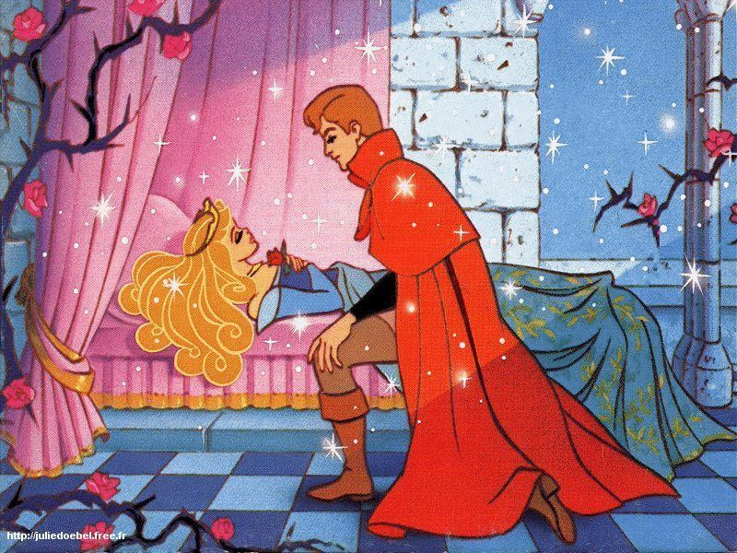
Good women:
innocent
helpless
passive („a beautiful object“)
victimized
Bad women:

Slide 7
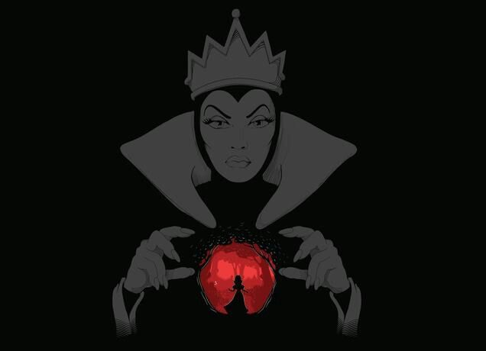
Good women:
innocent
helpless
passive („a beautiful object“)
victimized
Bad women:
active
authoritative
ambitious
wicked and brutal
(„ mother as figure of terror“)
Notes:
In contrast with their daughters, stepmothers are usually active and ambitious women
In a society that encourages passiveness for the “good girls”, the women that act otherwise are portrayed as evil. Cinderella, Snowhite, raupnzel, H.and G….
Exceptions: good mothers –but they die. Good fairies – they dissapear.
The good woman must be possessed. The bad woman must be destroyed. Both must be nullified.

Slide 8
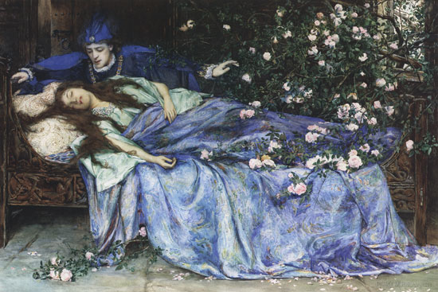
How to be a good girl
be passive: never think, act, initiate, confront, resist, chalenge, feel, question
do housework
be beautiful
sleep
die
“For a woman to be good, she must be dead. Catatonia is the good woman´s most winning quality.”
Notes:
Sexist ontology: the only good woman is a dead woman.
Beauty ensures male admiration, male alliance, male devotion, you can reach good marriage. „When she is good, she is so passive in life that death must be only more of the same.“

Slide 9
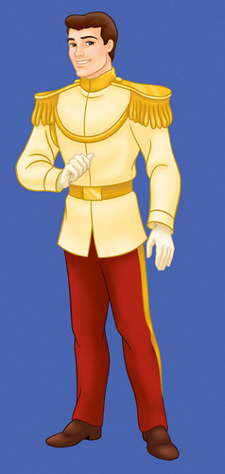
The prince
Notes:
Fairytales set role models for boys too.
Fathers: Mostly absent figures. Sometimes they consent to the abuse (Hansel and Gretel)…“He is the patriarch, and such he is beyond morel law and human decency.“

Slide 10
The prince
handsome and heroic
active, dominant
powerful, noble and good
“He matters, acts, succeeds.”
„He has a mission, a purpose.“
Notes:
Fairytales set role models for boys too.
Fathers: Mostly absent figures. Sometimes they consent to the abuse (Hansel and Gretel)…“He is the patriarch, and such he is beyond morel law and human decency.“

Slide 11
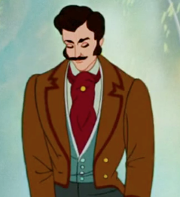
The prince
Husbands and fathers
handsome and heroic
active, dominant
powerful, noble and good
“He matters, acts, succeeds.”
„He has a mission, a purpose.“
witness evil, participate in evil
fail to notice when “their wives are slaughtering and abusing their beloved progeny” (Cinderella)
never held accountable
they are good
Notes:
Fairytales set role models for boys too.
Fathers: Mostly absent figures. Sometimes they consent to the abuse (Hansel and Gretel)…“He is the patriarch, and such he is beyond morel law and human decency.“

Slide 12
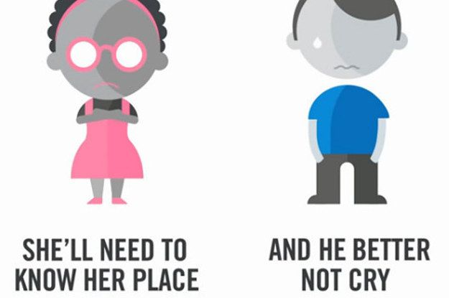
Summary
In a society, the roles are determined by gender.
The body ties us to a role that is “annihilating, totalitarian, which forbids us any real self-becoming or self-realization.”
Fairytales create paradigmas typical for male dominated civilization:
a woman is desirable when she is beautiful, passive and victimized
Notes:
Fairytales, as primary information of the culture, are delineating the roles, interactions and values which are available to as.

Slide 13
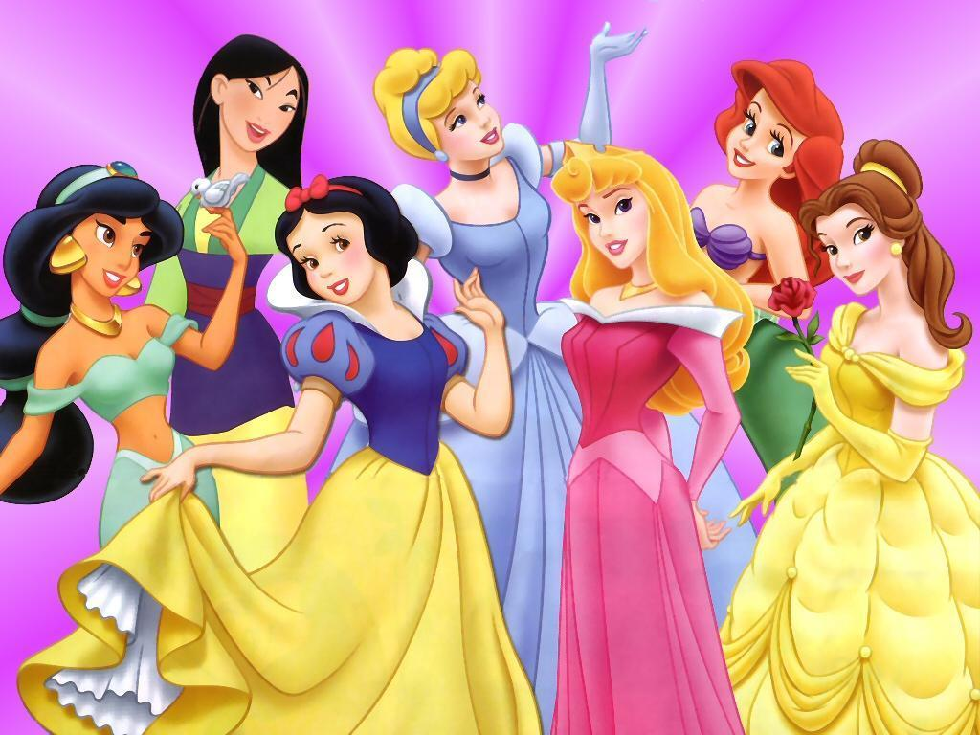
Discussion
Do you find these accusations relevant?
Say why - personal experience is welcome!
How would you judge Czech fairytales through this lens?

Slide 14
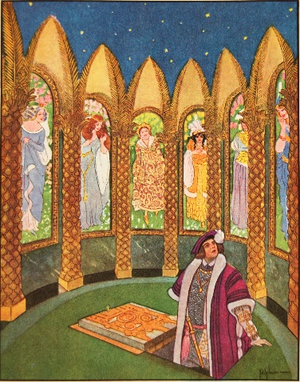
Gender themes in Czech Fairytales
Erben:
Long, Wide and Sharpeyes
The Fire Bird and the Red Fox
The Three Golden Hairs
Němcová:
Devil and Kate
Clever Manka
Clever Princess
Prince Bayaya
Film Fairytales:
- Till the Leaves Will Fall from the Oaks
The Sorcerer´s Apprentice
( Reason and Luck, The Seven Ravens)
- Three Wishes for Cinderella

Slide 16
Andrea Dworkin
Notes:
She then looks at the historical practices of Chinese foot binding and Medieval European witch burning from a radical feminist perspective.

Slide 17
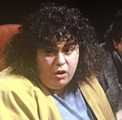
Andrea Dworkin
was an American radical feminist, women rights activist and writer
Woman Hating: A Radical Look at Sexuality, 1974
describes all manners of men´s abuse and oppression of women in history
criticism of pornography, a spokeswoman for the feminist anti-pornography movement
Pornography: Men Possessing Women (1981)
Intercourse (1987))
- she argued pornography was linked to rape and other forms of violence against women
parallel to fairytales : both show woman as passive, submissive, mute, opressed
- as a sexual delicacy for men
Very radical - widely criticized by liberal feminists and others.
But:
visionary, pioneer of examining gender problematic in fairy tales
Notes:
She then looks at the historical practices of Chinese foot binding and Medieval European witch burning from a radical feminist perspective.

Slide 18
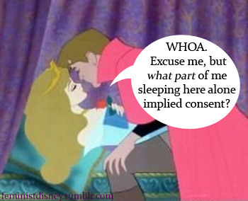
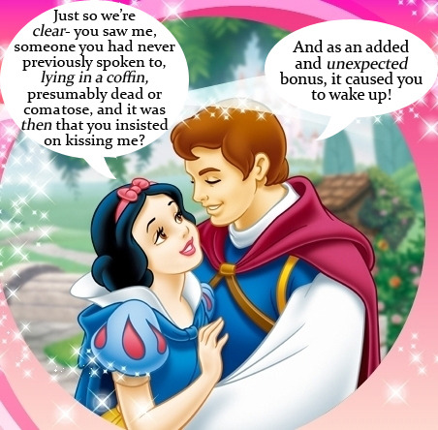
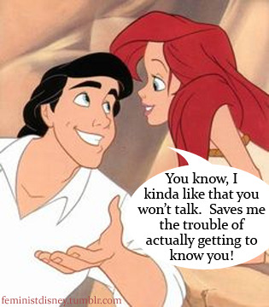
Motif of „sleeping beauty“
Motif of muteness

Slide 19
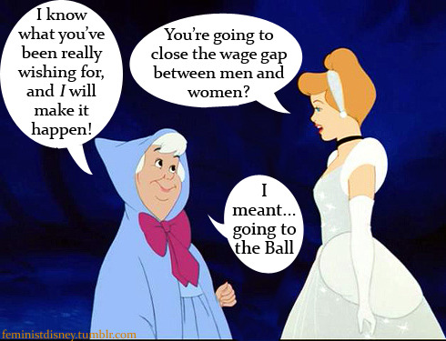
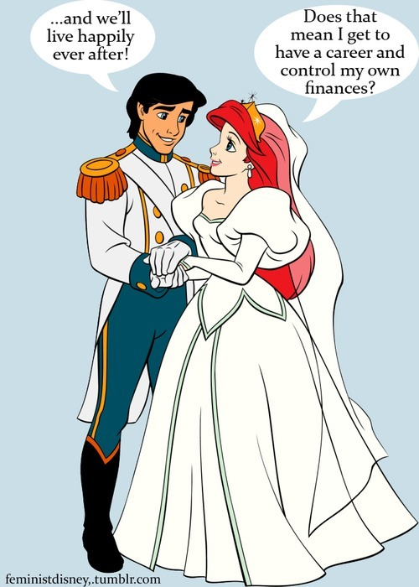
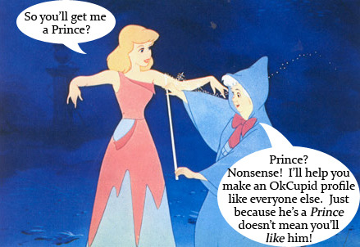
Motif of „waiting for the prince“

Slide 20
What Disney princesses teach woman about attracting men

Slide 21
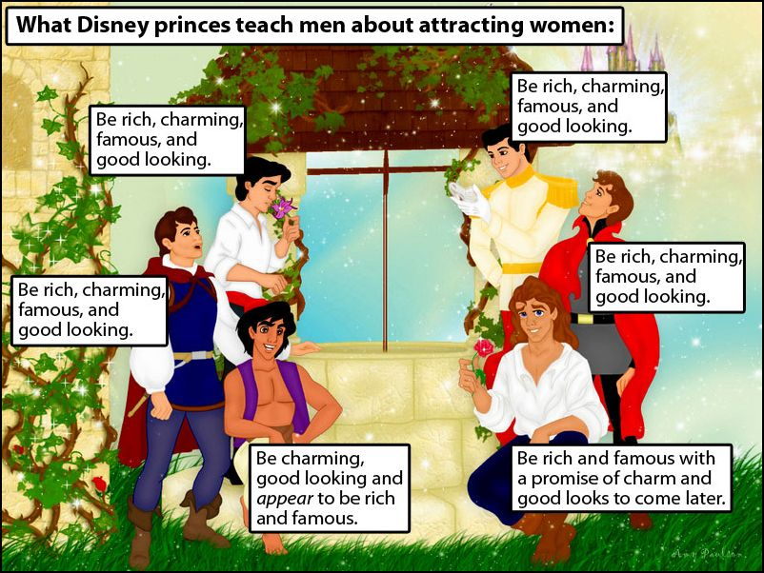
The Prince
Fairytales set role models for boys too

Slide 22
Ellen Pandolfo: Feminist Critique to Walt Disney’s Cinderella, 2006

Slide 23
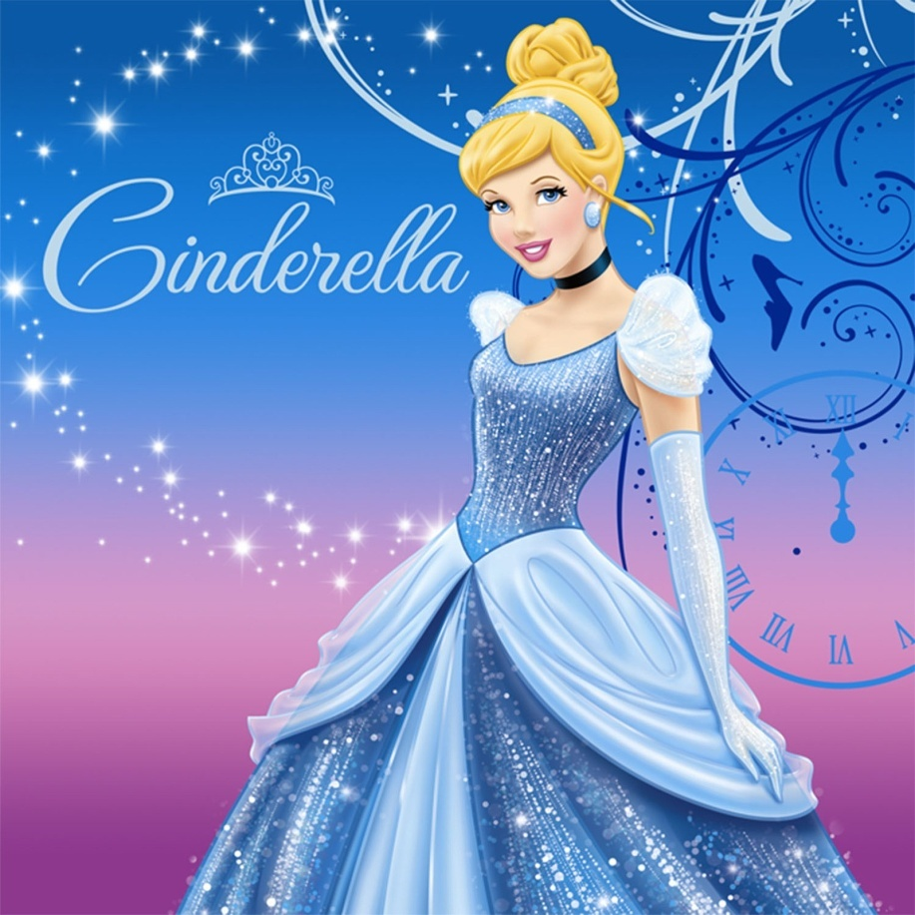
Disney’s Cinderella
highly altered from the original concept and meanings
based on a clearly sexist set of ideas

Slide 24
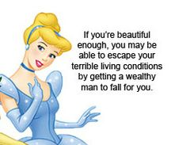
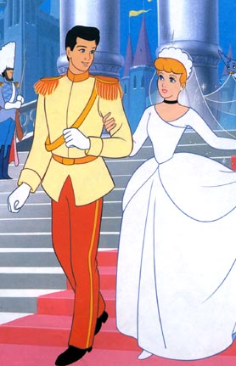
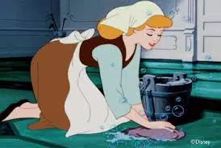
Oppressive gender mandates
The adaptation sets highly unrealistic standards of perfection in the physical aspect.
As a woman, Cinderella’s biggest accomplishment could come only in marriage.
The ultimate object of Cinderella’s dreams is settling in a domestic life.

Slide 25
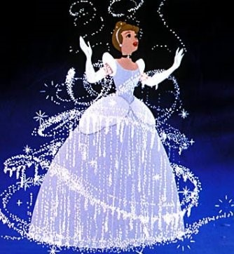
Capitalism and middle class conformity
The outcome of Cinderella’s struggle: accumulation of material wealth
The idea that while coming from the middle class, hard work would be rewarded with material benefits (rags to riches)
Materialist ideology
Mediocrity

Slide 26
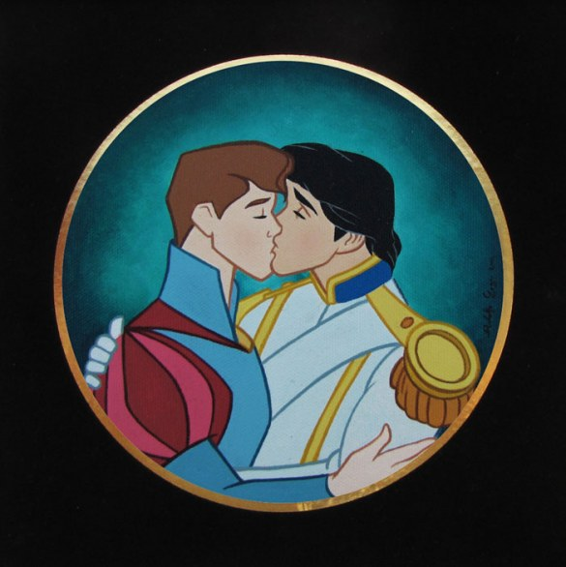
Heterosexism
the goodness of heterosexism is implied in the tale.
in the fairytale, all women seek marriage to a man.
homosexuality – ruled out.
anything else than a traditional, two-parent family results in catastrophe.

Slide 27
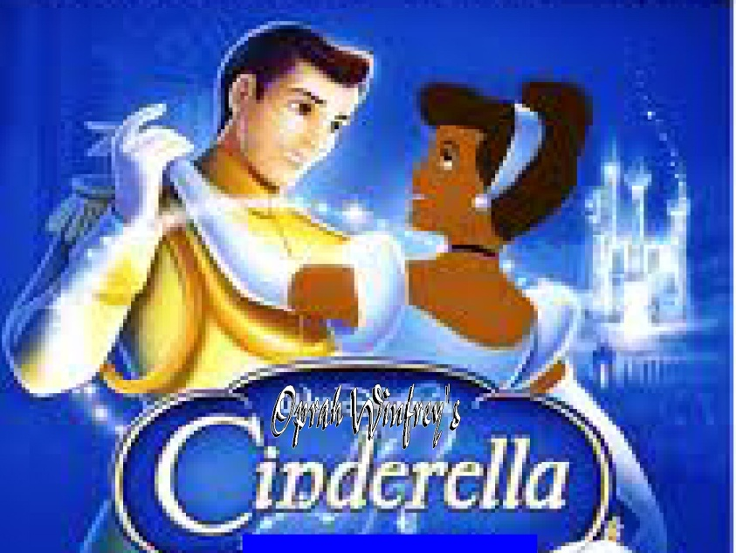
Racial implications
the story of Cinderella – intended for white, middle-class women.
women of colour are excluded
(Miss America 1968: only white can be the princess…).

Slide 28
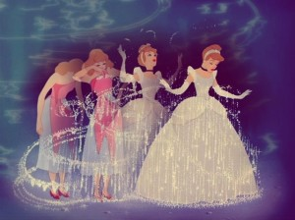
To sum up: Main themes implied by Disney’s Cinderella
Sexism
Patriarchy
Conformism
Capitalist values
Racism
Heterosexism
„…and the myth persists…“

Slide 29
Discussion
Do you find these accusations relevant? Are any of them farfetched?
Notes:
Banning books

Slide 30
Discussion
unachievable standard of perfect beauty
Notes:
Banning books

Slide 31
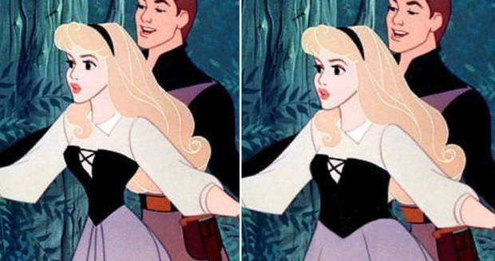
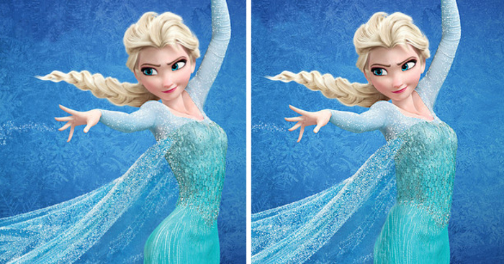
Disney princesses with realistic weist size

Slide 32
Disney princesses with realistic hair

Slide 33
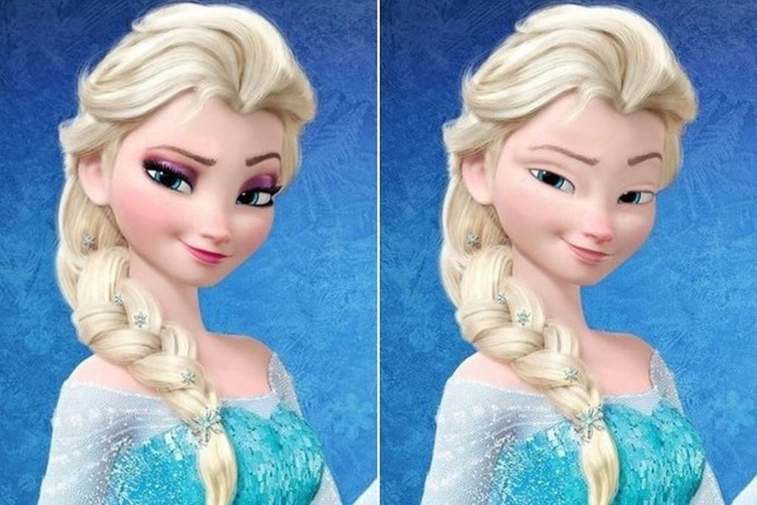
Disney princesses with realistic hair
Disney princesses with no make-up

Slide 34
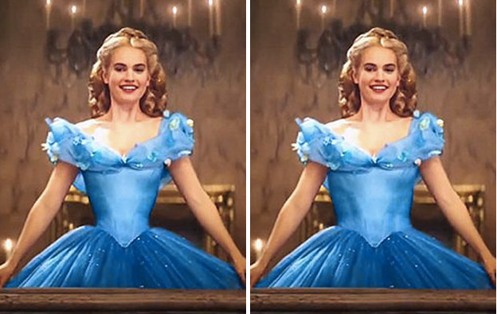
Cinderella, 2015 (!)
Digital alteration? Drastic diet? Drastic tightening? …Does it really matter?

Slide 35
To sum up: Main themes implied by Disney’s Cinderella
Sexism
Patriarchy
Conformism
Capitalist values
Racism
Heterosexism
„…and the myth persists…“

Slide 36
Racial implications?

Slide 37
Heteronormativity?
Racial implications?

Slide 38
Heteronormativity?
Racial implications?
Discussion:
What to do with the traditional fairytales now (the „wrong“ ones)? Should they be transformed so that they fit more to contemporary world? Should they be removed?

Slide 39
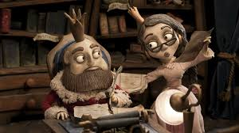
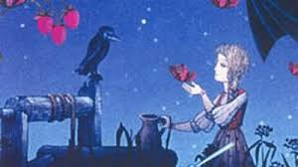
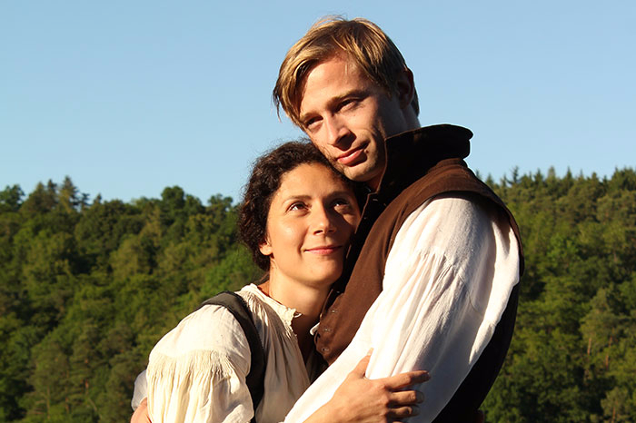
Discussion
How would you judge more current Disney production? How would you judge Czech film fairytales?
Notes:
Banning books

Slide 40
Discussion
How would you judge more current Disney production? How would you judge Czech film fairytales?
What to do with the traditional fairytales now (the „wrong“ ones)? Should they be transformed so that they fit more to contemporary world? Should they be removed?
Notes:
Banning books

Slide 41
Be beautiful, be object.
Notes:
These questions will be discussed next time… Very similar kind of analysis as for the theme, very differrent as for its outcome. Keep this question in mind till the next class – because it will be answered from very differrent angle...

Slide 42
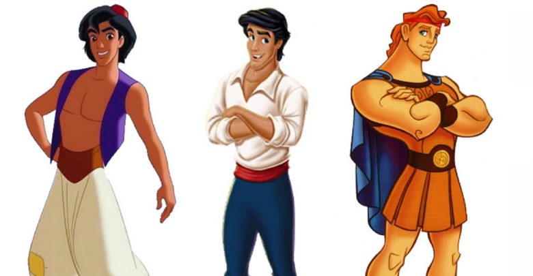
Be beautiful, be object.
Be handsome and powerfull. Be strong and brave.
Notes:
These questions will be discussed next time… Very similar kind of analysis as for the theme, very differrent as for its outcome. Keep this question in mind till the next class – because it will be answered from very differrent angle...

Slide 43
Be beautiful, be object.
Be handsome and powerfull. Be strong and brave.
What if I am not?...
Notes:
These questions will be discussed next time… Very similar kind of analysis as for the theme, very differrent as for its outcome. Keep this question in mind till the next class – because it will be answered from very differrent angle...

Slide 44
Be beautiful, be object.
Be handsome and powerfull. Be strong and brave.
What if I am not?...
What if I WANT to be like that?
Notes:
These questions will be discussed next time… Very similar kind of analysis as for the theme, very differrent as for its outcome. Keep this question in mind till the next class – because it will be answered from very differrent angle...

Slide 45
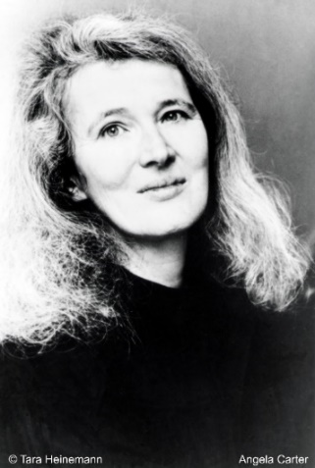
Feminist criticism on fairy tales
Jack Zipes:
Breaking the Magic Spell. Radical Theories of Fairy tales
Don´t Bet on the Prince (anthology of feminist essays on fairy tales)
D.P. Haase (ed.):
Fairytales and Feminism (anthology of feminist essays on fairy tales)
Angela Carter:
The Bloody Chamber (updating of the classic European fairy tales)
https://comicsalliance.com/disney-princes-princesses-relationships/
https://thesocietypages.org/socimages/2009/10/25/disney-princesses-deconstructed/
https://feministdisney.tumblr.com/post/13464162133/feminist-disney-image-collection
https://www.bustle.com/articles/17264-7-problematic-lessons-disney-movies-teach-boys-about-masculinity

