Slide 1
POLICY PROPOSAL
Tereza Klimešová
Patrik Kratochvíla
Nirsan Sriskantharajah
Valentin Schnabl
Dema Hajeb

Slide 2
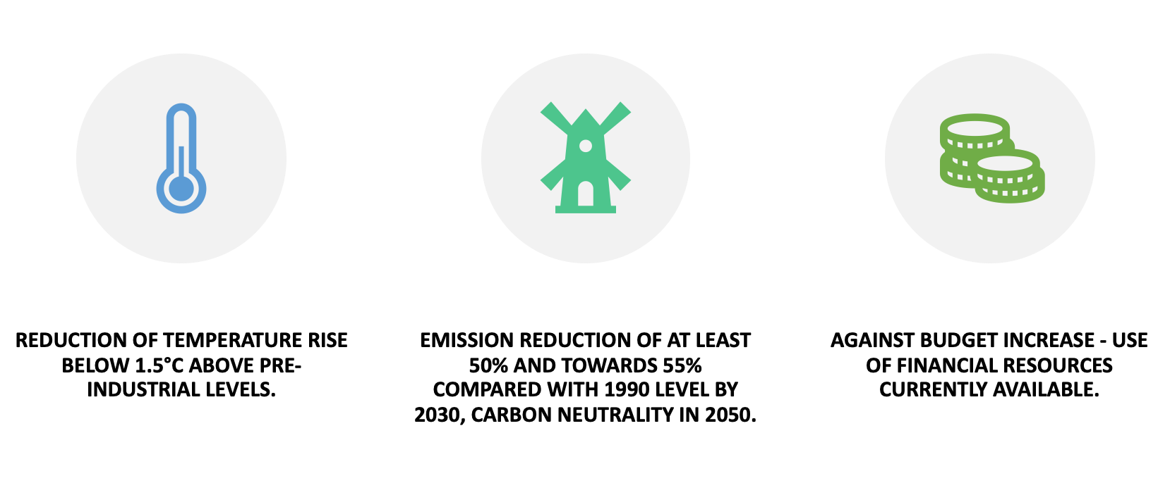
Sweden's proposal
However, in case that a reasonable increase of budget would help more carbon-dependent economies reach agreed-upon targets adequately faster, Sweden is willing to discuss providing extra financial resources.

Slide 3
Pros and Cons of Alternatives
In agreement with some proposals of Germany:
Clear classification of environmentally sustainable activities, and clarification of the investment outcomes will attract vital investments from the private sector to complement the budget, should it eventually be increased.
Emphasis on renewable energy sources, i.e. biofuels, or gradual establishment of LNG terminals…
Against Polish proposals such as flexible reduction of CO2 emissions

Slide 4
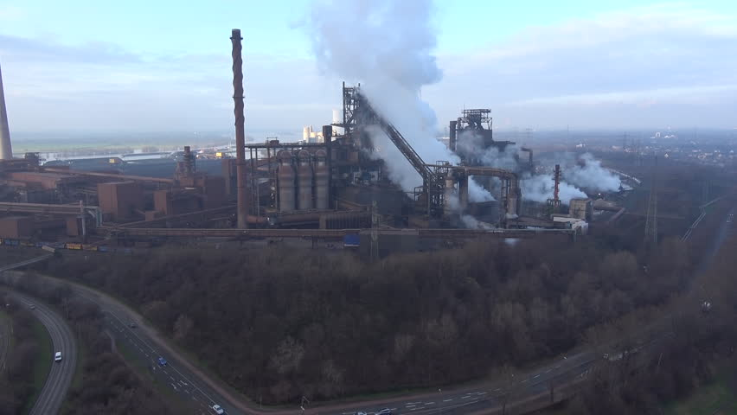
Suggested Actions
Solve “carbon leakage” problem and reduce GHG emission
Transform ETS into a quasi carbon tax
Narrow price gap of EUA
Choose a stable tariff rate
Aim for full border adjustment
“How to implement a WTO-compatible full border carbon adjustment as an important part of the European Green Deal”
A. Kranek , 17. January 2020, Vienna

Slide 5
Suggested Actions
Five policy recommendations to ensure a just transition
Set phase-out date for coal as early as possible
Ensure timeline and strategies are based on high-quality, quantitative analysis
Ensure adequate, targeted financial and policy support using EU as well as national funds
Aim for real economic diversification
Engage stakeholders in an ongoing process
Anczewska, M. et al., 2020. Just Transition to climate neutrality, Doing it right by regions, Berlin: WWF Germany.

Slide 6
THANK YOU FOR YOUR ATTENTION

