Slide 1
Intercultural marketing

Slide 2
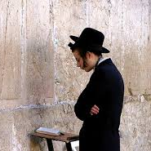
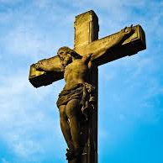
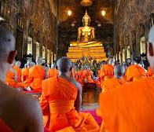
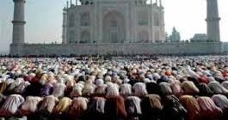
RELIGION AND MARKETING

Slide 3
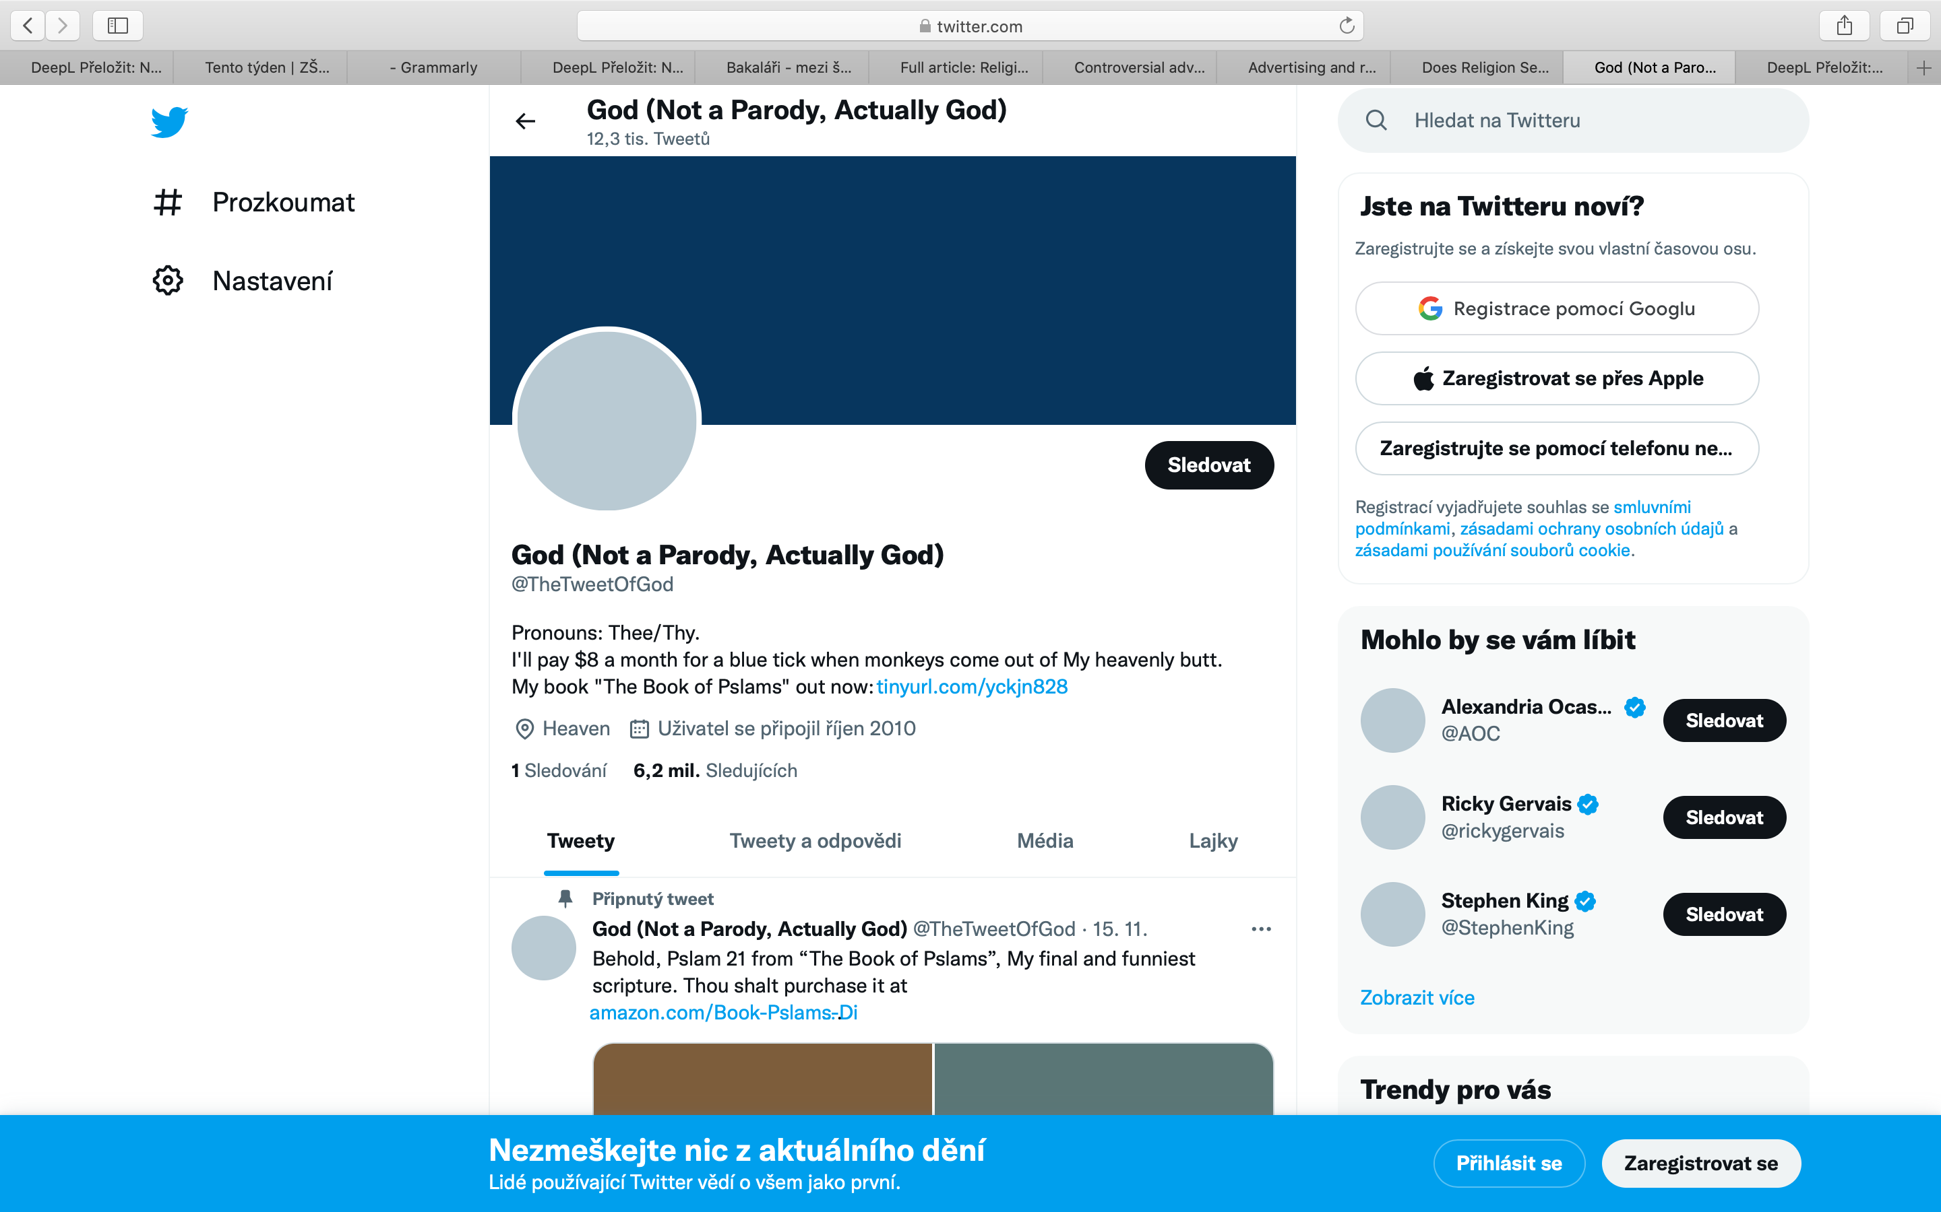
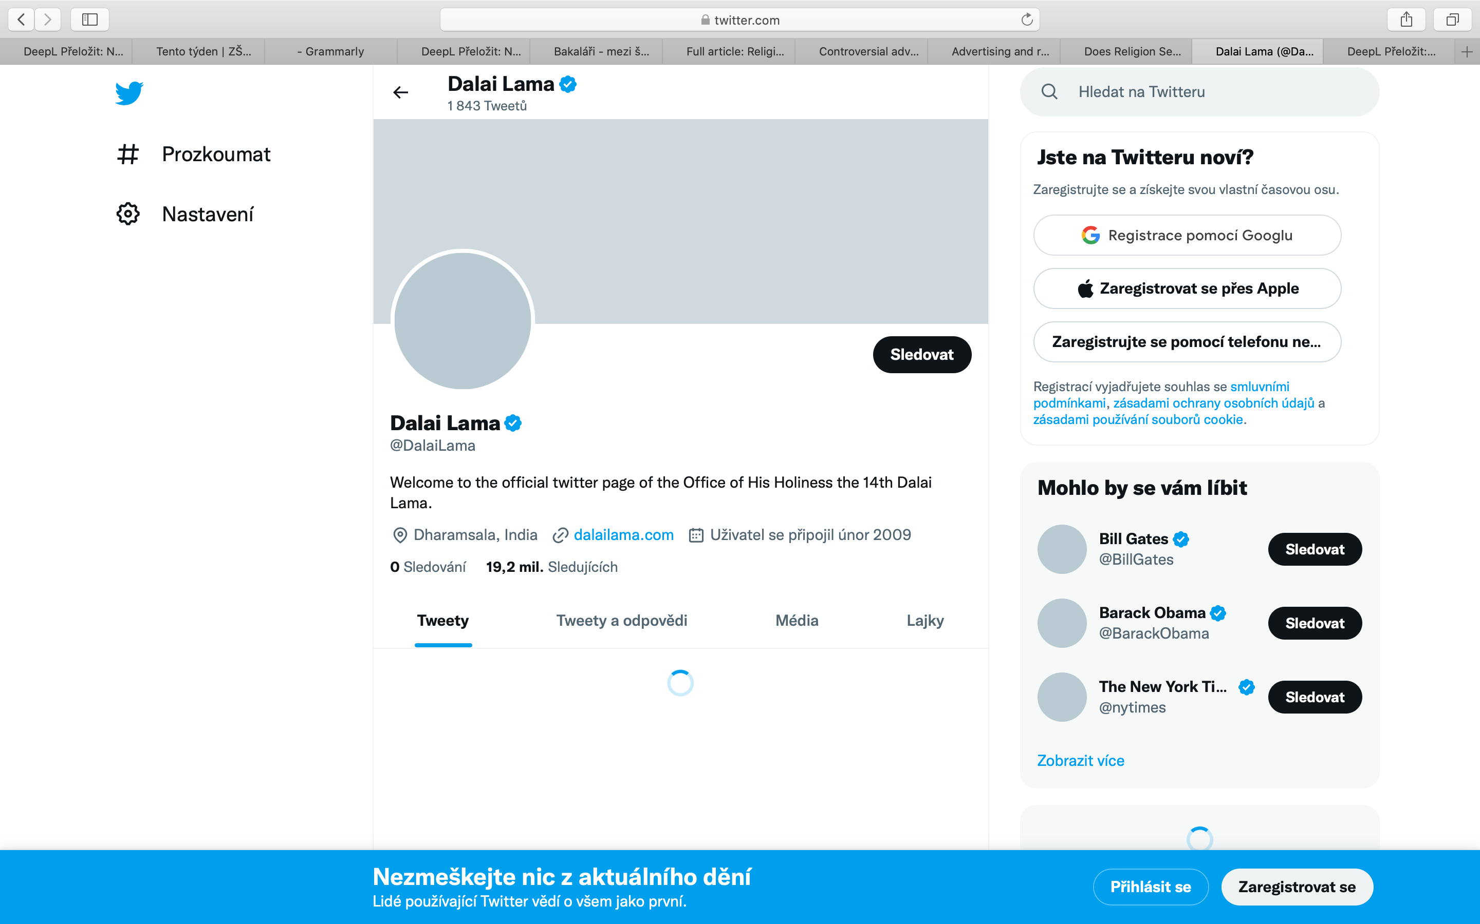
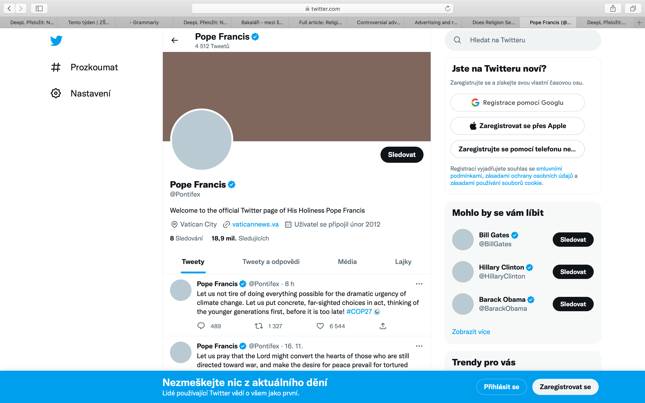

Slide 4
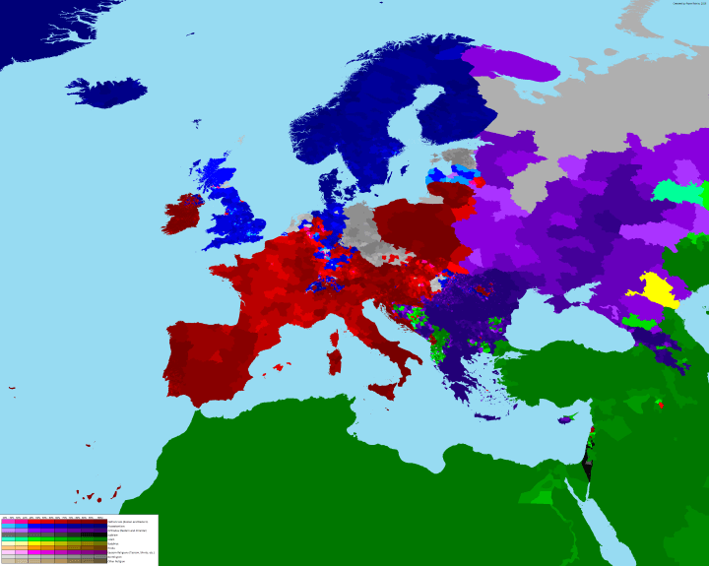

Slide 5
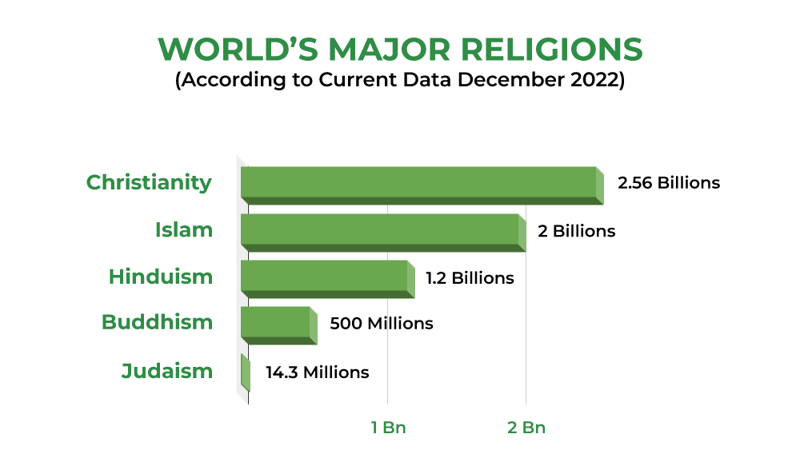

Slide 6
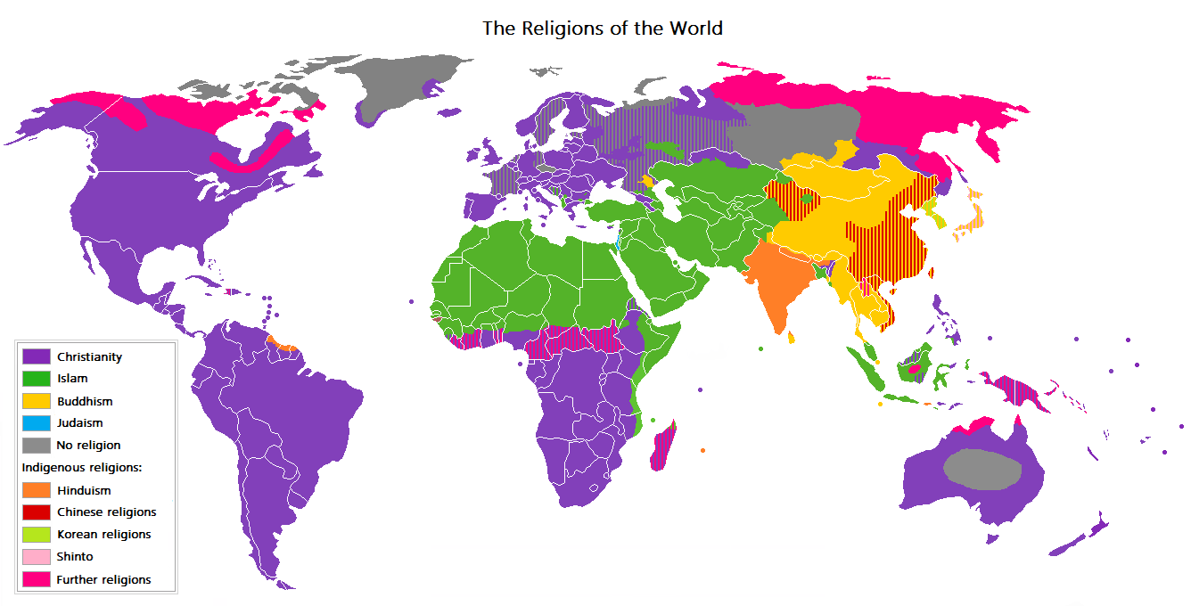
Religion

Slide 7
Religion
Hinduism
Judaism
Buddhism
Christianity
Islam
Non-believers

Slide 8
Religion
still plays an important role in influencing social and consumer behavior (the way people live, the choices they make, what they eat)
defines the ideals for life, which in turn are reﬂected in the values and attitudes of societies and individuals -> behavior and practices of institutions and members of culture

Slide 9
Religion
the meaning and influence of religion varies in different cultures - attitude towards material values - consumer behaviour - product policy - distribution policy - communication policy

Slide 10
WHAT IS EDIBLE?

Slide 11
FRIENDS OR FOOD?

Slide 12
McDonalds India

Slide 13
Islam vs pork/pigs

Slide 14
Religion
The inﬂuence of religious beliefs on individual and social behaviour is well documented
There are only a few studies that directly examined the inﬂuence of religion on marketing communications - they focused mainly on the inﬂuence of Islam on advertising content and regulation, for example in Saudi Arabia.
These studies revealed the importance of understanding the Islamic religion in relation to effective advertising.

Slide 15
Influence of religion on advertising perception
Fam, Waller, Erdogan (2002) – examined the influence of religion and intensity of belief on attitudes towards the advertising of particularly controversial products and services
1,393 people across six countries – Malaysia (I), Turkey (I), Taiwan (B), China (A), Britain (CH), New Zealand (CH)
the survey instrument included a list of 17 products/services from which respondents were asked to indicate their level of personal “offence”.
gender/sex related products, social/political groups, addictive products, health and care products

Slide 16
Influence of religion on advertising perception
Alcohol
Charities
Cigarettes
Condoms
Female contraceptives
Female hygiene products
Female underwear
Funeral services
Gambling
Guns and armaments
Male underwear
Political parties
Racially extreme groups
Religious denominations
Sexual diseases (AIDS, STD prevention)
Weight-loss programs

Slide 17
Influence of religion on advertising perception
in all four areas, people from Muslim countries felt the most affected by the depiction of these products or services - a statistically significant difference between Islam and other groups
the results indicate statistically significant differences between groups that may have important implications for global marketers
no „one size fits all“ promotion strategy
the more religious one is the more likely one will be offended by the advertising of controversial products
Non-believers does have values and morality similar to any of the three established religions

Slide 18
Influence of religion on advertising perception
Social/political groups – the four religions scored relatively high on the offensiveness scale for these products relative to the other three controversial products groups
Guns and armaments – advertising in opposition to most religious teachings
Funeral services – Asia (distasteful, disrespect to the elders)

Slide 19
Influence of religion on advertising perception
Addictive products – this products group scored the second highest on the offensiveness scale
However, the results can be divided into two groups, namely Buddhism and Islam versus Christianity and non-religious believers. The non-statistical difference between Buddhism and Islam could be linked to their respective principles.
Prohibition/restriction of alcohol or gambling in some religions
In Muslim-dominated Malaysia, advertising of alcoholic products is permitted only in English, Chinese and Indian language newspapers and also in cine

Slide 20
Influence of religion on advertising perception
Gender/sex related products
Muslims in general and the more devout Muslims in particular, found the advertising of gender/sex-related products more offensive than Buddhists or Christians
For instance, both Muslim men and women must cover their torso and upper legs at all times and women must dress conservatively in public. Sex before marriage is strictly prohibited and all Muslims are obliged to conform to sexual codes. Therefore, the advertising of male and female underwear would mean some parts of the body were exposed to the public.

Slide 21
Women in advertising
In a content analysis of pan-Arab, Egyptian, Lebanese and Emirati magazine advertisements, Al- Olayan and Karande (2000) found that in 83 percent of Arabic advertisements showing women, they were wearing long clothing, compared to 29 per cent in US advertisements
Arabic advertisements show women in advertisement if their presence relates directly to the product and if they are appropriately dressed
Dove – sensous x pleasant

Slide 22
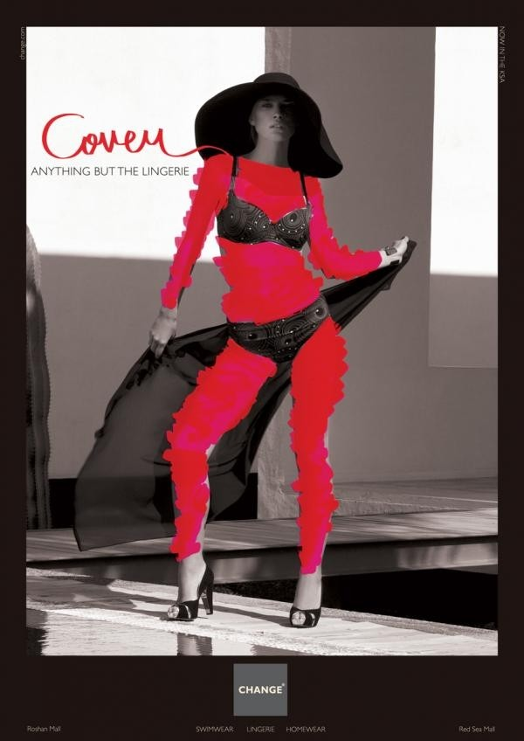
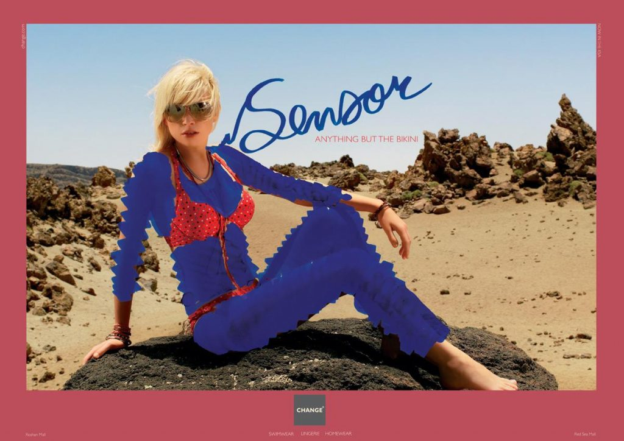
Women in advertising

Slide 23
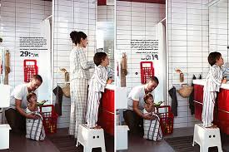
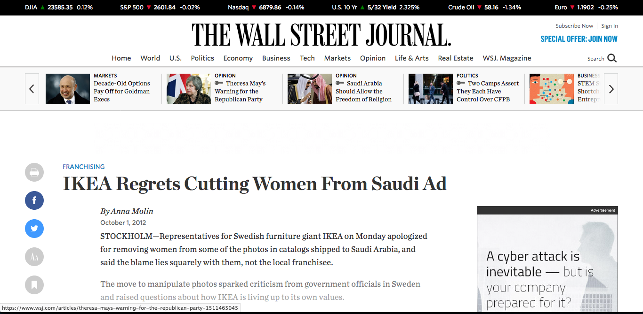
IKEA (2012)
IKEA (Saudi Arabia, 2012)

Slide 24
Lidl (2017)
Lidl (2017)
“We assure all customers that we take all their reactions and comments very seriously. We believe that even in a globalized world, international companies need to perceive and appreciate cultural, religious and other aspects of individual countries. (…) We will make sure that this criticism is taken into account when creating advertising materials and packaging.”
“We assure all customers that we take all their reactions and comments very seriously. We believe that even in a globalized world, international companies need to perceive and appreciate cultural, religious and other aspects of individual countries. (…) We will make sure that this criticism is taken into account when creating advertising materials and packaging.”

Slide 25
Influence of religion on advertising perception
Health/care products – the lowest score in terms of advertising offensiveness
AIDS issue had changed what was previously thought of as “unmentionable”
the giving of alms to the poor is the religious duty of every Muslim, Christian or Buddhist (challenging of obvious)
what one does or suffers is a subject too personal to discuss in public

Slide 26
Perception of advertisement
Islam x exaggerated messages
Research in Saudi Arabia has shown that over 70% of Muslim respondents think that advertising is a threat to culture of Islam (Al-Makaty et al., 1996).
Keenan and Shoreh (2000) conducted a research which shows that Muslims think that advertisements present western values and ignore Arab history and customs.
advertisers may utilize Islamic elements to produce a favorable feeling among Muslims (Royal Regina honey capsules in Saudi Arabia)

Slide 27
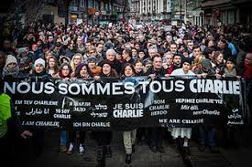
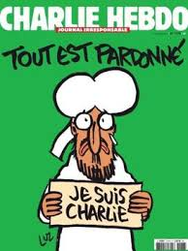
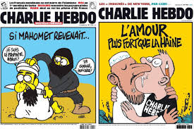
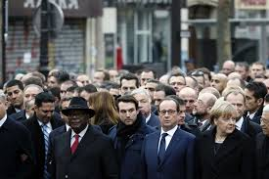

Slide 28
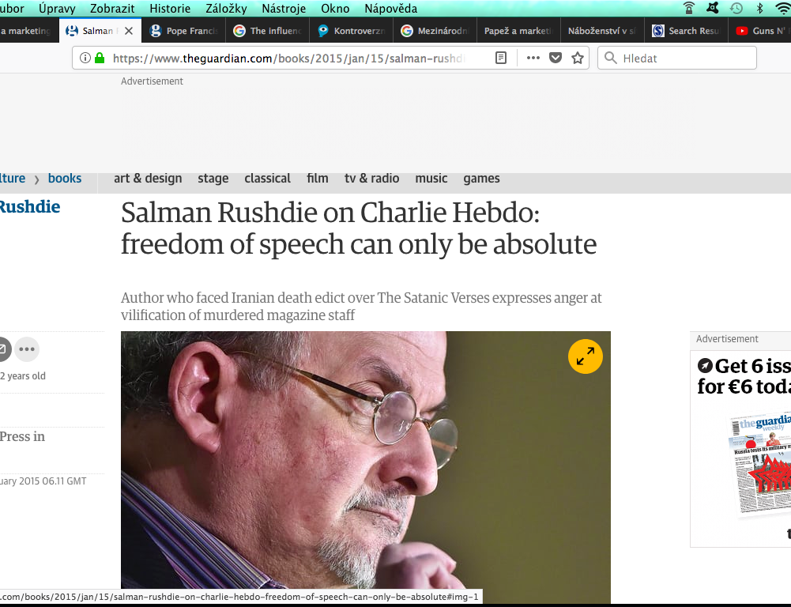
‘Both John F Kennedy and Nelson Mandela use the same three-word phrase which in my mind says it all, which is, ‘Freedom is indivisible,’’ he said. ‘You can’t slice it up otherwise it ceases to be freedom. You can dislike Charlie Hebdo … But the fact that you dislike them has nothing to do with their right to speak.’

Slide 29
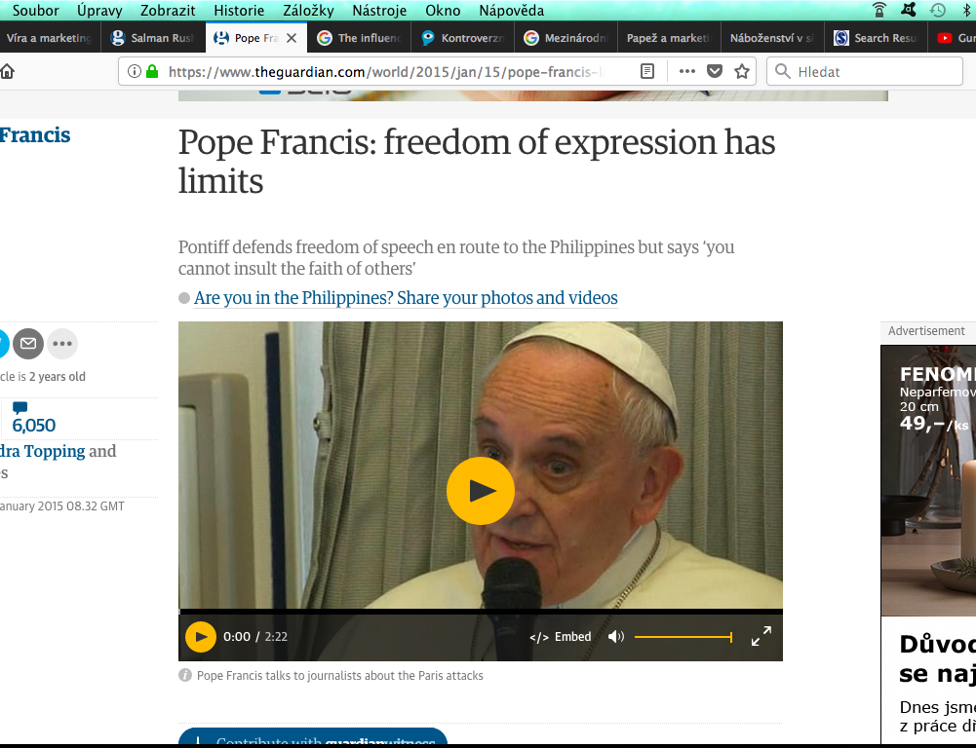
‘One cannot provoke, one cannot insult other people’s faith, one cannot make fun of faith.’
‘There is a limit. Every religion has its dignity … in freedom of expression there are limits.’

Slide 30
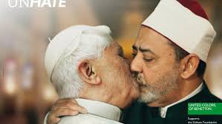
Benetton Unhate (2011)

Slide 31
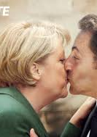
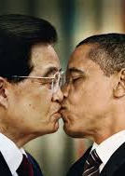
Benetton Unhate (2011)

Slide 32
Benetton Unhate (2011)
Press secretary Father Federico Lombardi said: "We cannot but express a resolute protest at the entirely unacceptable use of a manipulated image of the Holy Father, used as part of a publicity campaign which has commercial ends.”
"It is a serious lack of respect for the pope, an affront to the feelings of the faithful and an evident demonstration of how, in the field of advertising, the most elemental rules of respect for others can be broken in order to attract attention by provocation.”
"The secretariat of state has authorised its lawyers to initiate actions, in Italy and elsewhere, to prevent the circulation, via the mass media and in other ways, of a photomontage used in a Benetton advertising campaign in which the Holy Father appears in a way considered to be harmful, not only to the dignity of the pope and the Catholic church, but also to the sensibility of believers.”

Slide 33
Benetton Unhate (2011)
“We reiterate that the meaning of this campaign is exclusively to combat the culture of hatred in all its forms.”
"We are therefore sorry that the use of the image of the pope and the imam has so offended the sentiments of the faithful.”

Slide 34
Religion in advertising
Digital media – the risk of attracting negative attention to the brand is increasing
“any commodification of religion plays with the risk of antagonizing the believing audience“ (Y. Cohen)
Advertising uses people everyday’s life to sell them products. It portrays what happens in culture and society, it makes it a little hyperbolic, a little disturbing, a little rhetorical. People like when a commercial is slightly, and only slightly, controversial, because it makes them uncomfortable without making them ashamed. It makes them think about their life, but it is not so familiar to become boring. It is for this reason that sex sells, as we all know: people do not like to openly talk about sex, but they sure don’t change channel when they see it on TV. Religion has something in common with sex: people are a little anxious about it, they do not like to talk about it, sometimes they joke about it, and it is definitely a big part of everybody’s life, believers and non-believers alike.

Slide 35
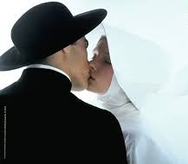
Religion in advertising
Benetton (90's)

Slide 36
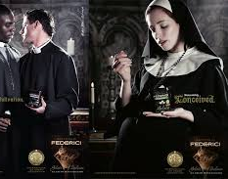
Religion in advertising
Antonio Federici (2010)

Slide 37
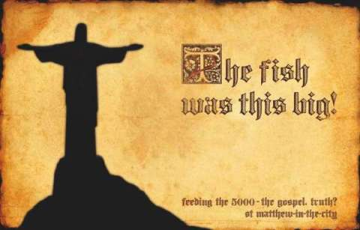
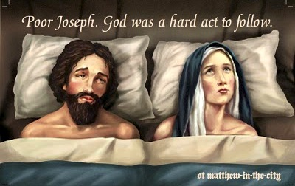
Religion in advertising
St Mathew-in-the-city

Slide 38
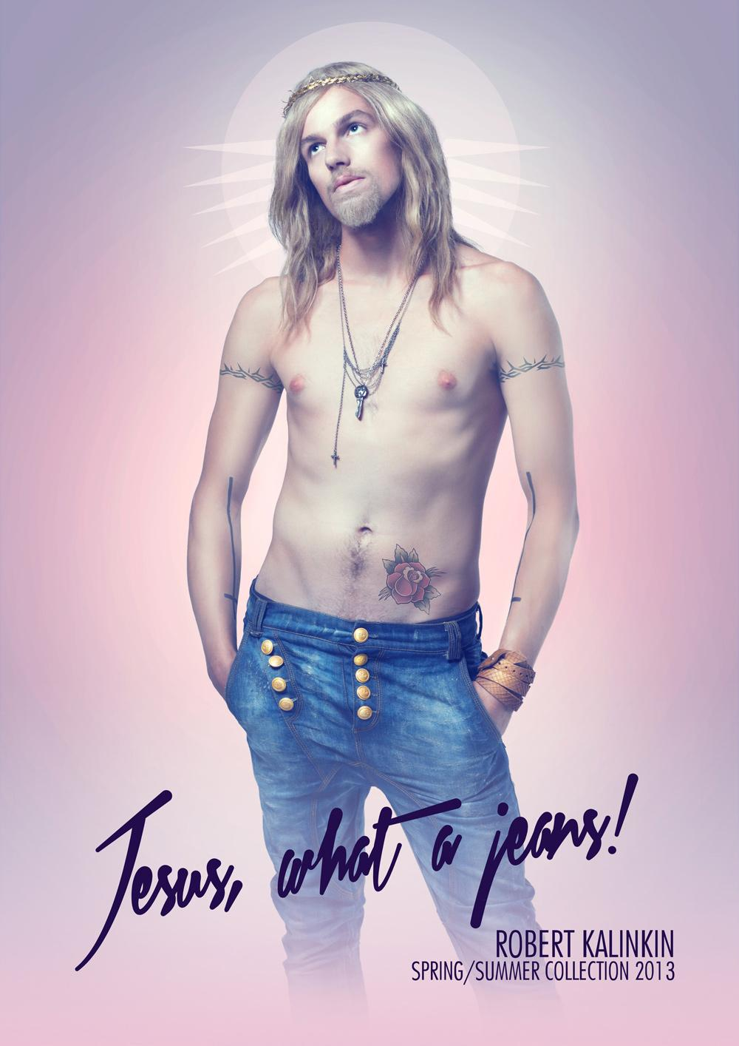
Religion in advertising
Sekmadienis 2012, Lithuania

Slide 39
Religion in advertising
Twisto (2017, Czech Republic) https://www.youtube.com/watch?v=TeaR7g9ZJas

Slide 40
Religion in advertising
„Byť Arbitrážní komise uznává, že motivem zadavatele pravděpodobně nebyla snaha zasáhnout do náboženského cítění spotřebitelů, upozorňuje, že rozhodujícím prvkem není subjektivní vnímání reklamy zadavatelem či motivace zadavatele, ale to, jak reklamu vnímá veřejnost.“
„Přiznáváme, že náš Twistus Splatitel je lehce na hraně, jsme ale přesvědčeni, že ji nijak nepřekračujeme. Považujeme domnělou podobnost s postavou Ježíše Krista za jasně rozpoznatelnou nadsázku … Zákaz reklamy je pro nás značnou komplikací a máme z toho pocit, že jsme se objevili v nové éře cenzury. Nevěřil bych, že se v zemi, kde je 80 procent ateistů a platí svoboda slova, může něco takového stát.“ (Janoušek, Twisto)

Slide 41
Religion in advertising
VW Polo (2005) https://www.youtube.com/watch?v=ePBvl_Q2oEA

Slide 42
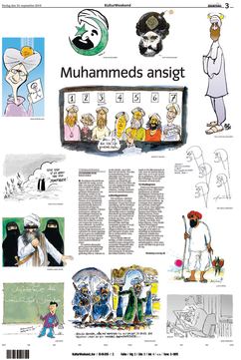
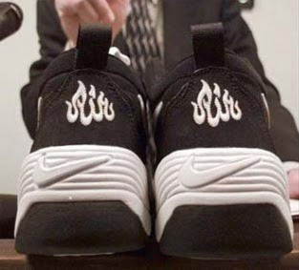
Islam controversies

Slide 43
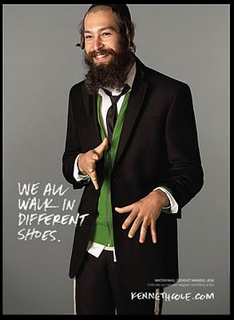
Religion in advertising
Keneth Cole

Slide 44
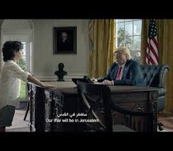
Religion in advertising
Zain 2018 - https://www.youtube.com/watch?v=JIJB7cv97Dg
Ahead of Ramadan, Zain – a Kuwaiti mobile and data services operator – released a spot of a young boy alongside dopplegangers of world leaders, including Donald Trump, Justin Trudeau and Kim Jong-un. The young boy wishes them ‘Ramadan Kareem’ – the traditional greeting during this period – and begins to sing. As the storyline progresses, the song gets more upsetting, speaking of religious persecution and depicting scenes of Muslim refugees.

Slide 45
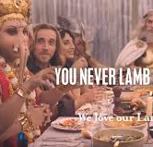
Religion in advertising
Meat & Livestock Australia (MLA) September 2017 - https://www.youtube.com/watch?v=PcyffOn0bu8

Slide 46
Religion in advertising
Toyota superbowl (2018) https://www.youtube.com/watch?v=14DBa33SGms

