Slide 1
POLAND
Our Position on the Climate Law and the MFF for 2021-2027

Slide 2
Content
Poland’s efforts to fight climate change
Poland’s need for a slower transition
Poland’s argument for higher MFF funds and keeping the existing distribution

Slide 3
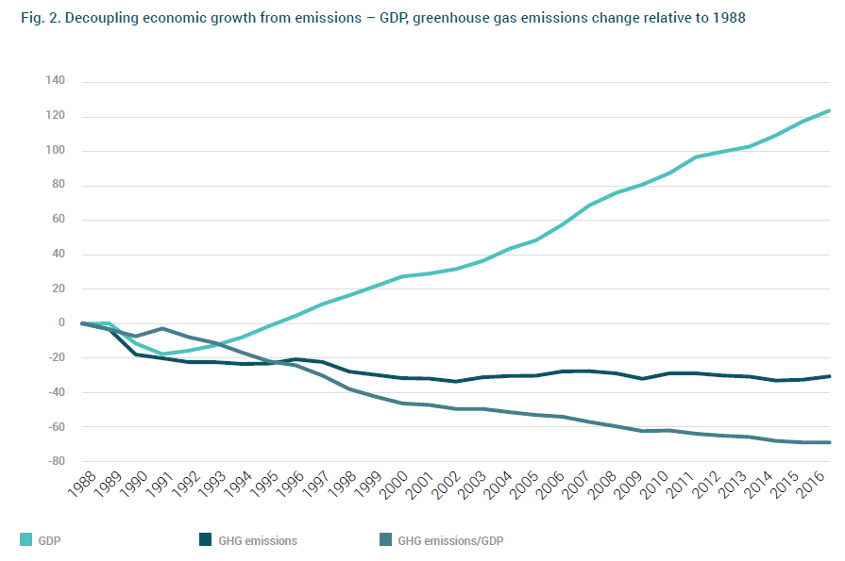
Poland’s economic decoupled from GHG emissions
Notes:
First sentence from 2nd paragraph. Both figures show that Poland’s recent economic development is an outstanding achievement, which should be seen as a blueprint for the development of other countries. Since joining the EU in 2003, it used the stability of the European community to reinforce and strengthen its own institutions (WTO, 2017). The fact that Poland continued to record positive growth during the financial crisis and avoided a collapse of the banking sector (OECD, 2015) present evidence that the mix of sound macroeconomic policies, prudent fiscal policies and a clear vision of a socially responsible market economy provided stability and enabled sustainable socio-economic growth (WTO, 2017). This development was acknowledged by the FTSE, which upgraded Poland’s status in 2018 to ‘developed market’.

Slide 4
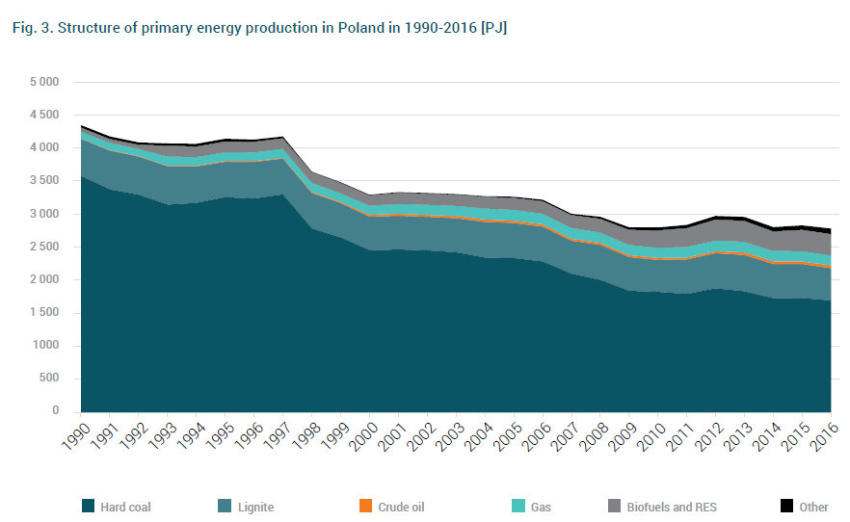
Poland’s energy mix
Energy production still heavily focused on fossil fuel
Share of biofules & RES steadily growing

Slide 5
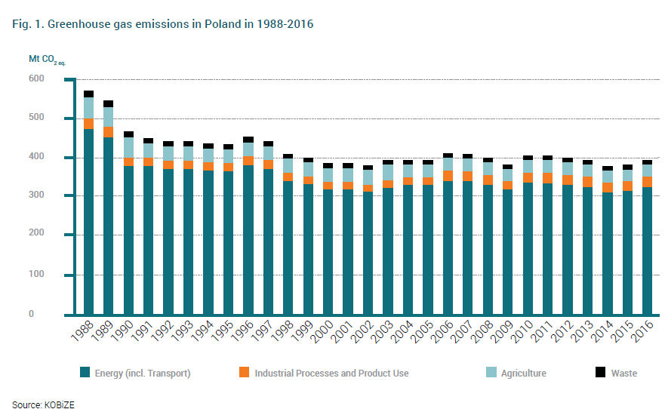
Poland’s GHG emissions
Positive trend for GHG emissions and changes in contributing industries
Notes:
Based on the UNFCCC the fight against global warming rests on two pillars: international cooperation and the principle of common but different responsibility (IOS-PIB, 2018). Poland signed the Kyoto protocol and achieved the set goals for the 2008-2012 period, reducing GHG emissions by ca. 30% in
comparison to the base year (OECD, 2015). As the focus lies on ensuring economic growth and stability, Poland has not been a frontrunner in climate change policies but accepts the binding international and regional agreements (Zbigniew, 2019). However, it must be noted that the
implementation of EU climate policy represents a big challenge for the Polish economy and political
stability.

Slide 6
Poland’s need for a slower transition
Poland needs an estimate of 900b€ to fully meet EC’s carbon neutrality by 2050
EU can provide only 320b€ to the whole EU!
Budget limitation slows the process of transition; Poland needs more time.
COVID-19 delayed economies and energy transition projects. The crises could potentially delay EU’s climate goal for 2050.

Slide 7
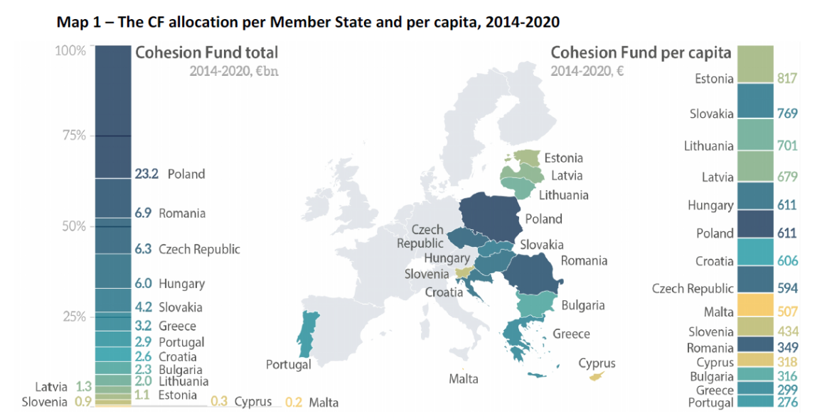
Distribution of funds 2014 -2020

Slide 8
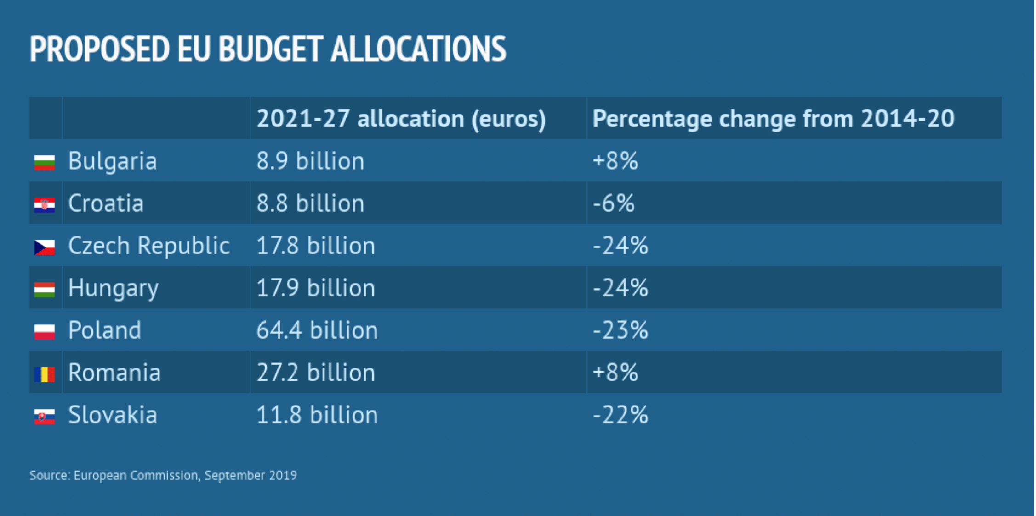
Higher MFF funds needed
23% lower share of MFF for Poland in the new presented MFF (2021-2027)
Poland is still poorer than other countries in WE (gaps in infrastructure and technologies)
The GDP per capita still ranks in the bottom 5 of OECD countries.
Poland will have high bills resulting from decarbonizing economy: Poland employs almost half of the 237,000 people who work in the coal industry in the EU

Slide 9
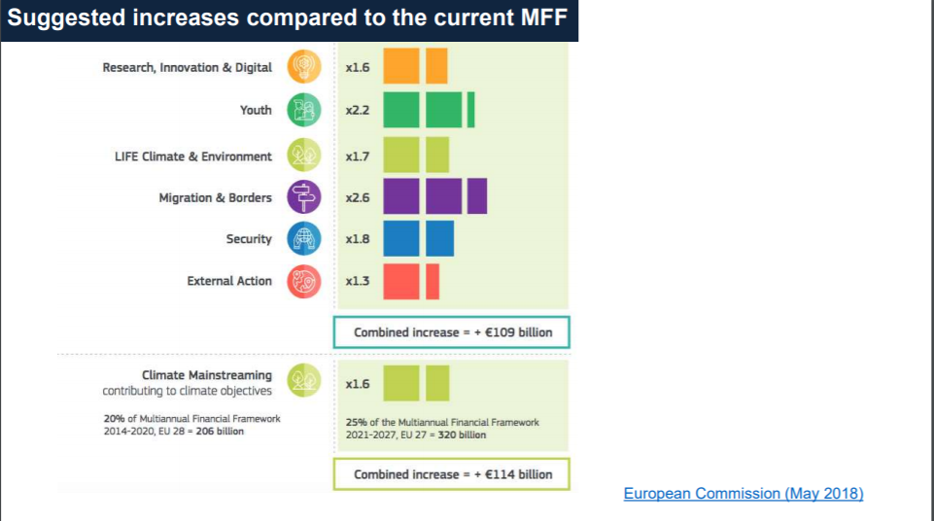
Suggested increases compared to current MMF
€320 billion is not enough for a fast and just transition
Even this estimated budget is short of EU’s own projected need
Either no Carbon Neutrality or more external technological and financially assistance

Slide 10
Poland’s Future CCT
Poland can not survive without Coal
-> Coal can be environmental friendly
-> Clean Coal Technologies (CCT) provide a alternative to expensive transformations of the energy sector
- instead of deconstructing the infra structure
-> invest the resources in other sectors
-> off-shore parcs

Slide 11
CCT

Slide 13
Current pandemic & impact

Slide 14
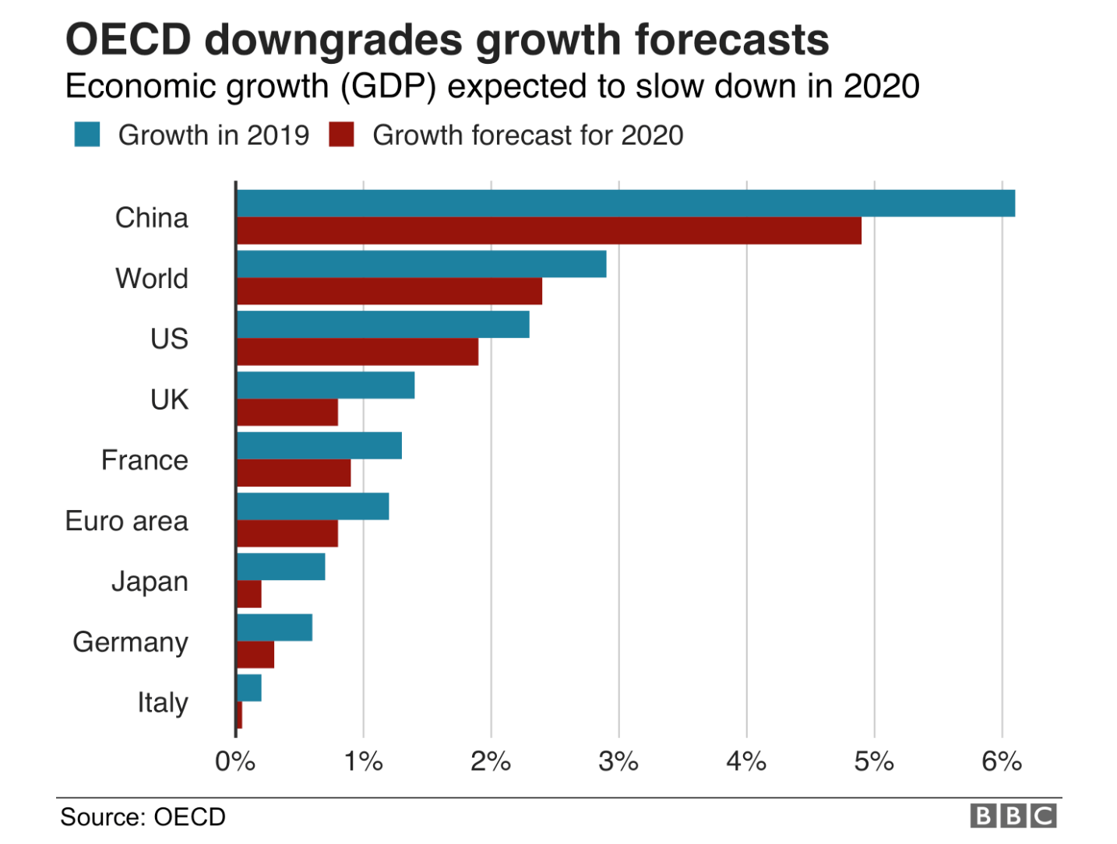
COVID-19 Impact on World Economic Growth

Slide 15
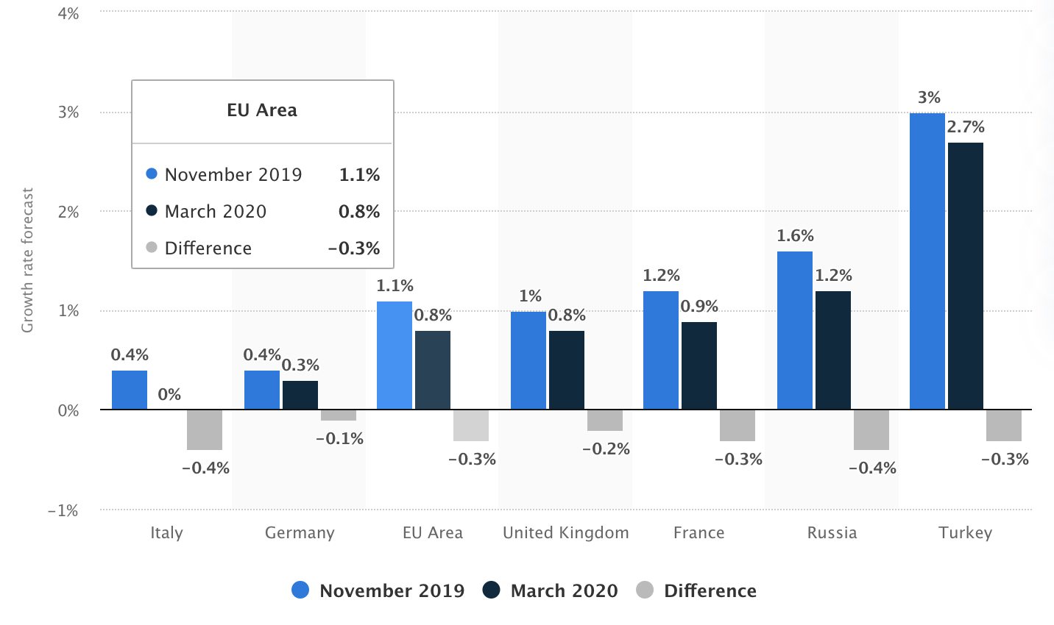
Notes:
https://www.statista.com/statistics/1102546/coronavirus-european-gdp-growth/

Slide 16
Conclusion
Carbon Neutrality in Poland’s case is unrealistic as it comes with great economic and political risks
Even substantial transition towards RES and clean power can only be achieved with financial and technological assistance from other states
CCT in combination with growth of RES/biofuels as prefered strategy
COVID-19 crisis puts already severe stress on EU economy

Slide 17
Sources
Abnett, K. (2020) Poland says virus fallout makes it tough to hit EU climate goal.
Ciobanu, C. (2019). Money Talks: EU Budget Negotiations Widen East-West Divide.
J.P. Morgan (2020) Special report: Risky business: the climate and the macroeconomy.
Klein, N. (2014) This changes everything. London: Penguin Books. 5. Kozowski (2000): Kohleindustrie. Polens stolze Bergarbeiter.
Kundzewicz, Z. W. (2013). Cieplejszy świat. Rzecz o zmianach klimatu
Morgan, S. (2019) Poland stokes dispute over net-zero emissions price and meaning
Nordhaus, T. (2018) The Two Degree Solution.
OECD (2015) OECD Environmental Performance Reviews: Poland 2015. OECD Publishing.
Rybak, A. and Rybak, A. (2019): IOP Conf. Ser.: Earth Environ.
Shotter, J. And Martin, K. (2018) Poland wins upgrade from EM status by FTSE Russel
Strzałkowski, M. (2018) European Funds: What next for the Polish Economy?
World Bank (2017) World Bank: Poland’s success is remarkable, but further reforms are needed
Zbigniew W. Kundzewicz, James Painter & Witold J. Kundzewicz (2019) Climate Change in the Media: Poland’s Exceptionalism, Environmental Communication

