Slide 1
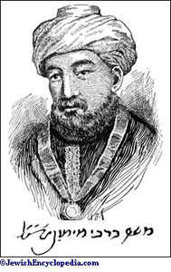
Moses Maimonides,
1138 – 1204
Rambam = Rabbi Moshe ben Maymon
Rabbi (Mishne Torah, legislative commentaries)
Philosopher (Guide for the perplexed, Eight chapters)
Physician (medical treatises)

Slide 2
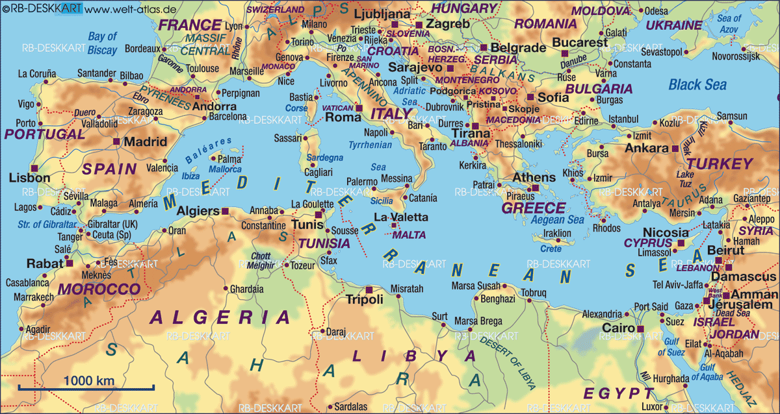
born in Cordoba, 1138
1148 Almohads conquered Córdoba
- settled in Fez, Morocco; studied the halakha and medicine
Treatise on calendar
Treatise on the art of logic
Commentaries on Talmud
- stayed for 5 months in Acre (Akko), Israel; pilgrimage to Jerusalem
- settled in Fustat (the Old Cairo), Egypt, 1166
- appointed as a physician of al-Fadil, the vizier of sultan Sallahudin, 1177; later, the physician of Sallahudin´s son al-Afdal
- died in 1204; burried in Tiberias, Israel
Cordoba → Fez → Acre → Fustat

Slide 3
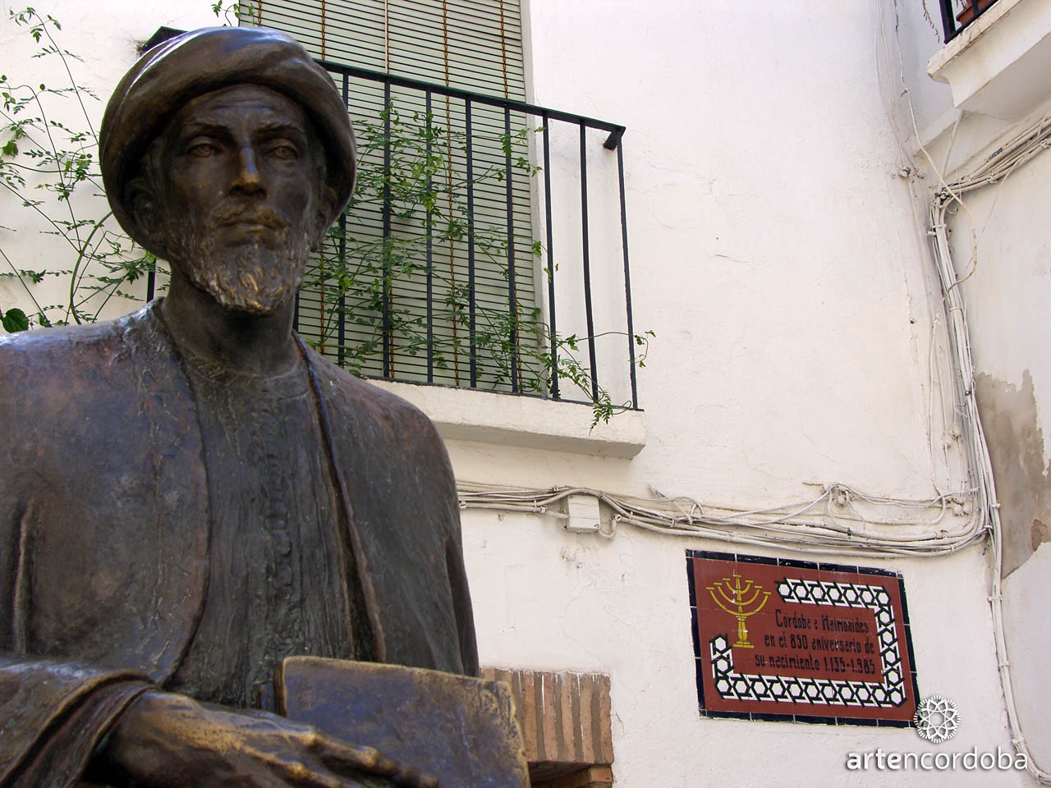
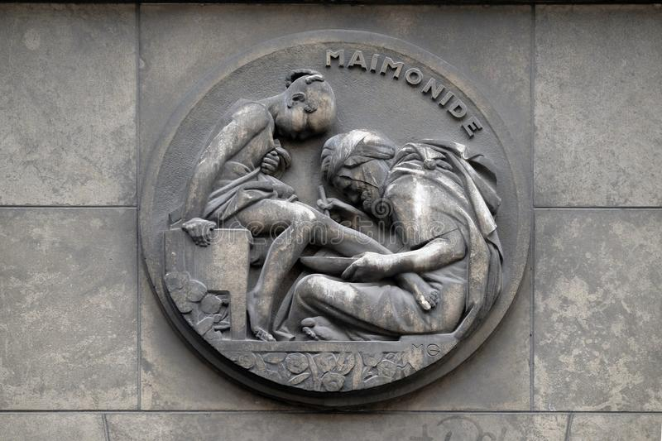
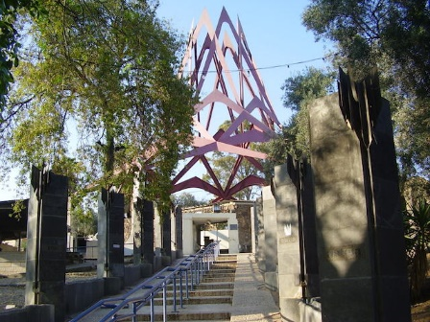
↑ Stone relief at the building of the Faculté de Medicine, Paris
↑
Statue of Maimonides
near Cordoba Synagogue
→
The tomb of Maimonides in Tiberias

Slide 4
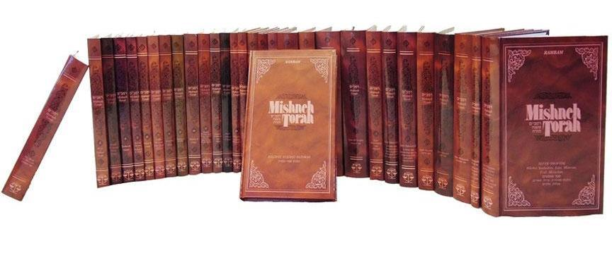
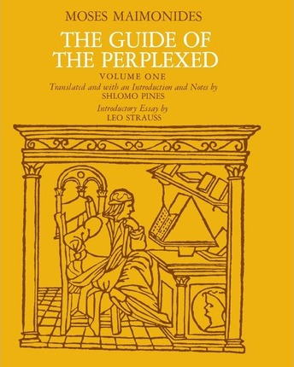
Mishne Torah
• systematisation of all
commandments of the Torah
• written in Hebrew
• 14 volumes (I. Book of Knowledge)
https://en.wikipedia.org/wiki/Mishneh_Torah
The Guide for the Perplexed
• commentary on biblical terms that appear to ascribe corporeal qualities to God
• defence of negative theology
• critique of the kalam
• systematic treatment of creation, prophecy and providence
https://en.wikipedia.org/wiki/The_Guide_for_the_Perplexed

Slide 5
The Guide for the Perplexed
Finished in 1190, written in Judeo-Arabic for one addressee: Joseph ibn Yehudah
Consists of 3 volumes (76 + 48 + 54 chapters = letters)
Why the book is called the Guide for the perplexed? In what sense Joseph was perplexed?
Joseph knows the religious tradition and he knows as well books of Aristotle, Ptolemy and Galen (Claudius Galenus) and he understands that the reason is extremely powerful and can beat the literary interpretation of the Torah.
Philosophy and secular sciences vs. Judaism and tradition

Slide 6
The Guide of the Perplexed
Title in Judeo-Arabic: Dalalat al-hairin
Dalala - guidance, indication, pointing at something.
Hayrun - someone who is confused, perplexed, disorientated.
Title in Latin: Doctor perplexorum sive neutrorum
„Neuter“: neither pure philosopher nor the pure commentator of religious texts
→ there are at least some possibilities of the figurative interpretation of biblical texts
→ harmonization of Aristotle and Moses is a work only for excellent researches

Slide 7
Week: 23rd – 29th March:
Read Satlow, Creating Judaism, chap. 8, pp. 209 – 211 and explain in your own words Maimonides´ parable of the Ruler in his palace (p. 209) in 300 – 400 words.
Optional (and very helpful) reading:
Satlow, Creating Judaism, chap. 8, following pages: 212 - 228.
Frank, Leaman, History of Jewish Philosophy, pp. 198 – 200.
Send me your paper via e-mail before 3rd April.

