Slide 1
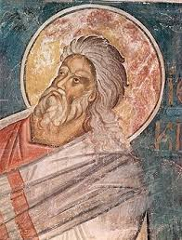
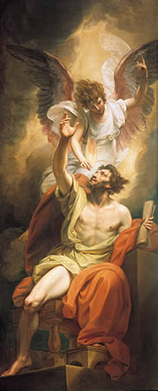
Theme: Prophecy
Maimonides
Guide for the Perplexed, II 36 – 39
19 prophetic books in the Hebrew Bible
the Former Prophets:
Joshua, Judges, Samuel, Kings
the Latter Prophets:
Isaiah, Jeremiah, Ezekiel
Twelve Minor Prophets:
Hosea, Joel, Amos, Obadiah, Jonah, Micah, Nahum,
Habakkuk, Zephaniah, Haggai, Zechariah, Malachi
Ezekiel the Prophet
Isaiah's lips
anointed with fire

Slide 2
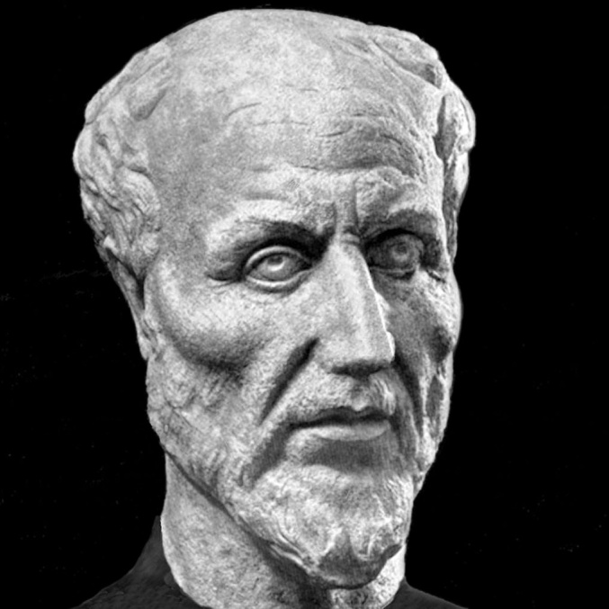
Maimonides´ Guide for the Perplexed, II, 36
Translation: Shlomo Pines
„Know that the true reality and quiddity of prophecy consists in its being an overflow overflowing from God, may He be cherished and honoured, through the intermediation of the Active Intellect, toward the rational faculty in the first place and thereafter toward the imaginative faculty.“
One (HEN)
Transcendental source of being
Absolute simple principle of all
↓
Intellect (NOUS)
United multiplicity
↓
Soul (PSYCHE)
↓
Nature / Matter
EMANATION (overflow or radiation)
Process of overflowing the intellectual contents from the One in successive steps.
Plotinus

Slide 3
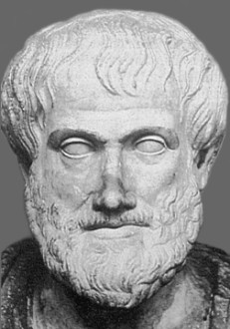
„Know that the true reality and quiddity of prophecy consists in its being an overflow overflowing
from God, may He be cherished and honoured, through the intermediation of the Active Intellect,
toward the rational faculty in the first place and thereafter toward the imaginative faculty.“ (GP II, 36)
Aristotle, De anima III, 5 (translation Shlomo Pines)
„Since, then, just in all nature there is something which is matter for each kind (this is what is all those things potentially) and something else which is the cause and productive agent (= active intellect) by producing all things (as a craft is related to its matter), this distinction must also exist in the soul. And one sort of thought exists by becoming all things, while the other exists by producing them all, as a sort of state like light. For in a way light, too, makes potential colours become actuals colours. And this thought is separable, unaffected, and unmixed, since it is, in its essential substance, actuality. For the thing that produces is always more honourable than the thing affected, and the principle than the matter. Actual knowledge is the same as its object; but potential knowledge is prior in the time in the individual, but on the whole it is not prior even in time. But it is not the case that it sometimes thinks and sometimes does not think. When it has been separated it is alone what it is, and this alone is deathless and eternal; but we do not remember, because, while this is unaffected, though which is capable of being affected is perishable, and without this, nothing thinks.“

Slide 4
„Know that the true reality and quiddity of prophecy consists in its being an overflow overflowing from God, may He be cherished and honoured, through the intermediation of the Active Intellect, toward the rational faculty in the first place and thereafter toward the imaginative faculty.“ (GP II, 36)

Slide 5
„Know that the true reality and quiddity of prophecy consists in its being an overflow overflowing from God, may He be cherished and honoured, through the intermediation of the Active Intellect, toward the rational faculty in the first place and thereafter toward the imaginative faculty.“ (GP II, 36)
Primary source: Aristotle, De Anima
Direct influence on Maimonides: al-Farabi (10th Century)
Five faculties of soul according Maimonides:
Rational
Imaginative
Appetitive
Sensitive
Vegetative
human beings
a few animals,
human beings
some animals, human beings
no plants, all animals, human beings
all plants, all animals, human beings

Slide 6
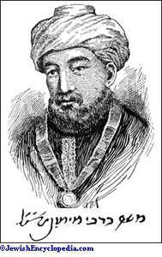
This is the highest degree of man and the ultimate term of perfection that can exists for his species; and this state is the ultimate term of perfection for the imaginative faculty. This is something that cannot by any means exist in every man. And it is not something that may be attained solely through perfection in the speculative sciences and through improvements of moral habits, even if all of them have become as fine and good as can be. There still is needed in addition the highest possible degree of perfection of the imaginative faculty in respect of its original natural disposition.“ (GP, II, 36)

Slide 7
Homework for week: 30th – 3nd April:
Listen to the commented presentation on Moodle “Maimonides Prophecy”.
Read Frank, Leaman, History of Jewish Philosophy, pp. 208 – 213 and explain in your own words Maimonides´ definition prophecy in 300 – 400 words.
Send me your paper via e-mail before 10th April.

